Slide 1
RULES

Slide 2
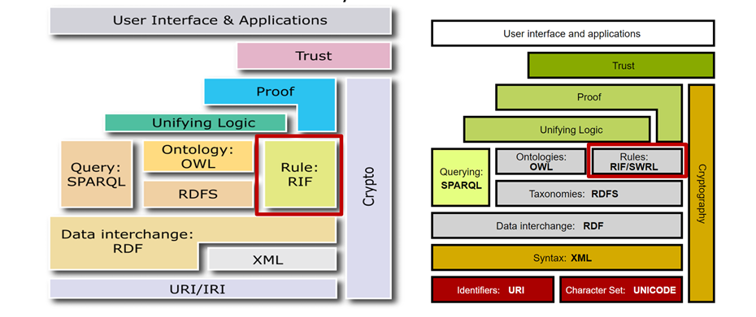
The Semantic Web “Layer Cake”

Slide 3
Rules
Horn Rules, Datalog Rules
SWRL
DL Rules, SROIQ Rules, ELP Rules
RIF

Slide 4
FOL Basics

Slide 5
Horn Clauses
Fact
Rule
Body
Head

Slide 6
Horn clauses

Slide 7
Horn clauses
*Decidable reasoning:
-without function symbols
-limited use of function symbols (e.g. no recursion over function symbols)

Slide 8
Datalog
Datalog program: a set of datalog rules

Slide 9
Datalog - examples

Slide 10
SWRL
SWRL: Semantic Web Rule Language
Idea: Datalog rules that apply on OWL ontologies
OWL individuals are datalog constants
OWL classes are unary datalog predicates (A: A(?x))
OWL properties are binary datalog predicates (r: r(?x, ?y))
Only variables that occur in the body of a rule may occur in the head

Slide 11
Why SWRL?
When do we need SWRL?
Try to express in DL:
if a child’s parents are married to each other then it belongs to the class ChildOfMarriedParents
You can use the properties hasParent, hasSpouse and the concept ChildOfMarriedParents

Slide 12
Why SWRL?
When do we need SWRL?
Try to express in DL:
if a child’s parents are married to each other then it belongs to the class ChildOfMarriedParents
There is no way in OWL 2 to express the relation between individuals with which an individual has relations
Can you do it with SWRL?

Slide 13
Why SWRL?
When do we need SWRL?
Try to express in DL:
if a child’s parents are married to each other then it belongs to the class ChildOfMarriedParents
There is no way in OWL 2 to express the relation between individuals with which an individual has relations
Can you do it with SWRL?
hasParent(x,y)^hasParent(x,z)^hasSpouse(y,z)->isChildOfMarriedParents(?x)
DLs can express only tree-like interdependencies of variables in the body
x
y
hasParent
hasParent
hasSpouse
z

Slide 26
DL-Safe rules
SWRL is undecidable
There is no algorithm that can draw all logical conclusions from all SWRL knowledge bases, even with unlimited time and resources
Idea: Restrict SWRL to guarantee decidability via restricting the number of possible variable assignments
DL Safe restriction: individual variables in a rule bind only to individuals named explicitly in the underlying ontology
OWL DL+DL-safe SWRL is decidable

Slide 28
DL-Safe rules –HOW THE REASONERS DO IT
brother(x,z)^father(z,y)->uncle(x,y)
Force DL-safety by restricting the rules to known individuals:
O(x)^O(y)^O(z)^brother(x,z)^father(z,y)->uncle(x,y)
Whereby the fact O(a) has to be asserted for all OWL individuals.

Slide 29
Pellet and Hermit force DL safety.
Slide from: Dr Harald Sack, Potsdam University

Slide 30
more SWRL
https://protege.stanford.edu/conference/2009/slides/SWRL2009ProtegeConference.pdf

Slide 31
What we cannot say with SWRL rules
We cannot require the existence of individuals with certain properties except by explicitly naming them
e.g. husband(x) -> married(x,person)
That’s where DLs come in.

Slide 32
*

Slide 34
DL Rules
Expressive new rule language for combining DLs with first-order rules
Decidable fragment of SWRL
Premises (rule bodies) consist of one or more of tree-shaped structures
Complex classes are allowed in the rules
When added to tractable DLs (eg EL⁺⁺) although they extend their expressivity the language remains tractable

Slide 42
Rule Interchange Format (RIF)
RIF became W3C recommendation in 2010
Original goal: pure exchange format between existing rule systems
Defines several “dialects” of languages
Rigorously defined rule languages
Interrelated dialects can serve the purpose of sharing and exchanging rules over the web

Slide 43
Rule Interchange Format (RIF)
Rule System1
Rule System2
Universal Rule Language
Rule System3
Rule System4
Prolog/Datalog/Business rule engine, etc

Slide 44
Rule Interchange Format (RIF)
Rule System1
Rule System2
Rule System1
Rule System2
Universal Rule Language
Core Rule Language
Rule System3
Rule System4
Rule System3
Rule System4
Partial exchange

Slide 45
Rule Interchange Format (RIF)
Rule System1
Rule System2
Rule System1
Rule System2
Rule System1
Rule System2
RIF BLD
Universal Rule Language
Core Rule Language
RIF Core
RIF PRD
Rule System3
Rule System4
Rule System3
Rule System4
Rule System3
Rule System4

Slide 46
RIF Dialects
RIF Basic Logic Dialect:
Is designed to be a simple dialect with limited expressiveness within the intersection of first-order and logic programming systems
Similar to datalog
RIF Production Rule Dialect:
A formalism for specifying production rules <condition><action> .The action asserts facts in the KB (non-monotonic).
e.g. A customer becomes a "Gold" customer when his cumulative purchases during the current year reach $5000.

Slide 47
RIF Dialects
RIF Datatypes and Built-ins (DTB)
Βuilt-in functions and built-in predicates expected to be supported by RIF dialects such as the RIF Core Dialect, the RIF Basic Logic Dialect, and the RIF Production Rules Dialect.
RIF Framework for Logic Dialects (FLD-super dialect):
A formalism for specifying all logic dialects for RIF: RIF BLD and RIF Core
Instead of defining dialects from scratch, define dialects by specializing from another dialect
Ensures that all dialects use the same concepts and constructs

Slide 48
Readings
Markus Krötzsch, Frederick Maier, Adila A. Krisnadhi, Pascal Hitzler, A Better Uncle for OWL, WWW 2011
Birte Glimm , Matthew Horridge , Bijan Parsia, Peter F. Patel-Schneider: A Syntax for Rules in OWL 2
Markus Krötzsch, Sebastian Rudolph, and Pascal Hitzler , Description Logic Rules⋆
RIF: https://www.w3.org/TR/rif-overview/
SWRL: https://www.w3.org/Submission/SWRL/

