Slide 1
An Introduction to Microsoft F#

Slide 2
F# is...
... a programming language.

Slide 3
F# is...
...a functional programming language

Slide 4
F# is...
... a functional programming language for .NET.

Slide 5
F# is...
...a functional and object oriented programming language for .NET

Slide 6
F# is...
...a functional, object oriented and imperative programming language for .NET

Slide 7
F# is...
...a functional, object oriented, imperative
and explorative programming language for .NET

Slide 8
F# is...
...a multi-paradigm programming language for .NET

Slide 9
F# is...
...a multi-paradigm programming language for .NET, ideally suited for technical, symbolic and algorithmic applications.

Slide 10
What is F# for?
General Purpose Language
Broad range of tasks
Also “A Bridge Language”
Researchers and Developers
Some Important Domains
Scientific data analysis
Data mining
Domain-specific modeling
Financial modeling and analysis
Academic

Slide 11
Let
Type inference.
The static typing of C# with the succinctness of a scripting language
Bind a static value
let data = (1,2,3)
let f(a,b,c) =
let sum = a + b + c
let g(x) = sum + x*x
g(a), g(b), g(c)
Bind a static function
Bind a local value
Bind a local function

Slide 12
Functions
Functions: like delegates + unified and simple
One simple
mechanism,
many
uses
Anonymous
Function value
(fun x -> x + 1)
let f(x) = x + 1
(f,f)
val f : int -> int
predicate = 'a -> bool
Declare a
function value
send = 'a -> unit
threadStart = unit -> unit
A pair
of function values
comparer = 'a -> 'a -> int
hasher = 'a -> int
A function type
equality = 'a -> 'a -> bool

Slide 13
Immutability (by default)
Data is immutable by default
Values may not be changed
Copy & Update, not Mutate

Slide 14
Pattern Matching
let data = (Some [1;2;3], Some [4;5;6])
val data : int list option * int list option
match data with
| Some(nums1), Some(nums2) -> nums1 @ nums2
| None, Some(nums) -> nums
| Some(nums), None -> nums
| None, None -> failwith "missing!"

Slide 15
Functional Collections
List.map Seq.fold
Array.filter Lazy.force Set.union
Map LazyList Events Async...
[ 0..1000 ]
[ for x in 0..10 -> (x, x * x) ]
[| for x in 0..10 -> (x, x * x) |]
seq { for x in 0..10 -> (x, x * x) }
Range Expressions
List via query
Array via query
IEnumerable via query

Slide 16
Imperative + Functional
Using .NET collections
open System.Collections.Generic
let dict = new Dictionary<int,string>(1000)
dict.[17] <- "Seventeen"
dict.[1000] <- "One Grand"
for (KeyValue(k,v)) in dict do
printfn "key = %d, value = %s" k v
Mutability when needed
Side effects when needed

Slide 17
Imperative + Functional
open System.IO
open System.Collections.Generic
let readAllLines(file) =
use inp = File.OpenText file
let res = new List<_>()
while not(inp.EndOfStream) do
res.Add(inp.ReadLine())
res.ToArray()
Localization and Separation
“use” =
C# “using”

Slide 18
Imperative + Functional
open System.IO
let allLines =
seq { use inp = File.OpenText "test.txt"
while not(inp.EndOfStream) do
yield (inp.ReadLine()) }
allLines
|> Seq.truncate 1000
|> Seq.map (fun s -> uppercase s,s)
|> Seq.to_array
Read lines on demand
Pipelines

Slide 19
Object Oriented + Functional
type Vector2D(dx:double,dy:double) =
member v.DX = dx
member v.DY = dy
member v.Length = sqrt(dx*dx+dy*dy)
member v.Scale(k) =Vector2D(dx*k,dy*k)
Inputs to object construction
Exported properties
Exported method

Slide 20
Object Oriented + Functional
type Vector2D(dx:double,dy:double) =
let norm2 = dx*dx+dy*dy
member v.DX = dx
member v.DY = dy
member v.Length = sqrt(norm2)
member v.Norm2 = norm2
Internal (pre-computed) values and functions

Slide 21
Object Oriented + Functional
type Vector2D(dx:double,dy:double) =
let mutable currDX = dx
let mutable currDY = dy
member v.DX = currDX
member v.DY = currDY
member v.Move(x,y) =
currDX <- currDX+x
currDY <- currDY+y
Internal state
Publish internal state
Modify internal state

Slide 22
Object Oriented + Functional
Immutable inputs
type MyTable(data: Set<string>) =
let table1 =
HashMultiMap.Create
[ for x in data -> x.Length,x ]
member x.GetStringsWithLength(n) =
table1.FindAll(n)
member x.GetStrings() = data
member x.NumStrings = data.Length
Internal tables
Publish access

Slide 23
F# Releases
April 2008
Microsoft Research refresh release
Language and libraries clean-up and completion
September 2008
Current CTP
Most important language decisions finalized
Foundation of F# Visual Studio integration
Future
Releases with Visual Studio 2010
Betas: Matching updates for Visual Studio 2008
Ships as part of Visual Studio 2010

Slide 24
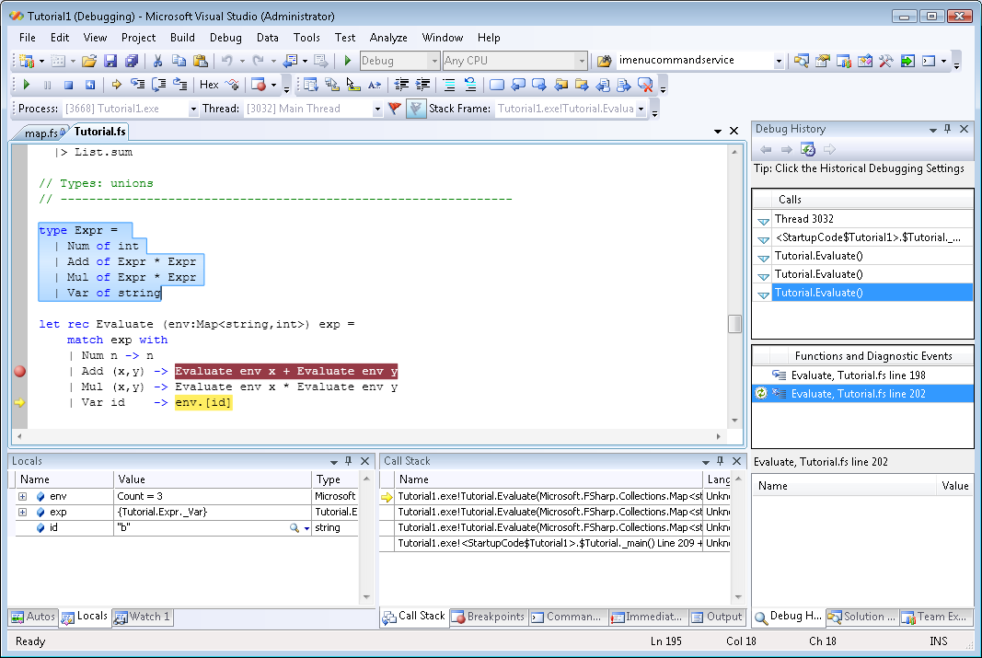
Visual Studio 2010
http://blogs.msdn.com/dsyme/archive/2008/12/10/fsharp-to-ship-as-part-of-visual-studio-2010.aspx

Slide 25
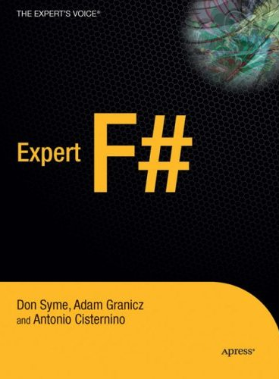
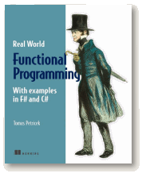
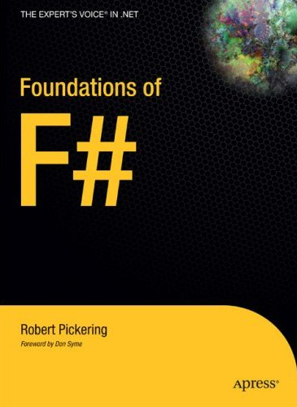
Books

Slide 26
Where to Now?
On the Web
http://fsharp.net/
http://research.microsoft.com/fsharp
Don Syme - http://blogs.msdn.com/dsyme
Luke Hoban - http://blogs.msdn.com/lukeh
Community
http://cs.hubfs.net
F# Samples
http://code.msdn.microsoft.com/fsharpsamples

