Slide 1
Discovering Sources for a Region
ESWC 2011 Tutorial
29 May 2011

Slide 2
Outline
Introduction
The data model stRDF
The query language stSPARQL
The system Strabon and the Semantic Registry
Hands-on session: Registering and discovering data sources

Slide 3
Objectives and motivation (1/2)
The vision of the Semantic Sensor Web: annotate sensor data and services to enable discovery, integration, interoperability etc.
We want to develop an open, dynamic and scalable registry containing these annotations.
Sensor annotations involve thematic, spatial and temporal metadata.
Examples:
The sensor measures temperature. (thematic)
The sensor is located in the location represented by point (A, B). (spatial)
The sensor measured −3o Celsius on 26/01/2010 at 03:00pm. (temporal)

Slide 4
Objectives and motivation (2/2)
How about using RDF?
Good idea. But RDF can represent only thematic metadata properly. We want to take into account spatial and temporal information to aid publication and discovery of sensors, sensor services etc.
What can we do about spatial and temporal metadata?
Answer: Extend RDF to represent spatial and temporal metadata.

Slide 5
Our Approach
Resource metadata is modeled using stRDF, an extension of RDF, that can be used to represent thematic, spatial and temporal metadata.
Resource metadata are queried using stSPARQL, an extension to SPARQL for querying stRDF data.
Design and implement a storage and query evaluation module for stRDF/stSPARQL.
Design and implement a semantic registry that stores metadata about SSW resources which is used for resource discovery using thematic, spatial and temporal criteria.

Slide 6
Outline
Introduction
The data model stRDF
The query language stSPARQL
The system Strabon and the Semantic Registry
Hands-on session: Registering and discovering data sources

Slide 7
From RDF to stRDF - Example
ex:sensor1 rdf:type ex:Sensor.
ex:sensor1 ex:measures ex:Temperature.
ex:sensor1 ex:hasLocation ex:location1.
RDF
Spatial
Literals
ex:location1 strdf:hasSpatialExtent
"POINT(0.1 50)"ˆˆogc:WKT .
sRDF
New Kind of Typed Literals

Slide 8
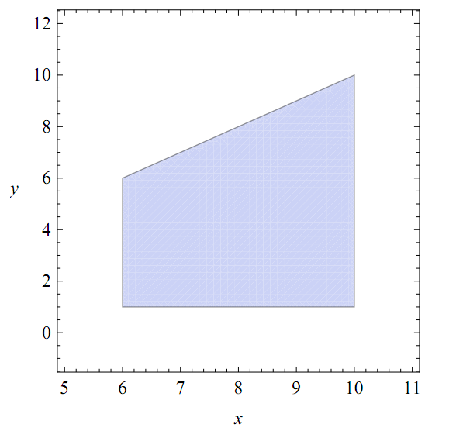
Example
POLYGON((6 1, 10 1,
10 10, 6 6,
6 1))

Slide 9
From sRDF to stRDF - Example
ex:sensor1 rdf:type ex:Sensor.
ex:sensor1 ex:measures ex:Temperature.
ex:sensor1 ex:hasLocation ex:location1.
RDF
Spatial
Literals
ex:location1 strdf:hasSpatialExtent
“POINT(40 15)"ˆˆogc:WKT
sRDF
“t = 11”^^strdf:SemiLinearPointSet
Temporal
Constraints
Valid Time
stRDF
Notes:
Valid time is the time a piece of information is true in the real world.
Transaction time is the time a transaction changing the current database state is committed,
whereas user-defined time is a time that appears in the database and has user-defined semantics e.g., a person's date of birth.
An stRDF quad is an sRDF triple (a; b; c) with a fourth component which is a temporal constraint. For quads, we will use the notation (a b c τ), where the temporal constraint defines the set of time points that the fact represented by the triple (a; b; c) is valid in the real world. An stRDF graph is a set of sRDF triples and stRDF quads.

Slide 10
Outline
Introduction
The data model stRDF
The query language stSPARQL
The system Strabon and the Semantic Registry
Hands-on session: Registering and discovering data sources

Slide 11
Example – Dataset
Sensor metadata using the CSIRO/SSN ontology:
ex:sensor1 rdf:type ssn:Sensor ;
ssn:measures ex:temperature ;
ssn:supports ex:grounding1 .
ex:grounding1 rdf:type ssn:SensorGrounding ;
ssn:hasLocation ex:location1 .
ex:location1 rdf:type ssn:Location .
ex:location1 strdf:hasSpatialExtent "POINT(40,15)"ˆˆogc:WKT.

Slide 12
Example – Dataset
Metadata about geographical areas:
ex:area1
rdf:type ex:UrbanArea ;
ex:hasName "Hersonissos" ;
strdf:hasSpatialExtent
"POLYGON((25 10,
115 10, 125 -5,
125 10, 135 75,
115 75, 25 10))"
ˆˆogc:WKT.

Slide 13
Example – Queries
Spatial selection. Find the URIs of the sensors
that are inside the rectangle R(0, 0, 100, 100).
select ?S
where { ?S rdf:type ssn:Sensor .
?G rdf:type ssn:SensorGrounding .
?L rdf:type ssn:Location .
?S ssn:supports ?G .
?G ssn:haslocation ?L .
?L strdf:hasSpatialExtent ?GEO .
filter(?GEO inside
"POLYGON((0 0, 0 100, 100 100, 100 0, 0 0))" ˆˆogc:WKT)
}

Slide 14
Example – Queries
Spatial selection. Find the URIs of the sensors
that are inside the rectangle R(0, 0, 100, 100).
select ?S
where { ?S rdf:type ssn:Sensor .
?G rdf:type ssn:SensorGrounding .
?L rdf:type ssn:Location .
?S ssn:supports ?G .
?G ssn:haslocation ?L .
?L strdf:hasSpatialExtent ?GEO .
filter(?GEO inside
"POLYGON((0 0, 0 100, 100 100, 100 0, 0 0))" ˆˆogc:WKT)
}

Slide 15
Answer
?S
ex:sensor1

Slide 16
Example – Queries
Spatial join. Find the URIs of the sensors that are
located inside an urban Area.
select ?S ?UANAME
where { ?S rdf:type ssn:Sensor .
?G rdf:type ssn:SensorGrounding .
?L rdf:type ssn:Location .
?S ssn:supports ?G .
?G ssn:haslocation ?L .
?L strdf:hasSpatialExtent ?GEO .
?UA rdf:type ex:UrbanArea .
?UA ex:hasName ?UANAME .
?UA strdf:hasSpatialExtent ?UAGEO .
filter(?GEO inside ?UAGEO) }

Slide 17
Example – Queries
Spatial join. Find the URIs of the sensors that are
located inside an urban Area.
select ?S ?UANAME
where { ?S rdf:type ssn:Sensor .
?G rdf:type ssn:SensorGrounding .
?L rdf:type ssn:Location .
?S ssn:supports ?G .
?G ssn:haslocation ?L .
?L strdf:hasSpatialExtent ?GEO .
?UA rdf:type ex:UrbanArea .
?UA ex:hasName ?UANAME .
?UA strdf:hasSpatialExtent ?UAGEO .
filter(?GEO inside ?UAGEO) }

Slide 18
Answer
?S | ?UANAME
ex:sensor1 | “Hersonissos”

Slide 19
What is new in stSPARQL syntax?
k-ary spatial terms
  quantifier-free formulas (constants)
  spatial variables
  projections of k-ary spatial terms
  the result of set operations on k-ary spatial terms: intersection, union, difference
  the result of geometric operations on k-ary spatial terms: boundary, buffer, minimum bounding box
Metric spatial terms
  VOL, AREA, LEN, MAX, MIN
Select clause: construction of new spatial terms
  intersection, union, difference, projection of spatial terms
Where clause: Quad patterns to refer to the valid time of a triple
Filter clause:
  Spatial predicates (topological): disjoint, touch, equals, inside, covered by, contains, covers, overlap
  Temporal predicates: before, equal, meets, overlaps, during, starts, finishes

Slide 20
Outline
Introduction
The data model stRDF
The query language stSPARQL
The system Strabon and the Semantic Registry
Hands-on session: Registering and discovering data sources

Slide 21
The System Strabon

Slide 22
Storing stRDF Data

Slide 23
Evaluating stSPARQL Queries

Slide 24
The Architecture of the Semantic Registry – First Look
The Semantic Registry stores semantic annotations of available resources:
sensors
sensor networks
data sources
web services.
Annotations are registered by service providers.
Clients discover resources by posing queries.

Slide 25
The Architecture of the Semantic Registry
Enables consumers to make well-informed and
well-formed interactions with the service
Allows a metadata consumer to query the contents of the registry in order to discover
relevant resources using stSPARQL
Enables a metadata producer to register an RDF(S) document about SSW resources
Notes:
A client may access the Service Interface to be informed about the interfaces that are offered by the registry and the
declarative query languages supported by the registry.
If a metadata provider wants to store an stRDF description of a data resource, he must use an appropriate message from the ones defined in the specification of
WS-DAI-RDF(S)-Query.
The consumer's query is encapsulated inside a SPARQLExecute message, which is defined in the WS-DAI-RDF(S) realization of WS-DAI

Slide 26
Example Orchestration
Consumer: Discover a Stored Data Service that observes tide height or wave height in Southeast England
Consumer/Producer: Register the description of an integrated data
source that associates wave height with the ship departure times
Producer: Register the description of an SDS service that exports the scheduled ship departure times from England
Producer: Register the description of an SDS service that observes wind speed and wave height in Southampton

Slide 27
Example Orchestration: stSPARQL query (Query 3)
SELECT DISTINCT ?ENDPOINT
WHERE {
?SERVICE rdf:type Services:WebService .
?SERVICE Services:hasEndpointReference ?ENDPOINT .
?SERVICE Services:hasDataset ?DATASET .
?DATASET Services:includesPropertyType ?PROPERTYTYPE .
FILTER(
(str(?PROPERTYTYPE) = "http://www.semsorgrid4env.eu/ontologies/CoastalDefences.owl#TideHeight")
||
(str(?PROPERTYTYPE) = "http://www.semsorgrid4env.eu/ontologies/CoastalDefences.owl#WaveHeight")
).
?DATASET Services:coversRegion ?SERVICEREGION .
?SERVICEREGION Services:hasSpatialExtent ?SERVICEREGIONGEO .
AdditionalRegions:SouthEastEngland Services:hasSpatialExtent ?SE_ENGLAND_GEO.
FILTER(?SERVICEREGIONGEO covers ?SE_ENGLAND_GEO ) .
}

Slide 28
Answer
?ENDPOINT
http://www.channelcoast.org/services/spatial/wms?SERVICE=WMS&VERSION=1.1.1&REQUEST=GetMap&LAYERS=wave_height
http://www.channelcoast.org/services/spatial/wms?SERVICE=WMS&VERSION=1.1.1&REQUEST=GetMap&LAYERS=tide_height

Slide 29
Outline
Introduction
The data model stRDF
The query language stSPARQL
The system Strabon and the Semantic Registry
Hands-on session: Registering and discovering data sources

Slide 30
Example: Service ontology

Slide 31
Example: Property Document
Service description
<Services:WebService rdf:about="#BRANCHService">
<rdfs:label>BRANCH</rdfs:label>
<Services:hasInterface rdf:resource="#BRANCHInterface"/>
<Services:hasEndpointReference> http://www.semsorgrid4env.eu/ontologies/ServiceOntology.owl#">http://www.channelcoast.org/services/spatial/wms?SERVICE=WFS&amp;VERSION=1.1.1&amp;REQUEST=GetFeature&amp;TYPENAME=branch</Services:hasEndpointReference>
<Services:hasDataset rdf:resource="#BRANCHDataset"/>
<Services:hasServiceType rdf:resource="&Services;WFS"/>
</Services:WebService>
<Services:Dataset rdf:about="# BRANCHDataset ">
<rdfs:label>Modelled flood ingress Dataset</rdfs:label>
<time:hasTemporalExtent rdf:datatype="&RegistryOntology;TemporalInstant">NOW</time:hasTemporalExtent>
<Services:coversRegion rdf:resource= "&AdditionalRegions; SouthEastEnglandBRANCH "/>
<Services:includesFeatureType rdf:resource="&CoastalDefences:Defence"/>
</Services:Dataset>
  Interfaces
  Endpoint reference
  Dataset pointers
Dataset description
  Temporal Extent
  Spatial Coverage
  Features Observed

Slide 32
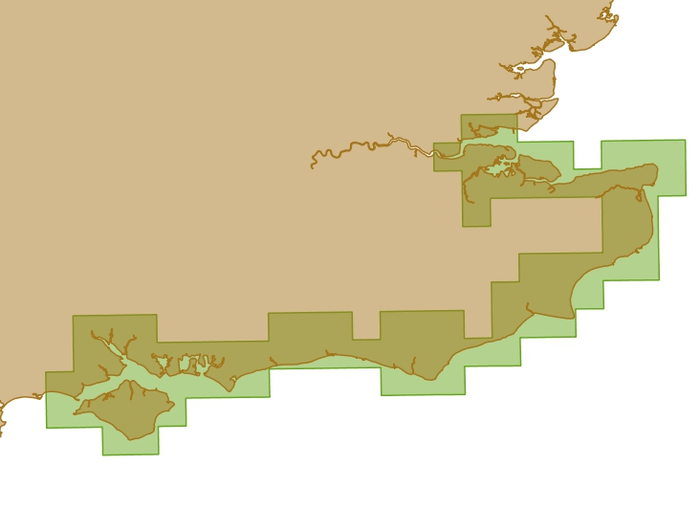
Spatial Extent (Well Known Text)
<Services:Region rdf:about="&AdditionalRegions: SouthEastEnglandBRANCH ">
<RegistryOntology:hasGeometry rdf:datatype= "http://strdf.di.uoa.gr/ontology#WKT">
POLYGON ((
590373.08467367 5628280.44984213, 590374.07417499 5628281.46963455, ...
590508.3165201 5618280.6452733,
590373.0846736 5628280.4498421))
</RegistryOntology:hasGeometry>
</services:Region>

Slide 33
Hands on: Register a property document
Open the Wavenet.rdf document
Copy the document to the clipboard
  Click Edit → Select All
  Click Edit → Copy
Launch a browser
Click Registry → GUI
Click Store
Paste the contents of the clipboard to the textbox
Click Store

Slide 34
Examples of Queries – Query 1
Find all services
Select ?SERVICE ?TYPE ?ENDPOINT
where {
?SERVICE
rdf:type Services:WebService ;
Services:hasEndpointReference ?ENDPOINT ;
Services:hasServiceType ?TYPE .
}

Slide 35
Examples of Queries – Query 4
Find all WFS services with FOI Flood defence infrastucture, cover the Solent and provide current information.
select distinct ?ENDPOINT
where { ?SERVICE rdf:type Services:WebService ;
Services:hasEndpointReference ?ENDPOINT ;
Services:hasServiceType Services:WFS ;
Services:hasDataset ?DATASET .
?DATASET Services:includesFeatureType CoastalDefences:TypeDefence ;
time:hasTemporalExtent ?TIME .
filter(?TIME contains "NOW"^^regont:TemporalInstant) .
?DATASET Services:coversRegion ?SERVICEREGION .
?SERVICEREGION regont:hasGeometry ?SERVICEREGIONGEO .
AdditionalRegions:SolentModelledArea regont:hasGeometry ?SOLENTGEO .
filter(?SERVICEREGIONGEO overlap ?SOLENTGEO) .
}
Find a WFS service
with a dataset that has flood defense infrastructure as FOI,
provides current information,
and covers an area that overlaps the Solent

Slide 36
Examples of Queries – Query 8
Find points of interest near a location
SELECT *
WHERE { { ?place a lgdo:Shops . } UNION
{ ?place a lgdo:Shop . } UNION
{ ?place a lgdo:Shopping . } UNION
{ ?place a lgdo:Supermarket . } UNION
{ ?place a lgdo:Bakery . } UNION
{ ?place a lgdo:Marketplace . } UNION
{ ?place a lgdo:PublicMarket . } UNION
{ ?place a lgdo:TakeAway . } UNION
{ ?place a lgdo:DrinkingWater . } UNION
{ ?place a lgdo:WaterFountain . } UNION
{ ?place a lgdo:WaterWell . }
?place a ?type ;
geo:geometry ?placegeo ;
rdfs:label ?placename .
FILTER(DISTANCE(?placegeo, "POINT(-1.83901 50.71076)"
^^<http://strdf.di.uoa.gr/ontology#WKT>) < 3) . }

Slide 37
Thank you for your attention!
(http://strabon.di.uoa.gr)

Slide 38
Backup slides

Slide 39
Comparison with OGC-SWE Catalogues
OGC-SWE uses the OpenGIS catalogue services specification.
The common query language developed for interoperability in this specification is based on attribute-value pairs (data model) and attribute operator value (atomic expression in a Boolean query). This is a reasonable query language for a catalogue.
But we are actually more permissive in our approach in the sense that we allow any query language to be used (the semantic registry service is a data store and we could use SQL, SPARQL etc.). This is more general in principle; also, the concrete realization of the semantic registry service by any RDF store offers a more expressive data model than an attribute-value pair data model.
Some of the service interfaces of the OpenGIS catalogue service are similar to what we have (getCapabilities etc.); others we have not dealt with (harvestResource).
2nd Year Review Meeting - Brussels, 16-17 Nov. 2010

Slide 40
Comparison with SANY Sensor Catalogue Service
Complementary approaches:
  SANY starts with the ORCHESTRA geospatial catalogue and extends it to become a semantic geospatial catalogue (terminology: the semantic bounding box). Semantics are based on the SANY schema.
  We go the other way around (we start from a platform that offers a general semantics-based data model and work on extending it with space and time).
Our approach is more expressive:
  Instead of a specific schema (SANY schema), we can support any relevant sensor ontology and pose very general queries toward the combination of the ontology and the data.
2nd Year Review Meeting - Brussels, 16-17 Nov. 2010

