Slide 1
On Green Scheduling for Desktop Grids
Thanasis Loukopoulos, Maria G. Koziri,
Kostas Kolomvatsos, Panagiotis Oikonomou
6th World Conference on Information Systems and Technologies
Pervasive Intelligent Systems
March 2018
Naples, Italy

Slide 2
Outline
Our motivation
Our contribution
Problem Formulation
Scheduling Algorithms
Algorithms adopted for Tasks Replication
Experimental Results
Conclusions

Slide 3
Motivation
A desktop grid consists of volunteers that share their computational resources
The aim is to jointly achieve a computationally intensive tasks
The scalability potential of the desktop grid involves the solution to various problems like:
Interoperability
Tasks scheduling
Monitoring
Checkpointing
In this paper, we focus on the scheduling problem

Slide 4
Contribution
Problem:
Given a set of volunteers and tasks, we should schedule tasks execution towards maximizing a specific metric
Both, volunteers and tasks, exhibit specific characteristics
We tackle the problem of scheduling tasks in desktop grids w.r.t. the cleanness of the energy sources used by peers
Our contributions:
We model the problem as a two function constrained optimization problem
We present heuristics for each of the optimization targets
We evaluate the heuristics experimentally

Slide 5
Formulation (1/3)
Assume N tasks denoted by T_{i}, with 1 ≤ i ≤ N
L_{i} denotes the load for T_{i} - L­_{i}s are known (or can be estimated) and express the amount of time required to complete T_{i} in a base machine
P_{j} denotes the j^{th} peer
P_{j} is associated with a speedup factor SP_{j} i.e., the ratio of its processing power to the processing power of the base machine
Depending on the country it resides, P_{j} is assigned a greenness value g(P_{j}) i.e., the percentage of energy in this country coming from renewable sources

Slide 6
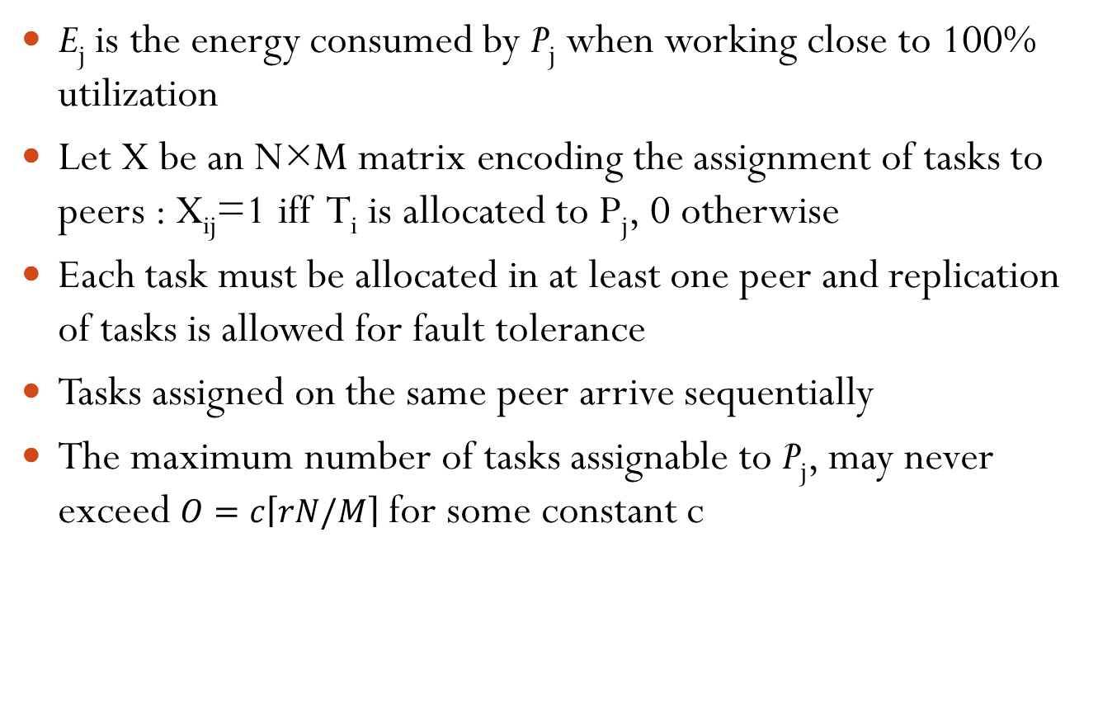
Formulation (2/3)
E_{j} is the energy consumed by P_{j} when working close to 100% utilization
Let X be an N×M matrix encoding the assignment of tasks to peers : X_{ij}=1 iff T_{i} is allocated to P_{j}, 0 otherwise
Each task must be allocated in at least one peer and replication of tasks is allowed for fault tolerance
Tasks assigned on the same peer arrive sequentially
The maximum number of tasks assignable to P_{j}, may never exceed $O=c\left\lceil rN/M\right\rceil$ for some constant c

Slide 7
Formulation (3/3)
X is now an N×M×O matrix; X_{ijk}=1, iff T_{i} is assigned at P_{j} as its k^{th} task to be executed
Let p(P_{j}) be the percentage of time P_{j} is available over a time period TP
A peer P_{j} that commences execution of a task T_{i} will finish it in time equal to: $\frac{L_{i}}{{SP}_{j}}$

Slide 8
Energy Footprint
The environmental unfriendly energy consumed by P_{j} for executing all the assigned tasks can be given by
Given a placement matrix X, the probability that the computation of T_{i} fails in all the peers it is assigned to, is given by:
$$G_{j}=\left(1−g\left(P_{j}\right)\right)E_{j}\frac{\sum_{k=1}^{O}{\sum_{i=1}^{N}{X_{ijk}L_{i}}}}{{SP}_{j}}$$
$F_{i}=\prod_{j=1}^{M}{(f(P_{j})\sum_{k=1}^{O}{X_{ijk}+(O−\sum_{k=1}^{O}{(1−X_{ijk}))}}}$

Slide 9
Deadline
T_{i} have a deadline D_{i} within which it should be completed
The greenness-aware scheduling problem with deadlines, replication and fault tolerance can be stated as a two function optimization problem
Given L_{i}s, SP_{j}s, p(P_{j})s, f(P_{j})s, O and r, find an X matrix such that the following two functions are minimized:
Subject to the previous equations and the fact that peers should meet the deadlines
$f_{1}=\sum_{j=1}^{M}{G_{j}}$
$$f_{2}=max\{F_{i }: 1≤i≤N\}$$

Slide 10
Scheduling Algorithms
We propose, two categories:
With no replicas – we take into account only f₁
With replicas – we focus on f₂

Slide 11
Algorithms with no Replication (1/2)
Random (Rand)
Each task will be assigned once to a random peer
Deadline should not be violated
Completion Time (CT)
Starting with the heaviest task, CT checks all possible (M in number) peer assignments
The task is assigned to the peer where it will be completed at the earliest possible time
The remaining tasks are assigned each in decreased order of load (L_{i})

Slide 12
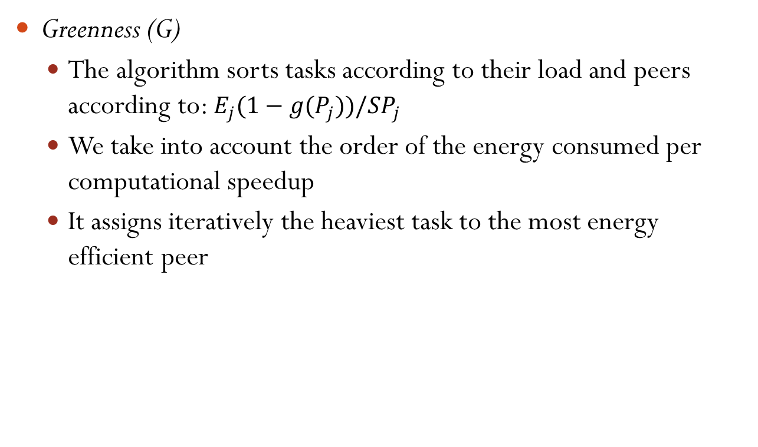
Algorithms with no Replication (2/2)
Greenness (G)
The algorithm sorts tasks according to their load and peers according to: $E_{j}(1−g(P_{j}))/{SP}_{j}$
We take into account the order of the energy consumed per computational speedup
It assigns iteratively the heaviest task to the most energy efficient peer

Slide 13
Algorithms with Replication (1/2)
Random (Rand)
The algorithm selects a task at random and creates to a random peer a replica
In case all possible peer assignments lead to deadline violation for the particular task, the task is taken out of the list
Replication for Fault Tolerance (RFT)
First the list of tasks is sorted in descending order of their failure probability
Then starting with the one most likely to fail an extra replica is created at the peer that has the minimum failure probability
The sorted task list is updated with the new failure probability of the task
The algorithm iterates until no eligible assignments exist

Slide 14
Algorithms with Replication (2/2)
Green Aware Replication (GAR)
Instead of assigning a task to the peer with the minimum failure probability, it assigns it to the most energy efficient peer

Slide 15
Simulation Setup
1,000 tasks must be assigned to 1,000 peers
Task load varies uniformly in [100, 10000] time units
The deadline was set as a multiple of its load (×2, ×5 and ×10)
The computational power of peers was set to vary uniformly in [0.1, 10]
The failure probability of a peer was set to vary in [0.1, 0.001[
The percentage of time devoted to computing tasks varies in [0.001, 0.3]
The greenness factor varies in [0.01, 0.3]
Energy consumption was set to vary in [100, 500]

Slide 16
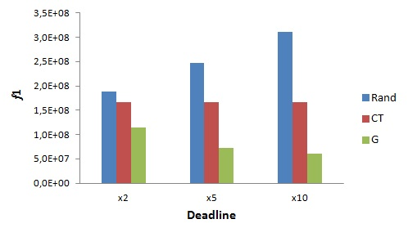
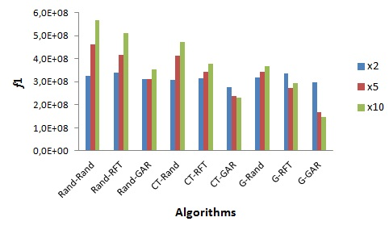
Results (1/2)

Slide 17
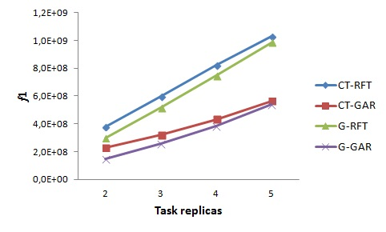
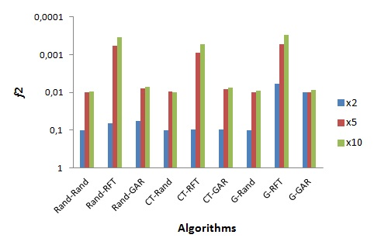
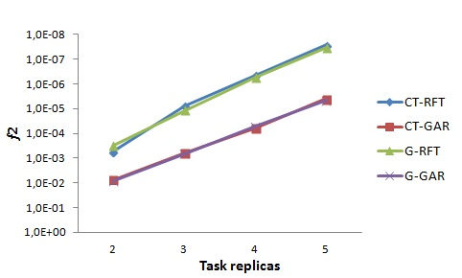
Results (2/2)

Slide 18
Conclusions
G_GAR that uses the greenness criterion both when placing a task for the first time and when creating replicas was found to achieve the best performance energy wise
G-RFT was the winner in fault tolerance criterion

Slide 19
Thank You!

