Slide 1
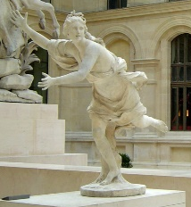















DAPHNE: An Open and Extensible
System Infrastructure for
Integrated Data Analysis Pipelines
Integrated Data Analysis Pipelines
for Large-scale Data Management,
HPC, and Machine Learning;
DAPHNE daughter of river god Peneus (fountains, streams), chased by Apollo
The DAPHNE project is funded by the European Union's Horizon 2020 research and innovation program under grant agreement number 957407 for the time period from Dec/2020 through Nov/2024.
[Louvre, Paris]
https://daphne-eu.eu/
Patrick Damme, Marius Birkenbach, Constantinos Bitsakos, Matthias Boehm, Philippe Bonnet, Florina Ciorba, Mark Dokter, Pawel Dowgiallo, Ahmed Eleliemy, Christian Faerber, Georgios Goumas, Dirk Habich, Niclas Hedam, Marlies Hofer, Wenjun Huang, Kevin Innerebner, Vasileios Karakostas, Roman Kern, Tomaž Kosar, Alexander Krause, Daniel Krems, Andreas Laber, Wolfgang Lehner, Eric Mier, Marcus Paradies, Bernhard Peischl, Gabrielle Poerwawinata, Stratos Psomadakis, Tilmann Rabl, Piotr Ratuszniak, Pedro Silva, Nikolai Skuppin, Andreas Starzacher, Benjamin Steinwender, Ilin Tolovski, Pınar Tözün, Wojciech Ulatowski, Yuanyuan Wang, Izajasz Wrosz, Aleš Zamuda, Ce Zhang, Xiao Xiang Zhu
CIDR 2022, January 9-12, 2022, Chaminade, CA, USA

Slide 2
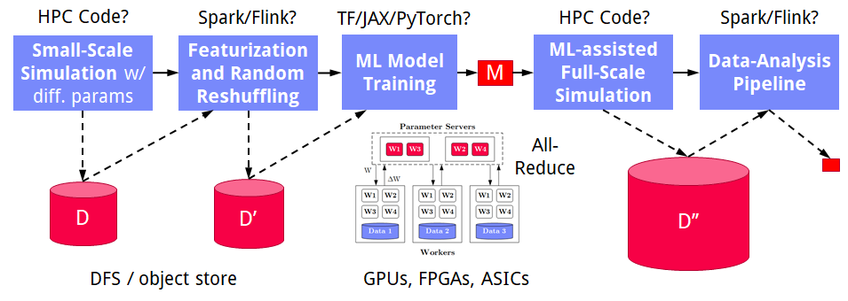
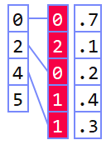

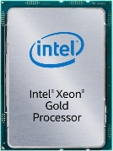
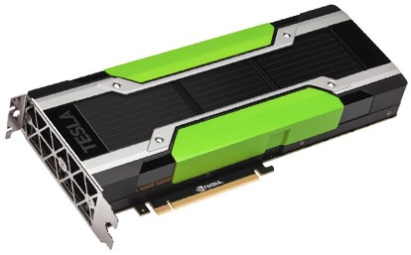
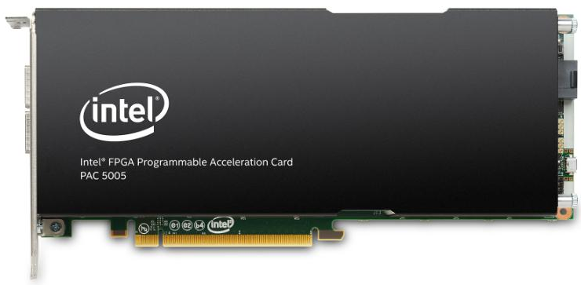
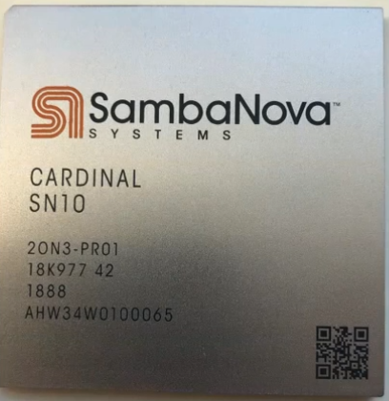
Motivation
➔ DAPHNE Overall Objective:
Open and extensible system infrastructure
Deployment Challenges
Integrated Data Analysis Pipelines
  Open data formats, query processing
  Data preprocessing and cleaning
  ML model training and scoring
  HPC, custom codes, and simulations
Hardware Challenges
  DM+ML+HPC share compilation
  and runtime techniques /
  converging cluster hardware
  End of Dennard scaling:
  P = α CFV² (power density 1)
  End of Moore’s law
  Amdahl’s law: sp = 1/s
  ➔ Increasing Specialization
Dev Teams
Programming Models
Different Systems/
Libraries
Cluster
Under-utilization
Data/File Exchange
Resource Managers
#1 Data
Representations
#2 Data
Placement
#3 Data
(Value) Types
graph
Local vs distributed
FP32, FP64, INT8,
INT32, INT64, UINT8, BF16, TF32, FlexPoint
CPUs/
NUMA
dense
sparse
compressed
GPUs
Sparsity Exploitation from Algorithms to HW
FPGAs/
ASICs
[NVIDIA
A100]

Slide 3
Example Use Cases
[Xiao Xiang Zhu et al: So2Sat LCZ42: A Benchmark Dataset for the Classification of Global Local Climate Zones. GRSM 8(3) 2020]
[So2Sat LC42: https://mediatum.ub.tum.de/1454690]
DLR Earth Observation
  ESA Sentinel-1/2 datasets → 4PB/year
  Training of local climate zone classifiers on So2Sat LCZ42
  (15 experts, 400K instances, 10 labels each, ~55GB HDF5)
  ML pipeline: preprocessing,
  ResNet-20, climate models
IFAT Semiconductor Ion Beam Tuning
KAI Semiconductor Material Degradation
AVL Vehicle Development Process (ejector geometries, KPIs)
ML-assisted simulations, data cleaning, augmentation
Cleaning during exploratory query processing

Slide 4
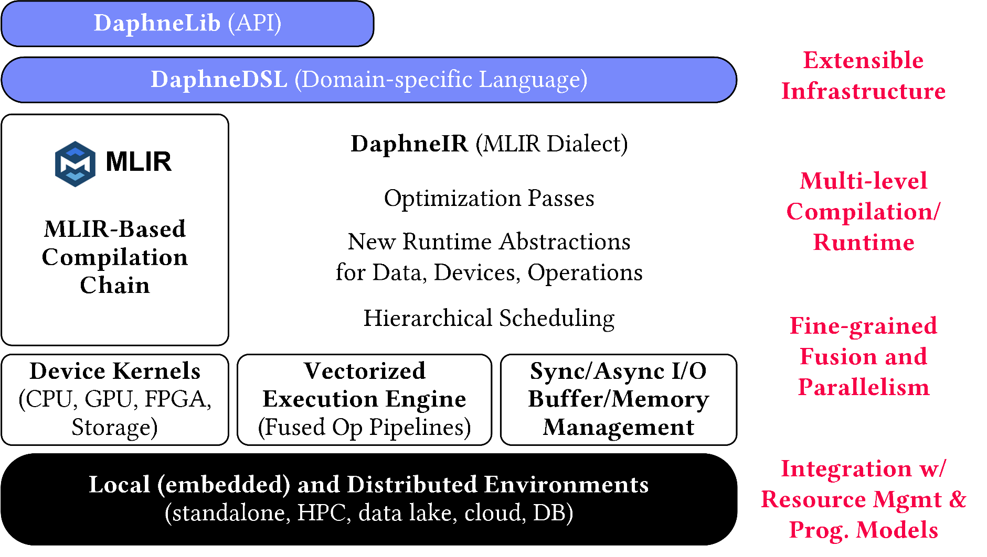
System Architecture
Python API w/ lazy evaluation
MLIR Dialects, Extension Catalog (new data types, kernels,
scheduling algs)
Sideways Entry, DSL-level constraints (data formats & data/op placement)
LLVM

Slide 5
Language Abstractions
Python API DaphneLib
Design Principles
  Frame and Matrix Operations
  (coarse-grained)
  Data Independence
  (abstract data types)
  Extensibility
  (data types, operations, HW)
DSL Operations
  Basic built-in operations (RA, LA)
  High-level built-in operations
  (e.g., SQL, PS, map on frames/matrices)
  MLIR SCF (loops, branches)
  Typed and untyped functions
  (hierarchy of composite primitives)
  UDFs and external libraries
dc = DaphneContext()
G = dc.from_numpy(npG)
G = (G != 0)
c = components(G, 100, True).compute()
Domain-specific Language DaphneDSL
def components(G, maxi, verbose) {
n = nrow(G); // get the number of vertexes
maxi = 100;
c = seq(1, n); // init vertex IDs
diff = inf; // init diff to +Infinity
iter = 1;
// iterative computation of connected components
while(diff>0 & iter<=maxi) {
u = max(rowMaxs(G * t(c)), c); // neighbor prop
diff = sum(u != c); // # of changed vertexes
c = u; // update assignment
iter = iter + 1;
}
}
Multiple dispatch of functions/kernels

Slide 6
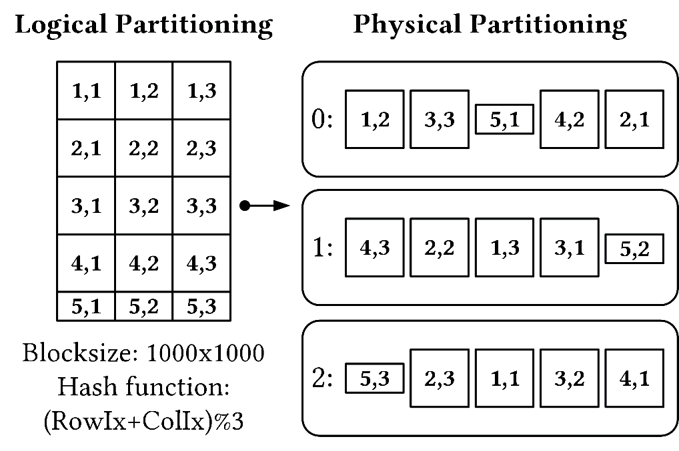
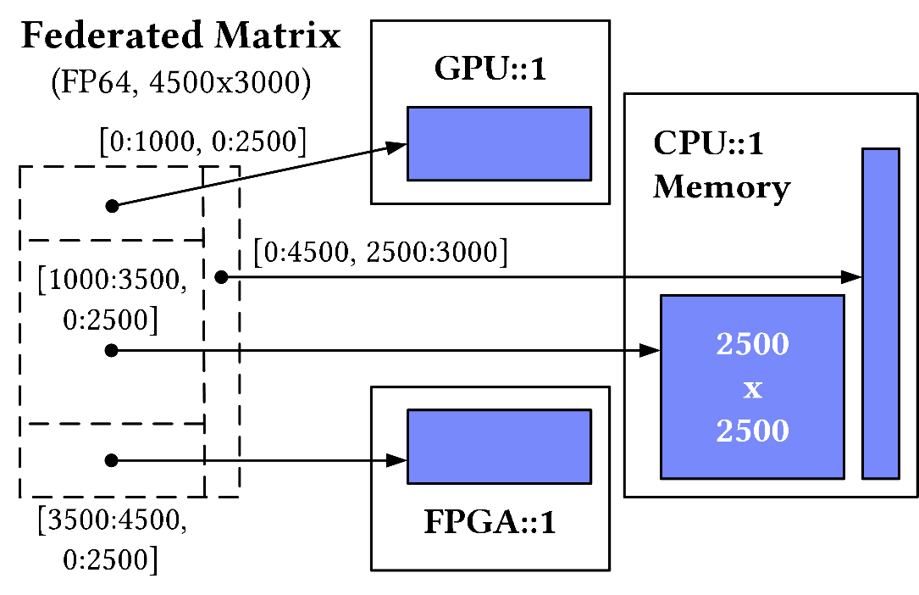
Data Representations
Data Types: Matrix, Frame, LLVM scalars, (Tensor, List)
Value Types: e.g., I8, I32, I64, UI8, UI32, UI64, FP32, FP64
Distributed/Multi-device Data:
CPU Array
Matrix
Dense/CSR
GPU Array
a) Distributed Collection of Tiles
b) Federated Matrix/Frame

Slide 7
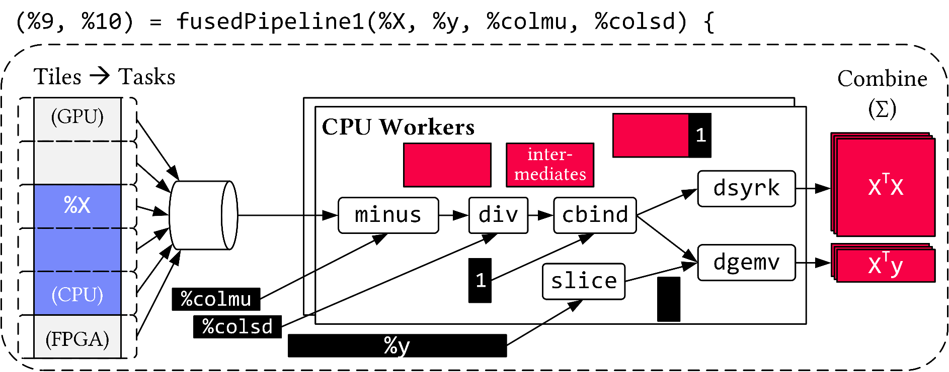
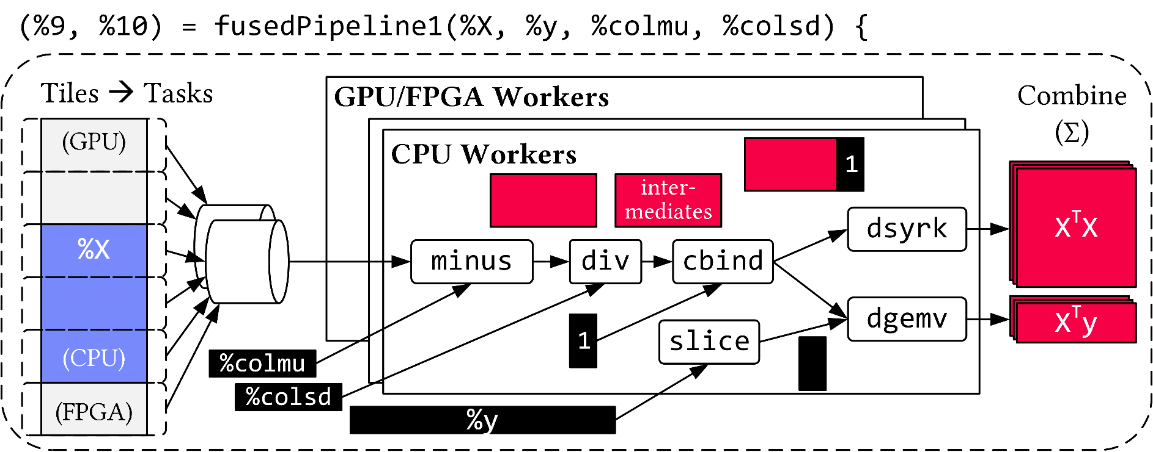
Vectorized (Tiled) Execution
Default Parallelization
Frame & Matrix Ops
Locality-aware,
Multi-device Scheduling
Fused Operator Pipelines
on Tiles/Scalars + Codegen

Slide 8
Vectorized (Tiled) Execution, cont.
#1 Zero-copy Input Slicing
  Create view on sliced input (no-op)
  All kernels work on views
#2 Sparse Intermediates
  Reuse dense/sparse kernels
  Sparse pipeline intermediates for free
#3 Fine-grained Control
  Task sizes (dequeue, data access) vs data binding (cache-conscious ops)
  Scheduling for load balance (e.g., sparse operations)
#4 Computational Storage
  Task queues connect eBPF programs, async I/O
  into buffers, and subsequent operator pipelines
SSD
UI8
ResNet-20 Scoring
FP32
FP32
FPGA
FP32
FP32

Slide 9

Extensibility
Goals for Extensibility
  New data types and kernels (e.g., compressed, HW devices)
  New optimization passes and scheduling algorithms
  Integration with other MLIR dialects
#1 Extension Catalog
  Register kernels/data types as shared libraries
  Type hierarchy, cost functions, constraints
#2 DSL-level Extensibility/Configuration
  Data representations, data/ops placement (constraints)
  Sideways Entry: daphnec takes DaphneDSL and DaphneIR
#3 System Internals
  Extended DaphneIR, new optimization passes, custom compilation chains
Artifact | Type | Cost | Lib
compress | K-Reorg |  | ./clib.so
mm_asic | K-Matmult |  | ./mma.so
CompMatrix | D-Matrix |  | ./clib.so
X = sparse(Y);
X = compress(Y);
X = device(Y, “/GPU:0”);
X = Y @_gpu Z;

Slide 10
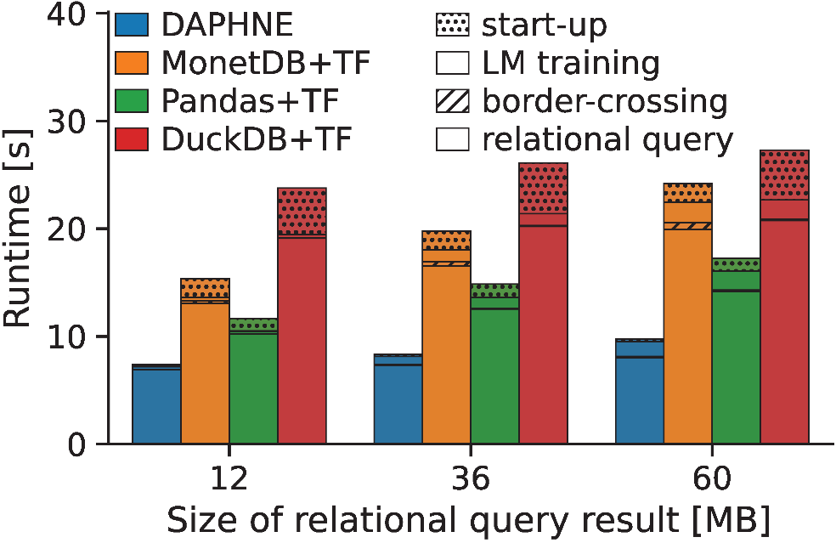
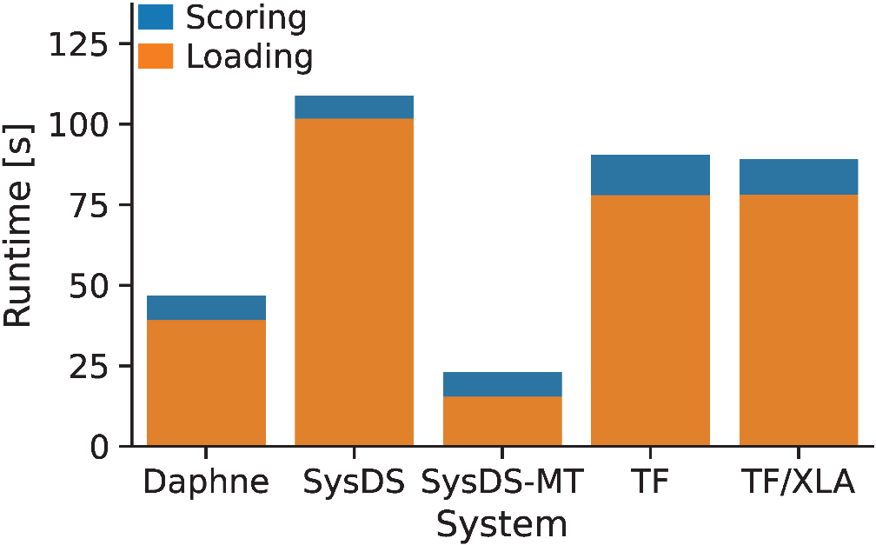
Experiments: Simple IDA Pipelines
Setup: Single node w/ 2x Intel Xeon Gold 6238 (112 vcores, 7.7 TFLOP/s),
768 GB DDR4 RAM, 12x 2TB SSDs (data), NVIDIA T4 GPU (8.1 TFLOP/s, 16 GB),
and Intel FPGA PAC D5005 (w/ Stratix 10SX FPGA, 32 GB) since Dec 29
P1: TPC-H SF10 csv, query processing
+ linear regression training on CPUs
P2: So2Sat LCZ42 csv (testset),
ResNet-20 scoring on GPU

Slide 11
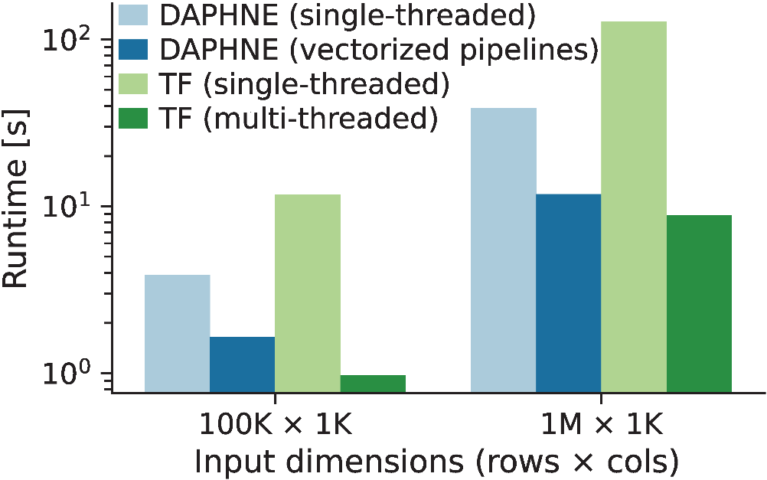
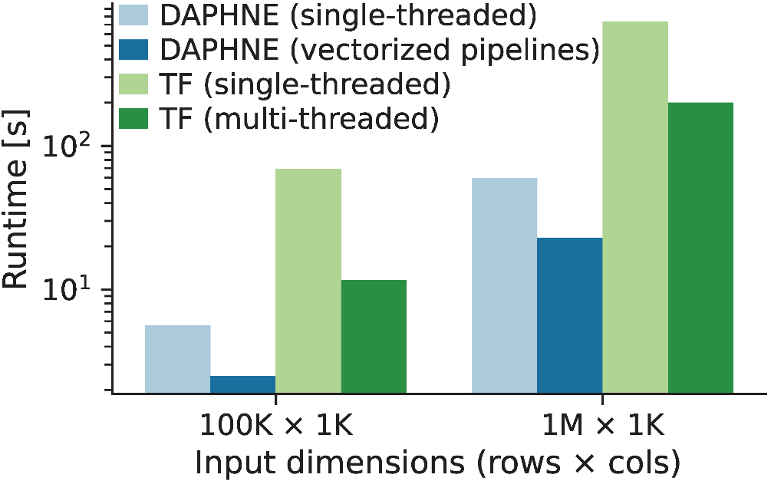
Experiments: Vectorized Execution
Linear Regression w/
varying Data Size and Vectorization
K-means Clustering w/
varying Data Size and Vectorization
Ongoing Experiments
  FPGA kernels on D5005, CPU+GPU vectorized pipelines
  Distributed sparse runtime operations on Vega supercomputer
  Sparse vectorized pipelines and scheduling algorithms

Slide 12


Status and Next Steps
https://daphne-eu.eu/
Current Status
  System Architecture and Design
  Initial DSL and Python API
  MLIR-based Compiler and Runtime Prototype
  Vectorized Execution (fused pipelines, scheduling)
  GPU (and FPGA) Integration, BLAS/DNN Libraries
  Standalone Distributed Runtime
Promising Progress and Preliminary Experiments
DAPHNE OSS Announcement
  Public release by 03/2022
  Apache v2 license
  Towards an inclusive dev community
➔ DAPHNE Overall Objective:
Open and extensible system infrastructure
DM + HPC + ML
Enable researchers to experiment with new prototypes and extensions

