Slide 1
Exploiting Page Table Locality for Agile TLB Prefetching
georgios.vavouliotis@bsc.es
Georgios Vavouliotis^{1,2} Lluc Alvarez^{1,2} Vasileios Karakostas³ Konstantinos Nikas³ Nectarios Koziris³ Daniel A. Jiménez⁴ Marc Casas^{1,2}
¹Barcelona Supercomputing Center
²Universitat Politecnica de Catalunya
³National Technical University of Athens
⁴Texas A&M University

Slide 2
Executive Summary
Problem Statement
Address translation overheads due to data accesses
Our approach —> TLB Prefetching
Operates on the microarchitectural level
Relies on the memory access patterns of the application
Does not disrupt the virtual memory subsystem
Contributions
Sampling-based Free TLB Prefetching (SBFP)
Exploit page table locality to enhance TLB prefetching
Agile TLB Prefetcher (ATP)
Novel composite TLB prefetching scheme
Combining ATP with SBFP improves geomean performance by more than 10% across different benchmark suites and reduces most of the page walk references to the memory hierarchy

Slide 3
Outline
Background
Sampling-based Free TLB Prefetching (SBFP)
Agile TLB Prefetcher (ATP)
Methodology
Evaluation
Conclusions

Slide 4
Address Translation
Each memory access requires a virtual to physical translation
Modern systems provide sophisticated software and hardware support to accelerate address translation
Virtual Address
Address Translation
Physical Address

Slide 5
x86 Architectural Support for Address Translation
Main Memory
PA17
PA25
Core
Cache Hierarchy
Page Table
VA1 —> PA17
VA5 —> PA25

Slide 6
x86 Architectural Support for Address Translation
Main Memory
PA17
PA25
Core
Cache Hierarchy
Page Table
1
¹Intel 5-level Paging, https://software.intel.com/content/www/us/en/develop/download/5-level-paging-and-5-level-ept-white-paper.html

Slide 7
x86 Architectural Support for Address Translation
Main Memory
PA17
PA25
Core
Cache Hierarchy
Page Table
TLB
VA1 —> PA17
VA5 —> PA25

Slide 8
x86 Architectural Support for Address Translation
Main Memory
PA17
PA25
Core
Cache Hierarchy
Page Table
TLB
PSC
VA1 —> PA17
VA5 —> PA25

Slide 9
Translation Lookaside Buffer (TLB)
Main Memory
L1 I-TLB
L1 D-TLB
PA17
PA25
Core
Cache Hierarchy
Page Table
L2 TLB
PSC
VA1 —> PA17
VA5 —> PA25
Last level TLB misses account for most of the cycles spent in the TLB miss handler¹
¹Basu et. al, “Efficient virtual memory for big memory servers”, ISCA’13

Slide 10
Translation Lookaside Buffer (TLB)
Main Memory
PA17
PA25
Core
Cache Hierarchy
Page Table
load VA1
TLB
PSC
VA1 —> PA17
VA5 —> PA25
TLB hit

Slide 11
Translation Lookaside Buffer (TLB)
Main Memory
PA17
PA25
Core
Cache Hierarchy
Page Table
load VA1
TLB
PSC
VA1 —> PA17
TLB miss

Slide 12
Translation Lookaside Buffer (TLB)
Address translation poses severe performance penalties, especially for big data applications^{1,2}
**
Our analysis indicates that a Perfect TLB³ improves geometric mean performance by up to 70% across different contemporary benchmark suites
L2-TLB Miss Penalty (Cycles)
Address translation overhead is an emerging problem
**Gras et. al, “Translation Leak-aside Buffer: Defeating Cache Side-channel Protections with TLB Attacks”, SEC’18
¹XSBench, https://github.com/ANL-CESAR/XSBench
²Beamer et. al, “The GAP benchmark suite”, CoRR’15
³Perfect TLB = ideal TLB where all accesses are hits

Slide 13
TLB Prefetching
Main Memory
Core
Cache Hierarchy
Page Table
TLB
load VA1
VA1 —> PA17
TLB Hit!
Prefetch
Queue
TLB prefetchers use a Prefetch Queue (PQ) to store the prefetches¹
TLB Prefetcher
Queue
¹G. B. Kandiraju and A. Sivasubramaniam, "Going the Distance for TLB Prefetching: An Application-driven Study", ISCA'02

Slide 14
TLB Prefetching
Main Memory
Demand Page Walk
Prefetch Page Walk
Core
Cache Hierarchy
Page Table
TLB
load VA1
TLB Miss!
Prefetch
Queue
Hit!
Miss!
TLB Prefetcher
Queue

Slide 15
x86 Page Table Walking
Main Memory
virtual address space
…
0xA0 | 0xA1 | 0xA2 | 0xA3 | 0xA4 | 0xA5 | 0xA6 | 0xA7
…
SE | PML4 offset | PDP offset | PD offset | PT offset | Page offset
Core
Cache Hierarchy
Page Table
PML4E
PDPE
PDE
PTE
TLB
CR3
load VA1
TLB miss!
Memory Hierarchy
L1
L2
LLC
DRAM

Slide 16
Motivation for Exploiting Page Table Locality
0xA0 | 0xA1 | 0xA2 | 0xA3 | 0xA4 | 0xA5 | 0xA6 | 0xA7
SE | PML4 offset | PDP offset | PD offset | PT offset | Page offset
PTE of 0xA0
PTE of 0xA1
PTE of 0xA2
PTE of 0xA3
PTE of 0xA4
PTE of 0xA5
PTE of 0xA6
PTE of 0xA7
PML4E
PDPE
PDE
8 bytes
CR3

Slide 17
Motivation for Exploiting Page Table Locality
0xA0 | 0xA1 | 0xA2 | 0xA3 | 0xA4 | 0xA5 | 0xA6 | 0xA7
SE | PML4 offset | PDP offset | PD offset | PT offset | Page offset
PTE of 0xA0
PTE of 0xA1
PTE of 0xA2
PTE of 0xA3
PTE of 0xA4
PTE of 0xA5
PTE of 0xA6
PTE of 0xA7
64 bytes
PML4E
PDPE
PDE
CR3

Slide 18
Motivation for Exploiting Page Table Locality
0xA0 | 0xA1 | 0xA2 | 0xA3 | 0xA4 | 0xA5 | 0xA6 | 0xA7
SE | PML4 offset | PDP offset | PD offset | PT offset | Page offset
PTE of 0xA0
PTE of 0xA1
PTE of 0xA2
PTE of 0xA3
PTE of 0xA4
PTE of 0xA5
PTE of 0xA6
PTE of 0xA7
Cache Hierarchy
TLB Prefetch
Queue
PML4E
PDPE
PDE
CR3
At the end of each page walk there are 7 PTEs that are prefetched for free
Prefetching all the free PTEs per page walk results in sub-optimal performance gains

Slide 19
Sampling-based Free TLB Prefetching (SBFP)
Prefetch only the useful free PTEs per page walk
Adapt to phase-based behaviors
Can be combined with any TLB prefetcher
Exploit page table locality for both demand and prefetch page walks

Slide 20
Terminology
After a page table walk, 8 PTEs are stored into a cache line
Free Distance = signed distance between the PTE that holds the demand translation and another free PTE
14 possible free distances, from -7 to +7 (excluding zero)
Assume a TLB miss for virtual page 0xA3
0xA0 | 0xA1 | 0xA2 | 0xA3 | 0xA4 | 0xA5 | 0xA6 | 0xA7
0xA0 | 0xA1 | 0xA2 | 0xA3 | 0xA4 | 0xA5 | 0xA6 | 0xA7
cache_position(0xA3) = 3
e.g., Free Distance(0xA0) = -3

Slide 21
Sampling-based Free TLB Prefetching — Overview
saturating counters
Free Distance Table (FDT)
C-7 | C-6 | C-5 | C-4 | C-3 | C-2 | C-1 | C+1 | C+2 | C+3 | C+4 | C+5 | C+6 | C+7
Prefetch Queue
Sampler
virtual page | physical page | free distance
virtual page | free distance

Slide 22
Sampling-based Free TLB Prefetching — Operation
cache_position(0xA3) = 3
0xA0 | 0xA1 | 0xA2 | 0xA3 | 0xA4 | 0xA5 | 0xA6 | 0xA7
FDT
C-7 | C-6 | C-5 | C-4 | C-3 | C-2 | C-1 | C+1 | C+2 | C+3 | C+4 | C+5 | C+6 | C+7
Prefetch Queue
Sampler
Threshold
virtual page | physical page | free distance
0xA1 | 0xF1 | -2
0xA2 | 0xG2 | -1
0xA6 | 0xF6 | 3
virtual page | free distance
0xA4 | 1
0xA0 | -3
0xA5 | 4
0xA7 | 2

Slide 23
Sampling-based Free TLB Prefetching — Updating FDT
Free Distance Table (FDT)
C-7 | C-6 | C-5 | C-4 | C-3 | C-2 | C-1 | C+1 | C+2 | C+3 | C+4 | C+5 | C+6 | C+7
Prefetch Queue
Sampler
virtual page | physical page | free distance
0xA1 | 0xF1 | -2
0xA2 | 0xG2 | -1
0xA6 | 0xF6 | 3
virtual page | free distance
0xA4 | 1
0xA0 | -3
0xA5 | 4
0xA7 | 2

Slide 24
Sampling-based Free TLB Prefetching — Updating FDT
Free Distance Table (FDT)
C-7 | C-6 | C-5 | C-4 | C-3 | C-2 | C-1 | C+1 | C+2 | C+3 | C+4 | C+5 | C+6 | C+7
++
++
Prefetch Queue
Sampler
virtual page | physical page | free distance
0xA1 | 0xF1 | -2
0xA2 | 0xG2 | -1
0xA6 | 0xF6 | 3
virtual page | free distance
0xA4 | 1
0xA0 | -3
0xA5 | 4
0xA7 | 2

Slide 25
Combining SBFP with a TLB Prefetcher
Main Memory
Core
Cache Hierarchy
Page Table
TLB
load VA1
VA1 —> PA17
SBFP
FDT
Prefetch
Queue
Sampler
TLB Prefetcher
Queue

Slide 26
Combining SBFP with a TLB Prefetcher
Main Memory
Prefetch Page Walk
Demand Page Walk
Core
Cache Hierarchy
Page Table
TLB
load VA1
SBFP
++
TLB Miss!
FDT
Prefetch
Queue
Sampler
Hit!
Miss!
TLB Prefetcher
Queue

Slide 27
Agile TLB Prefetcher (ATP)
Main Memory
Core
Cache Hierarchy
Page Table
TLB
Prefetch
Queue
TLB Prefetcher
Queue
ATP

Slide 28
Motivation for Agile TLB Prefetcher (ATP)
There is no state-of-the-art TLB prefetcher that performs best across all considered workloads
Different workloads correlate well with different features (e.g., strides, distances between virtual pages, PC)
When the TLB miss behavior is irregular, state-of-the-art TLB prefetchers issue useless prefetch requests

Slide 29
Agile TLB Prefetcher (ATP)
Combine three low-cost TLB prefetchers
Adaptive selection logic and throttling mechanisms

Slide 30
Constituent Prefetchers of ATP
Main Memory
Core
Cache Hierarchy
Page Table
TLB
Prefetch
Queue
ATP
STP
H2P
MASP

Slide 31
Stride TLB Prefetcher (STP)
Main Memory
STP targets TLB miss patterns that correlate well with small strides
Core
STP
vpn-2
Page Table
Cache Hierarchy
vpn-1
TLB
vpn
vpn+1
Prefetch
Queue
vpn+2
ATP
H2P
MASP

Slide 32
H2 Prefetcher (H2P)
Main Memory
Core
H2P detects miss patterns that correlate well with distances between virtual pages that produce TLB misses
H2P
Cache Hierarchy
E + distance(E,D)
Page Table
TLB
TLB Miss Stream = …, A, D, E, …
E + distance(D,A)
Prefetch
Queue
ATP
STP
MASP

Slide 33
Modified Arbitrary Stride Prefetcher (MASP)
Main Memory
More aggressive version of Arbitrary Stride Prefetcher (ASP)¹
Assume a TLB miss for page A
MASP prefetches the PTEs of the pages
A + 5
A + distance(A,E)
Core
Cache Hierarchy
Page Table
TLB
PC | Previous VPN | Stride
0xff | E | +5
PC | Previous VPN | Stride
Prefetch
Queue
ATP
STP
H2P
¹G. B. Kandiraju and A. Sivasubramaniam, "Going the Distance for TLB Prefetching: An Application-driven Study", ISCA'02

Slide 34
Selection and Throttling Schemes
Main Memory
Core
Cache Hierarchy
Page Table
TLB
ATP
Prefetch
Queue
STP
H2P
MASP
Selection & Throttling Logic

Slide 35
Selection and Throttling Schemes
Main Memory
Core
STP
H2P
MASP
Cache Hierarchy
Page Table
FPQ
FPQ
FPQ
TLB
C0
C1
C2
ATP
Prefetch
Queue
STP
H2P
MASP

Slide 36
Agile TLB Prefetcher (ATP) — Operation
Main Memory
Core
Cache Hierarchy
Page Table
TLB
load VA1
ATP
STP
H2P
MASP
TLB miss
Prefetch
Queue
FPQ
FPQ
FPQ
C0
C1
C2

Slide 37
Agile TLB Prefetcher (ATP) — Operation
Main Memory
C0
Core
Cache Hierarchy
Page Table
Disable
C1
TLB
load VA1
C2
STP
TLB miss
Prefetch
Queue
H2P
MASP

Slide 38
Simulation Infrastructure
ChampSim¹
Trace-driven multi-core out-of-order simulator
x86 page table walker
Component | Parameters | Latency
L1 I-TLB | 64-entry, 8-way | 1cc
L1 D-TLB | 64-entry, 8-way | 1cc
L2 TLB | 1536-entry, 12-way | 8cc
Page Structure Caches | 3-level Split PSC, PML4: 2-entry, PDP: 4-entry, PD: 32-entry | 2cc
Prefetch Queue | 64-entry, fully assoc. | 2cc
Sampler | 64-entry, fully assoc | 2cc
L1 iCache | 32KB, 8-way | 1cc
L1 dCache | 32KB, 8-way | 1cc
L2 Cache | 256KB, 8-way | 8cc
LLC | 2MB/core, 16-way | 20cc
DRAM | 4GB, tRP=tRCD=tCAS=11 | variable
¹https://github.com/ChampSim/ChampSim

Slide 39
Workloads
SPEC CPU 2006 benchmark suite
SPEC CPU 2017 benchmark suite
Industrial workloads provided by Qualcomm for Championship Value Prediction (CVP-1)
Big Data workloads
GAP benchmark suite
XSBench
SimPoint Methodology
TLB MPKI > 1

Slide 40
State-of-the-art Data TLB Prefetchers¹
Sequential Prefetcher (SP)
Prefetch the PTE of the page located next to the one produced the TLB miss
Distance Prefetcher (DP)
Distances between pages that produce consecutive TLB misses
Arbitrary Stride Prefetcher (ASP)
PC-correlated prefetcher
¹G. B. Kandiraju and A. Sivasubramaniam, "Going the Distance for TLB Prefetching: An Application-driven Study", ISCA'02

Slide 41
Scenarios that Exploit Free TLB Prefetching
No Free TLB Prefetching (NoFP)
Free prefetching is not exploited
Naive Free TLB Prefetching (NaiveFP)
All free PTEs are stored into the PQ
Static Free TLB Prefetching (StaticFP)
Static offline exploration of the overall most useful free distances per TLB prefetcher

Slide 42
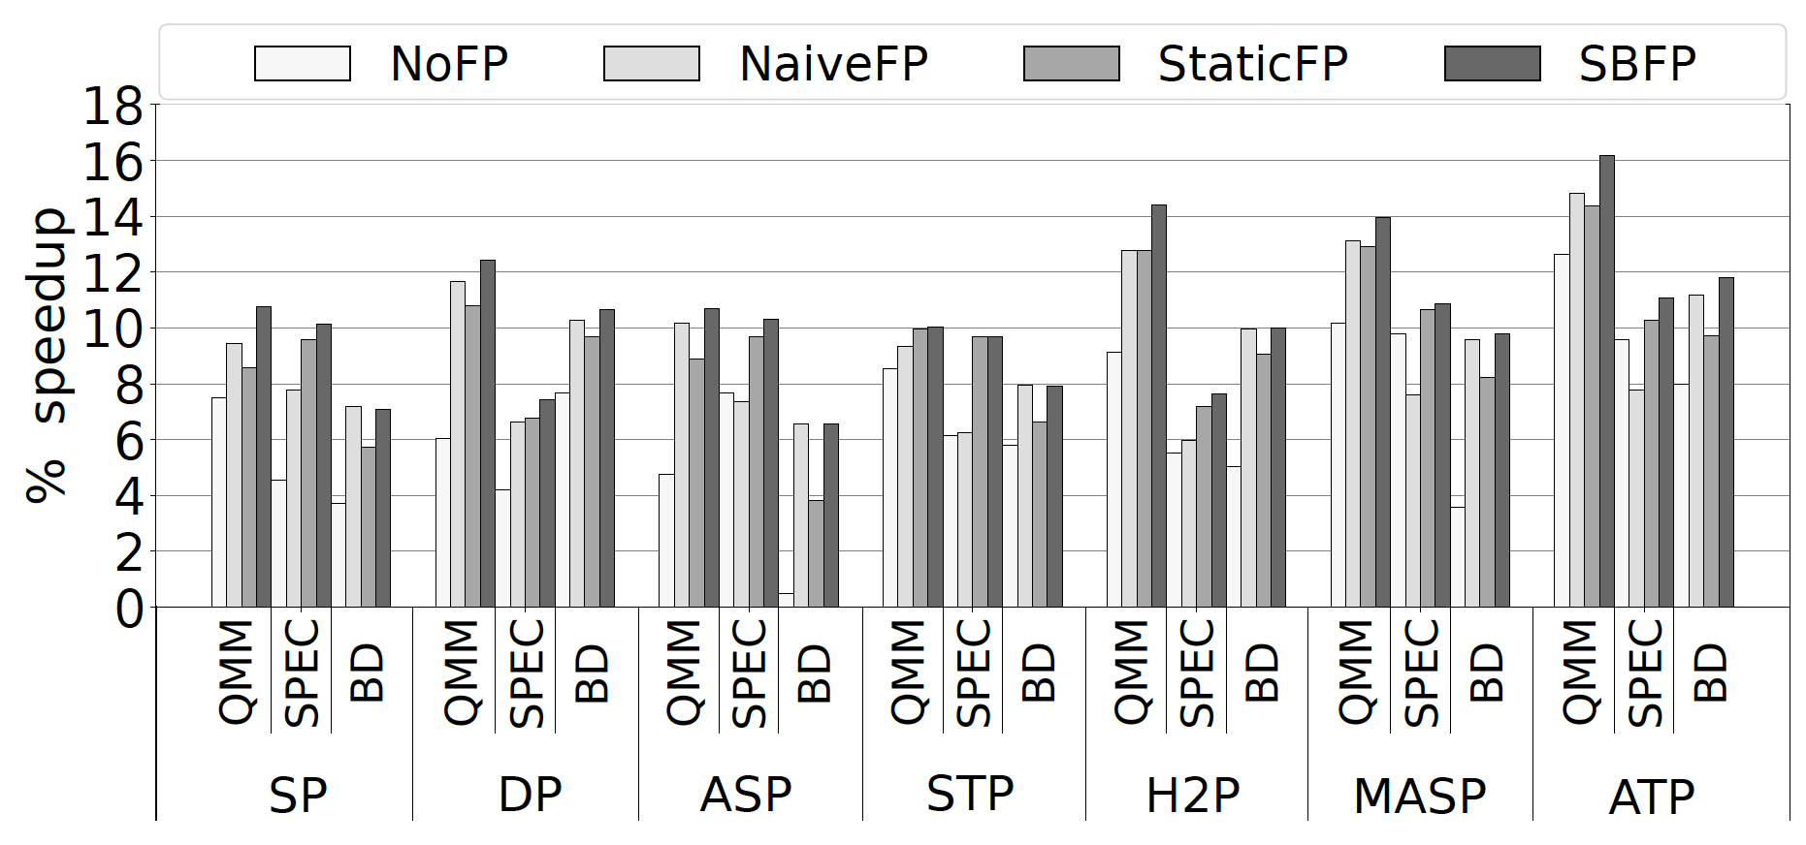
Performance Results

Slide 43
Performance Results
The scenarios that exploit page table locality (NaiveFP, StaticFP, SBFP) significantly improve performance over NoFP

Slide 44
Performance Results
SBFP provides larger speedups than the other scenarios that exploit page table locality across all evaluated TLB prefetchers

Slide 45
Performance Results
ATP combined with SBFP provides the overall best speedups

Slide 46
Performance Results
ATP+SBFP improves geomean performance by 16.2%, 11.1%, and 11.8% for the Qualcomm, SPEC, and Big Data workloads
ATP+SBFP outperforms the best already proposed TLB prefetcher by 8.7%, 3.4%, and 4.2% for the Qualcomm, SPEC, and Big Data workloads

Slide 47
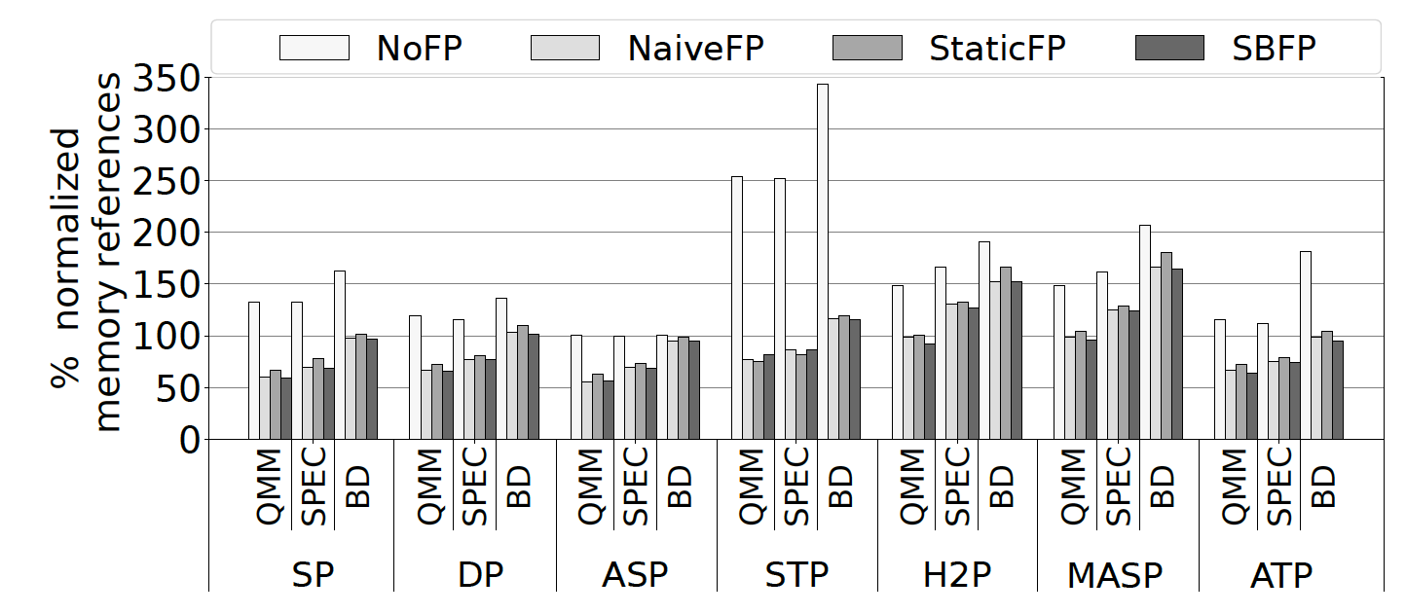
Page Walk Memory References
‘page walk memory reference’ is a reference to the memory hierarchy (L1, L2, LLC, DRAM) due to a page walk

Slide 48
Page Walk Memory References
Large increase in page walk memory references when page table locality is not exploited (NoFP)

Slide 49
Page Walk Memory References
The scenarios that exploit page table locality (NaiveFP, StaticFP, SBFP) significantly reduce the page walk memory references

Slide 50
Page Walk Memory References
SBFP provides the highest reduction in page walk memory references across all evaluated TLB prefetchers

Slide 51
Page Walk Memory References
ATP combined with SBFP provides the overall highest reduction in page walk memory references

Slide 52
Page Walk Memory References
ATP+SBFP reduces the page walk memory references by 37%, 26%, and 5% for the Qualcomm, SPEC, and Big Data workloads, over a baseline without TLB prefetching

Slide 53
Storage Overhead
SBFP requires 0.31KB of storage
ATP requires 1.68KB of storage
ATP combined with SBFP requires 1.99KB of storage
ATP combined with SBFP outperforms the ISO-storage¹ scenario by more than 9% across all the benchmark suites
¹L2-TLB is augmented with additional entries to match the storage budget of ATP+SBFP

Slide 54
Additional Evaluation Results
Activation ratio of the constituent prefetchers of ATP
Portion of the PQ hits provided by ATP and SBFP
Performance improvement when 2MB pages are used
Dynamic energy consumption of address translation
Comparison with other approaches that improve TLB performance

Slide 55
Conclusions
This work reduces the address translation overheads via TLB prefetching
microarchitectural technique | relies on the memory access patterns | not disruptive
Our proposal
Sampling-based Free TLB Prefetching (SBFP)
Exploit page table locality to enhance the performance of prior and novel TLB prefetchers
Agile TLB Prefetcher (ATP)
Composite TLB prefetcher that combines three low-cost TLB prefetchers and disables prefetching when the TLB miss stream is irregular
Combining ATP with SBFP improves geomean performance by more than 10% across different benchmark suites and reduces most of the page walk references to the memory hierarchy

Slide 56
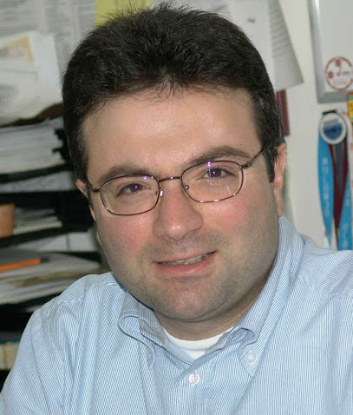
Thank you!
georgios.vavouliotis@bsc.es

