Slide 1
FaaS in the Age of (sub-)μs I/O: A Performance Analysis of Snapshotting
Christos Katsakioris, Chloe Alverti, Vasileios Karakostas*, Konstantinos Nikas, Georgios Goumas, Nectarios Koziris
National Technical University of Athens
*University of Athens

Slide 2
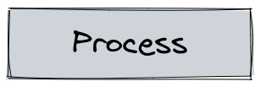
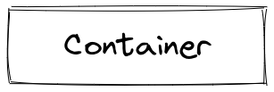
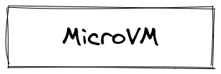
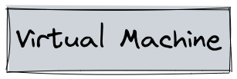
FaaS for Cloud Providers
Massive Colocation
Cluster Utilization
Isolation
Cold Start

Slide 3
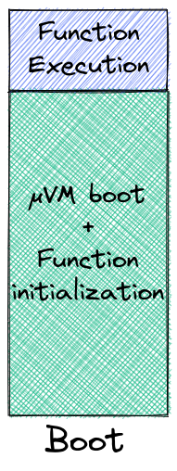
Cold Start: Killing Functions’ Performance
Boot & initialize a new function instance?
~50% of apps run for <= 670ms on avg ¹
~90% of apps run for <= 10s on avg ¹
Functions are short-lived
poor performance
Booting function instances is too expensive
¹ Shahrad et al – ATC 20: Azure Functions trace

Slide 4
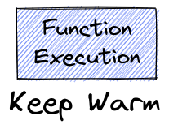
Cold Start vs Resource Utilization
Boot & initialize a new function instance?
~50% of apps run for <= 670ms on avg ¹
~90% of apps run for <= 10s on avg ¹
Functions are short-lived
Keep them warm?
~81% of apps invoked more rarely than once per minute ¹
~45% of apps invoked more rarely than once per hour ¹
→ Functions are invoked infrequently
poor performance
Keeping function instances warm is too expensive
resources
wasted
¹ Shahrad et al – ATC 20: Azure Functions trace

Slide 5
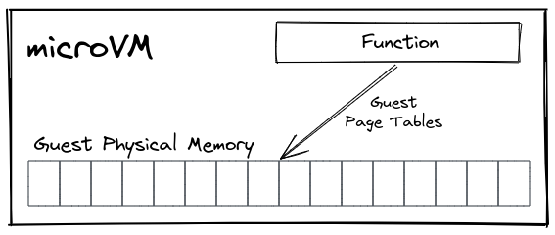
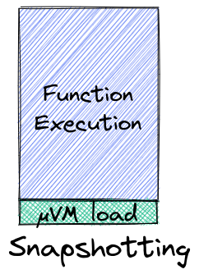
Cold Start: μVM Snapshots to the Rescue
poor performance
Du et al – ASPLOS'20
Ustiugov et al – ASPLOS’21
Tan et al – arXiv:2109.13319, 2021
Implemented in Firecracker¹
performance still limited by cold-start (overhead in Function Execution)
resources
wasted
Firecracker mmaps the snapshot file
Firecracker dumps guest physical
memory onto a snapshot file
¹ https://github.com/firecracker-microvm/firecracker/blob/b6d6f712131e4e746f603c4562de7fea8a318a02/docs/snapshotting/snapshot-support.md

Slide 6
Snapshot Restoration over Local Disk
Guest Physical Memory
EPT
mmap’ed snapshot file
Read-only page
(Page Cache Buffering)
Writable page
(Copy-on-Write)
SSD
DRAM
Storage I/O (because of page faults) slows down snapshotted Functions

Slide 7
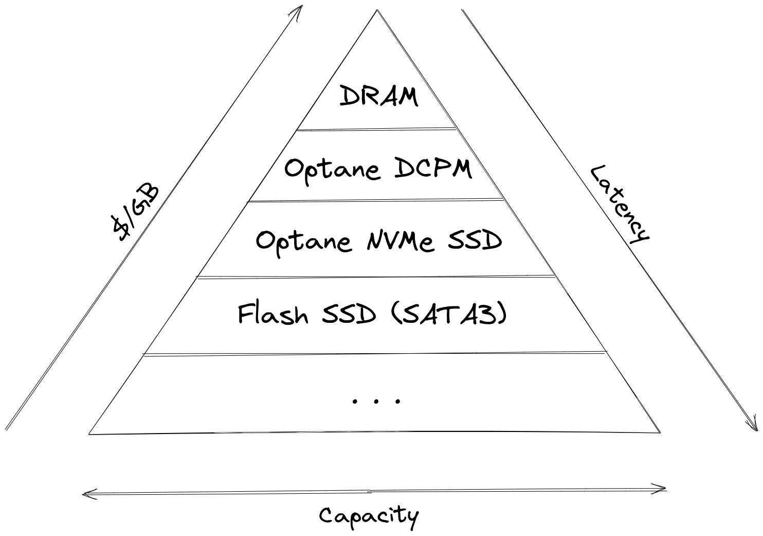
Modern Storage Hierarchy
BW (GB/s)
R: 23
W: 23
Volatile
~80ns
Non-Volatile
R: 6.8
W: 1.85
Direct Access
~300ns
Buffered Access
R: 2.2
W: 2
~10μs
R: 0.5
W: 0.5
~180μs

Slide 8
Snapshot Restoration over Persistent Memory
Guest Physical Memory
EPT
Direct
Access
mmap’ed snapshot file
Read-only page
Writable page
(Copy-on-Write)
PMEM
DRAM

Slide 9
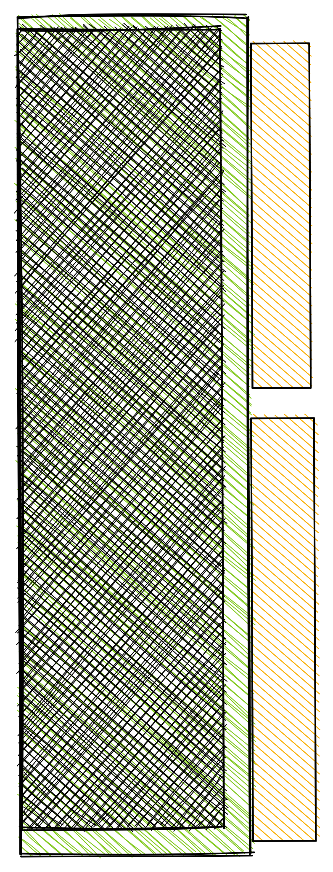
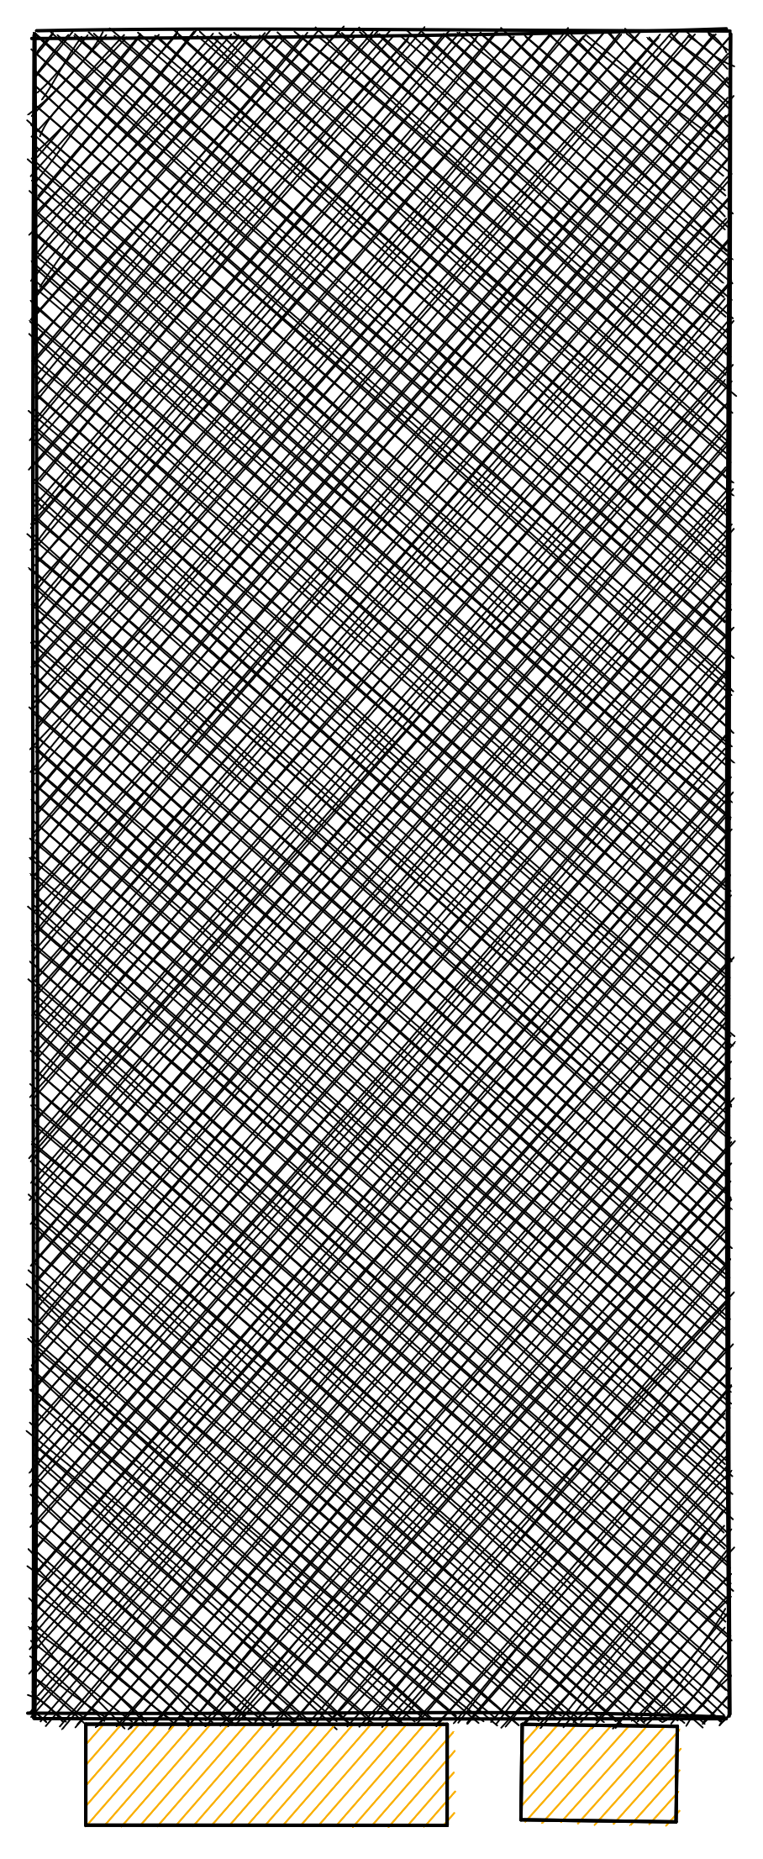
Experimental Setup
Host
Intel Xeon Gold 5812T Cascade Lake
2x16 physical cores (SMT disabled)
fixed frequency
Intel Optane DCPM (AppDirect mode)
Intel Optane DC P4801X Series SSD (PCIe 3.0)
Intel SSD 520 Series (SATA3)
Linux 5.1.0 (with minor adjustments)
THP always
Firecracker v1.0.0 (with minor adjustments)
Guest
1 vCPU, pinned to one of host’s cores
512 MB memory
Linux 5.14.6
THP always
Alpine or Debian
NUMA 0
NUMA 1
Kim and Lee, FunctionBench
SoCC ’19
CLOUD ‘19
DCPM
(ext4-DAX)
NVMe
(ext4)
Flash SSD
(ext4)

Slide 10
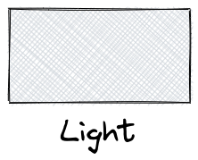
Function Classification

Slide 11
Flash SSD vs Optane NVMe: Cold-start Latency
~6×
Notes:
[Takeaway1]

Slide 12
Flash SSD vs Optane NVMe: Cold-start Latency
Optane NVMe SSDs suffice to speed up cold starts by up to 6×.
~6×
Notes:
[Takeaway1]

Slide 13
Flash SSD vs Optane NVMe: Cold vs Warm
Notes:
[Takeaway4]

Slide 14
Flash SSD vs Optane NVMe: Cold vs Warm
Optane NVMe SSDs bring cold-start latency closer to warm.
Notes:
[Takeaway4]

Slide 15
Optane NVMe vs Optane DCPM: Cold-start Latency
WS | 13 MB
RO | 68%
RW | 32%
DCPM Reads | 11 MB
WS | 49 MB
RO | 44%
RW | 56%
DCPM Reads | 76 MB
WS | 51 MB
RO | 43%
RW | 57%
DCPM Reads | 59 MB
>2×
Notes:
[Takeaway2]

Slide 16
Optane NVMe vs Optane DCPM: Cold-start Latency
WS | 13 MB
RO | 68%
RW | 32%
DCPM Reads | 11 MB
WS | 49 MB
RO | 44%
RW | 56%
DCPM Reads | 76 MB
WS | 51 MB
RO | 43%
RW | 57%
DCPM Reads | 59 MB
Functions that are not CPU-bound and access their working set
sparsely and mostly for reads, benefit the most from DCPM.
Notes:
[Takeaway2]

Slide 17
Optane NVMe vs Optane DCPM: Cold-start Latency
WS | 13 MB
RO | 68%
RW | 32%
DCPM Reads | 11 MB
WS | 49 MB
RO | 44%
RW | 56%
DCPM Reads | 76 MB
WS | 51 MB
RO | 43%
RW | 57%
DCPM Reads | 59 MB

Slide 18
Optane DCPM vs SSDs: Resource Utilization
WS | 13 MB
RO | 68%
RW | 32%
DCPM Reads | 11 MB
WS | 49 MB
RO | 44%
RW | 56%
DCPM Reads | 76 MB
WS | 51 MB
RO | 43%
RW | 57%
DCPM Reads | 59 MB
Notes:
[Takeaway3]

Slide 19
Optane DCPM vs SSDs: Resource Utilization
WS | 13 MB
RO | 68%
RW | 32%
DCPM Reads | 11 MB
WS | 49 MB
RO | 44%
RW | 56%
DCPM Reads | 76 MB
WS | 51 MB
RO | 43%
RW | 57%
DCPM Reads | 59 MB
Storing snapshots on DCPM can save up to ~70% of DRAM resources per function.
Notes:
[Takeaway3]

Slide 20
Optane DCPM: Warm Invocations
Notes:
[Takeaway5]

Slide 21
Optane DCPM: Warm Invocations
Restoring μVMs from snapshots on DCPM minimally affects functions’ latency.
Notes:
[Takeaway5]

Slide 22
Experimental Setup: Multiple μVMs
DCPM
NVMe
Flash SSD

Slide 23
Flash SSD vs Optane NVMe: Cold-start Latency at Scale

Slide 24
Flash SSD vs Optane NVMe: Cold-start Latency at Scale
Read BW severely affects scalability of cold invocations.
Optane NVMe enables scaling to 2× - 4× μVMs in parallel, each running ~8× faster.

Slide 25
Optane NVMe vs Optane DCPM: Cold-start at Scale
→ DCPM: 6.8 GB/s
→ NVMe: 2.2 GB/s
Yang et al – FAST'20
Izraelevitz et al – arXiv: 1903.05714

Slide 26
Optane NVMe vs Optane DCPM: Cold-start at Scale
→ DCPM: 6.8 GB/s
→ NVMe: 2.2 GB/s
Yang et al – FAST'20
Izraelevitz et al – arXiv: 1903.05714
Inherent characteristics of snapshot restoration at scale are not
aligned to the best programming practices for Persistent Memory.

Slide 27
More in the paper
Further analysis
Warm invocations at scale
Disk readahead

Slide 28
Future Work
Experimentation on multi-NVDIMM setup
Experimentation on multi-node setup
Model / Rules to decide on snapshot placement
E.g.:
Important Factors ?
Workload Characterization ?
Integration with an Orchestrator
 | Execution Time | R/W Ratio | Invocation Frequency | … ? | DECISION
Workload A | short | read mostly | frequent | … | DCPM
Workload B | long | X | X | … | Flash SSD

Slide 29
Summary
Cold starts:
Snapshots improve performance but are still susceptible to cold start
Storage I/O due to Page Faults
Why not take advantage of modern storage hierarchy’s richness?
Modern devices bring cold-start latency close to warm
PMEM: opportunity for high consolidation
Newer storage media have their limits too (e.g., at scale)
Snapshot placement in resource allocation policies
 | Performance | Resource Utilization
Boot new instances
Keep instances warm
Snapshotting | Storage I/O

Slide 30
Questions?

