Slide 1
AVL Trees
Manolis Koubarakis

Slide 2
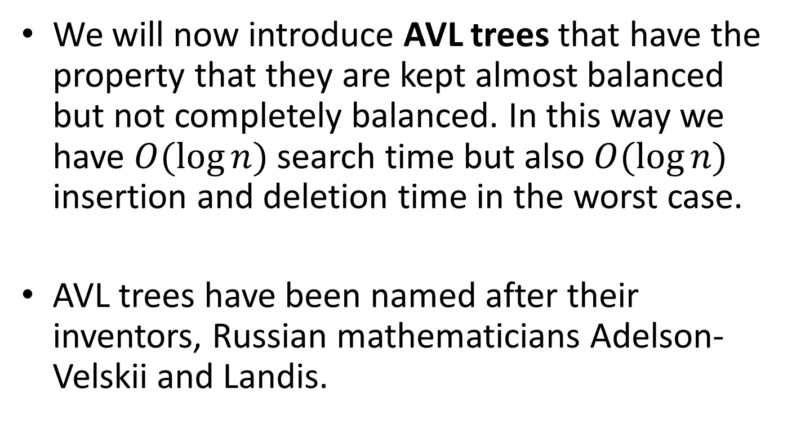
AVL Trees
We will now introduce AVL trees that have the property that they are kept almost balanced but not completely balanced. In this way we have $O(\log{n})$ search time but also $O(\log{n})$ insertion and deletion time in the worst case.
AVL trees have been named after their inventors, Russian mathematicians Adelson-Velskii and Landis.

Slide 3
Definitions
We define the height of a binary search tree to be the length of the longest path from the root to some leaf.
The height of a tree with only one node is 0. The height of the empty tree is defined to be -1.
If N is a node in a binary search tree T, then we say that N has the AVL property if the heights of the left and right subtrees of N are either equal or they differ by 1.
An AVL tree is a binary search tree in which each node has the AVL property.

Slide 4
Example – AVL tree

Slide 5
Example – AVL tree

Slide 6
Example – AVL tree

Slide 7
Fact
It is easy to see that all the subtrees of an AVL tree are AVL trees.

Slide 8
Example – Non-AVL tree

Slide 9
Example – Non-AVL tree

Slide 10
Example – Non AVL tree

Slide 11
Extended AVL Trees
If we consider trees in their extended form then the AVL property needs to hold for internal nodes.

Slide 12

Proposition
The height of an AVL tree storing $n$ entries is $O\left(\log{n}\right).$
Proof?

Slide 13
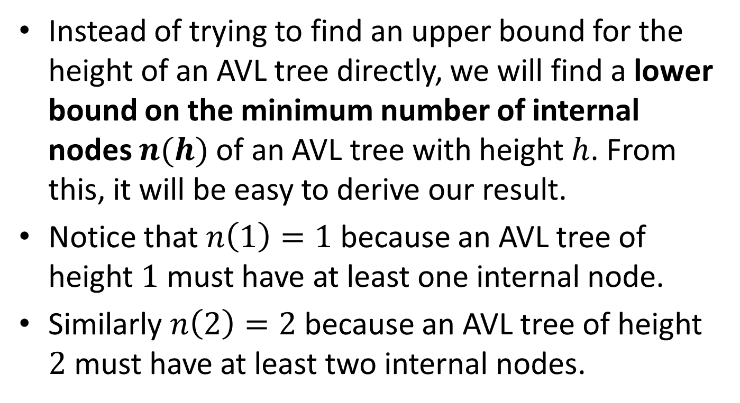
Proof
Instead of trying to find an upper bound for the height of an AVL tree directly, we will find a lower bound on the minimum number of internal nodes $n(h)$ of an AVL tree with height $h$. From this, it will be easy to derive our result.
Notice that $n\left(1\right)=1$ because an AVL tree of height $1$ must have at least one internal node.
Similarly $n\left(2\right)=2$ because an AVL tree of height $2$ must have at least two internal nodes.

Slide 14
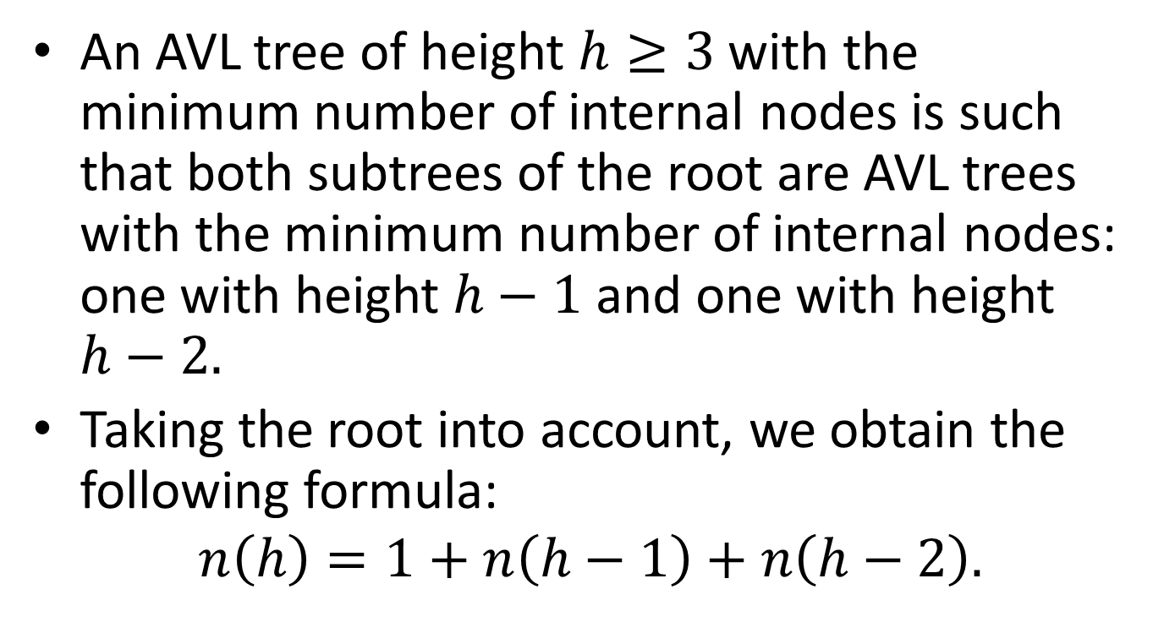
Proof (cont’d)
An AVL tree of height $h≥3$ with the minimum number of internal nodes is such that both subtrees of the root are AVL trees with the minimum number of internal nodes: one with height $h−1$ and one with height $h−2.$
Taking the root into account, we obtain the following formula:
$$n\left(h\right)=1+n\left(h−1\right)+n\left(h−2\right).$$

Slide 15
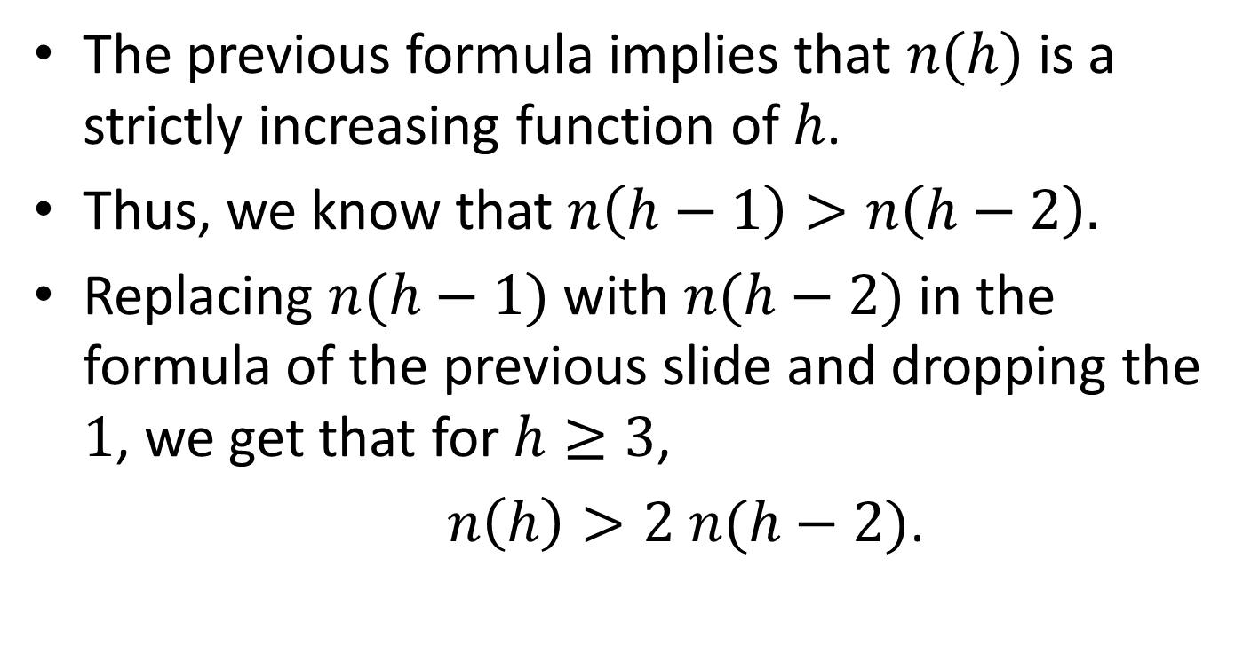
Proof (cont’d)
The previous formula implies that $n(h)$ is a strictly increasing function of $h$.
Thus, we know that $n\left(h−1\right)>n\left(h−2\right).$
Replacing $n(h−1)$ with $n(h−2)$ in the formula of the previous slide and dropping the $1$, we get that for $h≥3$,
$n\left(h\right)>2 n(h−2)$.

Slide 16
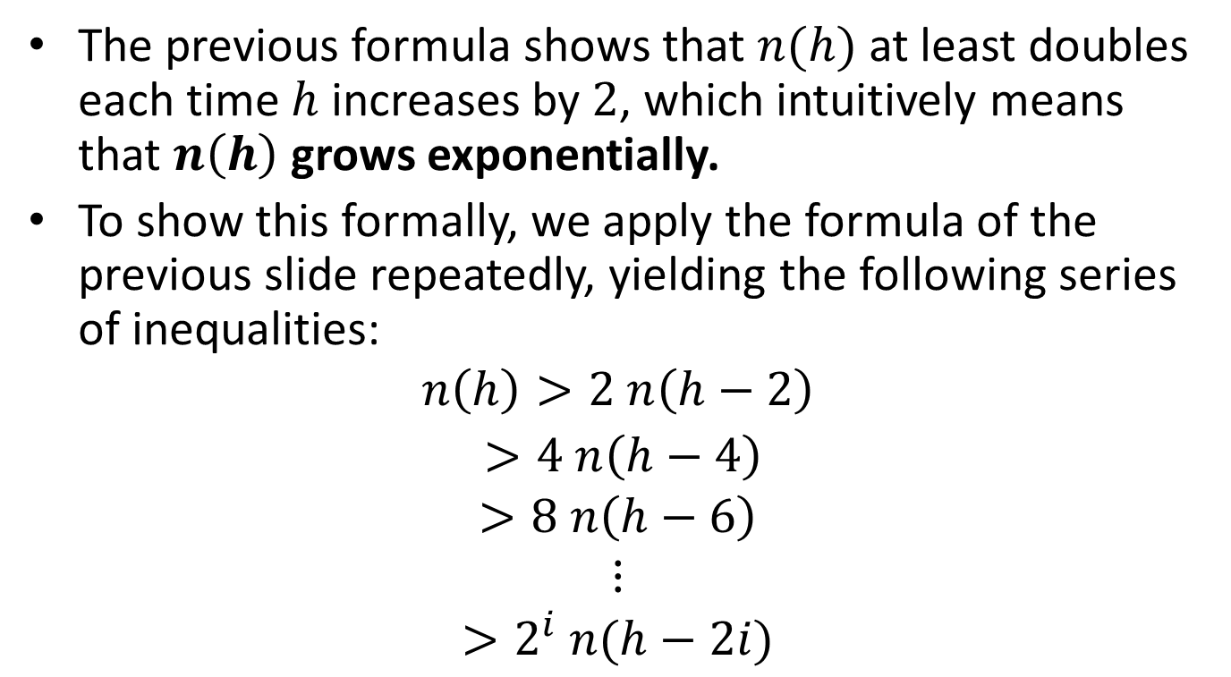
Proof (cont’d)
The previous formula shows that $n(h)$ at least doubles each time $h$ increases by $2$, which intuitively means that $n\left(h\right)$ grows exponentially.
To show this formally, we apply the formula of the previous slide repeatedly, yielding the following series of inequalities:
$$n\left(h\right)>2 n\left(h−2\right)$$
$>4 n\left(h−4\right)$
$$>8 n\left(h−6\right)$$
$$⋮$$
$$>2^{i} n(h−2i)$$

Slide 17
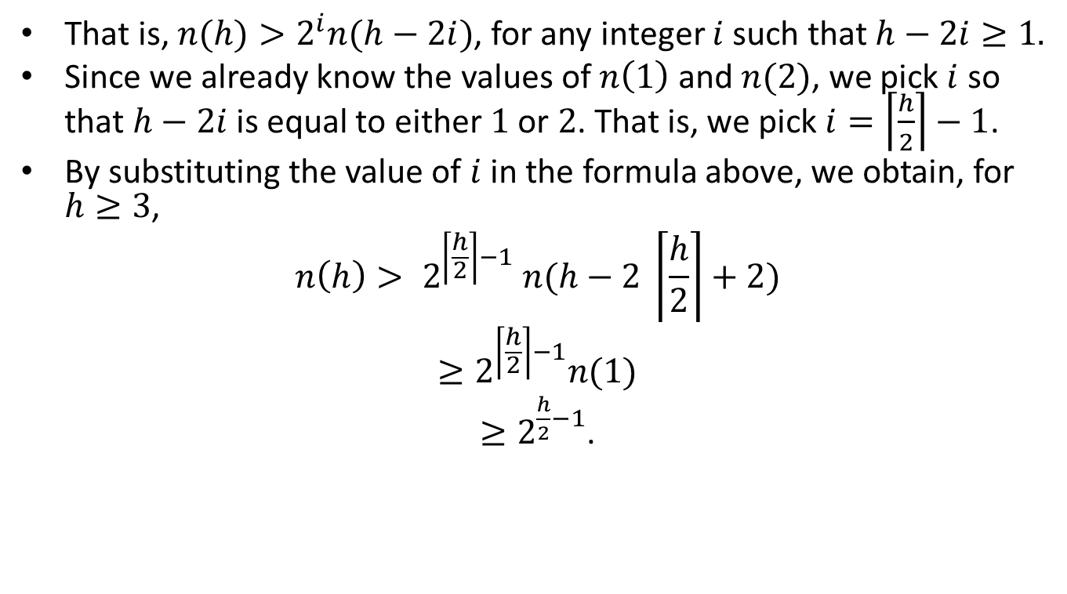
Proof (cont’d)
That is, $n(h)>2^{i}n(h−2i)$, for any integer $i$ such that $h−2i≥1.$
Since we already know the values of $n\left(1\right)$ and $n(2)$, we pick $i$ so that $h−2i$ is equal to either $1$ or $2$. That is, we pick $i=\left\lceil \frac{h}{2}\right\rceil −1$.
By substituting the value of $i$ in the formula above, we obtain, for $h≥3$,
$$n\left(h\right)> 2^{\left\lceil \frac{h}{2}\right\rceil −1} n(h−2 \left\lceil \frac{h}{2}\right\rceil +2)$$
$$≥2^{\left\lceil \frac{h}{2}\right\rceil −1}n(1)$$
$≥2^{\frac{h}{2}−1}$.

Slide 18
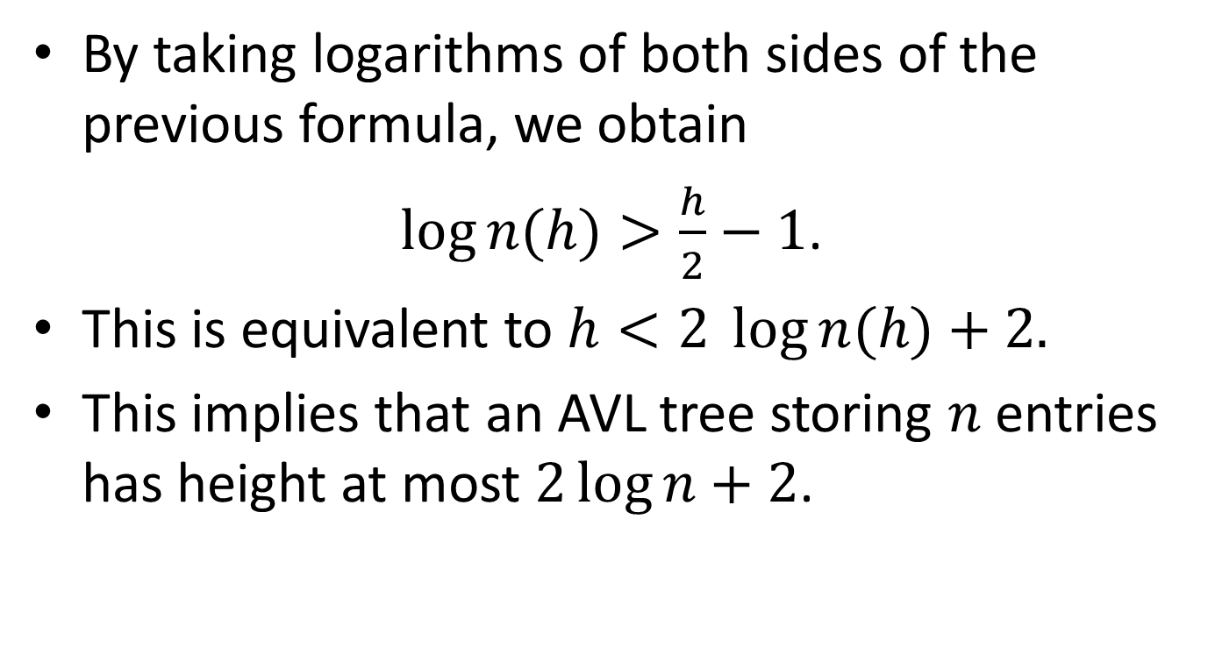
Proof (cont’d)
By taking logarithms of both sides of the previous formula, we obtain
$\log{n(h)}>\frac{h}{2}−1$.
This is equivalent to $h<2 \log{n(h)}+2.$
This implies that an AVL tree storing $n$ entries has height at most $2\log{n}+2$.

Slide 19
Keeping Track of Balance Factors
By adding a new member to each node of an AVL tree, we can keep track of whether the left and right subtree are of equal height, or whether one is higher than the other.
typedef enum {LeftHigh, Equal, RightHigh} BalanceFactor;
typedef struct AVLTreeNodeTag {
BalanceFactor BF;
KeyType Key;
struct AVLTreeNodeTag *LLink;
struct AVLTreeNodeTag *RLink;
} AVLTreeNode;

Slide 20
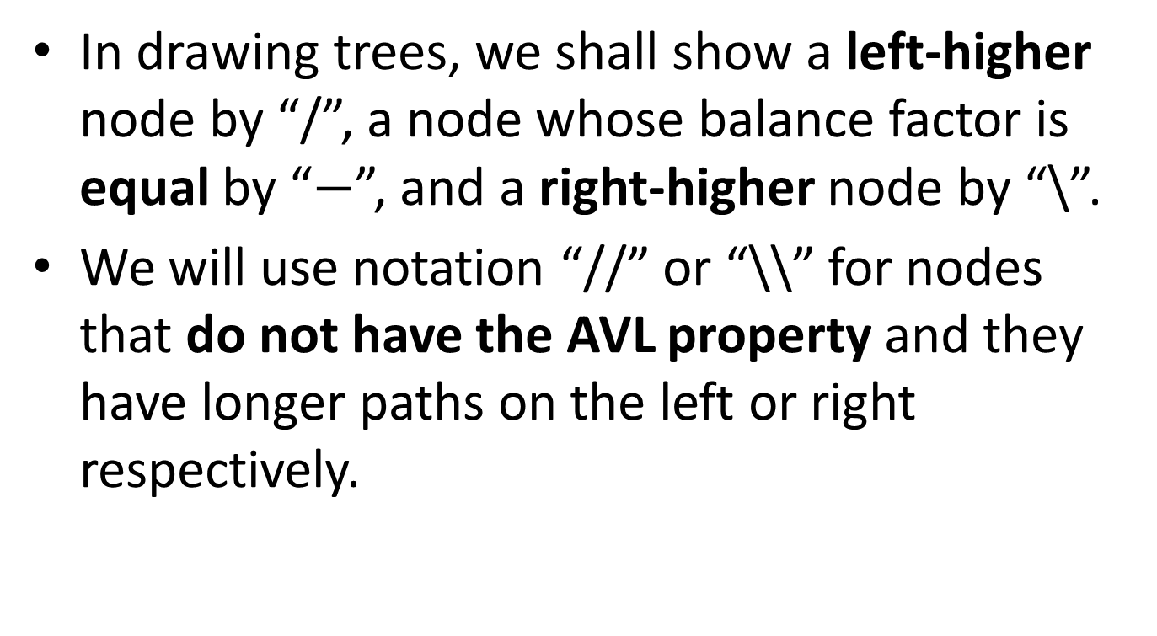
Notation
In drawing trees, we shall show a left-higher node by “/”, a node whose balance factor is equal by “$−$”, and a right-higher node by “\”.
We will use notation “//” or “\\” for nodes that do not have the AVL property and they have longer paths on the left or right respectively.

Slide 21

Example AVL Tree
$$−$$

Slide 22


Example AVL Tree
$$/$$
$$−$$

Slide 23




Example AVL Tree
$$\backslash$$
$$−$$
$$/$$
$$−$$

Slide 24





Example AVL Tree
$$−$$
$$−$$
$$\backslash$$
$$−$$
$$−$$
$$−$$

Slide 25









Example AVL Tree
$$/$$
$$−$$
$$/$$
$$−$$
$$−$$
$$−$$
$$−$$
$$−$$
$$−$$
$$−$$

Slide 26


Example non-AVL Tree
//
$$/$$
$$−$$

Slide 27


Example non-AVL Tree
\\
$$−$$
\\
\
$$−$$

Slide 28


Example non-AVL Tree
$$−$$
//
\\
/
\
$$−$$
$$−$$

Slide 29


Example non-AVL Tree
\\
$$−$$
$$−$$
$$−$$

Slide 30
Rebalancing an AVL Tree
In the insertion and deletion algorithm for AVL trees that we will present now, it is possible that the AVL property will be lost at some point.
In this case we apply to the tree some shape-changing transformations to restore the AVL property. These transformations are the rotations we have already introduced.

Slide 31
Insertion in an AVL Tree
If a node N is “-” and we insert a new node in its left or right subtree then the AVL tree property at node N is not lost and N becomes “/” or “\” respectively.
If a node is “/” and we insert a node in its right subtree (i.e., its shorter subtree) then the AVL tree property at node N is not lost and N becomes “-”.
If a node is “\” and we insert a node in its left subtree (i.e., its shorter subtree) then the AVL tree property at node N is not lost and N becomes “-”.

Slide 32
Insertion (cont’d)
Let us consider the case when a new node has been inserted into the taller subtree of a node and its height has increased, so that now one subtree has height 2 more than the other, and the node no longer satisfies the AVL property.
Let us assume we have inserted the new node into the right subtree of node r, its height has increased, and r previously was right higher (so now it will become “\\”).
So r is the node where the AVL property was lost and let x be the root of its right subtree. Then there are three cases to consider depending on the balance factor of x.

Slide 33
Insertion (cont’d)
Case 1: x is right higher. Therefore the new node was inserted in the right subtree of x. Then, we can do a single left rotation that restores the AVL property as shown on the next slide.
We have rotated the node x upward to the root, dropping r down into the left subtree of x. The subtree T₂ of nodes with keys between those of r and x now becomes the right subtree of r.
Note that in the tallest subtree we had height h+2, then height h+3 when the new node was inserted, then height h+2 again when the AVL property was restored. Thus, there are no further height increases in the tree that would force us to examine nodes other than r.
Note that r was the closest ancestor of the inserted node where the AVL property was lost. We do not need to consider any other nodes higher than r.

Slide 34


Single Left Rotation at r
\\
r
$$−$$
x
\
x
$$−$$
r
h
T₃
h
T₁
h
T₂
h
T₃
h
T₁
h
T₂
New node
Tree height h+3
New node
Tree height h+2

Slide 35
Insertion (cont’d)
Case 2: x is left higher. Therefore, the new node was inserted in the left subtree of x. In this case, we have to move down two levels to the node w that roots the left subtree of x, to find the new root of the local tree where the rotation will take place.
This is called double right-left rotation because the transformation can be obtained in two steps by first rotating the subtree with root x to the right (so that w becomes the root), and then rotating the tree with root r to the left (moving w up to become the new root).
Note that after the rotation the heights have been restored to h+2 as they were before the rotation so no other nodes of the tree need to be considered.
Some authors call this rotation double left rotation. The term double right-left that we use is more informative.

Slide 36
Double Right-Left Rotation at x and r
\\
r
−
w
/
x
r
x
w
h
T₁
T₂
h-1
or
h
T₃
T₄
h
T₁
h
T₄
T₂
h
h-1
or
h
T₃
One of T₂ or T₃ has the new node and height h
Tree height h+3
Tree height h+2

Slide 37
Insertion (cont’d)
In this case, the new balance factors of r and x depend on the balance factor of w after the node was inserted. The diagram shows the subtrees of w as having equal heights but it is possible that w may be either left or right higher. The resulting balance factors are as follows:
Old w | New r | New x
− | − | −
/ | − | \
\ | / | −

Slide 38
Insertion (cont’d)
Case 3: Equal Height. This case cannot happen.
Remember that we have just inserted a new node into the subtree rooted at x, and this subtree now has height 2 more than the left subtree of the root. The new node went either into the left or the right subtree of x. Hence its insertion increased the height of only one subtree of x. If these subtrees had equal heights after the insertion then the height of the full subtree rooted at x was not changed by the insertion, contrary to what we already know.

Slide 39
Insertion (cont’d)
Let us now consider the case symmetric to the one we considered so far: r was left higher and we introduced the new node in the left subtree of r.
In this case we will use single right rotation and double left-right rotation to restore the AVL property.

Slide 40
Single Right Rotation at r
//
r
−
x
x
/
−
r
T₃
h
h
T₁
h
T₁
h
T₂
h
T₂
h
T₃
New node
Tree height h+3
Tree height h+2

Slide 41
Double Left-Right Rotation at x and r
//
r
−
w
\
x
x
r
w
h
T₄
h
T₁
T₂
h-1
or
h
T₃
h
T₁
h
T₄
T₂
h-1
or
h
T₃
One of T₂ or T₃ has the new node and height h
Tree height h+3
Tree height h+2

Slide 42
Rotations are Local
Rotations are done only when the height of a subtree has increased. After the rotations, the increase in height has been removed so no further rotations or changes of balance factors are done.
So the AVL property is restored with a single or a double rotation.

Slide 43
Example: Building an AVL Tree
Insert ORY
ORY
−

Slide 44
Insert JFK
ORY
/
JFK
−

Slide 45
Insert BRU
The tree is unbalanced.
ORY
//
JFK
/
BRU
−

Slide 46
Do a Single Right Rotation at ORY
JFK
−
BRU
−
−
ORY

Slide 47
Insert DUS, ZRH, MEX and ORD
JFK
\
BRU
\
/
ORY
DUS
−
\
MEX
−
ZRH
ORD
−

Slide 48
Insert NRT
JFK
\
BRU
\
/
ORY
DUS
−
\\
MEX
−
ZRH
/
ORD
The subtree rooted at MEX is unbalanced.
−
NRT

Slide 49
Double Right-Left Rotation at ORD and MEX
\
JFK
BRU
\
/
ORY
DUS
−
−
NRT
−
ZRH
MEX
−
−
ORD

Slide 50
Insert ARN and GLA
−
JFK
BRU
\
/
ORY
ARN
−
DUS
\
NRT
−
−
ZRH
GLA
−
−
MEX
−
ORD

Slide 51
Insert GCM
−
JFK
BRU
\
/
ORY
ARN
−
\\
DUS
−
NRT
−
ZRH
GLA
/
−
MEX
−
ORD
The subtree rooted at DUS becomes unbalanced.
GCM
−

Slide 52
Double Right-Left Rotation at GLA and DUS
−
JFK
\
BRU
/
ORY
ARN
−
GCM
−
−
NRT
−
ZRH
DUS
−
GLA
−
−
MEX
−
ORD

Slide 53
Deletion of a Node
To delete a node from an AVL tree, we will use similar ideas with the ones we used for insertion.
We will reduce the problem to the case when the node x to be deleted has at most one child.
Suppose x has two children. Find the immediate predecessor y of x under inorder traversal by first taking the left child of x, and then moving right as far as possible to obtain y.
The node y is guaranteed to have no right child because of the way it was found.
Place y into the position in the tree occupied by x.
Delete y from its former position by proceeding as follows.

Slide 54
Deletion of a Node (cont’d)
Delete node y from the tree. Since we know that y has at most one child, we delete y by simply linking the parent of y to the single child of y (or to NULL, if there is no child).
The height of the subtree formerly rooted at y has been reduced by 1, and we must now trace the effects of this change on height through all the nodes on the path from y back to the root of the tree.
We will use a Boolean variable shorter to show if the height of a subtree has been shortened. The action to be taken at each node depends on the value of shorter, on the balance factor of the node and sometimes on the balance factor of a child of the node.
The Boolean variable shorter is initially TRUE. The following steps are to be done for each node p on the path from the parent of y to the root of the tree, provided shorter remains TRUE. When shorter becomes FALSE, then no further changes are needed and the algorithm terminates.

Slide 55
Case 1: No rotation
The current node p has balance factor equal. The balance factor of p is changed accordingly as its left or right subtree has been shortened, and shorter becomes FALSE.

Slide 56

Case 1 Graphically
$$−$$
p
\
p
T₁
T₂
T₁
T₂
Deleted node
Height unchanged

Slide 57
Case 2: No rotation
The balance factor of p is not equal, and the taller subtree was shortened. Change the balance factor of p to equal and leave shorter as TRUE because the height of subtrees has changed.

Slide 58
Case 2 Graphically
/
p
−
p
T₁
T₁
T₂
T₂
Deleted node
Height reduced

Slide 59
Case 3
The balance factor of p is not equal and the shorter subtree was shortened. The height requirement for an AVL tree is now violated at p, so we apply a rotation as follows to restore balance.
Let q be the root of the taller subtree of p (the one not shortened). We have three cases according to the balance factor of q.

Slide 60
Case 3a: Single left rotation
The balance factor of q is equal. A single left rotation at p (with changes to the balance factors of p and q) restores balance, and shorter becomes FALSE.

Slide 61
Case 3a Graphically
\\
p
/
q
−
q
\
p
h-1
T₁
T₃
h
T₂
T₃
h-1
T₁
h
h
T₂
h
Deleted node
Height unchanged

Slide 62
Case 3b: Single left rotation
The balance factor of q is the same as that of p. Apply a single left rotation at p, set the balance factors of p and q to equal, and leave shorter as TRUE.

Slide 63
Case 3b Graphically
\\
p
−
q
\
q
−
p
h-1
T₁
T₃
h
h-1
T₂
h-1
T₁
h-1
T₂
T₃
h
T₂
Deleted node
Height reduced

Slide 64
Case 3c: Double right-left rotation
The balance factors of p and q are opposite. Apply a double right-left rotation (first at q, then at p), set the balance factor of the new root to equal and the other balance factors as appropriate, and leave shorter as TRUE.

Slide 65
Case 3c Graphically
\\
p
−
r
/
q
p
q
h-1
T₁
r
h-1
or
h-2
h-1
T₄
h-1
T₁
T₃
T₄
h-1
T₂
Deleted
node
h-1
or
h-2
T₂
T₃
Height reduced

Slide 66








Example of Deletion in an AVL Tree
/
m
\
e
\
p
n
\
s
\
/
c
/
j
b
/
d
$$−$$
/
h
\
k
o
$$−$$
$$−$$
u
/
r
$$−$$
a
g
/
$$−$$
i
$$−$$
l
$$−$$
t
$$−$$
f

Slide 67
Delete p
/
m
\
e
\
p
n
\
s
\
/
c
/
j
b
/
d
$$−$$
/
h
\
k
o
$$−$$
$$−$$
u
/
r
$$−$$
a
g
/
$$−$$
i
$$−$$
l
$$−$$
t
The immediate predecessor of p under the inorder traversal is o
$$−$$
f

Slide 68
Replace p with o and Delete o
/
m
\
e
\
p
o
n
\
s
\
/
c
/
j
b
/
d
$$−$$
/
h
\
k
o
$$−$$
$$−$$
u
/
r
$$−$$
a
g
/
$$−$$
i
$$−$$
l
$$−$$
t
$$−$$
f

Slide 69
Adjust Balance Factors
/
m
\
e
\
o
n
\
s
\
/
c
/
j
b
/
d
$$−$$
/
h
\
k
$$−$$
u
/
r
$$−$$
a
g
/
$$−$$
i
$$−$$
l
$$−$$
t
$$−$$
f

Slide 70

Balance Factors Adjusted
/
m
\
e
\\
o
c
n
$$−$$
s
\
/
/
j
b
/
d
$$−$$
/
h
\
k
$$−$$
u
/
r
$$−$$
a
g
/
$$−$$
i
$$−$$
l
$$−$$
t
$$−$$
f

Slide 71
Rotate Left at o
/
m
\
e
\\
o
c
n
$$−$$
s
\
/
/
j
b
/
d
$$−$$
/
h
\
k
$$−$$
u
/
r
$$−$$
a
g
/
$$−$$
i
$$−$$
l
$$−$$
t
$$−$$
f

Slide 72



Result of Left Rotation
//
m
\
e
$$−$$
s
o
$$−$$
/
u
/
c
/
j
b
/
d
$$−$$
/
h
\
k
n
$$−$$
r
$$−$$
$$−$$
t
$$−$$
a
g
/
$$−$$
i
$$−$$
l
$$−$$
f

Slide 73

Double Rotate Left-Right at e and m
//
m
\
e
$$−$$
s
o
$$−$$
/
u
/
c
/
j
b
/
d
$$−$$
/
h
\
k
n
$$−$$
r
$$−$$
$$−$$
t
$$−$$
a
g
/
$$−$$
i
$$−$$
l
$$−$$
f

Slide 74





Result of Double Rotation
$$−$$
j
$$−$$
e
\
m
k
\
$$−$$
s
/
c
/
h
/
b
/
d
$$−$$
/
g
$$−$$
l
$$−$$
$$−$$
o
u
/
$$−$$
a
f
$$−$$
$$−$$
$$−$$
$$−$$
n
r
t

Slide 75
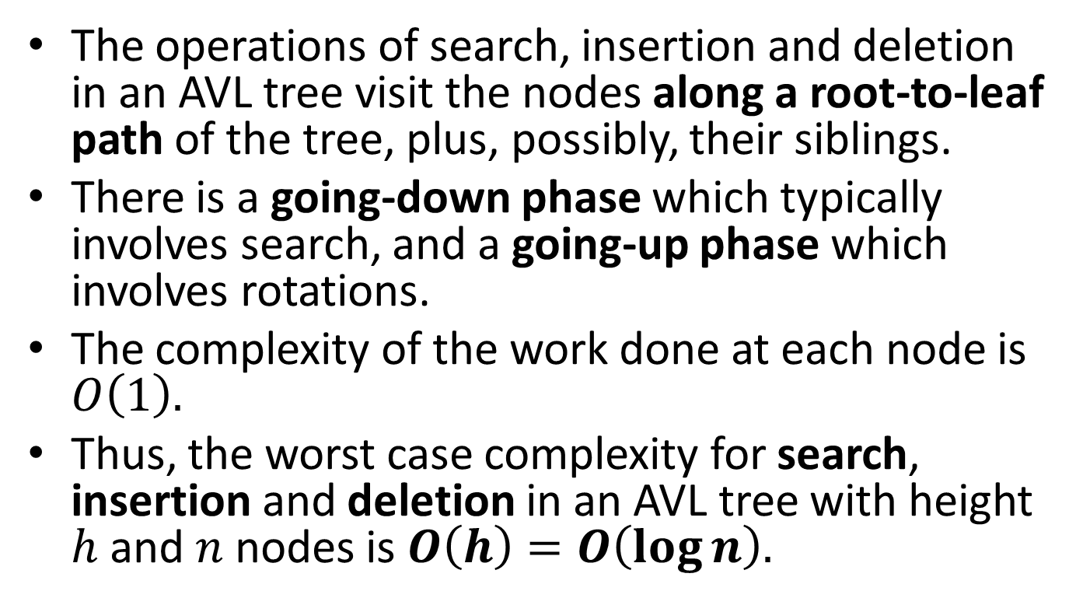
Complexity of Operations on AVL Trees
The operations of search, insertion and deletion in an AVL tree visit the nodes along a root-to-leaf path of the tree, plus, possibly, their siblings.
There is a going-down phase which typically involves search, and a going-up phase which involves rotations.
The complexity of the work done at each node is $O\left(1\right).$
Thus, the worst case complexity for search, insertion and deletion in an AVL tree with height $h$ and $n$ nodes is $O\left(h\right)=O\left(\log{n}\right).$

Slide 76
Readings
T. A. Standish. Data Structures, Algorithms and Software Principles in C.
  Chapter 9. Section 9.8.
R. Kruse, C.L. Tondo and B.Leung. Data Structures and Program Design in C.
  Chapter 9. Section 9.4.
M.T. Goodrich, R. Tamassia and D. Mount. Data Structures and Algorithms in C++. 2nd edition.
  Section 10.2

