Slide 1
B-Trees
Manolis Koubarakis

Slide 2
The Memory Hierarchy
Faster
External Memory
Main (Internal) Memory
Cache
Registers
Bigger
CPU

Slide 3
External Memory
So far we have assumed that our data structures are stored in main memory. However, if the size of a data structure is too big then it will be stored on external memory e.g., on a hard disk.
Examples: the database of a bank, a database of images, a database of videos etc.

Slide 4
External Searching
When we access data on a disk or another external memory device, we perform external searching.
A disk access can be at least 100,000 to 1,000,000 times longer than a main memory access.
Thus, for data structures residing on disk, we want to minimize disk accesses.

Slide 5
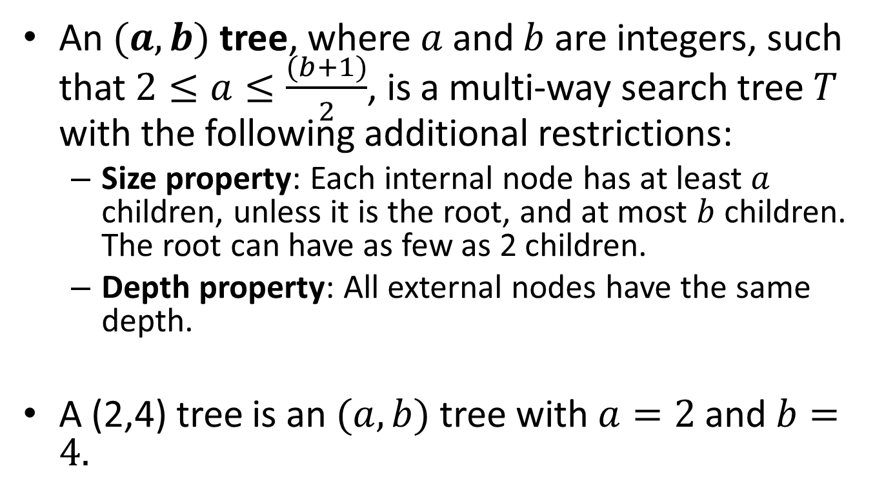

$(a,b)$ Trees
An $(a,b)$ tree, where $a$ and $b$ are integers, such that $2≤a≤\frac{(b+1)}{2}$, is a multi-way search tree $T$ with the following additional restrictions:
  Size property: Each internal node has at least $a$ children, unless it is the root, and at most $b$ children. The root can have as few as 2 children.
  Depth property: All external nodes have the same depth.
A (2,4) tree is an $(a,b)$ tree with $a=2$ and $b=4.$

Slide 6
Example (3,5) Tree
j
c f
m r
a b
d e
g h i
k l
n p
s t u x

Slide 7

Proposition
The height of an $(a,b)$ tree storing $n$ entries is $O\left(\frac{\log{n}}{\log{a}}\right).$
Proof?

Slide 8
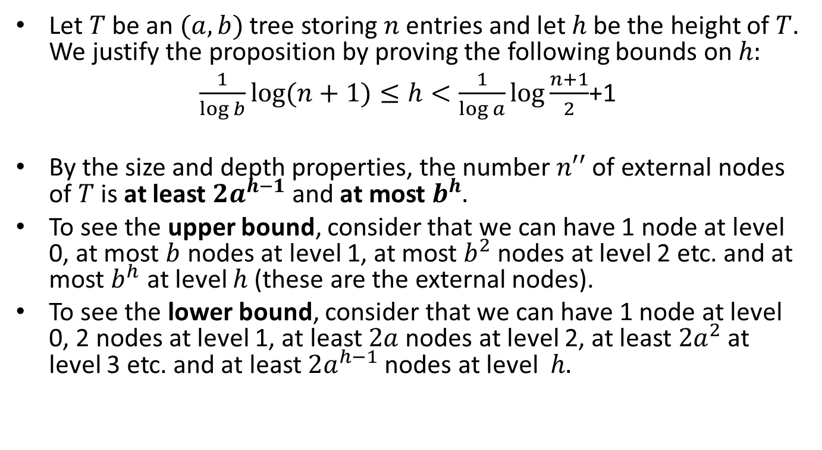
Proof
Let $T$ be an $(a,b)$ tree storing $n$ entries and let $h$ be the height of $T$. We justify the proposition by proving the following bounds on $h:$
$\frac{1}{\log{b}}\log{(n+1)}≤h<\frac{1}{\log{a}}\log{\frac{n+1}{2}}$+1
By the size and depth properties, the number $n′′$ of external nodes of $T$ is at least $2a^{h−1}$ and at most $b^{h}.$
To see the upper bound, consider that we can have 1 node at level 0, at most $b$ nodes at level 1, at most $b^{2}$ nodes at level 2 etc. and at most $b^{h}$ at level $h$ (these are the external nodes).
To see the lower bound, consider that we can have 1 node at level 0, 2 nodes at level 1, at least $2a$ nodes at level 2, at least $2a^{2}$ at level 3 etc. and at least $2a^{h−1}$ nodes at level $h.$

Slide 9
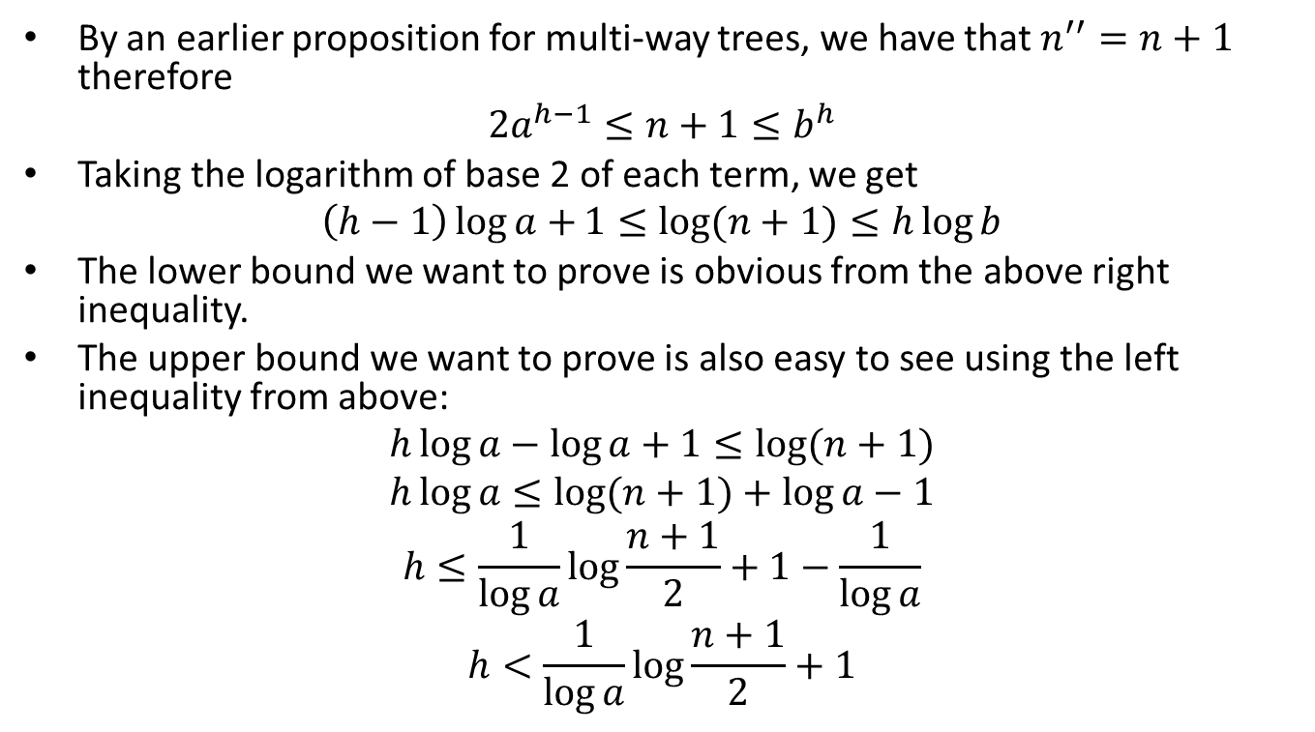
Proof (cont’d)
By an earlier proposition for multi-way trees, we have that $n^{′′}=n+1$ therefore
$$2a^{h−1}≤n+1≤b^{h}$$
Taking the logarithm of base 2 of each term, we get
$$\left(h−1\right)\log{a+}1≤\log{(n+1)}≤h\log{b}$$
The lower bound we want to prove is obvious from the above right inequality.
The upper bound we want to prove is also easy to see using the left inequality from above:
$$h\log{a}−\log{a}+1≤\log{(n+1)}$$
$$h\log{a}≤\log{(n+1)}+\log{a}−1$$
$$h≤\frac{1}{\log{a}}\log{\frac{n+1}{2}}+1−\frac{1}{\log{a}}$$
$$h<\frac{1}{\log{a}}\log{\frac{n+1}{2}}+1$$

Slide 10
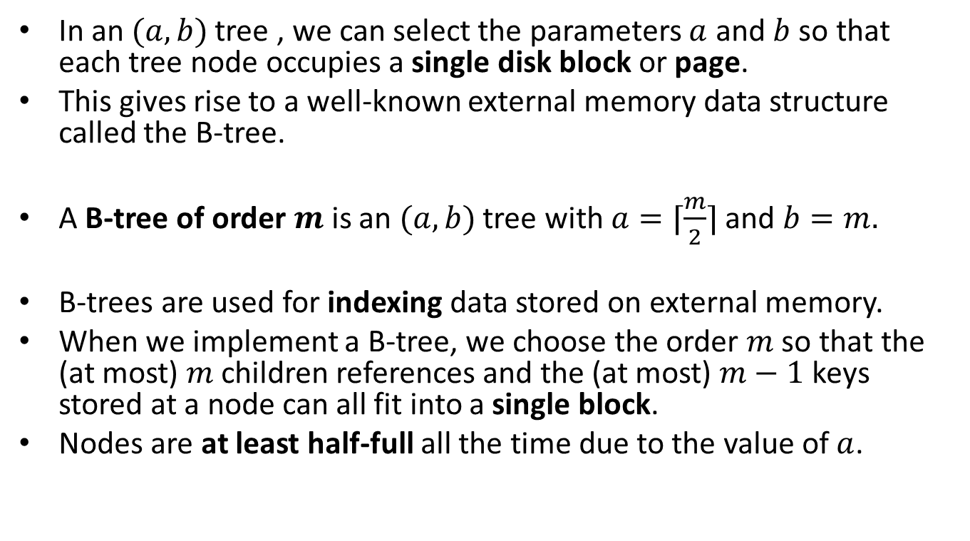
B-Trees
In an $(a,b)$ tree , we can select the parameters $a$ and $b$ so that each tree node occupies a single disk block or page.
This gives rise to a well-known external memory data structure called the B-tree.
A B-tree of order $m$ is an $(a,b)$ tree with $a=⌈\frac{m}{2}⌉$ and $b=m.$
B-trees are used for indexing data stored on external memory.
When we implement a B-tree, we choose the order $m$ so that the (at most) $m$ children references and the (at most) $m−1$ keys stored at a node can all fit into a single block.
Nodes are at least half-full all the time due to the value of $a$.

Slide 11
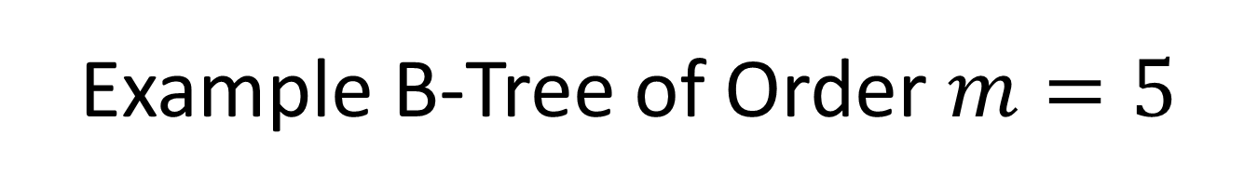
Example B-Tree of Order $m=5$
j
c f
m r
a b
d e
g h i
k l
n p
s t u x

Slide 12
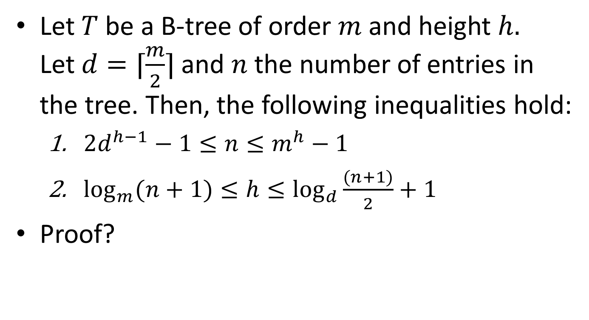
Proposition
Let $T$be a B-tree of order $m$ and height $h.$ Let$d=⌈\frac{m}{2}⌉$ and $n$ the number of entries in the tree. Then, the following inequalities hold:
  $2d^{h−1}−1≤n≤m^{h}−1$
  $\log_{m}{(n+1)}{≤h≤\log_{d}{\frac{(n+1)}{2}}}+1$
Proof?

Slide 13
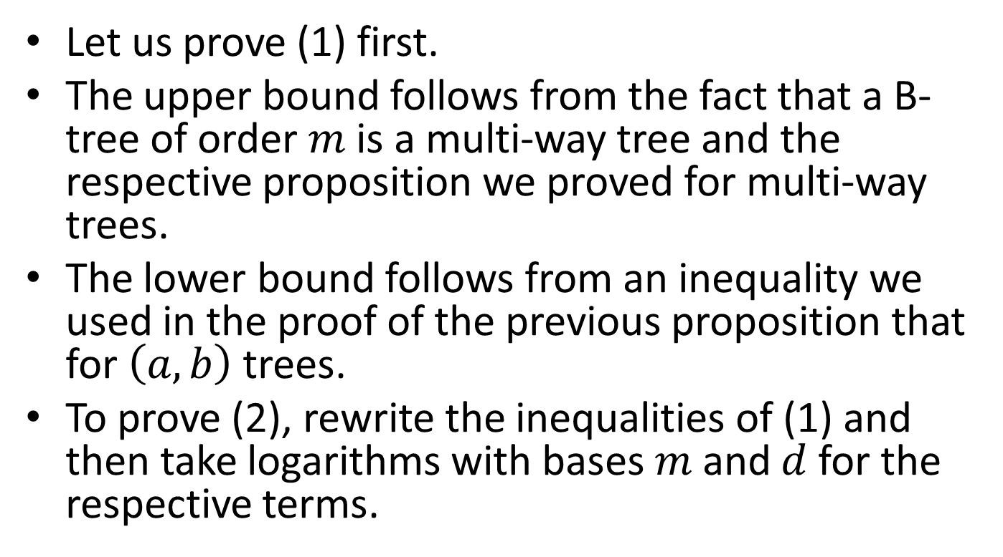
Proof
Let us prove (1) first.
The upper bound follows from the fact that a B-tree of order $m$ is a multi-way tree and the respective proposition we proved for multi-way trees.
The lower bound follows from an inequality we used in the proof of the previous proposition that for $\left(a,b\right)$trees.
To prove (2), rewrite the inequalities of (1) and then take logarithms with bases $m$ and $d$ for the respective terms.

Slide 14

Result
From the right inequality of (2) in the previous proposition, we have that the height of a B-tree is $O\left(\log_{d}{n}\right)$ where $d=⌈\frac{m}{2}⌉$ , as we would like it for a balanced search tree.

Slide 15
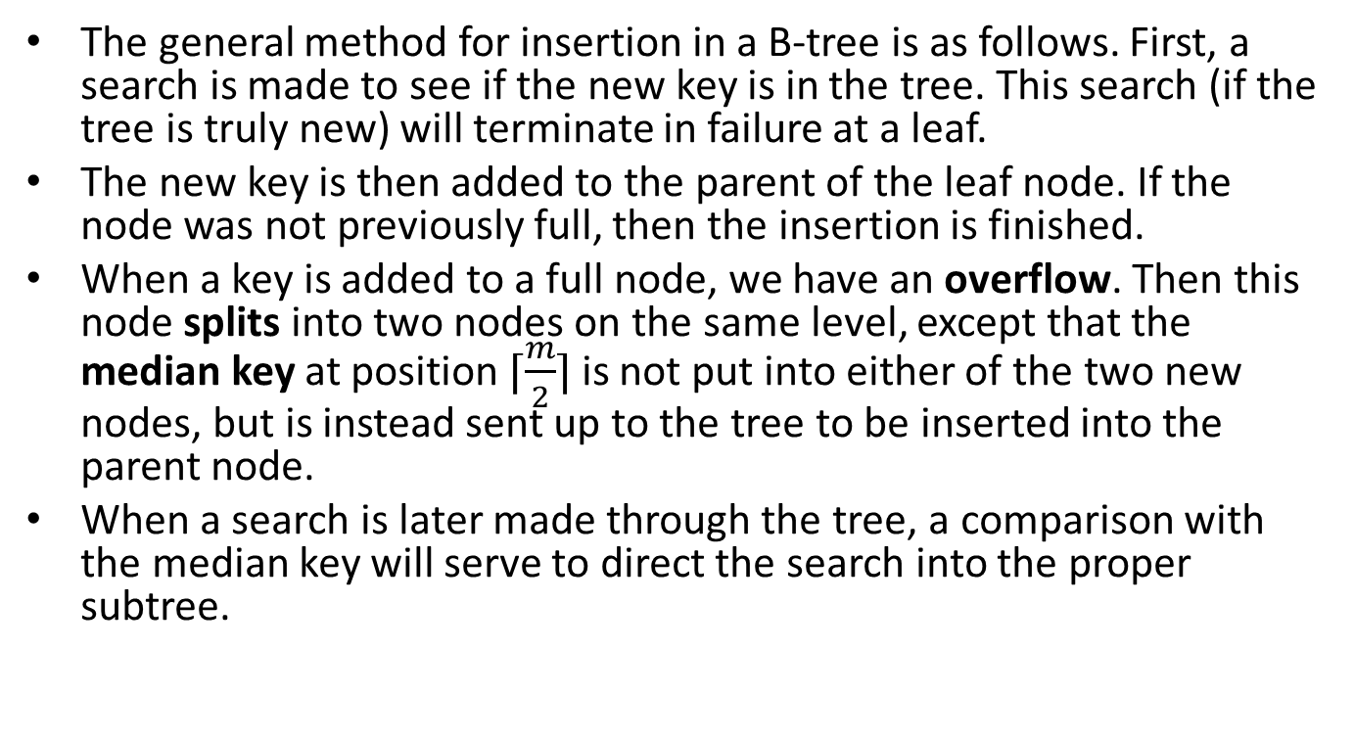
Insertion into a B-tree
The general method for insertion in a B-tree is as follows. First, a search is made to see if the new key is in the tree. This search (if the tree is truly new) will terminate in failure at a leaf.
The new key is then added to the parent of the leaf node. If the node was not previously full, then the insertion is finished.
When a key is added to a full node, we have an overflow. Then this node splits into two nodes on the same level, except that the median key at position $⌈\frac{m}{2}⌉$ is not put into either of the two new nodes, but is instead sent up to the tree to be inserted into the parent node.
When a search is later made through the tree, a comparison with the median key will serve to direct the search into the proper subtree.

Slide 16
Example
Let us see an example of insertions into an initially empty B-tree of order 5.

Slide 17
Insert a
a

Slide 18
Insert g
a g

Slide 19
Insert f
a f g

Slide 20
Insert b
a b f g

Slide 21
Insert k - Overflow
a b f g k

Slide 22
Creation of a New Root Node
f
a b g k

Slide 23
Split
f
a b
g k

Slide 24
Insert d
f
a b d
g k

Slide 25
Insert h
f
a b d
g h k

Slide 26
Insert m
f
a b d
g h k m

Slide 27
Insert j - Overflow
f
a b d
g h j k m

Slide 28
Sent j to the Parent Node
f
j
a b d
g h k m

Slide 29
Split
f j
a b d
g h
k m

Slide 30
Insert e
f j
a b d e
g h
k m

Slide 31
Insert s
f j
a b d e
g h
k m s

Slide 32
Insert i
f j
a b d e
g h i
k m s

Slide 33
Insert r
f j
a b d e
g h i
k m r s

Slide 34
Insert x - Overflow
f j
a b d e
g h i
k m r s x

Slide 35
r is Sent to the Parent Node
f j
r
a b d e
g h i
k m s x

Slide 36
Split
f j r
a b d e
g h i
k m
s x

Slide 37
Insert c - Overflow
f j r
a b c d e
g h i
k m
s x

Slide 38
c is Sent to the Parent
f j r
c
a b d e
g h i
k m
s x

Slide 39
Split
c f j r
a b
d e
g h i
k m
s x

Slide 40
Insert l
c f j r
a b
d e
g h i
k l m
s x

Slide 41
Insert n
c f j r
a b
d e
g h i
k l m n
s x

Slide 42
Insert t
c f j r
a b
d e
g h i
k l m n
s t x

Slide 43
Insert u
c f j r
a b
d e
g h i
k l m n
s t u x

Slide 44
Insert p - Overflow
c f j r
a b
d e
g h i
k l m n p
s t u x

Slide 45
m is Sent to the Parent Node
c f j r
m
a b
d e
g h i
k l n p
s t u x

Slide 46
Split
c f j m r
a b
d e
g h i
k l
n p
s t u x

Slide 47
Overflow at the Root
c f j m r
a b
d e
g h i
k l
n p
s t u x

Slide 48
j is Sent up to a New Root
j
c f m r
a b
d e
g h i
k l
n p
s t u x

Slide 49
Split
j
c f
m r
a b
d e
g h i
k l
n p
s t u x

Slide 50
Final Tree
j
c f
m r
a b
d e
g h i
k l
n p
s t u x

Slide 51
Deletion from a B-tree
Let us now see how we delete a key from a B-tree.
If the key to be deleted is in a node with only external nodes as children, then it can be deleted immediately.
If the key to be deleted is in an internal node with only internal nodes as children, then its immediate predecessor (or successor) under the natural order of keys is guaranteed to be in a node with only external-node children.
Hence, we can promote the immediate predecessor or successor into the position occupied by the key to be deleted, and delete the key from the node with only external-node children.

Slide 52
Deletion from a B-tree (cont’d)
If the node where the deletion takes place contains more than the minimum number of keys, then one can be deleted with no further action.
If the node contains the minimum number, then we first look at its two immediate siblings (or in the case of a node on the outside, one sibling).
If one of these has more than the minimum number for entries, then we can do a transfer operation: one child of the sibling is moved to the node where the deletion takes place, one of the keys of the sibling is moved into the parent node, and a key from the parent node is moved into the node where the deletion takes place.
If the immediate sibling has only the minimum number of keys then we perform a fusion operation: the current node and its sibling are merged into a new node and a key is moved from the parent into this new node.
If this fusion step leaves the parent with too few entries, the process propagates upward.

Slide 53
Example
j
c f
m r
a b
d e
g h i
k l
n p
s t u x

Slide 54
Delete h
j
c f
m r
a b
d e
g i
k l
n p
s t u x

Slide 55
Delete r
j
c f
m r
a b
d e
g i
k l
n p
s t u x

Slide 56
Find the Successor of r
j
c f
m r
a b
d e
g i
k l
n p
s t u x

Slide 57
Promote the Successor of r – Delete the Successor from its Place
j
c f
m s
a b
d e
g i
k l
n p
t u x

Slide 58
Delete p
j
c f
m s
a b
d e
g i
k l
n p
t u x

Slide 59
Transfer
j
c f
m
s
t
a b
d e
g i
k l
n
u x

Slide 60
After the Transfer
j
c f
m t
a b
d e
g i
k l
n s
u x

Slide 61
Delete d
j
c f
m t
a b
e
g i
k l
n s
u x
d

Slide 62
Fusion
j
f
m t
c
a b
e
g i
k l
n s
u x

Slide 63
After the Fusion – Underflow at f
j
f
m t
a b c e
g i
k l
n s
u x

Slide 64
Fusion
j
f
m t
a b c e
g i
k l
n s
u x

Slide 65
After the Fusion – Delete Root
f j m t
a b c e
g i
k l
n s
u x

Slide 66
Final Tree
f j m t
a b c e
g i
k l
n s
u x

Slide 67
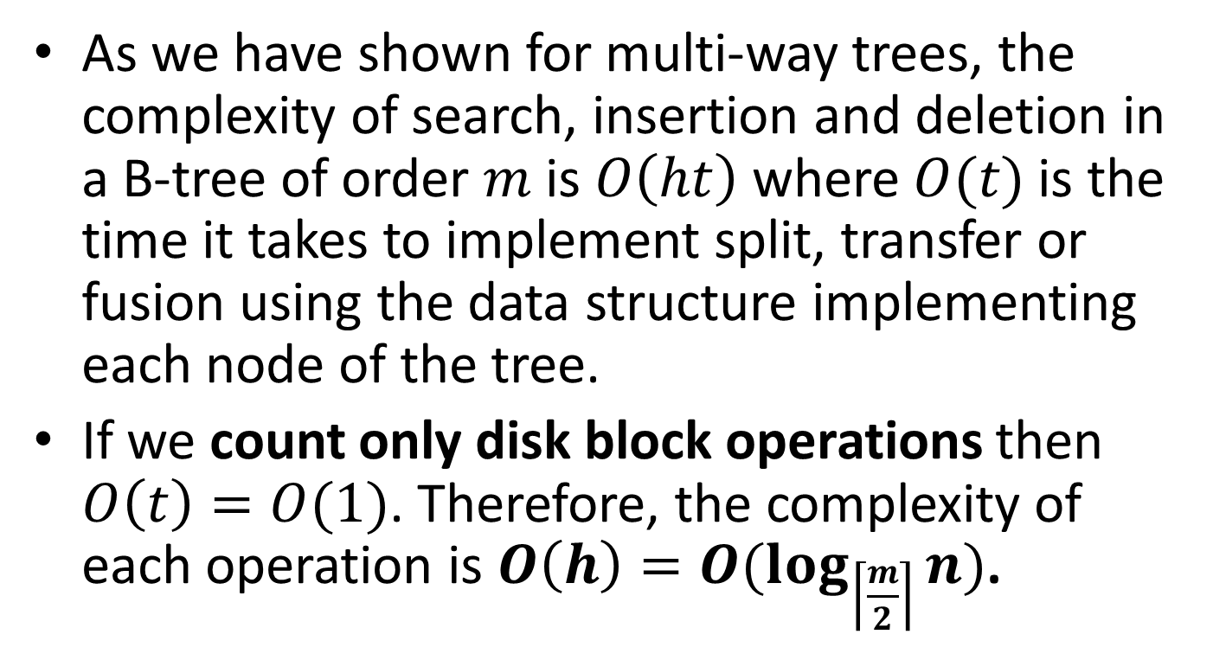
Complexity of Operations in a B-tree
As we have shown for multi-way trees, the complexity of search, insertion and deletion in a B-tree of order $m$is $O\left(ht\right)$ where $O(t)$is the time it takes to implement split, transfer or fusion using the data structure implementing each node of the tree.
If we count only disk block operations then $O\left(t\right)=O(1)$. Therefore, the complexity of each operation is $O\left(h\right)=O(\log_{\left\lceil \frac{m}{2}\right\rceil }{n})$.

Slide 68
B⁺-trees
A variation of B-trees called B⁺-trees is one of the most important indexing structures used in today’s file systems and relational database management systems.

Slide 69
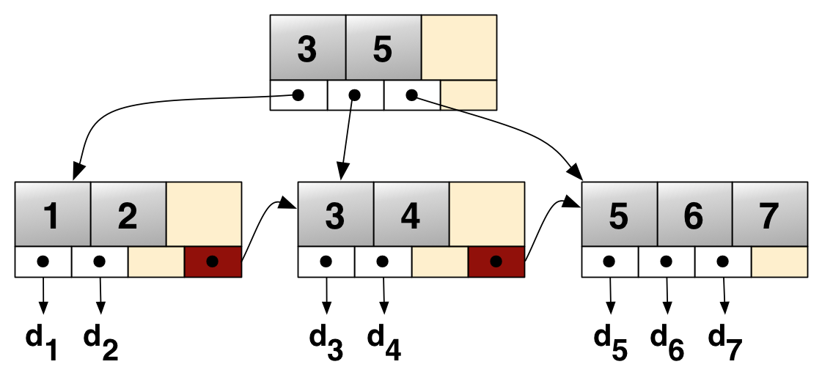
B⁺-tree Example

Slide 70
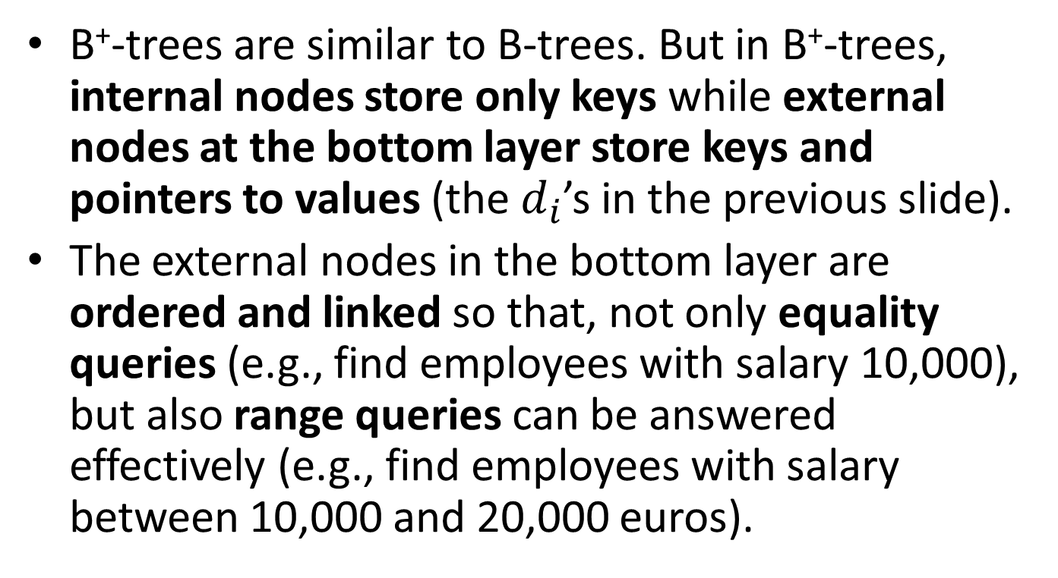
B⁺-trees (cont’d)
B⁺-trees are similar to B-trees. But in B⁺-trees, internal nodes store only keys while external nodes at the bottom layer store keys and pointers to values (the $d_{i}$’s in the previous slide).
The external nodes in the bottom layer are ordered and linked so that, not only equality queries (e.g., find employees with salary 10,000), but also range queries can be answered effectively (e.g., find employees with salary between 10,000 and 20,000 euros).

Slide 71
Readings
M. T. Goodrich, R. Tamassia and D. Mount. Data Structures and Algorithms in C++. 2nd edition. John Wiley.
M. T. Goodrich, R. Tamassia. Δομές Δεδομένων και Αλγόριθμοι σε Java. 5^{η} έκδοση. Εκδόσεις Δίαυλος.
  Κεφ. 10.5
Sartaj Sahni. Δομές Δεδομένων, Αλγόριθμοι και Εφαρμογές στη C++. Εκδόσεις Τζιόλα.

Slide 72
Readings (cont’d)
You can also see the following chapter but notice that the data structure called B-tree there is essentially a B⁺-tree (but without the linking of the external nodes on the bottom layer):
    R. Sedgewick. Αλγόριθμοι σε C.
      Κεφ. 16.3

