Slide 1
Data Structures for Disjoint Sets
Manolis Koubarakis

Slide 2
Dynamic Sets
Sets are fundamental for mathematics but also for computer science.
In computer science, we usually study dynamic sets i.e., sets that can grow, shrink or otherwise change over time.
The data structures we have presented so far in this course offer us ways to represent finite, dynamic sets and manipulate them on a computer.

Slide 3
Dynamic Sets and Symbol Tables
Many of the data structures we have so far presented for symbol tables can be used to implement a dynamic set (e.g., a linked list, a hash table, a (2,4) tree etc.).

Slide 4
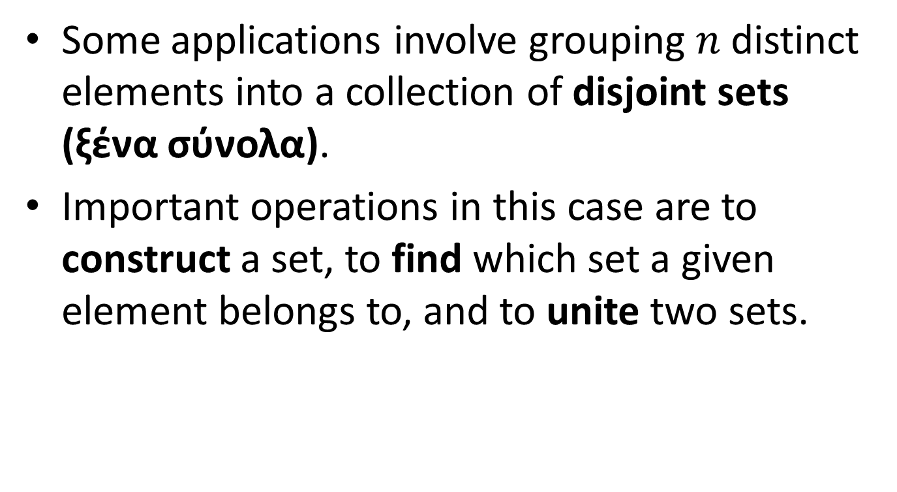
Disjoint Sets
Some applications involve grouping $n$ distinct elements into a collection of disjoint sets (ξένα σύνολα).
Important operations in this case are to construct a set, to find which set a given element belongs to, and to unite two sets.

Slide 5
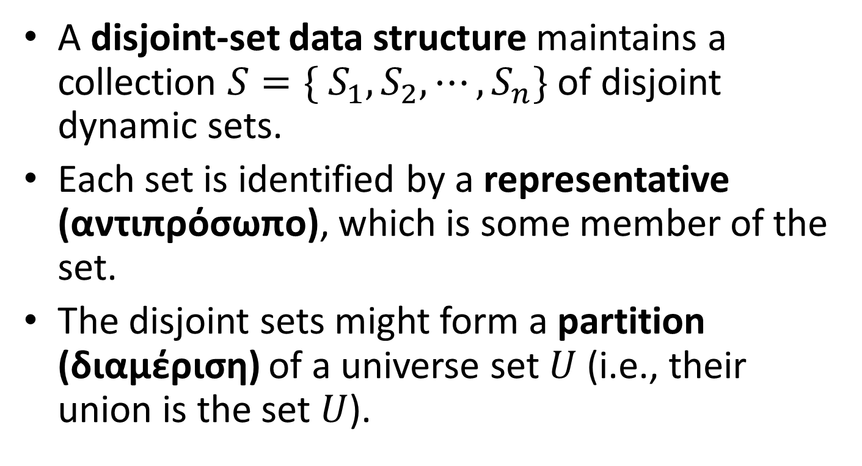
Definitions
A disjoint-set data structure maintains a collection $S=\{ S_{1}, S_{2},⋯,S_{n}\}$ of disjoint dynamic sets.
Each set is identified by a representative (αντιπρόσωπο), which is some member of the set.
The disjoint sets might form a partition (διαμέριση) of a universe set $U$ (i.e., their union is the set $U$).

Slide 6
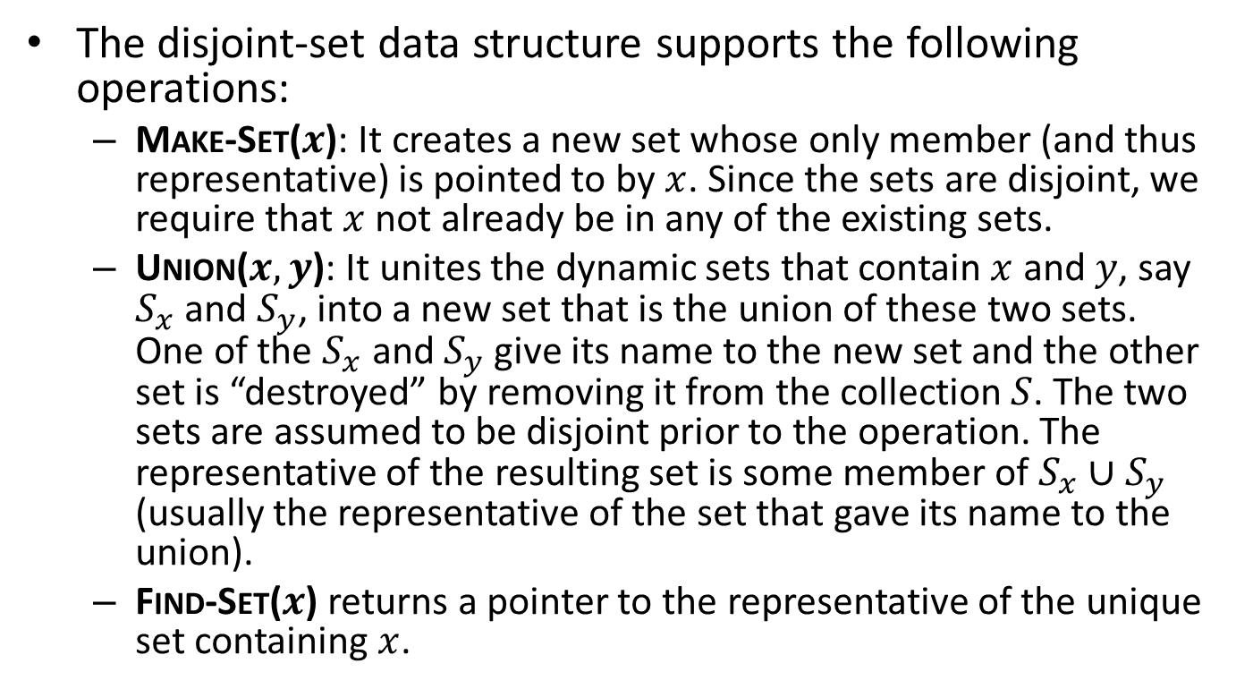
Definitions (cont’d)
The disjoint-set data structure supports the following operations:
  Make-Set($x$): It creates a new set whose only member (and thus representative) is pointed to by $x$. Since the sets are disjoint, we require that $x$ not already be in any of the existing sets.
  Union($x,y$): It unites the dynamic sets that contain $x$ and $y$, say $S_{x}$ and $S_{y}$, into a new set that is the union of these two sets. One of the $S_{x}$ and $S_{y}$ give its name to the new set and the other set is “destroyed” by removing it from the collection $S$. The two sets are assumed to be disjoint prior to the operation. The representative of the resulting set is some member of $S_{x}∪S_{y}$ (usually the representative of the set that gave its name to the union).
  Find-Set($x$) returns a pointer to the representative of the unique set containing $x$.

Slide 7
Determining the Connected Components of an Undirected Graph
One of the many applications of disjoint-set data structures is determining the connected components (συνεκτικές συνιστώσες) of an undirected graph.
The implementation based on disjoint-sets that we will present here is appropriate when the edges of the graph are not static e.g., when edges are added dynamically and we need to maintain the connected components as each edge is added.

Slide 8
Example Graph
a
b
e
f
h
j
c
d
g
i

Slide 9
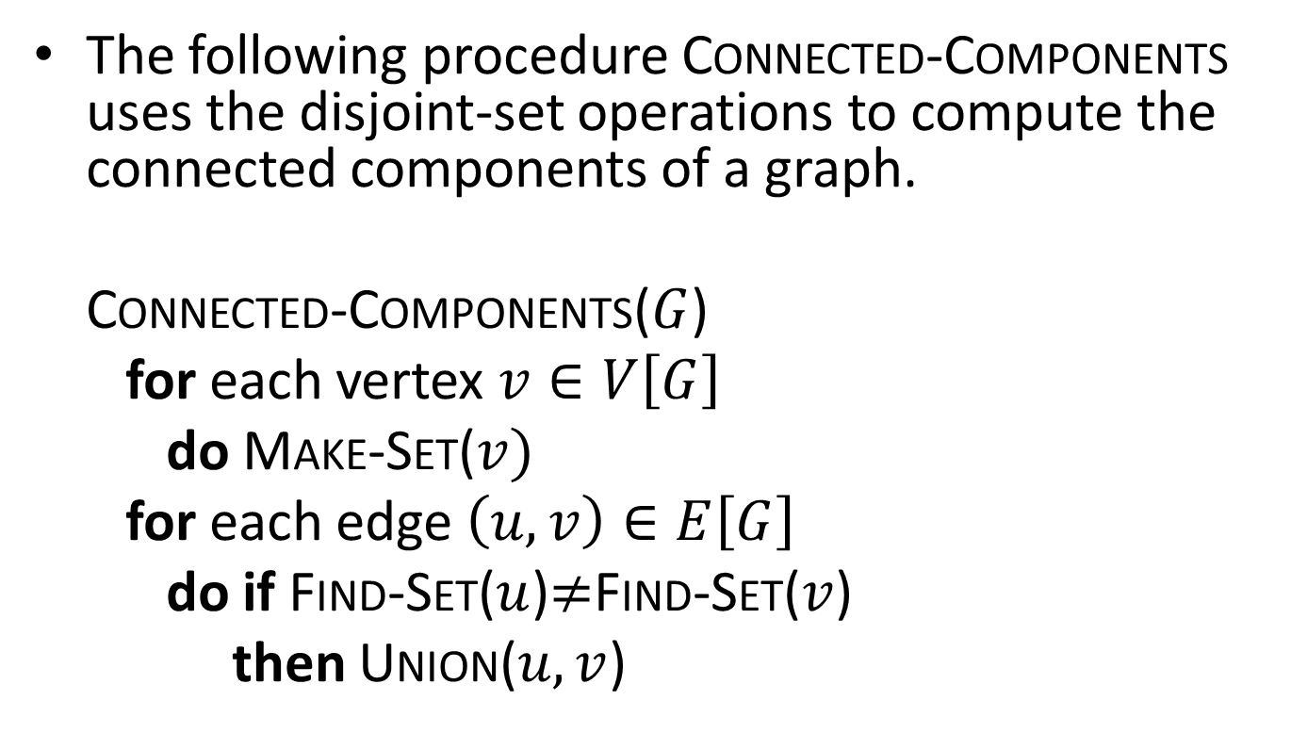
Computing the Connected Components of an Undirected Graph
The following procedure Connected-Components uses the disjoint-set operations to compute the connected components of a graph.
Connected-Components($G$)
for each vertex $v∈V\left[G\right]$
do Make-Set($v)$
for each edge $\left(u,v\right)∈E\left[G\right]$
do if Find-Set($u$)$≠$Find-Set($v$)
then Union($u,v$)

Slide 10
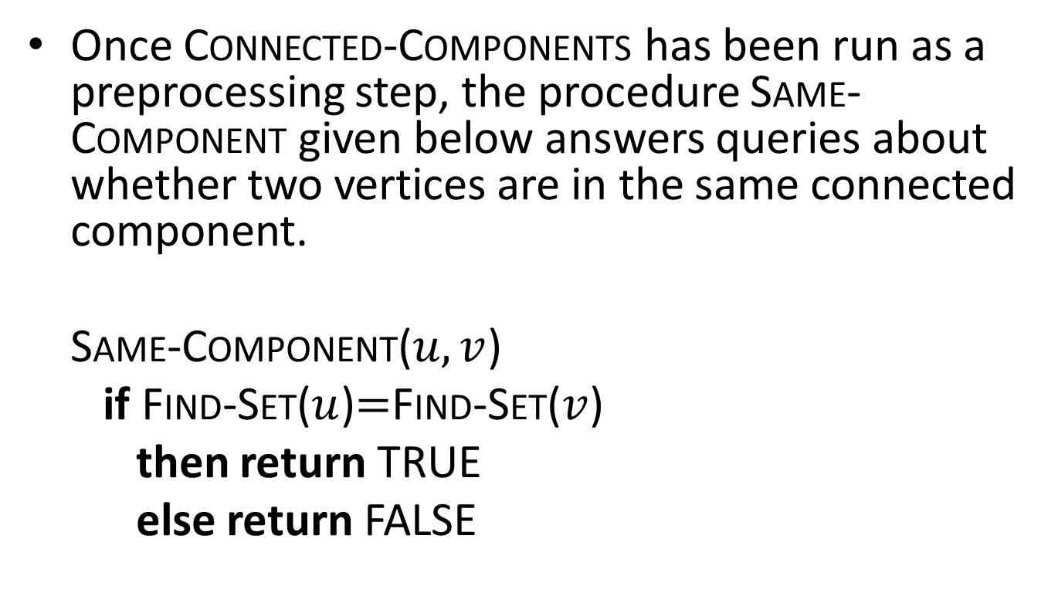
Computing the Connected Components (cont’d)
Once Connected-Components has been run as a preprocessing step, the procedure Same-Component given below answers queries about whether two vertices are in the same connected component.
Same-Component($u,v$)
if Find-Set($u$)$=$Find-Set($v$)
then return TRUE
else return FALSE

Slide 11
Example Graph
a
b
e
f
h
j
c
d
g
i

Slide 12
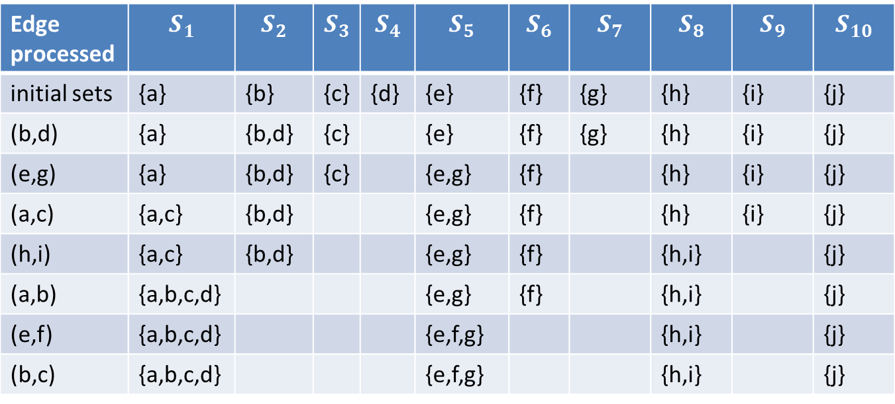
The Collection of Disjoint Sets After Each Edge is Processed
Edge processed | $$S_{1}$$ | $$S_{2}$$ | $$S_{3}$$ | $$S_{4}$$ | $$S_{5}$$ | $$S_{6}$$ | $$S_{7}$$ | $$S_{8}$$ | $$S_{9}$$ | $$S_{10}$$
initial sets | {a} | {b} | {c} | {d} | {e} | {f} | {g} | {h} | {i} | {j}
(b,d) | {a} | {b,d} | {c} |  | {e} | {f} | {g} | {h} | {i} | {j}
(e,g) | {a} | {b,d} | {c} |  | {e,g} | {f} |  | {h} | {i} | {j}
(a,c) | {a,c} | {b,d} |  |  | {e,g} | {f} |  | {h} | {i} | {j}
(h,i) | {a,c} | {b,d} |  |  | {e,g} | {f} |  | {h,i} |  | {j}
(a,b) | {a,b,c,d} |  |  |  | {e,g} | {f} |  | {h,i} |  | {j}
(e,f) | {a,b,c,d} |  |  |  | {e,f,g} |  |  | {h,i} |  | {j}
(b,c) | {a,b,c,d} |  |  |  | {e,f,g} |  |  | {h,i} |  | {j}

Slide 13
Minimum Spanning Trees
Another application of the disjoint set operations that we will see is Kruskal’s algorithm for computing the minimum spanning tree of a graph.
We will see this algorithm in the next lecture.

Slide 14
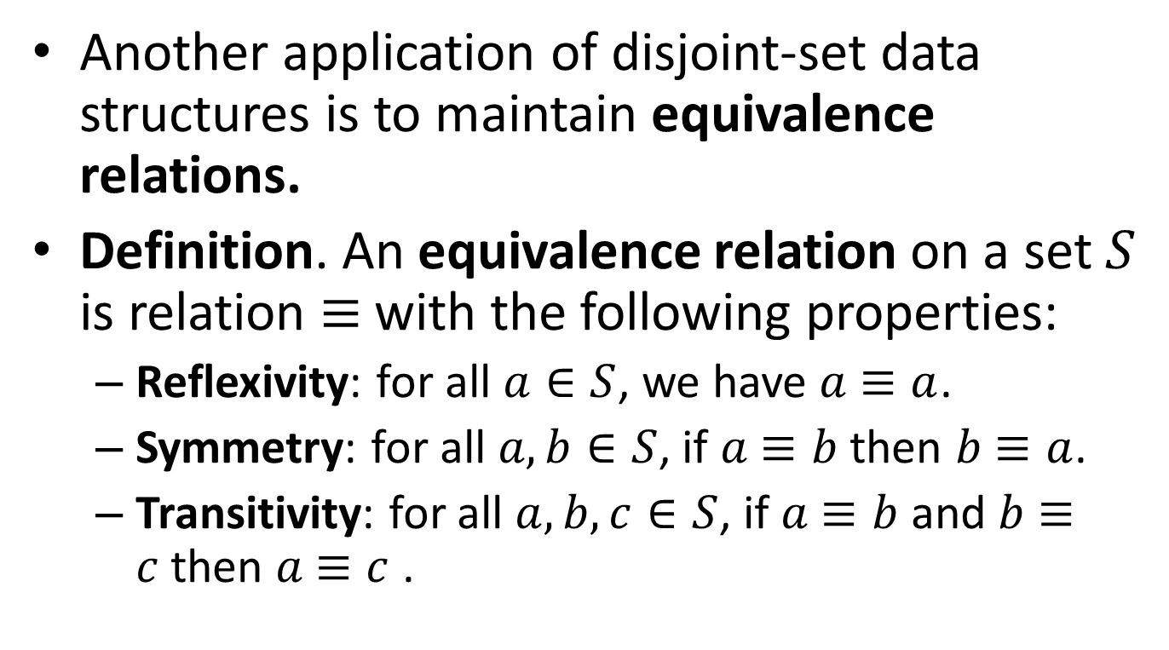
Maintaining Equivalence Relations
Another application of disjoint-set data structures is to maintain equivalence relations.
Definition. An equivalence relation on a set $S$ is relation $≡$with the following properties:
  Reflexivity: for all $a∈S$, we have $a$ $≡a$.
  Symmetry: for all $a,b∈S$, if $a$ $≡b$ then $b$ $≡a$.
  Transitivity: for all $a,b, c∈S$, if $a$ $≡b$ and $b$ $≡c$then $a$ $≡c$ .

Slide 15

Examples of Equivalence Relations
Equality in some set $S$.
Connectivity of vertices in an undirected graph.

Slide 16
Examples of Equivalence Relations (cont’d)
Equivalent type definitions in programming languages. For example, consider the following type definitions in C:
  struct A {
  int a;
  int b;
  };
  typedef A B;
  typedef A C;
  typedef A D;
The types A, B, C and D are equivalent in the sense that variables of one type can be assigned to variables of the other types without requiring any casting.

Slide 17
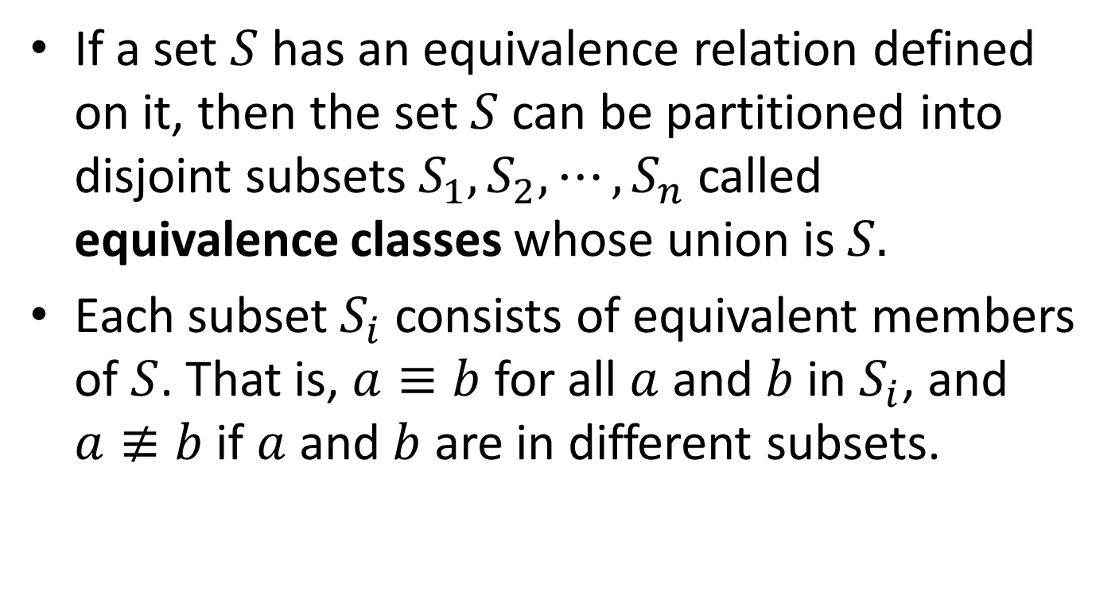
Equivalent Classes
If a set $S$ has an equivalence relation defined on it, then the set $S$ can be partitioned into disjoint subsets $S_{1}, S_{2}, ⋯, S_{n}$ called equivalence classes whose union is $S.$
Each subset $S_{i}$ consists of equivalent members of $S$. That is, $a≡b$ for all $a$ and $b$ in $S_{i}$, and $a≢b$ if $a$ and $b$ are in different subsets.

Slide 18
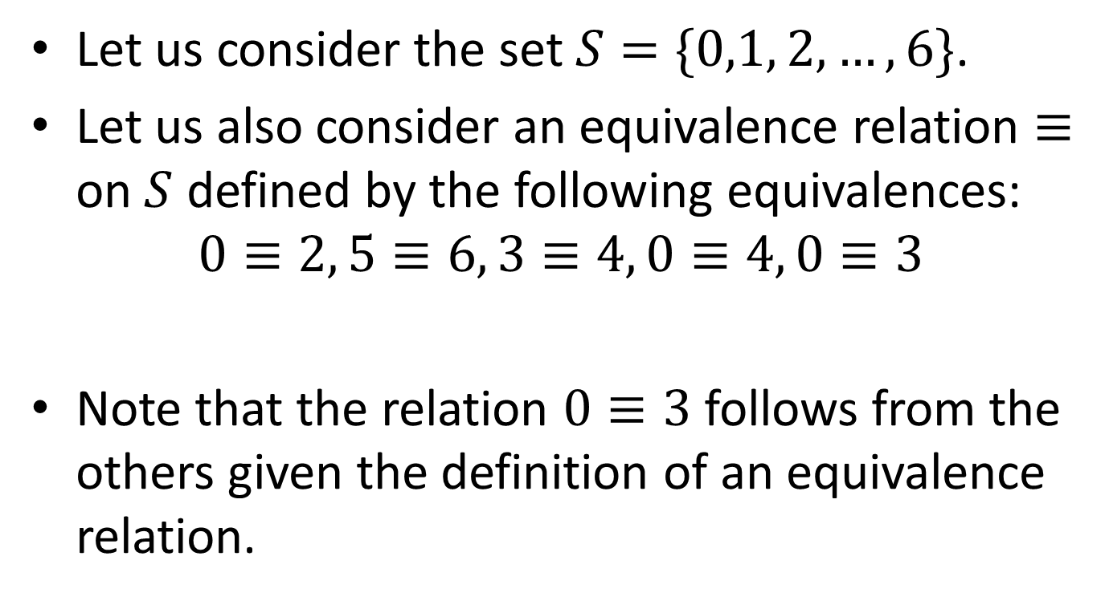
Example
Let us consider the set $S=\{0,1, 2, …, 6\}$.
Let us also consider an equivalence relation $≡$ on $S$ defined by the following equivalences:
$$0≡2, 5≡6, 3≡4, 0≡4, 0≡3$$
Note that the relation $0≡3$ follows from the others given the definition of an equivalence relation.

Slide 19
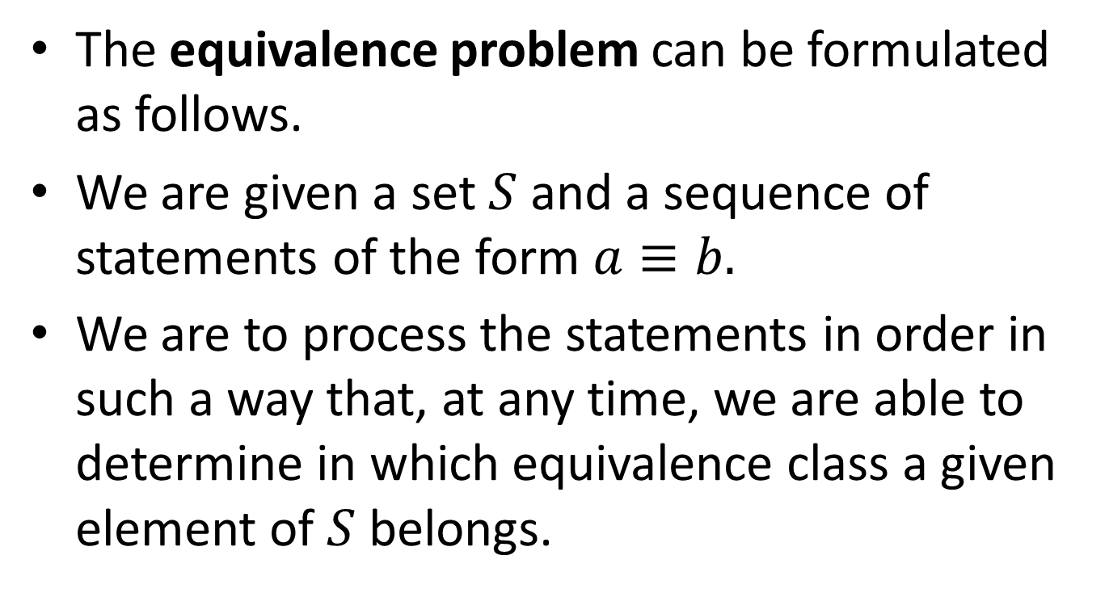
The Equivalence Problem
The equivalence problem can be formulated as follows.
We are given a set $S$ and a sequence of statements of the form $a≡b.$
We are to process the statements in order in such a way that, at any time, we are able to determine in which equivalence class a given element of $S$ belongs.

Slide 20
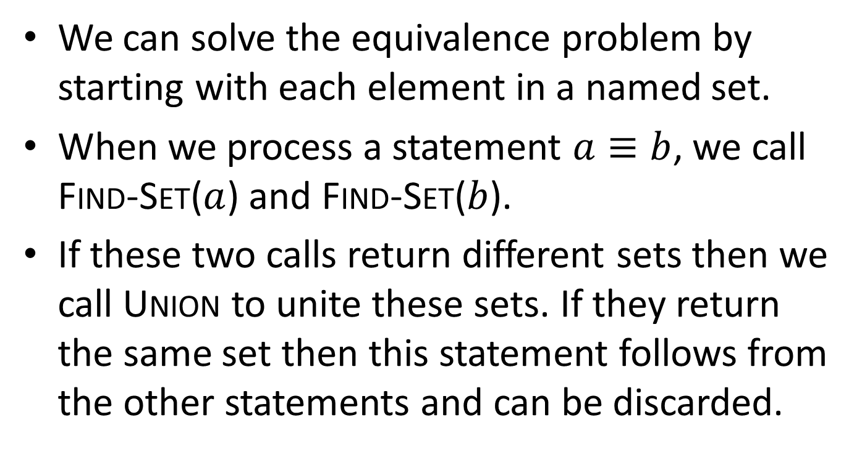
The Equivalence Problem (cont’d)
We can solve the equivalence problem by starting with each element in a named set.
When we process a statement $a≡b$, we call Find-Set($a$) and Find-Set($b$).
If these two calls return different sets then we call Union to unite these sets. If they return the same set then this statement follows from the other statements and can be discarded.

Slide 21
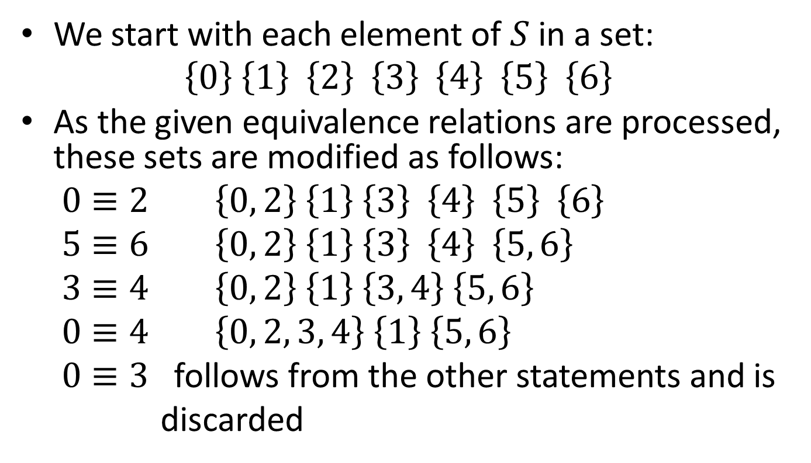
Example (cont’d)
We start with each element of $S$in a set:
$$\left\{0\right\} \left\{1\right\} \left\{2\right\} \left\{3\right\} \left\{4\right\} \left\{5\right\} \left\{6\right\}$$
As the given equivalence relations are processed, these sets are modified as follows:
$0≡2$ $\left\{0, 2\right\} \left\{1\right\} \left\{3\right\} \left\{4\right\} \left\{5\right\} \left\{6\right\}$
$5≡6$ $\left\{0, 2\right\} \left\{1\right\} \left\{3\right\} \left\{4\right\} \left\{5, 6\right\}$
$3≡4$ $\left\{0, 2\right\} \left\{1\right\} \left\{3, 4\right\} \left\{5, 6\right\}$
$0≡4$ $\left\{0, 2, 3, 4\right\} \left\{1\right\} \left\{5, 6\right\}$
$0≡3$ follows from the other statements and is
discarded

Slide 22

Example (cont’d)
Therefore, the equivalent classes of $S$ are the subsets $\left\{0, 2, 3, 4\right\}, \left\{1\right\}$ and $\{5, 6\}$.

Slide 23
Implementation in C
Let us assume that the sets will have positive integers in the range 0 to N-1 as their members.
The simplest way to implement in C the disjoint sets data structure is to use an array id[N] of integers that take values in the range 0 to N-1. This array will be used to keep track of the representative of each set but also the members of each set.
Initially, we set id[i]=i, for each i between 0 and N-1. This is equivalent to N Make-Set operations that create the initial versions of the sets.
To implement the Union operation for the sets that contain integers p and q, we scan the array id and change all the array elements that have the value p to have the value q. In other words, q becomes the representative of the union of the two sets.
The implementation of the Find-Set(p) simply returns the value of id[p].
This algorithm is called quick-find.

Slide 24
Implementation in C (cont’d)
The program on the next slide initializes the array id, and then reads pairs of integers (p,q) and performs the operation Union(p,q) if p and q are not in the same set yet.
The program is an implementation of the equivalence problem defined earlier.

Slide 25
Implementation in C (cont’d)
#include <stdio.h>
#define N 10000
main()
{ int i, p, q, t, id[N];
for (i = 0; i < N; i++) id[i] = i;
while (scanf("%d %d", &p, &q) == 2)
{
if (id[p] == id[q]) continue;
for (t = id[p], i = 0; i < N; i++)
if (id[i] == t) id[i] = id[q];
printf("%d %d\n", p, q);
}
}

Slide 26
Example
p | q |  | id[0] | id[1] | id[2] | id[3] | id[4] | id[5] | id[6]
 |  |  | 0 | 1 | 2 | 3 | 4 | 5 | 6
0 | 2 |  | 2 | 1 | 2 | 3 | 4 | 5 | 6
5 | 6 |  | 2 | 1 | 2 | 3 | 4 | 6 | 6
3 | 4 |  | 2 | 1 | 2 | 4 | 4 | 6 | 6
0 | 4 |  | 4 | 1 | 4 | 4 | 4 | 6 | 6
0 | 3 |  | 4 | 1 | 4 | 4 | 4 | 6 | 6

Slide 27
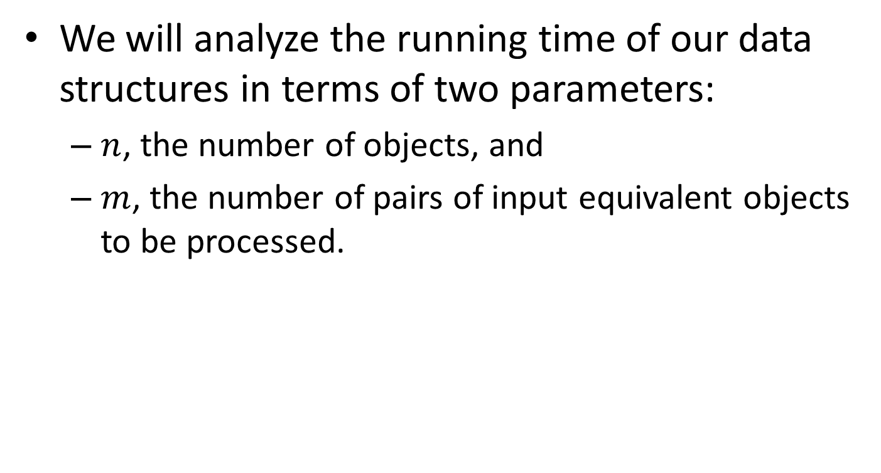
Complexity Parameters for the Disjoint-Set Data Structures
We will analyze the running time of our data structures in terms of two parameters:
  $n$, the number of objects, and
  $m$, the number of pairs of input equivalent objects to be processed.

Slide 28

Proposition
The quick-find algorithm has time complexity $O(nm)$where $n$ is the number of objects and $m$ is the number of input pairs of objects.
Proof?

Slide 29

Proof
For each of the $m$ input pairs, we iterate the for loop $n$ times.

Slide 30
Linked-List Representation of Disjoint Sets
Another way to implement a disjoint-set data structure is to represent each set by a linked list.
The first object in each linked list serves as its set’s representative. The remaining objects can appear in the list in any order.
Each object in the linked list contains a set member, a pointer to the object containing the next set member, and a pointer back to the representative.

Slide 31
The Structure of Each List Object
Set Member
Pointer Back to
Representative
Pointer to Next Object

Slide 32
Example: the Sets {c, h, e, b} and
{f, g, d}
.
c
h
e
b
.
f
g
d
The representatives of the two sets are c and f.

Slide 33
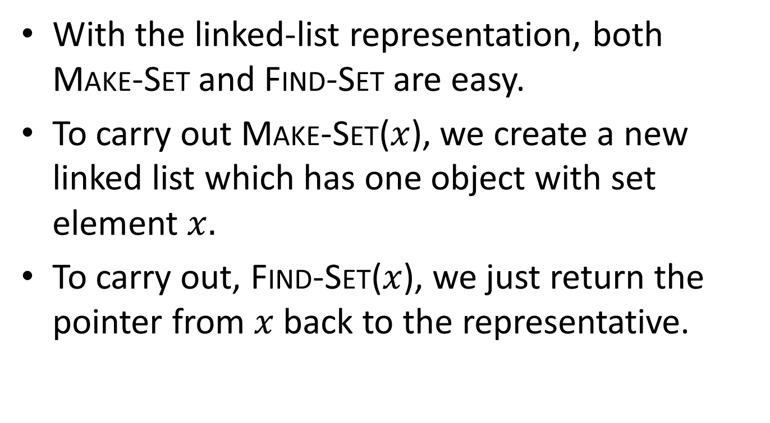
Implementation of Make-Set and
Find-Set
With the linked-list representation, both Make-Set and Find-Set are easy.
To carry out Make-Set($x$), we create a new linked list which has one object with set element $x.$
To carry out, Find-Set($x$), we just return the pointer from $x$ back to the representative.

Slide 34
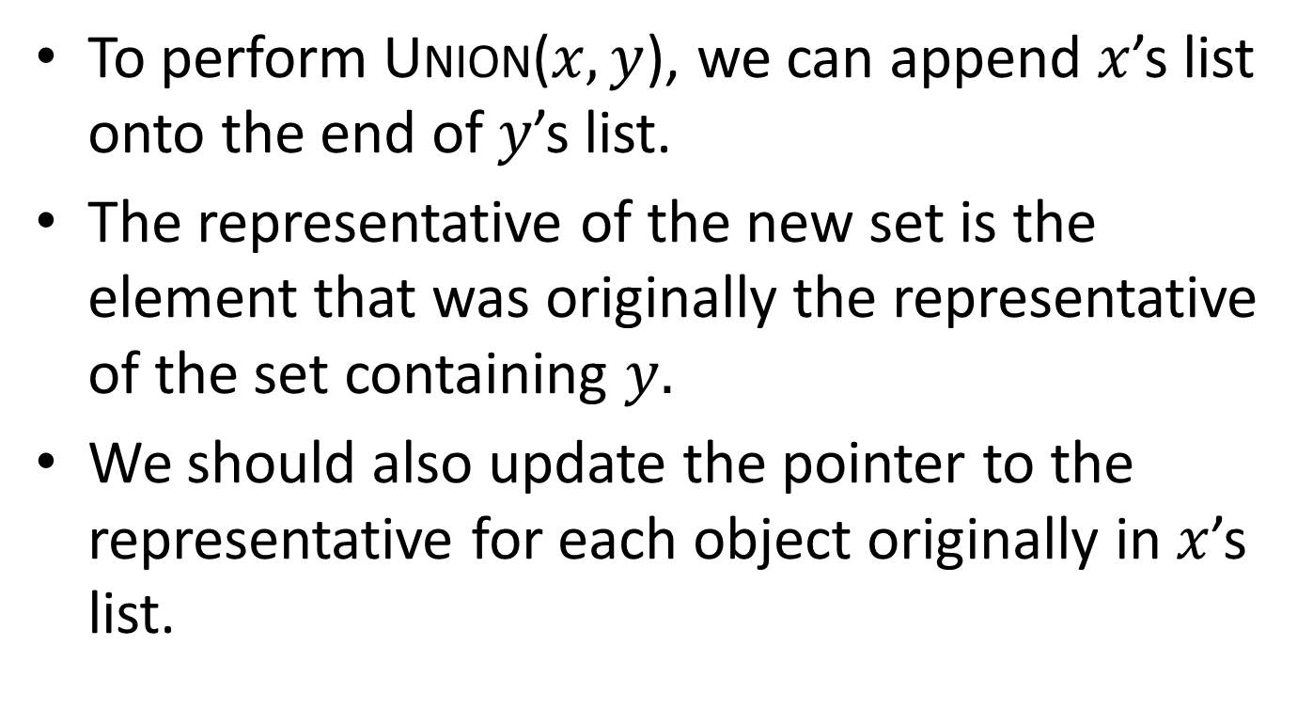
Implementation of Union
To perform Union($x,y$), we can append $x$’s list onto the end of $y$’s list.
The representative of the new set is the element that was originally the representative of the set containing $y.$
We should also update the pointer to the representative for each object originally in $x$’s list.

Slide 35
The Weighted Union Heuristic
In the above implementation of the Union operation we may be appending a longer list onto a shorter list, and we must update the pointer to the representative of each member of the longer list.
If each representative also includes the length of the list then we can always append the smaller list onto the longer, with ties broken arbitrarily. This is called the weighted union heuristic.
The word heuristic is used in Computer Science to mean “a rule of thumb” that allows us to improve an algorithm.

Slide 36
Implementation in C
The implementation in C for the case where sets are represented by linked lists is left as an exercise.

Slide 37
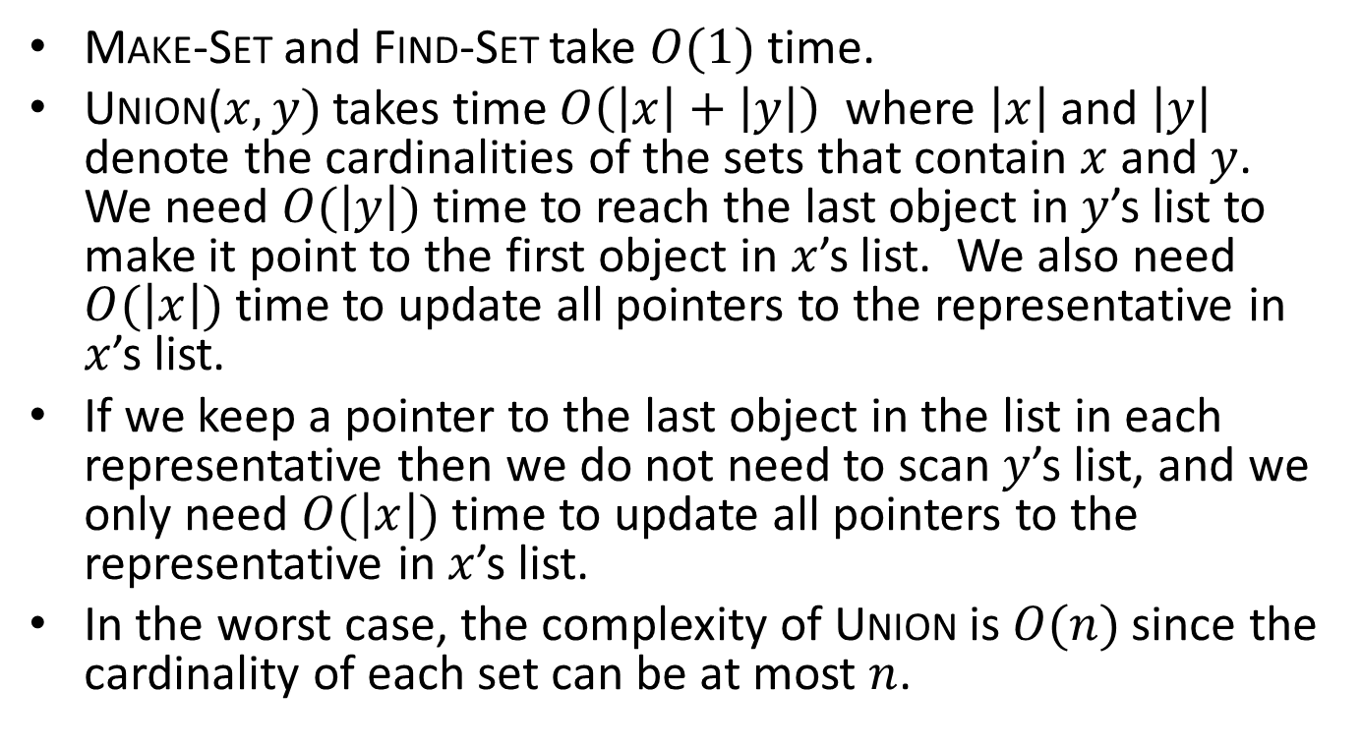
Complexity of Operations for the Linked List Representation
Make-Set and Find-Set take $O(1)$ time.
Union($x,y)$ takes time $O\left(\left|x\right|+\left|y\right|\right)$ where $\left|x\right|$ and $\left|y\right|$ denote the cardinalities of the sets that contain $x$ and $y$. We need $O(\left|y\right|)$ time to reach the last object in $y$’s list to make it point to the first object in $x$’s list. We also need $O(\left|x\right|)$ time to update all pointers to the representative in $x$’s list.
If we keep a pointer to the last object in the list in each representative then we do not need to scan $y$’s list, and we only need $O(\left|x\right|)$ time to update all pointers to the representative in $x$’s list.
In the worst case, the complexity of Union is $O(n)$ since the cardinality of each set can be at most $n$.

Slide 38
Disjoint-Set Forests
There is another interesting implementation of disjoint sets in which we represent sets by directed rooted trees.
Each node of a tree represents one set member and each tree represents a set.
In a tree, each set member points only to its parent. The root of each tree contains the representative of the set and is its own parent.
For many sets, we have a disjoint-set forest.

Slide 39
Example: the Sets {b, c, e, h} and
{d, f, g}
c
f
h
e
d
b
g
The representatives of the two sets are c and f.

Slide 40
Implementing Make-Set,
Find-Set and Union
A Make-Set operation simply creates a tree with just one node.
A Find-Set operation can be implemented by chasing parent pointers until we find the root of the tree. The nodes visited on this path towards the root constitute the find-path.
A Union operation can be implemented by making the root of one tree to point to the root of the other.

Slide 41
Example: the Union of Sets {b, c, e, h} and {d, f, g}
f
c
d
h
e
g
b

Slide 42
Implementation in C
The disjoint-forests data structure can easily be implemented by changing the meaning of the elements of array id in our earlier C implementation. Now each id[i] represents the element i of a set and points to another element of that set. These pointers give the paths towards the root of the tree. The root element points to itself.
The program on the next slide illustrates this functionality. Note that after we have found the roots of the two sets, the Union operation is simply implemented by the assignment statement id[i]=j. In other words, element j becomes the representative of the united sets and the root of the new tree.
This algorithm is called quick-union.
The implementation of the Find-Set(i) operation is similar: we just follow pointers starting at id[i] until we find the root of the tree.

Slide 43
Implementation in C (cont’d)
#include <stdio.h>
#define N 10000
main()
{ int i, j, p, q, t, id[N];
for (i = 0; i < N; i++) id[i] = i;
while (scanf("%d %d", &p, &q) == 2)
{
for (i = p; i != id[i]; i = id[i]) ;
for (j = q; j != id[j]; j = id[j]) ;
if (i == j) continue;
id[i] = j;
printf("%d %d\n", p, q);
}
}

Slide 44
Example
p | q |  | id[0] | id[1] | id[2] | id[3] | id[4] | id[5] | id[6]
 |  |  | 0 | 1 | 2 | 3 | 4 | 5 | 6
0 | 2 |  | 2 | 1 | 2 | 3 | 4 | 5 | 6
5 | 6 |  | 2 | 1 | 2 | 3 | 4 | 6 | 6
3 | 4 |  | 2 | 1 | 2 | 4 | 4 | 6 | 6
0 | 4 |  | 2 | 1 | 4 | 4 | 4 | 6 | 6
0 | 3 |  | 2 | 1 | 4 | 4 | 4 | 6 | 6
0 | 5 |  | 2 | 1 | 4 | 4 | 6 | 6 | 6

Slide 45
The Example By Showing the Trees
0
1
2
3
4
5
6
This is the initial forest. We do not show the self-loops.

Slide 46
Example (cont’d)
1
2
3
4
5
6
0
After processing the pair (0,2).

Slide 47
Example (cont’d)
1
2
3
4
6
0
5
After processing the pair (5,6).

Slide 48
Example (cont’d)
1
2
4
6
0
3
5
After processing the pair (3,4).

Slide 49
Example (cont’d)
1
4
6
2
3
5
0
After processing the pair (0,4).

Slide 50
Example (cont’d)
1
4
6
2
3
5
0
After processing the pair (0,3), there is no change in the forest.

Slide 51
Example (cont’d)
1
6
4
5
2
3
0
After processing the pair (0,5).

Slide 52
Discussion
The quick-union algorithm would seem to be faster than the quick-find algorithm, because it does not have to go through the entire array for each input pair; but how much faster is it?
By running empirical studies or studying the amortized time complexity of the two algorithms we can show that quick-union is more efficient.
But we cannot guarantee that quick-union will be substantially faster than quick-find in the worst-case because the input data could conspire to make the Find-Set operation slow.

Slide 53

Proposition
For $m>n$, the quick-union algorithm could take more than $\frac{mn}{2}$ instructions to solve a disjoint set problem with $m$ pairs of $n$ objects.
Proof?

Slide 54
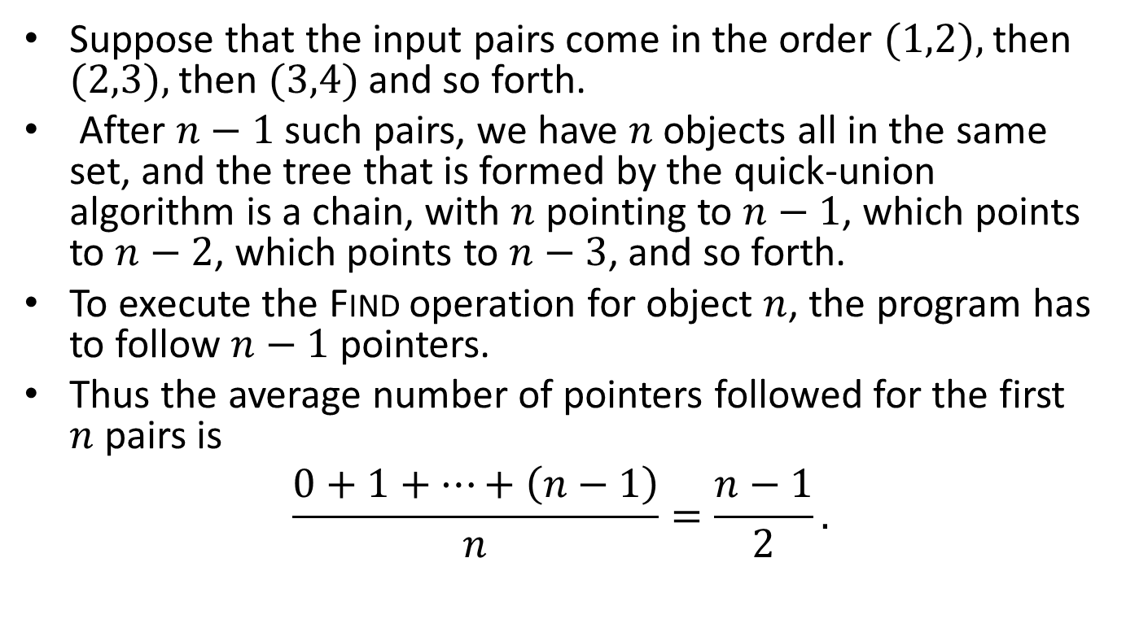
Proof
Suppose that the input pairs come in the order $(1,2),$then $(2,3),$then $(3,4)$and so forth.
After $n−1$ such pairs, we have $n$ objects all in the same set, and the tree that is formed by the quick-union algorithm is a chain, with $n$ pointing to $n−1$, which points to $n−2$, which points to $n−3$, and so forth.
To execute the Find operation for object $n$, the program has to follow $n−1$ pointers.
Thus the average number of pointers followed for the first $n$ pairs is
$$\frac{0+1+…+\left(n−1\right)}{n}=\frac{n−1}{2}.$$

Slide 55
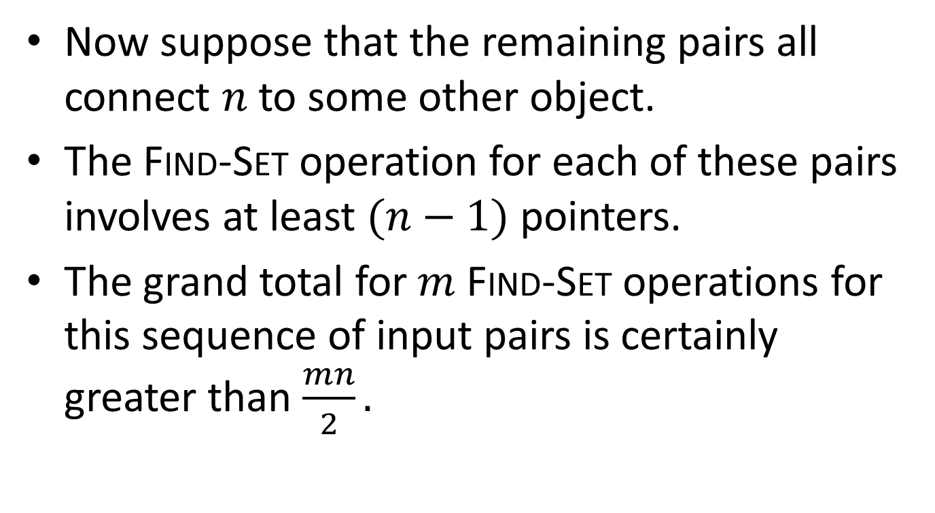
Proof (cont’d)
Now suppose that the remaining pairs all connect $n$ to some other object.
The Find-Set operation for each of these pairs involves at least $(n−1)$pointers.
The grand total for $m$ Find-Set operations for this sequence of input pairs is certainly greater than $\frac{mn}{2}.$

Slide 56
The Weighted Quick-Union Algorithm
We can implement a weighted version of the Union operation by keeping track of the size of the two trees and making the root of the smaller tree point to the root of the larger.
The code on the next slide implements this functionality by making use of an array sz[N] (for size).

Slide 57
Implementation in C
#include <stdio.h>
#define N 10000
main()
{ int i, j, p, q, id[N], sz[N];
for (i = 0; i < N; i++)
{ id[i] = i; sz[i] = 1; }
while (scanf("%d %d", &p, &q) == 2)
{
for (i = p; i != id[i]; i = id[i]) ;
for (j = q; j != id[j]; j = id[j]) ;
if (i == j) continue;
if (sz[i] < sz[j])
{ id[i] = j; sz[j] += sz[i]; }
else { id[j] = i; sz[i] += sz[j]; }
printf("%d %d\n", p, q);
}
}

Slide 58
Example
0
1
2
3
4
5
6
This is the initial forest. We do not show the self-loops.

Slide 59
Example (cont’d)
1
2
3
4
5
6
0
After processing the pair (0,2).

Slide 60
Example (cont’d)
1
2
3
4
6
0
5
After processing the pair (5,6).

Slide 61
Example (cont’d)
1
2
4
6
0
3
5
After processing the pair (3,4).

Slide 62
Example (cont’d)
1
4
6
2
3
5
0
After processing the pair (0,4).

Slide 63
Example (cont’d)
1
4
6
2
3
5
0
After processing the pair (0,3), there is no change in the forest.

Slide 64
Example (cont’d)
1
4
2
3
6
0
5
After processing the pair (0,5). The shorter tree is now joined to the taller one and the paths in the resulting tree are shorter.

Slide 65

Proposition
The weighted quick-union algorithm follows at most $2 \log{n}$ pointers to determine whether two of $n$ objects are connected.
Proof?

Slide 66
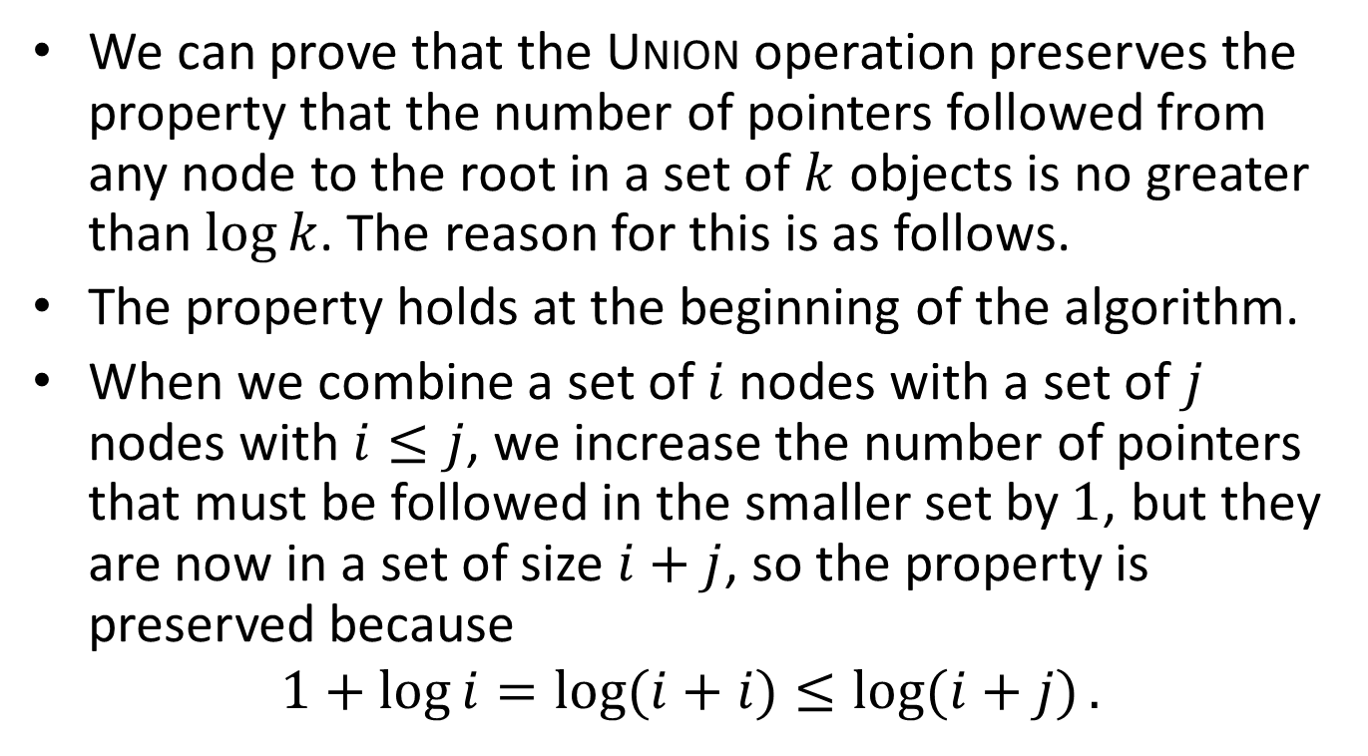
Proof
We can prove that the Union operation preserves the property that the number of pointers followed from any node to the root in a set of $k$ objects is no greater than $\log{k}$. The reason for this is as follows.
The property holds at the beginning of the algorithm.
When we combine a set of $i$nodes with a set of $j$ nodes with $i≤j$, we increase the number of pointers that must be followed in the smaller set by$1$, but they are now in a set of size $i+j$, so the property is preserved because
$$1+\log{i}=\log{(i+i)}≤\log{(i+j)}.$$

Slide 67
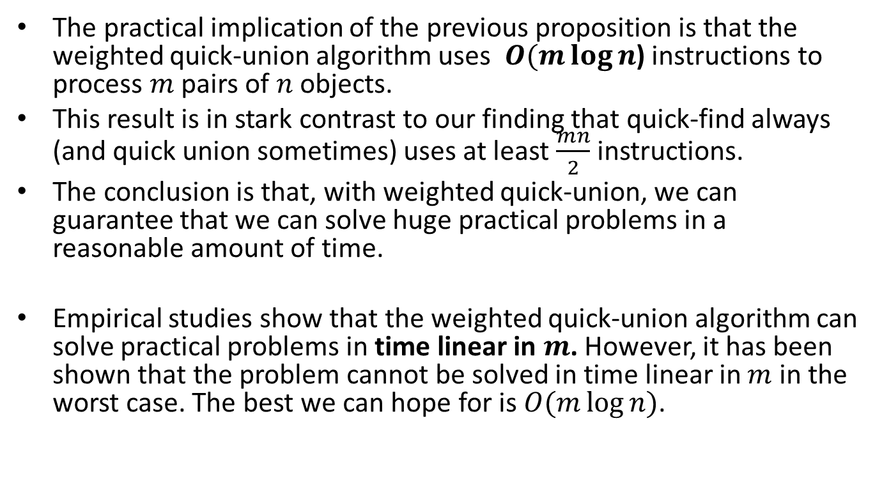
Discussion
The practical implication of the previous proposition is that the weighted quick-union algorithm uses $O(m\log{n}$) instructions to process $m$ pairs of $n$ objects.
This result is in stark contrast to our finding that quick-find always (and quick union sometimes) uses at least $\frac{mn}{2}$instructions.
The conclusion is that, with weighted quick-union, we can guarantee that we can solve huge practical problems in a reasonable amount of time.
Empirical studies show that the weighted quick-union algorithm can solve practical problems in time linear in $m$. However, it has been shown that the problem cannot be solved in time linear in $m$ in the worst case. The best we can hope for is $O(m\log{n)}$.

Slide 68
The Path Compression Heuristic
We can extend the weighted quick-union algorithm with a second heuristic, called path compression (συμπίεση μονοπατιού), which is also simple and very effective.
This heuristic is used during Find-Set operations to make each node on the find-path point directly to the root.
In this way, trees with small height are constructed.
Path compression does not change any weights.

Slide 69
The Path Compression Heuristic Graphically
f
e
d
c
b

Slide 70
The Path Compression Heuristic Graphically (cont’d)
f
b
c
d
e

Slide 71
Path Compression by Halving
An easy way to implement path compression is by halving the length of paths on the way up the tree by taking two links at a time, and setting the bottom one point to the same node as the top one, as shown in the next figure.

Slide 72
Example (cont’d)
1
1
2
2
3
3
4
5
4
6
7
5
6
When traversing the tree on the left from node 7 up to node 1, we can halve its height as shown on the right.
7

Slide 73
Path Compression by Halving (cont’d)
The new algorithm is easily implemented by replacing the for loops of the weighted quick-union program as shown on the next slide.

Slide 74
Implementation in C
#include <stdio.h>
#define N 10000
main()
{ int i, j, p, q, id[N], sz[N];
for (i = 0; i < N; i++)
{ id[i] = i; sz[i] = 1; }
while (scanf("%d %d", &p, &q) == 2)
{
for (i = p; i != id[i]; i = id[i])
id[i]=id[id[i]];
for (j = q; j != id[j]; j = id[j])
id[j]=id[id[j]];
if (i == j) continue;
if (sz[i] < sz[j])
{ id[i] = j; sz[j] += sz[i]; }
else { id[j] = i; sz[i] += sz[j]; }
printf("%d %d\n", p, q);
}
}

Slide 75
Readings
Robert Sedgewick. Αλγόριθμοι σε C. 3^{η} Αμερικανική Έκδοση. Εκδόσεις Κλειδάριθμος.
  Κεφάλαιο 1
T.H. Cormen, C. E. Leiserson and R. L. Rivest. Introduction to Algorithms. MIT Press.
  Chapter 22

