Slide 1
Graphs (Γράφοι)
Manolis Koubarakis

Slide 2
Graphs
Graphs are collections of nodes in which various pairs are connected by line segments. The nodes are usually called vertices (κορυφές) and the line segments edges (ακμές).
Graphs are more general than trees. Graphs are allowed to have cycles and can have more than one connected component.
Some authors use the terms nodes (κόμβοι) and arcs (τόξα) instead of vertices and edges.
Graphs can be undirected or directed.

Slide 3
Examples of Graphs (Undirected)

Slide 4
Examples of Graphs (Directed)

Slide 5
Examples of Graphs
Transportation networks
Interesting problem: What is the path with one or more stops of shortest overall distance connecting a starting city and a destination city?

Slide 6
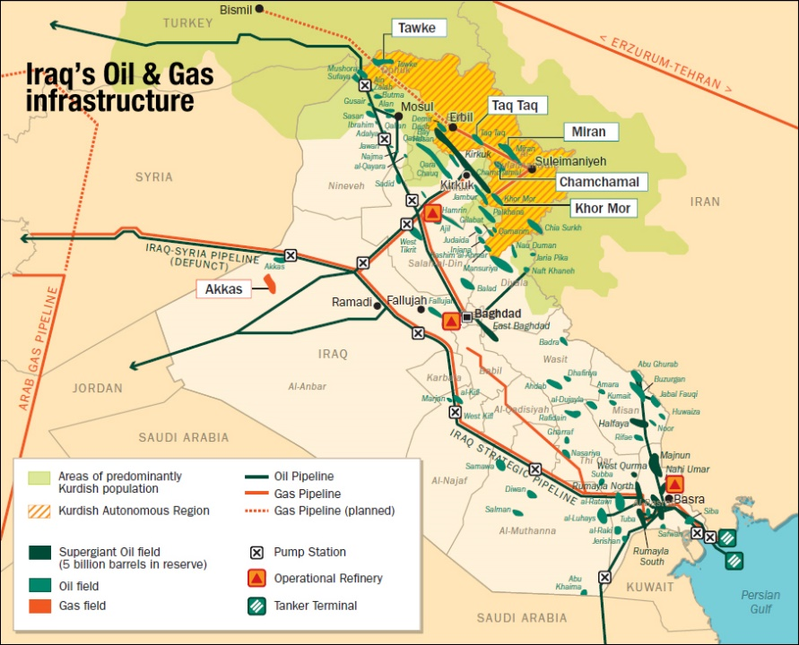
Examples (cont’d)
A network of oil pipelines
Interesting problem: What is the maximum possible overall flow of oil from the source to the destination?

Slide 7

Examples (cont’d)
The Internet
Interesting problem: Deliver an e-mail from user A to user B

Slide 8

Examples (cont’d)
The Web
Interesting problem: What is the PageRank of a Web site?

Slide 9
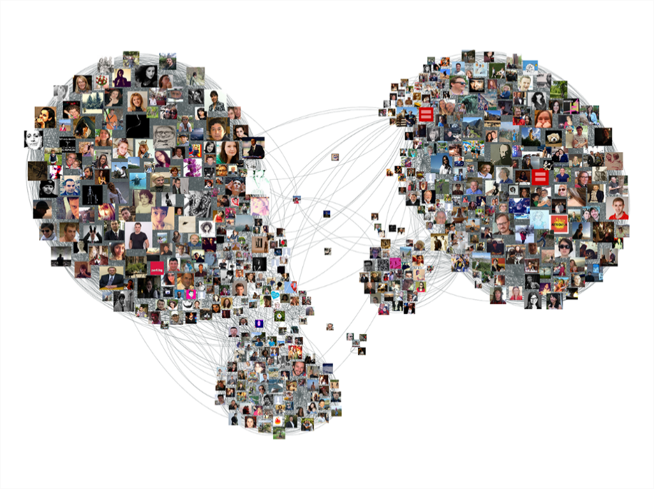
Examples (cont’d)
The Facebook social network
Interesting problem: Are John and Mary connected? What interesting clusters exist?

Slide 10
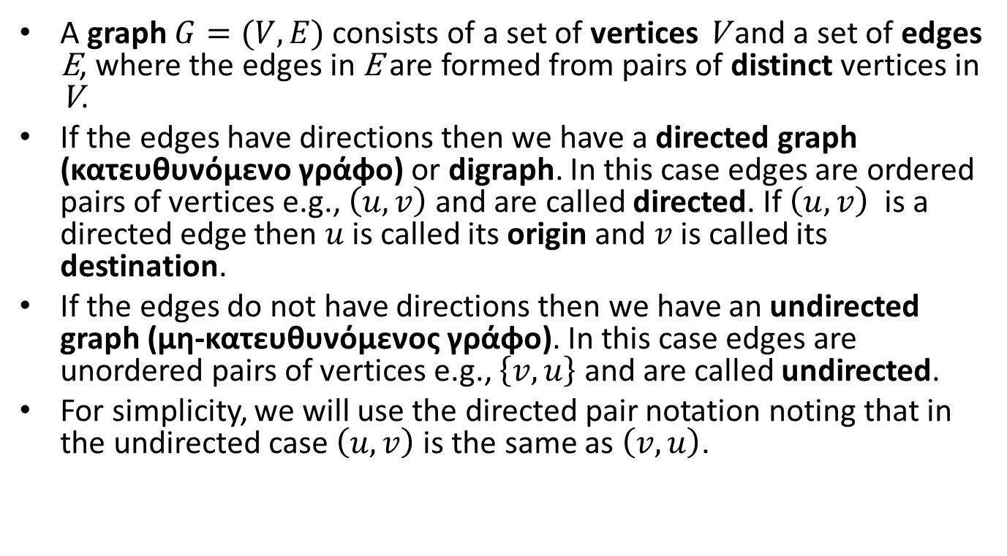
Formal Definitions
A graph $G=(V,E)$ consists of a set of vertices V and a set of edges E, where the edges in E are formed from pairs of distinct vertices in V.
If the edges have directions then we have a directed graph (κατευθυνόμενο γράφο) or digraph. In this case edges are ordered pairs of vertices e.g., $\left(u,v\right)$ and are called directed. If $\left(u,v\right)$ is a directed edge then $u$ is called its origin and $v$ is called its destination.
If the edges do not have directions then we have an undirected graph (μη-κατευθυνόμενος γράφο). In this case edges are unordered pairs of vertices e.g., $\left\{v,u\right\}$ and are called undirected.
For simplicity, we will use the directed pair notation noting that in the undirected case $\left(u,v\right)$ is the same as $\left(v,u\right)$.

Slide 11
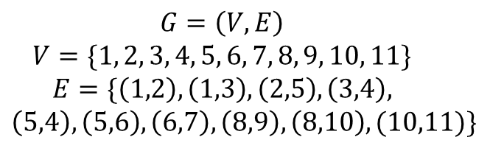
Example of a Directed Graph
2
5
6
1
3
4
7
8
9
$$G=\left(V,E\right)$$
$$V=\{1, 2, 3, 4, 5, 6, 7, 8, 9, 10, 11\}$$
$$E=\{\left(1,2\right), \left(1,3\right), \left(2,5\right), \left(3,4\right),$$
$$\left(5,4\right), \left(5,6\right), \left(6,7\right), \left(8,9\right), \left(8,10\right), (10,11)\}$$
10
11

Slide 12
Example of an Undirected Graph
2
5
6
1
3
4
7
8
9
$$G=\left(V,E\right)$$
$$V=\{1, 2, 3, 4, 5, 6, 7, 8, 9, 10, 11\}$$
$$E=\{\left(1,2\right), \left(1,3\right), \left(2,5\right), \left(3,4\right),$$
$$\left(5,4\right), \left(5,6\right), \left(6,7\right), \left(8,9\right), \left(8,10\right), (10,11)\}$$
10
11

Slide 13
Note
In the following slides, when we say simply graph in a definition, the definition will apply to both directed and undirected graphs.

Slide 14
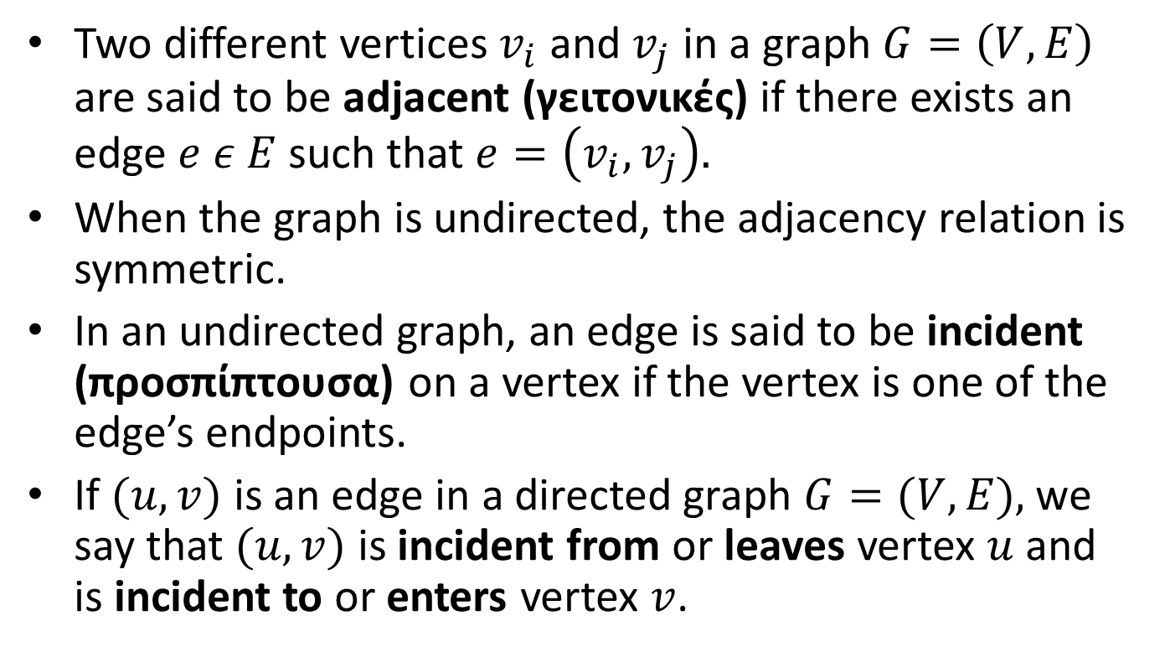
Definitions (cont’d)
Two different vertices $v_{i}$ and $v_{j}$ in a graph $G=\left(V,E\right)$ are said to be adjacent (γειτονικές) if there exists an edge $e ε E$such that $e=\left(v_{i},v_{j}\right).$
When the graph is undirected, the adjacency relation is symmetric.
In an undirected graph, an edge is said to be incident (προσπίπτουσα) on a vertex if the vertex is one of the edge’s endpoints.
If $(u,v)$ is an edge in a directed graph $G=(V,E),$we say that $(u,v)$ is incident from or leaves vertex $u$ and is incident to or enters vertex $v$.

Slide 15
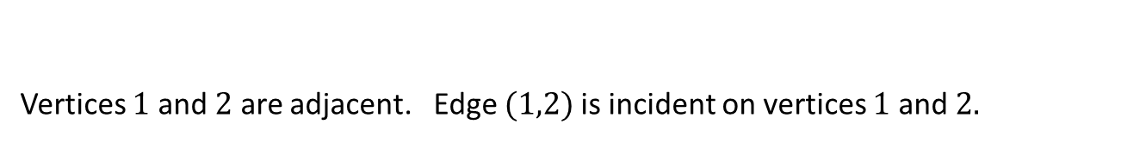
Examples – Undirected Graph
2
5
6
1
3
4
7
Vertices $1$ and $2$ are adjacent. Edge $(1,2)$is incident on vertices $1$ and $2.$

Slide 16
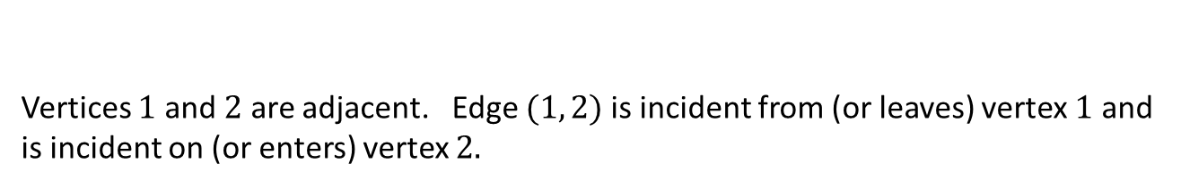
Examples – Directed Graph
2
5
6
1
3
4
7
Vertices $1$ and $2$ are adjacent. Edge $(1, 2)$is incident from (or leaves) vertex $1$ and is incident on (or enters) vertex $2.$

Slide 17
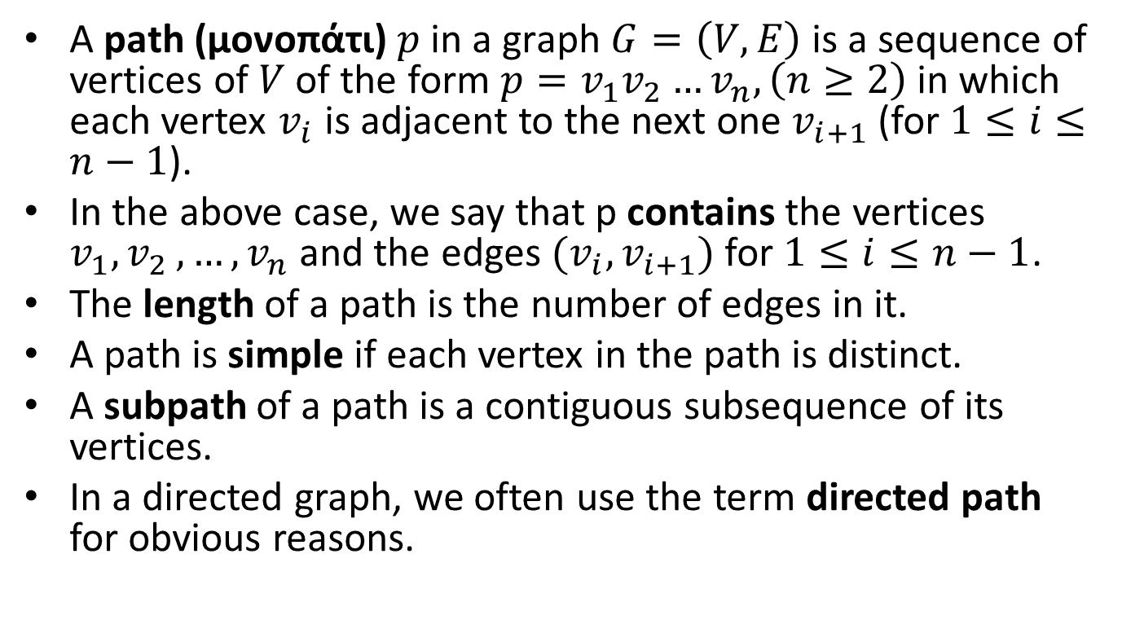
Definitions (cont’d)
A path (μονοπάτι) $p \text{in} \text{a} \text{graph} G=\left(V,E\right)$is a sequence of vertices of $V$ of the form $p=v_{1}v_{2}…v_{n}, \left(n≥2\right)$in which each vertex $v_{i}$ is adjacent to the next one $v_{i+1}$ (for $1≤i≤n−1$).
In the above case, we say that p contains the vertices $v_{1}{,v}_{2},…,v_{n}$ and the edges $(v_{i},v_{i+1})$ for $1≤i≤n−1$.
The length of a path is the number of edges in it.
A path is simple if each vertex in the path is distinct.
A subpath of a path is a contiguous subsequence of its vertices.
In a directed graph, we often use the term directed path for obvious reasons.

Slide 18
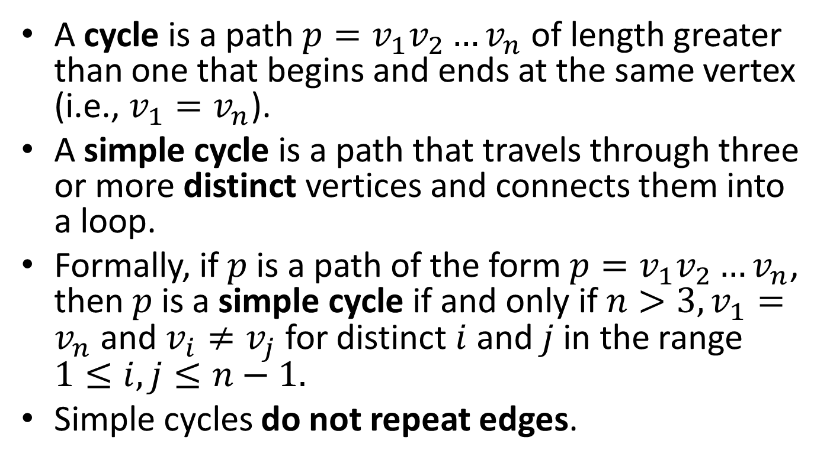
Definitions (cont’d)
A cycle is a path $p=v_{1}v_{2}…v_{n}$ of length greater than one that begins and ends at the same vertex (i.e., $v_{1}=v_{n}$).
A simple cycle is a path that travels through three or more distinct vertices and connects them into a loop.
Formally, if $p$is a path of the form $p=v_{1}v_{2}…v_{n}$, then $p$is a simple cycle if and only if $n>3, v_{1}=v_{n}$ and $v_{i}≠v_{j}$ for distinct $i$ and $j$ in the range $1≤i,j≤n−1.$
Simple cycles do not repeat edges.

Slide 19
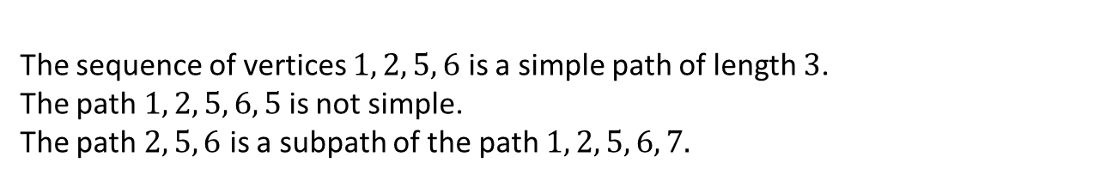
Examples – Undirected Graph
2
5
6
1
3
4
7
The sequence of vertices $1, 2, 5, 6$ is a simple path of length $3$.
The path$1, 2, 5, 6, 5$ is not simple.
The path $2, 5, 6$ is a subpath of the path $1, 2, 5, 6, 7.$

Slide 20
Example Undirected Graph
5
4
6
8
7
2
1
3
Four simple cycles: (1,2,3,1) (4,5,6,7,4) (4,5,6,4) (4,6,7,4)

Slide 21
Example (cont’d)
5
4
6
8
7
2
1
3
One non-simple cycle: (4,5,6,4,7,6,4)

Slide 22
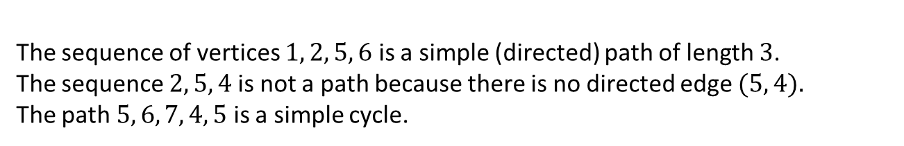
Examples – Directed Graph
2
5
6
1
3
4
7
The sequence of vertices $1, 2, 5, 6$ is a simple (directed) path of length $3$.
The sequence $2, 5, 4$is not a path because there is no directed edge $(5, 4).$
The path $5, 6, 7, 4, 5$ is a simple cycle.

Slide 23

Reachability
Let $G$ be a graph. If there is a path $p$ from $v$ to $u$ in $G$ then we say that $u$ is reachable from $v$ via $p$.

Slide 24
Examples - Undirected Graph
2
5
6
1
3
4
7
8
9
Vertices 1 and 6 are reachable from each other.
Vertex 1 is not reachable from vertex 8
(or 9, 10, 11).
10
11

Slide 25
Examples – Directed Graph
2
5
6
1
3
4
7
8
9
Vertex 6 is reachable from vertex 1.
Vertex 1 is not reachable from vertex 6.
Vertex 1 is not reachable from vertex 8 (or 9, 10, 11).
10
11

Slide 26
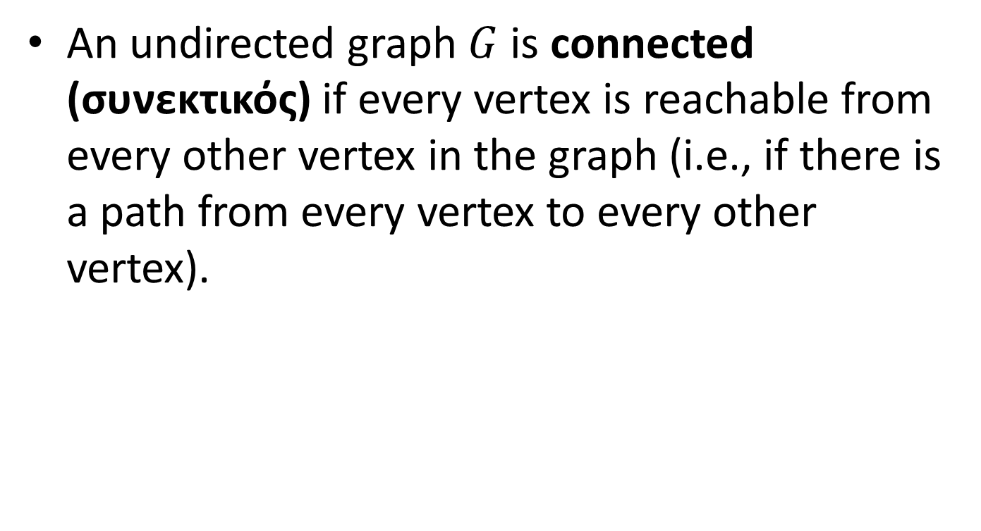
Connected Undirected Graphs
An undirected graph $G$ is connected (συνεκτικός) if every vertex is reachable from every other vertex in the graph (i.e., if there is a path from every vertex to every other vertex).

Slide 27
Example of Connected Undirected Graph

Slide 28
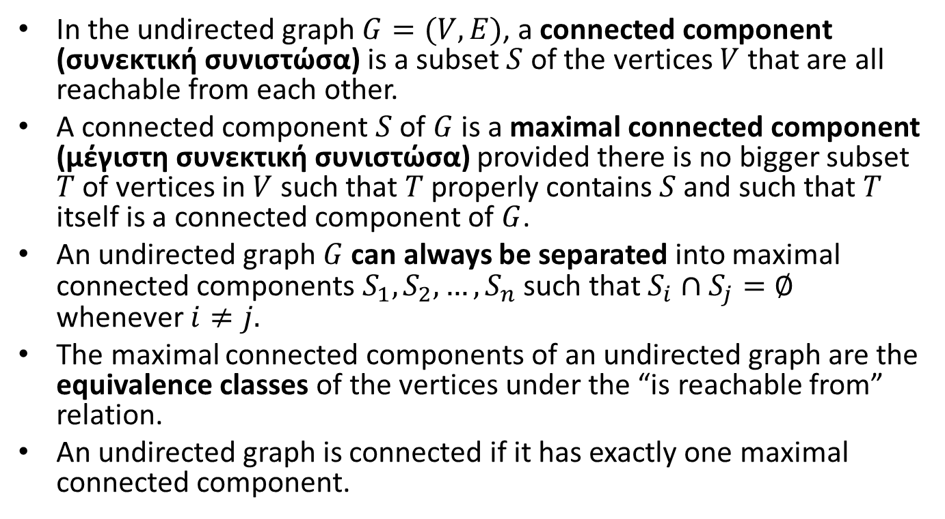
Connected Components of Undirected Graphs
In the undirected graph $G=(V,E)$, a connected component (συνεκτική συνιστώσα) is a subset $S$ of the vertices $V$ that are all reachable from each other.
A connected component $S$ of $G$ is a maximal connected component (μέγιστη συνεκτική συνιστώσα) provided there is no bigger subset $T$ of vertices in $V$ such that $T$ properly contains $S$ and such that $T$ itself is a connected component of $G$.
An undirected graph $G$ can always be separated into maximal connected components $S_{1},S_{2},…,S_{n}$ such that $S_{i}∩S_{j}=∅$ whenever $i≠j.$
The maximal connected components of an undirected graph are the equivalence classes of the vertices under the “is reachable from” relation.
An undirected graph is connected if it has exactly one maximal connected component.

Slide 29
Example of Undirected Graph and its Separation into Two Maximal Connected Components

Slide 30
Strongly Connected Directed Graphs
A directed graph is strongly connected (ισχυρά συνεκτικός) if every two vertices are reachable from each other (i.e., there is a path from the first to the second and vice versa).

Slide 31
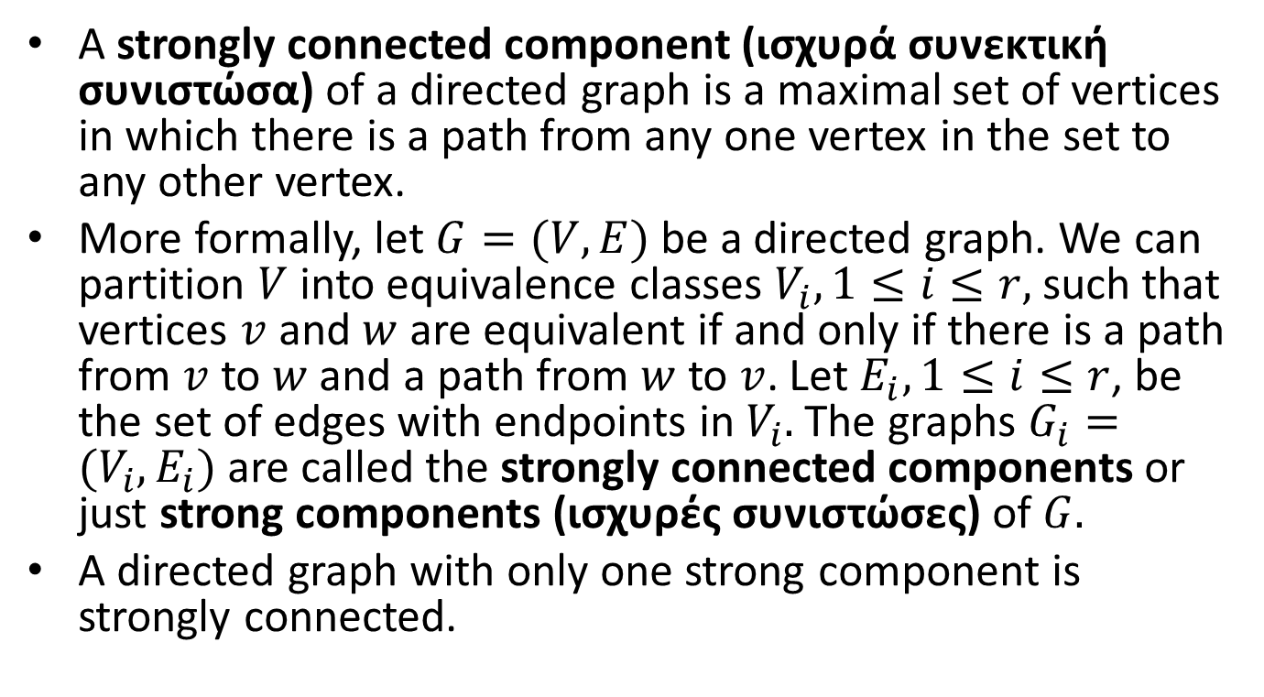
Strongly Connected Components of a Directed Graph
A strongly connected component (ισχυρά συνεκτική συνιστώσα) of a directed graph is a maximal set of vertices in which there is a path from any one vertex in the set to any other vertex.
More formally, let $G=(V,E)$ be a directed graph. We can partition $V$ into equivalence classes $V_{i}, 1≤i≤r,$ such that vertices $v$ and $w$ are equivalent if and only if there is a path from $v$ to $w$ and a path from $w$ to $v$. Let $E_{i}, 1≤i≤r$, be the set of edges with endpoints in $V_{i}.$ The graphs $G_{i}=(V_{i},E_{i})$ are called the strongly connected components or just strong components (ισχυρές συνιστώσες) of $G.$
A directed graph with only one strong component is strongly connected.

Slide 32
Example Directed Graph
A
B
D
C

Slide 33
The Strong Components of the Digraph
A
B
D
C

Slide 34
Another Example Directed Digraph
This graph consists of a single strong component.

Slide 35
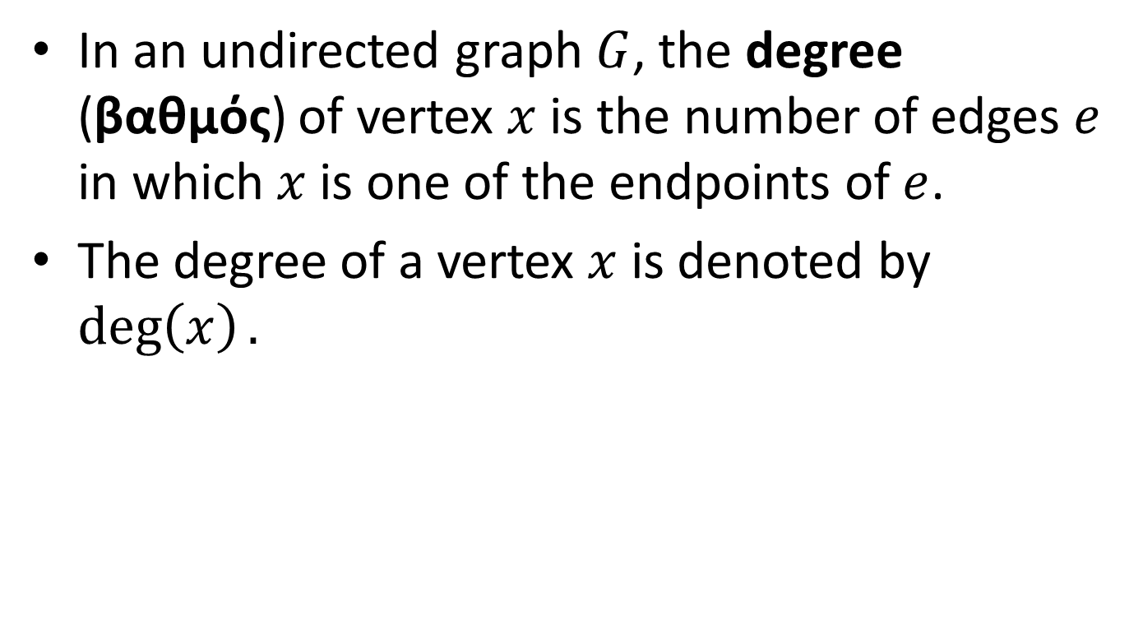
Degree in Undirected Graphs
In an undirected graph $G$, the degree (βαθμός) of vertex $x$ is the number of edges $e$ in which $x$ is one of the endpoints of $e$.
The degree of a vertex $x$ is denoted by $\deg\left(x\right).$

Slide 36
Example
5
4
6
8
7
2
1
3
The degree of vertex 1 is 2. The degree of vertex 4 is 4. The degree of vertex 8 is 1.

Slide 37

Proposition
If $G$ is an undirected graph with $m$ edges, then
$$\sum_{v in G}{deg⁡(v)}=2m.$$
Proof?

Slide 38
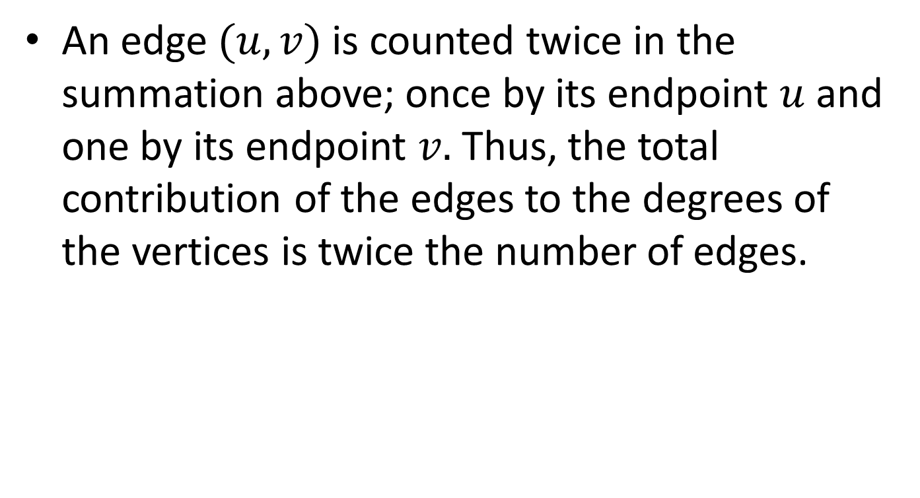
Proof
An edge $(u,v)$ is counted twice in the summation above; once by its endpoint $u$ and one by its endpoint $v.$ Thus, the total contribution of the edges to the degrees of the vertices is twice the number of edges.

Slide 39
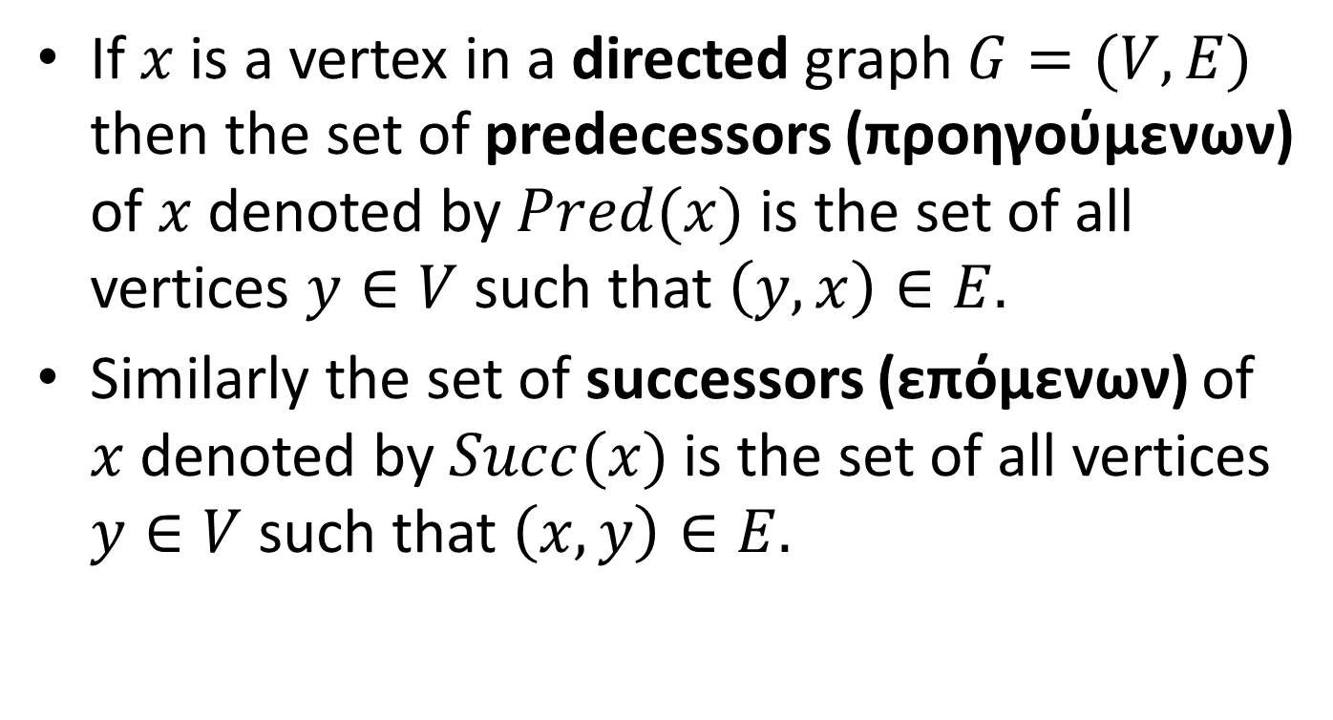
Predecessors and Successors in Directed Graphs
If $x$ is a vertex in a directed graph $G=(V,E)$ then the set of predecessors (προηγούμενων) of $x$ denoted by $Pred(x)$ is the set of all vertices $y∈V$ such that $\left(y,x\right)∈E.$
Similarly the set of successors (επόμενων) of $x$ denoted by $Succ(x)$ is the set of all vertices $y∈V$ such that $\left(x,y\right)∈E.$

Slide 40
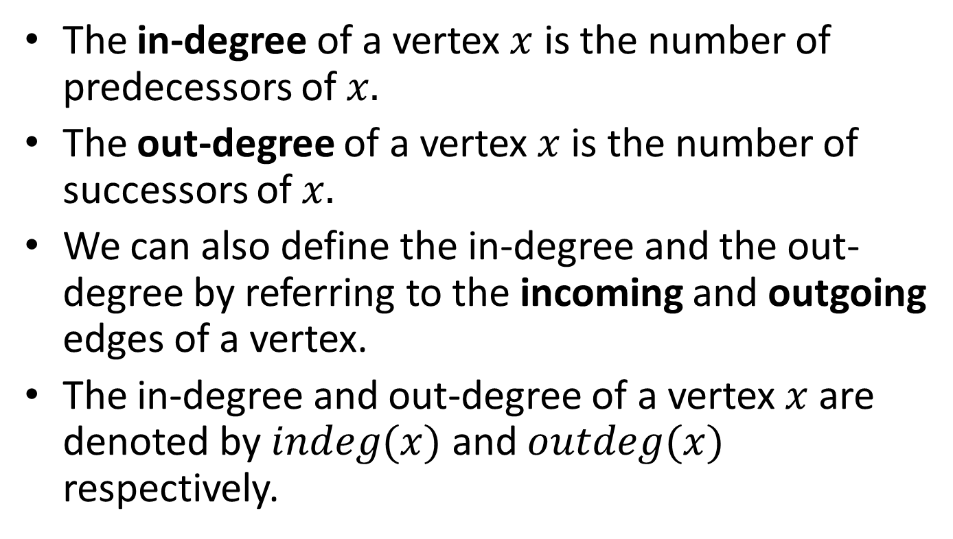
In-Degree and Out-Degree in Directed Graphs
The in-degree of a vertex $x$ is the number of predecessors of $x.$
The out-degree of a vertex $x$ is the number of successors of $x.$
We can also define the in-degree and the out-degree by referring to the incoming and outgoing edges of a vertex.
The in-degree and out-degree of a vertex $x$ are denoted by $indeg(x)$ and $outdeg(x)$ respectively.

Slide 41
Example
1
2
3
4
5
The in-degree of vertex 4 is 2. The out-degree of vertex 4 is 1.

Slide 42

Proposition
If $G$ is a directed graph with $m$ edges, then
$$\sum_{v in G}{indeg\left(v\right)=}\sum_{v in G}{outdeg(v)}=m.$$
Proof?

Slide 43
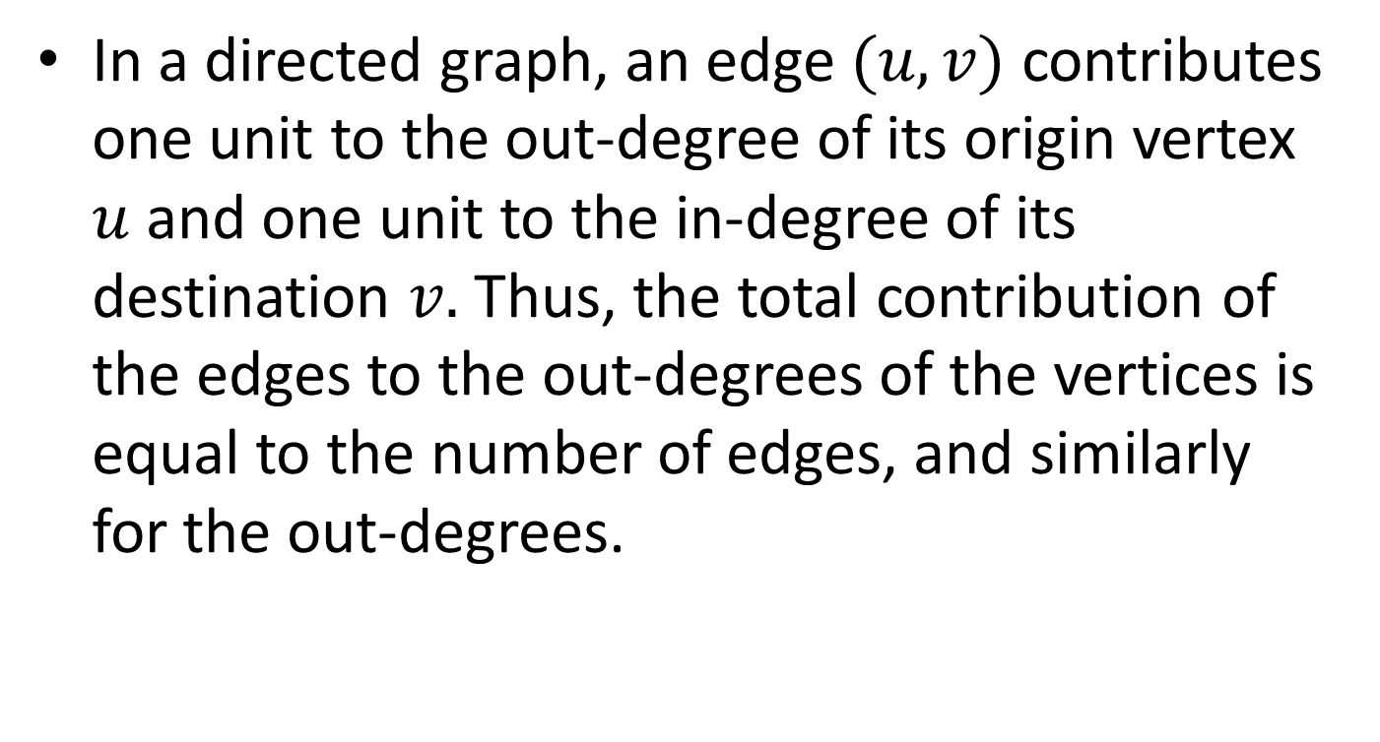
Proof
In a directed graph, an edge $(u,v)$ contributes one unit to the out-degree of its origin vertex $u$and one unit to the in-degree of its destination $v.$ Thus, the total contribution of the edges to the out-degrees of the vertices is equal to the number of edges, and similarly for the out-degrees.

Slide 44

Proposition
Let $G$ be a graph with$n$ vertices and $m$ edges. If $G$ is undirected, then $m≤\frac{n\left(n−1\right)}{2},$and if $G$ is directed, then $m≤n\left(n−1\right).$
Proof?

Slide 45
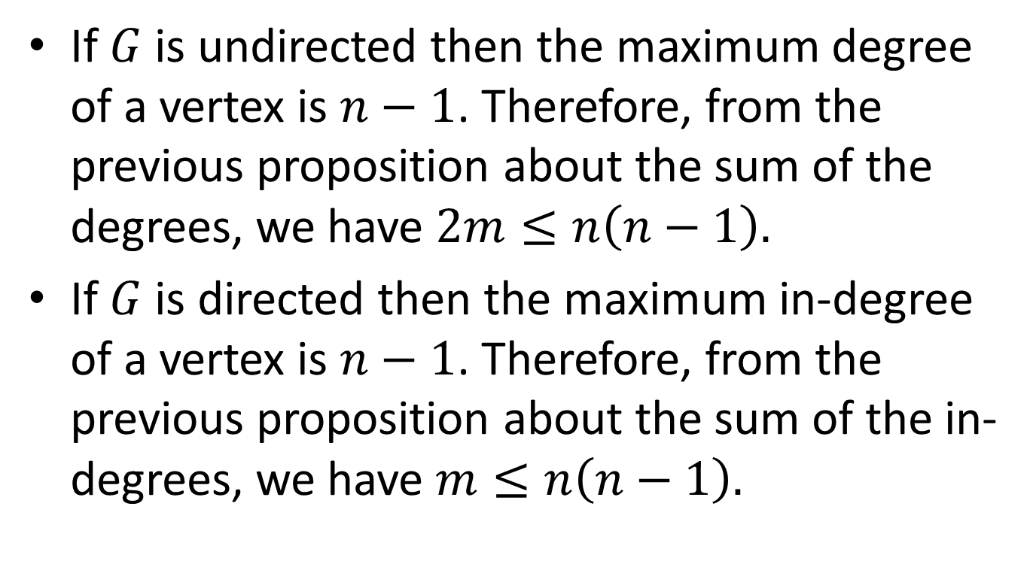
Proof
If $G$ is undirected then the maximum degree of a vertex is $n−1$. Therefore, from the previous proposition about the sum of the degrees, we have $2m≤n\left(n−1\right).$
If $G$ is directed then the maximum in-degree of a vertex is $n−1$. Therefore, from the previous proposition about the sum of the in-degrees, we have $m≤n\left(n−1\right).$

Slide 46
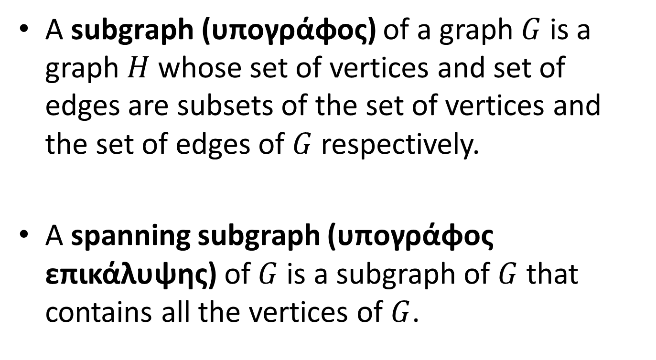
More definitions
A subgraph (υπογράφος) of a graph $G$ is a graph $H$ whose set of vertices and set of edges are subsets of the set of vertices and the set of edges of $G$ respectively.
A spanning subgraph (υπογράφος επικάλυψης) of $G$ is a subgraph of $G$ that contains all the vertices of $G$.

Slide 47
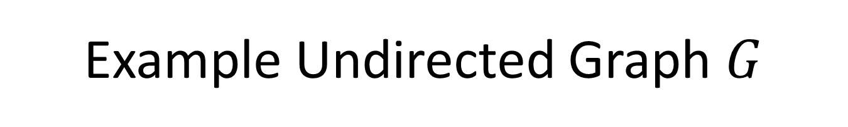
Example Undirected Graph $G$
5
4
6
8
7
2
1
3

Slide 48
Example (cont’d)
5
4
6
8
7
2
1
3
The above are three subgraphs of the previous graph $G.$

Slide 49
Example (cont’d)
5
4
6
8
7
2
1
3
The above graph is a spanning subgraph of the previous graph $G.$

Slide 50
More Definitions
A forest (δάσος) is an undirected graph without cycles.
A free tree (ελεύθερο δένδρο) is a connected forest i.e., a connected, undirected graph without cycles.
The trees that we studied in earlier lectures are rooted trees (δένδρα με ρίζα) and they are different than free trees.
A spanning tree (δένδρο επικάλυψης ή επικαλύπτον δένδρο) of an undirected graph is a spanning subgraph that is a free tree.
A spanning forest (δάσος επικάλυψης ή επικαλύπτον δάσος) is an undirected graph which is the union of spanning trees, one for each connected component of the graph.

Slide 51
More definitions (cont’d)
We can give similar definitions for the case of directed graphs but now our trees will be directed, rooted trees in which all edges point away from the root (technically such a tree is called an arborescence or directed rooted tree if you don’t like words that come from French).

Slide 52
Example
5
4
6
8
7
2
1
3
The thick green lines define a spanning tree of the graph.

Slide 53
Example
The thick green lines define a spanning forest which consists of two spanning trees.

Slide 54
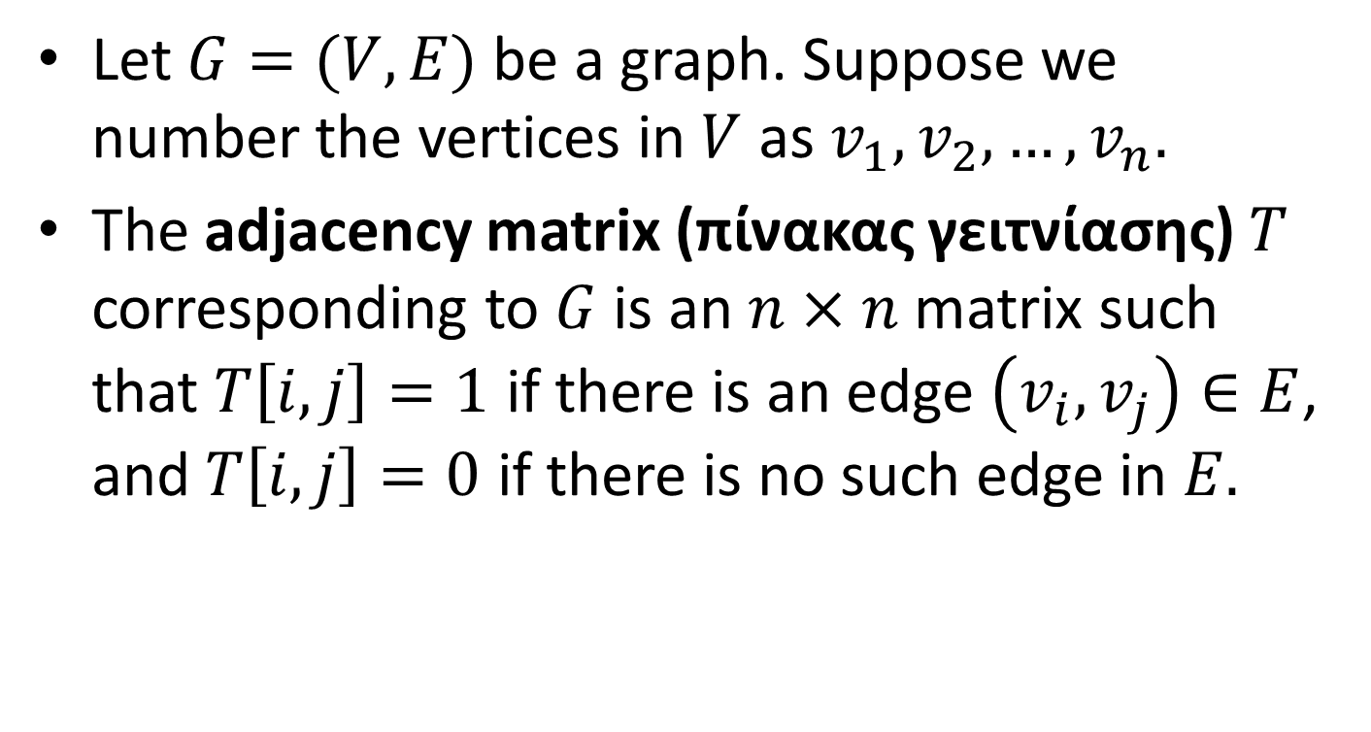
Graph Representations: Adjacency Matrices
Let $G=(V,E)$ be a graph. Suppose we number the vertices in $V$ as $v_{1},v_{2},…,v_{n}.$
The adjacency matrix (πίνακας γειτνίασης) $T$ corresponding to $G$ is an $n×n$ matrix such that $T\left[i,j\right]=1$ if there is an edge $\left(v_{i},v_{j}\right)∈E$, and $T\left[i,j\right]=0$ if there is no such edge in $E.$

Slide 55
Example
1
2
1
2
3
4
1
0 | 1 | 0 | 0
0 | 0 | 1 | 1
1 | 0 | 0 | 1
1 | 0 | 0 | 0
2
3
4
3
4
A graph G
The adjacency matrix for graph G

Slide 56
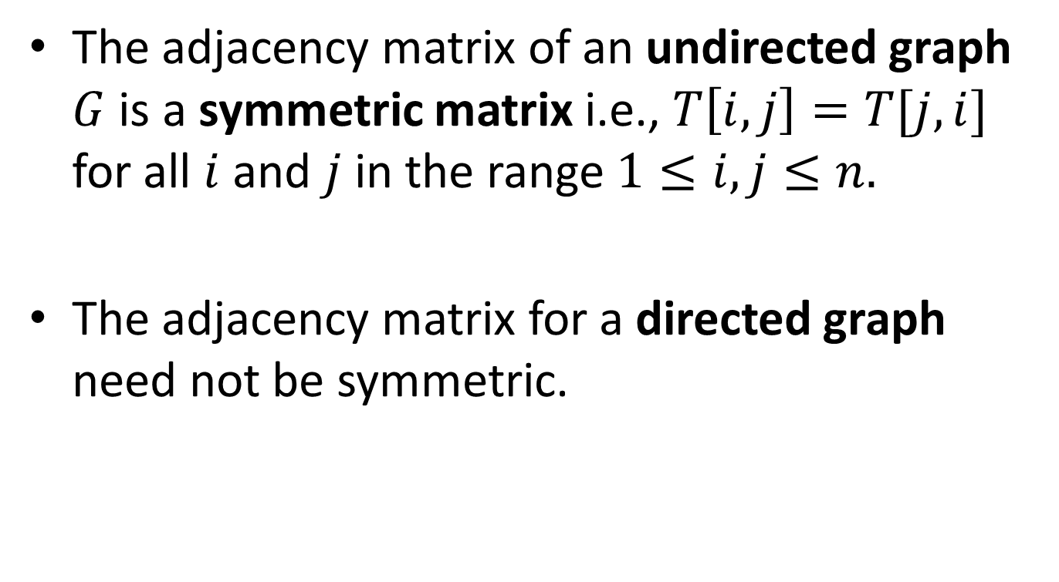
Adjacency Matrices
The adjacency matrix of an undirected graph $G$ is a symmetric matrix i.e., $T\left[i,j\right]=T[j,i]$ for all $i$ and $j$ in the range $1≤i,j≤n.$
The adjacency matrix for a directed graph need not be symmetric.

Slide 57
Adjacency Matrices
The diagonal entries in an adjacency matrix (of a directed or undirected graph) are zero, since graphs as we have defined them are not permitted to have looping self-referential edges that connect a vertex to itself.

Slide 58
Example
1
2
1
2
3
4
1
0 | 1 | 1 | 0
1 | 0 | 1 | 1
1 | 1 | 0 | 1
0 | 1 | 1 | 0
2
3
4
3
4
An undirected graph G
The adjacency matrix for graph G

Slide 59
Another Example
1
2
1
2
3
4
1
0 | 1 | 1 | 1
1 | 0 | 1 | 1
1 | 1 | 0 | 1
1 | 1 | 1 | 0
2
3
4
3
4
An undirected graph G
The adjacency matrix for graph G

Slide 60
Adjacency Matrices in C
#define MAXVERTEX 10
typedef enum {FALSE, TRUE} Boolean
/* FALSE and TRUE will be 0 and 1 respectively */
typedef Boolean
AdjacencyMatrix[MAXVERTEX][MAXVERTEX]
typedef struct graph {
int n /*number of vertices in graph */
AdjacencyMatrix A;
} Graph;

Slide 61
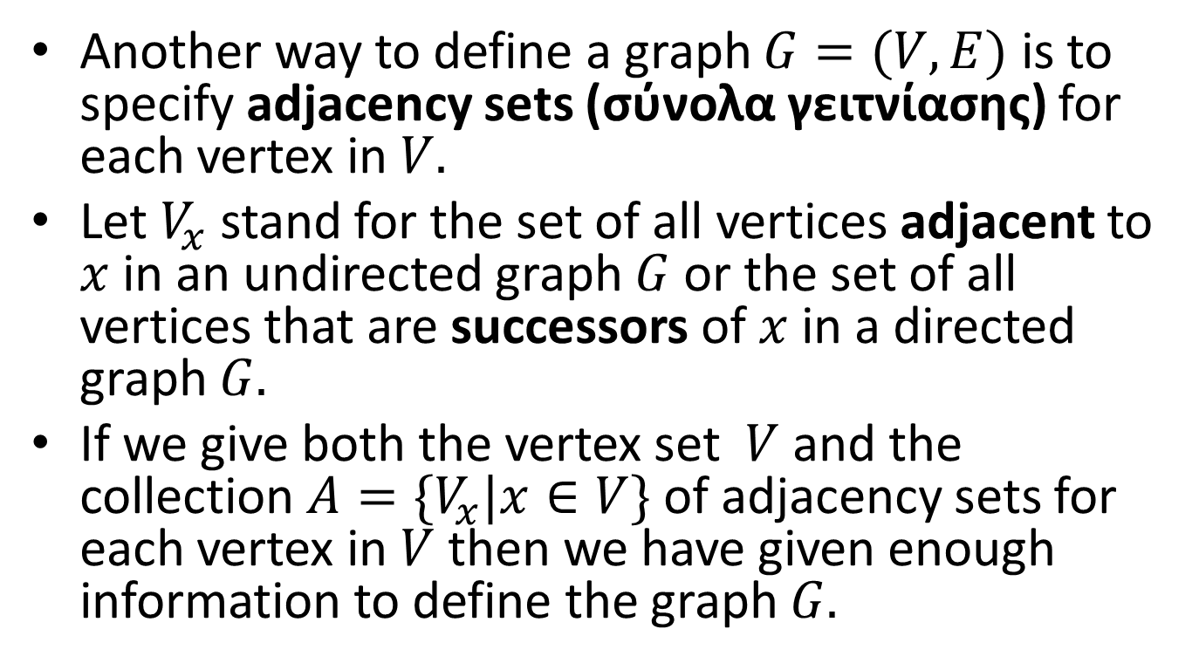
Adjacency Sets
Another way to define a graph $G=(V,E)$ is to specify adjacency sets (σύνολα γειτνίασης) for each vertex in $V.$
Let $V_{x}$ stand for the set of all vertices adjacent to $x$ in an undirected graph $G$ or the set of all vertices that are successors of $x$ in a directed graph $G.$
If we give both the vertex set $V$ and the collection $A=\{V_{x}|x∈V\}$ of adjacency sets for each vertex in $V$ then we have given enough information to define the graph $G.$

Slide 62
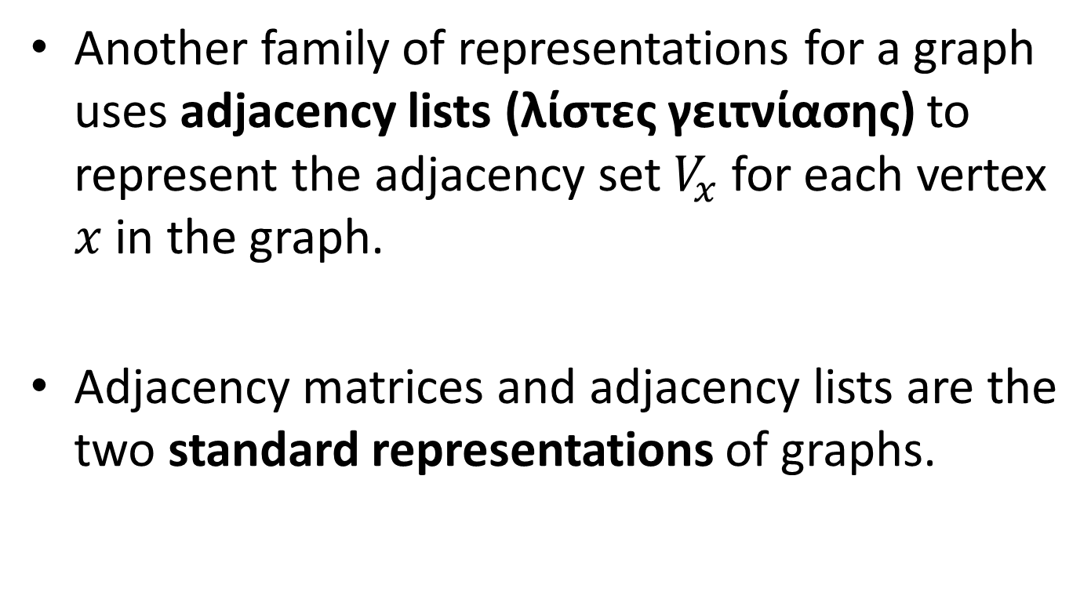
Graph Representations: Adjacency Lists
Another family of representations for a graph uses adjacency lists (λίστες γειτνίασης) to represent the adjacency set $V_{x}$ for each vertex $x$ in the graph.
Adjacency matrices and adjacency lists are the two standard representations of graphs.

Slide 63
Example Directed Graph
2
Vertex Number
1
3
Out Degree
Adjacency list
1 | 2 | 2 3
2 | 3 | 3 4 5
3 | 1 | 4
4 | 0
5 | 1 | 1
5
4
A directed graph G
The sequential adjacency lists for graph G. Notice that vertices are listed in their natural order.

Slide 64
Example Directed Graph
.
2
1:
2
3
.
2:
3
.
4
5
1
3
3:
.
4
4:
.
5
4
5:
1
A directed graph G
The linked adjacency lists for graph G. Notice that vertices in a list are organized according to their natural order.

Slide 65
Example Undirected Graph
2
Vertex Number
1
3
Degree
Adjacency list
1 | 3 | 2 3 5
2 | 4 | 1 3 4 5
3 | 3 | 1 2 4
4 | 2 | 2 4
5 | 2 | 1 2
5
4
An undirected graph G
The sequential adjacency lists for graph G

Slide 66
Example Undirected Graph
The linked adjacency list representation for the graph of the previous slide is similar to the one for the directed case.

Slide 67
Assumptions
In the previous slides, the vertices of the graph appear in their natural order in the arrays and linked lists used in the adjacency matrix and the adjacency links representations.
This will be our assumption in all examples from now on.
In the adjacency lists representation, we also showed the degrees of vertices. This information is not necessary and can be omitted.

Slide 68
Sequential Adjacency Lists in C
typedef int AdjacencyList[MAXVERTEX];
typedef struct graph{
int n; /*number of vertices in graph */
int degree[MAXVERTEX];
AdjacencyList A[MAXVERTEX];
} Graph;
In the above representation, each index i of array A is a vertex of the graph while each element A[i] is an array storing the adjacency list of vertex i.

Slide 69
Linked Adjacency Lists in C
typedef int Vertex;
typedef struct edge {
Vertex endpoint;
struct edge *nextedge;
} Edge;
typedef struct graph{
int n; /*number of vertices in graph */
Edge *firstedge[MAXVERTEX];
} Graph;
In the above representation, each index i of array firstedge is a vertex and each element firstedge[i] is a pointer to a linked list that contains the adjacent vertices of vertex i.

Slide 70
Linked Adjacency Lists in C (cont’d)
The previous representation used an array for the vertices and linked lists for the adjacency lists.
We can use linked lists for the vertices as well as follows.

Slide 71
Linked Adjacency Lists in C (cont’d)
typedef struct vertex Vertex;
typedef struct edge Edge;
struct vertex {
Edge *firstedge;
Vertex *nextvertex;
}
struct edge {
Vertex *endpoint;
Edge *nextedge;
};
typedef Vertex *Graph;

Slide 72
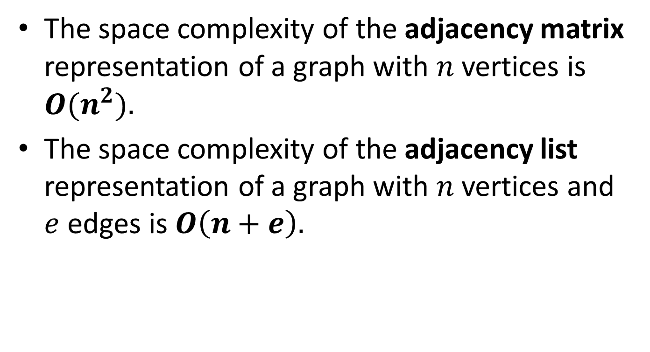
Space Complexity
The space complexity of the adjacency matrix representation of a graph with $n$ vertices is ${O(n}^{2}).$
The space complexity of the adjacency list representation of a graph with $n$ vertices and $e$ edges is $O\left(n+e\right).$

Slide 73
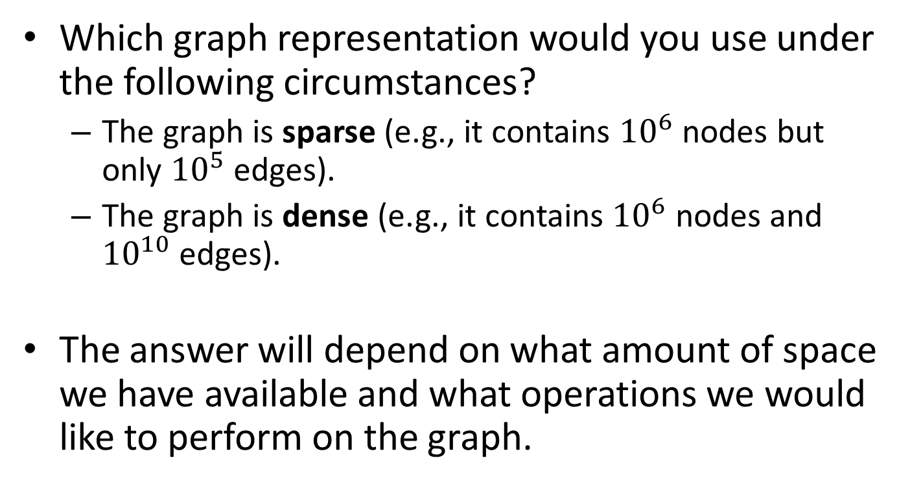
Questions
Which graph representation would you use under the following circumstances?
  The graph is sparse (e.g., it contains ${10}^{6}$ nodes but only ${10}^{5}$ edges).
  The graph is dense (e.g., it contains ${10}^{6}$ nodes and ${10}^{10}$ edges).
The answer will depend on what amount of space we have available and what operations we would like to perform on the graph.

Slide 74
Graph Searching
To search a graph G, we need to visit all vertices of G in some systematic order.
Let us define an enumeration
typedef enum {FALSE, TRUE} Boolean;
Each vertex v can be a structure with a Boolean valued member v.Visited which is initially FALSE for all vertices of G. When we visit v, we will set it to TRUE.

Slide 75
An Algorithm for Graph Searching
void GraphSearch(G,v)
{
Let G=(V,E) be a graph.
Let C be an empty container.
for (each vertex x in V){
x.Visited=FALSE;
}
Put v into C;
while (C is non-empty){
Remove a vertex x from container C;
if (!(x.Visited)){
Visit(x);
x.Visited=TRUE;
for (each vertex w in V_{x}){
if (!(w.Visited)) Put w into C;
}
}
}
}

Slide 76
Graph Searching (cont’d)
Let us consider what happens when the container C is a stack.

Slide 77
Example Undirected Graph
1
2
3
4
5
6
7
8

Slide 78
Representation with Adjacency Lists
Vertex Number
Adjacency list
1 | 2 3 4
2 | 1 5 6
3 | 1
4 | 1 7 8
5 | 2
6 | 2
7 | 4
8 | 4

Slide 79
Example (cont’d)
1
2
3
4
5
6
7
8
What is the order in which vertices are visited if the start vertex is 1?

Slide 80
Example (cont’d)
1
2
3
4
5
6
7
8
The vertices are visited in the order 1, 4, 8, 7, 3, 2, 6 and 5.

Slide 81
Depth-First Search (DFS)
When C is a stack, the tree in the previous example is searched in depth-first order.
Depth-first search (αναζήτηση πρώτα κατά βάθος) at a vertex always goes down (by visiting unvisited children) before going across (by visiting unvisited brothers and sisters).
Depth-first search of a graph is analogous to a pre-order traversal of an ordered tree.

Slide 82
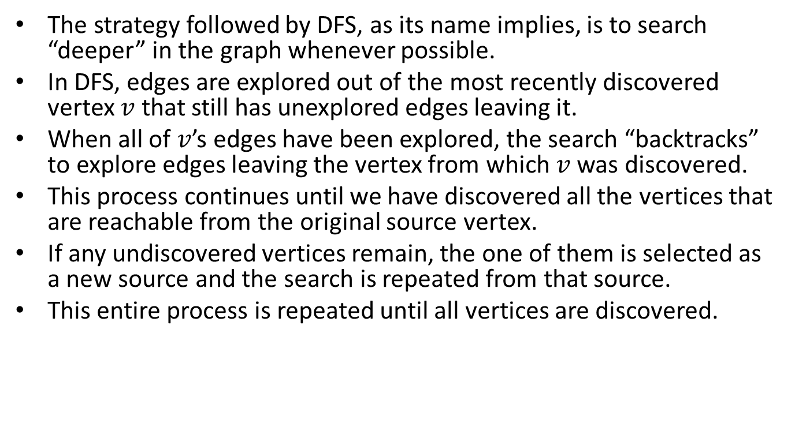
DFS (cont’d)
The strategy followed by DFS, as its name implies, is to search “deeper” in the graph whenever possible.
In DFS, edges are explored out of the most recently discovered vertex $v$ that still has unexplored edges leaving it.
When all of $v$’s edges have been explored, the search “backtracks” to explore edges leaving the vertex from which $v$ was discovered.
This process continues until we have discovered all the vertices that are reachable from the original source vertex.
If any undiscovered vertices remain, the one of them is selected as a new source and the search is repeated from that source.
This entire process is repeated until all vertices are discovered.

Slide 83
Graph Searching (cont’d)
Let us consider what happens when the container C is a queue.

Slide 84
Example Undirected Graph
1
2
3
4
5
6
7
8
What is the order in which vertices are visited if the start vertex is 1?

Slide 85
Example (cont’d)
1
2
3
4
5
6
7
8
The vertices are visited in the order 1, 2, 3, 4, 5, 6, 7 and 8.

Slide 86
Breadth-First Search (BFS)
When C is a queue, the tree in the previous example is searched in breadth-first order.
Breadth-first search (αναζήτηση πρώτα κατά πλάτος) at a vertex always goes broad before going deep.
Breadth-first traversal of a graph is analogous to a traversal of an ordered tree that visits the nodes of the tree in level-order.
BFS subdivides the vertices of a graph in levels. The starting vertex is at level 0, then we have the vertices adjacent to the starting vertex at level 1, then the vertices adjacent to these vertices at level 2 etc.

Slide 87
BFS (cont’d)
BFS works as follows.
We start from the start vertex (level 0) and visit all the vertices that we can reach by following one edge (these are the vertices at level 1).
Then we visit all vertices that we can reach from the start vertex by following two edges (these are the vertices at level 2).
We continue with the vertices at level 3 and so forth.

Slide 88
Example Directed Graph
8
4
7
1
3
6
2
5
What is the order of visiting vertices for DFS if the start vertex is 1?

Slide 89
Representation with Adjacency Lists
Vertex Number
Adjacency list
1 | 2 3 4
2 | 5 6
3
4 | 7 8
5
6 | 5
7 | 1 3 6
8 | 6

Slide 90
Example (cont’d)
8
4
7
1
3
6
2
5
DFS visits the vertices in the order 1, 4, 8, 6, 5, 7, 3 and 2.

Slide 91
Example (cont’d)
8
4
7
1
3
6
2
5
What is the order of visit for BFS if the start vertex is 1?

Slide 92
Example (cont’d)
8
4
7
1
3
6
2
5
BFS visits the vertices in the order 1, 2, 3, 4, 5, 6, 7 and 8.

Slide 93
Exhaustive Search
Either the stack version or the queue version of the algorithm GraphSearch will visit every vertex in a graph G provided that G consists of a single strongly connected component.
If this is not the case, then we can enumerate all the vertices of G and run GraphSearch starting from each one of them in order to visit all the vertices of G.

Slide 94
Exhaustive Search (cont’d)
void ExhaustiveGraphSearch(G)
{
Let G=(V,E) be a graph.
for (each vertex v in G){
GraphSearch(G, v)
}
}

Slide 95
Theseus in the Labyrinth
DFS can be simulated using a string and a can of paint for painting the vertices i.e., using a version of the algorithm that Theseus might have used in the labyrinth of the Minotaur!
BFS is analogous to a group of people exploring a graph by fanning out in all directions.

Slide 96
Implementing DFS in C
We will now show how to implement depth-first search in C.
We will use the linked adjacency lists representation of a graph.
We will write a function DepthFirst which calls the recursive function Traverse.

Slide 97
Implementing DFS in C (cont’d)
/* global variable visited */
Boolean visited[MAXVERTEX];
/* DepthFirst: depth-first traversal of a graph
Pre: The graph G has been created.
Post: The function Visit has been performed at each vertex of G in
depth-first order
Uses: Function Traverse produces the recursive depth-first order */
void DepthFirst(Graph G, void (*Visit)(Vertex x))
{
Vertex v;
for (v=0; v < G.n; v++)
visited[v]=FALSE;
for (v=0; v < G.n; v++)
if (!visited[v]) Traverse(G, v, Visit);
}

Slide 98
Implementing DFS in C (cont’d)
/* Traverse: recursive traversal of a graph
Pre: v is a vertex of graph G
Post: The depth first traversal, using function Visit, has been
completed for v and for all vertices adjacent to v.
Uses: Traverse recursively, Visit */
void Traverse(Graph G, Vertex v, void (*Visit)(Vertex x))
{
Vertex w;
Edge *curedge;
visited[v]=TRUE;
Visit(v);
curedge=G.firstedge[v]; /* curedge is a pointer to the first edge (v,_) of V */
while (curedge){
w=curedge->endpoint; /* w is a successor of v and (v,w) is the current edge */
if (!visited[w]) Traverse(G, w, Visit);
curedge=curedge->nextedge; /*curedge is a pointer to the next edge (v,_) of V */
}
}

Slide 99
Example Undirected Graph
1
2
3
4
5
6
7
8

Slide 100
Representation with Adjacency Lists
Vertex Number
Adjacency list
1 | 2 3 4
2 | 1 5 6
3 | 1
4 | 1 7 8
5 | 2
6 | 2
7 | 4
8 | 4

Slide 101
Example of Recursive DFS
1
2
3
4
5
6
7
8
What is the order vertices are visited if the start vertex is 1?

Slide 102
Example (cont’d)
1
2
3
4
5
6
7
8
The vertices are visited in the order 1, 2, 5, 6, 3, 4, 7 and 8. This is different than the order we got when using a stack!

Slide 103
Important
There is more than one way to traverse a graph in a DFS fashion (e.g., starting from a different node gives us different DFS traversals).
The order the vertices of a graph are visited by DFS depends on:
  The representation of the graph (e.g., adjacency matrix vs. adjacency list, the order of vertices in the two representations).
  The implementation of the DFS algorithm (e.g., recursive DFS vs. using a stack).

Slide 104
Important (cont’d)
DFS traverses all edges and visits all the vertices reachable from the start vertex (i.e., all the vertices in the connected component containing the start vertex), regardless of in what order it examines edges incident on each vertex.

Slide 105
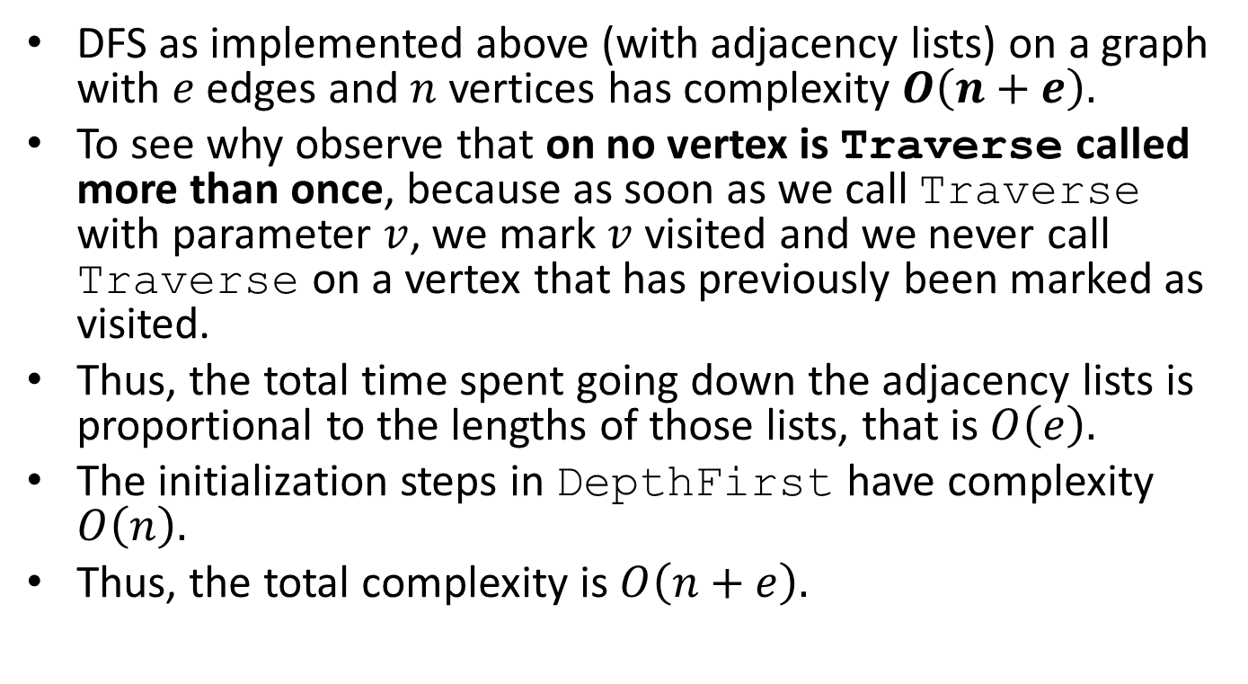
Complexity of DFS
DFS as implemented above (with adjacency lists) on a graph with $e$ edges and $n$ vertices has complexity $O\left(n+e\right).$
To see why observe that on no vertex is Traverse called more than once, because as soon as we call Traverse with parameter $v$, we mark $v$ visited and we never call Traverse on a vertex that has previously been marked as visited.
Thus, the total time spent going down the adjacency lists is proportional to the lengths of those lists, that is $O\left(e\right).$
The initialization steps in DepthFirst have complexity $O\left(n\right).$
Thus, the total complexity is $O\left(n+e\right).$

Slide 106
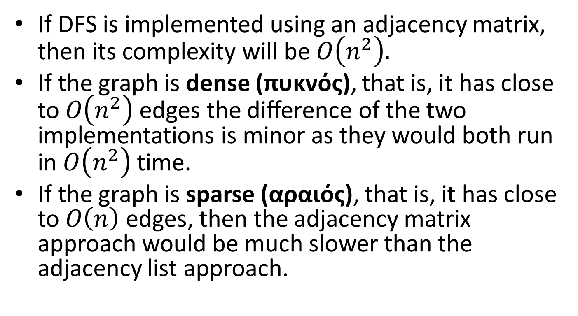
Complexity of DFS (cont’d)
If DFS is implemented using an adjacency matrix, then its complexity will be $O\left(n^{2}\right).$
If the graph is dense (πυκνός), that is, it has close to $O\left(n^{2}\right)$ edges the difference of the two implementations is minor as they would both run in $O\left(n^{2}\right)$ time.
If the graph is sparse (αραιός), that is, it has close to $O\left(n\right)$ edges, then the adjacency matrix approach would be much slower than the adjacency list approach.

Slide 107
Implementing BFS in C
Let us now show how to implement breadth-first search in C.
The algorithm BreadthFirst makes use of a queue which can be implemented using any of the implementations we presented in earlier lectures.

Slide 108
Implementing BFS in C (cont’d)
/* BreadthFirst: breadth-first traversal of a graph
Pre: The graph G has been created
Post: The function visit has been performed at each vertex of G, where the vertices
are chosen in breadth-first order.
Uses: Queue functions */
void BreadthFirst(Graph G, void (*Visit)(Vertex))
{
Queue Q;
Boolean visited[MAXVERTEX];
Vertex v, w;
Edge *curedge;
for (v=0; v < G.n; v++)
visited[v]=FALSE;
InitializeQueue(&Q);
for (v=0; v < G.n; v++)
if (!visited[v]){
Insert(v, &Q);
do {
Remove(&Q, &v);;
if (!visited[v]){
visited[v]=TRUE;
Visit(v);
}
curedge=G.firstedge[v]; /* curedge is a pointer to the first edge (v,_) of V */
while (curedge){
w=curedge->endpoint; /* w is a successor of v and (v,w) is the current edge */
if (!visited[w]) Insert(w, &Q);
curedge=curedge->nextedge; /*curedge is a pointer to the next edge (v,_) of V */
}
} while (!Empty(&Q));
}
}

Slide 109

Complexity of BFS
BFS as implemented above (with adjacency lists) has the same complexity as DFS i.e., $O(n+e).$

Slide 110
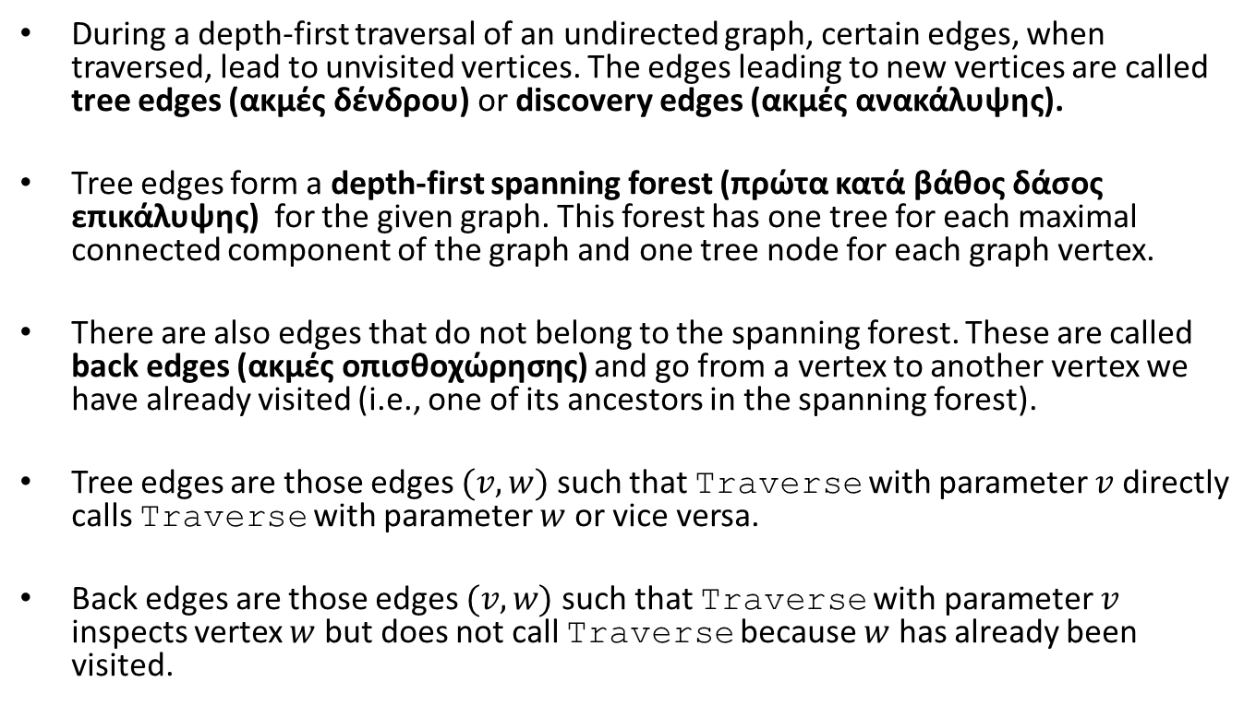
DFS of an Undirected Graph
During a depth-first traversal of an undirected graph, certain edges, when traversed, lead to unvisited vertices. The edges leading to new vertices are called tree edges (ακμές δένδρου) or discovery edges (ακμές ανακάλυψης).
Tree edges form a depth-first spanning forest (πρώτα κατά βάθος δάσος επικάλυψης) for the given graph. This forest has one tree for each maximal connected component of the graph and one tree node for each graph vertex.
There are also edges that do not belong to the spanning forest. These are called back edges (ακμές οπισθοχώρησης) and go from a vertex to another vertex we have already visited (i.e., one of its ancestors in the spanning forest).
Tree edges are those edges $(v,w)$ such that Traverse with parameter $v$ directly calls Traverse with parameter $w$ or vice versa.
Back edges are those edges $(v,w)$ such that Traverse with parameter $v$ inspects vertex $w$ but does not call Traverse because $w$ has already been visited.

Slide 111

Example
Let us search the above graph $G$ using the function DepthFirst presented earlier starting from vertex A.
A
B
C
F
G
D
E

Slide 112

Representation of $G$ with Adjacency Lists
Vertex ID
Adjacency list
A | B C D E
B | A D E
C | A F G
D | A B E
E | A B D
F | C G
G | F C

Slide 113
Example (cont’d)
A
B
C
F
G
D
E
Tree edges
Back edges

Slide 114

Example (cont’d)
The above is the depth-first spanning forest for the graph $G$ we saw previously. The forest consists of one tree only.
A
B
C
F
G
D
E

Slide 115
Important
The edge types are properties of the dynamics of the search, rather than only the graph.
Different depth-first spanning forests of the same graph can differ remarkably in character.
Can you give examples for the above facts?

Slide 116
Question
How can we modify function Traverse so that it outputs the edges of the depth-first spanning tree (tree edges) and the back edges?

Slide 117
DFS Traversal of a Directed Graph
During a depth-first traversal of a directed graph, certain edges, when traversed, lead to unvisited vertices. The edges leading to new vertices are called tree edges (ακμές δένδρου) and they form a depth-first spanning forest (πρώτα κατά βάθος δάσος επικάλυψης) for the given digraph.
Tree edges form a depth-first spanning forest (πρώτα κατά βάθος δάσος επικάλυψης) for the given graph. This forest has one tree for each strong connected component of the graph and one tree node for each graph vertex.
There are also edges that do not belong to the spanning forest and can be classified as follows:
  Back edges (ακμές οπισθοχώρησης) that go from a vertex to one of its ancestors in a depth-first tree.
  Forward edges (ακμές προώθησης) that go from a vertex to one of its descendants in a depth-first tree.
  Cross edges (εγκάρσιες ακμές). These are all the remaining edges. They can go between vertices in the same depth-first tree, as long as one vertex is not an ancestor of the other, or they can go between vertices in different depth-first trees.

Slide 118

Example
I
Let us search the above graph $G$ using the function DepthFirst presented earlier starting from vertex A. We will need to modify Depth-First to cover all the components of $G$ as done by ExhaustiveSearch.
H
F
B
A
E
G
D
C

Slide 119
Representation with Adjacency Lists
Vertex ID
Adjacency list
A | B
B | C D
C | A
D | A C
E | F G
F | H I
G | F
H | I
I

Slide 120
Example (cont’d)
I
The vertices will be visited in the order A, B, D, C, E, F, H, I, G.
H
F
B
A
E
G
D
C

Slide 121
Example (cont’d)
A
E
F
G
B
H
I
C
D
Tree edges
Cross edges
Back edges
Forward edges

Slide 122

Example (cont’d)
The above is the depth-first spanning forest of graph $G$ for the depth-first traversal we saw previously.
A
E
F
G
B
H
I
C
D

Slide 123
Important
As we also saw for undirected graphs, the edge types are properties of the dynamics of the search, rather than only the graph.
Different depth-first forests of the same graph can differ remarkably in character.
Even the number of trees in the depth-first forest depends upon the start vertex.
Can you give examples for the above facts?

Slide 124
Classification of Edges
How do we distinguish among the four types of edges?
Tree edges are easy to find since they lead to an unvisited vertex during DFS.
The other three types of edges can be distinguished by keeping track of the preorder and postorder numbering of nodes and using an interesting proposition that we present below.

Slide 125
Preorder Numbering of Vertices
We can number the vertices of a digraph in the order in which we first mark them as visited during a DFS.
For this, we can use a counter count that is initially set to zero, a vertex-indexed array pre with all its elements set to -1 initially, and add the code
pre[v]=count++;
in the function Traverse, immediately after the
statement marking a vertex as visited.
We will call this the preorder numbering (προδιατεταγμένη αρίθμηση) of a digraph.

Slide 126
Example Directed Graph
Consider performing a DFS starting from vertex A.
A
B
E
D
C

Slide 127
Preorder Numbering
2
1
A
B
E
5
4
D
C
3
Tree edges
Forward edges
Back edges
Cross edges

Slide 128
Postorder Numbering of Vertices
We can also have a postorder numbering (μεταδιατεταγμένη αρίθμηση) of the vertices of a digraph.
This is the order that we finish processing them (just before returning from the recursive function Traverse).
Postorder numbering can be implemented in a similar way as the preorder one, using a vertex-indexed array post, a counter and introducing appropriate code in the function Traverse.

Slide 129
Example Directed Graph
Consider performing a DFS starting from vertex A.
A
B
E
D
C

Slide 130
Postorder Numbering
3
4
A
B
E
5
1
D
C
2
Tree edges
Forward edges
Back edges
Cross edges

Slide 131
Proposition
In a depth-first forest corresponding to a digraph, an edge to a visited vertex is a back edge if it leads to a vertex with a higher postorder number; otherwise, it is a cross edge if it leads to a vertex with a lower preorder number and a forward edge if it leads to a vertex with a higher preorder number.
Proof?

Slide 132
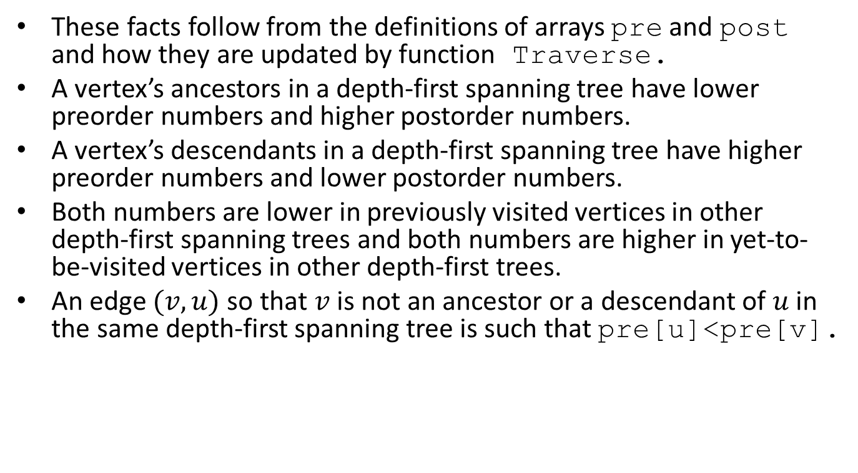
Proof
These facts follow from the definitions of arrays pre and post and how they are updated by function Traverse.
A vertex’s ancestors in a depth-first spanning tree have lower preorder numbers and higher postorder numbers.
A vertex’s descendants in a depth-first spanning tree have higher preorder numbers and lower postorder numbers.
Both numbers are lower in previously visited vertices in other depth-first spanning trees and both numbers are higher in yet-to-be-visited vertices in other depth-first trees.
An edge $(v,u)$so that $v$ is not an ancestor or a descendant of $u$ in the same depth-first spanning tree is such that pre[u]<pre[v].

Slide 133
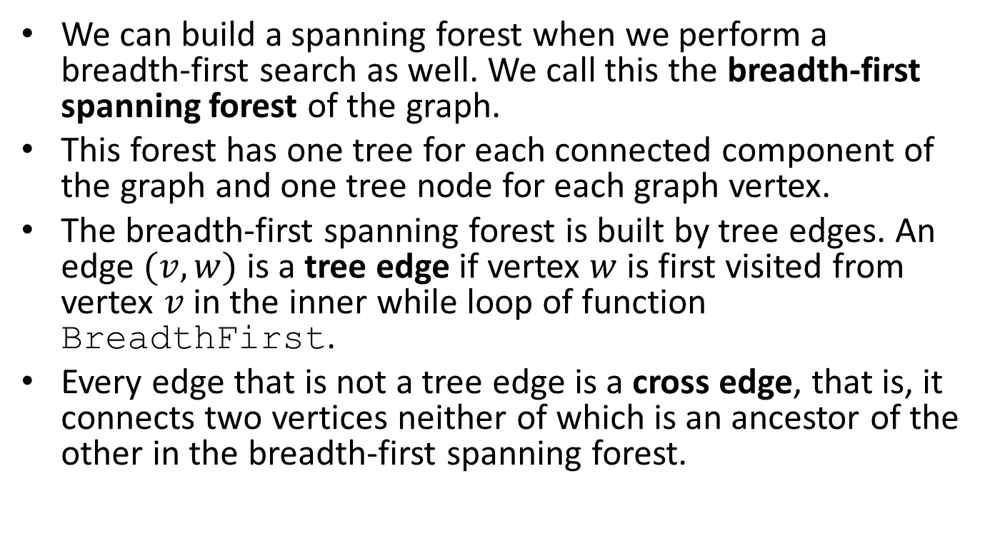
BFS of an Undirected Graph
We can build a spanning forest when we perform a breadth-first search as well. We call this the breadth-first spanning forest of the graph.
This forest has one tree for each connected component of the graph and one tree node for each graph vertex.
The breadth-first spanning forest is built by tree edges. An edge $(v,w)$ is a tree edge if vertex $w$ is first visited from vertex $v$ in the inner while loop of function BreadthFirst.
Every edge that is not a tree edge is a cross edge, that is, it connects two vertices neither of which is an ancestor of the other in the breadth-first spanning forest.

Slide 134
Example
A
B
C
F
G
D
E
Let us execute the algorithm Breadth-First presented earlier on the above graph $G$ starting from vertex A.

Slide 135
Representation of $G$ with Adjacency Lists
Vertex ID
Adjacency list
A | B C D E
B | A D E
C | A F G
D | A B E
E | A B D
F | C G
G | F C

Slide 136
Example (cont’d)
A
B
C
F
G
D
E
The vertices will be visited in the order A, B, C, D, E, F, G.

Slide 137
Example (cont’d)
A
B
C
F
G
D
E
Tree edges
Cross edges

Slide 138

Example (cont’d)
The above is the breadth-first spanning forest for the breadth-first traversal the graph $G$ given previously.
A
B
C
F
G
D
E

Slide 139
Important
The edge types are properties of the dynamics of the BFS, rather than only the graph.
Different breadth-first spanning forests of the same graph can differ remarkably in character.
Can you give examples for the above facts?

Slide 140
BFS of Directed Graphs
BFS can also work on directed graphs.
The algorithm visits vertices level by level and partitions the edges into two sets: tree edges and non-tree edges.
Tree edges define a breadth-first spanning forest.
Non-tree edges are of two kinds: back edges and cross edges.
Back edges connect a vertex to one of its ancestors in the breadth-spanning forest. Cross edges connect a vertex to another vertex that is neither its ancestor nor its descendant in the forest.
There are no forward edges as in the DFS case.

Slide 141

Example
I
Let us search this graph $G$ using the function BreadthFirst presented earlier starting from vertex A. We will need to modify Breadth-First to cover all the connected components of $G$ as done by ExhaustiveSearch.
H
F
B
A
E
G
D
C

Slide 142
Representation with Adjacency Lists
Vertex ID
Adjacency list
A | B
B | C D
C | A
D | A C
E | F G
F | H I
G | F
H | I
I

Slide 143
Example (cont’d)
I
The vertices will be visited in the order A, B, C, D, E, F, G, H, I.
H
F
B
A
E
G
D
C

Slide 144
Example (cont’d)
A
E
F
G
B
H
I
C
D
Tree edges
Cross edges
Back edges

Slide 145

Example (cont’d)
The above is the breadth-first spanning forest of graph $G$ for the breadth-first traversal we saw previously.
A
E
F
G
B
H
I
C
D

Slide 146
Question
How do we modify the code of algorithm Breadth-First so that we output the edges of various kinds for undirected or directed graphs?

Slide 147
Directed Acyclic Graphs
Let G be a directed graph with no cycles. Such a graph is called acyclic. We abbreviate the term directed acyclic graph to dag.
Dags are more general than trees but less general than arbitrary directed graphs.

Slide 148
Example Tree

Slide 149
Example Dag

Slide 150
Another Example Dag

Slide 151
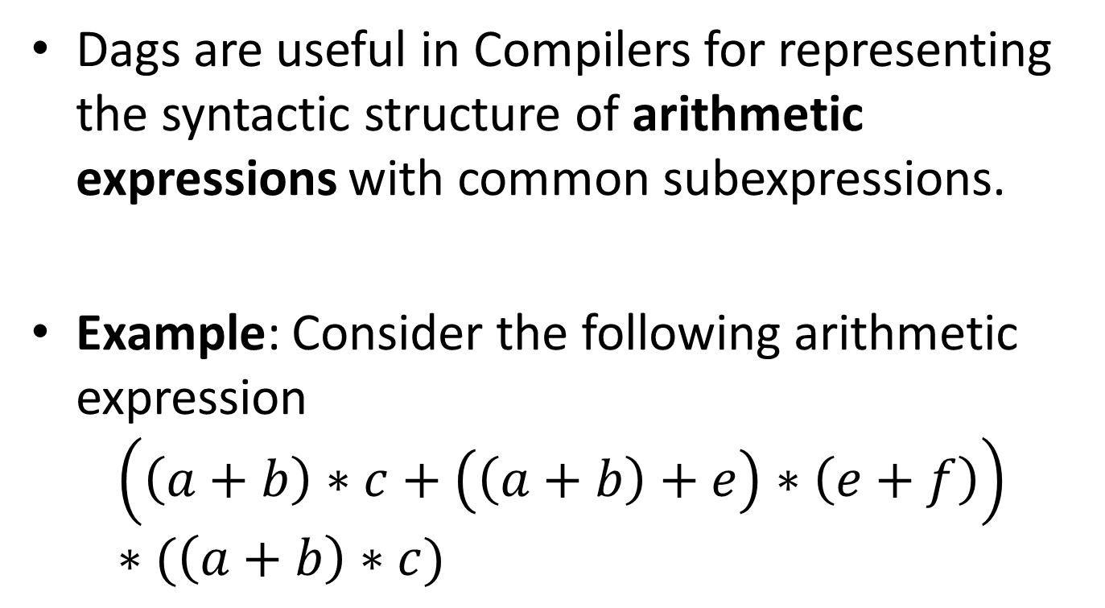
Applications of Dags
Dags are useful in Compilers for representing the syntactic structure of arithmetic expressions with common subexpressions.
Example: Consider the following arithmetic expression
$$\left(\left(a+b\right)∗c+\left(\left(a+b\right)+e\right)∗\left(e+f\right)\right)∗(\left(a+b\right)∗c)$$

Slide 152
The Dag for the Example
*
+
*
*
c
+
+
+
a
b
e
f

Slide 153
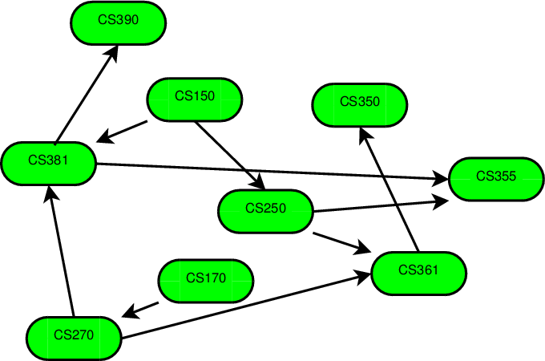
Prerequisites in a Program of Study

Slide 154
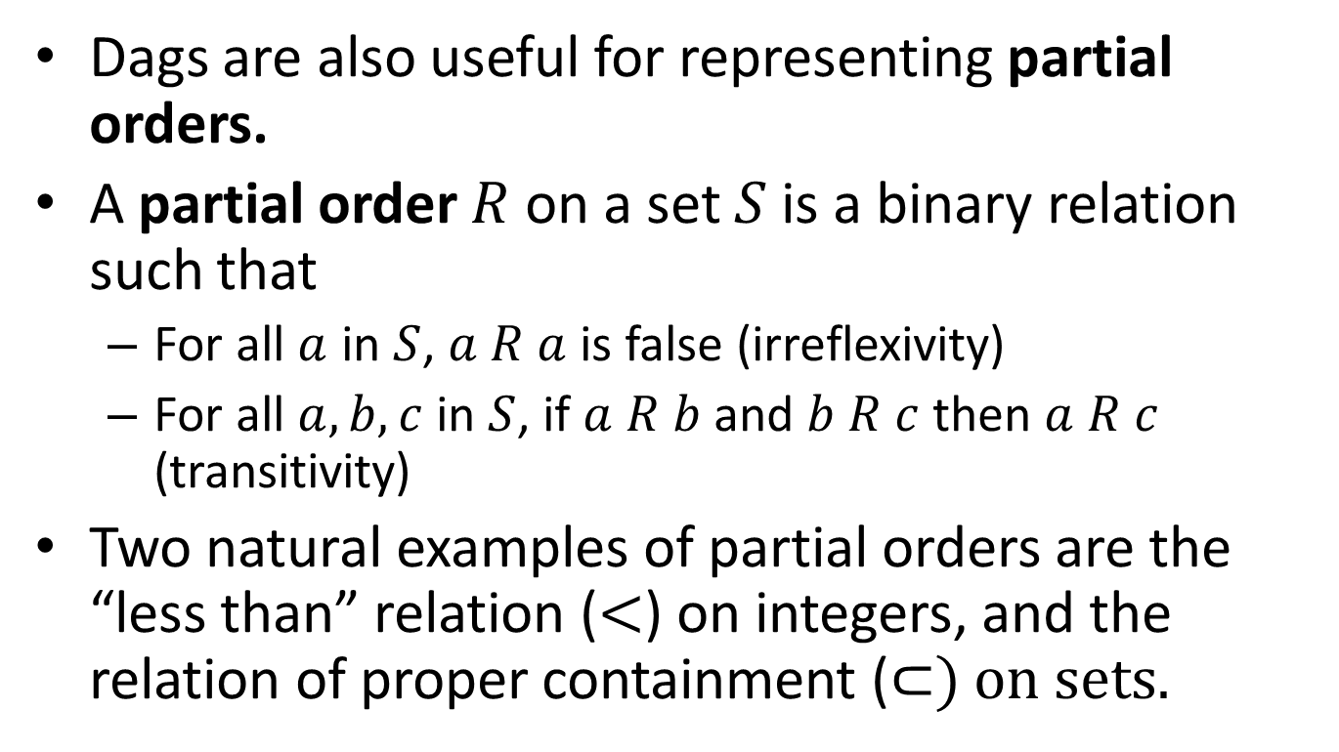
Applications of Dags (cont’d)
Dags are also useful for representing partial orders.
A partial order $R$ on a set $S$ is a binary relation such that
  For all $a$ in $S$, $a R a$ is false (irreflexivity)
  For all $a,b,c$ in $S$, if $a R b$ and $b R c$ then $a R c$ (transitivity)
Two natural examples of partial orders are the “less than” relation ($<$) on integers, and the relation of proper containment (⊂) on sets.

Slide 155

Example
Let $S=\left\{1, 2, 3\right\}$ and let $P(S)$ be the power set of $S$, that is, the set of all subsets of $S$. The relation ⊂ is a partial order on $P(S)$.

Slide 156








The Dag of the Example
$$\{1,2,3\}$$
$$\{1,2\}$$
$$\{1,3\}$$
$$\{2,3\}$$
$$\{1\}$$
$$\{2\}$$
$$\{3\}$$
$$∅$$

Slide 157

Class Hierarchies

Slide 158

Test for Acyclicity
Suppose we are given a digraph $G$ and we wish to determine whether $G$ is acyclic.
DFS can be used to answer this question.
If a back edge is encountered during a DFS then clearly the graph has a cycle.
Conversely, if the graph has a cycle then a back edge will be encountered in any DFS of the graph. Proof?

Slide 159

Proof
Suppose $G$ is cyclic. If we do a DFS of $G$, there will be one vertex $v$ having the lowest preorder number of any vertex on a cycle.
Consider an edge $(u,v)$ on some cycle containing $v$. Since $u$ is on the cycle, $u$ must be a descendant of $v$ in the depth-first spanning forest. Thus, $(u,v)$ cannot be a cross edge.
Since the preorder number of $u$ is greater than the preorder number of $v$, $(u,v)$ cannot be a tree edge or a forward edge. Hence, $(u,v)$ is a back edge.

Slide 160
Important
In undirected graphs, any edge to a previously visited vertex indicates a cycle.
In directed graphs, this is true only for back edges.

Slide 161
Topological Ordering of a DAG
A topological ordering (τοπολογική ταξινόμηση) of the vertices of a dag G is a sequential list L of the vertices of G (a linear ordering) such that if there is a directed path from vertex A to vertex B in G, then A comes before B in the list L.

Slide 162
Example
G might be a graph in which the vertices represent university courses to take and in which an edge is directed from the vertex for course A to the vertex for course B if course A is a prerequisite of B.
Then a topological ordering of the vertices of G gives us a possible way to organize one’s studies.

Slide 163
Example
2
1
3
1
3
2
4
5
4
5
A Topological Ordering
A DAG

Slide 164
Example (cont’d)
2
1
3
1
2
3
4
5
4
5
Another Topological Ordering
A DAG

Slide 165
Another Example
2
1
3
1
3
2
4
5
4
5
A Topological Ordering
A DAG

Slide 166
Important
In general, there can be more than one topological orderings for a given dag.
Question: How many topological orderings do the previous two dags have?

Slide 167
Computing a Topological Ordering
We will compute a list of vertices L that contains the vertices of G in topological order.
We will use an array D such that D[v] gives the number of predecessors p of vertex v in graph G such that p is not in L.
We will use a queue Q of vertices from where we will take vertices to process (from the front of the queue).
The vertices of G in Q will be processed in breadth-first order.
Initially Q will contain all the vertices of G with no predecessors.
When we find a vertex w of G such that D[w]==0, we see that w has all its predecessors in list L so we add w to the rear of queue Q so it can be processed.

Slide 168
Algorithm for Topological Ordering
void BreadthTopSort(Graph G, List *L)
{
Let G=(V,E) be the input graph.
Let L be a list of vertices.
Let Q be a queue of vertices.
Let D[V] be an array of vertices indexed by vertices
in V.
/* Compute the in-degrees D[x] of the vertices x
in G */
for (each vertex x in V) D[x]=0;
for (each vertex x in V){
for (each successor w in Succ(x)) D[w]++;
}

Slide 169
Algorithm for Topological Ordering (cont’d)
/* Initialize the queue Q to contain all vertices having zero in-degrees */
Initialize(&Q);
for (each vertex x in V){
if (D[x]==0) Insert(x, &Q);
}

Slide 170
Algorithm for Topological Ordering (cont’d)
/* Initialize the list L to be the empty list */
InitializeList(&L);
/* Process vertices in the queue Q until the queue becomes
empty */
while (!Empty(&Q)){
Remove(&Q,x);
AddToList(x,&L);
for (each successor w in Succ(x)){
D[w]--;
if (D[w]==0) Insert(w, &Q);
}
}
/* The list L now contains the vertices of G in
topological order */
}

Slide 171
Implementing Topological Sort in C
We first need to define a new type for an array that will be used to store the vertices of a graph in topological order:
typedef Vertex Toporder[MAXVERTEX];
We will also use the functions for the ADT queue that we have defined in a previous lecture.

Slide 172
Topological Sort in C (cont’d)
/* BreadthTopSort: generates breadth-first topological ordering
Pre: G is a directed graph with no cycles implemented with a contiguous list of vertices
and linked adjacency lists.
Post: The function makes a breadth-first traversal of G and generates the resulting
topological order in T
Uses: Queue functions */
void BreadthTopSort(Graph G, Toporder T)
{
int predecessorcount[MAXVERTEX]; /* number of predecessors of each vertex */
Queue Q;
Vertex v, succ;
Edge *curedge;
int place;
/* initialize all the predecessor counts to 0 */
for (v=0; v < G.n; v++)
predecessorcount[v]=0;
/* increase the predecessor count for each vertex that is a successor of another one */
for (v=0; v < G.n; v++)
for (curedge=G.firstedge[v]; curedge; curedge=curedge->nextedge)
predecessorcount[curedge->endpoint]++;

Slide 173
Topological Sort in C (cont’d)
/* initialize a queue */
InitializeQueue(&Q);
/* place all vertices with no predecessors into the queue */
for (v=0; v < G.n; v++)
if (predecessorcount[v]==0)
Insert(v, &Q);
/* start the breadth-first traversal */
place=-1;
while (!Empty(&Q)) {
/* visit v by placing it into the topological order */
Remove(&Q, &v);
place++;
T[place]=v;
/* traverse the list of successors of v */
for (curedge=G.firstedge[v]; curedge; curedge=curedge->nextedge){
/* reduce the predecessor count for each successor */
succ=curedge->endpoint;
predecessorcount[succ]--;
if (predecessorcount[succ]==0)
/* succ has no further predecessors, so it is ready to process */
Insert(succ, &Q);
}
}
}

Slide 174

Complexity of Topological Sort
We can easily see that the complexity of topological sort is $O(n+e).$

Slide 175

Strongly Connected Components of a Directed Graph (Reminder)
A strongly connected component (ισχυρά συνεκτική συνιστώσα) of a directed graph is a maximal set of vertices in which there is a path from any one vertex in the set to any other vertex.
More formally, let $G=(V,E)$ be a directed graph. We can partition $V$ into equivalence classes $V_{i}, 1≤i≤r,$ such that vertices $v$ and $w$ are equivalent if and only if there is a path from $v$ to $w$ and a path from $w$ to $v$. Let $E_{i}, 1≤i≤r$, be the set of edges with endpoints in $V_{i}.$ The graphs $G_{i}=(V_{i},E_{i})$ are called the strongly connected components or just strong components (ισχυρές συνιστώσες) of $G.$
A directed graph with only one strong component is strongly connected (ισχυρά συνεκτικός).

Slide 176
Example Directed Graph
A
B
D
C

Slide 177
The Strong Components of the Digraph
A
B
D
C

Slide 178

Strong Components (cont’d)
Every vertex of a directed graph $G$ is in some strong component, but certain edges may not be in any component.
Such edges, called cross-component edges, go from one vertex in one component to a vertex in another.
We can represent the interconnections among components by constructing a reduced graph (ελαττωμένο γράφο) for $G$. There is an edge from vertex $C$ to vertex $C′$ of the reduced graph if there is an edge in $G$from some vertex in the component $C$ to some vertex in the component $C′$.
The reduced graph is always a dag.

Slide 179

Example Directed Graph $G$
A
B
D
C

Slide 180

Example Reduced Graph for $G$
A, B, C
D

Slide 181

Kosaraju’s Algorithm for Computing Strong Components
We can use DFS to compute the strong components of a given directed graph $G$ as follows:
  Perform a DFS of $G$ and number the vertices in order of completion of the recursive calls of function Traverse (postorder numbering).
  Construct the reverse of $G$, a new directed graph $G_{r}$ by reversing the direction of each edge in $G$.
  Perform a DFS of $G_{r}$, starting the search from the highest numbered vertex according to the postorder numbering assigned in Step 1. If the DFS does not reach all vertices, start the next DFS from the highest-numbered remaining vertex.
  Each tree in the resulting spanning forest of $G_{r}$gives us a strongly connected component of $G.$

Slide 182
Example Directed Graph $G$
We first perform a DFS starting from vertex A.
A
B
D
C

Slide 183
After Step 1
The numbers show the post-order numbering.
4
A
B
3
1
D
C
2
Tree edges
Forward edges
Back edges

Slide 184


The Reverse Directed Graph $G_{r}$
Then we perform a DFS of $G_{r}$ starting from the highest-numbered vertex A. The search which will visit the vertices in the order A, C, B and D.
4
A
B
3
1
D
C
2

Slide 185

Characterization of Edges of $G_{r}$
4
A
B
3
1
D
C
2
Tree edges
Cross edges
Back edges

Slide 186

Depth-first Spanning Forest for $G_{r}$
A
B
D
C

Slide 187

The Strong Components of $G$
A
B
D
C

Slide 188

Complexity of Algorithm for Computing Strong Components
The complexity of the algorithm we presented for computing strong components is again $O(n+e).$
This can be seen easily because the complexity for every step of the algorithm is $O(n+e).$

Slide 189
Readings
T. A. Standish. Data Structures , Algorithms and Software Principles in C.
  Chapter 10
A. V. Aho, J. E. Hopcroft and J. D. Ullman. Data Structures and Algorithms.
  Chapters 6 and 7
M. T. Goodrich, R. Tamassia and D. Mount. Data Structures and Algorithms in C++. 2nd edition.
  Chapter 13
M. T. Goodrich, R. Tamassia. Δομές Δεδομένων και Αλγόριθμοι σε Java. 5^{η} έκδοση. Εκδόσεις Δίαυλος.
  Chapter 13
R. Sedgewick. Algorithms in C. 3rd edition. Part 5. Graph Algorithms.
  Chapters 18 and 19

