Slide 1
Hashing (Κατακερματισμός)
Manolis Koubarakis

Slide 2
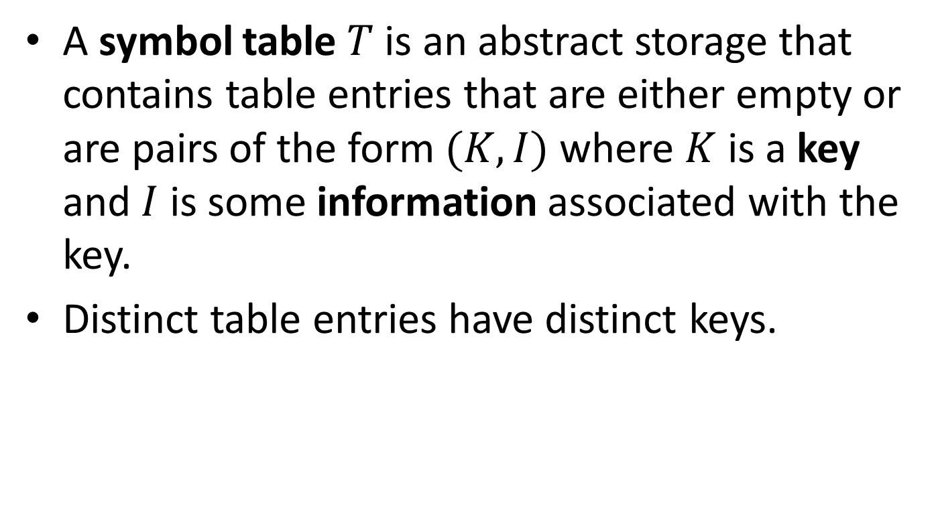
The Symbol Table ADT (Reminder)
A symbol table $T$ is an abstract storage that contains table entries that are either empty or are pairs of the form $(K,I)$ where $K$ is a key and $I$ is some information associated with the key.
Distinct table entries have distinct keys.

Slide 3
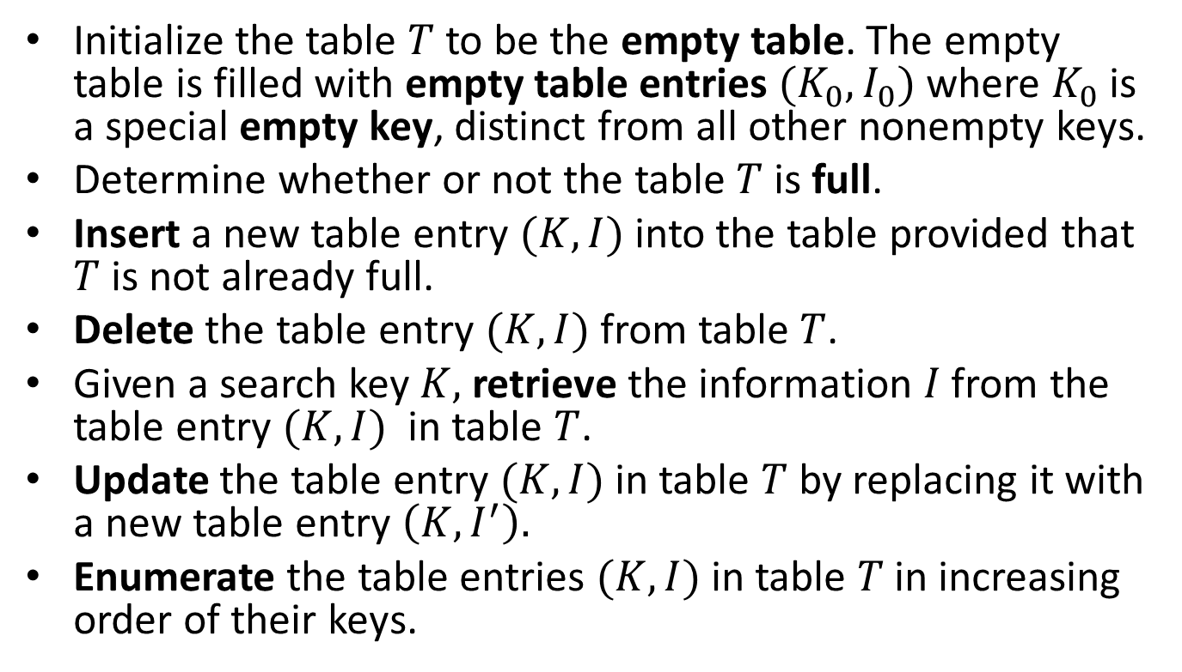
Operations for the Symbol Table ADT
Initialize the table $T$ to be the empty table. The empty table is filled with empty table entries $(K_{0},I_{0})$ where $K_{0}$ is a special empty key, distinct from all other nonempty keys.
Determine whether or not the table $T$ is full.
Insert a new table entry $(K,I)$ into the table provided that $T$ is not already full.
Delete the table entry $(K,I)$ from table $T$.
Given a search key $K,$ retrieve the information $I$ from the table entry $(K,I)$ in table $T$.
Update the table entry $(K,I)$ in table $T$by replacing it with a new table entry $\left(K,I^{′}\right).$
Enumerate the table entries $(K,I)$ in table $T$ in increasing order of their keys.

Slide 4
Possible Representations for the Symbol Table ADT
We have already discussed the following data structures for symbol tables:
  Arrays of structs sorted in ascending order of their keys
  Linked lists of structs
  Binary search trees
  AVL trees
  (2,4) trees
  Red-black trees

Slide 5
Hashing
We will introduce a new method to implement a symbol table called hashing.
Hashing differs from the representations based on searching by key comparisons because we are trying to refer directly to elements of the table by transforming keys into addresses in the table.

Slide 6
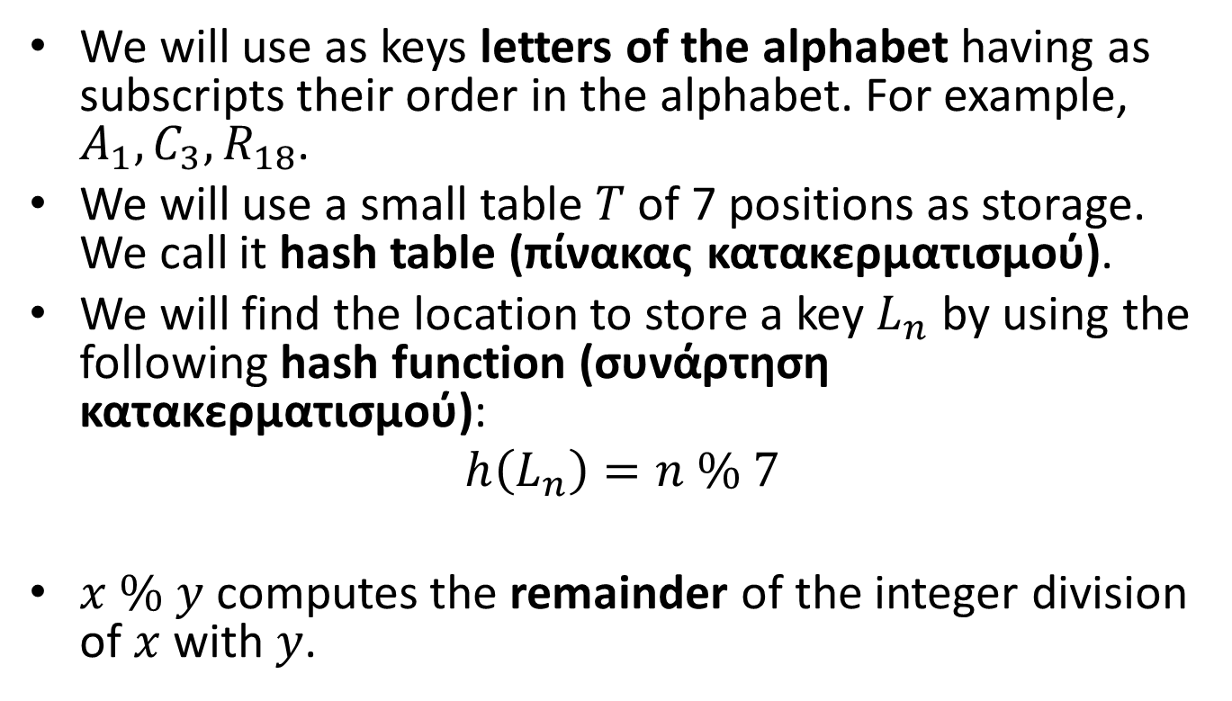
Introducing Hashing by Example
We will use as keys letters of the alphabet having as subscripts their order in the alphabet. For example, $A_{1},C_{3},R_{18}$.
We will use a small table $T$ of 7 positions as storage. We call it hash table (πίνακας κατακερματισμού).
We will find the location to store a key $L_{n}$ by using the following hash function (συνάρτηση κατακερματισμού):
$$h\left(L_{n}\right)=n \% 7$$
$x \% y$ computes the remainder of the integer division of $x$ with $y$.

Slide 7
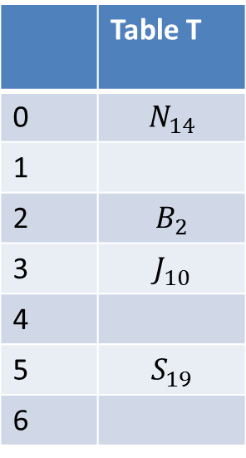

Table T after Inserting keys $B_{2},J_{10},S_{19},N_{14}$
 | Table T
0 | $$N_{14}$$
1
2 | $$B_{2}$$
3 | $$J_{10}$$
4
5 | $$S_{19}$$
6
Keys are stored in their hash addresses. The cells of the table are often called buckets (κάδοι).

Slide 8
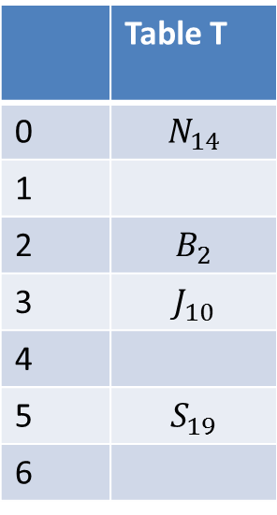


Insert $X_{24}$
 | Table T
0 | $$N_{14}$$
1
2 | $$B_{2}$$
3 | $$J_{10}$$
4
5 | $$S_{19}$$
6
$$h\left(X_{24}\right)=3$$
Now we have a collision (σύγκρουση). We will use the collision resolution policy (πολιτική επίλυσης συγκρούσεων) of looking at lower locations of the table to find a place for the key.

Slide 9
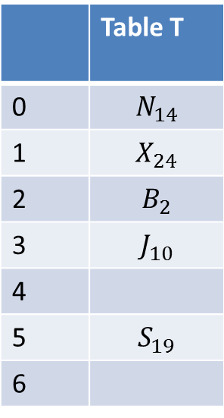
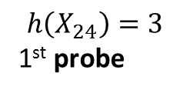
Insert $X_{24}$
 | Table T
0 | $$N_{14}$$
1 | $$X_{24}$$
2 | $$B_{2}$$
3 | $$J_{10}$$
4
5 | $$S_{19}$$
6
3rd probe
2nd probe
$$h\left(X_{24}\right)=3$$
1st probe

Slide 10
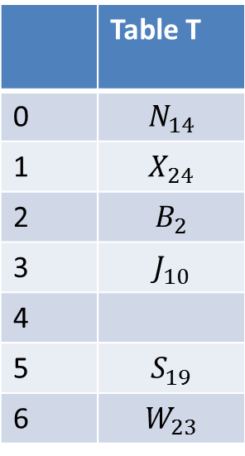

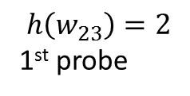
Insert $W_{23}$
 | Table T
0 | $$N_{14}$$
1 | $$X_{24}$$
2 | $$B_{2}$$
3 | $$J_{10}$$
4
5 | $$S_{19}$$
6 | $$W_{23}$$
3rd probe
2nd probe
$$h\left(w_{23}\right)=2$$
1st probe
4th probe

Slide 11
Open Addressing
The method of inserting colliding keys into empty locations of the table is called open addressing (ανοικτή διευθυνσιοδότηση).
The inspection of each location is called a probe (διερεύνηση).
The locations we examined are called a probe sequence.
The probing process we followed is called linear probing (γραμμική διερεύνηση).
So our hashing technique is called open addressing with linear probing.

Slide 12
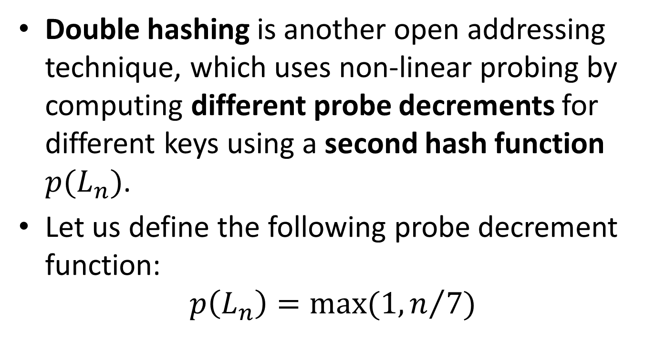
Double Hashing
Double hashing is another open addressing technique, which uses non-linear probing by computing different probe decrements for different keys using a second hash function $p(L_{n})$.
Let us define the following probe decrement function:
$$p\left(L_{n}\right)=max(1, n/7)$$

Slide 13
Table T after Inserting keys $B_{2},J_{10},S_{19},N_{14}$
 | Table T
0 | $$N_{14}$$
1
2 | $$B_{2}$$
3 | $$J_{10}$$
4
5 | $$S_{19}$$
6

Slide 14
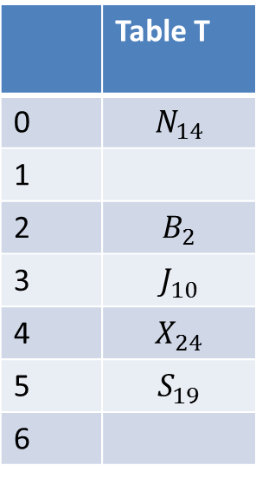
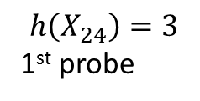
Insert $X_{24}$
 | Table T
0 | $$N_{14}$$
1
2 | $$B_{2}$$
3 | $$J_{10}$$
4 | $$X_{24}$$
5 | $$S_{19}$$
6
2nd probe
$$h\left(X_{24}\right)=3$$
1st probe
3rd probe
We use a probe decrement of $p\left(X_{24}\right)=3.$

Slide 15
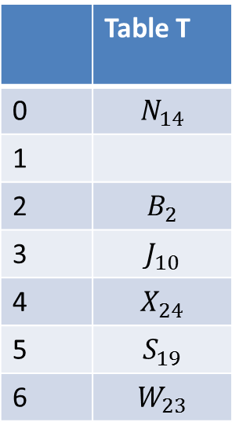
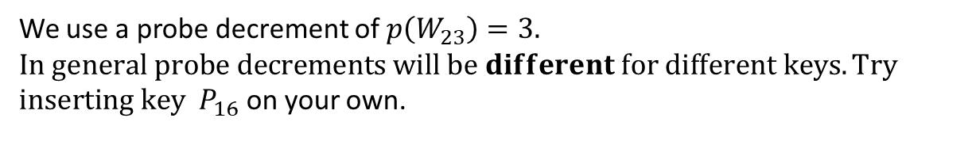
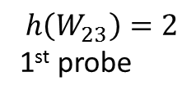
Insert $W_{23}$
 | Table T
0 | $$N_{14}$$
1
2 | $$B_{2}$$
3 | $$J_{10}$$
4 | $$X_{24}$$
5 | $$S_{19}$$
6 | $$W_{23}$$
$$h\left(W_{23}\right)=2$$
1st probe
2nd probe
We use a probe decrement of $p\left(W_{23}\right)=3.$
$$In general probe decrements will be different for different keys. Try$$
$inserting key P_{16}$ on your own.

Slide 16
Collision Resolution by Separate Chaining
The method of collision resolution by separate chaining (χωριστή αλυσίδωση) uses a linked list to store keys at each table entry.
This method should not be chosen if space is at a premium, for example, if we are implementing a hash table for a mobile device.

Slide 17







Example
.
Table T
0
1
2
3
4
5
6
$$N_{14}$$
.
$$B_{2}$$
$$W_{23}$$
.
$$J_{10}$$
$$X_{24}$$
.
$$S_{19}$$
$$S_{19}$$

Slide 18
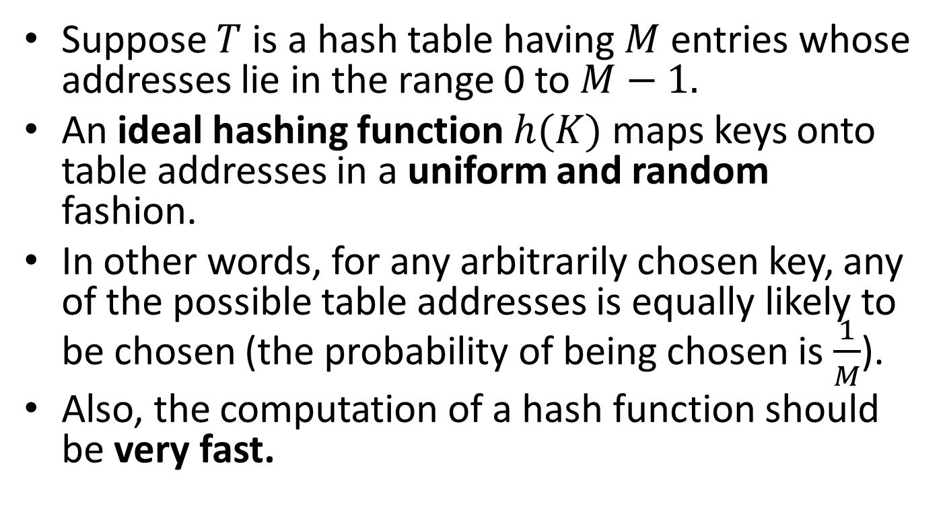
Good Hash Functions
Suppose $T$ is a hash table having $M$ entries whose addresses lie in the range 0 to $M−1.$
An ideal hashing function $h(K)$ maps keys onto table addresses in a uniform and random fashion.
In other words, for any arbitrarily chosen key, any of the possible table addresses is equally likely to be chosen (the probability of being chosen is $\frac{1}{M}$).
Also, the computation of a hash function should be very fast.

Slide 19
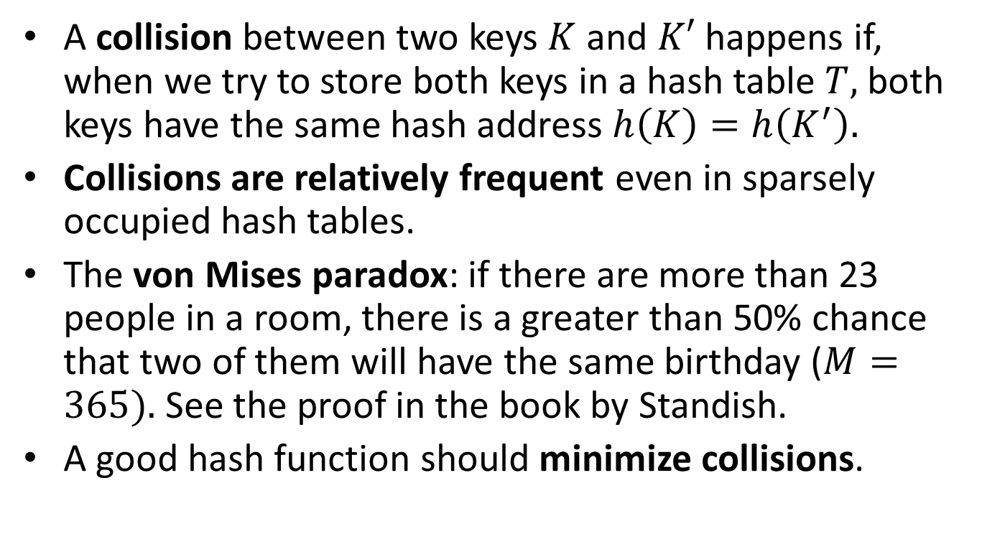
Collisions
A collision between two keys $K$ and $K′$ happens if, when we try to store both keys in a hash table $T,$ both keys have the same hash address $h\left(K\right)=h\left(K^{′}\right).$
Collisions are relatively frequent even in sparsely occupied hash tables.
The von Mises paradox: if there are more than 23 people in a room, there is a greater than 50% chance that two of them will have the same birthday ($M=365).$ See the proof in the book by Standish.
A good hash function should minimize collisions.

Slide 20
Primary clustering
Linear probing suffers from what we call primary clustering (πρωταρχική συσταδοποίηση).
A cluster (συστάδα) is a sequence of adjacent occupied entries in a hash table.
In open addressing with linear probing such clusters are formed and then grow bigger and bigger. This happens because all keys colliding in the same initial location trace out identical search paths when looking for an empty table entry.
Double hashing does not suffer from primary clustering because initially colliding keys search for empty locations along separate probe sequence paths.

Slide 21
Ensuring that Probe Sequences Cover the Table
In order for the open addressing hash insertion and hash searching algorithms to work properly, we have to guarantee that every probe sequence used can probe all locations of the hash table.
This is obvious for linear probing.
Is it true for double hashing?

Slide 22
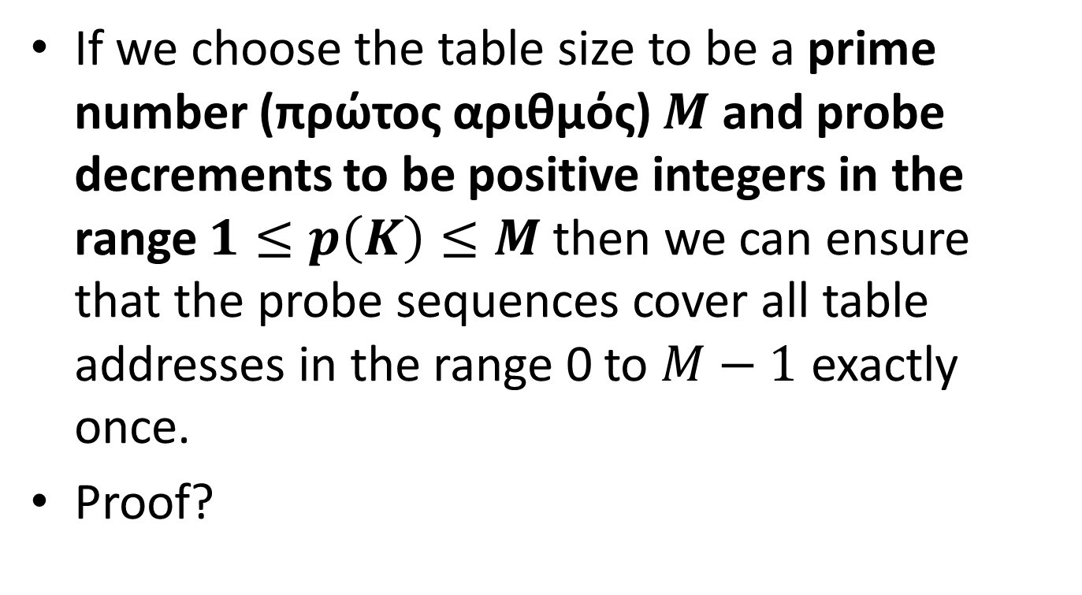
Choosing Table Sizes and Probe Decrements
If we choose the table size to be a prime number (πρώτος αριθμός) $M$ and probe decrements to be positive integers in the range $1≤p\left(K\right)≤M$then we can ensure that the probe sequences cover all table addresses in the range 0 to $M−1$ exactly once.
Proof?

Slide 23
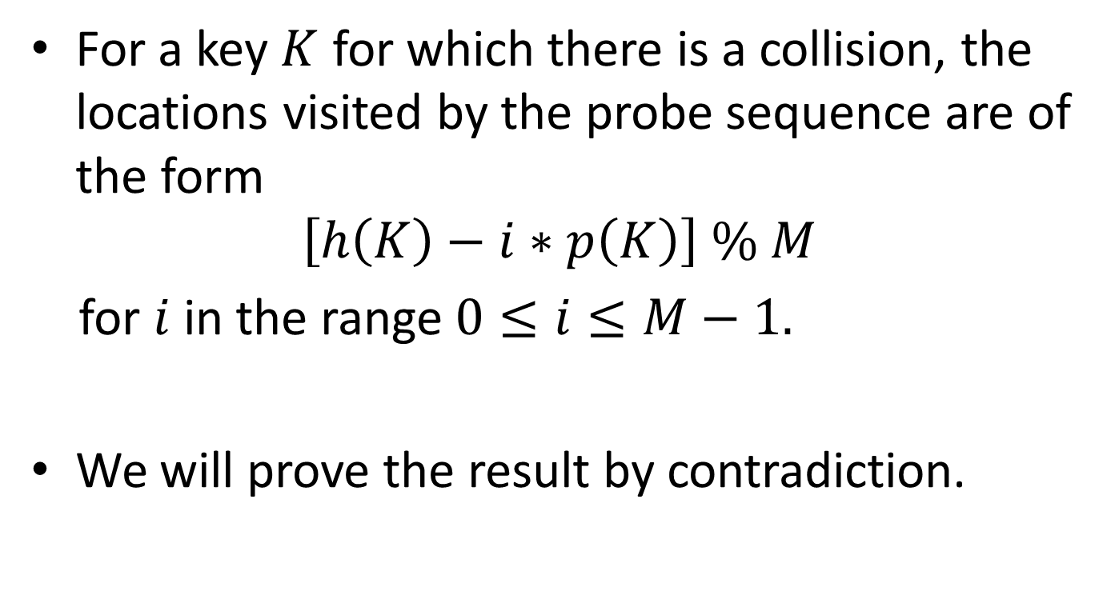
Proof
For a key $K$ for which there is a collision, the locations visited by the probe sequence are of the form
$$\left[h\left(K\right)−i∗p\left(K\right)\right] \% M$$
for $i$ in the range $0≤i≤M−1.$
We will prove the result by contradiction.

Slide 24
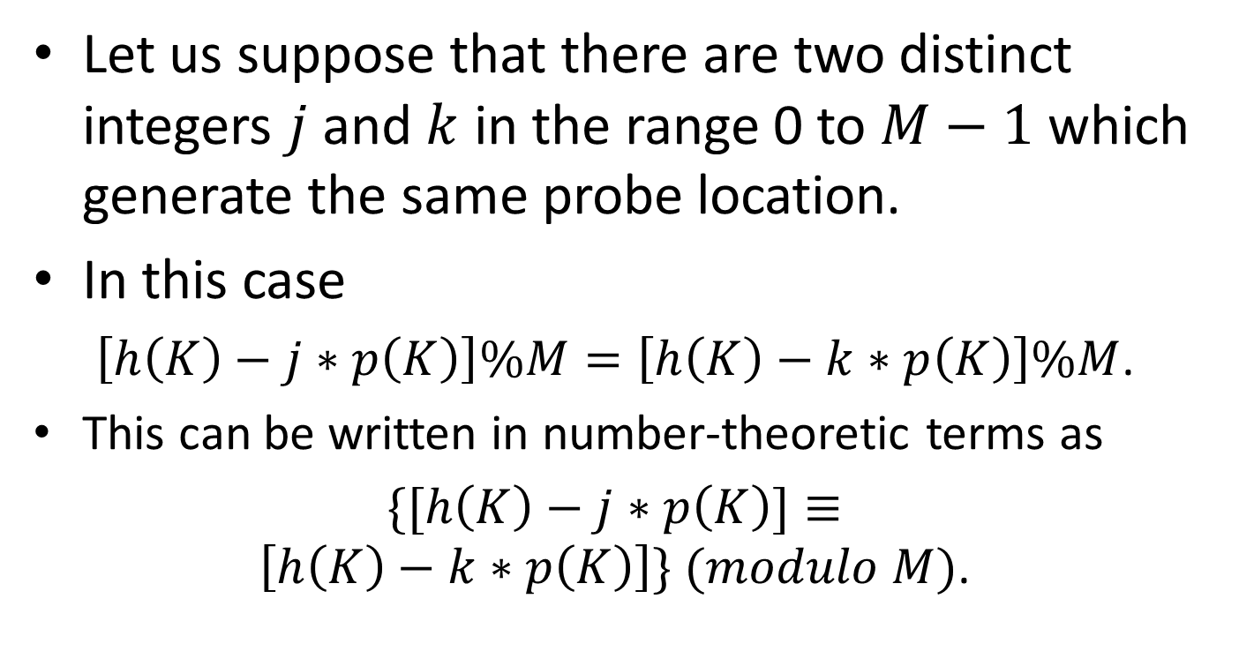
Proof (cont’d)
Let us suppose that there are two distinct integers $j$ and $k$ in the range 0 to $M−1$ which generate the same probe location.
In this case
$\left[h\left(K\right)−j∗p\left(K\right)\right]\%M=\left[h\left(K\right)−k∗p\left(K\right)\right]\%M$.
This can be written in number-theoretic terms as
$\{[h\left(K\right)−j∗p\left(K\right)]≡\left[h\left(K\right)−k∗p\left(K\right)\right]\} (modulo M)$.

Slide 25
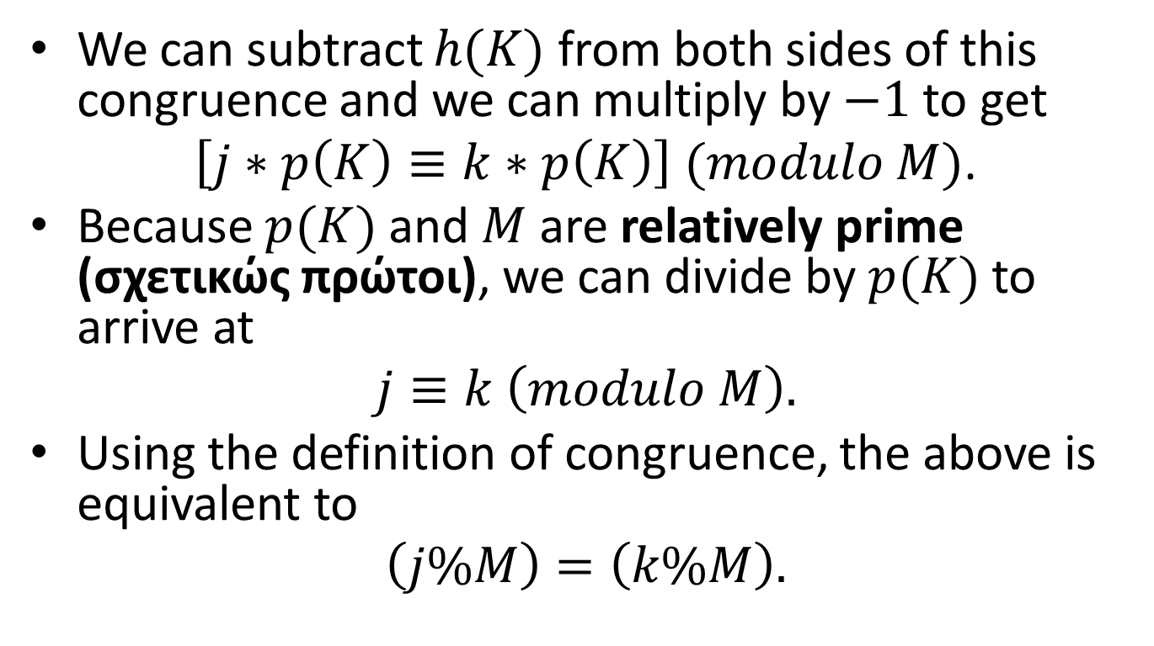
Proof (cont’d)
We can subtract $h(K)$ from both sides of this congruence and we can multiply by $−1$to get
$\left[j∗p\left(K\right)≡k∗p\left(K\right)\right] (modulo M)$.
Because $p(K)$ and $M$ are relatively prime (σχετικώς πρώτοι), we can divide by $p(K)$ to arrive at
$$j≡k \left(modulo M\right).$$
Using the definition of congruence, the above is equivalent to
$$\left(j\%M\right)=\left(k\%M\right).$$

Slide 26
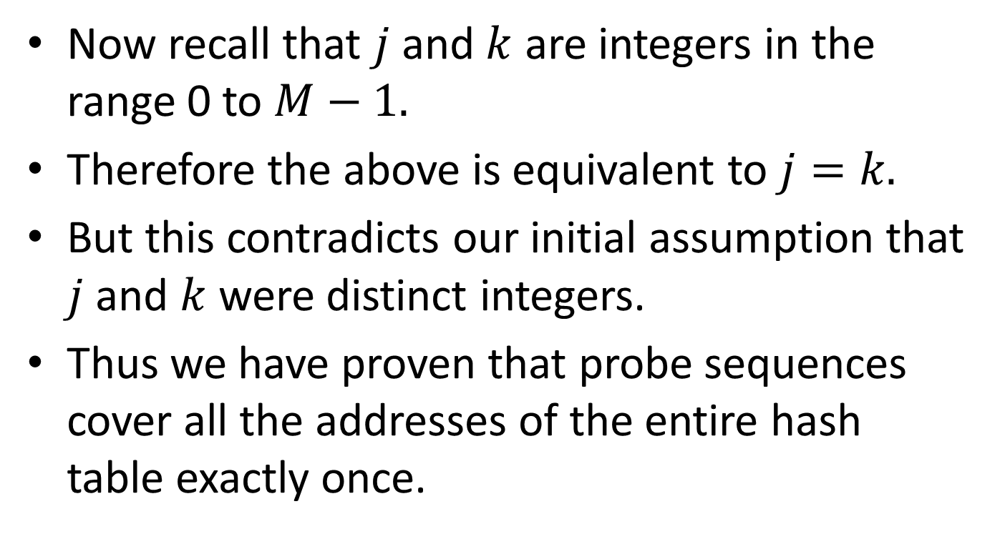
Proof (cont’d)
Now recall that $j$ and $k$ are integers in the range 0 to $M−1.$
Therefore the above is equivalent to $j=k.$
But this contradicts our initial assumption that $j$ and $k$ were distinct integers.
Thus we have proven that probe sequences cover all the addresses of the entire hash table exactly once.

Slide 27
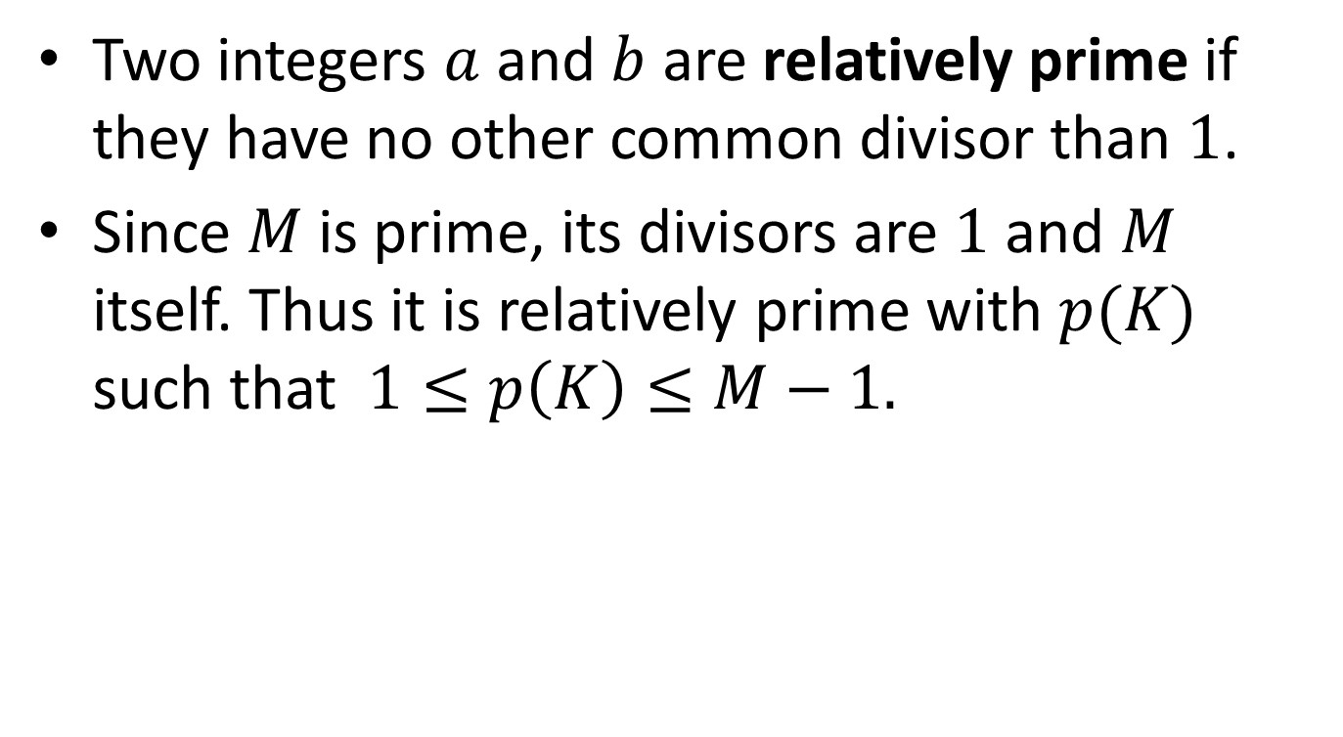
Proof (cont’d)
Two integers $a$ and $b$ are relatively prime if they have no other common divisor than $1$.
Since $M$ is prime, its divisors are $1$ and $M$ itself. Thus it is relatively prime with $p(K)$ such that $1≤p\left(K\right)≤M−1.$

Slide 28
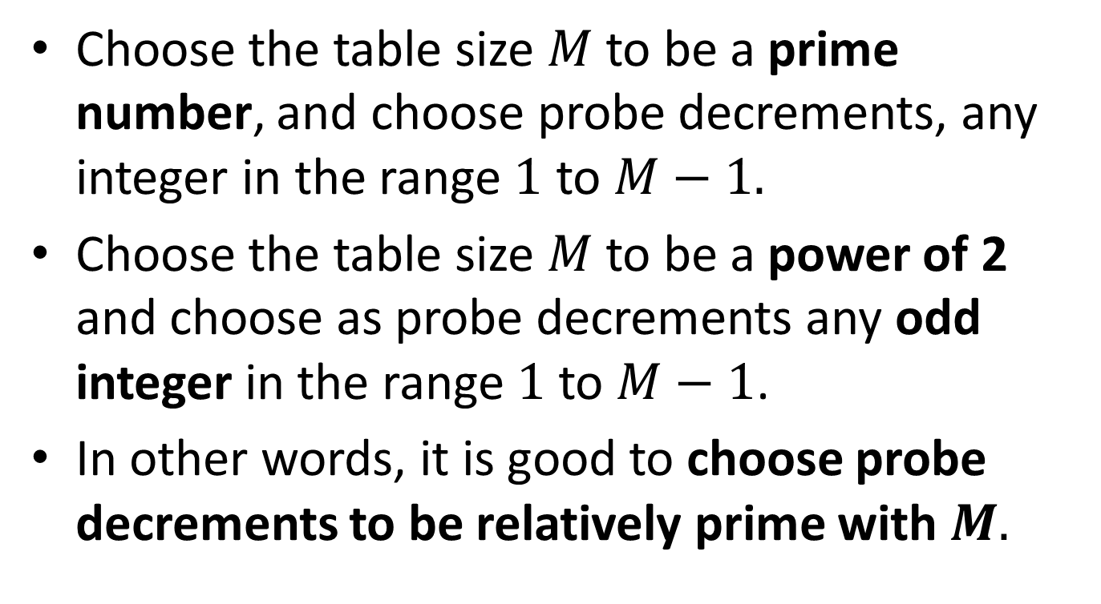
Good Double Hashing Choices
Choose the table size $M$ to be a prime number, and choose probe decrements, any integer in the range $1$ to $M−1.$
Choose the table size $M$ to be a power of 2 and choose as probe decrements any odd integer in the range $1$to $M−1$.
In other words, it is good to choose probe decrements to be relatively prime with $M.$

Slide 29
Open Addressing with Double Hashing Implemented in C
We will use the following two constants:
#define M 997 /* 997 is prime */
#define EmptyKey 0

Slide 30
Open Addressing (cont’d)
We will define the following types:
typedef int KeyType;
typedef struct {
/* some members of various types giving */
/* information associated with search keys */
} InfoType;
typedef struct {
KeyType Key;
InfoType Info;
} TableEntry;
typedef TableEntry Table[M];

Slide 31
Initialization
/* global variable T for the hash table */
Table T;
void Initialize(void)
{
int i;
for (i=0; i<M; i++)
T[i].Key=EmptyKey
}

Slide 32
Insertion
void HashInsert(KeyType K, InfoType I)
{
int i;
int ProbeDecrement;
i=h(K);
ProbeDecrement=p(K);
while (T[i].Key != EmptyKey){
i-=ProbeDecrement;
if (i<0)
i+=M;
}
T[i].Key=K;
T[i].Info=I;
}

Slide 33
Search
int HashSearch(KeyType K)
{
int I;
int ProbeDecrement;
KeyType ProbeKey;
/*Initializations */
i=h(K);
ProbeDecrement=p(K);
ProbeKey=T[i].Key;
/* Search loop */
while ((K!=ProbeKey) && (ProbeKey!=EmptyKey)){
i-=ProbeDecrement;
if (i<0)
i+=M;
ProbeKey=T[i].Key;
}
/* Determine success or failure */
if (ProbeKey==EmptyKey)
return -1;
else
return i;
}

Slide 34
Deletion
The function for deletion from a hash table is left as an exercise.
But notice that deletion poses some problems.
If we delete an entry and leave a table entry with an empty key in its place then we destroy the validity of subsequent search operations because a search terminates when an empty key is encountered.
As a solution, we can leave the deleted entry in its place and mark it as deleted (or substitute it by a special entry “available”). Then search algorithms can treat these entries as not deleted while insert algorithms can treat them as deleted and insert other entries in their place.
However, in this case, if we have many deletions, the hash table can easily become clogged with entries marked as deleted.

Slide 35
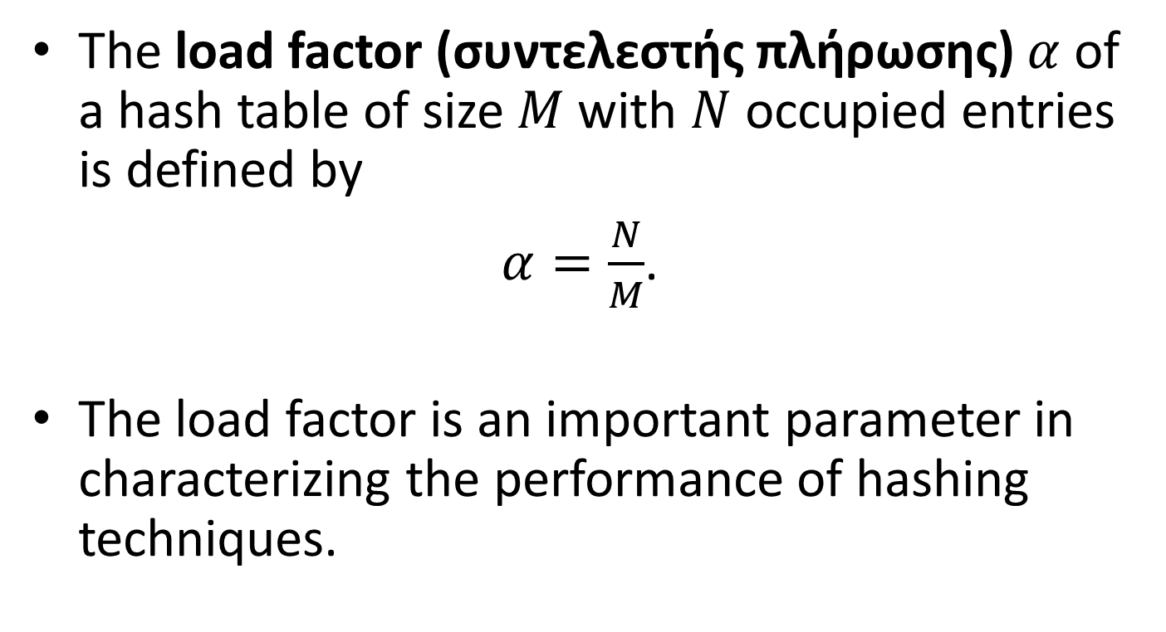
Load Factor
The load factor (συντελεστής πλήρωσης) $α$ of a hash table of size $M$ with $N$ occupied entries is defined by
$α=\frac{N}{M}$.
The load factor is an important parameter in characterizing the performance of hashing techniques.

Slide 36
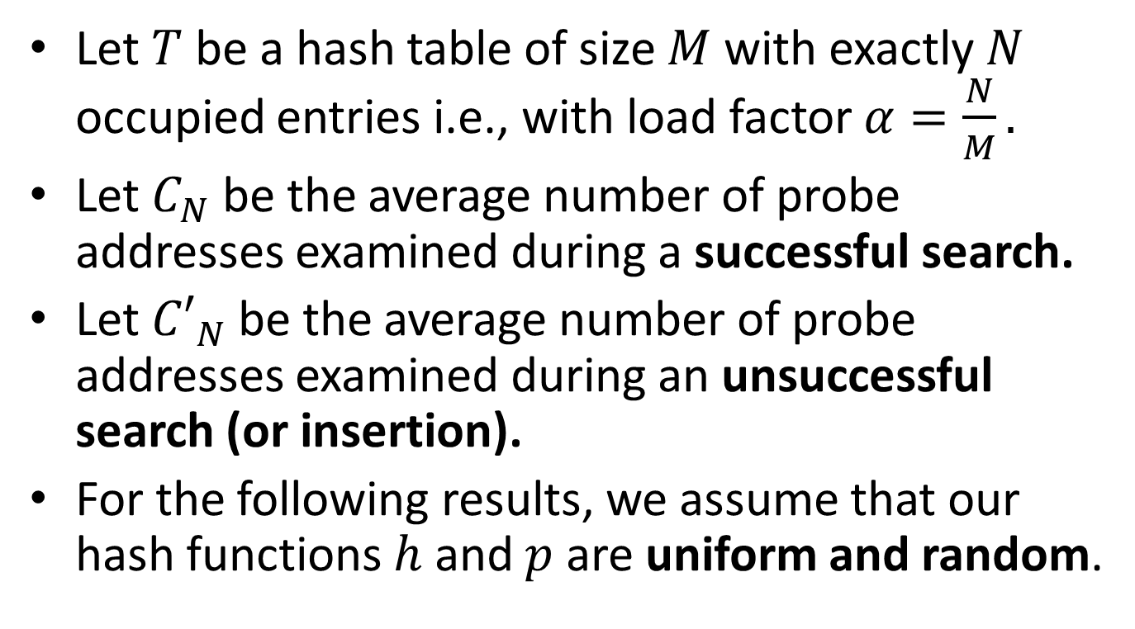
Performance Formulas
Let $T$ be a hash table of size $M$ with exactly $N$ occupied entries i.e., with load factor $α=\frac{N}{M}.$
Let $C_{N}$ be the average number of probe addresses examined during a successful search.
Let ${C′}_{N}$ be the average number of probe addresses examined during an unsuccessful search (or insertion).
For the following results, we assume that our hash functions $h$ and $p$ are uniform and random.

Slide 37
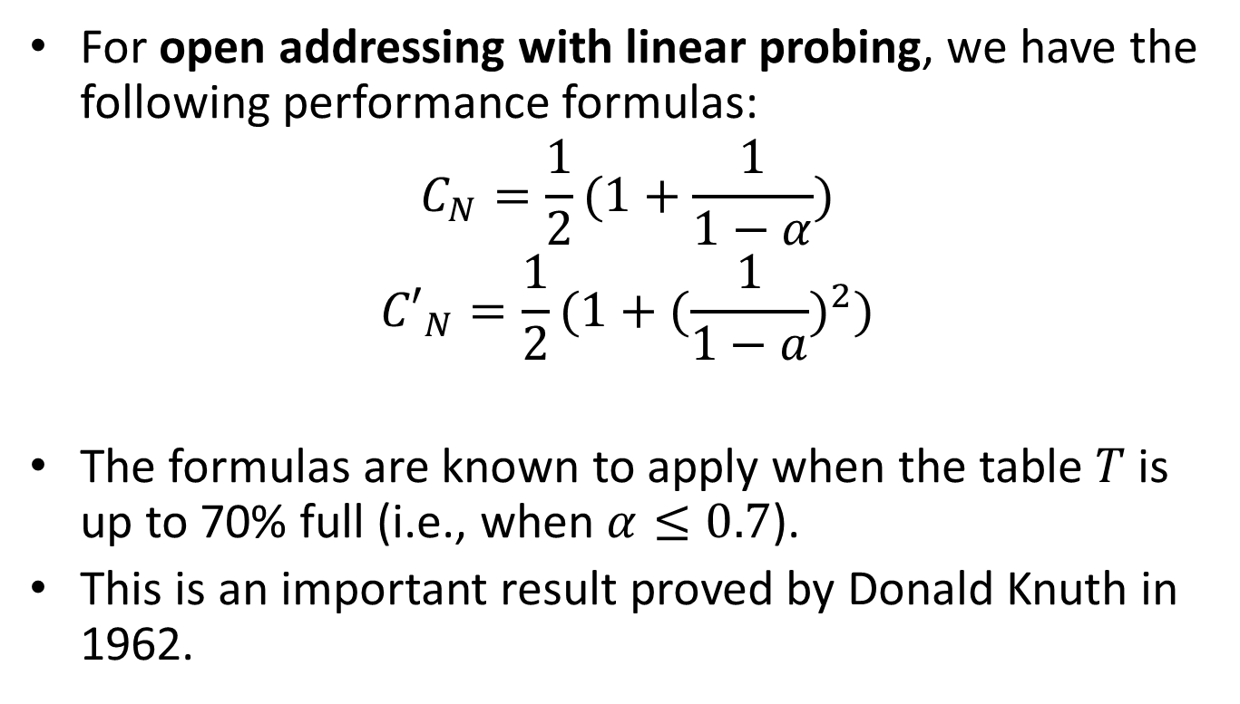
Efficiency of Linear Probing
For open addressing with linear probing, we have the following performance formulas:
$$C_{N}=\frac{1}{2}(1+\frac{1}{1−α})$$
$${C′}_{N}=\frac{1}{2}(1+{(\frac{1}{1−a})}^{2})$$
The formulas are known to apply when the table $T$ is up to 70% full (i.e., when $α≤0.7$).
This is an important result proved by Donald Knuth in 1962.

Slide 38

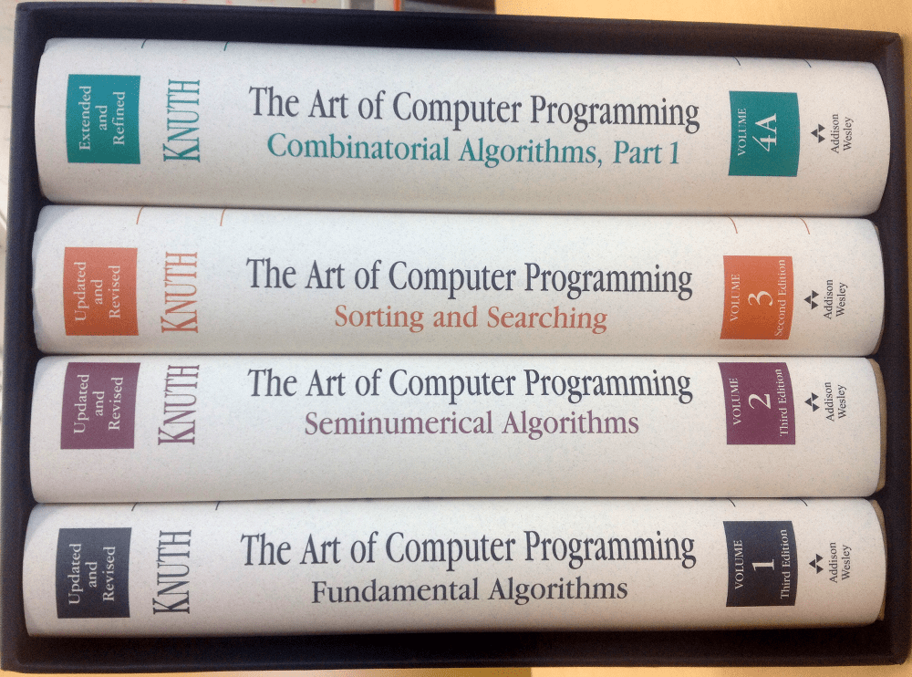

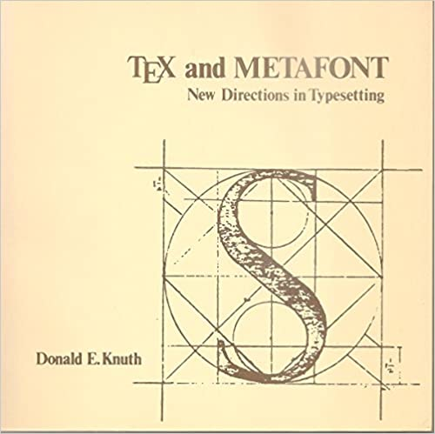
Donald Knuth
Donald Knuth is one of the most important theoretical computer scientists (https://en.wikipedia.org/wiki/Donald_Knuth).
He won the Turing Award in 1974.

Slide 39
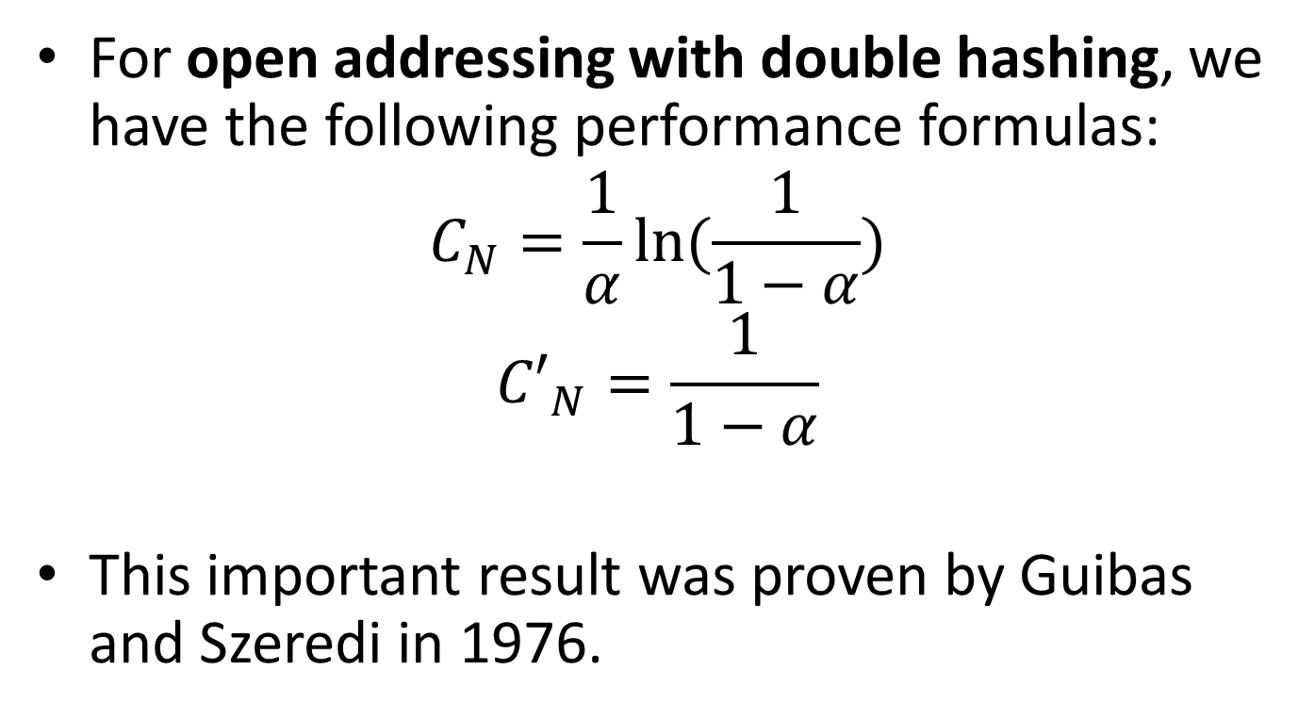
Efficiency of Double Hashing
For open addressing with double hashing, we have the following performance formulas:
$$C_{N}=\frac{1}{α}ln(\frac{1}{1−α})$$
$${C′}_{N}=\frac{1}{1−α}$$
This important result was proven by Guibas and Szeredi in 1976.

Slide 40
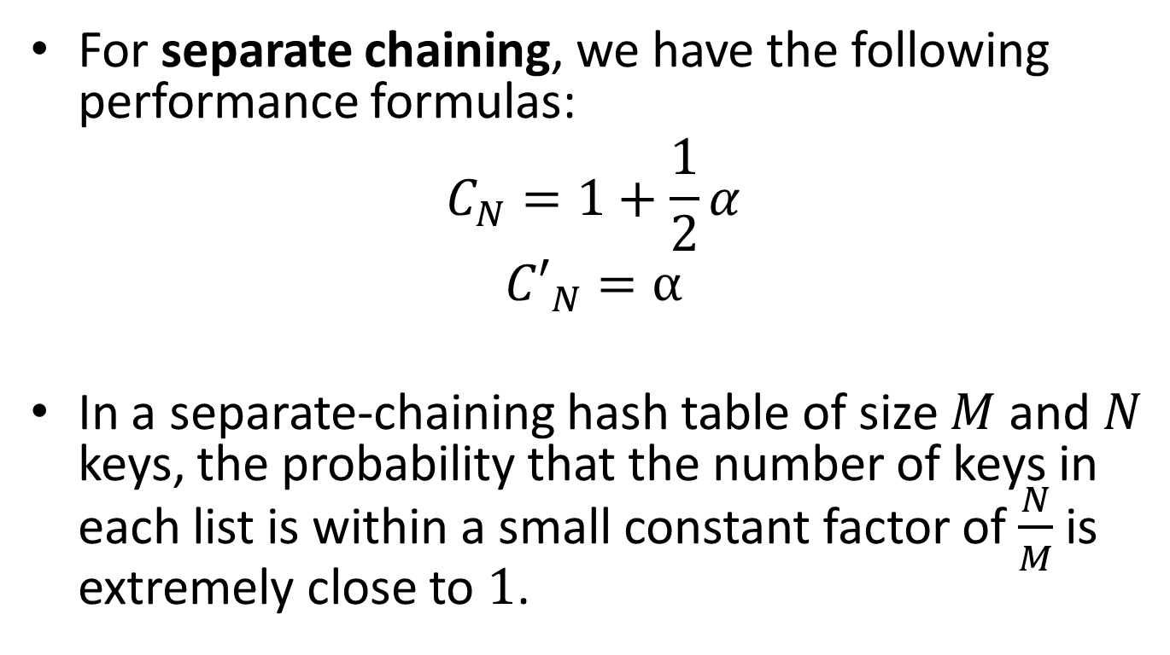
Efficiency of Separate Chaining
For separate chaining, we have the following performance formulas:
$$C_{N}=1+\frac{1}{2}α$$
$${C′}_{N}=α$$
In a separate-chaining hash table of size $M$ and $N$ keys, the probability that the number of keys in each list is within a small constant factor of $\frac{N}{M}$ is extremely close to $1$.

Slide 41
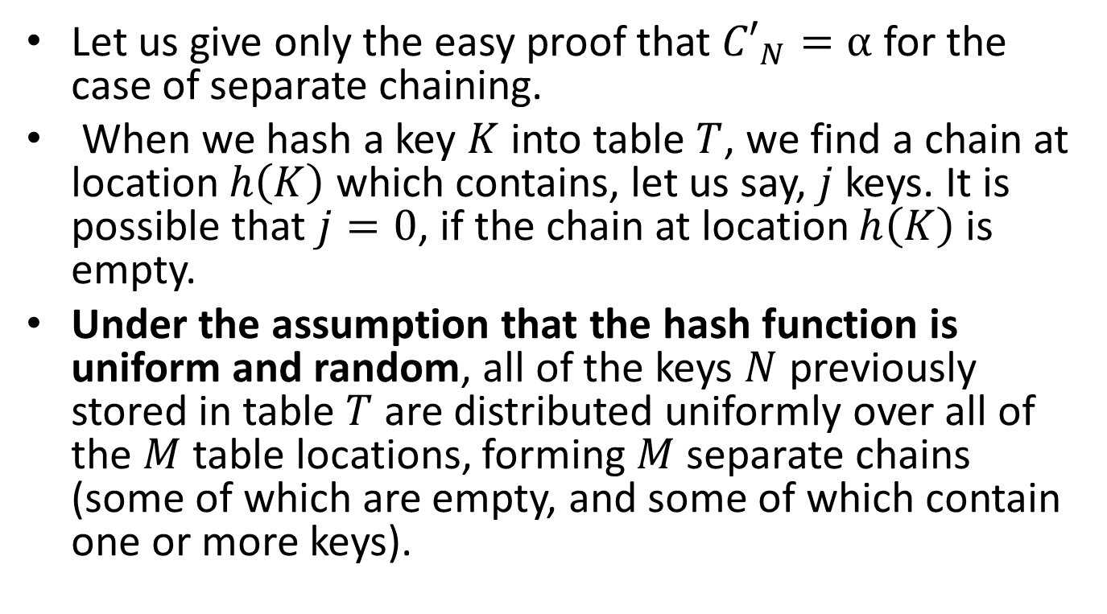
Proof
Let us give only the easy proof that ${C′}_{N}=α$ for the case of separate chaining.
When we hash a key $K$ into table $T$, we find a chain at location $h\left(K\right)$ which contains, let us say, $j$ keys. It is possible that $j=0$, if the chain at location $h\left(K\right)$ is empty.
Under the assumption that the hash function is uniform and random, all of the keys $N$ previously stored in table $T$ are distributed uniformly over all of the $M$ table locations, forming $M$ separate chains (some of which are empty, and some of which contain one or more keys).

Slide 42
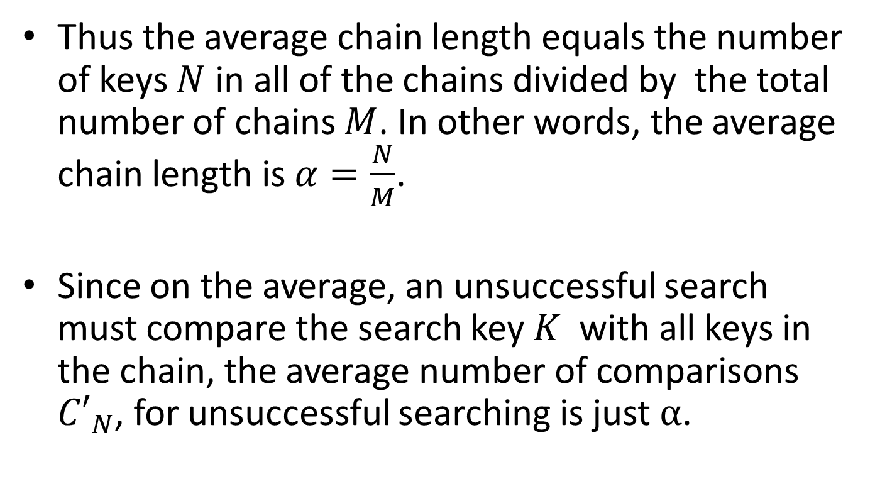
Proof (cont’d)
Thus the average chain length equals the number of keys $N$ in all of the chains divided by the total number of chains $M$. In other words, the average chain length is $α=\frac{N}{M}$.
Since on the average, an unsuccessful search must compare the search key $K$ with all keys in the chain, the average number of comparisons ${C′}_{N}$, for unsuccessful searching is just $α$.

Slide 43
Important
Note that the previous formulas show that the performance of a hash table depends only on the load factor and not on the number of keys or the size of the table.

Slide 44
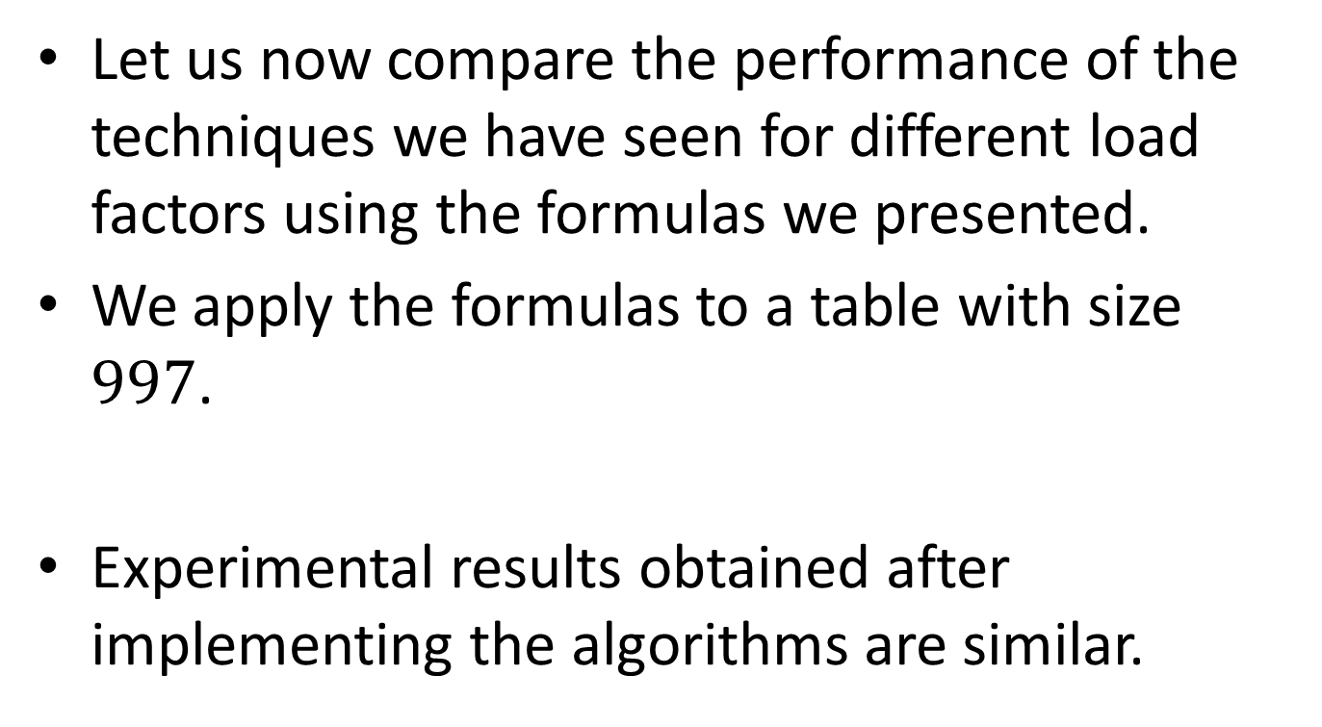
Theoretical Results: Apply the Formulas
Let us now compare the performance of the techniques we have seen for different load factors using the formulas we presented.
We apply the formulas to a table with size $997$.
Experimental results obtained after implementing the algorithms are similar.

Slide 45

Successful Search
The cells of the table give $C_{N},$the average number of probe addresses, for each of the hashing techniques.
Notice that $C_{N}$ increases when the load factor increases.
Open addressing with linear probing performs worse than the other two techniques for big load factor.
The best performing technique is separate chaining.
Load Factors
 | 0.10 | 0.25 | 0.50 | 0.75 | 0.90 | 0.99
Separate chaining | 1.05 | 1.12 | 1.25 | 1.37 | 1.45 | 1.49
Open/linear probing | 1.06 | 1.17 | 1.50 | 2.50 | 5.50 | 50.5
Open/double hashing | 1.05 | 1.15 | 1.39 | 1.85 | 2.56 | 4.65

Slide 46

Unsuccessful Search
The cells of the table give ${C′}_{N},$the average number of probe addresses, for each of the hashing techniques.
Notice that ${C′}_{N}$ increases when the load factor increases.
Open addressing with linear probing performs worse than the other two techniques for big load factor.
The best performing technique is separate chaining.
Load Factors
 | 0.10 | 0.25 | 0.50 | 0.75 | 0.90 | 0.99
Separate chaining | 0.10 | 0.25 | 0.50 | 0.75 | 0.90 | 0.99
Open/linear probing | 1.12 | 1.39 | 2.50 | 8.50 | 50.5 | 5000.5
Open/double hashing | 1.11 | 1.33 | 2.50 | 4.00 | 10.0 | 100.0

Slide 47
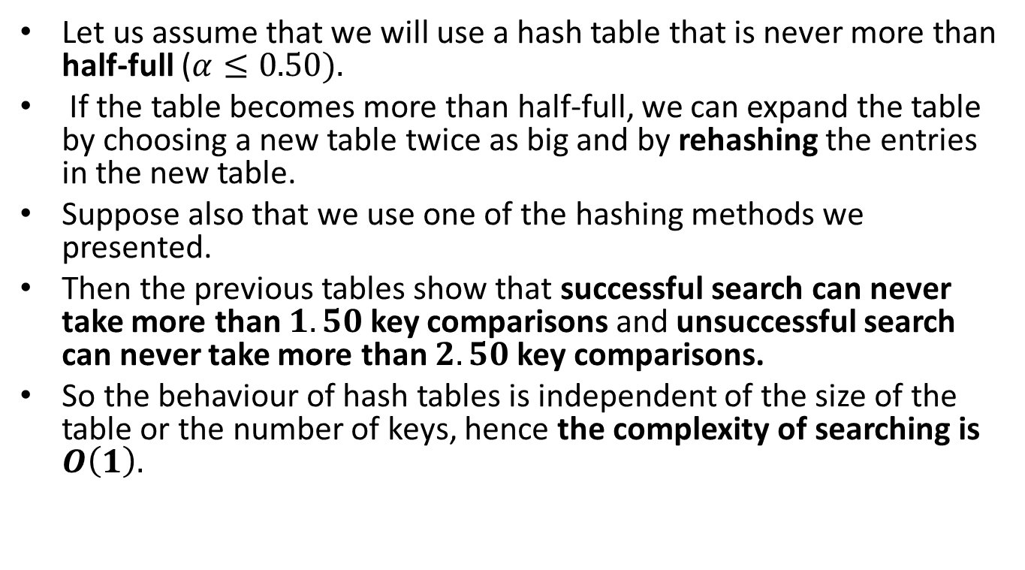
Complexity of Hashing
Let us assume that we will use a hash table that is never more than half-full ($α≤0.50).$
If the table becomes more than half-full, we can expand the table by choosing a new table twice as big and by rehashing the entries in the new table.
Suppose also that we use one of the hashing methods we presented.
Then the previous tables show that successful search can never take more than $1.50$key comparisons and unsuccessful search can never take more than $2.50$ key comparisons.
So the behaviour of hash tables is independent of the size of the table or the number of keys, hence the complexity of searching is $O\left(1\right).$

Slide 48
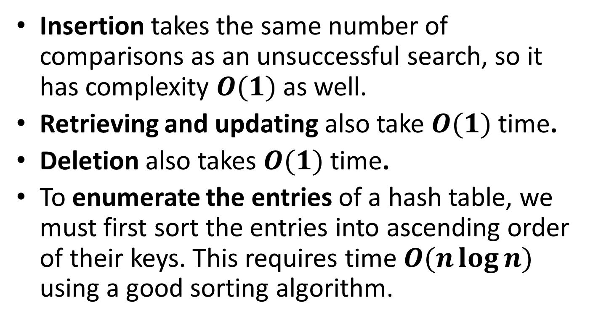
Complexity of Hashing (cont’d)
Insertion takes the same number of comparisons as an unsuccessful search, so it has complexity $O(1)$ as well.
Retrieving and updating also take $O(1)$ time.
Deletion also takes $O(1)$ time.
To enumerate the entries of a hash table, we must first sort the entries into ascending order of their keys. This requires time $O(n\log{n})$ using a good sorting algorithm.

Slide 49
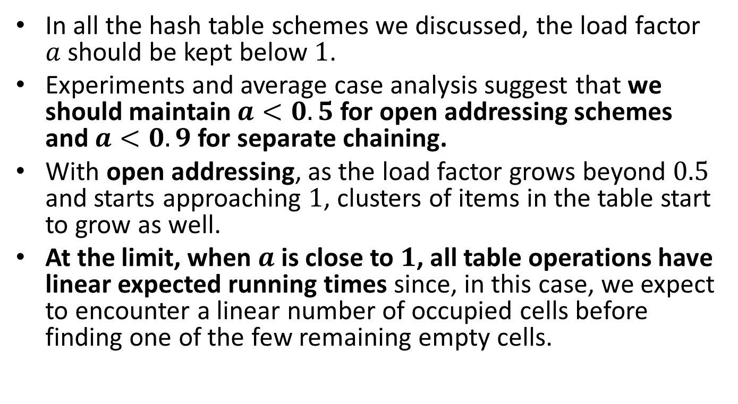
Load Factors and Rehashing
In all the hash table schemes we discussed, the load factor $a$ should be kept below $1$.
Experiments and average case analysis suggest that we should maintain $a<0.5$ for open addressing schemes and $a<0.9$ for separate chaining.
With open addressing, as the load factor grows beyond $0.5$ and starts approaching $1$, clusters of items in the table start to grow as well.
At the limit, when $a$ is close to $1$, all table operations have linear expected running times since, in this case, we expect to encounter a linear number of occupied cells before finding one of the few remaining empty cells.

Slide 50
Load Factors and Rehashing (cont’d)
If the load factor of a hash table goes significantly above a specified threshold, then it is common to require the table to be resized to regain the specified load factor. This process is called rehashing (ανακατακερματισμός) or dynamic hashing (δυναμικός κατακερματισμός).
When rehashing to a new table, a good requirement is having the new array’s size be at least double the previous size.

Slide 51
Summary: Open Addressing or Separate Chaining?
Open addressing schemes save space but they are not faster.
As you can see in the above theoretical results (and corresponding experimental results), the separate chaining method is either competitive or faster than the other methods depending on the load factor of the table.
So, if memory is not a major issue, the collision handling method of choice is separate chaining.

Slide 52
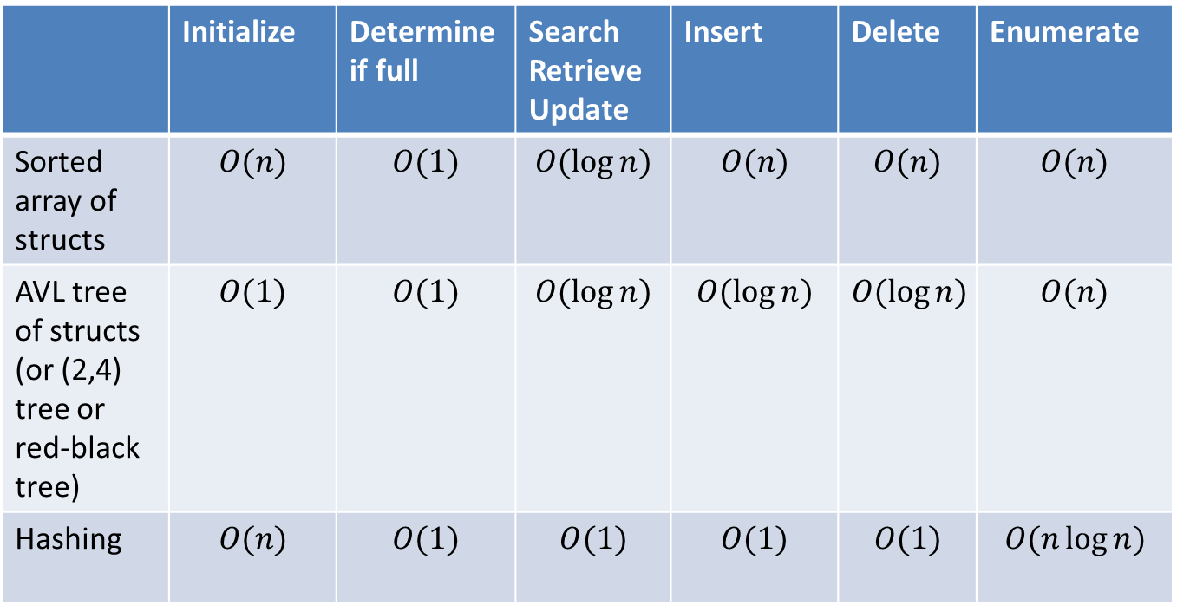
Comparing the Performance of Some Table ADT Representations
 | Initialize | Determine if full | Search Retrieve Update | Insert | Delete | Enumerate
Sorted array of structs | $$O(n)$$ | $$O(1)$$ | $$O(\log{n})$$ | $$O(n)$$ | $$O(n)$$ | $$O(n)$$
AVL tree of structs (or (2,4) tree or red-black tree) | $$O(1)$$ | $$O(1)$$ | $$O(\log{n})$$ | $$O(\log{n})$$ | $$O(\log{n})$$ | $$O(n)$$
Hashing | $$O(n)$$ | $$O(1)$$ | $$O(1)$$ | $$O(1)$$ | $$O(1)$$ | $$O(n\log{n})$$

Slide 53
Choosing a Good Hash Function
Ideally, a hash function will map keys uniformly and randomly onto the entire range of the hash table locations with each location being equally likely to be the target of the function for a randomly chosen key.

Slide 54
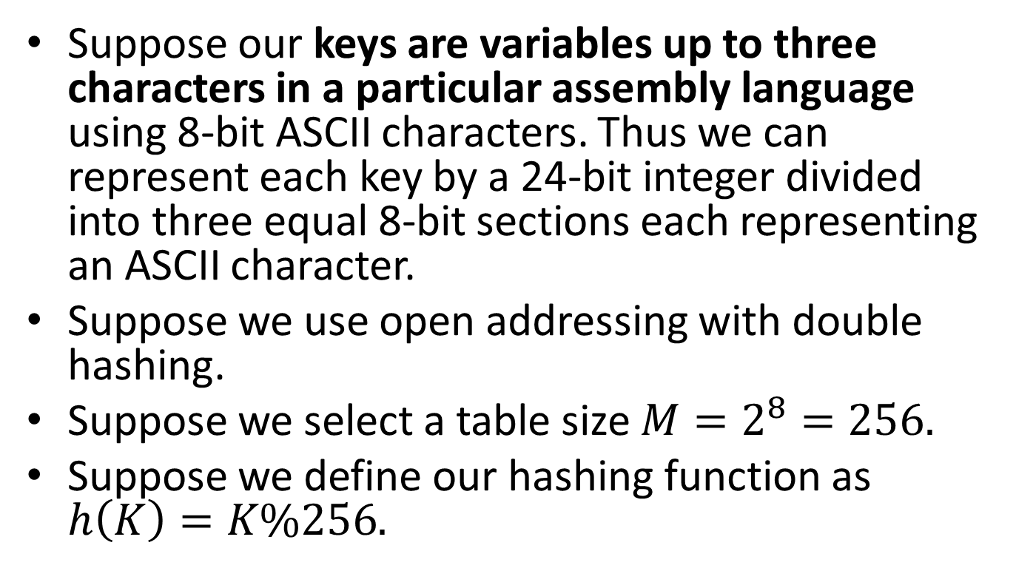
Example of a Bad Choice
Suppose our keys are variables up to three characters in a particular assembly language using 8-bit ASCII characters. Thus we can represent each key by a 24-bit integer divided into three equal 8-bit sections each representing an ASCII character.
Suppose we use open addressing with double hashing.
Suppose we select a table size $M=2^{8}=256.$
Suppose we define our hashing function as $h\left(K\right)=K\%256.$

Slide 55
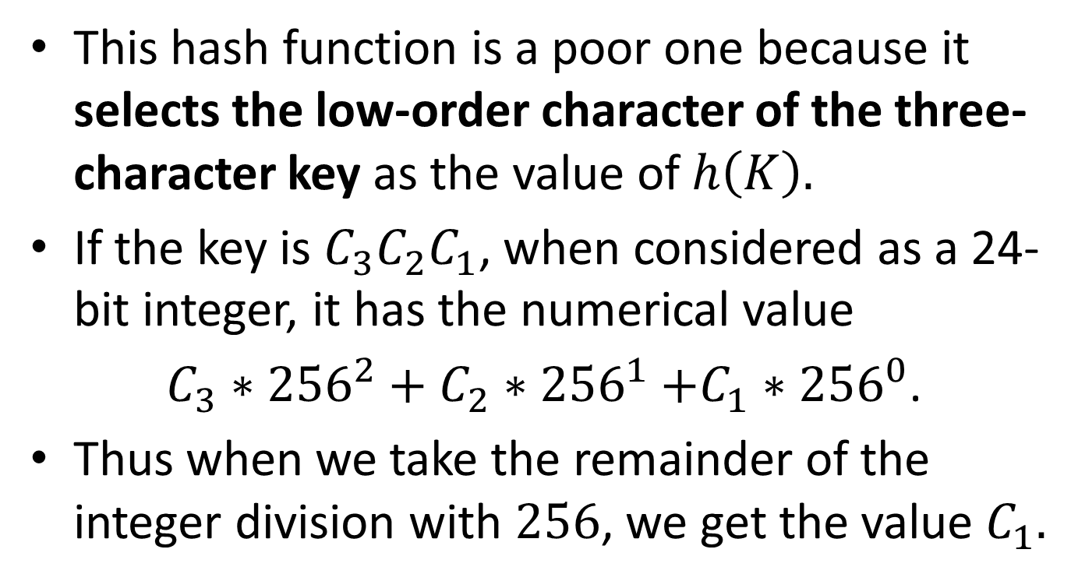
Example (cont’d)
This hash function is a poor one because it selects the low-order character of the three-character key as the value of $h\left(K\right).$
If the key is $C_{3}C_{2}C_{1}$, when considered as a 24-bit integer, it has the numerical value
$C_{3}∗{256}^{2}+C_{2}{∗256}^{1}+C_{1}{∗256}^{0}$.
Thus when we take the remainder of the integer division with $256$, we get the value $C_{1}.$

Slide 56
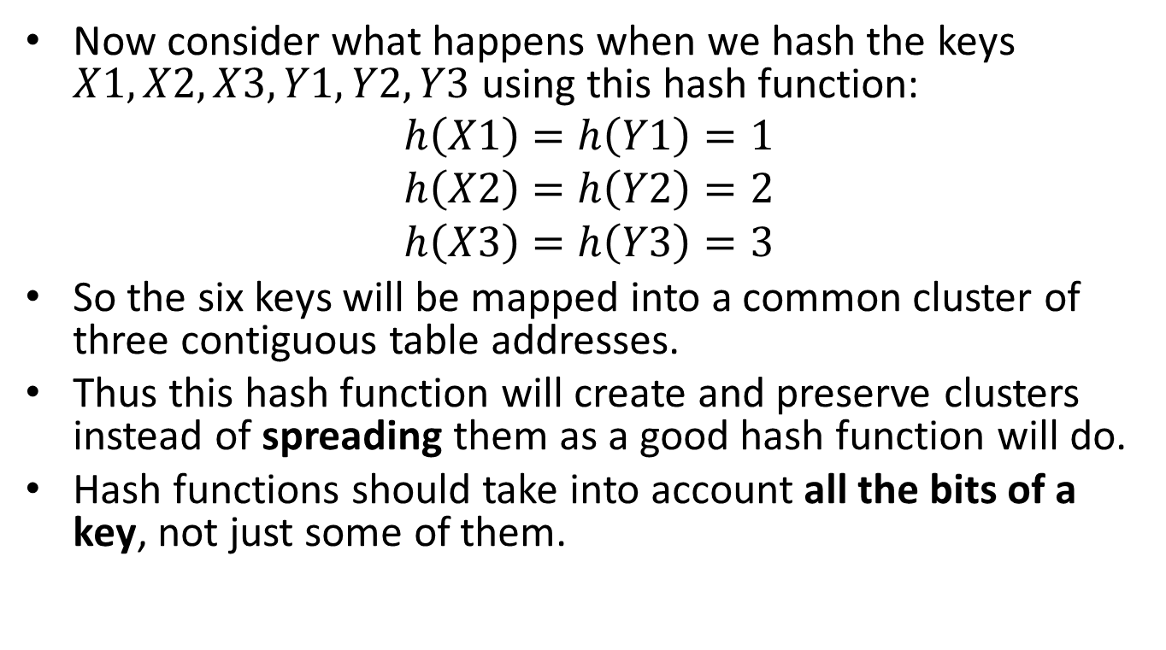
Example (cont’d)
Now consider what happens when we hash the keys $X1, X2, X3, Y1, Y2, Y3$ using this hash function:
$$h\left(X1\right)=h\left(Y1\right)=1$$
$$h\left(X2\right)=h\left(Y2\right)=2$$
$$h\left(X3\right)=h\left(Y3\right)=3$$
So the six keys will be mapped into a common cluster of three contiguous table addresses.
Thus this hash function will create and preserve clusters instead of spreading them as a good hash function will do.
Hash functions should take into account all the bits of a key, not just some of them.

Slide 57
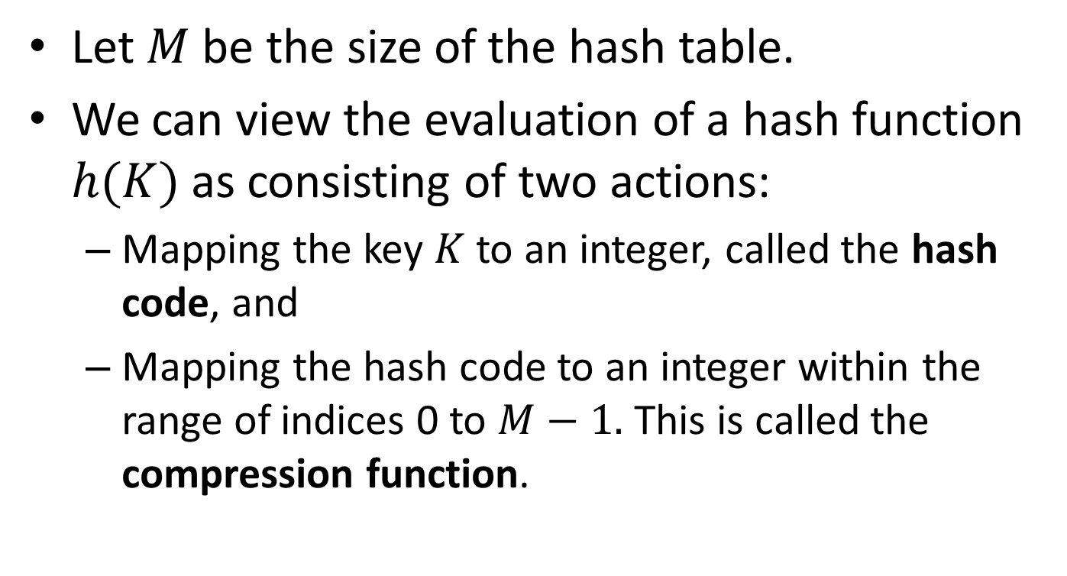
Designing Hash Functions
Let $M$ be the size of the hash table.
We can view the evaluation of a hash function $h(K)$ as consisting of two actions:
  Mapping the key $K$ to an integer, called the hash code, and
  Mapping the hash code to an integer within the range of indices 0 to $M−1.$ This is called the compression function.

Slide 58
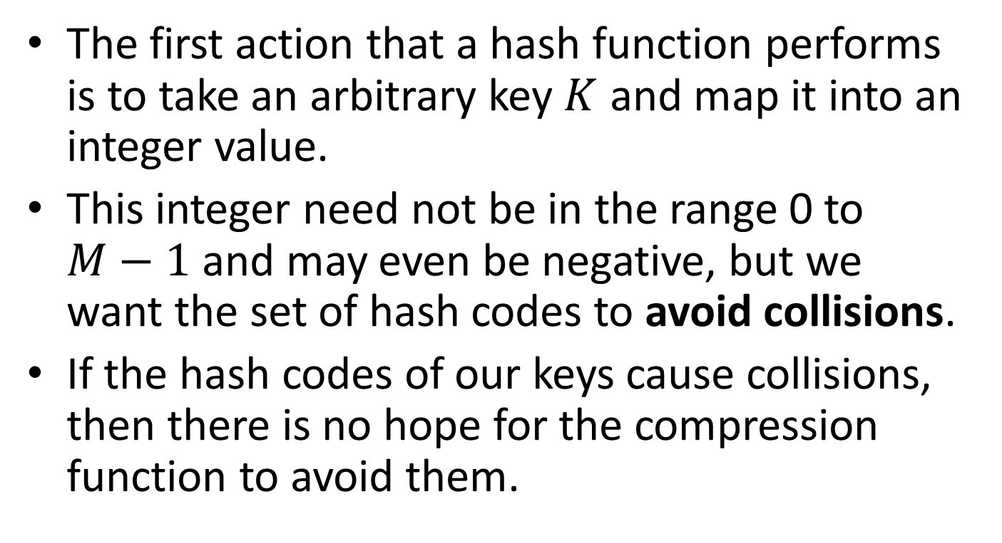
Hash Codes
The first action that a hash function performs is to take an arbitrary key $K$ and map it into an integer value.
This integer need not be in the range 0 to $M−1$ and may even be negative, but we want the set of hash codes to avoid collisions.
If the hash codes of our keys cause collisions, then there is no hope for the compression function to avoid them.

Slide 59
Hash Codes for Elements of C Datatypes
The hash codes for elements of C datatypes described below are based on the assumption that the number of bits of each data type is known.

Slide 60
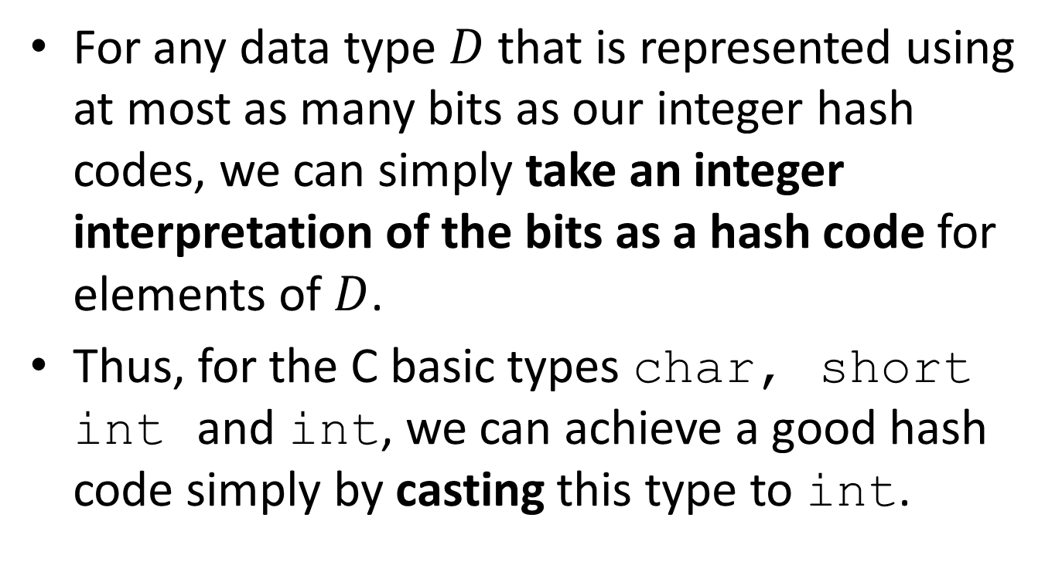
Converting to an Integer
For any data type $D$ that is represented using at most as many bits as our integer hash codes, we can simply take an integer interpretation of the bits as a hash code for elements of $D$.
Thus, for the C basic types char, short int and int, we can achieve a good hash code simply by casting this type to int.

Slide 61
Converting to an Integer (cont’d)
On many machines, the type long int has a bit representation that is twice as long as type int.
One possible hash code for a long int element is to simply cast it down to an int.
But notice that this hash code ignores half of the information present in the original value. So, if many of the keys differ only in these bits, they will collide using this simple hash code.
A better hash code, which takes all the original bits into consideration, sums an integer representation of the high-order bits with an integer representation of the low-order bits.

Slide 62
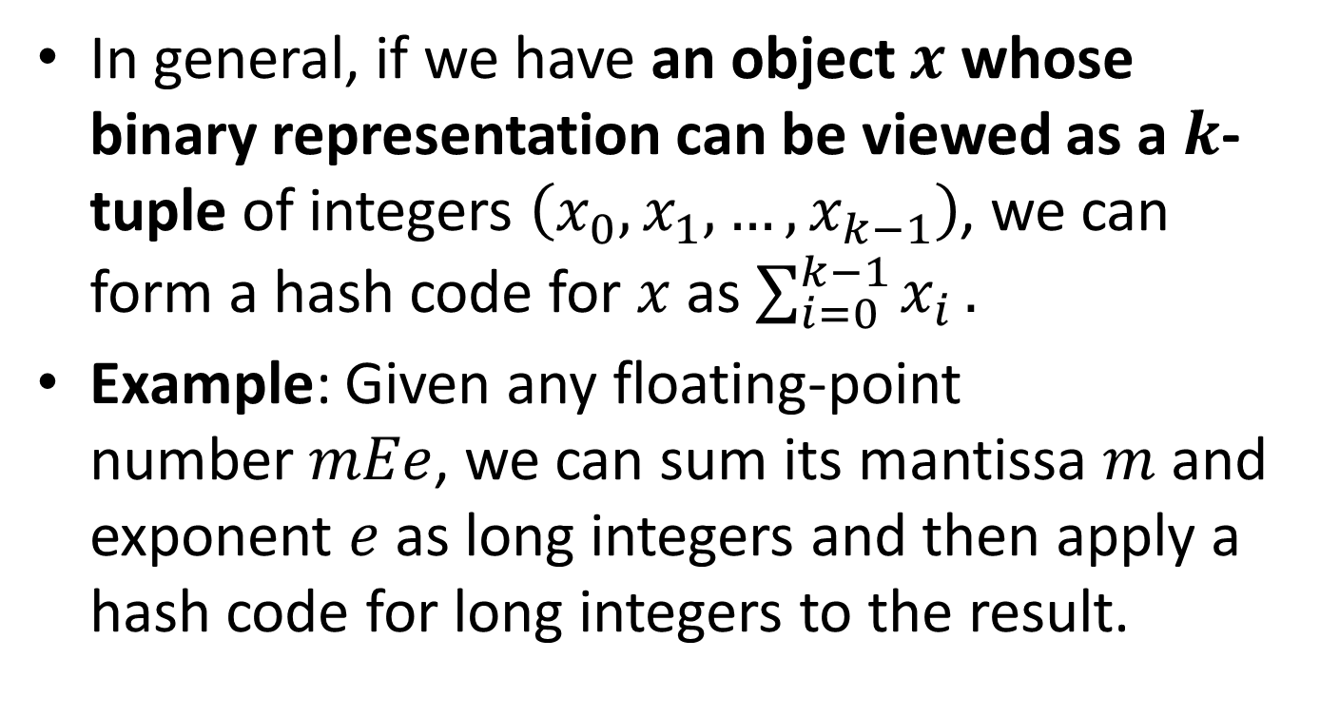
Converting to an Integer (cont’d)
In general, if we have an object $x$ whose binary representation can be viewed as a $k$-tuple of integers $\left(x_{0},x_{1},…,x_{k−1}\right)$, we can form a hash code for $x$ as $\sum_{i=0}^{k−1}{x_{i}}.$
Example: Given any floating-point number$mEe$, we can sum its mantissa $m$and exponent $e$as long integers and then apply a hash code for long integers to the result.

Slide 63
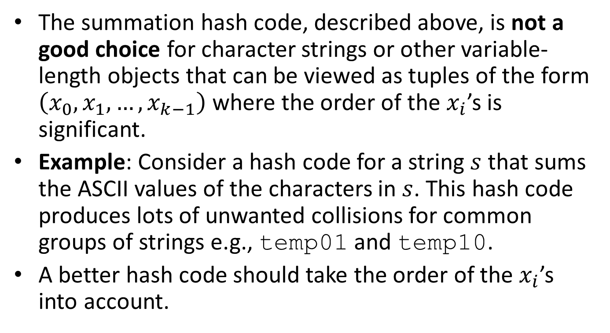
Summation Hash Codes
The summation hash code, described above, is not a good choice for character strings or other variable-length objects that can be viewed as tuples of the form $\left(x_{0},x_{1},…,x_{k−1}\right)$ where the order of the $x_{i}$’s is significant.
Example: Consider a hash code for a string $s$that sums the ASCII values of the characters in $s$. This hash code produces lots of unwanted collisions for common groups of strings e.g., temp01 and temp10.
A better hash code should take the order of the $x_{i}$’s into account.

Slide 64
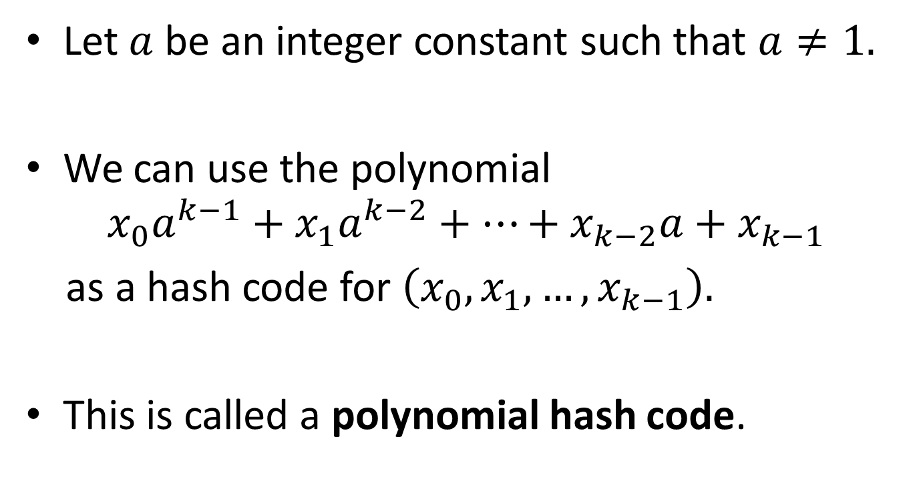
Polynomial Hash Codes
Let $a$ be an integer constant such that $a≠1.$
We can use the polynomial
$$x_{0}a^{k−1}+x_{1}a^{k−2}+…+x_{k−2}a+x_{k−1}$$
as a hash code for $\left(x_{0},x_{1},…,x_{k−1}\right).$
This is called a polynomial hash code.

Slide 65
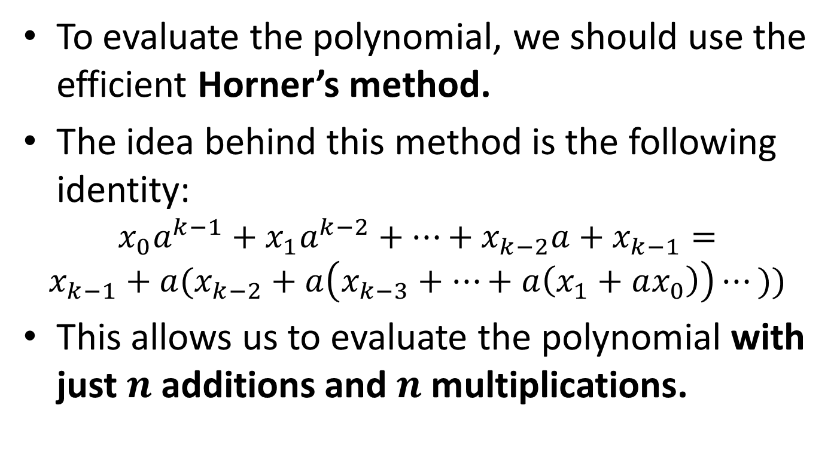
Polynomial Hash Codes (cont’d)
To evaluate the polynomial, we should use the efficient Horner’s method.
The idea behind this method is the following identity:
$$x_{0}a^{k−1}+x_{1}a^{k−2}+…+x_{k−2}a+x_{k−1}=$$
$$x_{k−1}+a(x_{k−2}+a\left(x_{k−3}+…+a\left(x_{1}+ax_{0}\right)\right)⋯))$$
This allows us to evaluate the polynomial with just $n$ additions and $n$ multiplications.

Slide 66

Polynomial Hash Codes (cont’d)
Experiments show that in a list of over 50,000 English words, if we choose $a=33, 37, 39$ or $41,$ we produce less than seven collisions in each case.
For the sake of speed, we can apply the hash code to only a fraction of the characters in a long string.

Slide 67
Polynomial Hash Codes (cont’d)
/* This is a complete hash function, not just a hash code. */
int hash(char *K)
{
int h=0, a=33;
for (; *K!='\0'; K++)
h=(a*h + *K) % Μ;
return h;
}

Slide 68

Polynomial Hash Codes (cont’d)
In theory, we first compute a polynomial hash code and then apply the compression function modulo $M$(another way of saying that we compute the remainder of the integer division with $M$).
The previous hash function takes the modulo $M$at each step.
The two approaches are the same because the following equality holds for all $a,b,x,M$ that are nonnegative integers:
$$\left(\left(\left(ax\right) mod M\right)+b\right)mod M=\left(ax+b\right) mod M$$
Note: the $mod$ operator is the same as $\%$
The approach of the previous function is preferable because, otherwise, we get errors with long strings when the polynomial computation produces overflows (try it!).

Slide 69

Cyclic Shift Hash Codes
A variant of the polynomial hash code replaces multiplication by $a$ with a cyclic shift of a partial sum by a certain number of bits.
Experiments with a list of 25,000 English words show that with a 5-bit cyclic shift, we have at most 2 collisions for any one hash code.
The following function achieves a 5-bit cyclic shift by taking the bitwise OR of a 5-bit left shift and a 27-bit right shift.

Slide 70
Cyclic Shift Hash Codes (cont’d)
int hashCode(const char *p, int len){
unsigned int h=0;
int i;
for (i=0; i<len; i++){
h=(h << 5) | (h >> 27);
h+=(unsigned int) p[i];
}
return h;
}

Slide 71
Hash Codes for Floating Point Numbers
We can achieve a better hash code for floating point numbers than casting them down to int as follows.
Assuming that a char is stored as an 8-bit byte, we could interpret a 32-bit float as a four-element character array and use the hash code functions we discussed for strings.

Slide 72

Compression Functions
Once we have determined an integer hash code for a key $K$, there is still the issue of mapping that integer into the range 0 to $M−1.$
This can be done using the following methods.

Slide 73

The Division Method
One good method for choosing a compression function is the division method we have demonstrated already in the context of double hashing:
  $M$ is chosen to be a prime number (important!)
  $h\left(K\right)=K\%M$
  $p\left(K\right)=max⁡(1,K/M)$

Slide 74

Precautions
If there is a repeated pattern of key values of the form $iM+j$ for several different $i$, then there are still collisions.

Slide 75

Precautions (cont’d)
If $r$ is the radix (or base) of the character set for the keys and $k$ and $a$ are small integers, then we should not choose a prime of the form $M=r^{k}±a$.

Slide 76

Example
Let us suppose we again consider three character keys $C_{3}C_{2}C_{1}$ in 8-bit ASCII where the radix of the character set is again $2^{8}=256.$
Suppose we choose $M=2^{16}+1=65537.$
Then $h(C_{3}C_{2}C_{1}$)$={(C_{2}C_{1}−C_{3})}_{256}$.
Generally, if $M=r^{k}±a$, the value of $h(K)$ will tend to be simple sums and differences of products of the characters $C_{i}.$
Such a hash function will not spread clusters of keys, nor will it map keys uniformly and randomly onto the space of hash table locations.

Slide 77

Double Hashing
Another good way to choose $p(K)$ in double hashing is the following:
$$p\left(K\right)=Q−K\%Q$$
where $Q$ is prime and $Q<M.$
The values of $p(K)$ are $1,…, Q.$

Slide 78

The MAD Method
A more sophisticated compression function which helps eliminate repeated patterns in a set of integer hash codes is the multiply and divide (or MAD) method.
In this case, the compression function maps integer $i$to
$$h\left(i\right)=(\left(ai+b\right) \% p) \% M$$
where $M$ is the size of the hash table, $p$ is a prime
number greater than $M$, $a$ and $b$ are nonnegative
integers randomly chosen in the interval $[0,p−1]$ and
$a>0.$

Slide 79
Some Applications of Hash Tables
Databases (including hashing for external storage).
Cryptography
Symbol tables in compilers
Browser caches
Peer-to-peer systems and torrents (distributed hash tables)
…

Slide 80
Readings
T. A. Standish. Data Structures, Algorithms and Software Principles in C.
  Chapter 11
M.T. Goodrich, R. Tamassia and D. Mount. Data Structures and Algorithms in C++. 2nd edition.
  Chapter 9
M. T. Goodrich, R. Tamassia. Δομές Δεδομένων και Αλγόριθμοι σε Java. 5^{η} έκδοση. Εκδόσεις Δίαυλος.
  Chapter 9
R. Sedgewick. Αλγόριθμοι σε C. 3^{η} Αμερικανική Έκδοση. Εκδόσεις Κλειδάριθμος.
  Κεφάλαιο 14

