Slide 1
Introduction to the Analysis of Algorithms
Manolis Koubarakis

Slide 2
Outline
How can we measure and compare algorithms meaningfully?
O notation.
Analysis of a few interesting algorithms.

Slide 3
Introduction
How do we measure and compare algorithms meaningfully given that the same algorithm will run at different speeds and will require different amounts of space when run on different computers or when implemented in different programming languages?
Example: let us consider a sorting algorithm for sorting an array A[0:n-1].

Slide 4
Selection Sorting Algorithm
void SelectionSort(InputArray A)
{
int MinPosition, temp, i, j;
for (i=n-1; i>0; --i){
MinPosition=i;
for (j=0; j<i; ++i){
if (A[j] < A[MinPosition]){
MinPosition=j;
}
}
temp=A[i];
A[i]=A[MinPosition];
A[MinPosition]=temp;
}
}

Slide 5
Comments
The previous algorithm sorts the elements of an input array A in descending order using the technique of selection sorting.
The algorithm proceeds in steps controlled by the outer for statement. In each such step the i-th element of the array is interchanged with the minimum element among elements 0 to i-1.
The minimum element is computed by the inner for statement.
The interchanging steps start with the last element of the array and proceed down to the first element.

Slide 6
Running Times in Seconds to Sort an Array of 2000 Integers
Computers A, B, etc. up to E are progressively faster.
The algorithm runs faster on faster computers.
Type of Computer | Time
Computer A | 51.915
Computer B | 11.508
Computer C | 2.382
Computer D | 0.431
Computer E | 0.087

Slide 7
More Measurements
In addition to trying different computers, we should try different programming languages and different compilers.
Shall we take all these measurements to decide whether an algorithm is better than another one?

Slide 8
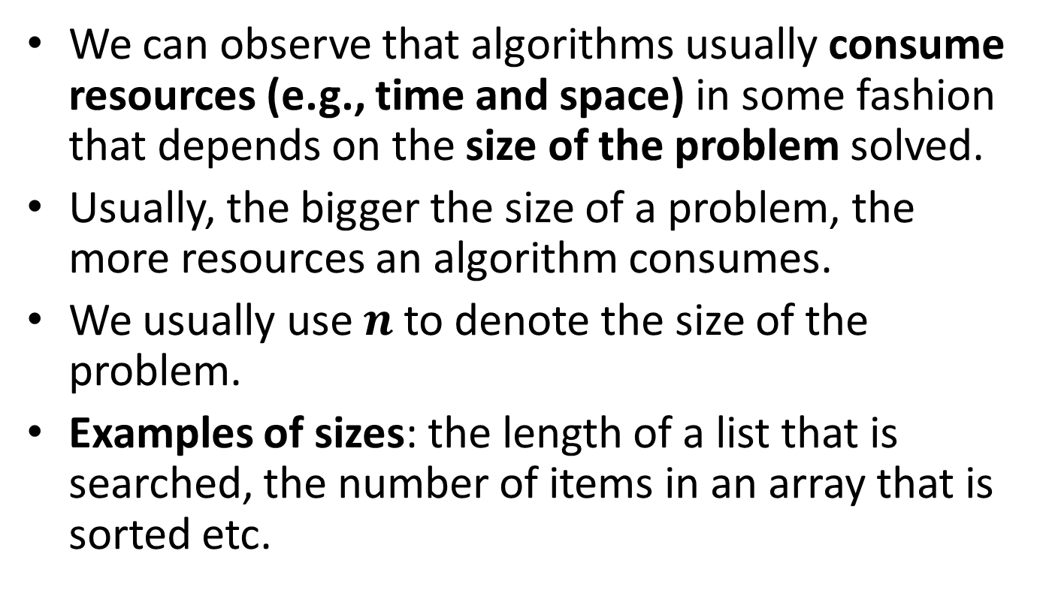
A More Meaningful Criterion
We can observe that algorithms usually consume resources (e.g., time and space) in some fashion that depends on the size of the problem solved.
Usually, the bigger the size of a problem, the more resources an algorithm consumes.
We usually use $n$ to denote the size of the problem.
Examples of sizes: the length of a list that is searched, the number of items in an array that is sorted etc.

Slide 9
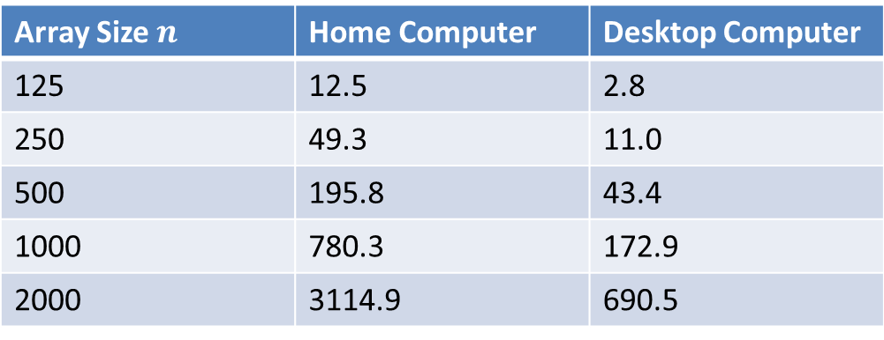
SelectionSort Running Times in Milliseconds on Two Types of Computers
Array Size $n$ | Home Computer | Desktop Computer
125 | 12.5 | 2.8
250 | 49.3 | 11.0
500 | 195.8 | 43.4
1000 | 780.3 | 172.9
2000 | 3114.9 | 690.5

Slide 10
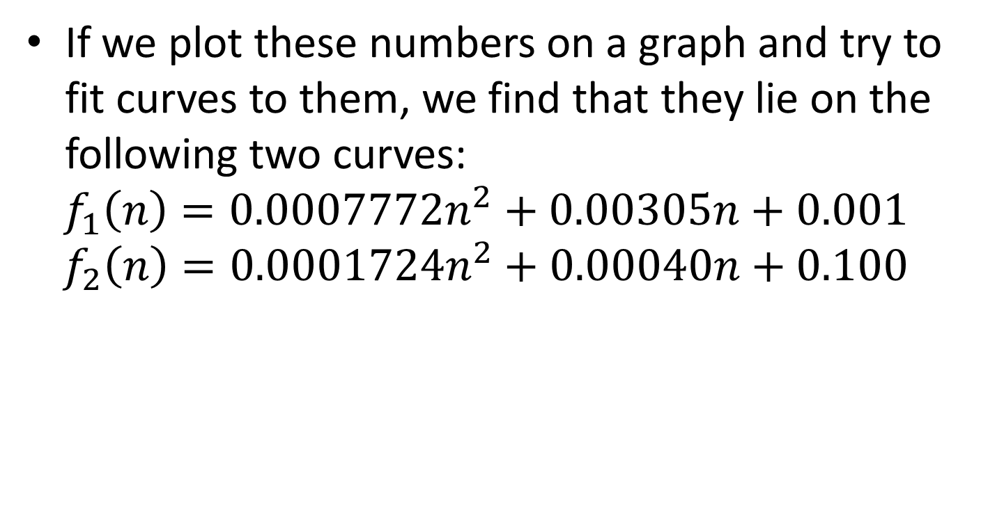
Two Curves Fitting the Previous Data
If we plot these numbers on a graph and try to fit curves to them, we find that they lie on the following two curves:
$$f_{1}\left(n\right)=0.0007772n^{2}+0.00305n+0.001$$
$$f_{2}\left(n\right)=0.0001724n^{2}+0.00040n+0.100$$

Slide 11
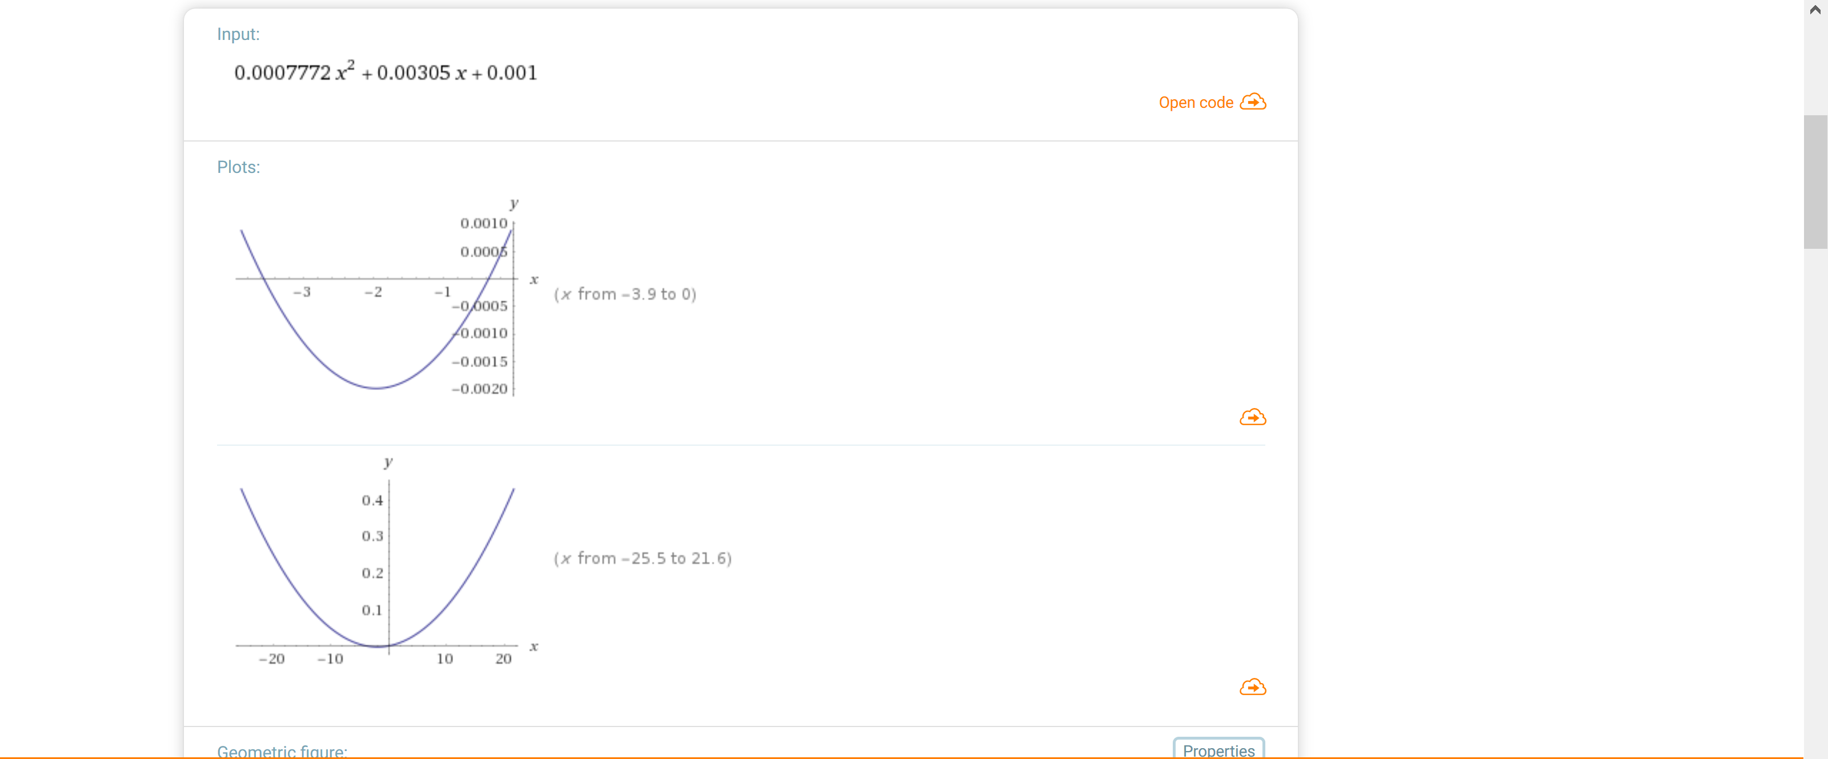

$$f_{1}\left(x\right)$$

Slide 12
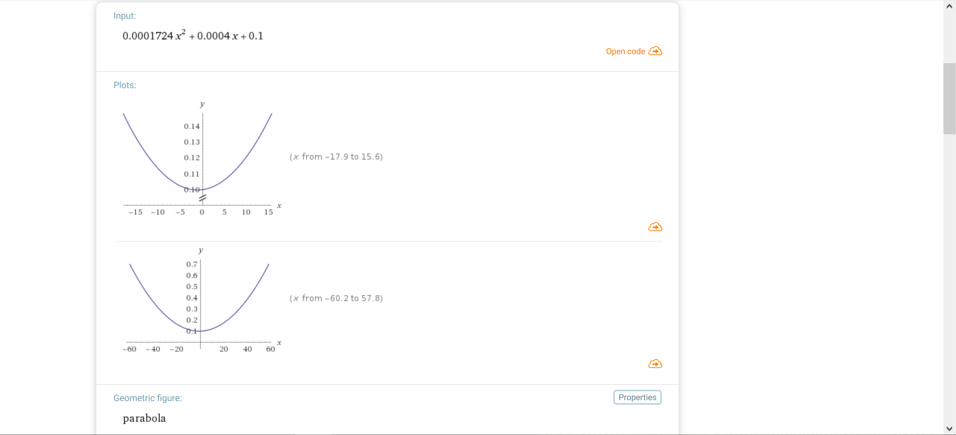

$$f_{2}\left(x\right)$$

Slide 13
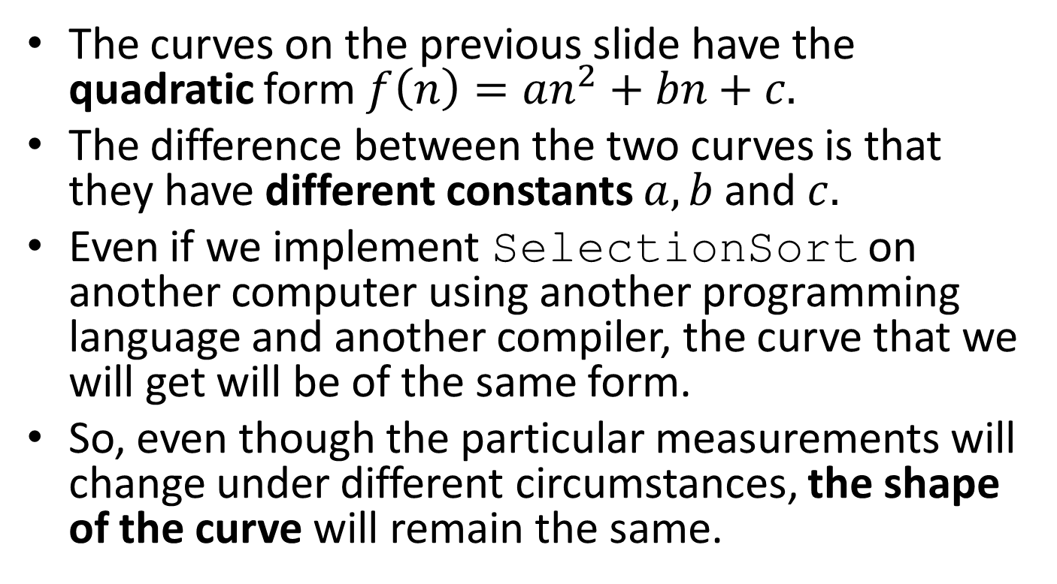
Discussion
The curves on the previous slide have the quadratic form $f\left(n\right)=an^{2}+bn+c.$
The difference between the two curves is that they have different constants $a,b$and $c.$
Even if we implement SelectionSort on another computer using another programming language and another compiler, the curve that we will get will be of the same form.
So, even though the particular measurements will change under different circumstances, the shape of the curve will remain the same.

Slide 14
Complexity Classes
The running times of various algorithms belong to different complexity classes.
Each complexity class is characterized by a different family of curves.
All of the curves in a given complexity class share the same basic shape. The shape is characterized by an equation that gives running times as a function of problem size.

Slide 15
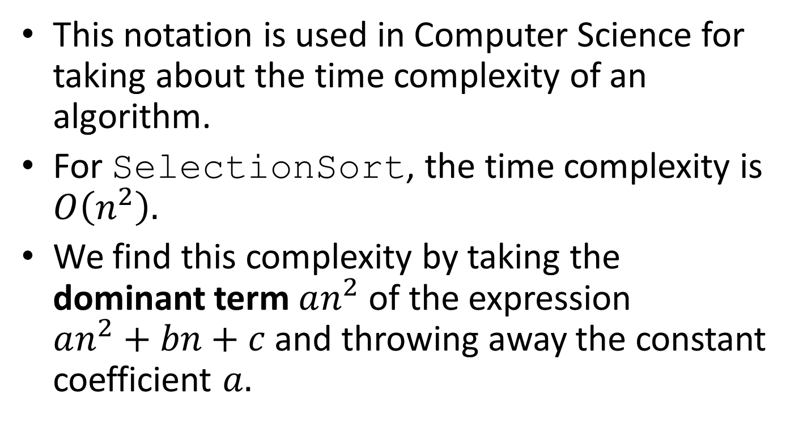

$O$-notation
This notation is used in Computer Science for taking about the time complexity of an algorithm.
For SelectionSort, the time complexity is $O\left(n^{2}\right).$
We find this complexity by taking the dominant term $an^{2}$ of the expression $an^{2}+bn+c$ and throwing away the constant coefficient $a.$

Slide 16


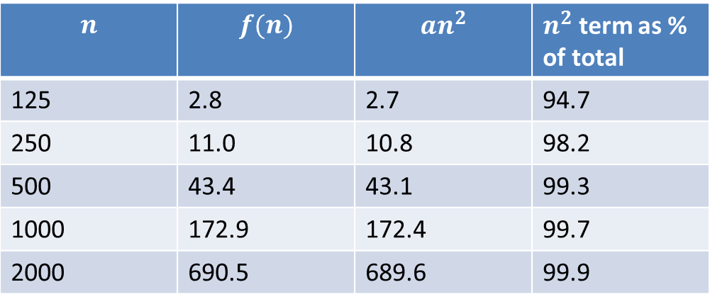
$O$-notation (cont’d)
Let us consider the equation $f\left(n\right)=an^{2}+bn+c$ with $a=0.0001724$, $b=0.0004$ and $c=0.1$. Then we have the following table:
$$n$$ | $$f(n)$$ | $${an}^{2}$$ | $n^{2}$ term as % of total
125 | 2.8 | 2.7 | 94.7
250 | 11.0 | 10.8 | 98.2
500 | 43.4 | 43.1 | 99.3
1000 | 172.9 | 172.4 | 99.7
2000 | 690.5 | 689.6 | 99.9

Slide 17
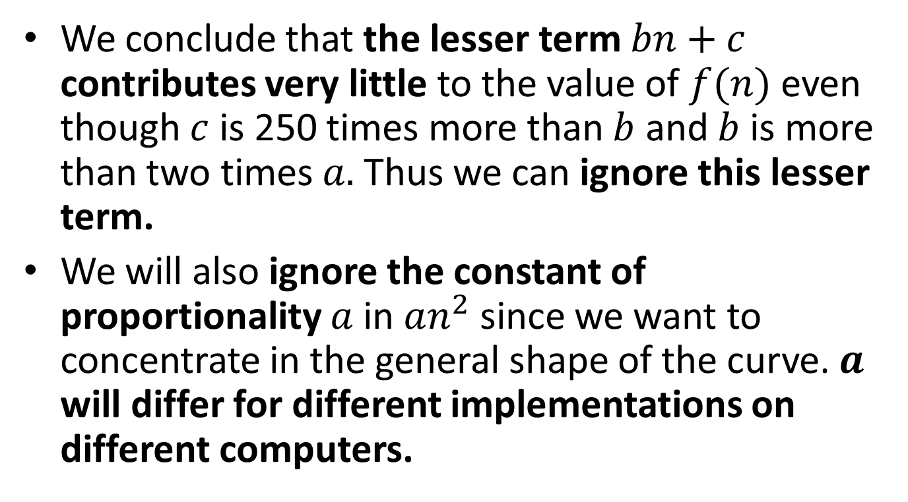
$O$-notation (cont’d)
We conclude that the lesser term $bn+c$ contributes very little to the value of $f(n)$ even though $c$ is 250 times more than $b$ and $b$is more than two times $a.$ Thus we can ignore this lesser term.
We will also ignore the constant of proportionality $a$ in $an^{2}$ since we want to concentrate in the general shape of the curve. $a$ will differ for different implementations on different computers.

Slide 18
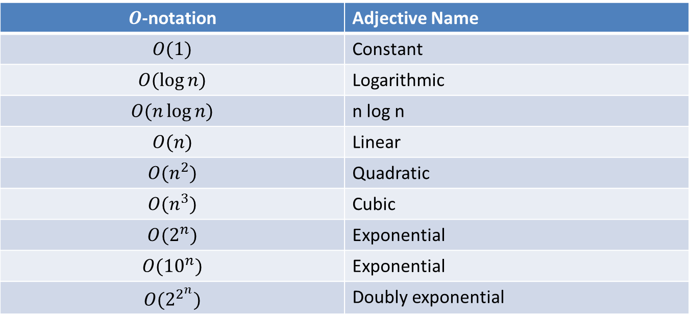
Some Common Complexity Classes
$O$-notation | Adjective Name
$$O(1)$$ | Constant
$$O(\log{n)}$$ | Logarithmic
$$O(n\log{n)}$$ | n log n
$$O(n)$$ | Linear
$$O(n^{2})$$ | Quadratic
$$O(n^{3})$$ | Cubic
$$O(2^{n})$$ | Exponential
$$O({10}^{n})$$ | Exponential
$$O(2^{2^{n}})$$ | Doubly exponential

Slide 19
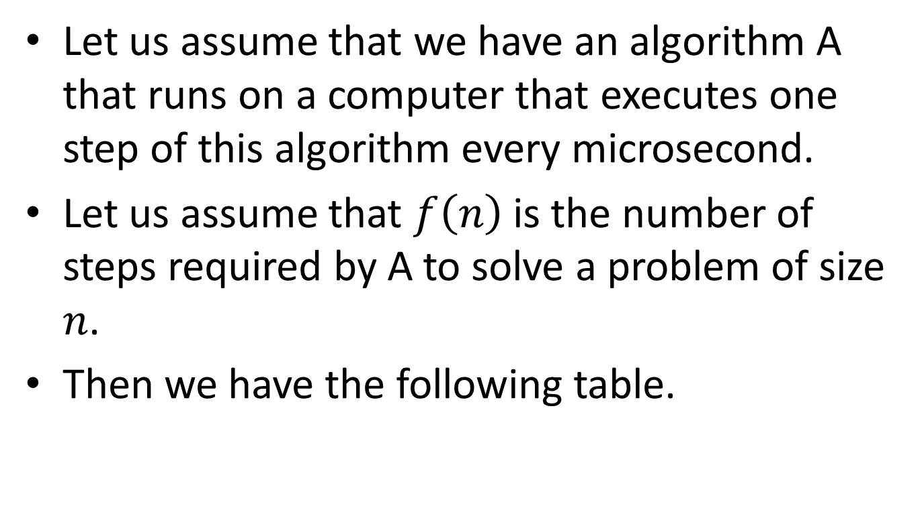
Comparing Complexity Classes
Let us assume that we have an algorithm A that runs on a computer that executes one step of this algorithm every microsecond.
Let us assume that $f\left(n\right)$is the number of steps required by A to solve a problem of size $n$.
Then we have the following table.

Slide 20
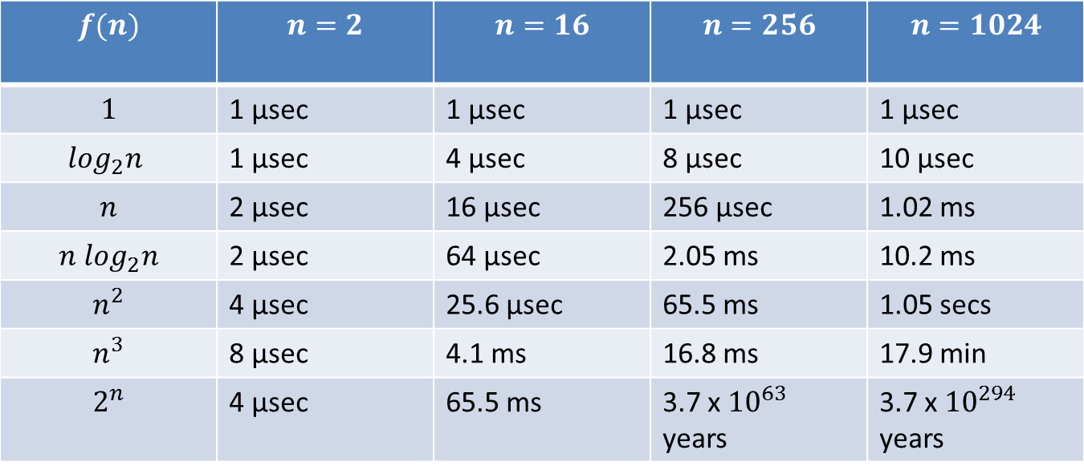
Running Times for Algorithm A
$$f(n)$$ | $$n=2$$ | $$n=16$$ | $$n=256$$ | $$n=1024$$
$$1$$ | 1 μsec | 1 μsec | 1 μsec | 1 μsec
$$\log_{2}n$$ | 1 μsec | 4 μsec | 8 μsec | 10 μsec
$$n$$ | 2 μsec | 16 μsec | 256 μsec | 1.02 ms
$${n log}_{2}n$$ | 2 μsec | 64 μsec | 2.05 ms | 10.2 ms
$$n^{2}$$ | 4 μsec | 25.6 μsec | 65.5 ms | 1.05 secs
$$n^{3}$$ | 8 μsec | 4.1 ms | 16.8 ms | 17.9 min
$$2^{n}$$ | 4 μsec | 65.5 ms | 3.7 x ${10}^{63}$ years | 3.7 x ${10}^{294}$ years

Slide 21
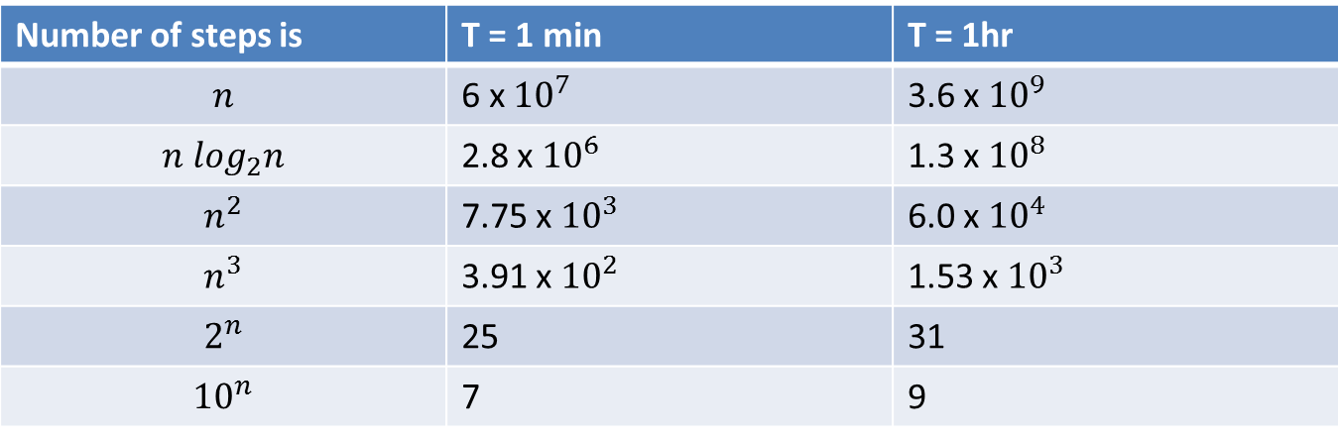
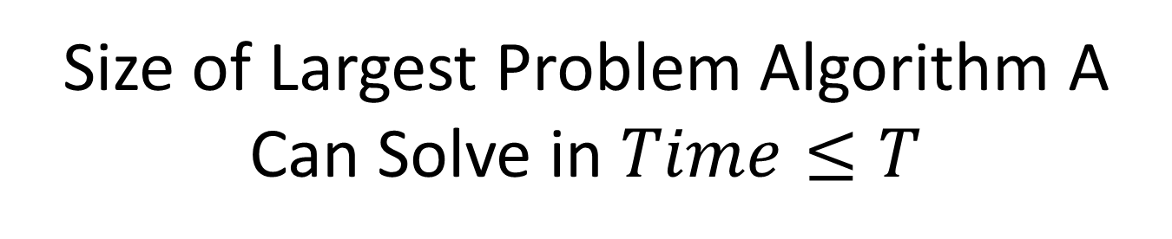
Size of Largest Problem Algorithm A Can Solve in $Time≤T$
Number of steps is | T = 1 min | T = 1hr
$$n$$ | 6 x ${10}^{7}$ | 3.6 x ${10}^{9}$
$${n log}_{2}n$$ | 2.8 x ${10}^{6}$ | 1.3 x ${10}^{8}$
$$n^{2}$$ | 7.75 x ${10}^{3}$ | 6.0 x ${10}^{4}$
$$n^{3}$$ | 3.91 x ${10}^{2}$ | 1.53 x ${10}^{3}$
$$2^{n}$$ | 25 | 31
$${10}^{n}$$ | 7 | 9

Slide 22
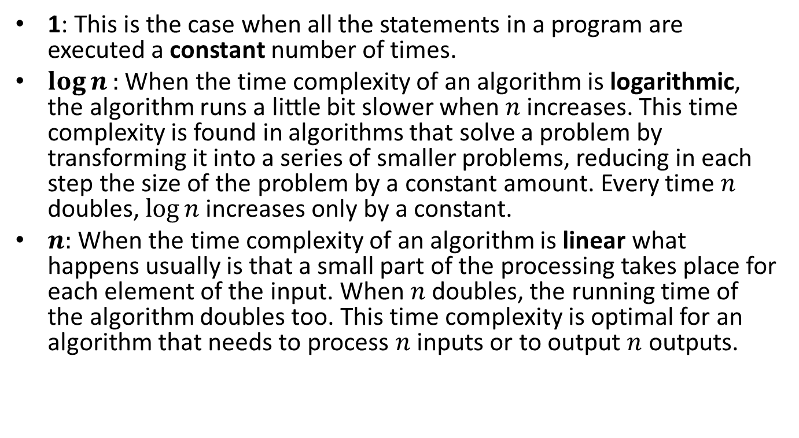
Time Complexity Discussion
1: This is the case when all the statements in a program are executed a constant number of times.
$\log{n}:$ When the time complexity of an algorithm is logarithmic, the algorithm runs a little bit slower when $n$ increases. This time complexity is found in algorithms that solve a problem by transforming it into a series of smaller problems, reducing in each step the size of the problem by a constant amount. Every time $n$ doubles, $\log{n}$increases only by a constant.
$n:$When the time complexity of an algorithm is linear what happens usually is that a small part of the processing takes place for each element of the input. When $n$ doubles, the running time of the algorithm doubles too. This time complexity is optimal for an algorithm that needs to process $n$ inputs or to output $n$ outputs.

Slide 23
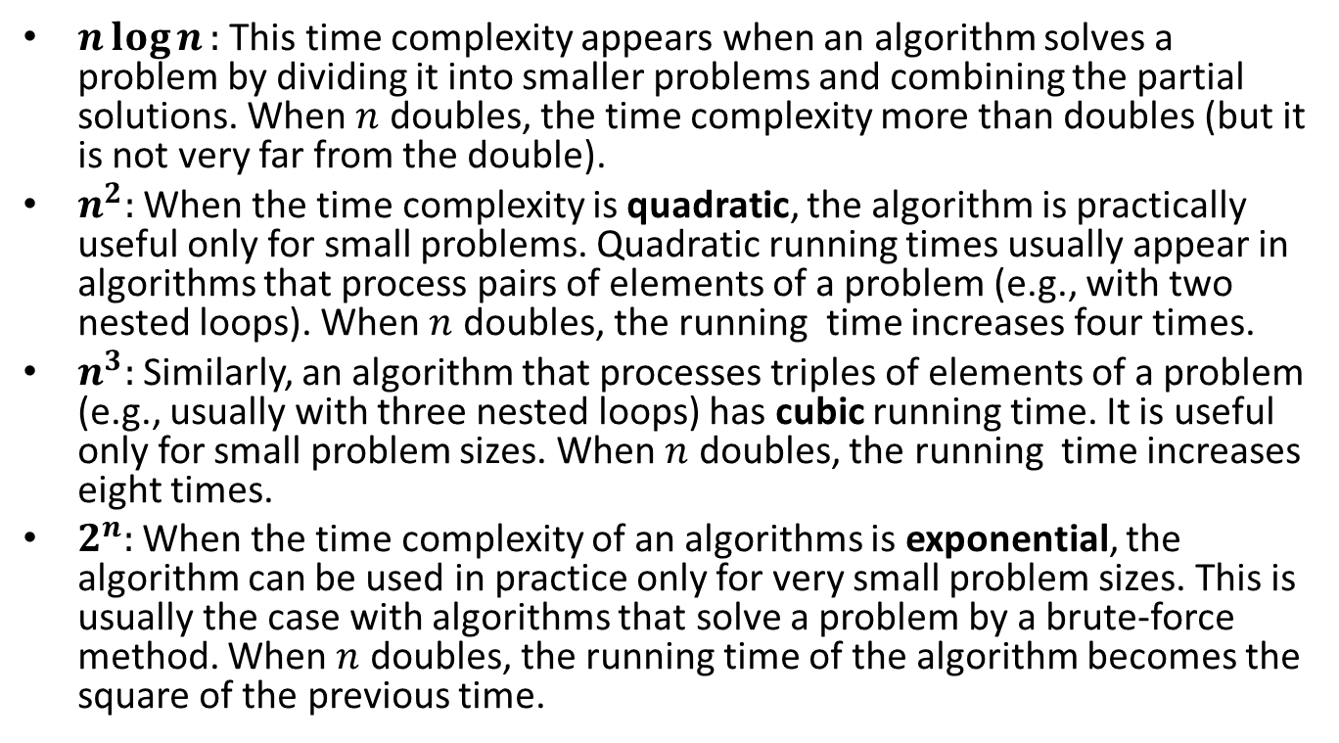
Time Complexity Discussion (cont’d)
$n\log{n}:$ This time complexity appears when an algorithm solves a problem by dividing it into smaller problems and combining the partial solutions. When $n$ doubles, the time complexity more than doubles (but it is not very far from the double).
$n^{2}:$ When the time complexity is quadratic, the algorithm is practically useful only for small problems. Quadratic running times usually appear in algorithms that process pairs of elements of a problem (e.g., with two nested loops). When $n$ doubles, the running time increases four times.
$n^{3}:$ Similarly, an algorithm that processes triples of elements of a problem (e.g., usually with three nested loops) has cubic running time. It is useful only for small problem sizes. When $n$ doubles, the running time increases eight times.
$2^{n}:$ When the time complexity of an algorithms is exponential, the algorithm can be used in practice only for very small problem sizes. This is usually the case with algorithms that solve a problem by a brute-force method. When $n$ doubles, the running time of the algorithm becomes the square of the previous time.

Slide 24
Time Complexity
We have to consider the following cases:
  Worst case
  Best case
  Average case

Slide 25
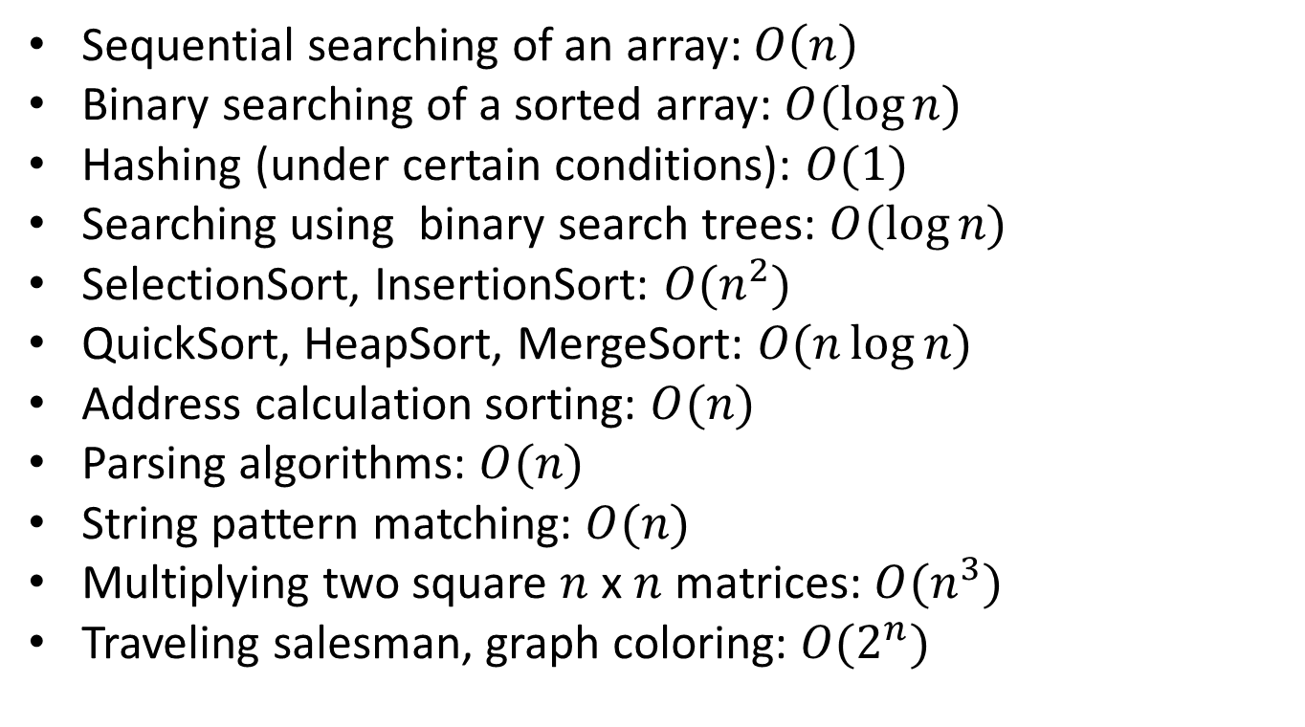
Examples of Well-Known Algorithms and Their Time Complexity
Sequential searching of an array: $O\left(n\right)$
Binary searching of a sorted array: $O(\log{n) }$
Hashing (under certain conditions): $O(1)$
Searching using binary search trees: $O(\log{n) }$
SelectionSort, InsertionSort: $O(n^{2})$
QuickSort, HeapSort, MergeSort: $O(n\log{n)}$
Address calculation sorting: $O(n)$
Parsing algorithms: $O(n)$
String pattern matching: $O(n)$
Multiplying two square $n$ x $n$ matrices: $O(n^{3})$
Traveling salesman, graph coloring: $O(2^{n})$

Slide 26

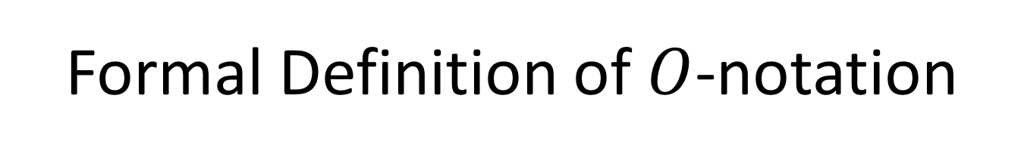
Formal Definition of $O$-notation
We say that $f(n)$ is $O(g\left(n\right))$ if there exist two positive constants $K$ and $n_{0}$ such that $|f\left(n\right)|≤K\left|g\left(n\right)\right|$ for all $n≥n_{0}$ .

Slide 27
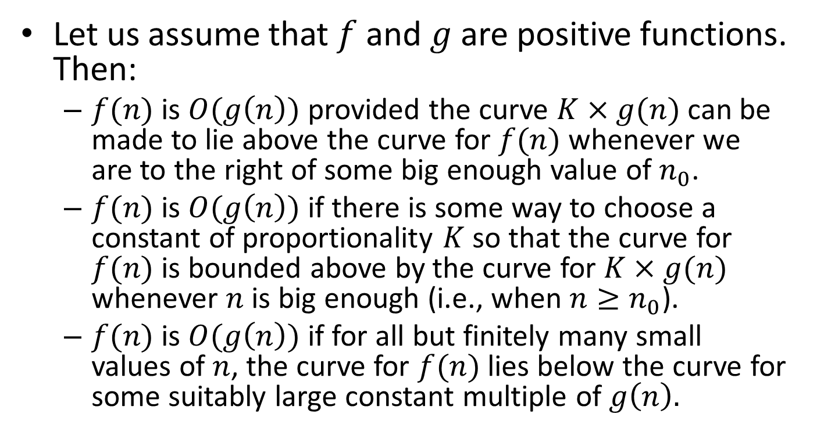
Three Ways of Saying it in Words
Let us assume that $f$ and $g$ are positive functions. Then:
  $f(n)$ is $O(g\left(n\right))$ provided the curve $K×g(n)$ can be made to lie above the curve for $f(n)$ whenever we are to the right of some big enough value of $n_{0}$.
  $f(n)$ is $O(g\left(n\right))$ if there is some way to choose a constant of proportionality $K$ so that the curve for $f(n)$ is bounded above by the curve for $K×g(n)$ whenever $n$ is big enough (i.e., when $n≥n_{0}$).
  $f(n)$ is $O(g\left(n\right))$if for all but finitely many small values of $n$, the curve for $f(n)$ lies below the curve for some suitably large constant multiple of $g\left(n\right).$

Slide 28
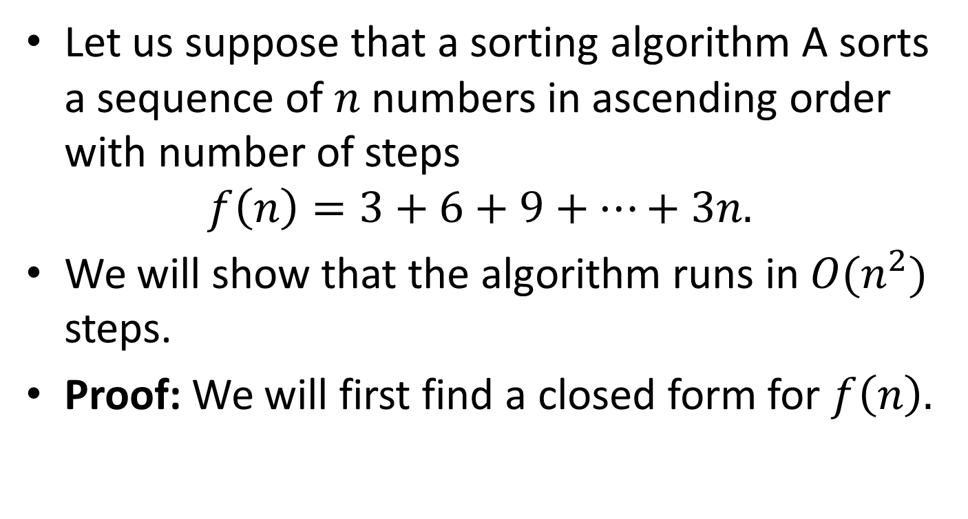
Example of a Formal Proof
Let us suppose that a sorting algorithm A sorts a sequence of $n$ numbers in ascending order with number of steps
$$f\left(n\right)=3+6+9+⋯+3n.$$
We will show that the algorithm runs in $O(n^{2})$ steps.
Proof: We will first find a closed form for $f\left(n\right).$

Slide 29
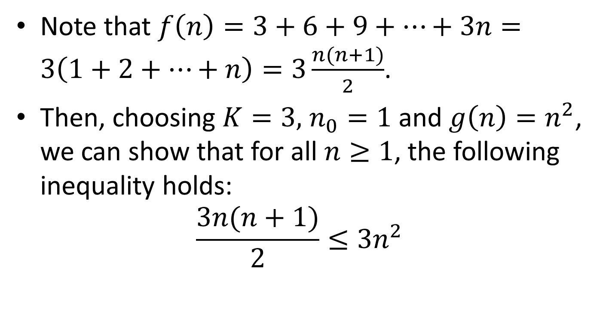
Proof (cont’d)
Note that $f\left(n\right)=3+6+9+⋯+3n=3\left(1+2+⋯+n\right)=3\frac{n(n+1)}{2}$.
Then, choosing $K=3,$ $n_{0}=1$ and $g\left(n\right)=n^{2}$, we can show that for all $n≥1$, the following inequality holds:
$$\frac{3n(n+1)}{2}≤3n^{2}$$

Slide 30
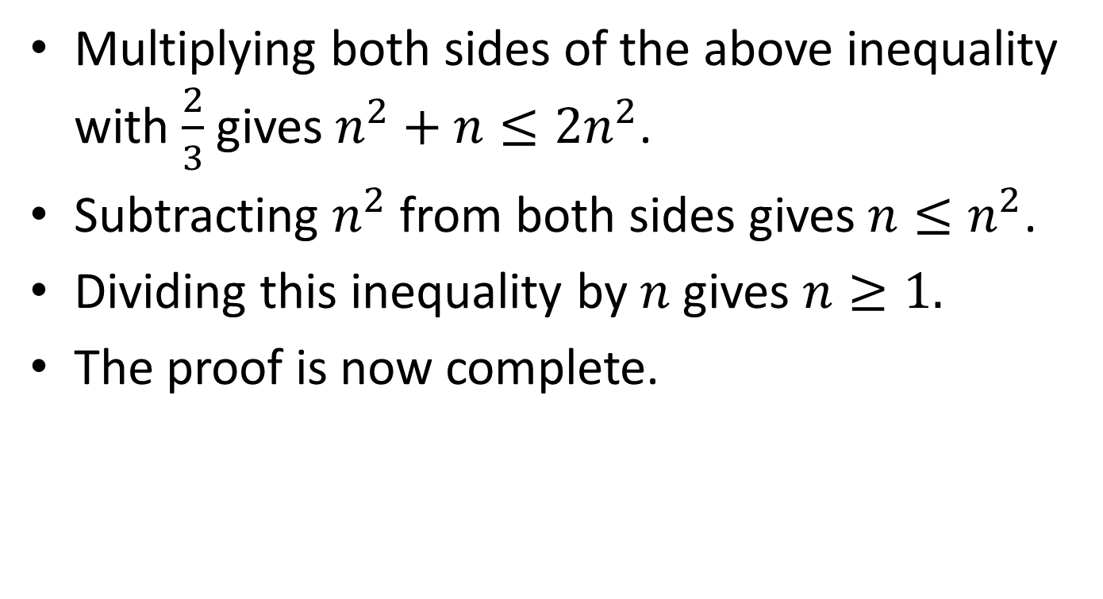
Proof (cont’d)
Multiplying both sides of the above inequality with $\frac{2}{3}$ gives $n^{2}+n≤{2n}^{2}$.
Subtracting $n^{2}$ from both sides gives $n≤n^{2}$.
Dividing this inequality by $n$ gives $n≥1.$
The proof is now complete.

Slide 31
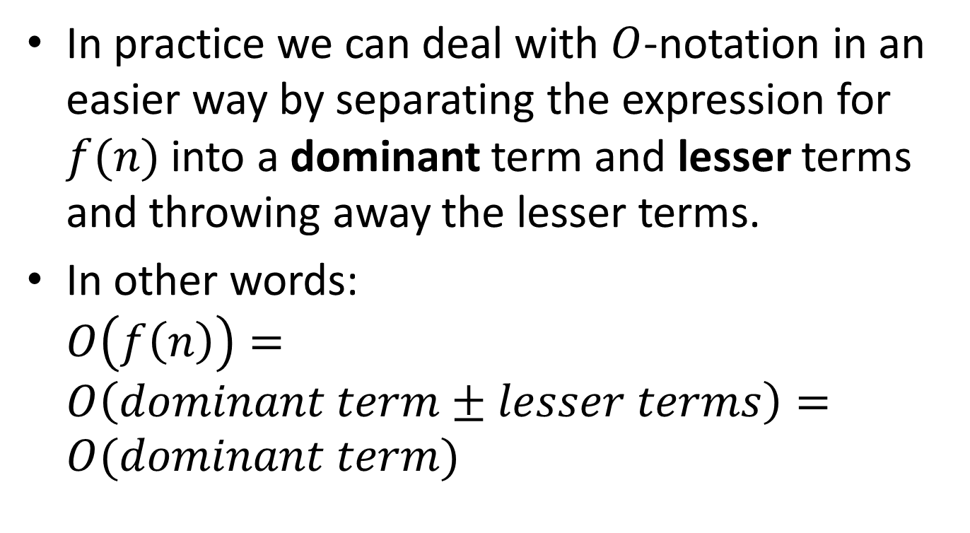
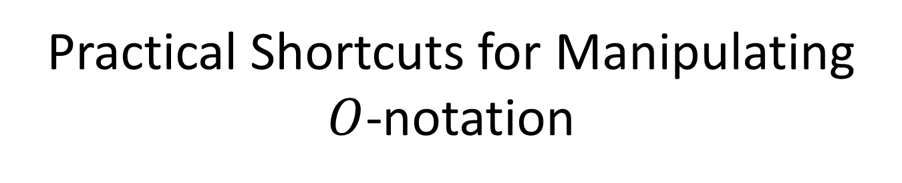
Practical Shortcuts for Manipulating
$O$-notation
In practice we can deal with $O$-notation in an easier way by separating the expression for $f(n)$into a dominant term and lesser terms and throwing away the lesser terms.
In other words: $O\left(f\left(n\right)\right)=O\left(dominant term±lesser terms\right)=O(dominant term)$

Slide 32
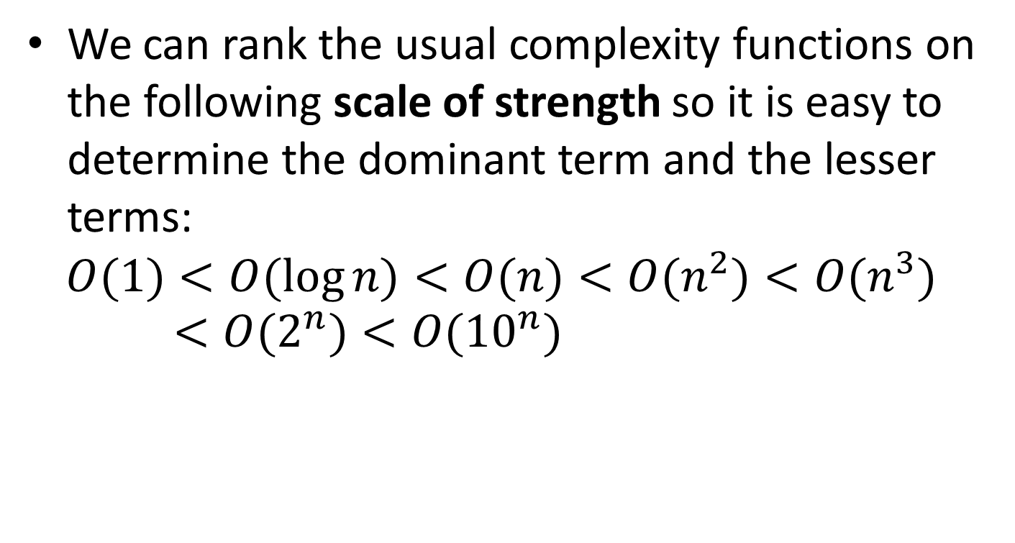
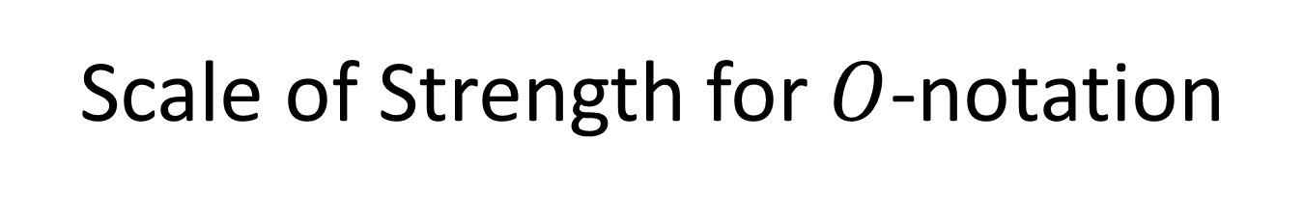
Scale of Strength for $O$-notation
We can rank the usual complexity functions on the following scale of strength so it is easy to determine the dominant term and the lesser terms:
$$O(1)<O(\log{n})<O(n)<O(n^{2})<O(n^{3})<O(2^{n})<O({10}^{n})$$

Slide 33
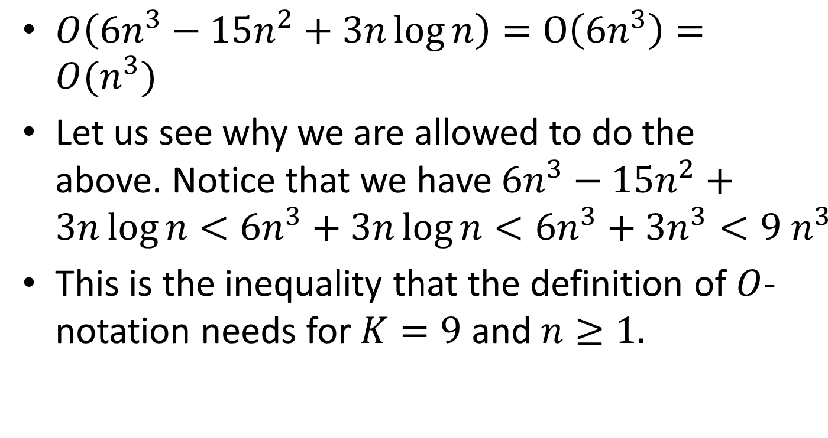
Example
$O\left(6n^{3}−15n^{2}+3n\log{n}\right)=O\left(6n^{3}\right)=O(n^{3})$
Let us see why we are allowed to do the above. Notice that we have $6n^{3}−15n^{2}+3n\log{n<6n^{3}+3n\log{n}<6n^{3}+3n^{3}<9{ n}^{3}}$
This is the inequality that the definition of $O$-notation needs for $K=9$ and $n≥1.$

Slide 34
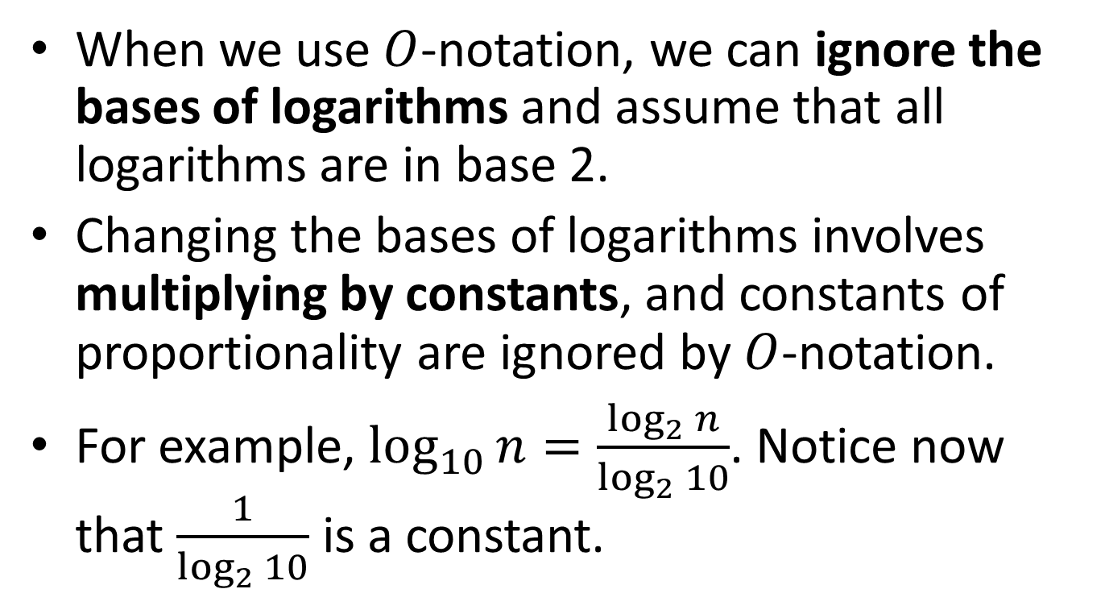
Ignoring Bases of Logarithms
When we use $O$-notation, we can ignore the bases of logarithms and assume that all logarithms are in base 2.
Changing the bases of logarithms involves multiplying by constants, and constants of proportionality are ignored by $O$-notation.
For example, $\log_{10}{n=\frac{\log_{2}{n}}{\log_{2}{10}}}$. Notice now that $\frac{1}{\log_{2}{10}}$ is a constant.

Slide 35
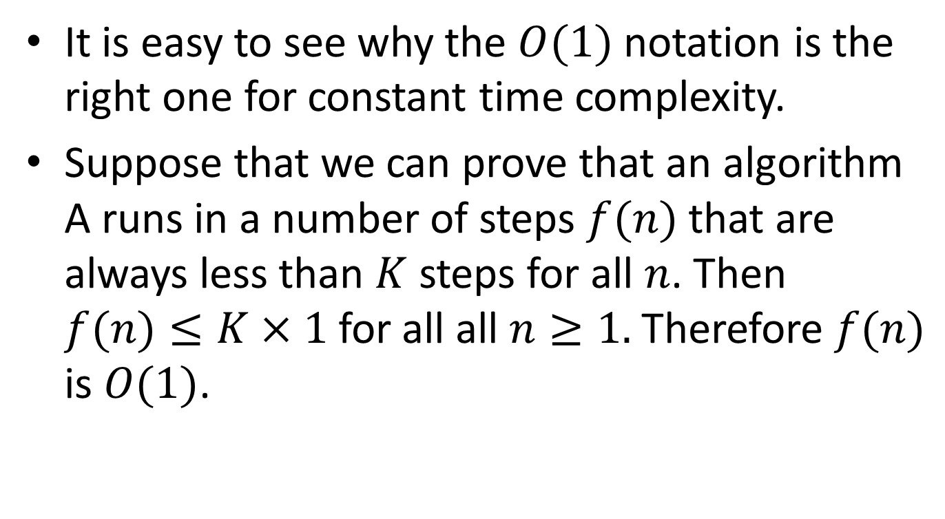

$$O(1)$$
It is easy to see why the $O(1)$ notation is the right one for constant time complexity.
Suppose that we can prove that an algorithm A runs in a number of steps $f(n)$ that are always less than $K$ steps for all $n$. Then $f(n)≤K×1$for all all $n≥1.$ Therefore $f(n)$ is $O(1)$.

Slide 36
Some Algorithms and Their Complexity
Sequential searching
Selection sort
Recursive selection sort
Towers of Hanoi

Slide 37
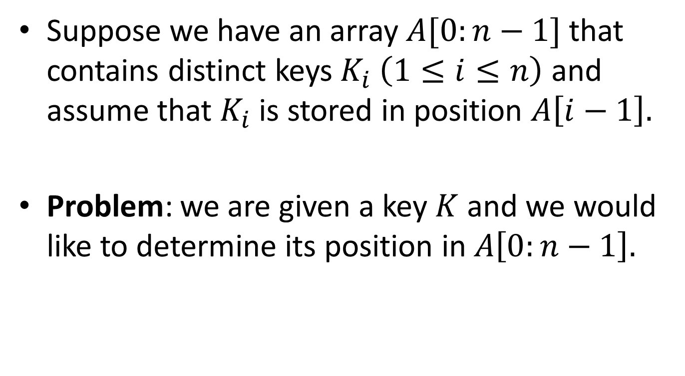
Analysis of Sequential Searching
Suppose we have an array $A[0:n−1]$ that contains distinct keys $K_{i}$ $\left(1≤i≤n\right)$ and assume that $K_{i}$ is stored in position $A\left[i−1\right].$
Problem: we are given a key $K$ and we would like to determine its position in $A\left[0:n−1\right].$

Slide 38
An Algorithm for Sequential Searching
#define n 100
typedef int Key;
typedef Key SearchArray[n];
int SequentialSearch(Key K, SearchArray A)
{
int i;
for (i=0; i<n; ++i){
if (K==A[i]) return i;
}
return(-1);
}

Slide 39
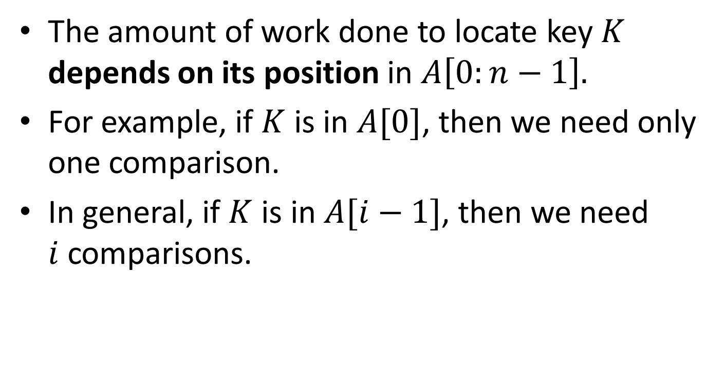
Complexity Analysis
The amount of work done to locate key $K$ depends on its position in $A\left[0:n−1\right].$
For example, if $K$ is in $A[0]$, then we need only one comparison.
In general, if $K$ is in $A[i−1]$, then we need $i$comparisons.

Slide 40
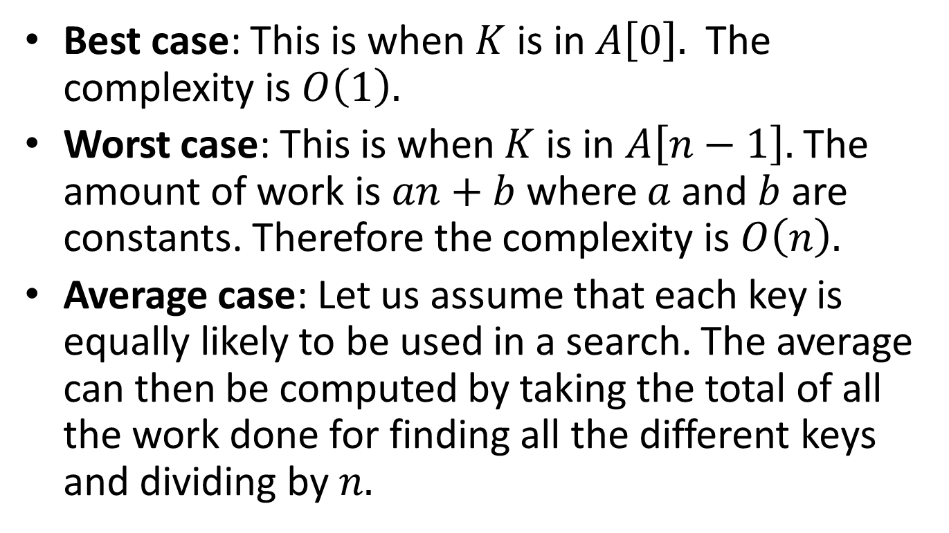
Complexity Analysis (cont’d)
Best case: This is when $K$ is in $A\left[0\right].$ The complexity is $O\left(1\right).$
Worst case: This is when $K$ is in $A\left[n−1\right].$ The amount of work is $an+b$where $a$ and $b$ are constants. Therefore the complexity is $O\left(n\right).$
Average case: Let us assume that each key is equally likely to be used in a search. The average can then be computed by taking the total of all the work done for finding all the different keys and dividing by $n.$

Slide 41
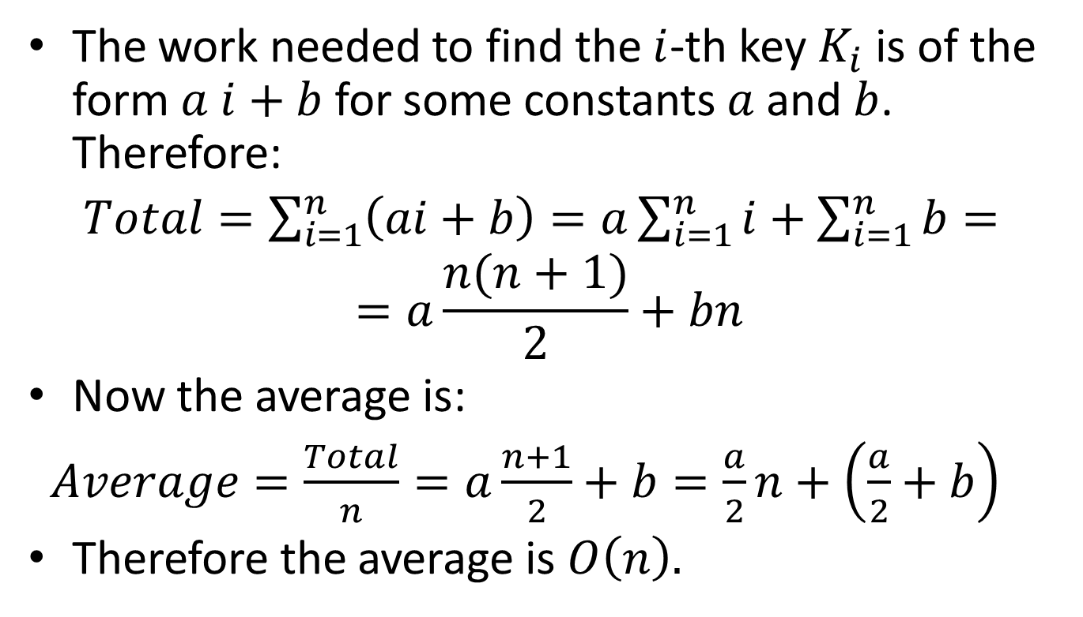
Complexity Analysis (cont’d)
The work needed to find the $i$-th key $K_{i}$ is of the form $a i+b$ for some constants $a$and $b$. Therefore:
$Total=\sum_{i=1}^{n}{\left(ai+b\right)=a\sum_{i=1}^{n}{i}}+\sum_{i=1}^{n}{b=}$
$$=a\frac{n(n+1)}{2}+bn$$
Now the average is:
$Average=\frac{Total}{n}=a\frac{n+1}{2}+b=\frac{a}{2}n+\left(\frac{a}{2}+b\right)$
Therefore the average is $O\left(n\right).$

Slide 42
Selection Sorting Algorithm
void SelectionSort(InputArray A)
{
int MinPosition, temp, i, j;
for (i=n-1; i>0; --i){
MinPosition=i;
for (j=0; j<i; ++i){
if (A[j] < A[MinPosition]){
MinPosition=j;
}
}
temp=A[i];
A[i]=A[MinPosition];
A[MinPosition]=temp;
}
}

Slide 43
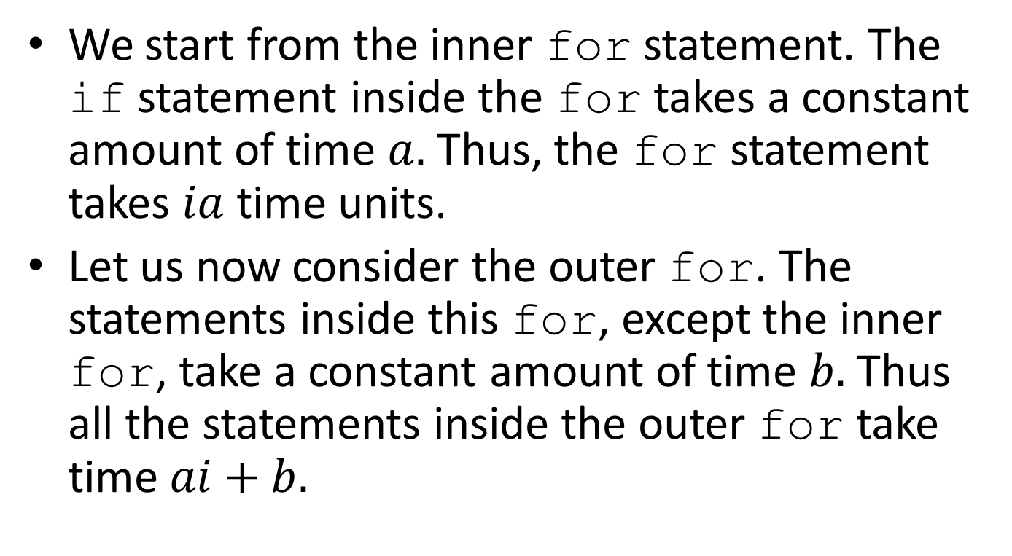
Complexity Analysis of SelectionSort
We start from the inner for statement. The if statement inside the for takes a constant amount of time $a.$ Thus, the for statement takes $ia$ time units.
Let us now consider the outer for. The statements inside this for, except the inner for, take a constant amount of time $b.$ Thus all the statements inside the outer for take time $ai+b.$

Slide 44
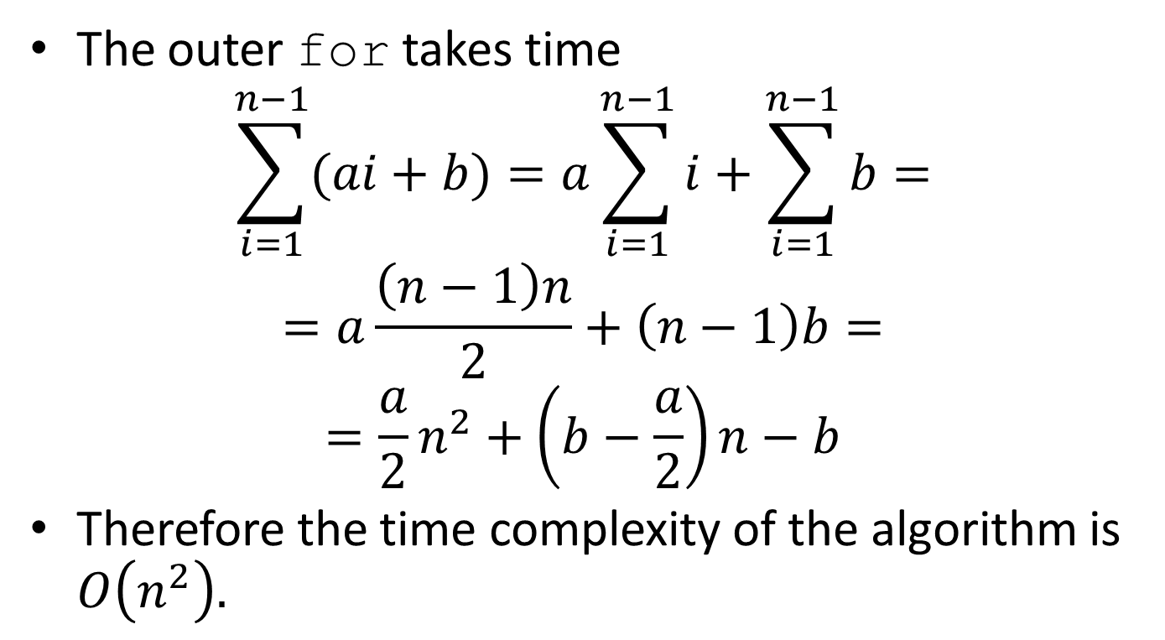
Complexity Analysis (cont’d)
The outer for takes time
$$\sum_{i=1}^{n−1}{(ai+b)=a\sum_{i=1}^{n−1}{i+\sum_{i=1}^{n−1}{b=}}}$$
$$=a\frac{\left(n−1\right)n}{2}+\left(n−1\right)b=$$
$$=\frac{a}{2}n^{2}+\left(b−\frac{a}{2}\right)n−b$$
Therefore the time complexity of the algorithm is $O\left(n^{2}\right).$

Slide 45
Recursive SelectionSort
/* FindMin is an auxiliary function used by the Selection sort below */
int FindMin(InputArray A, int n)
{
int i,j=n;
for (i=0; i<n; ++i) if (A[i]<A[j]) j=i;
return j;
}
void SelectionSort(InputArray A, int n)
{
int MinPosition, temp;
if (n>0){
MinPosition=FindMin(A,n);
temp=A[n]; A[n]=A[MinPosition]; A[MinPosition]=temp;
SelectionSort(A, n-1)
}
}

Slide 46
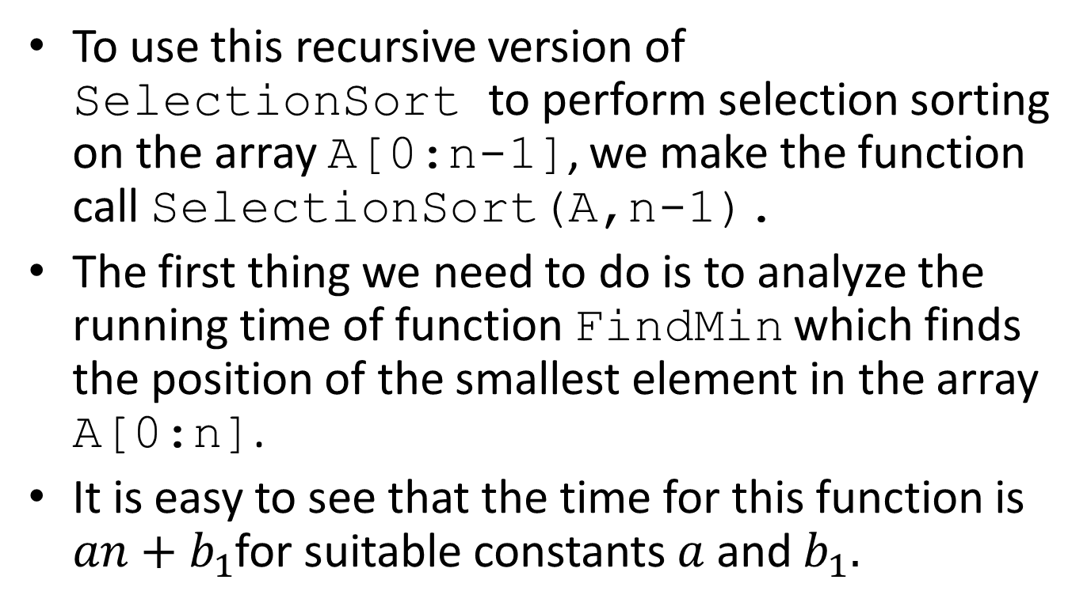
Analysis of Recursive SelectionSort
To use this recursive version of SelectionSort to perform selection sorting on the array A[0:n-1], we make the function call SelectionSort(A,n-1).
The first thing we need to do is to analyze the running time of function FindMin which finds the position of the smallest element in the array A[0:n].
It is easy to see that the time for this function is $an+b_{1}$for suitable constants $a$ and $b_{1}.$

Slide 47
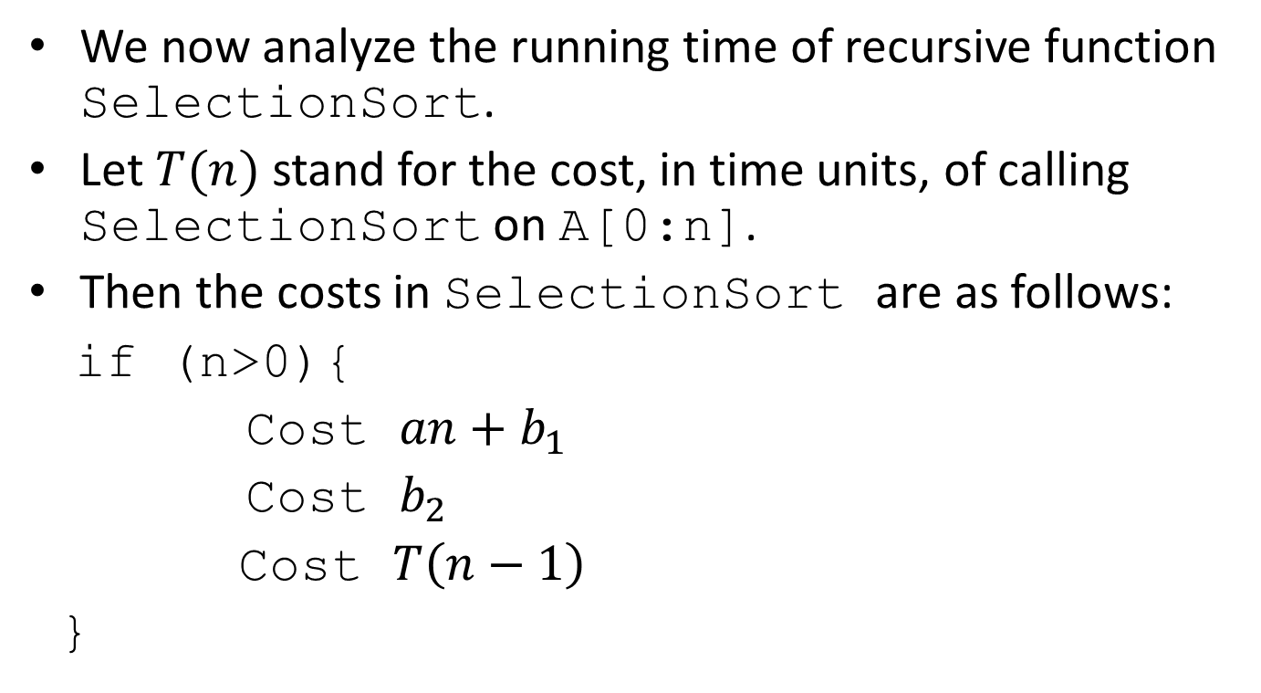
Analysis of Recursive SelectionSort (cont’d)
We now analyze the running time of recursive function SelectionSort.
Let $T(n)$ stand for the cost, in time units, of calling SelectionSort on A[0:n].
Then the costs in SelectionSort are as follows:
if (n>0){
Cost $an+b_{1}$
Cost $b_{2}$
Cost $T\left(n−1\right)$
}

Slide 48
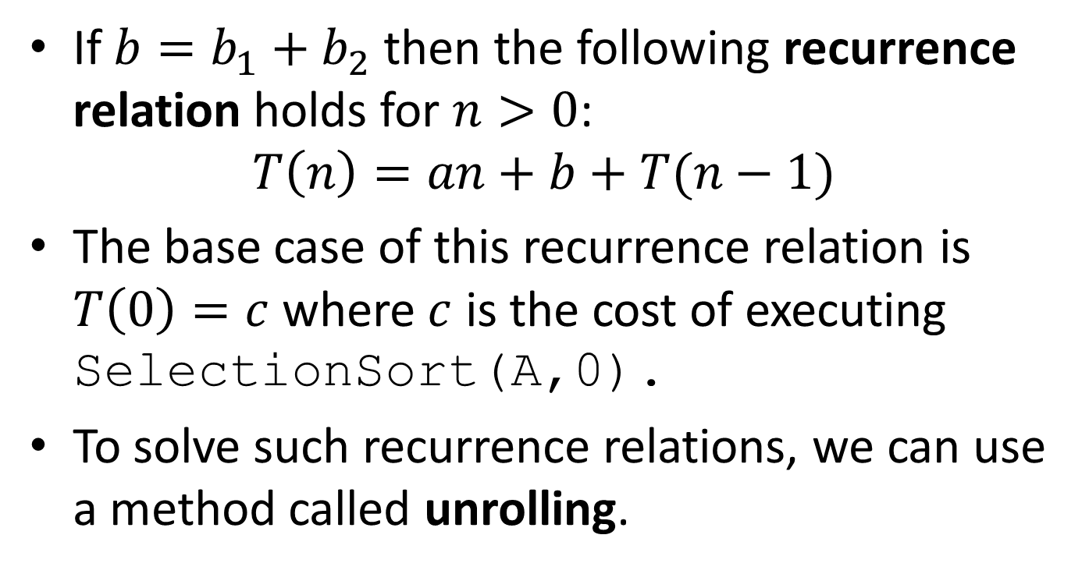
Analysis of Recursive SelectionSort (cont’d)
If $b=b_{1}+b_{2}$ then the following recurrence relation holds for $n>0$:
$$T\left(n\right)=an+b+T(n−1)$$
The base case of this recurrence relation is $T\left(0\right)=c$ where $c$ is the cost of executing SelectionSort(A,0).
To solve such recurrence relations, we can use a method called unrolling.

Slide 49
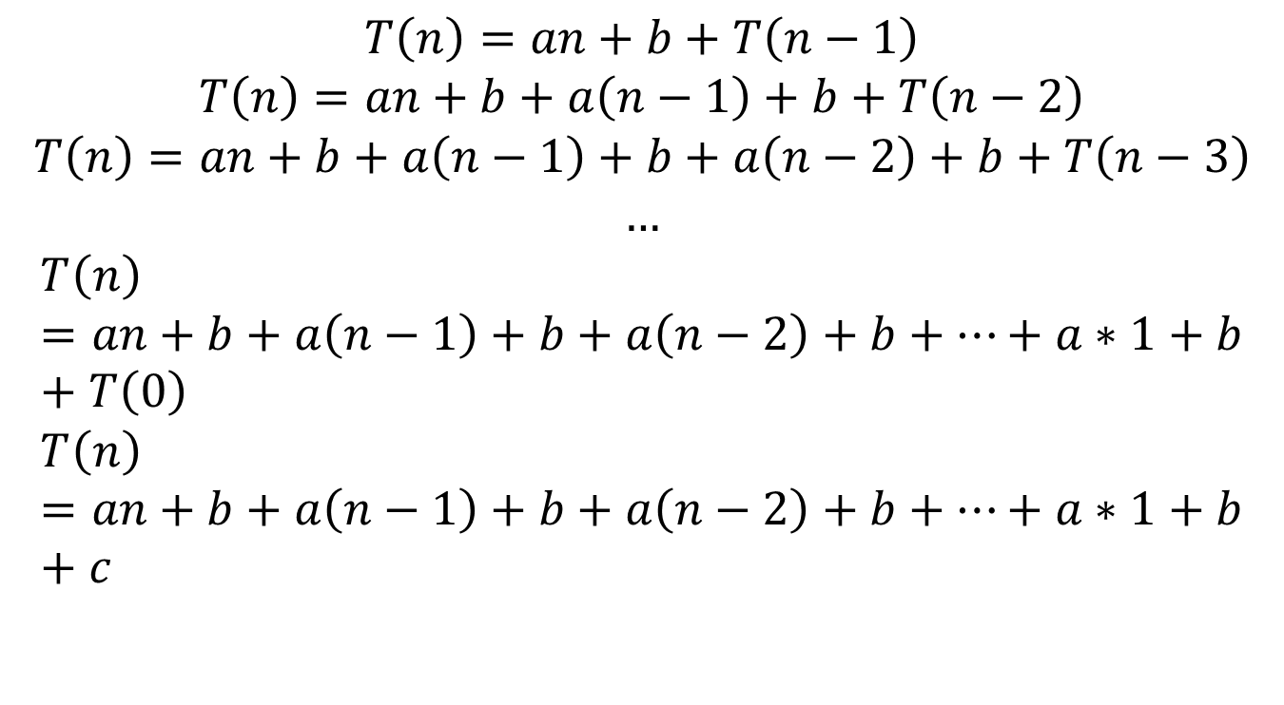
Analysis of Recursive SelectionSort (cont’d)
$$T\left(n\right)=an+b+T\left(n−1\right)$$
$$T\left(n\right)=an+b+a\left(n−1\right)+b+T\left(n−2\right)$$
$$T\left(n\right)=an+b+a\left(n−1\right)+b+a\left(n−2\right)+b+T\left(n−3\right)$$
$$…$$
$$T\left(n\right)=an+b+a\left(n−1\right)+b+a\left(n−2\right)+b+⋯+a∗1+b+T\left(0\right)$$
$$T\left(n\right)=an+b+a\left(n−1\right)+b+a\left(n−2\right)+b+⋯+a∗1+b+c$$

Slide 50
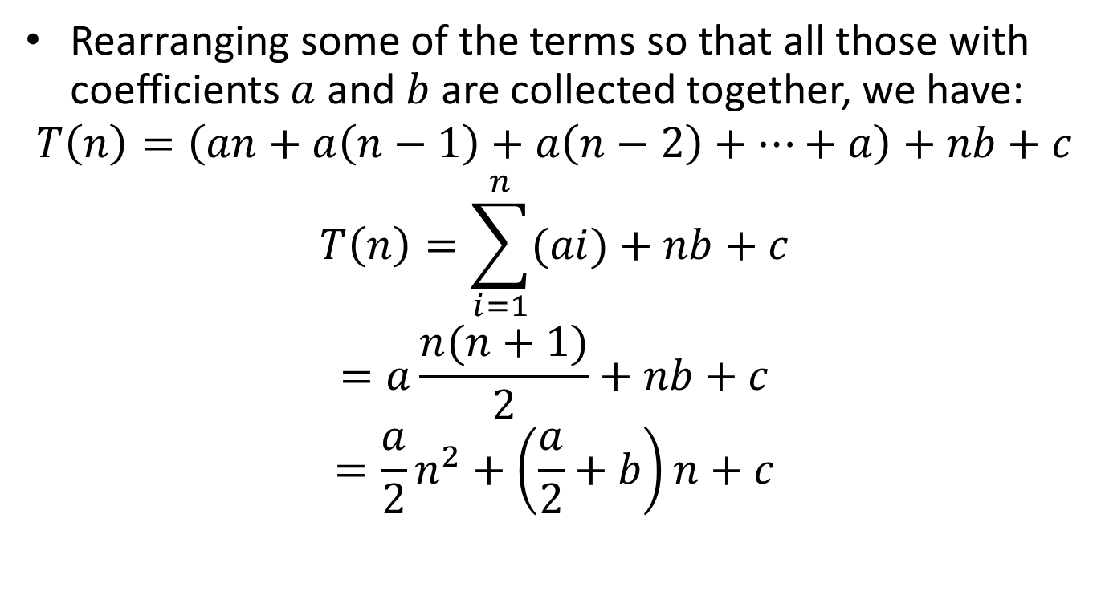
Analysis of Recursive SelectionSort (cont’d)
Rearranging some of the terms so that all those with coefficients $a$ and $b$ are collected together, we have:
$$T\left(n\right)=\left(an+a\left(n−1\right)+a\left(n−2\right)+⋯+a\right)+nb+c$$
$$T\left(n\right)=\sum_{i=1}^{n}{(ai)}+nb+c$$
$$=a\frac{n(n+1)}{2}+nb+c$$
$$=\frac{a}{2}n^{2}+\left(\frac{a}{2}+b\right)n+c$$

Slide 51

Analysis of Recursive SelectionSort (cont’d)
Therefore $T(n)$ but also $T(n−1)$ is $O\left(n^{2}\right).$

Slide 52
A Recursive Solution to the Towers of Hanoi
void MoveTowers(int n, int start, int finish, int spare)
{
if (n==1){
printf(“Move a disk from peg %1d to peg %1d\n”, start, finish);
} else {
MoveTowers(n-1, start, spare, finish);
printf(“Move a disk from peg %1d to peg %1d\n”, start, finish);
MoveTowers(n-1, spare, finish, start);
}
}

Slide 53
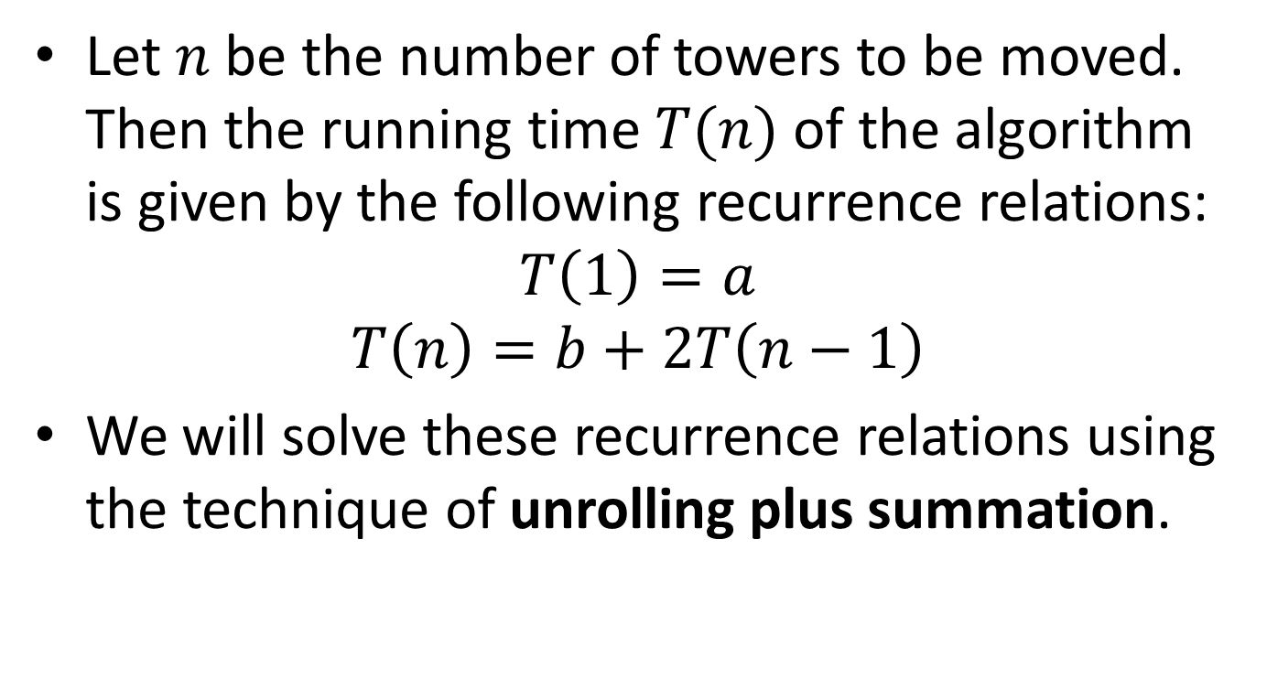
Analysis of Towers of Hanoi
Let $n$ be the number of towers to be moved. Then the running time $T(n)$ of the algorithm is given by the following recurrence relations:
$$T\left(1\right)=a$$
$$T\left(n\right)=b+2T\left(n−1\right)$$
We will solve these recurrence relations using the technique of unrolling plus summation.

Slide 54
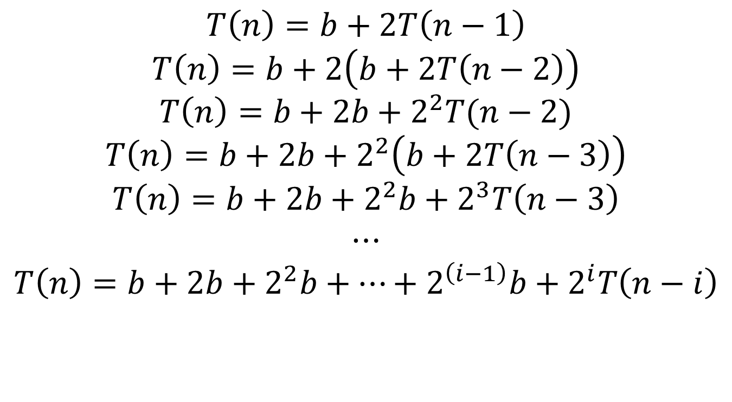
Analysis of Towers of Hanoi (cont’d)
$$T\left(n\right)=b+2T\left(n−1\right)$$
$$T\left(n\right)=b+2\left(b+2T\left(n−2\right)\right)$$
$$T\left(n\right)=b+2b+2^{2}T(n−2)$$
$$T\left(n\right)=b+2b+2^{2}\left(b+2T\left(n−3\right)\right)$$
$$T\left(n\right)=b+2b+2^{2}b+2^{3}T\left(n−3\right)$$
$$⋯$$
$$T\left(n\right)=b+2b+2^{2}b+…+2^{\left(i−1\right)}b+2^{i}T\left(n−i\right)$$

Slide 55
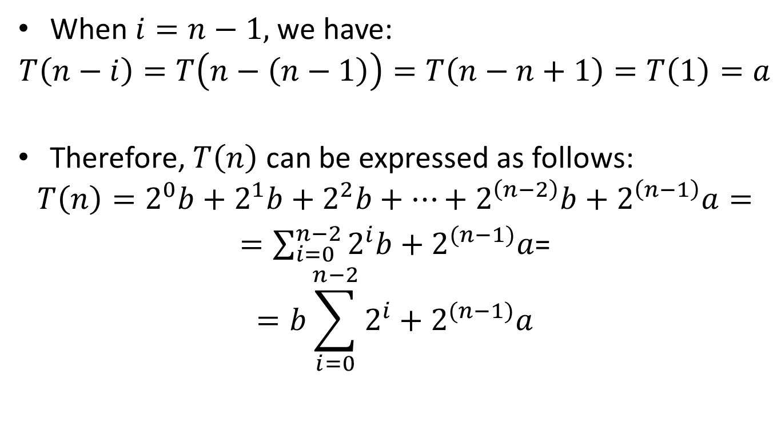
Analysis of Towers of Hanoi (cont’d)
When $i=n−1,$we have:
$$T\left(n−i\right)=T\left(n−\left(n−1\right)\right)=T\left(n−n+1\right)=T\left(1\right)=a$$
Therefore, $T\left(n\right)$ can be expressed as follows:
$$T\left(n\right)=2^{0}b+2^{1}b+2^{2}b+…+2^{\left(n−2\right)}b+2^{\left(n−1\right)}a=$$
$=\sum_{i=0}^{n−2}{2^{i}b+2^{(n−1)}a}$=
$$=b\sum_{i=0}^{n−2}{2^{i}}+2^{(n−1)}a$$

Slide 56
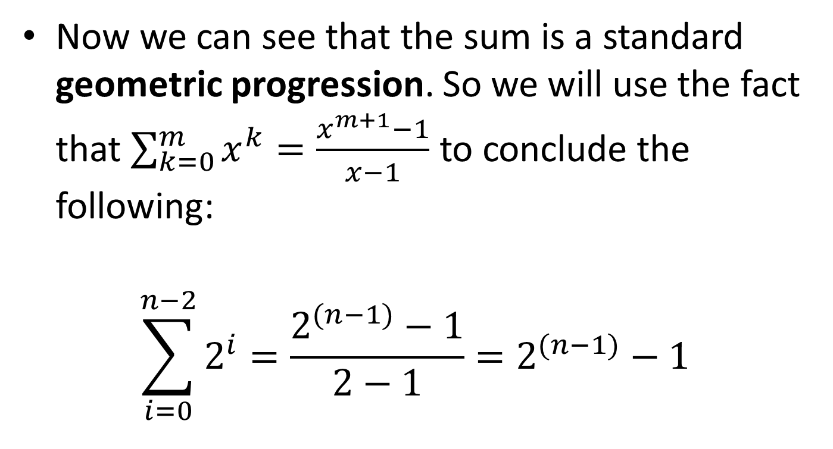
Analysis of Towers of Hanoi (cont’d)
Now we can see that the sum is a standard geometric progression. So we will use the fact that $\sum_{k=0}^{m}{x^{k}}=\frac{x^{m+1}−1}{x−1}$ to conclude the following:
$$\sum_{i=0}^{n−2}{2^{i}}=\frac{2^{(n−1)}−1}{2−1}=2^{(n−1)}−1$$

Slide 57
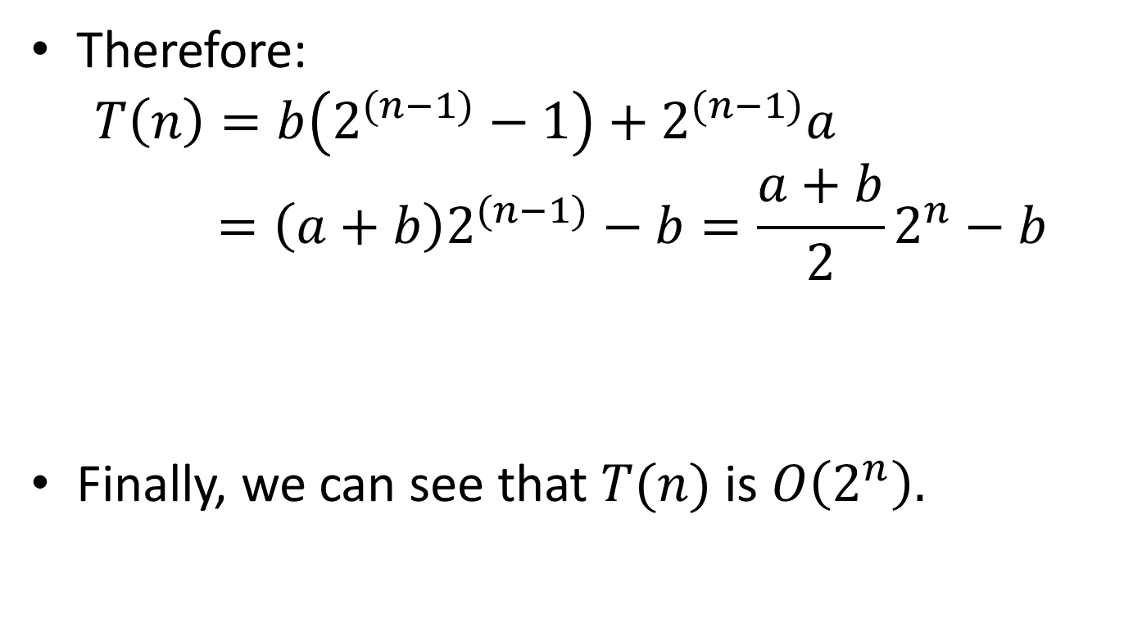
Analysis of Towers of Hanoi (cont’d)
Therefore:
$$T\left(n\right)=b\left(2^{(n−1)}−1\right)+2^{(n−1)}a=\left(a+b\right)2^{(n−1)}−b=\frac{a+b}{2}2^{n}−b$$
Finally, we can see that $T(n)$ is $O\left(2^{n}\right).$

Slide 58
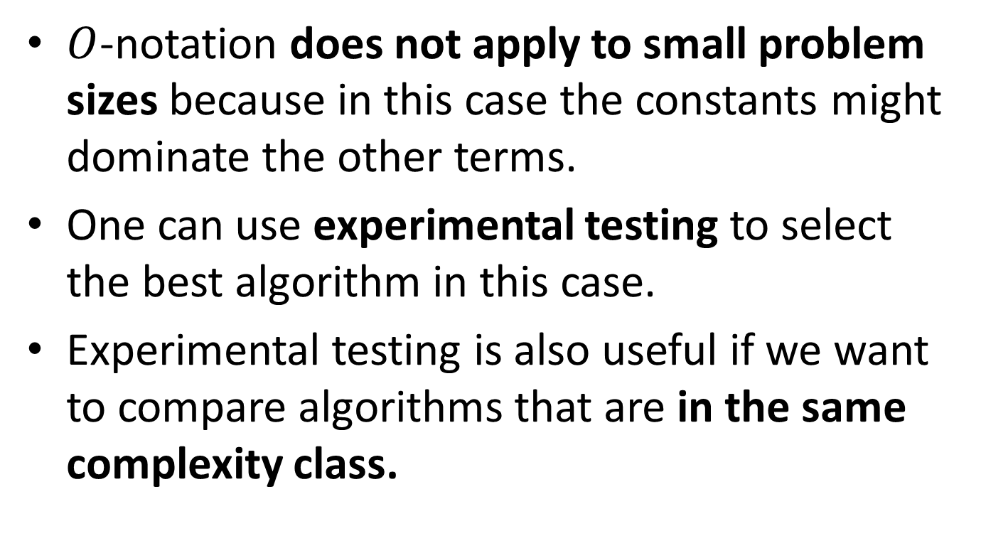

What $O$-notation Does Not Tell You
$O$-notation does not apply to small problem sizes because in this case the constants might dominate the other terms.
One can use experimental testing to select the best algorithm in this case.
Experimental testing is also useful if we want to compare algorithms that are in the same complexity class.

Slide 59
Space Complexity
In a similar way, we can measure the space complexity of an algorithm.

Slide 60

Other notations
There also other complexity notations such as $o\left(n\right), Θ\left(n\right), Ω\left(n\right),ω\left(n\right).$
More details in the Algorithms course.

Slide 61
Readings
T. A. Standish. Data Structures, Algorithms and Software Principles in C.
Chapter 6.
Robert Sedgewick. Αλγόριθμοι σε C.
Κεφ. 2.

