Slide 1
Red-Black Trees
Manolis Koubarakis

Slide 2
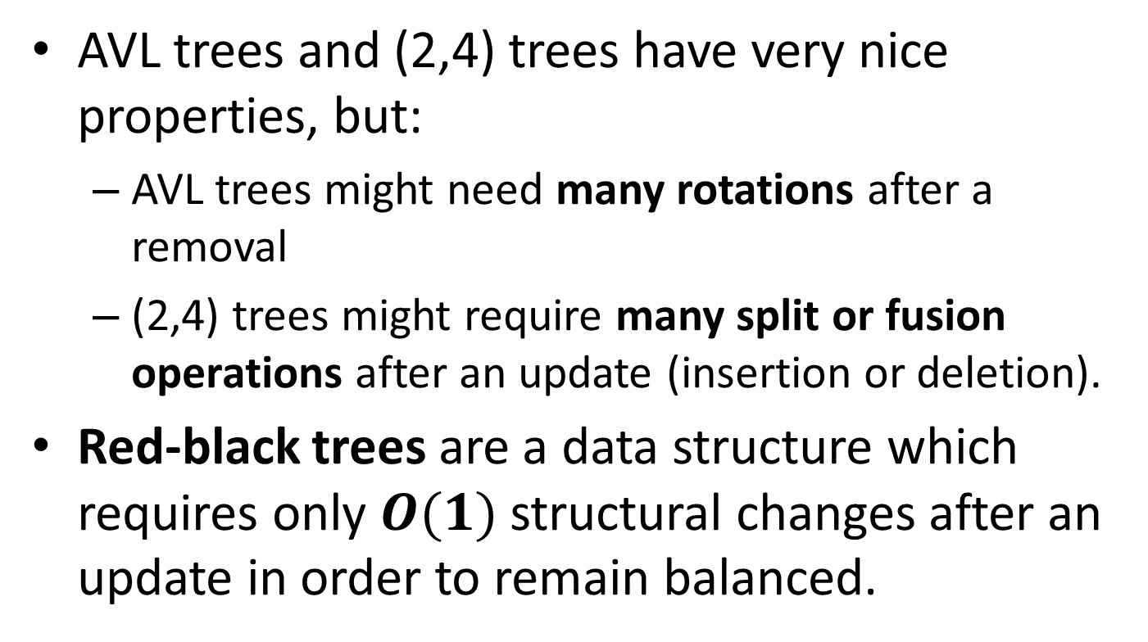
Red-Black Trees
AVL trees and (2,4) trees have very nice properties, but:
  AVL trees might need many rotations after a removal
  (2,4) trees might require many split or fusion operations after an update (insertion or deletion).
Red-black trees are a data structure which requires only $O(1)$ structural changes after an update in order to remain balanced.

Slide 3
Definition
A red-black tree is a binary search tree with nodes colored red and black in a way that satisfies the following properties:
  Root Property: The root is black.
  External Property: Every external node is black.
  Internal Property: The children of a red node are black.
  Depth Property: All the external nodes have the same black depth, defined as the number of black ancestors minus one (recall that a node is an ancestor of itself).

Slide 4
Example Red-Black Tree
12
5
15
3
10
13
17
14
4
7
11
6
8
In our figures, we use light blue color instead of black.

Slide 5
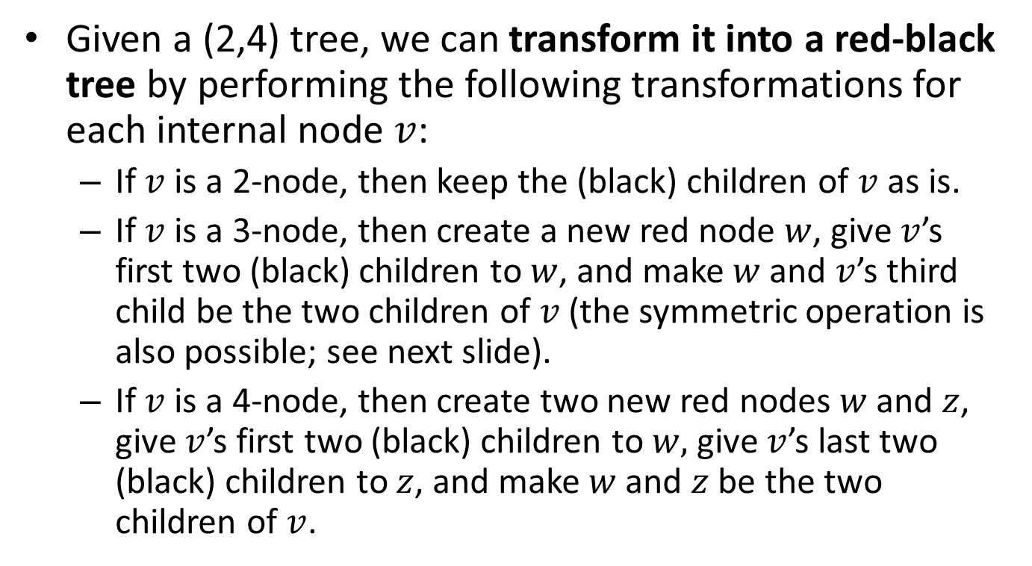
From (2,4) Trees to Red-Black Trees
Given a (2,4) tree, we can transform it into a red-black tree by performing the following transformations for each internal node $v$:
  If $v$ is a 2-node, then keep the (black) children of $v$ as is.
  If $v$ is a 3-node, then create a new red node $w$, give $v$’s first two (black) children to $w$, and make $w$ and $v$’s third child be the two children of $v$(the symmetric operation is also possible; see next slide).
  If $v$ is a 4-node, then create two new red nodes $w$ and $z$, give $v$’s first two (black) children to $w,$give $v$’s last two (black) children to $z$, and make $w$ and $z$ be the two children of $v$.

Slide 6
From (2,4) Trees to Red-Black Trees (cont’d)
15
15
13 14
13
14
14
13
6 7 8
7
6
8

Slide 7
Example (2,4) Tree
12
5 10
15
3 4
6 7 8
13 14
17
11

Slide 8
Corresponding Red-Black Tree
12
5
15
3
10
13
17
14
4
7
11
6
8

Slide 9
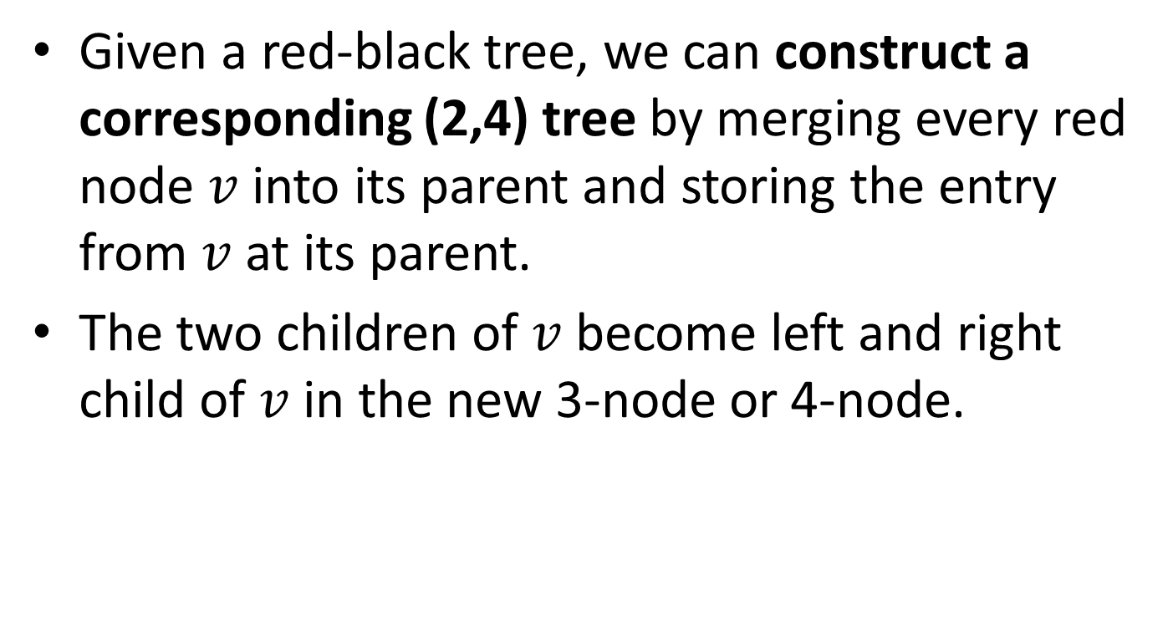
From Red-Black Trees to (2,4) Trees
Given a red-black tree, we can construct a corresponding (2,4) tree by merging every red node $v$ into its parent and storing the entry from $v$ at its parent.
The two children of $v$ become left and right child of $v$ in the new 3-node or 4-node.

Slide 10
Example Red-Black Tree
12
5
15
3
10
13
17
14
4
7
11
6
8

Slide 11
Corresponding (2,4) Tree
12
5 10
15
3 4
6 7 8
13 14
17
11

Slide 12

Proposition
The height of a red-black tree storing $n$ entries is $O(\log{n})$.
Proof?

Slide 13
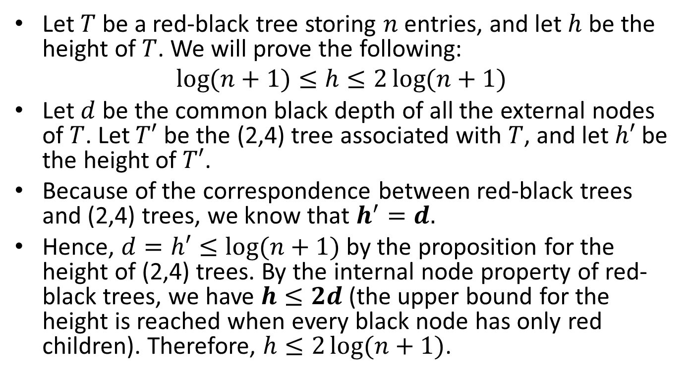
Proof
Let $T$ be a red-black tree storing $n$ entries, and let $h$ be the height of $T$. We will prove the following:
$$\log{(n+1)}≤h≤2\log{(n+1)}$$
Let $d$ be the common black depth of all the external nodes of $T$. Let $T′$ be the (2,4) tree associated with $T$, and let $h′$ be the height of $T′$.
Because of the correspondence between red-black trees and (2,4) trees, we know that $h^{′}=d.$
Hence, $d=h′≤\log{(n+1)}$ by the proposition for the height of (2,4) trees. By the internal node property of red-black trees, we have $h≤2d$(the upper bound for the height is reached when every black node has only red children). Therefore, $h≤2\log{(n+1)}$.

Slide 14

Proof (cont’d)
The other inequality, $\log{(n+1)}≤h$ follows from the properties of proper binary trees and the fact that $T$ has $n$ internal nodes.

Slide 15
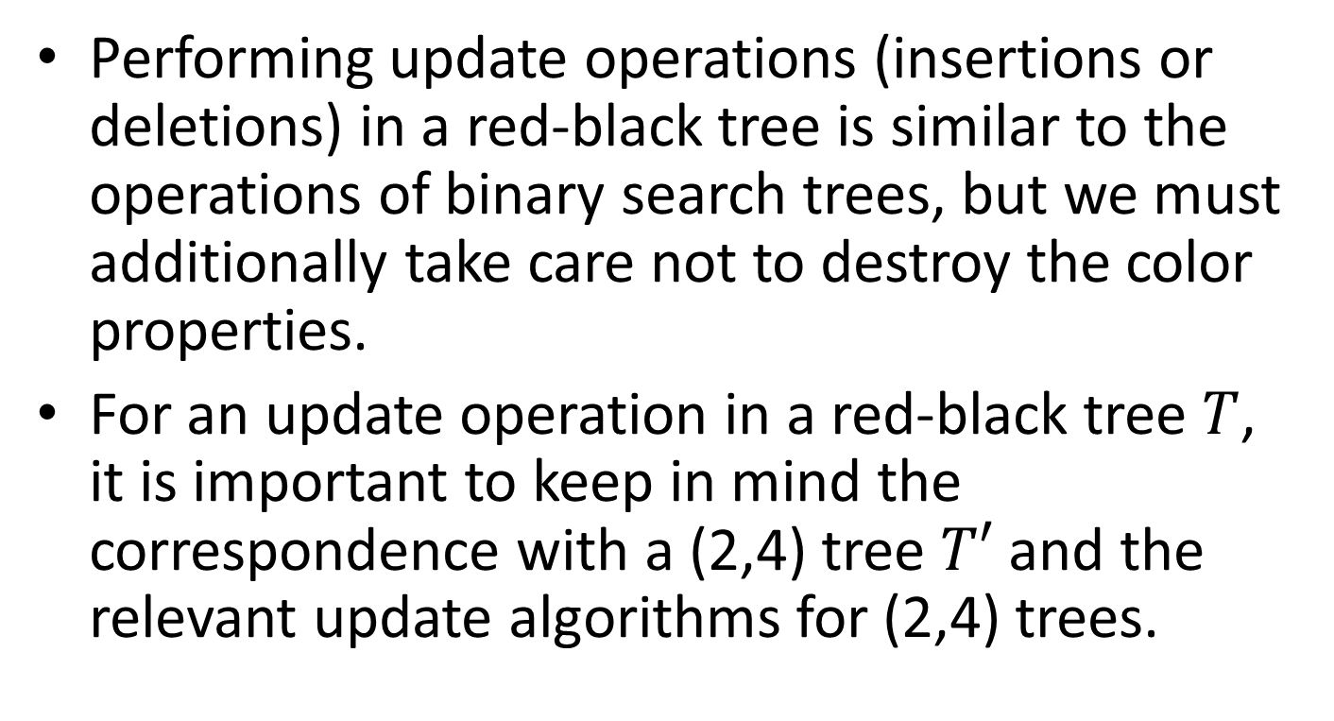
Updates
Performing update operations (insertions or deletions) in a red-black tree is similar to the operations of binary search trees, but we must additionally take care not to destroy the color properties.
For an update operation in a red-black tree $T$, it is important to keep in mind the correspondence with a (2,4) tree $T′$ and the relevant update algorithms for (2,4) trees.

Slide 16
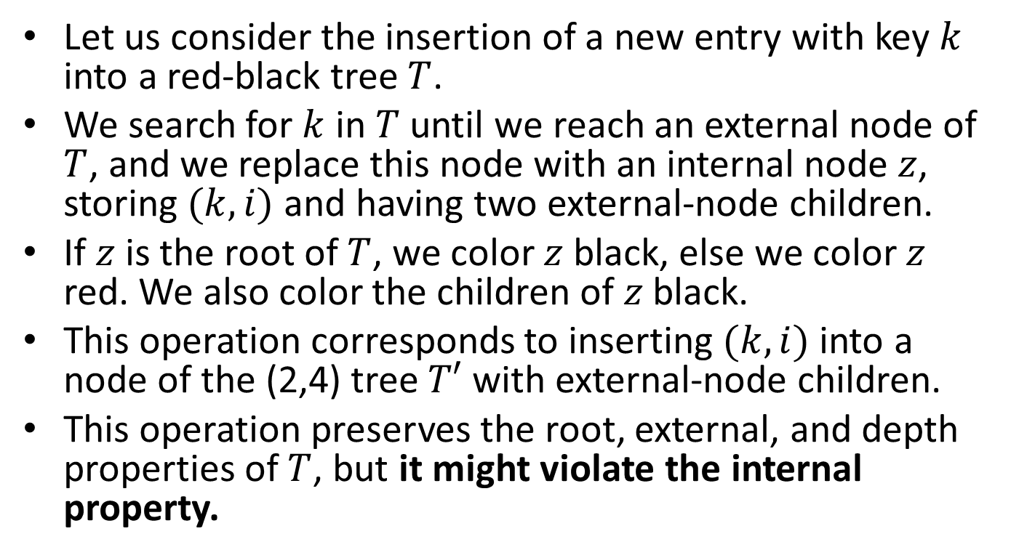
Insertion
Let us consider the insertion of a new entry with key $k$ into a red-black tree $T$.
We search for $k$ in $T$ until we reach an external node of $T$, and we replace this node with an internal node $z$, storing $(k,i)$ and having two external-node children.
If $z$ is the root of $T$, we color $z$ black, else we color $z$ red. We also color the children of $z$ black.
This operation corresponds to inserting $(k,i)$ into a node of the (2,4) tree $T′$ with external-node children.
This operation preserves the root, external, and depth properties of $T$, but it might violate the internal property.

Slide 17
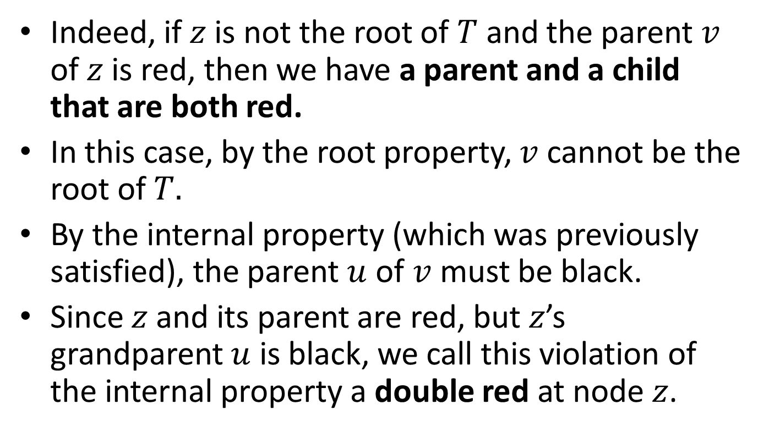
Insertion (cont’d)
Indeed, if $z$ is not the root of $T$ and the parent $v$ of $z$ is red, then we have a parent and a child that are both red.
In this case, by the root property, $v$ cannot be the root of $T.$
By the internal property (which was previously satisfied), the parent $u$ of $v$ must be black.
Since $z$ and its parent are red, but $z$’s grandparent $u$ is black, we call this violation of the internal property a double red at node $z$.

Slide 18
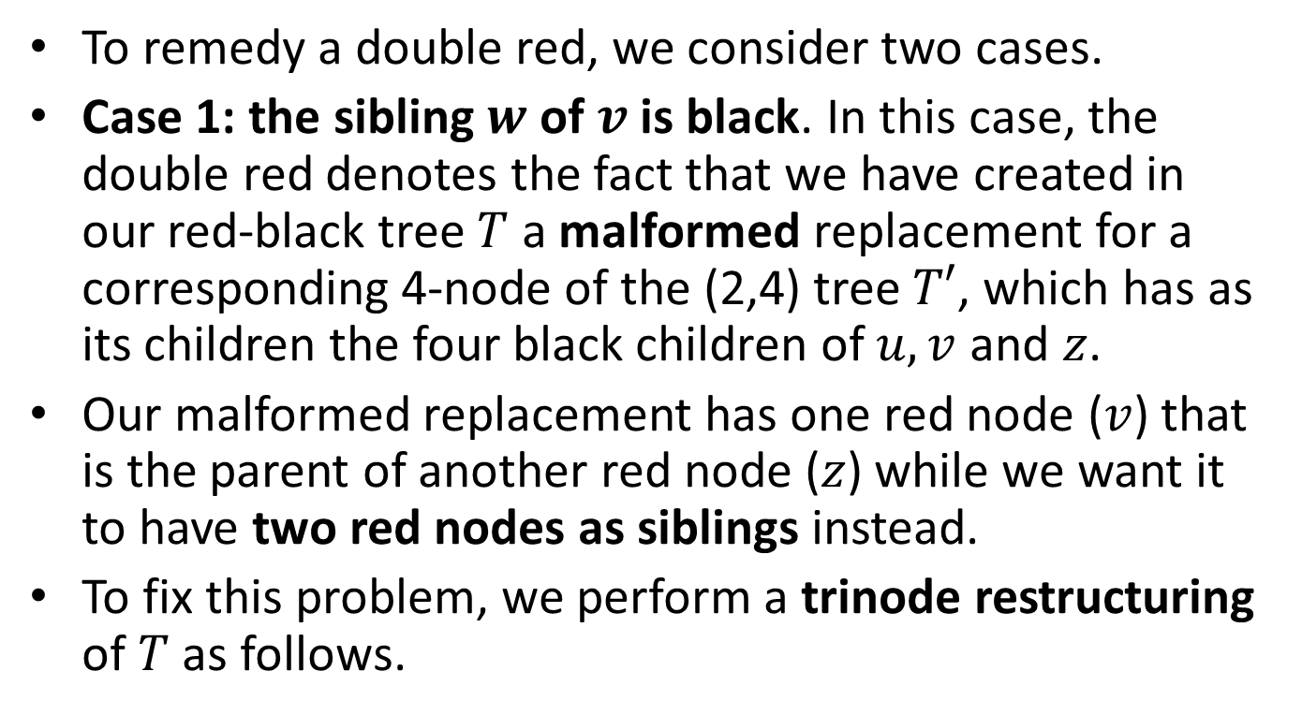
Insertion (cont’d)
To remedy a double red, we consider two cases.
Case 1: the sibling $w$ of $v$ is black. In this case, the double red denotes the fact that we have created in our red-black tree $T$ a malformed replacement for a corresponding 4-node of the (2,4) tree $T′$, which has as its children the four black children of $u,v$ and $z$.
Our malformed replacement has one red node ($v$) that is the parent of another red node ($z$) while we want it to have two red nodes as siblings instead.
To fix this problem, we perform a trinode restructuring of $T$ as follows.

Slide 19
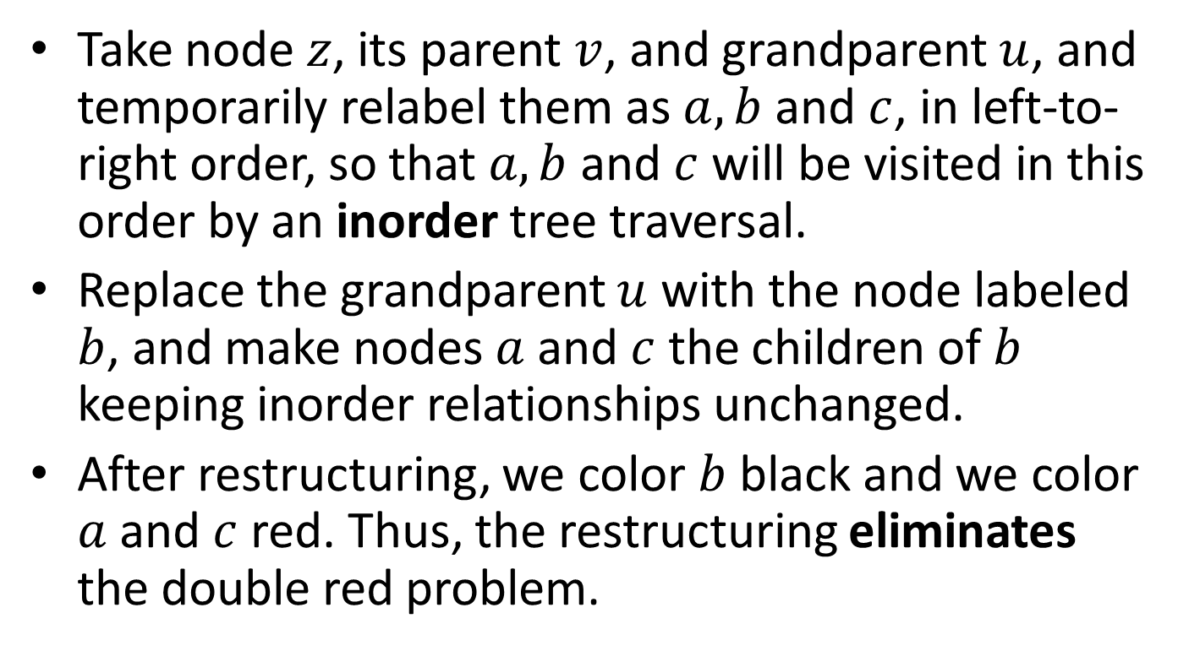
Trinode Restructuring
Take node $z$, its parent $v$, and grandparent $u$, and temporarily relabel them as $a,b$ and $c$, in left-to-right order, so that $a,b$ and $c$ will be visited in this order by an inorder tree traversal.
Replace the grandparent $u$ with the node labeled $b$, and make nodes $a$ and $c$ the children of $b$ keeping inorder relationships unchanged.
After restructuring, we color $b$ black and we color $a$ and $c$ red. Thus, the restructuring eliminates the double red problem.

Slide 20
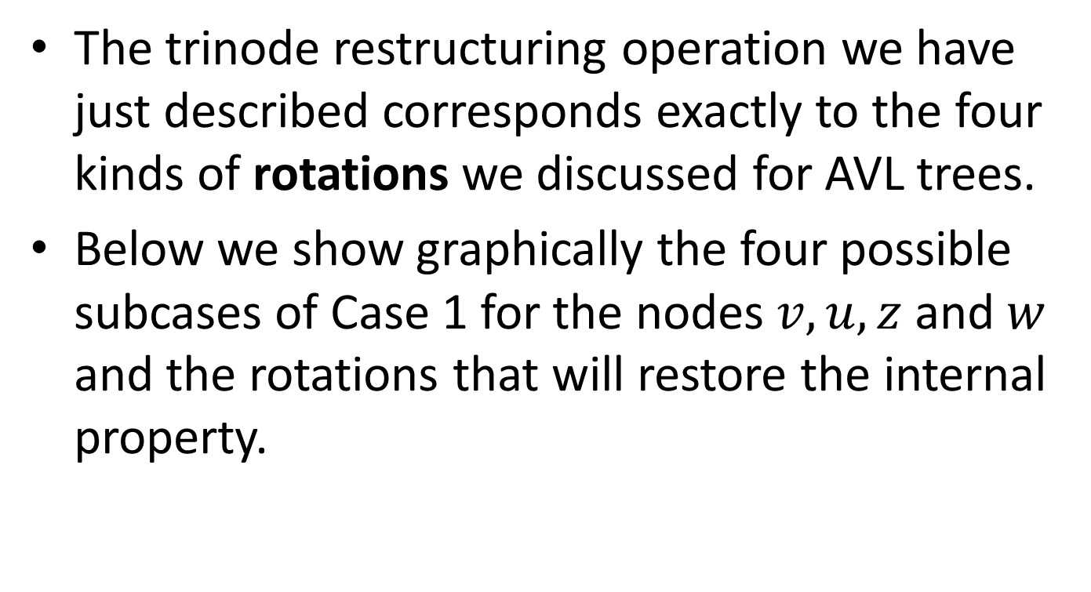
Trinode Restructuring vs. Rotations
The trinode restructuring operation we have just described corresponds exactly to the four kinds of rotations we discussed for AVL trees.
Below we show graphically the four possible subcases of Case 1 for the nodes $v,u,z$ and $w$ and the rotations that will restore the internal property.

Slide 21









Trinode Restructuring Graphically
Right rotation at $u$
$$b$$
$$u$$
30
20
$$v$$
20
$$w$$
$$a$$
10
30
$$c$$
$$z$$
10
$$w$$

Slide 22



Trinode Restructuring Graphically (cont’d)
Double left-right rotation at $v$ and $u$ (first a left rotation at $v$ then a right rotation at $u$).
$$b$$
$$u$$
30
20
$$v$$
10
$$w$$
$$a$$
10
30
$$c$$
$$z$$
20
$$w$$

Slide 23




Trinode Restructuring Graphically (cont’d)
Left rotation at $u$
$$b$$
$$u$$
10
20
$$w$$
$$v$$
20
$$a$$
10
30
$$c$$
$$z$$
30
$$w$$

Slide 24




Trinode Restructuring Graphically (cont’d)
Double right-left rotation at $v$ and $u$ (first a right rotation at $v$ then a left rotation at $u$).
$$b$$
$$u$$
10
20
$$w$$
$$v$$
30
$$a$$
10
30
$$c$$
$$z$$
20
$$w$$

Slide 25
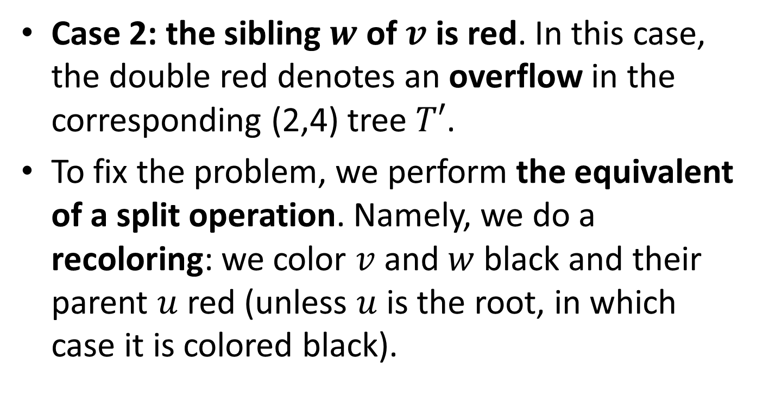
Insertion (cont’d)
Case 2: the sibling $w$ of $v$ is red. In this case, the double red denotes an overflow in the corresponding (2,4) tree $T′$.
To fix the problem, we perform the equivalent of a split operation. Namely, we do a recoloring: we color $v$ and $w$ black and their parent $u$ red (unless $u$ is the root, in which case it is colored black).

Slide 26




Overflow
$$u$$
30
10 20 30 40
$$v$$
20
40
$$w$$
$$z$$
10

Slide 27
Recoloring
$$u$$
… 30 …
30
…
…
10 20
40
$$v$$
20
40
$$w$$
$$z$$
10

Slide 28
Recoloring vs. Trinode Restructuring
The trinode restructuring operation involves a local restructuring of the tree (implemented by pointer manipulation) and changes in color.
Recoloring only needs changes in color and the structure of the tree does not change.
The term “recoloring” should be used in the case of trinode restructuring although colors change in that case too.

Slide 29
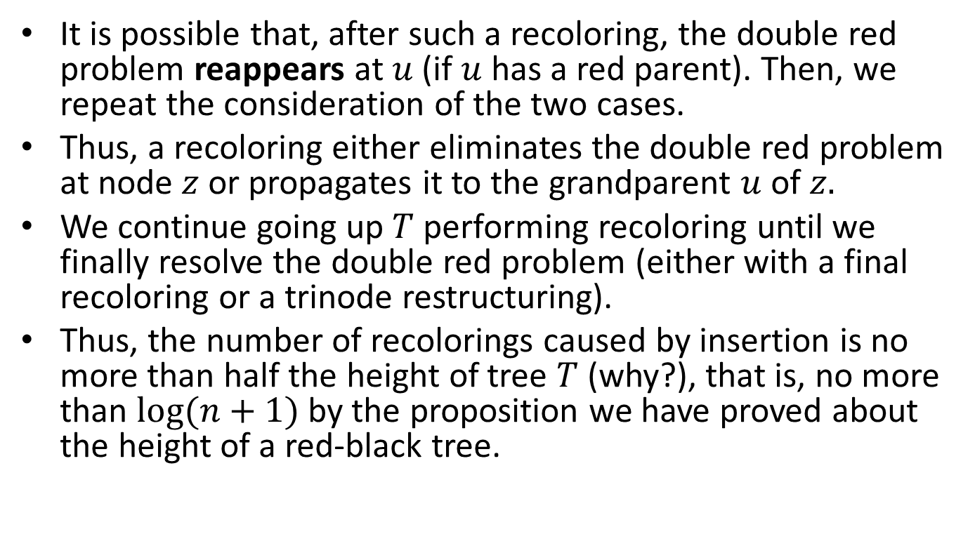
Insertion (cont’d)
It is possible that, after such a recoloring, the double red problem reappears at $u$ (if $u$ has a red parent). Then, we repeat the consideration of the two cases.
Thus, a recoloring either eliminates the double red problem at node $z$ or propagates it to the grandparent $u$ of $z.$
We continue going up $T$ performing recoloring until we finally resolve the double red problem (either with a final recoloring or a trinode restructuring).
Thus, the number of recolorings caused by insertion is no more than half the height of tree $T$ (why?), that is, no more than $\log{(n+1)}$ by the proposition we have proved about the height of a red-black tree.

Slide 30
Example
Let us now see some examples of insertions in an initially empty red-black tree.

Slide 31
Initial Empty Tree

Slide 32
Insert 4
Easy.
4

Slide 33
Insert 7
Easy.
4
7

Slide 34
Insert 12 – Double Red
We are in Case 1. We will do a trinode restructuring (left rotation at 4).
4
7
12

Slide 35
After Restructuring
7
4
12

Slide 36
Insert 15 – Double Red
We are in Case 2. We will do a recoloring.
7
4
12
15

Slide 37
After Recoloring
7
4
12
15

Slide 38
Insert 3
Easy.
7
4
12
3
15

Slide 39
Insert 5
Easy.
7
4
12
3
5
15

Slide 40
Insert 14 – Double Red
We are in Case 1. We will do a trinode restructuring (double right-left rotation at 15 and 12).
7
4
12
3
5
15
14

Slide 41
After Restructuring
7
4
14
3
5
12
15

Slide 42
Insertion of 18 – Double Red
We are in Case 2. We will do a recoloring.
7
4
14
3
5
12
15
18

Slide 43
After Recoloring
7
4
14
3
5
12
15
18

Slide 44
Insertion of 16 – Double Red
We are in Case 1. We will do a trinode restructuring (double right-left rotation at 18 and 15).
7
4
14
3
5
12
15
18
16

Slide 45
After Restructuring
7
4
14
3
5
12
16
15
18

Slide 46
Insertion of 17 – Double Red
We are in Case 2. We will do a recoloring.
7
4
14
3
5
12
16
15
18
17

Slide 47
After Recoloring – Double Red
We are in Case 1. We will do a trinode restructuring (left rotation at 7).
7
4
14
3
5
12
16
15
18
17

Slide 48
After Restructuring
14
7
16
4
12
15
18
3
5
17

Slide 49

Proposition
The insertion of a key-value entry in a red-black tree storing $n$ entries can be done in $O(log{n})$ time and requires $O(log{n})$ recolorings and one trinode restructuring.

Slide 50
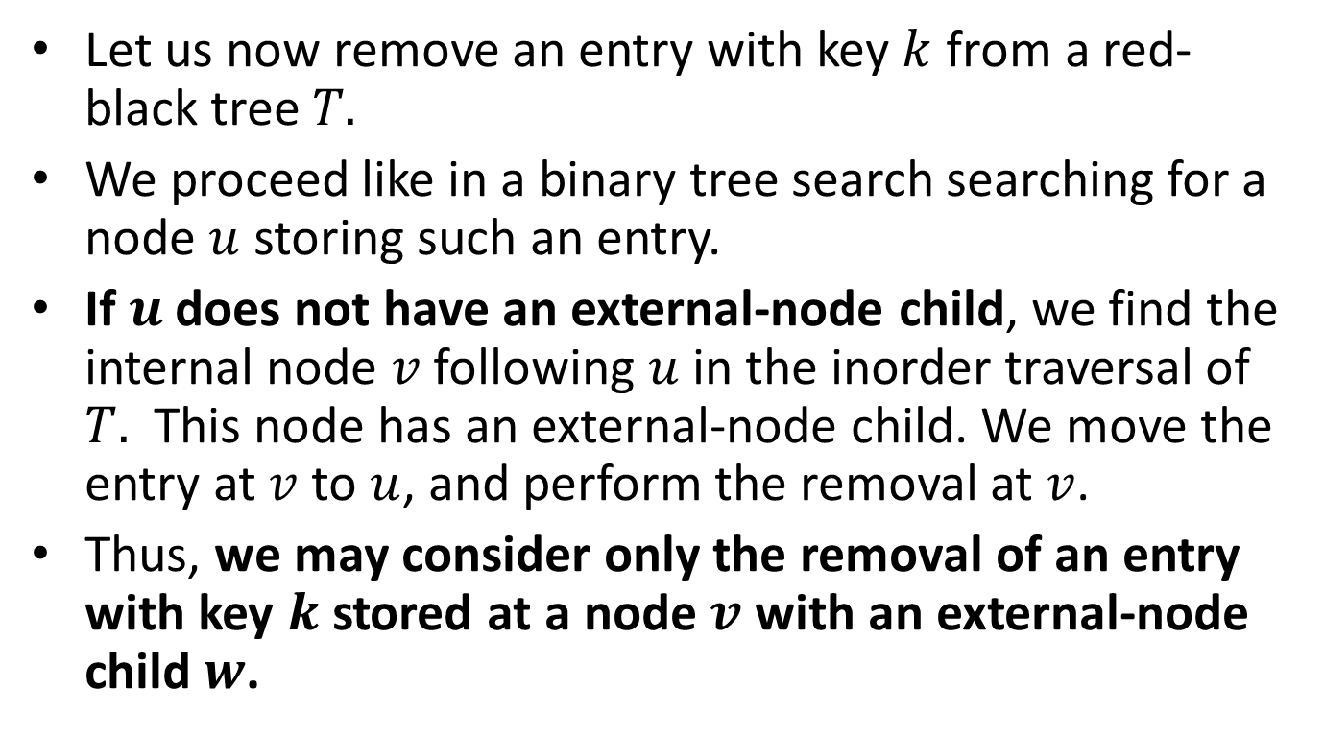
Removal
Let us now remove an entry with key $k$ from a red-black tree $T.$
We proceed like in a binary tree search searching for a node $u$ storing such an entry.
If $u$ does not have an external-node child, we find the internal node $v$ following $u$ in the inorder traversal of $T.$ This node has an external-node child. We move the entry at $v$ to $u$, and perform the removal at $v$.
Thus, we may consider only the removal of an entry with key $k$ stored at a node $v$ with an external-node child $w$.

Slide 51
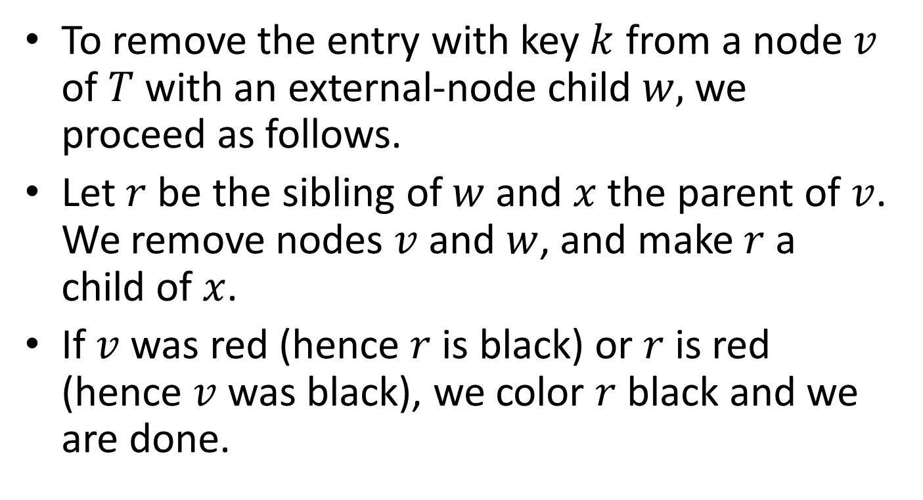
Removal (cont’d)
To remove the entry with key $k$ from a node $v$ of $T$with an external-node child $w,$we proceed as follows.
Let $r$ be the sibling of $w$ and $x$ the parent of $v$. We remove nodes $v$ and $w$, and make $r$ a child of $x$.
If $v$ was red (hence $r$ is black) or $r$ is red (hence $v$ was black), we color $r$ black and we are done.

Slide 52














Graphically
$$x$$
$$x$$
$$v$$
$$k$$
$$r$$
$$r$$
$$w$$
$$x$$
$$x$$
$$v$$
$$k$$
$$r$$
$$r$$
$$w$$

Slide 53
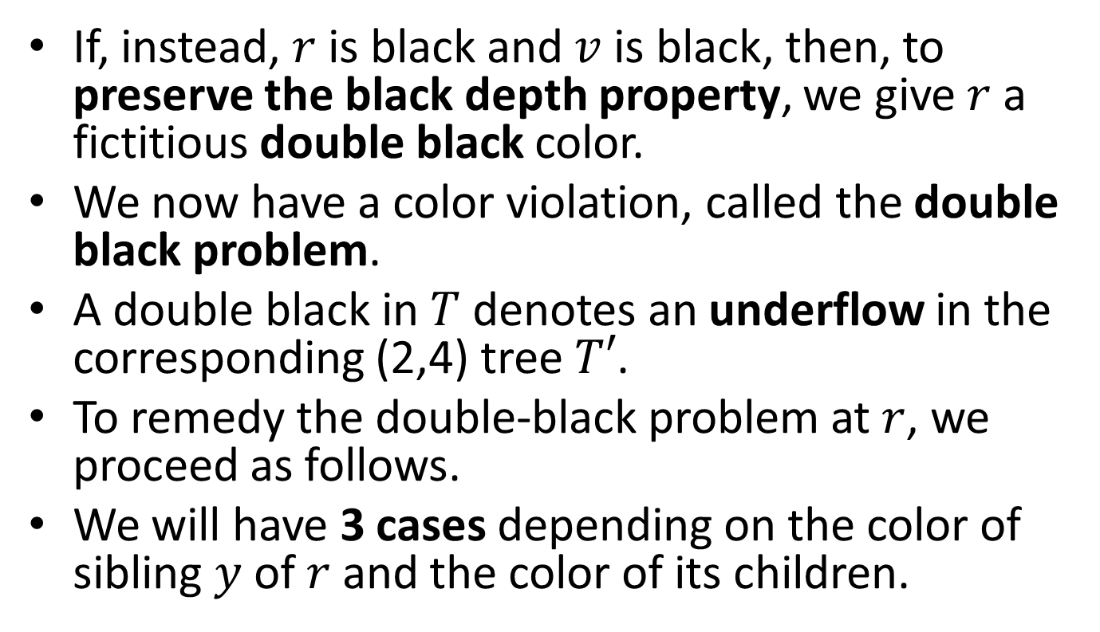
Removal (cont’d)
If, instead, $r$ is black and $v$ is black, then, to preserve the black depth property, we give $r$ a fictitious double black color.
We now have a color violation, called the double black problem.
A double black in $T$ denotes an underflow in the corresponding (2,4) tree $T′$.
To remedy the double-black problem at $r$, we proceed as follows.
We will have 3 cases depending on the color of sibling $y$ of $r$ and the color of its children.

Slide 54
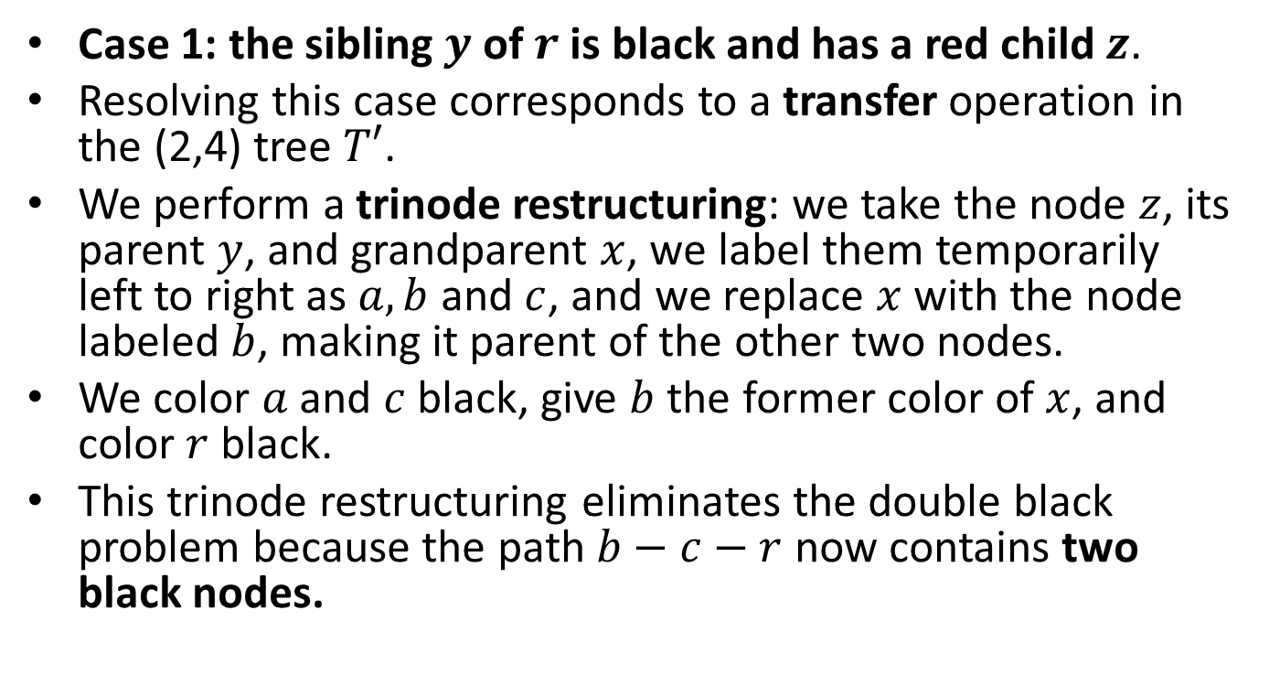
Removal (cont’d)
Case 1: the sibling $y$ of $r$ is black and has a red child $z$.
Resolving this case corresponds to a transfer operation in the (2,4) tree $T′$.
We perform a trinode restructuring: we take the node $z$, its parent $y$, and grandparent $x$, we label them temporarily left to right as $a,b$ and $c$, and we replace $x$ with the node labeled $b$, making it parent of the other two nodes.
We color $a$ and $c$ black, give $b$ the former color of $x$, and color $r$ black.
This trinode restructuring eliminates the double black problem because the path $b−c−r$ now contains two black nodes.

Slide 55




Example of Case 1
$$x$$
… 30 …
30
…
…
10 20
$$y$$
$$r$$
20
40
40
$$z$$
10

Slide 56




After the Restructuring (Right Rotation at $x$)
$$b$$
… 20 …
20
…
…
10
30
$$a$$
10
30
$$c$$
40
40
$$r$$

Slide 57

Alternative Example of Case 1
$$x$$
… 30 …
30
…
…
10 20
$$y$$
$$r$$
10
40
40
$$z$$
20

Slide 58

After the Restructuring (Double Left-Right Rotation at $y$ and $x$)
$$b$$
… 20 …
20
…
…
10
30
$$a$$
10
30
$$c$$
40
40
$$r$$

Slide 59
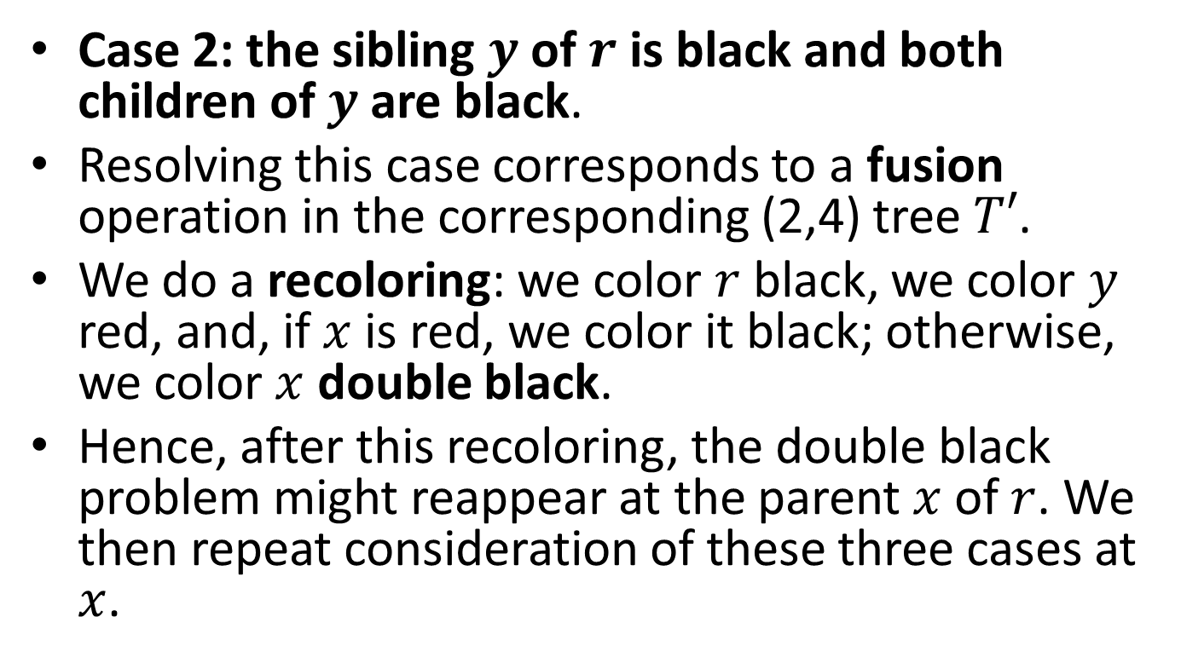
Removal (cont’d)
Case 2: the sibling $y$ of $r$ is black and both children of $y$ are black.
Resolving this case corresponds to a fusion operation in the corresponding (2,4) tree $T′$.
We do a recoloring: we color $r$ black, we color $y$ red, and, if $x$ is red, we color it black; otherwise, we color $x$ double black.
Hence, after this recoloring, the double black problem might reappear at the parent $x$ of $r$. We then repeat consideration of these three cases at $x$.

Slide 60



Recoloring a Red-Black Tree that Fixes the Double Black Problem
10 30 …
10
…
20
$$x$$
30
40
$$y$$
20
40
$$r$$

Slide 61
After the Recoloring
10 …
10
…
20 30
$$x$$
30
40
$$y$$
20
40
$$r$$

Slide 62



Recoloring a Red-Black Tree that Propagates the Double Black Problem
30
30
$$x$$
20
$$y$$
20
40
$$r$$
40

Slide 63
After the Recoloring
30
$$x$$
20 30
$$y$$
20
40
$$r$$
40

Slide 64
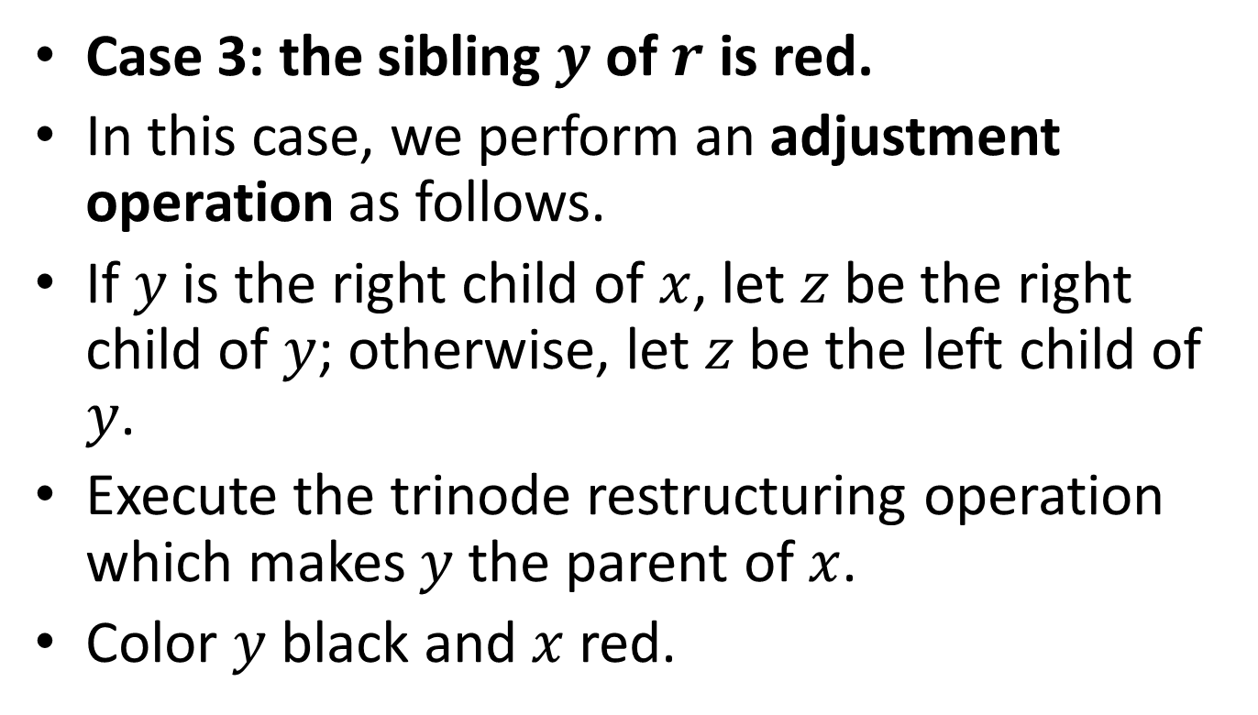
Removal (cont’d)
Case 3: the sibling $y$ of $r$ is red.
In this case, we perform an adjustment operation as follows.
If $y$ is the right child of $x$, let $z$ be the right child of $y$; otherwise, let $z$ be the left child of $y$.
Execute the trinode restructuring operation which makes $y$ the parent of $x$.
Color $y$ black and $x$ red.

Slide 65
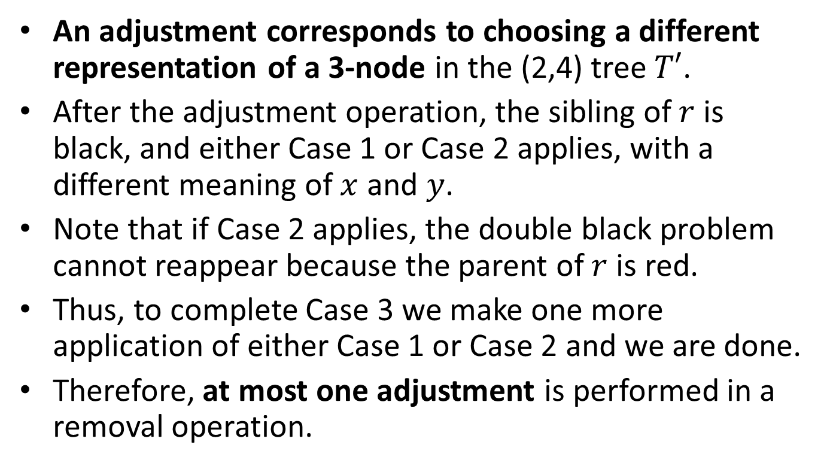
Removal (cont’d)
An adjustment corresponds to choosing a different representation of a 3-node in the (2,4) tree $T′$.
After the adjustment operation, the sibling of $r$ is black, and either Case 1 or Case 2 applies, with a different meaning of $x$ and $y$.
Note that if Case 2 applies, the double black problem cannot reappear because the parent of $r$ is red.
Thus, to complete Case 3 we make one more application of either Case 1 or Case 2 and we are done.
Therefore, at most one adjustment is performed in a removal operation.

Slide 66




Adjustment of a Red-Black Tree in the Presence of a Double Black Problem
$$x$$
20 30
30
… 10 …
$$y$$
$$r$$
…
…
20
40
40
$$z$$
10

Slide 67





After the Adjustment (Right Rotation at $x$)
20 30
$$y$$
20
… 10 …
…
…
$$z$$
10
30
$$x$$
40
40
$$r$$

Slide 68
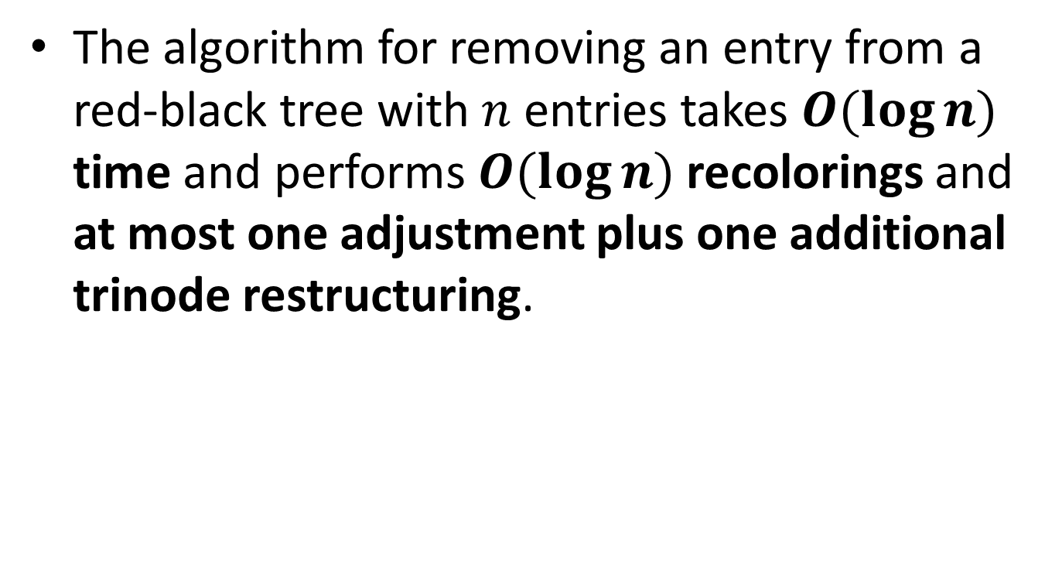
Removal (cont’d)
The algorithm for removing an entry from a red-black tree with $n$ entries takes $O(\log{n})$ time and performs $O(\log{n})$ recolorings and at most one adjustment plus one additional trinode restructuring.

Slide 69
Example
Let us now see a few removals from a given red-black tree.

Slide 70
Initial Tree
14
7
16
4
12
15
18
3
5
17

Slide 71
Remove 3
Easy.
14
7
16
4
12
15
18
3
5
17

Slide 72
After Removing 3
14
7
16
4
12
15
18
5
17

Slide 73
Remove 12
A black node is removed hence a double black will be created.
14
7
16
4
12
15
18
5
17

Slide 74
After Removing 12 – Double Black
14
7
16
4
15
18
5
17

Slide 75
Double Black
We are in Case 1. We need to do trinode restructuring (double left-right rotation at 4 and 7).
14
7
16
4
15
18
5
17

Slide 76
After Restructuring
14
5
16
4
7
15
18
17

Slide 77
Remove 17
Easy.
14
5
16
4
7
15
18
17

Slide 78
After Removing 17
14
5
16
4
7
15
18

Slide 79
Remove 18
A black node is removed hence a double black is created.
14
5
16
4
7
15
18

Slide 80
After Removing 18 – Double Black
We are in Case 2. We will do a recoloring.
14
5
16
4
7
15

Slide 81
After Recoloring
14
5
16
4
7
15

Slide 82
Remove 15
Easy.
14
5
16
4
7
15

Slide 83
After Removing 15
14
5
16
4
7

Slide 84
Remove 16
A black node is removed hence a double black will be created.
14
5
16
4
7

Slide 85
After Removing 16 – Double Black
We are in Case 3. We will do an adjustment (right rotation at 14).
14
5
4
7

Slide 86
After the Adjustment – Double Black
We are in Case 2. Will do a recoloring.
5
4
14
7

Slide 87
After the Recoloring
5
4
14
7

Slide 88





Complexity of Operations in a Red-Black Tree
Time per level
Height
$$O(1)$$
Up phase
$$O(1)$$
$$O(\log{n})$$
$$O(1)$$
Down phase
Worst-case time:
$$O(\log{n})$$

Slide 89
Summary
The red-black tree data structure is slightly more complicated than its corresponding (2,4) tree.
However, the red-black tree has the conceptual advantage that only a constant number of trinode restructurings are ever needed to restore the balance after an update.

Slide 90
Readings
M. T. Goodrich, R. Tamassia and D. Mount. Data Structures and Algorithms in C++. 2nd edition. John Wiley.
  Section 10.5
M. T. Goodrich, R. Tamassia. Δομές Δεδομένων και Αλγόριθμοι σε Java. 5^{η} έκδοση. Εκδόσεις Δίαυλος.
  Κεφ. 10.5
R. Sedgewick. Αλγόριθμοι σε C.
  Κεφ. 13.4

