Slide 1
Trees
Manolis Koubarakis

Slide 2
Trees
Trees (δένδρα) are one of the most important data structures in Computer Science.
Examples of trees:
  Directory structure
  Search trees (for stored information associated with search keys e.g., in relational databases)
  Parse trees (in compilers)
  Search trees (for problem solving in Artificial Intelligence)
  Game trees (in Artificial Intelligence)
  Decision trees (in Artificial Intelligence)
  Heaps (for implementing priority queues)

Slide 3
Example
R
S
T
X
U
V
W
Y
Z

Slide 4
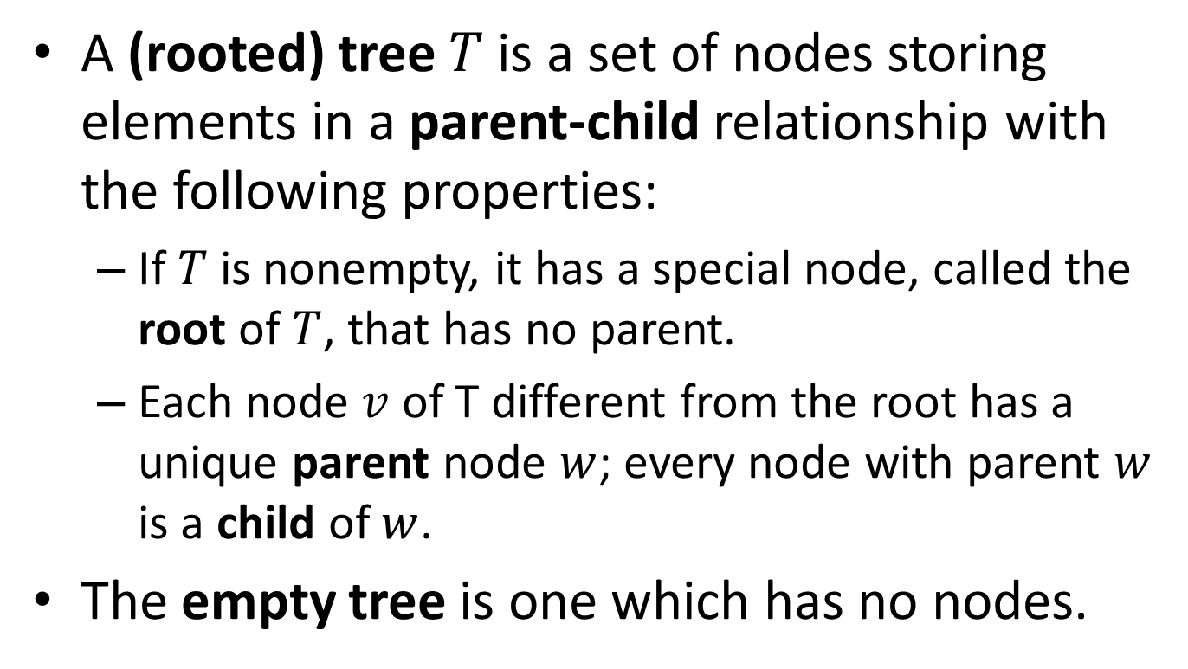
Formal Definition of Tree
A (rooted) tree $T$ is a set of nodes storing elements in a parent-child relationship with the following properties:
  If $T$ is nonempty, it has a special node, called the root of $T$, that has no parent.
  Each node $v$ of T different from the root has a unique parent node $w$; every node with parent $w$ is a child of $w$.
The empty tree is one which has no nodes.

Slide 5
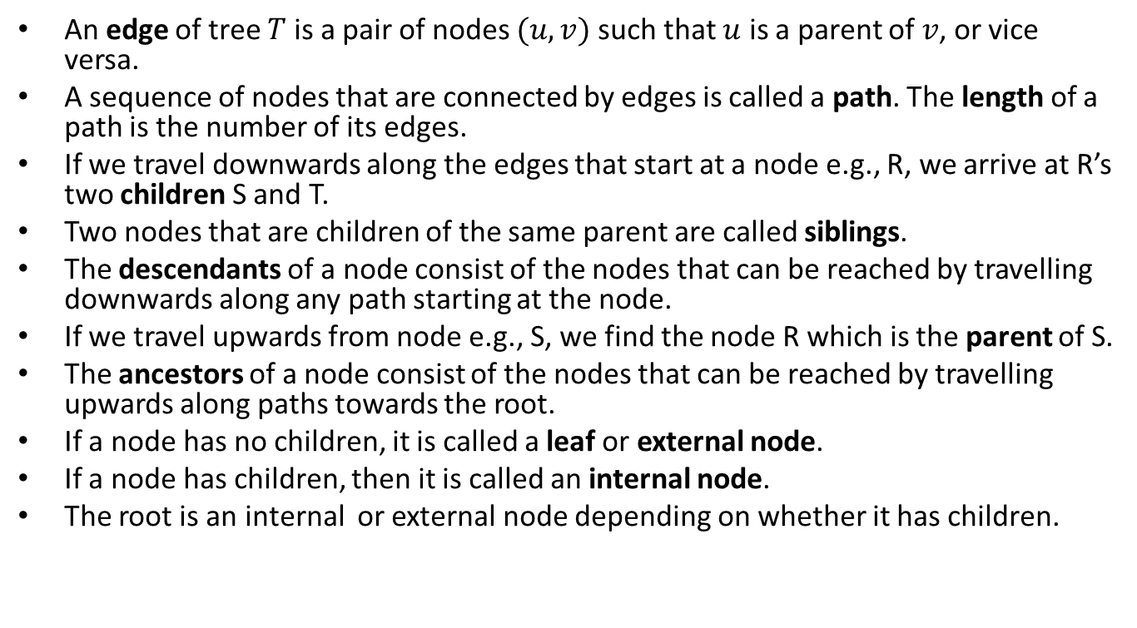
Terminology
An edge of tree $T$ is a pair of nodes $(u,v)$ such that $u$ is a parent of $v$, or vice versa.
A sequence of nodes that are connected by edges is called a path. The length of a path is the number of its edges.
If we travel downwards along the edges that start at a node e.g., R, we arrive at R’s two children S and T.
Two nodes that are children of the same parent are called siblings.
The descendants of a node consist of the nodes that can be reached by travelling downwards along any path starting at the node.
If we travel upwards from node e.g., S, we find the node R which is the parent of S.
The ancestors of a node consist of the nodes that can be reached by travelling upwards along paths towards the root.
If a node has no children, it is called a leaf or external node.
If a node has children, then it is called an internal node.
The root is an internal or external node depending on whether it has children.

Slide 6
Terminology (cont’d)
The nodes of a tree can be arranged in levels.
The root is at level 0. The children of the root are at level 1, their children are at level 2 and so on.
We often say depth instead of level.
In a tree, there is exactly one path from the root R to each descendant of R.
The length of the path from the root to a node is equal to the level or depth of the node.
The largest depth of any node in a tree is called the height of the tree.
We can use spatial terminology to refer to parts of a tree. For example, left child or right child or middle child.

Slide 7
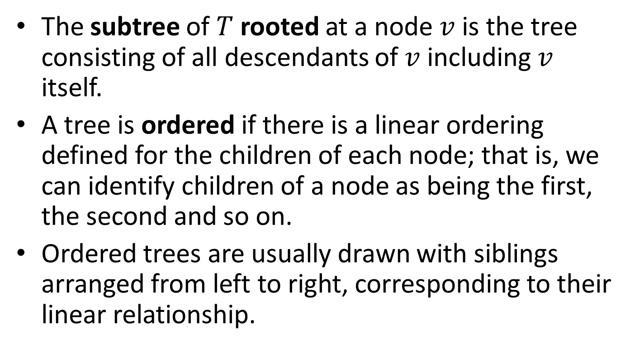
Terminology (cont’d)
The subtree of $T$ rooted at a node $v$ is the tree consisting of all descendants of $v$including $v$ itself.
A tree is ordered if there is a linear ordering defined for the children of each node; that is, we can identify children of a node as being the first, the second and so on.
Ordered trees are usually drawn with siblings arranged from left to right, corresponding to their linear relationship.

Slide 8

Proposition
Let $T$ be a tree with $n$ nodes, and let $c_{p}$ denote the number of children of a node $p$ of $T$. Then $\sum_{p}{c_{p}}=n−1.$
Proof?

Slide 9

Proof
Each node of $T$ with the exception of the root is a child of another node, and thus contributes one unit to the above sum.

Slide 10
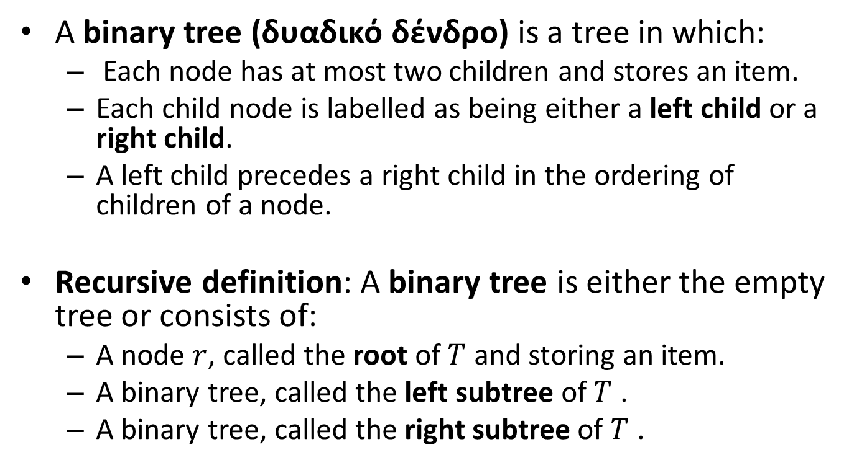
Binary Trees
A binary tree (δυαδικό δένδρο) is a tree in which:
  Each node has at most two children and stores an item.
  Each child node is labelled as being either a left child or a right child.
  A left child precedes a right child in the ordering of children of a node.
Recursive definition: A binary tree is either the empty tree or consists of:
  A node $r$, called the root of $T$ and storing an item.
  A binary tree, called the left subtree of $T$ .
  A binary tree, called the right subtree of $T$ .

Slide 11
Example: a Binary Tree
R
S
T
X
Y
U
V
Z
W

Slide 12
Example: a Different Binary Tree
R
S
T
X
Y
U
V
Z
W
Whether a child is left or right matters. Now node W is the right child of node V.

Slide 13
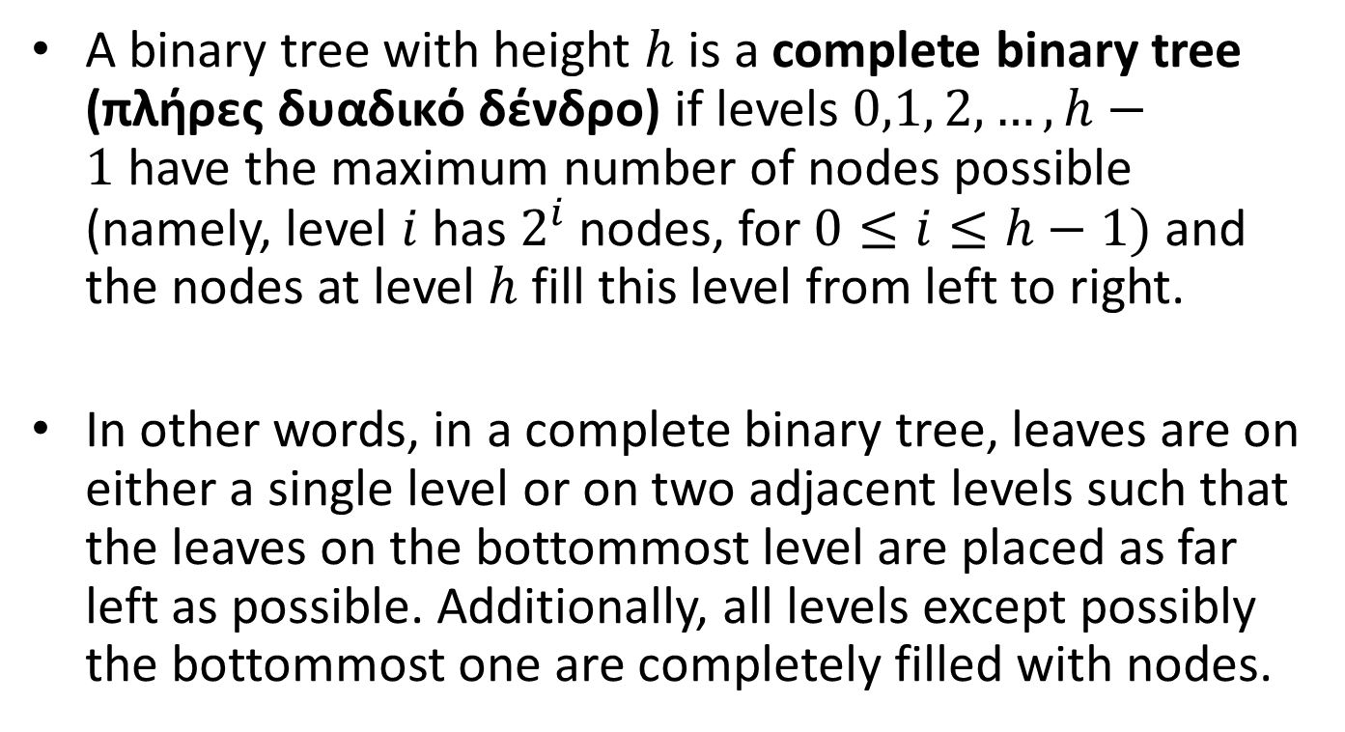
Complete Binary Trees
A binary tree with height $h$ is a complete binary tree (πλήρες δυαδικό δένδρο) if levels $0,1, 2, …, h−1$have the maximum number of nodes possible (namely, level $i$has $2^{i}$ nodes, for $0≤i≤h−1)$ and the nodes at level $h$ fill this level from left to right.
In other words, in a complete binary tree, leaves are on either a single level or on two adjacent levels such that the leaves on the bottommost level are placed as far left as possible. Additionally, all levels except possibly the bottommost one are completely filled with nodes.

Slide 14
Example: complete binary tree

Slide 15
Example: not complete binary tree

Slide 16
Example: not complete binary tree

Slide 17
Proper Binary Trees
A binary tree is called proper or full (γνήσιο) if each node has either zero or two children.
A binary tree that is not proper is called improper.
In a proper binary tree, each internal node has exactly two children.

Slide 18
Example: proper binary tree

Slide 19
Example: improper binary tree

Slide 20
Extended Binary Trees
Often, we view a binary tree as a non-empty proper binary tree. In this case, we draw each internal node of a binary tree as having exactly two children. Each external node is special: it has no children and it is represented by a square symbol.
In the literature, the term extended (επεκταμένο) binary tree is also used for this case.
This view of binary trees simplifies the programming of search and update functions (in a linked representation of the tree external nodes are represented by null links), and also the statement of relevant theoretical results.
This view of binary trees also clarifies cases where a node has one child regarding whether it is a left or a right one.

Slide 21
Example
R
S
T
X
Y
U
V
Z
W

Slide 22
Level Order of Nodes in a Tree
If we number the nodes of a tree level-by-level and, in each level, going from left to right, we have the level order (διάταξη επιπέδου) of the nodes of the tree.

Slide 23
Example
1
H
2
3
D
K
4
5
6
7
B
F
J
L
8
9
10
11
12
A
C
E
G
I

Slide 24
Nodes of a Complete Binary Tree
Question: How many nodes does a complete binary tree have at each level?

Slide 25
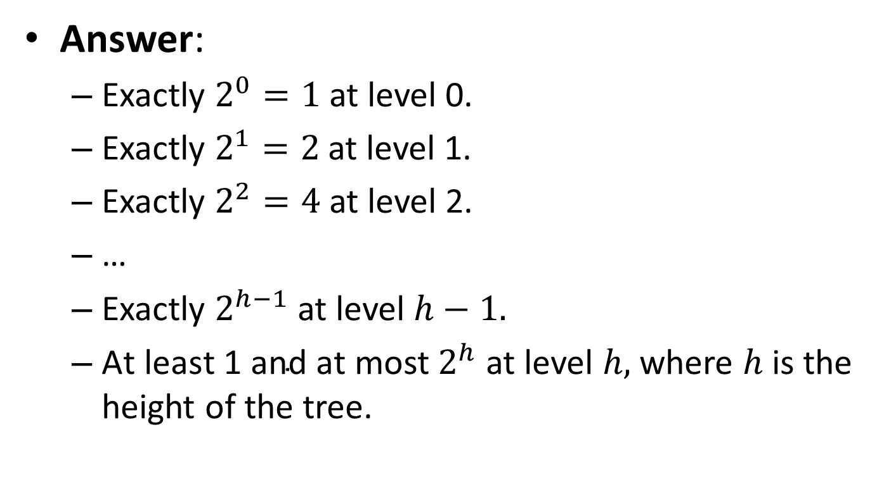
Nodes of a Complete Binary Tree
Answer:
  Exactly $2^{0}=1$ at level 0.
  Exactly $2^{1}=2$ at level 1.
  Exactly $2^{2}=4$ at level 2.
  …
  Exactly $2^{h−1}$ at level $h−1.$
  ${\text{At} \text{least}\text{ 1 }\text{and} \text{at} \text{most} 2}^{h}$ at level $h,$where $h$ is the height of the tree.

Slide 26
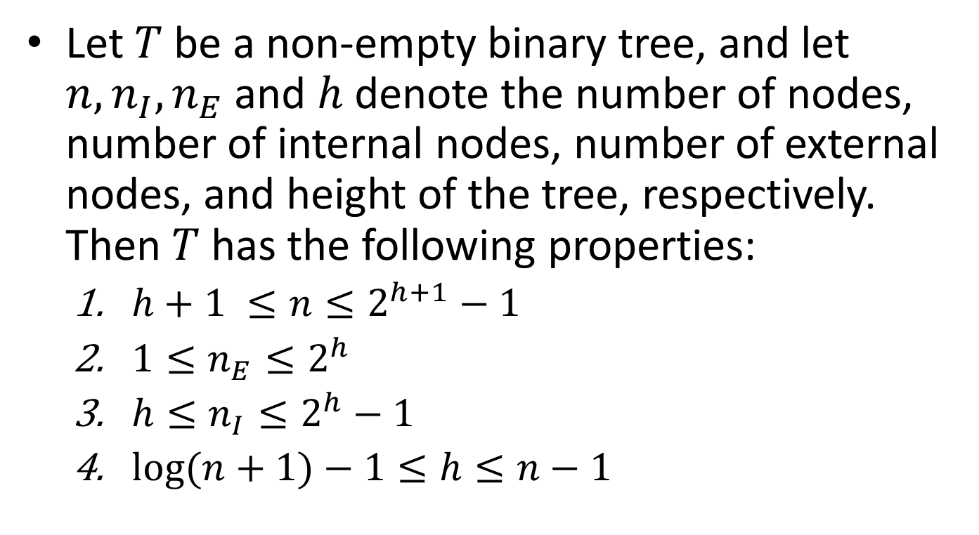
Properties of Binary Trees
Let $T$ be a non-empty binary tree, and let $n, n_{I},n_{E}$ and $h$ denote the number of nodes, number of internal nodes, number of external nodes, and height of the tree, respectively. Then $T$ has the following properties:
  $h+1 ≤n≤2^{h+1}−1$
  $1≤n_{E}≤2^{h}$
  $h≤n_{I}≤2^{h}−1$
  $\log{(n+1)}−1≤h≤n−1$

Slide 27
Proof
Let us prove (2) first. The lower bound is easy to see since the simplest non-empty binary tree has a single node, the root. The upper bound is reached when we have each node at each level of the tree having exactly two children.

Slide 28



Proof (cont’d)
Let us now prove (3). The case that gives us the lower bound is a tree like the following where the internal nodes are $h$ in number:
$$h$$
$$⋱$$

Slide 29
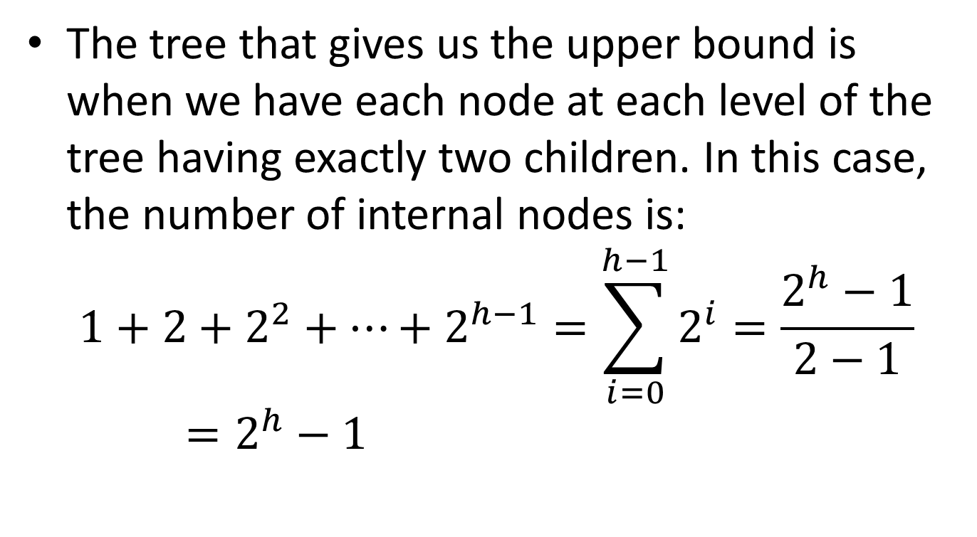
Proof (cont’d)
The tree that gives us the upper bound is when we have each node at each level of the tree having exactly two children. In this case, the number of internal nodes is:
$$1+2+2^{2}+⋯+2^{h−1}=\sum_{i=0}^{h−1}{2^{i}}=\frac{2^{h}−1}{2−1}=2^{h}−1$$

Slide 30
Proof (cont’d)
To prove (1) simply add up the inequalities of (2) and (3).
To prove (4), rewrite (1) and then take logarithms of each term.

Slide 31
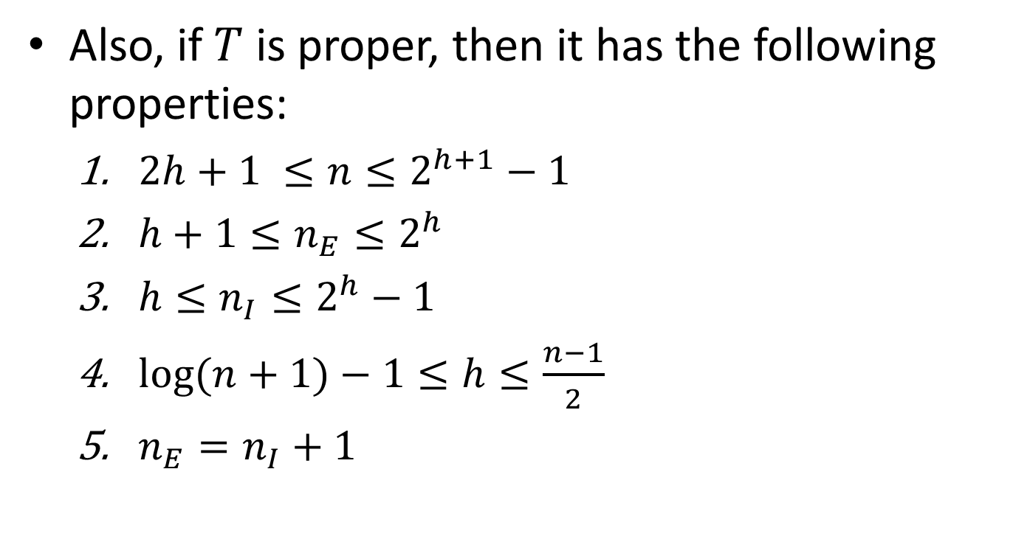
Properties of Binary Trees (cont’d)
Also, if $T$ is proper, then it has the following properties:
  $2h+1 ≤n≤2^{h+1}−1$
  $h+1≤n_{E}≤2^{h}$
  $h≤n_{I}≤2^{h}−1$
  $\log{(n+1)}−1≤h≤\frac{n−1}{2}$
  $n_{E}=n_{I}+1$

Slide 32

Proof
The lower bounds of (2) and (3) can be seen from the following tree which has $h$ internal nodes and $h+1$ external nodes:
$$h$$
$$⋱$$

Slide 33
Proof (cont’d)
The upper bounds for (2) and (3) can be seen from the previous proposition since the trees used in the proofs there are proper.
(1) and (4) can then be proved as in the previous proposition.

Slide 34
Proof (cont’d)
We can prove (5) using induction. For the base case, consider a tree consisting of a single root node. In this case we have 1 external node and 0 internal nodes so the relationship holds.
If, on the other hand, we have a tree with two or more nodes, then the root has two subtrees. Since these subtrees are smaller than the original tree, we may assume they satisfy the relationship. Thus each subtree has one more external node than internal nodes. Between the two of these subtrees, there are two more external nodes than internal nodes. But the root is an internal node. So in total we have one more external node than internal nodes.

Slide 35
How Do We Represent a Binary Tree?
1
H
2
3
D
K
4
5
6
7
B
F
J
L
8
9
10
11
12
A
C
E
G
I

Slide 36
A Sequential Binary Tree Representation
If a complete binary tree has n nodes then its contiguous sequential representation is an array A[0:n] as follows (for the previous example n=12). Note that the array stores the information on the tree nodes using level order.
A:
H
D
K
B
F
J
L
A
C
E
G
I
1
2
3
4
5
6
7
8
9
10
11
12

Slide 37
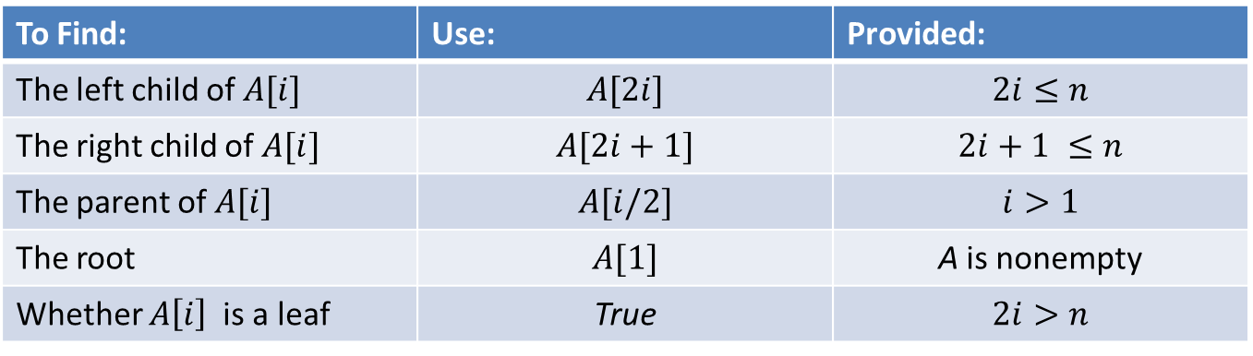
How to Find Nodes
To Find: | Use: | Provided:
The left child of $A[i]$ | $$A[2i]$$ | $$2i≤n$$
The right child of $A[i]$ | $$A[2i+1]$$ | $$2i+1 ≤n$$
The parent of $A[i]$ | $$A[i/2]$$ | $$i>1$$
The root | $$A[1]$$ | A is nonempty
Whether $A\left[i\right]$is a leaf | True | $$2i>n$$

Slide 38
Sequential Representation (cont’d)
The sequential representation can also be used in the case that a binary tree is not complete.
In this case there will be empty cells in the respective array so such a representation can be wasteful.

Slide 39
Heaps
A heap (σωρός) is a complete binary tree with values stored in its nodes such that no child has a value bigger than the value of its parent (i.e., the value of the parent of each node is greater than or equal the value of the node itself).
Some authors call this a max-heap (σωρός μεγίστων).
We can also define a min-heap (σωρός ελαχίστων) when the relationship between the value of a parent and the value of its child is “less than or equal”.

Slide 40
Example
10
9
8
7
6
5
2
1
4
3

Slide 41
Heaps and Priority Queues
A heap provides a representation for a priority queue.
Reminder: A priority queue is an ADT having the property that items are removed in the order of highest-to-lowest priority regardless of the order in which they were inserted.
If a heap is used to represent a priority queue, it is easy to find the item of highest priority, since it sits at the root of the tree.
If we remove the value at the root, we have to restructure the tree to be a heap again.

Slide 42
Restructuring the Tree
The algorithm for restructuring the tree is as follows:
  We delete the rightmost leaf on the bottom row (this is the last leaf in level order).
  We place the deleted node’s value into the root node.
  We restore the heap property of the tree by starting at the root node and repeatedly exchanging its value with the larger of the values of its children, until no more exchanges are possible.

Slide 43
Example
9
8
7
6
5
2
1
4
3
Let us restore the heap property in the above tree.

Slide 44
Restructuring the Tree
9
8
7
6
5
2
1
4
3
Delete the node with value 3 and insert this value into the root.

Slide 45
Restructuring the Tree (cont’d)
3
9
8
7
6
5
2
1
4
Interchange 3 with 9.

Slide 46
Restructuring the Tree (cont’d)
9
3
8
7
6
5
2
1
4
Interchange 3 with 7.

Slide 47
Restructuring the Tree (cont’d)
9
7
8
3
6
5
2
1
4
Interchange 3 with 4.

Slide 48
Restructuring the Tree (cont’d)
9
7
8
4
6
5
2
1
3
The above tree has the heap property restored.

Slide 49
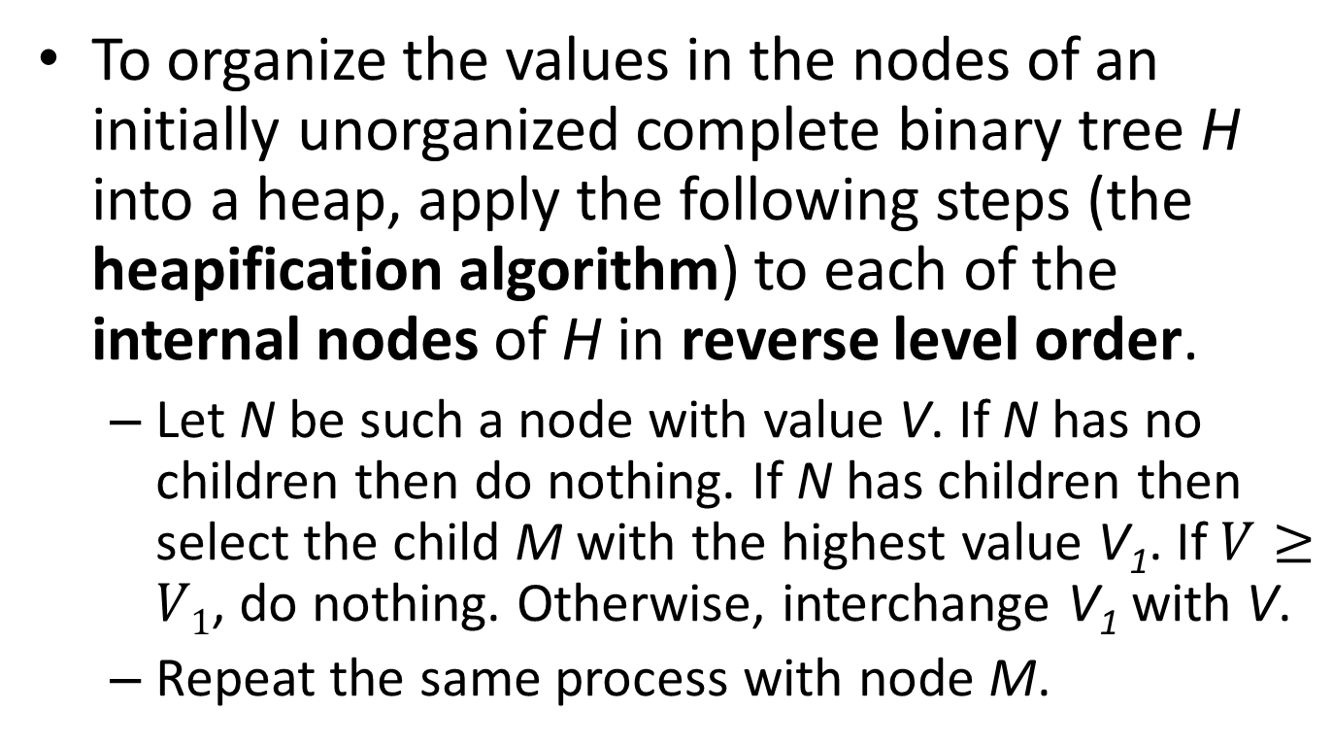
Heapifying a Complete Binary Tree
To organize the values in the nodes of an initially unorganized complete binary tree H into a heap, apply the following steps (the heapification algorithm) to each of the internal nodes of H in reverse level order.
  Let N be such a node with value V. If N has no children then do nothing. If N has children then select the child M with the highest value V₁. If $V≥V1$, do nothing. Otherwise, interchange V₁ with V.
  Repeat the same process with node M.

Slide 50
Example
2
4
5
7
3
10
8
1
9
6
Let us heapify the above tree.

Slide 51
Heapifying the Tree
2
4
5
7
3
10
8
1
9
6
The internal nodes in reverse level order are 3, 7, 5, 4 and 2.

Slide 52
Heapifying the Tree
2
4
5
7
3
10
8
1
9
6
We start with the node with value 3. Exchange 3 with 6.

Slide 53
Heapifying the Tree (cont’d)
2
4
5
7
6
10
8
1
9
3
Since the node with value 3 has no children, we have nothing more to do in this subtree.

Slide 54
Heapifying the Tree (cont’d)
2
4
5
7
6
10
8
1
9
3
We continue with the subtree rooted at 7. We exchange 7 with 9.

Slide 55
Heapifying the Tree (cont’d)
2
4
5
9
6
10
8
1
7
3
There is nothing more to do in this subtree.

Slide 56
Heapifying the Tree (cont’d)
2
4
5
9
6
10
8
1
7
3
We continue with the subtree rooted at 5. We exchange 5 with 10.

Slide 57
Heapifying the Tree (cont’d)
2
4
10
9
6
5
8
1
7
3
We have nothing more to do in this subtree. We continue with the subtree rooted at 4. We exchange 4 with 9.

Slide 58
Heapifying the Tree (cont’d)
2
9
10
4
6
5
8
1
7
3
We now exchange 4 with 7.

Slide 59
Heapifying the Tree (cont’d)
2
9
10
7
6
5
8
1
4
3
We have nothing more to do in this subtree. We now consider the root having value 2.

Slide 60
Heapifying the Tree (cont’d)
2
9
10
7
6
5
8
1
4
3
We exchange 2 with 10.

Slide 61
Heapifying the Tree (cont’d)
10
9
2
7
6
5
8
1
4
3
We exchange 2 with 8.

Slide 62
Heapifying the Tree (cont’d)
10
9
8
7
6
5
2
1
4
3
There is nothing more to do in this subtree. The tree has now been turned into a heap.

Slide 63

Heapifying the Tree (cont’d)
The order the nodes are processed guarantees that subtrees rooted at the children of node $i$ are heaps before the algorithm of heapification runs at that node.

Slide 64
Insertion of a New Element in a Heap
Let us now see how to add a new element to a heap.
We start by adding a new empty node as a leaf at the first available place on the bottom level.
Then, we reheapify the tree starting at the parent of this empty node trying to find the correct place of the new element.

Slide 65
Example Insertion
10
9
8
7
6
5
2
1
4
3
Let us insert the new element 15 in the heap.

Slide 66
Example Insertion (cont’d)
10
9
8
7
6
5
2
1
4
3
A new leaf is added to the tree at the first available position at the bottom level.

Slide 67
Example Insertion (cont’d)
10
9
8
7
6
5
2
1
4
3
Values on the path from the new leaf node to the root are copied down until a place for the key 15 is found.

Slide 68
Example Insertion (cont’d)
10
9
8
7
5
2
1
4
3
6
6 is copied down.

Slide 69
Example Insertion (cont’d)
10
8
7
9
5
2
1
4
3
6
9 is copied down.

Slide 70
Example Insertion (cont’d)
10
8
7
9
5
2
1
4
3
6
10 is copied down. Now a place for 15 has been found.

Slide 71
Example Insertion (cont’d)
15
10
8
7
9
5
2
1
4
3
6

Slide 72
Example Insertion
15
10
8
7
9
5
2
1
4
3
6
Let us now insert the key 12 in the heap.

Slide 73
Example Insertion (cont’d)
15
10
8
7
9
5
2
1
4
3
6
A new empty leaf is added to the tree at the first available place in the bottom level.

Slide 74
Example Insertion (cont’d)
15
10
8
7
9
2
1
4
3
6
5
5 is copied down.

Slide 75
Example Insertion (cont’d)
15
10
7
9
8
2
1
4
3
6
5
8 is copied down.

Slide 76
Example Insertion (cont’d)
15
10
12
7
9
8
2
1
4
3
6
5
Now a place for 12 has been found.

Slide 77
Implementation of Priority Queues Using Heaps
Let us now develop a third implementation of the Priority Queue ADT using heaps implemented by the sequential representation of binary trees.

Slide 78
The Priority Queue ADT
A priority queue is a finite collection of items for which the following operations are defined:
  Initialize the priority queue, PQ, to the empty priority queue.
  Determine whether or not the priority queue, PQ, is empty.
  Determine whether or not the priority queue, PQ, is full.
  Insert a new item, X, into the priority queue, PQ.
  If PQ is non-empty, remove from PQ an item X of highest priority in PQ.

Slide 79
The Priority Queue Data Types
/* This is the file “PQTypes.h” */
#define MAXCOUNT 10
typedef int PQItem;
typedef PQItem PQArray[MAXCOUNT+1];
typedef struct {
int Count;
PQArray ItemArray;
} PriorityQueue;

Slide 80
The Priority Queue Interface File
/* this is the file “PQInterface.h” */
#include “PQTypes.h”
/* defines types PQItem and PriorityQueue */
void Initialize (PriorityQueue *);
int Empty (PriorityQueue *);
int Full (PriorityQueue *);
void Insert (PQItem, PriorityQueue *);
PQItem Remove (PriorityQueue *);

Slide 81
The Priority Queue Implementation File
/* This is the file “PQImplementation.c” */
#include “PQInterface.h”
void Initialize(PriorityQueue *PQ)
{
PQ->Count=0;
}
int Empty(PriorityQueue *PQ)
{
return(PQ->Count==0);
}
int Full(PriorityQueue *PQ)
{
return(PQ->Count==MAXCOUNT);
}

Slide 82
The Priority Queue Implementation File (cont’d)
void Insert(PQItem Item, PriorityQueue *PQ)
{
int ChildLoc;
int ParentLoc;
(PQ->Count)++;
ChildLoc=PQ->Count;
ParentLoc=ChildLoc/2;
while (ParentLoc != 0){
if (Item <= PQ->ItemArray[ParentLoc]){
PQ->ItemArray[ChildLoc]=Item;
return;
} else {
PQ->ItemArray[ChildLoc]=PQ->ItemArray[ParentLoc];
ChildLoc=ParentLoc;
ParentLoc=ParentLoc/2;
}
}
PQ->ItemArray[ChildLoc]=Item;
}

Slide 83
Notes
The previous algorithm first introduces a new empty node in the first available position in the complete binary tree. The index of this node is ChildLoc and the index of its parent is ParentLoc.
Then, it propagates this empty node upwards on the path towards the root, until the correct location is found where the new value can be inserted without violating the heap property.

Slide 84
The Priority Queue Implementation File (cont’d)
PQItem Remove(PriorityQueue *PQ)
{
int CurrentLoc;
int ChildLoc;
PQItem ItemToPlace;
PQItem ItemToReturn;
if(Empty(PQ)) return;
ItemToReturn=PQ->ItemArray[1];
ItemtoPlace=PQ->ItemArray[PQ->Count];
(PQ->Count)--;
CurrentLoc=1;
ChildLoc=2*CurrentLoc;

Slide 85
The Priority Queue Implementation File (cont’d)
while (ChildLoc <= PQ->Count){
if (ChildLoc < PQ->Count){
if (PQ->ItemArray[ChildLoc+1] > PQ->ItemArray[ChildLoc]){
ChildLoc++;
}
}
if (PQ->ItemArray[ChildLoc] <= ItemToPlace){
PQ->ItemArray[CurrentLoc]=ItemToPlace;
return(ItemToReturn);
} else {
PQ->ItemArray[CurrentLoc]=PQ->ItemArray[ChildLoc];
CurrentLoc=ChildLoc;
ChildLoc=2*CurrentLoc;
}
}
PQ->ItemArray[CurrentLoc]=ItemToPlace;
return(ItemToReturn);
}

Slide 86
Comments on the Remove Function
9
8
7
6
5
2
1
4
3
The Remove function optimizes our earlier method by moving 9, 7 and 4 upward to make a hole where 3 will come to be inserted.

Slide 87
Comments on the Remove Function
The variables ItemToReturn and ItemToPlace hold the maximum priority item to be returned by the function and the deleted leaf value respectively.
The variables ChildLoc and CurrentLoc will be the indexes of the nodes of the heap to be interchanged so that the right place is found for the deleted value of the leaf.
CurrentLoc is the index of the empty location and it is the parent of the node indexed by ChildLoc. The deleted leaf value will go into the location indexed by CurrentLoc.
The first if statement inside the while chooses the child of the empty node which has the largest value. This is the value that will be interchanged with the empty position in the parent.
The second if statement inside the while checks whether the location for the deleted value has been found. The else part of that statement advances the indices ChildLoc and ParentLoc so that we can move down the tree since the location of the deleted value has not been found yet.
The indices ChildLoc and ParentLoc are advanced using the formulas for the array representation of a complete binary tree that we have presented earlier.

Slide 88
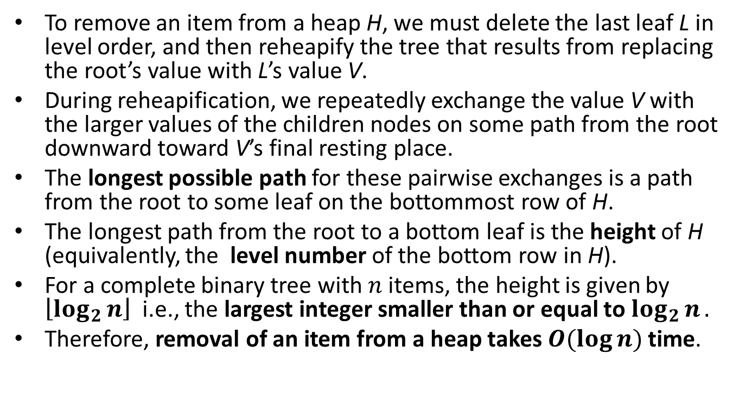
Complexity of Removing an Item from a Heap
To remove an item from a heap H, we must delete the last leaf L in level order, and then reheapify the tree that results from replacing the root’s value with L’s value V.
During reheapification, we repeatedly exchange the value V with the larger values of the children nodes on some path from the root downward toward V’s final resting place.
The longest possible path for these pairwise exchanges is a path from the root to some leaf on the bottommost row of H.
The longest path from the root to a bottom leaf is the height of H (equivalently, the level number of the bottom row in H).
For a complete binary tree with $n$ items, the height is given by $\left\lfloor \log_{2}{n}\right\rfloor$i.e., the largest integer smaller than or equal to $\log_{2}{n}.$
Therefore, removal of an item from a heap takes $O(\log{n})$ time.

Slide 89

Proposition
A heap $T$ storing $n$ entries has height $h=⌊\log{n}⌋$.
Proof?

Slide 90
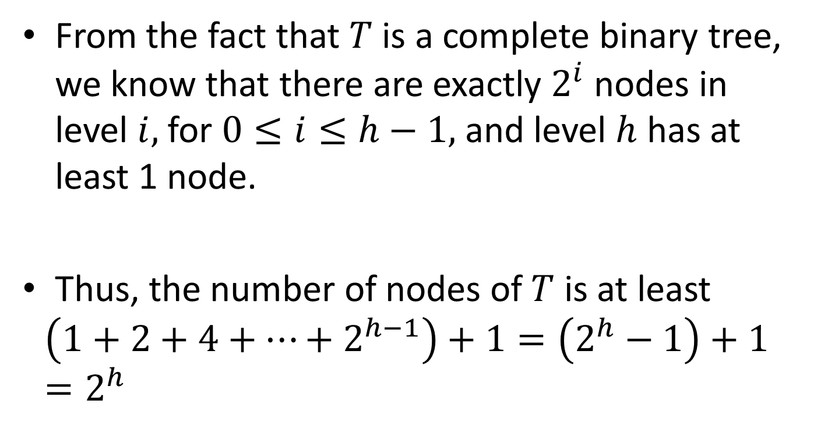
Proof
From the fact that $T$ is a complete binary tree, we know that there are exactly $2^{i}$ nodes in level $i,$ for $0≤i≤h−1,$ and level $h$ has at least 1 node.
Thus, the number of nodes of $T$ is at least
$$\left(1+2+4+…+2^{h−1}\right)+1=\left(2^{h}−1\right)+1=2^{h}$$

Slide 91
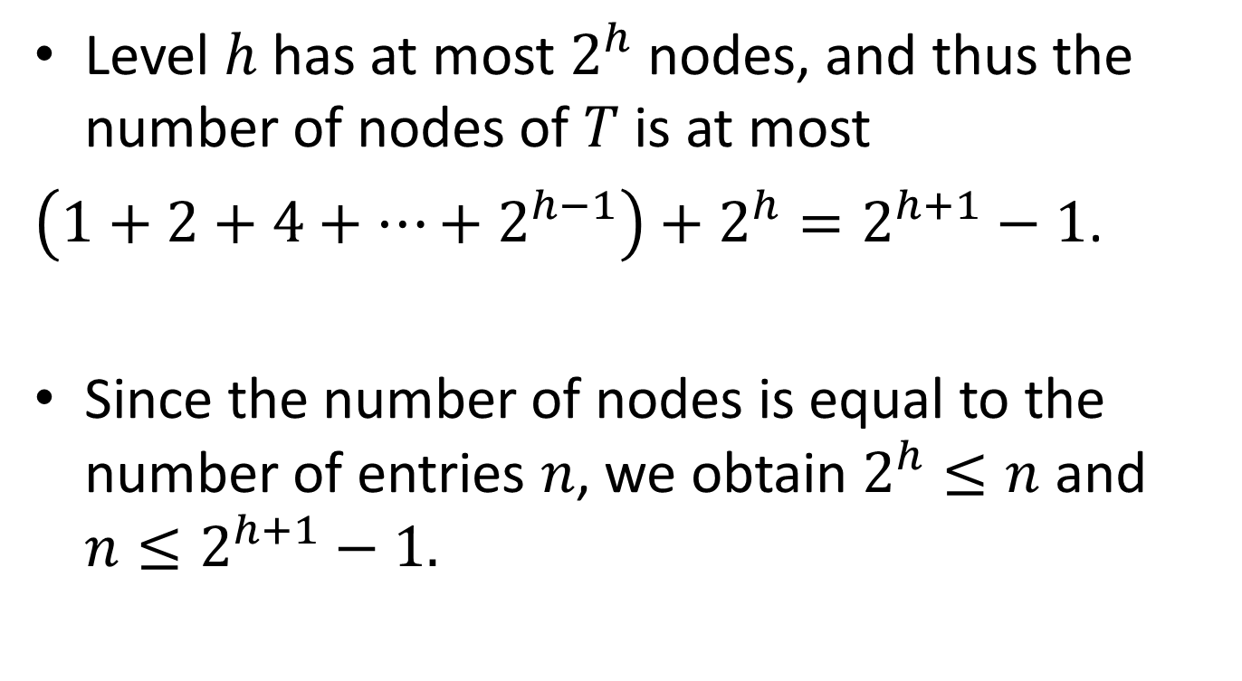
Proof (cont’d)
Level $h$ has at most $2^{h}$ nodes, and thus the number of nodes of $T$ is at most
$\left(1+2+4+…+2^{h−1}\right)+2^{h}=2^{h+1}−1$.
Since the number of nodes is equal to the number of entries $n$, we obtain $2^{h}≤n$ and $n≤2^{h+1}−1.$

Slide 92
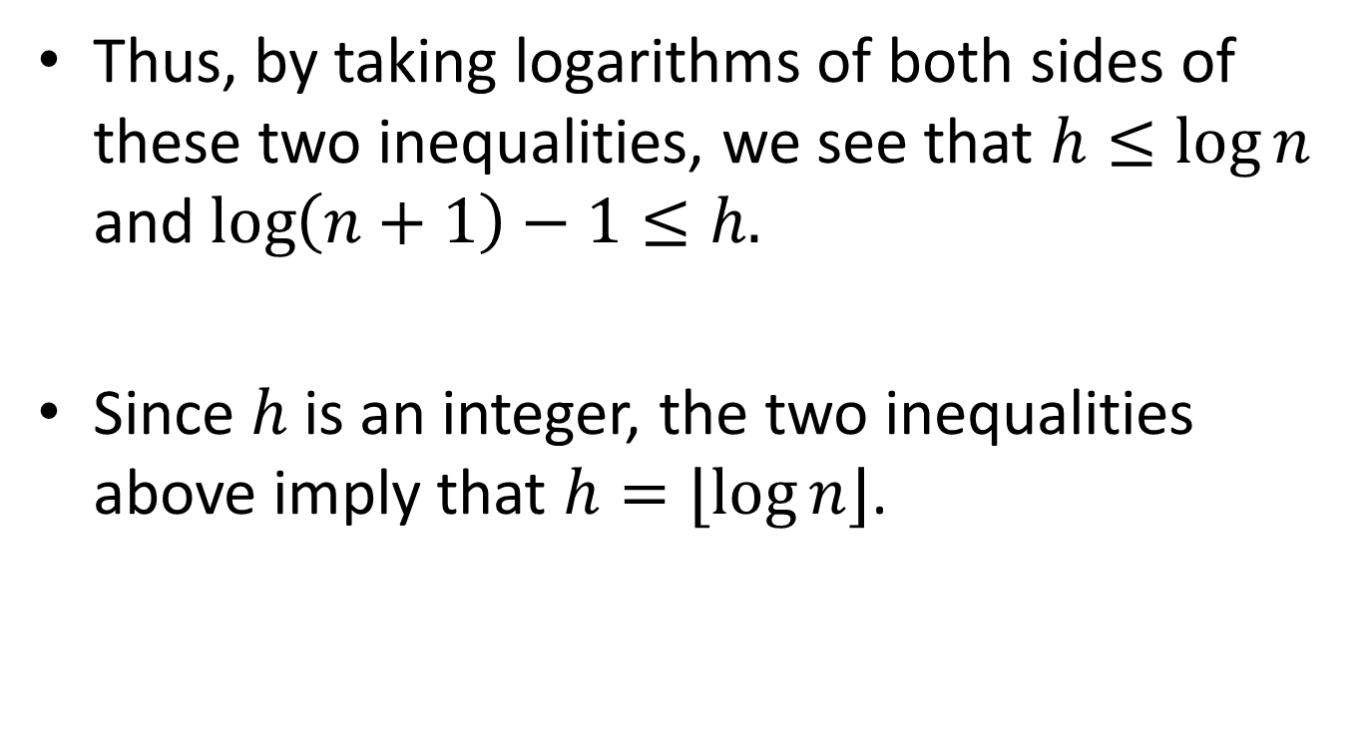
Proof (cont’d)
Thus, by taking logarithms of both sides of these two inequalities, we see that $h≤\log{n}$ and $\log\left(n+1\right)−1≤h.$
Since $h$ is an integer, the two inequalities above imply that $h=⌊\log{n}⌋$.

Slide 93
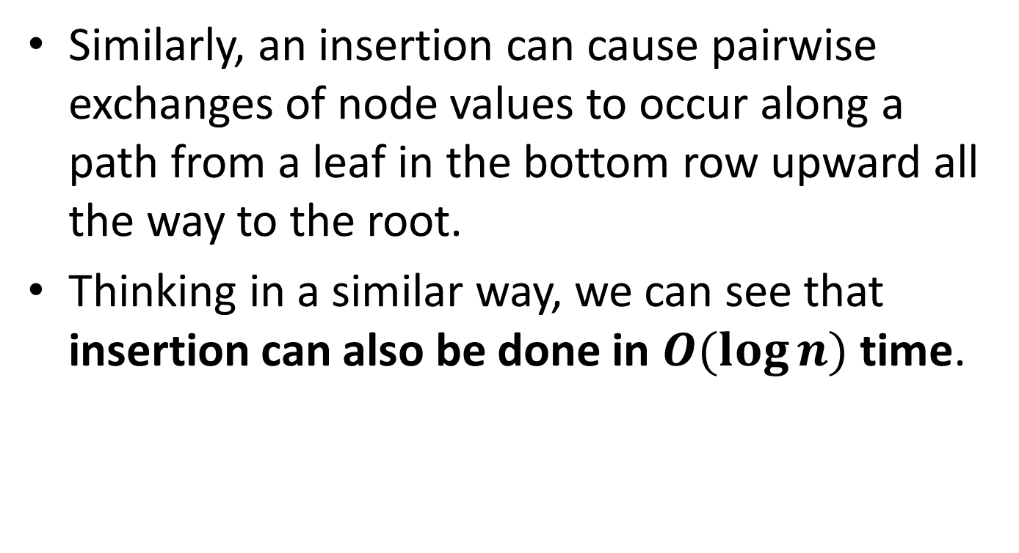
Complexity of Inserting an Item in a Heap
Similarly, an insertion can cause pairwise exchanges of node values to occur along a path from a leaf in the bottom row upward all the way to the root.
Thinking in a similar way, we can see that insertion can also be done in $O(\log{n})$ time.

Slide 94





Complexity of Making a Heap
1
Level 0
2
3
Level 1
4
5
6
7
Level 2
. . .
. . .
. . .
. . .
. . .
$$2^{l}$$
$$2^{l}+1$$
$$2^{l+1}−2$$
$$2^{l+1}−1$$
Level $l$

Slide 95
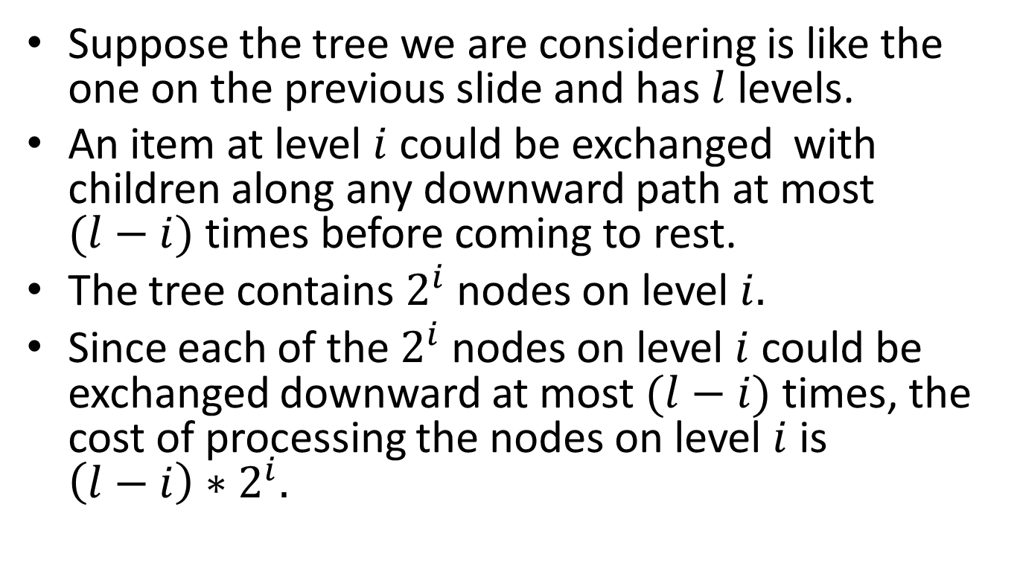
Complexity of Making a Heap (cont’d)
Suppose the tree we are considering is like the one on the previous slide and has $l$ levels.
An item at level $i$ could be exchanged with children along any downward path at most $(l−i)$ times before coming to rest.
The tree contains $2^{i}$ nodes on level $i.$
Since each of the $2^{i}$ nodes on level $i$ could be exchanged downward at most $(l−i)$ times, the cost of processing the nodes on level $i$ is $\left(l−i\right)∗2^{i}.$

Slide 96
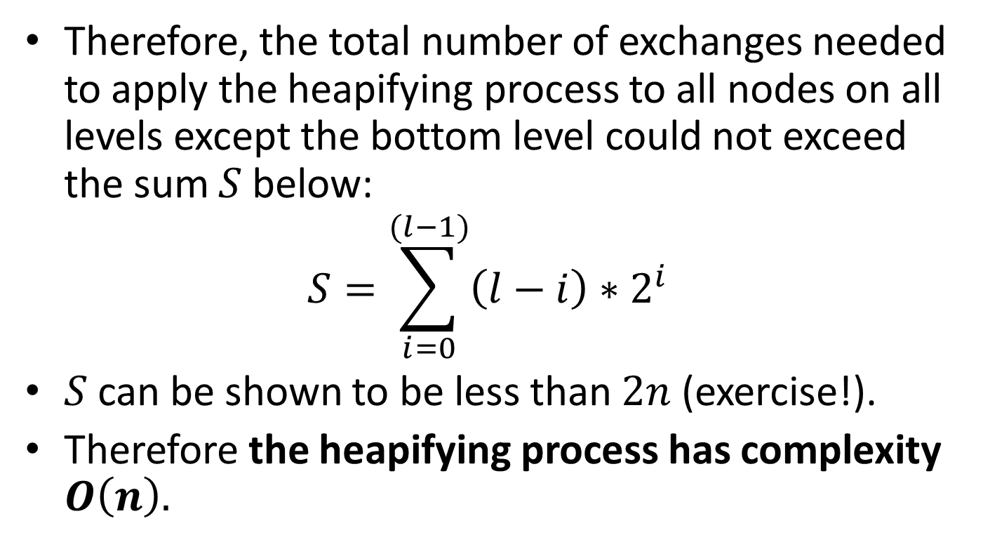
Complexity of Making a Heap (cont’d)
Therefore, the total number of exchanges needed to apply the heapifying process to all nodes on all levels except the bottom level could not exceed the sum $S$ below:
$$S=\sum_{i=0}^{(l−1)}{\left(l−i\right)∗2^{i}}$$
$S$ can be shown to be less than $2n$ (exercise!).
Therefore the heapifying process has complexity $O\left(n\right).$

Slide 97
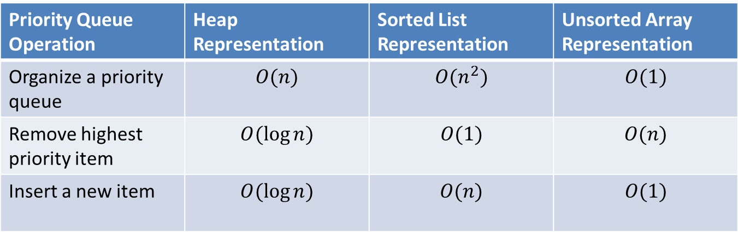
Comparing Running Times of Priority Queue Operations for the Three Representations
Priority Queue Operation | Heap Representation | Sorted List Representation | Unsorted Array Representation
Organize a priority queue | $$O(n)$$ | $$O(n^{2})$$ | $$O(1)$$
Remove highest priority item | $$O(\log{n})$$ | $$O(1)$$ | $$O(n)$$
Insert a new item | $$O(\log{n})$$ | $$O(n)$$ | $$O(1)$$

Slide 98
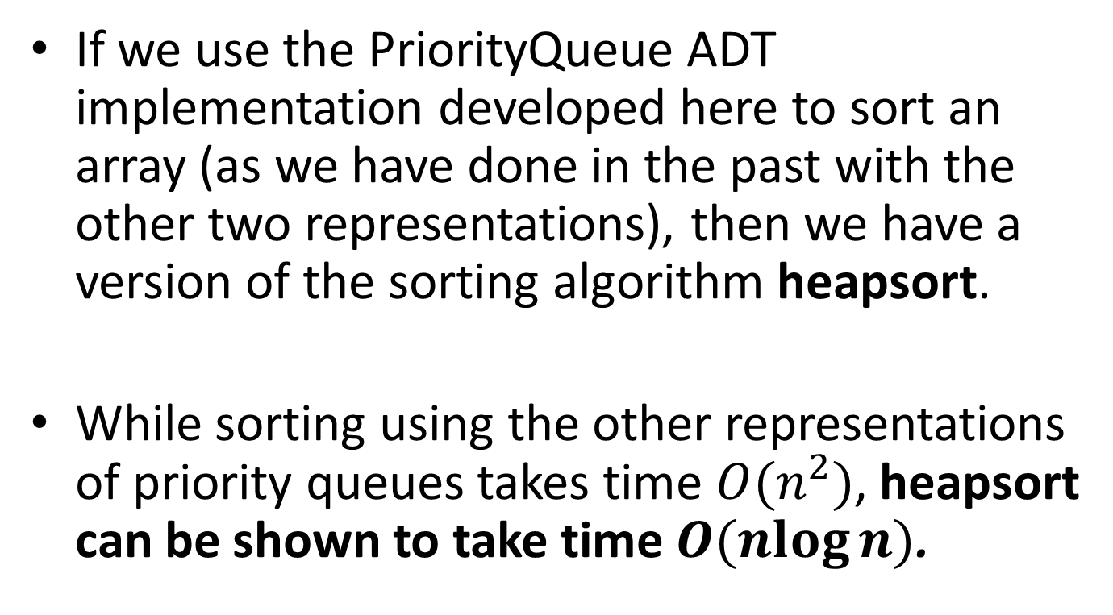
Heapsort
If we use the PriorityQueue ADT implementation developed here to sort an array (as we have done in the past with the other two representations), then we have a version of the sorting algorithm heapsort.
While sorting using the other representations of priority queues takes time $O(n^{2})$, heapsort can be shown to take time $O(\operatorname{nlog}{n})$.

Slide 99
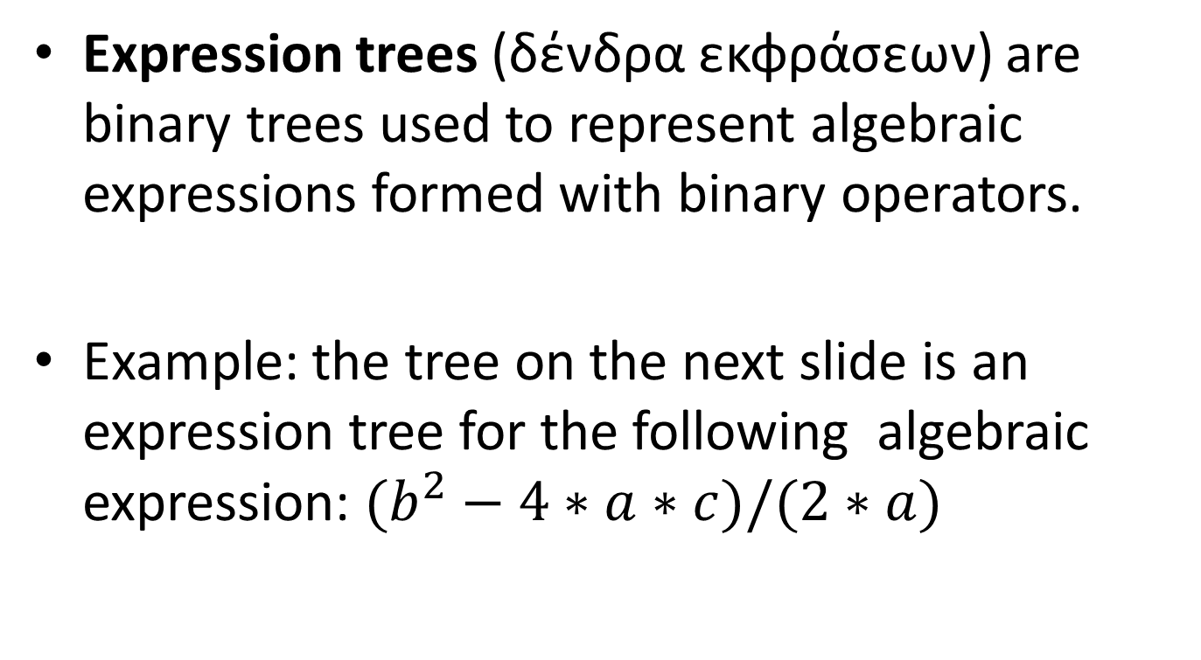
Expression Trees
Expression trees (δένδρα εκφράσεων) are binary trees used to represent algebraic expressions formed with binary operators.
Example: the tree on the next slide is an expression tree for the following algebraic expression: $(b^{2}−4∗a∗c)/(2∗a)$

Slide 100

Example (cont’d)
/
$$−$$
*
^
*
2
a
b
2
*
c
4
a

Slide 101
Parse Trees
Compilers parse algebraic expressions (and, in general, program statements) and build parse trees (δένδρα συντακτικής ανάλυσης) such as the expression tree of the previous example.
Parse trees are then traversed by code generators to produce assembly code.

Slide 102
Traversing Binary Trees
A traversal of a tree is a process that visits each node in the tree exactly once in some particular order.
Three popular traversal orders for binary trees are preorder, inorder and postorder (προδιατεταγμένη, ενδοδιατεταγμένη και μεταδιατεταγμένη διάσχιση).

Slide 103
Traversal Orders for Binary Trees
PreOrder | InOrder | PostOrder
Visit the root | Traverse left subtree in InOrder | Traverse left subtree in PostOrder
Traverse left subtree in PreOrder | Visit the root | Traverse right subtree in PostOrder
Traverse right subtree in PreOrder | Traverse right subtree in InOrder | Visit the root

Slide 104
Example
If, when we visit a node, we print the character contained in the node, then, for the above example tree, we have:
  PreOrder: +a b
  InOrder: a+b
  PostOrder: ab+
+
a
b

Slide 105

Example
/
$$−$$
*
^
*
2
a
b
2
*
c
4
a

Slide 106
Example (cont’d)
PreOrder: / – ^ b 2 * * 4 a c * 2 a
InOrder: b ^ 2 – 4 * a * c / 2 * a
PostOrder: b 2 ^ 4 a * c * – 2 a * /
The preorder traversal of an expression tree gives the prefix (προθεματική) representation of the expression.
The postorder traversal of an expression tree gives the postfix (μεταθεματική) representation of the expression.
The inorder traversal of an expression tree gives the infix(ενδοθεματική) representation of the expression without parentheses.

Slide 107
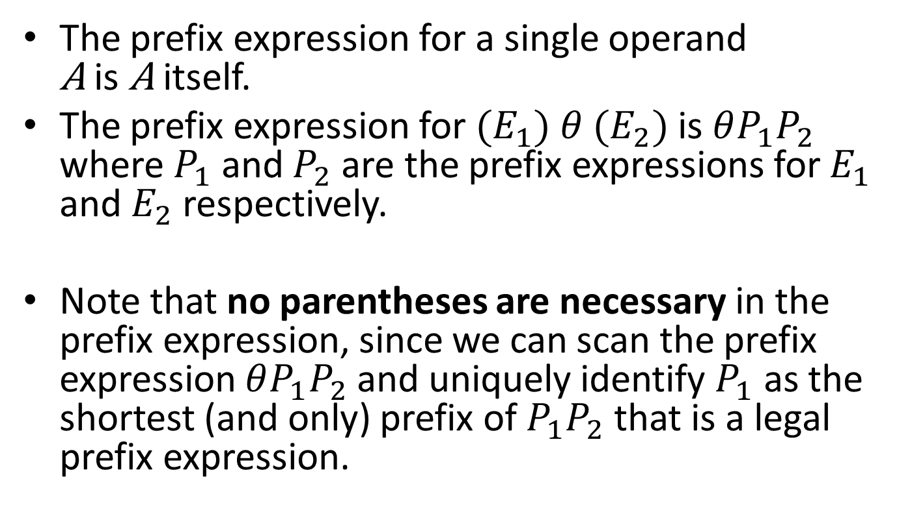
Prefix Representation
The prefix expression for a single operand
A is A itself.
The prefix expression for ${(E}_{1}) θ{ (E}_{2})$ is $θP_{1}P_{2}$ where $P_{1}$ and $P_{2}$ are the prefix expressions for $E_{1}$ and $E_{2}$ respectively.
Note that no parentheses are necessary in the prefix expression, since we can scan the prefix expression $θP_{1}P_{2}$ and uniquely identify $P_{1}$ as the shortest (and only) prefix of $P_{1}P_{2}$ that is a legal prefix expression.

Slide 108
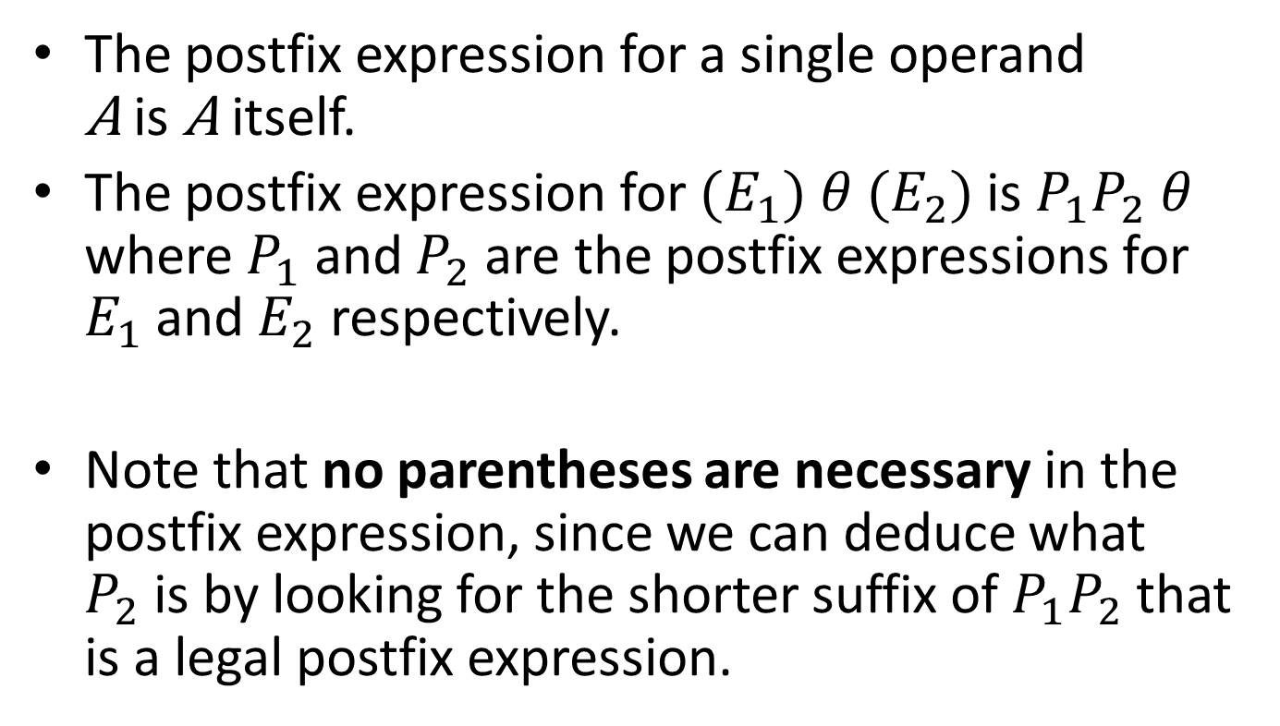
Postfix Representation
The postfix expression for a single operand
A is A itself.
The postfix expression for ${(E}_{1}) θ{ (E}_{2})$ is $P_{1}P_{2}$ $θ$ where $P_{1}$ and $P_{2}$ are the postfix expressions for $E_{1}$ and $E_{2}$ respectively.
Note that no parentheses are necessary in the postfix expression, since we can deduce what $P_{2}$is by looking for the shorter suffix of $P_{1}P_{2}$ that is a legal postfix expression.

Slide 109
Infix Representation
Question: What is the algorithm for producing an infix representation with parentheses of a given arithmetic expression represented by an expression tree?

Slide 110
Traversals Using the Linked Representation of Binary Trees
We can declare the type for tree nodes to use in the linked representation as follows:
typedef struct NodeTag{
char Symbol;
struct NodeTag *LLink;
struct NodeTag *RLink;
} TreeNode;

Slide 111

Example Expression Tree
+
$$−$$
z
x
y

Slide 112

Its Linked Representation
LLink
Symbol
RLink
+
Symbol
.
.
LLink
RLink
LLink
Symbol
RLink
$$−$$
z
.
.
.
.
LLink
Symbol
RLink
LLink
Symbol
RLink
x
y

Slide 113
The Linked Representation
The linked representation of binary trees presented in the previous example can also be used when we consider non-empty proper binary trees (extended trees).
In this case, NULL links represent the special external nodes we denote by a square.
In the next lecture we will also see the alternative representation where external nodes are represented by a special dummy node.

Slide 114
Traversals Using the Linked Representation (cont’d)
Let us define the folowing enumeration type:
typedef enum {PreOrder, InOrder, PostOrder} OrderOfTraversal;
We can now write a general recursive function to perform traversals in the various traversal orders.

Slide 115
Generalized Recursive Traversal Function
void Traverse(TreeNode *T, OrderOfTraversal TraversalOrder)
{
if (T!=NULL){
if (TraversalOrder==PreOrder){
Visit(T);
Traverse(T->LLink, PreOrder);
Traverse(T->RLink, PreOrder);
} else if (TraversalOrder==InOrder){
Traverse(T->LLink, InOrder);
Visit(T);
Traverse(T->RLink, InOrder);
} else if (TraversalOrder==PostOrder){
Traverse(T->LLink, PostOrder);
Traverse(T->RLink, PostOrder);
Visit(T);
}
}
}

Slide 116
Generalized Recursive Traversal Function (cont’d)
void Visit(TreeNode *T)
{
printf("%c\n", T->Symbol);
}

Slide 117
The Main Program
#include <stdio.h>
#include <stdlib.h>
typedef struct NodeTag{
char Symbol;
struct NodeTag *LLink;
struct NodeTag *RLink;
} TreeNode;
typedef enum {PreOrder, InOrder, PostOrder} OrderOfTraversal;
/* code for Visit */
/* code for Traverse */
int main(void)
{
TreeNode *T;
/* code to construct a binary tree to which T points */
Traverse(T, PreOrder);
}

Slide 118
Using a Stack
We can use the linked representation of binary trees and the stack ADT to write non-recursive traversal functions.
A stack is used to hold pointers to subtrees awaiting further traversal.

Slide 119
PreOrder Traversal of an Expression Tree Using a Stack
#include <stdio.h>
#include “StackInterface.h”
void PreOrderTraversal(TreeNode *T)
{
Stack S;
TreeNode *N;
InitializeStack(&S);
Push(T,&S);
while (!Empty(&S)){
Pop(&S, &N);
if (N!=NULL){
printf(“%c\n”, N->Symbol);
Push(N->RLink, &S);
Push(N->LLink, &S);
}
}
}

Slide 120
Comments
Note that the stack in the previous function contains pointers to TreeNode.
Therefore, to have a working program with our earlier stack implementations, we need to change the file “StackTypes.h” as we show on the next slide for the case that the stack is implemented using an array.

Slide 121
The Stack Data Types
/* This is the new file StackTypes.h */
#define MAXSTACKSIZE 100
typedef struct NodeTag{
char Symbol;
struct NodeTag *LLink;
struct NodeTag *RLink;
} TreeNode;
typedef TreeNode *ItemType;
typedef struct{
int Count;
ItemType Items[MAXSTACKSIZE];
} Stack;

Slide 122
The Main Program
#include <stdio.h>
#include <stdlib.h>
#include “StackInterface.h”
/* code for PreOrderTraversal */
int main(void)
{
TreeNode *T;
/* code to construct a binary tree to which T points*/
PreOrderTraversal(T);
}

Slide 123
Using a Queue
We can use the linked representation of binary trees and the ADT Queue to write a non-recursive function that prints the nodes of the tree in level order.

Slide 124
Level Order Binary Tree Traversal Using Queues
#include <stdio.h>
#include “QueueInterface.h”
void LevelOrderTraversal(TreeNode *T)
{
Queue Q;
TreeNode *N;
InitializeQueue(&Q);
Insert(T, &Q);
while (!Empty(&Q)){
Remove(&Q, &N);
if (N!=NULL){
printf(“%c\n”, N->Symbol);
Insert(N->LLink, &Q);
Insert(N->RLink, &Q);
}
}
}

Slide 125
Comments
Note that the queue in the previous function contains pointers to TreeNode.
Therefore, to have a working program with our earlier queue implementations, we need to change the file “QueueTypes.h” as we show on the next slide for the case that the queue is implemented using an array.

Slide 126
The Queue Data Types
/* This is the new file QueueTypes.h */
#define MAXQUEUESIZE 100
typedef struct NodeTag{
char Symbol;
struct NodeTag *LLink;
struct NodeTag *RLink;
} TreeNode;
typedef TreeNode *ItemType;
typedef struct {
int Count;
int Front;
int Rear;
ItemType Items[MAXQUEUESIZE];
} Queue;

Slide 127
The Main Program
#include <stdio.h>
#include <stdlib.h>
#include “QueueInterface.h”
/* code for LevelOrderTraversal */
int main(void)
{
TreeNode *T;
/* code to construct a binary tree to which T points*/
LevelOrderTraversal(T);
}

Slide 128
The Abstract Data Type Binary Tree
We can now define the ADT Binary Tree with the following operations:
  Create: create an empty binary tree.
  IsEmpty: return true if the tree is empty, otherwise return false.
  MakeTree(Root, Left, Right): create a binary tree with Root as the root element and Left (resp. Right) as the left (resp. right) subtree.
  Delete: delete the tree by freeing all its nodes.
  PreOrder, InOrder, PostOrder, LevelOrder: traverse the tree and visit its nodes in the respective order.
  Print: print the tree using an intuitive representation
  Height: return the height of the tree.
  Size: return the number of elements in the tree.

Slide 129
The ADT Binary Tree (cont’d)
For some of the operations, we have already shown how to implement them.
The implementation of the remaining operations is left as an exercise.

Slide 130
Readings
T. A. Standish. Data Structures, Algorithms and Software Principles in C.
  Chapter 9. Sections 9.1 to 9.6.
R. Sedgewick. Αλγόριθμοι σε C.
Κεφ. 5 και 9.
The formal propositions we have seen appear in the following book:
  M. T. Goodrich, R. Tamassia and D. Mount. Data Structures and Algorithms in C++. 2nd edition. John Wiley and Sons, 2011.

