Slide 1
B-Trees
Manolis Koubarakis

Slide 2
External Searching
So far we have assumed that our data structures are stored in main memory. However, if the size of a data structure is too big then it will be stored on hard disk.
Examples: the database of a bank, a database of satellite images, a database of videos etc.

Slide 3
External Searching (cont’d)
A disk access can be at least 100,000 to 1,000,000 times longer than a main memory access.
Thus, for data structures residing on disk, we want to minimize disk accesses.

Slide 4
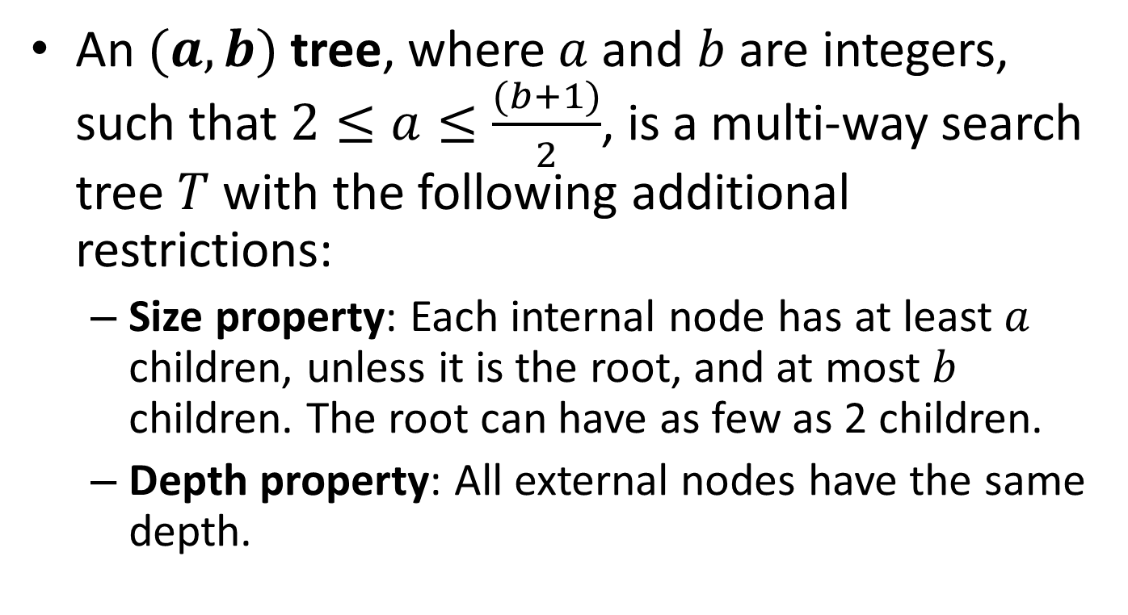

$(a,b)$ Trees
An $(a,b)$ tree, where $a$ and $b$ are integers, such that $2≤a≤\frac{(b+1)}{2}$, is a multi-way search tree $T$ with the following additional restrictions:
  Size property: Each internal node has at least $a$ children, unless it is the root, and at most $b$ children. The root can have as few as 2 children.
  Depth property: All external nodes have the same depth.

Slide 5
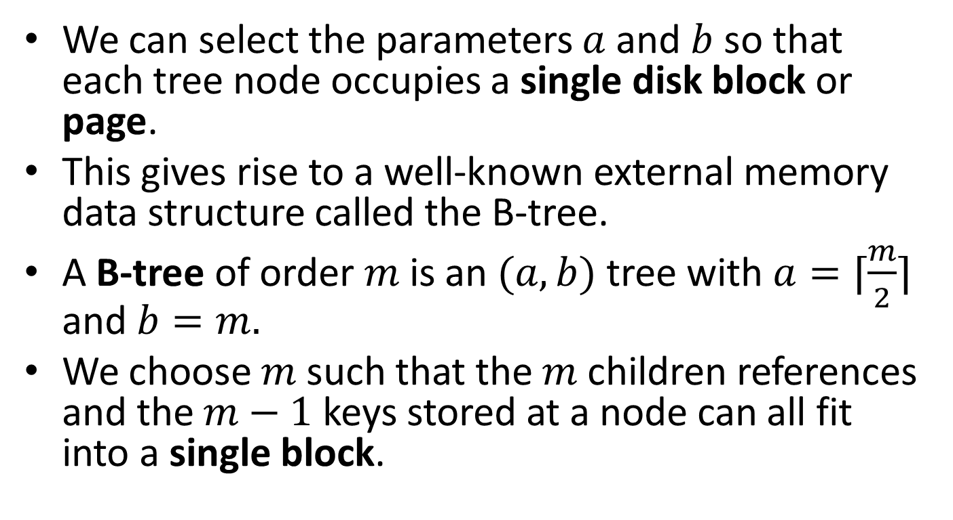
B-Trees
We can select the parameters $a$ and $b$ so that each tree node occupies a single disk block or page.
This gives rise to a well-known external memory data structure called the B-tree.
A B-tree of order $m$ is an $(a,b)$ tree with $a=⌈\frac{m}{2}⌉$ and $b=m.$
We choose $m$ such that the $m$ children references and the $m−1$ keys stored at a node can all fit into a single block.

Slide 6

Proposition
The height of an $(a,b)$ tree storing $n$ entries is $O\left(\frac{\log{n}}{\log{a}}\right).$
Proof?

Slide 7
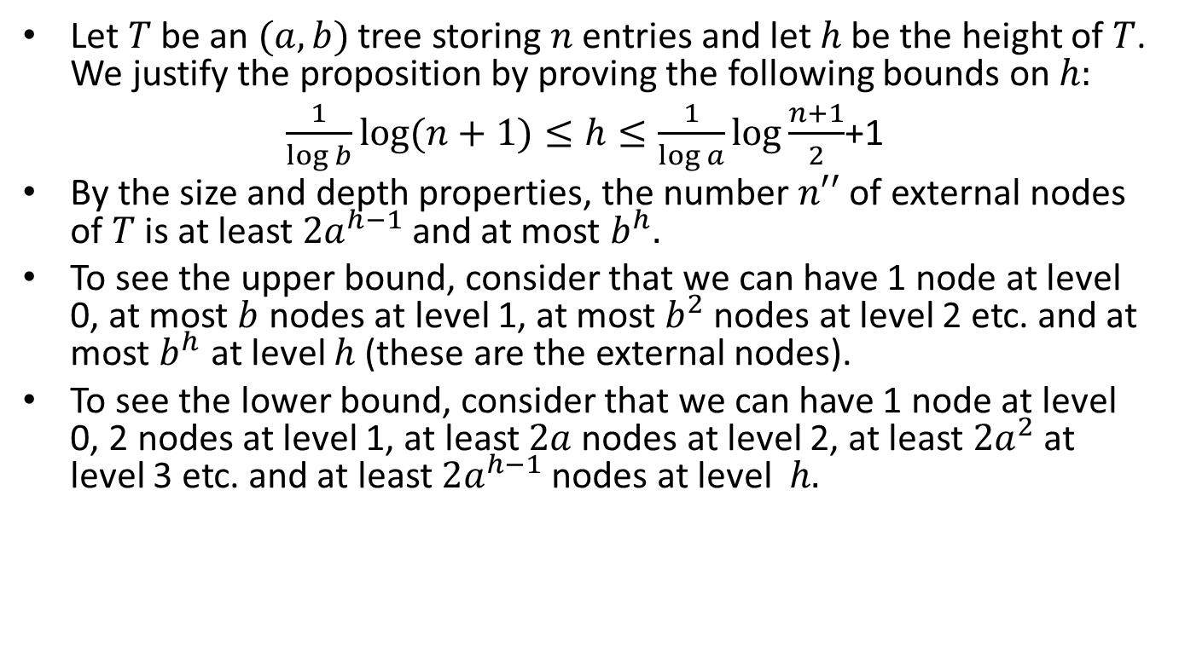
Proof
Let $T$ be an $(a,b)$ tree storing $n$ entries and let $h$ be the height of $T$. We justify the proposition by proving the following bounds on $h:$
$\frac{1}{\log{b}}\log{(n+1)}≤h≤\frac{1}{\log{a}}\log{\frac{n+1}{2}}$+1
By the size and depth properties, the number $n′′$ of external nodes of $T$ is at least $2a^{h−1}$ and at most $b^{h}.$
To see the upper bound, consider that we can have 1 node at level 0, at most $b$ nodes at level 1, at most $b^{2}$ nodes at level 2 etc. and at most $b^{h}$ at level $h$ (these are the external nodes).
To see the lower bound, consider that we can have 1 node at level 0, 2 nodes at level 1, at least $2a$ nodes at level 2, at least $2a^{2}$ at level 3 etc. and at least $2a^{h−1}$ nodes at level $h.$

Slide 8
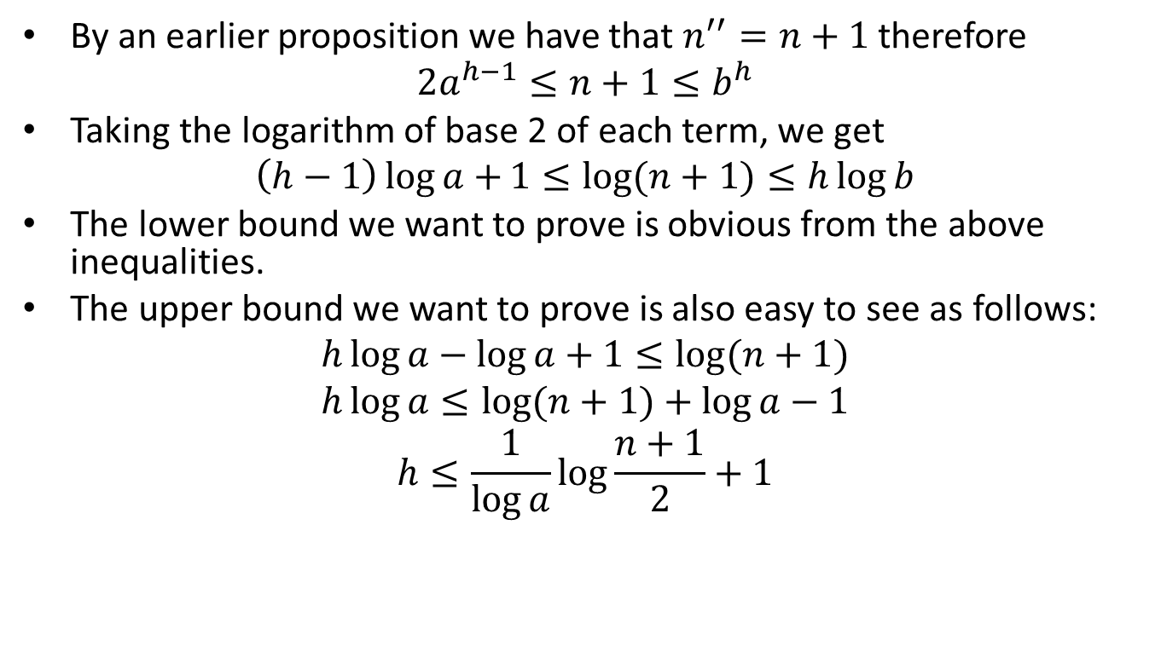
Proof (cont’d)
By an earlier proposition we have that $n^{′′}=n+1$ therefore
$$2a^{h−1}≤n+1≤b^{h}$$
Taking the logarithm of base 2 of each term, we get
$$\left(h−1\right)\log{a+}1≤\log{(n+1)}≤h\log{b}$$
The lower bound we want to prove is obvious from the above inequalities.
The upper bound we want to prove is also easy to see as follows:
$$h\log{a}−\log{a}+1≤\log{(n+1)}$$
$$h\log{a}≤\log{(n+1)}+\log{a}−1$$
$$h≤\frac{1}{\log{a}}\log{\frac{n+1}{2}}+1$$

Slide 9
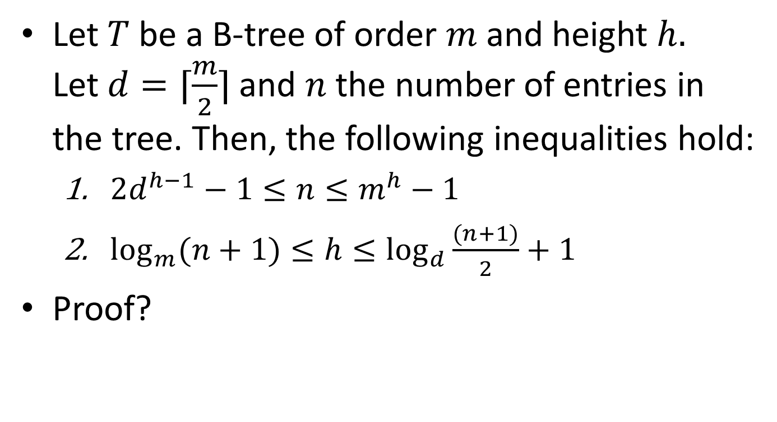
Proposition
Let $T$be a B-tree of order $m$ and height $h.$ Let$d=⌈\frac{m}{2}⌉$ and $n$ the number of entries in the tree. Then, the following inequalities hold:
  $2d^{h−1}−1≤n≤m^{h}−1$
  $\log_{m}{(n+1)}{≤h≤\log_{d}{\frac{(n+1)}{2}}}+1$
Proof?

Slide 10
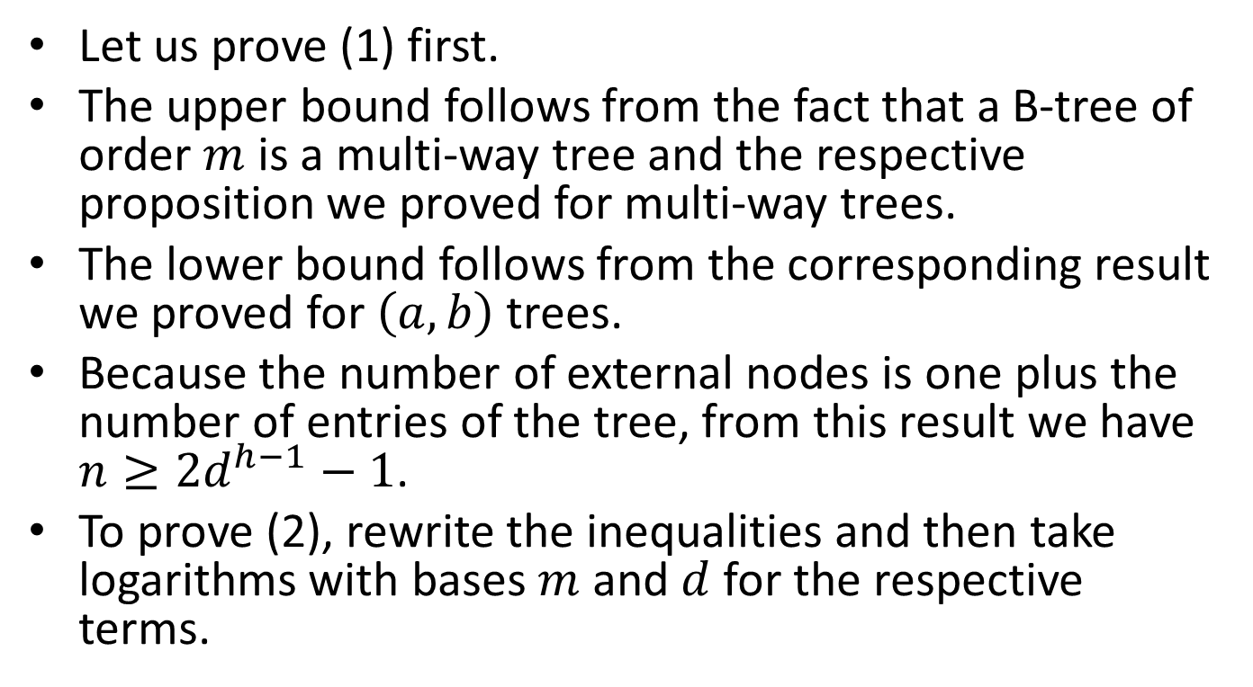
Proof
Let us prove (1) first.
The upper bound follows from the fact that a B-tree of order $m$ is a multi-way tree and the respective proposition we proved for multi-way trees.
The lower bound follows from the corresponding result we proved for $\left(a,b\right)$trees.
Because the number of external nodes is one plus the number of entries of the tree, from this result we have $n≥2d^{h−1}−1$.
To prove (2), rewrite the inequalities and then take logarithms with bases $m$ and $d$ for the respective terms.

Slide 11

Fact
From the previous proposition, we have that the height of a B-tree is $O\left(\log_{d}{n}\right)$ as we would like it for a balanced search tree.

Slide 12
Declarations
To implement B-trees in C, we can start with the following declarations:
#define MAX 4 /* maximum number of keys in node */
#define MIN 2 /* minimum number of keys in node */
typedef int Key;
typedef struct {
Key key;
int value; /* values can be of arbitrary type */
} Treeentry;
typedef struct treenode Treenode;
struct treenode {
int count; /* number of keys in node */
Treeentry entry[MAX+1];
Treenode *branch[MAX+1];
};

Slide 13
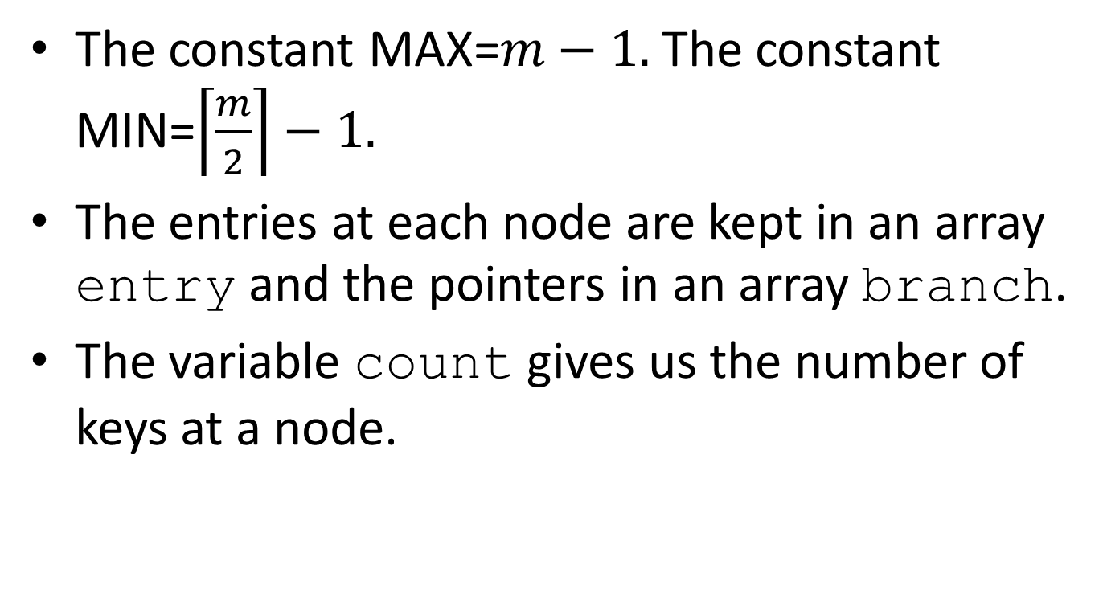
Declarations (cont’d)
The constant MAX=$m−1.$ The constant MIN=$\left\lceil \frac{m}{2}\right\rceil −1.$
The entries at each node are kept in an array entry and the pointers in an array branch.
The variable count gives us the number of keys at a node.

Slide 14
Insertion into a B-tree
The general method for insertion in a B-tree is as follows. First, a search is made to see if the new key is in the tree. This search (if the tree is truly new) will terminate in failure at a leaf.
The new key is then added to the parent of the leaf node. If the node was not previously full, then the insertion is finished.
When a key is added to a full node, we have an overflow. Then this node splits into two nodes on the same level, except that the median key is not put into either of the two new nodes, but is instead sent up to the tree to be inserted into the parent node.
When a search is later made through the tree, a comparison with the median key will serve to direct the search into the proper subtree.

Slide 15
Example
Let us see an example of insertions into an initially empty B-tree of order 5.

Slide 16
Insert a
a

Slide 17
Insert g
a g

Slide 18
Insert f
a f g

Slide 19
Insert b
a b f g

Slide 20
Insert k - Overflow
a b f g k

Slide 21
Creation of a New Root Node
f
a b g k

Slide 22
Split
f
a b
g k

Slide 23
Insert d
f
a b d
g k

Slide 24
Insert h
f
a b d
g h k

Slide 25
Insert m
f
a b d
g h k m

Slide 26
Insert j - Overflow
f
a b d
g h j k m

Slide 27
Sent j to the Parent Node
f
j
a b d
g h k m

Slide 28
Split
f j
a b d
g h
k m

Slide 29
Insert e
f j
a b d e
g h
k m

Slide 30
Insert s
f j
a b d e
g h
k m s

Slide 31
Insert i
f j
a b d e
g h i
k m s

Slide 32
Insert r
f j
a b d e
g h i
k m r s

Slide 33
Insert x - Overflow
f j
a b d e
g h i
k m r s x

Slide 34
r is Sent to the Parent Node
f j
r
a b d e
g h i
k m s x

Slide 35
Split
f j r
a b d e
g h i
k m
s x

Slide 36
Insert c - Overflow
f j r
a b c d e
g h i
k m
s x

Slide 37
c is Sent to the Parent
f j r
c
a b d e
g h i
k m
s x

Slide 38
Split
c f j r
a b
d e
g h i
k m
s x

Slide 39
Insert l
c f j r
a b
d e
g h i
k l m
s x

Slide 40
Insert n
c f j r
a b
d e
g h i
k l m n
s x

Slide 41
Insert t
c f j r
a b
d e
g h i
k l m n
s t x

Slide 42
Insert u
c f j r
a b
d e
g h i
k l m n
s t u x

Slide 43
Insert p - Overflow
c f j r
a b
d e
g h i
k l m n p
s t u x

Slide 44
m is Sent to the Parent Node
c f j r
m
a b
d e
g h i
k l n p
s t u x

Slide 45
Split
c f j m r
a b
d e
g h i
k l
n p
s t u x

Slide 46
Overflow at the Root
c f j m r
a b
d e
g h i
k l
n p
s t u x

Slide 47
j is Sent up to a New Root
j
c f m r
a b
d e
g h i
k l
n p
s t u x

Slide 48
Split
j
c f
m r
a b
d e
g h i
k l
n p
s t u x

Slide 49
Final Tree
j
c f
m r
a b
d e
g h i
k l
n p
s t u x

Slide 50
Insertion into a B-tree
We will write a recursive function for inserting a key into a B-tree.
The recursion is started by the function InsertTree which calls the recursive function PushDown. If the outermost call to function PushDown returns TRUE, then there is a key to be placed in a new root and the height of the tree increases.

Slide 51
Insertion into a B-tree (cont’d)
/* InsertTree: Inserts entry into the B-tree.
Pre: The B-tree to which root points has been created, and no entry in the B-tree
has key equal to newentry key.
Post: newentry has been inserted into the B-tree, the root is returned.
Uses: PushDown */
Treenode *InsertTree(Treeentry newentry, Treenode *root)
{
Treeentry medentry; /* node to be reinserted as new root */
Treenode *medright; /* subtree on right of medentry */
Treenode *newroot; /* used when the height of the tree increases */
if (PushDown(newentry, root, &medentry, &medright)){
/* Tree grows in height. Make a new root */
newroot=(Treenode *)malloc(sizeof(Treenode));
newroot->count=1;
newroot->entry[1]=medentry;
newroot->branch[0]=root;
newroot->branch[1]=medright;
return newroot;
}
return root;
}

Slide 52
Recursive Insertion into a Subtree
The recursive function PushDown recursively moves down the tree looking for a position for newentry.
We continue searching until we hit an empty subtree. Then we return TRUE and send the key (now called medentry) back up for insertion.
The parameter current points to the root of the subtree being searched.
medentry is the median key sent up to a parent.
When a recursive call returns TRUE, we attempt to insert the key medentry in the current node. If there is room, we are finished.
Otherwise, the current node *current splits into *current and *medright and a (possibly different) median key medentry is sent up the tree.

Slide 53
Recursive Insertion into a Subtree (cont’d)
/* PushDown: recursively move down tree searching for newentry.
Pre: newentry belongs in the subtree to which current points.
Post: newentry has been inserted into the subtree to which current points; if TRUE
is returned, then the height of the subtree has grown, and medentry needs
to be reinserted higher in the tree, with subtree medright on its right.
Uses: PushDown recursively, SearchNode, Split, PushIn. */
Boolean PushDown(Treeentry newentry, Treenode *current, Treeentry *medentry, Treenode **medright)
{
int pos; /*branch on which to continues the search */
if (current==NULL){ /* cannot insert into empty tree; terminates */
*medentry=newentry;
*medright=NULL;
return TRUE;
} else { /* Search the current node */
if (SearchNode(newentry.key, current, &pos))
printf("Inserting duplicate key into B-tree");
if (PushDown(newentry, current->branch[pos], medentry, medright))
if (current->count < MAX){ /*Reinsert median key. */
PushIn(*medentry, *medright, current, pos);
return FALSE;
} else {
Split(*medentry, *medright, current, pos, medentry, medright);
return TRUE;
}
return FALSE;
}
}

Slide 54
Searching a Node
The Boolean function SearchNode determines if the target key target is in the current node and, if not, finds which of the count+1 branches will contain the target key.
The position of the target or the branch to continue searching is returned in variable pos.
The branch 0 is considered separately. For the rest of the entries, the function SearchNode uses sequential search starting at the end of the array entry.
If nodes of the tree contain many keys, we might want to use binary search.

Slide 55
Searching a Node (cont’d)
/* SearchNode: searches keys in node for target.
Pre: target is a key and current points to a node of a B-tree.
Post: Searches keys in node for target; returns location pos of
target, or branch on which to continue search.*/
Boolean SearchNode(Key target, Treenode *current, int *pos)
{
if (target < current->entry[1].key){ /* Take the leftmost branch */
*pos=0;
return FALSE;
} else { /* Start a sequential search through the keys */
for (*pos=current->count; target < current->entry[*pos].key && *pos > 1; (*pos)--)
;
return (target == current->entry[*pos].key);
}
}

Slide 56
Insertion of a Key into a Node
The function PushIn inserts the key medentry and its right-hand pointer medright into node *current at position pos provided that there is space.

Slide 57
Insertion of a Key into a Node (cont’d)
/* PushIn: inserts a key into a node.
Pre: medentry belongs at index pos in node *current, which has room
for it.
Post: Inserts key medentry and pointer medright into *current at
index pos. */
void PushIn(Treeentry medentry, Treenode *medright, Treenode *current, int pos)
{
int i; /* index to move keys to make room for medentry */
for (i=current->count; i>pos; i--){
/* Shift all keys and branches to the right */
current->entry[i+1]=current->entry[i];
current->branch[i+1]=current->branch[i];
}
current->entry[pos+1]=medentry;
current->branch[pos+1]=medright;
current->count++;
}

Slide 58
Splitting a Full Node
The function Split inserts the key medentry with subtree pointer medright into the full node *current, splits the right half off as new node *newright, and sends the median key newmedian upward for reinsertion later.

Slide 59
Splitting a Full Node
/* Split: splits a full node.
Pre: medentry belongs at index pos of node *current which is full.
Post: Splits node *current with entry medentry and pointer medright at index pos
into nodes *current and *newright with median entry newmedian.
Uses: PushIn */
void Split(Treeentry medentry, Treenode *medright, Treenode *current, int pos, Treeentry *newmedian, Treenode **newright)
{
int i; /* used for copying from *current to new node */
int median; /* median position in the combined, overfull node */
if (pos<=MIN) /* Find splitting point. Determine if new key goes to left or right half */
median=MIN;
else
median=MIN+1;
/* Get a new node and put it on the right */
*newright=(Treenode *)malloc(sizeof(Treenode));
for (i=median+1; i<=MAX; i++){ /* Move half the keys to the right node */
(*newright)->entry[i-median]=current->entry[i];
(*newright)->branch[i-median]=current->branch[i];
}
(*newright)->count=MAX-median;
current->count=median;
if (pos <= MIN) /* Push in the new key */
PushIn(medentry, medright, current, pos);
else
PushIn(medentry, medright, *newright, pos-median);
*newmedian=current->entry[current->count];
(*newright)->branch[0]=current->branch[current->count];
current->count--;
}

Slide 60
Deletion from a B-tree
Let us now see how we delete a key from a B-tree.
If the key to be deleted is in a node with only external nodes as children, then it can be deleted immediately.
If the key to be deleted is in an internal node with only internal nodes as children, then its immediate predecessor (or successor) under the natural order of keys is guaranteed to be in a node with only external-node children. (Proof?)
Hence, we can promote the immediate predecessor or successor into the position occupied by the key to be deleted, and delete the key from the node with only external-node children.

Slide 61
Deletion from a B-tree (cont’d)
If the node where the deletion takes place contains more than the minimum number of keys, then one can be deleted with no further action.
If the node contains the minimum number, then we first look at its two immediate siblings (or in the case of a node on the outside, one sibling).
If one of these has more than the minimum number for entries, then we can do a transfer operation: one child of the sibling is moved to the node where the deletion takes place, one of the keys of the sibling is moved into the parent node, and a key from the parent node is moved into the node where the deletion takes place.
If the immediate sibling has only the minimum number of keys then we perform a fusion operation: the current node and its sibling are merged into a new node and a key is moved from the parent into this new node.
If this step leaves the parent with too few entries, the process propagates upward.

Slide 62
Example
j
c f
m r
a b
d e
g h i
k l
n p
s t u x

Slide 63
Delete h
j
c f
m r
a b
d e
g i
k l
n p
s t u x

Slide 64
Delete r
j
c f
m r
a b
d e
g i
k l
n p
s t u x

Slide 65
Find the Successor of r
j
c f
m r
a b
d e
g i
k l
n p
s t u x

Slide 66
Promote the Successor of r – Delete the Successor from its Place
j
c f
m s
a b
d e
g i
k l
n p
t u x

Slide 67
Delete p
j
c f
m s
a b
d e
g i
k l
n p
t u x

Slide 68
Transfer
j
c f
m
s
t
a b
d e
g i
k l
n
u x

Slide 69
After the Transfer
j
c f
m t
a b
d e
g i
k l
n s
u x

Slide 70
Delete d
j
c f
m t
a b
e
g i
k l
n s
u x
d

Slide 71
Fusion
j
f
m t
c
a b
e
g i
k l
n s
u x

Slide 72
After the Fusion – Underflow at f
j
f
m t
a b c e
g i
k l
n s
u x

Slide 73
Fusion
j
f
m t
a b c e
g i
k l
n s
u x

Slide 74
After the Fusion – Delete Root
f j m t
a b c e
g i
k l
n s
u x

Slide 75
Final Tree
f j m t
a b c e
g i
k l
n s
u x

Slide 76
Deletion Function
/* DeleteTree: deletes target from the B-tree.
Pre: target is the key of some entry in the B-tree to which root
points.
Post: This entry has been deleted from the B-tree.
Uses: RecDeleteTree */
Treenode *DeleteTree(Key target, Treenode *root)
{
Treenode *oldroot; /* used to dispose of an empty root */
RecDeleteTree(target, root);
if (root->count==0){ /* root is empty */
oldroot=root;
root=root->branch[0];
free(oldroot);
}
return root;
}

Slide 77
Recursive Deletion
Most of the work is done in the recursive function RecDeleteTree.
This function first searches the current node for the target. If it is found and the node has only internal-node children, then the immediate successor of the key is found and is placed in the current node, and the successor is deleted.
Deletion from a node with only external-node children is straightforward.
Otherwise, the function continues recursively. When a recursive call returns, the function checks to see if enough entries remain in the appropriate node, and, if not, moves entries as required.

Slide 78
Recursive Deletion (cont’d)
/* RecDeleteTree: look for target to delete.
Pre: target is the key of some entry in the subtree of a B-tree to which current points.
Post: This entry has been deleted from the B-tree.
Uses: RecDeleteTree recursively, SearchNode, Successor, Remove, Restore */
void RecDeleteTree(Key target, Treenode *current)
{
int pos; /* location of target or of branch on which to search */
if (!current){
printf("Target was not in the B-tree");
return; /* Hitting an empty tree is an error */
} else {
if (SearchNode(target, current, &pos))
if (current->branch[pos-1]){
Successor(current, pos); /* replaces entry[pos] by its successor */
RecDeleteTree(current->entry[pos].key, current->branch[pos]);
} else
Remove(current, pos); /* removes key from pos of *current */
else /* Target was not found in the current node */
RecDeleteTree(target, current->branch[pos]);
if (current->branch[pos])
if (current->branch[pos]->count < MIN)
Restore(current, pos);
}
}

Slide 79
Auxiliary Functions
/* Remove: delete an entry and the branch to its right.
Pre: current points to a node in a B-tree with an entry
in index pos.
Post: This entry and the branch to its right are
removed from *current */
void Remove(Treenode *current, int pos)
{
int i; /* index for moving entries */
for (i=pos+1; i<=current->count; i++){
current->entry[i-1]=current->entry[i];
current->branch[i-1]=current->branch[i];
}
current->count--;
}

Slide 80
Auxiliary Functions (cont’d)
/* Successor: replaces an entry by its
immediate successor.
Pre: current points to a node in a B-tree with an
entry in index pos.
Post: This entry is replaced by its immediate
successor under order of keys. */
void Successor(Treenode *current, int pos)
{
/* The code is left as exercise */
}

Slide 81
Auxiliary Functions (cont’d)
The function Restore implements the transfer or fusion operation required when we have an underflow.
The transfer operation is implemented by functions MoveLeft and MoveRight.
The fusion operation is implemented by function Combine.

Slide 82
Auxiliary Functions (cont’d)
/* Restore: restore the minimum number of entries.
Pre: current points to a node in a B-tree with an entry in index pos; the branch to
the right of pos has one too few entries.
Post: An entry taken from elsewhere is used to restore the minimum number of entries by
entering it at current->branch[pos].
Uses: MoveLeft, MoveRight, Combine */
void Restore(Treenode *current, int pos)
{
if (pos==0) /* case: leftmost key */
if (current->branch[1]->count > MIN)
MoveLeft(current, 1);
else
Combine(current, 1);
else if (pos == current->count) /*case: rightmost key */
if (current->branch[pos-1]->count > MIN)
MoveRight(current, pos);
else
Combine(current, pos);
else if (current->branch[pos-1]->count > MIN)
MoveRight(current, pos);
else if (current->branch[pos+1]->count > MIN)
MoveLeft(current, pos+1);
else
Combine(current, pos);
}

Slide 83
Auxiliary Functions (cont’d)
/* MoveRight: move a key to the right.
Pre: current points to a node in a B-tree with entries in the branches pos and
pos-1, with too few entries in branch pos.
Post: The rightmost entry from branch pos-1 has moved into *current, which has
sent an entry into the branch pos */
void MoveRight(Treenode *current, int pos)
{
int c;
Treenode *t;
t=current->branch[pos];
for (c=t->count; c>0; c--){
/* shift all keys in the right node one position */
t->entry[c+1]=t->entry[c];
t->branch[c+1]=t->branch[c];
}
t->branch[1]=t->branch[0]; /* move key from parent to right node */
t->count++;
t->entry[1]=current->entry[pos];
t=current->branch[pos-1]; /* move last key of left node into parent */
current->entry[pos]=t->entry[t->count];
current->branch[pos]->branch[0]=t->branch[t->count];
t->count--;
}

Slide 84
Auxiliary Functions (cont’d)
/* MoveLeft: move a key to the left.
Pre: current points to a node in a B-tree with entries in the branches pos and
pos-1, with too few in branch pos-1.
Post: The leftmost entry from branch pos has moved into *current, which has sent
an entry into the branch pos-1 */
void MoveLeft(Treenode *current, int pos)
{
int c;
Treenode *t;
t=current->branch[pos-1]; /* move key from parent into left node */
t->count++;
t->entry[t->count]=current->entry[pos];
t->branch[t->count]=current->branch[pos]->branch[0];
t=current->branch[pos]; /* Move first key from right node into parent */
current->entry[pos]=t->entry[1];
t->branch[0]=t->branch[1];
t->count--;
for (c=1; c<=t->count; c++){
/* shift all keys in the right node one position leftward */
t->entry[c]=t->entry[c+1];
t->branch[c]=t->branch[c+1];
}
}

Slide 85
Auxiliary Functions
/* Combine: combine adjacent nodes.
Pre: current points to a node in a B-tree with entries in the branches pos and
pos-1, with too few to move entries.
Post: The nodes at branches pos-1 and pos have been combined into one node,
which also includes the entry formerly in *current at index pos. */
void Combine(Treenode *current, int pos)
{
int c;
Treenode *right;
Treenode *left;
right=current->branch[pos];
left=current->branch[pos-1]; /* work with the left node */
left->count++; /* insert the key from the parent */
left->entry[left->count]=current->entry[pos];
left->branch[left->count]=right->branch[0];
for (c=1; c<=right->count; c++){ /* insert all keys from right node */
left->count++;
left->entry[left->count]=right->entry[c];
left->branch[left->count]=right->branch[c];
}
for (c=pos; c< current->count; c++){ /* delete key from parent node */
current->entry[c]=current->entry[c+1];
current->branch[c]=current->branch[c+1];
}
current->count--;
free(right); /* dispose of the empty right node */
}

Slide 86
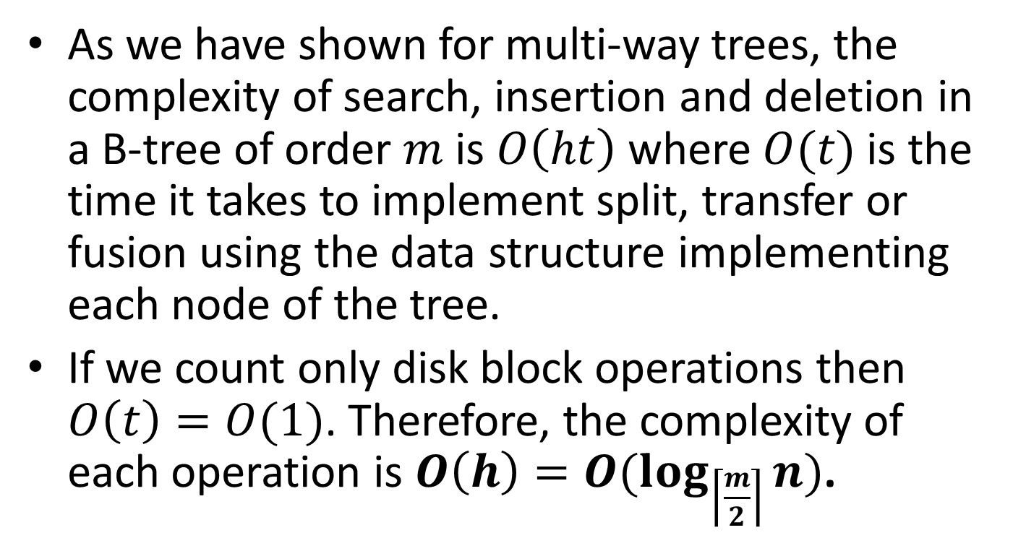
Complexity of Operations in a B-tree
As we have shown for multi-way trees, the complexity of search, insertion and deletion in a B-tree of order $m$is $O\left(ht\right)$ where $O(t)$is the time it takes to implement split, transfer or fusion using the data structure implementing each node of the tree.
If we count only disk block operations then $O\left(t\right)=O(1)$. Therefore, the complexity of each operation is $O\left(h\right)=O(\log_{\left\lceil \frac{m}{2}\right\rceil }{n})$.

Slide 87
B⁺-trees
A variation of B-trees called B⁺-trees is one of the most important indexing structures used in today’s file systems and relational database management systems.

Slide 88
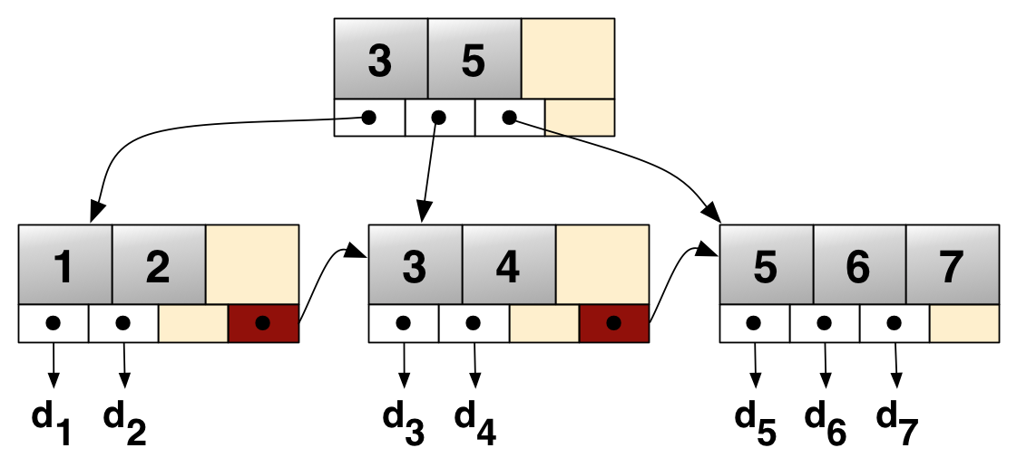
B⁺-tree Example

Slide 89
Readings
The code we presented is from the following book:
  R. Kruse, C. L. Tondo and B. Leung. Data Structures and Program Design in C.
    Chapter 10
The theoretical results are from the following books:
  M. T. Goodrich, R. Tamassia and D. Mount. Data Structures and Algorithms in C++. 2nd edition. John Wiley.
  Sartaj Sahni. Δομές Δεδομένων, Αλγόριθμοι και Εφαρμογές στη C++. Εκδόσεις Τζιόλα.
R. Sedgewick. Αλγόριθμοι σε C.
  Κεφ. 16.3

