Slide 1
Binary Search Trees
Manolis Koubarakis

Slide 2
Search
The retrieval of a particular piece of information from large volumes of previously stored data is a fundamental operation, called search (αναζήτηση).
Search is an important operation in many applications e.g., bank information systems, airline information systems, Web search etc.

Slide 3
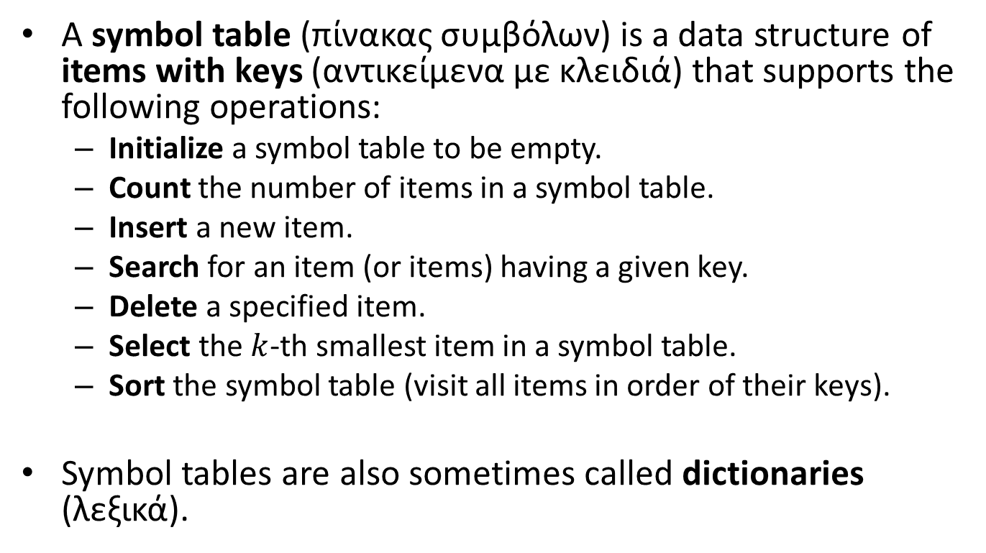
The ADT Symbol Table
A symbol table (πίνακας συμβόλων) is a data structure of items with keys (αντικείμενα με κλειδιά) that supports the following operations:
  Initialize a symbol table to be empty.
  Count the number of items in a symbol table.
  Insert a new item.
  Search for an item (or items) having a given key.
  Delete a specified item.
  Select the $k$-th smallest item in a symbol table.
  Sort the symbol table (visit all items in order of their keys).
Symbol tables are also sometimes called dictionaries (λεξικά).

Slide 4
A Symbol Table Interface
void STinit(int);
int STcount();
void STinsert(Item);
Item STsearch(Key);
void STdelete(Item);
Item STselect(int);
void STsort(void (*visit)(Item));

Slide 5
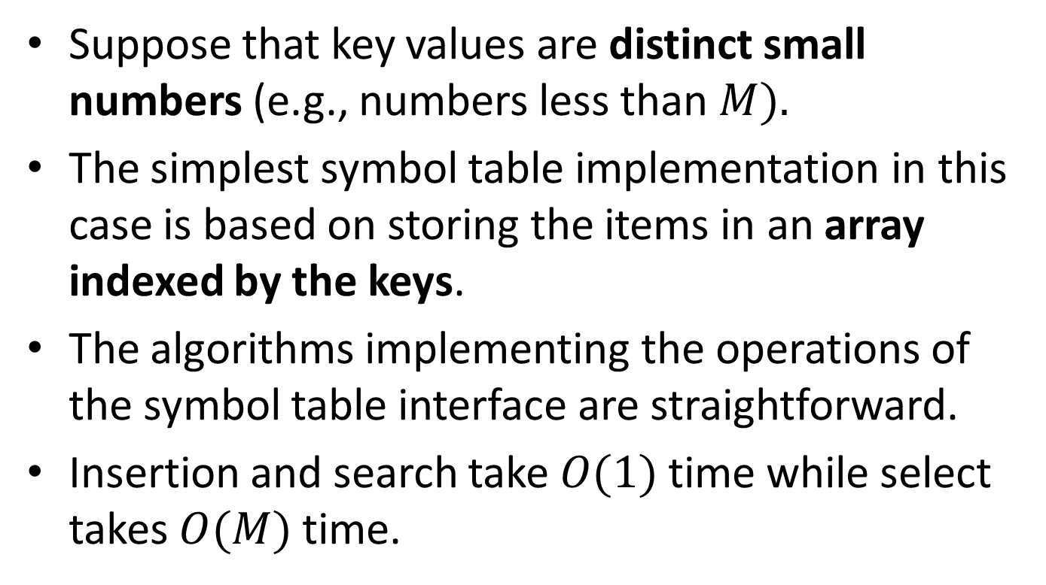
Key-Indexed Search
Suppose that key values are distinct small numbers (e.g., numbers less than $M).$
The simplest symbol table implementation in this case is based on storing the items in an array indexed by the keys.
The algorithms implementing the operations of the symbol table interface are straightforward.
Insertion and search take $O(1)$ time while select takes $O(M)$ time.

Slide 6
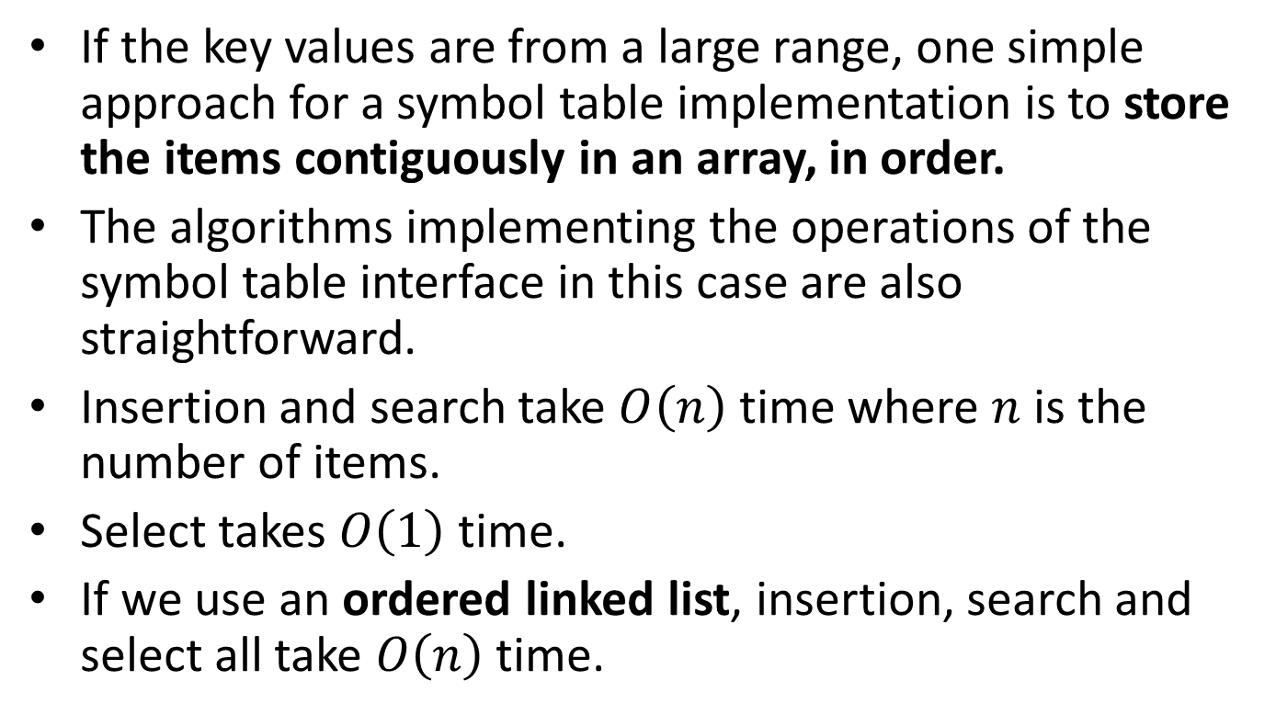
Sequential Search
If the key values are from a large range, one simple approach for a symbol table implementation is to store the items contiguously in an array, in order.
The algorithms implementing the operations of the symbol table interface in this case are also straightforward.
Insertion and search take $O\left(n\right)$ time where $n$ is the number of items.
Select takes $O\left(1\right)$ time.
If we use an ordered linked list, insertion, search and select all take $O\left(n\right)$ time.

Slide 7
Binary Search
In the array implementation of sequential search, we can reduce significantly the search time for a large set of items by using a search procedure called binary search (δυαδική αναζήτηση) which is based on the divide-and-conquer paradigm.

Slide 8
Binary Search
The problem to be addressed in binary searching is to find the position of a search key K in an ordered array A[0:n-1] of distinct keys arranged in ascending order:
A[0] < A[1] < … < A[n-1].
The algorithm chooses the key in the middle of A[0:n-1], which is located at A[Middle], where Middle=(0+(n-1))/2, and compares the search key K and A[Middle].
If K==A[Middle], the search terminates successfully.
If K < A[Middle] then further search is conducted among the keys to the left of A[Middle].
If K > A[Middle] then further search is conducted among the keys to the right of A[Middle].

Slide 9
Iterative Binary Search
int BinarySearch(Key K)
{
int L, R, Midpoint;
/* Initializations */
L=0;
R=n-1;
/* While the interval L:R is non-empty, test key K against the middle key */
while (L<=R){
Midpoint=(L+R)/2;
if (K==A[Midpoint]){
return Midpoint;
} else if (K > Midpoint) {
L=Midpoint+1;
} else {
R=Midpoint-1;
}
}
/* If the search interval became empty, key K was not found */
return -1;
}

Slide 10
Recursive Binary Search
int BinarySearch (Key K, int L, int R)
{
/* To find the position of the search key K in the subarray
A[L:R]. Note: To search for K in A[0:n-1], the initial call
is BinarySearch(K, 0, n-1) */
int Midpoint;
Midpoint=(L+R)/2;
if (L>R){
return -1;
} else if (K==A[Midpoint]){
return Midpoint;
} else if (K > A[Midpoint]){
return BinarySearch(K, Midpoint+1, R);
} else {
return BinarySearch(K, L, Midpoint-1);
}
}

Slide 11
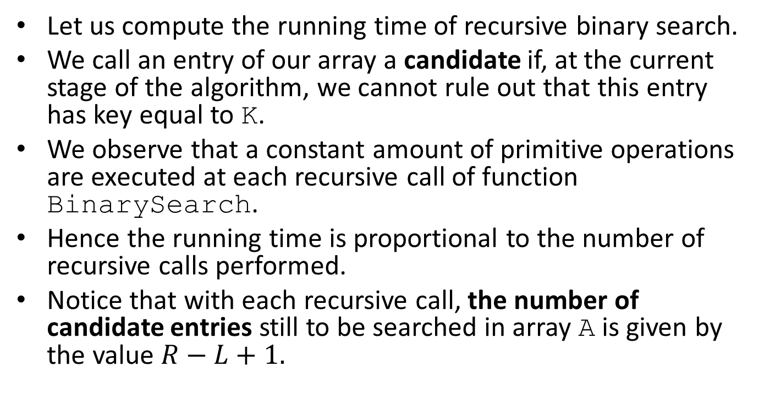
Complexity
Let us compute the running time of recursive binary search.
We call an entry of our array a candidate if, at the current stage of the algorithm, we cannot rule out that this entry has key equal to K.
We observe that a constant amount of primitive operations are executed at each recursive call of function BinarySearch.
Hence the running time is proportional to the number of recursive calls performed.
Notice that with each recursive call, the number of candidate entries still to be searched in array A is given by the value $R−L+1.$

Slide 12
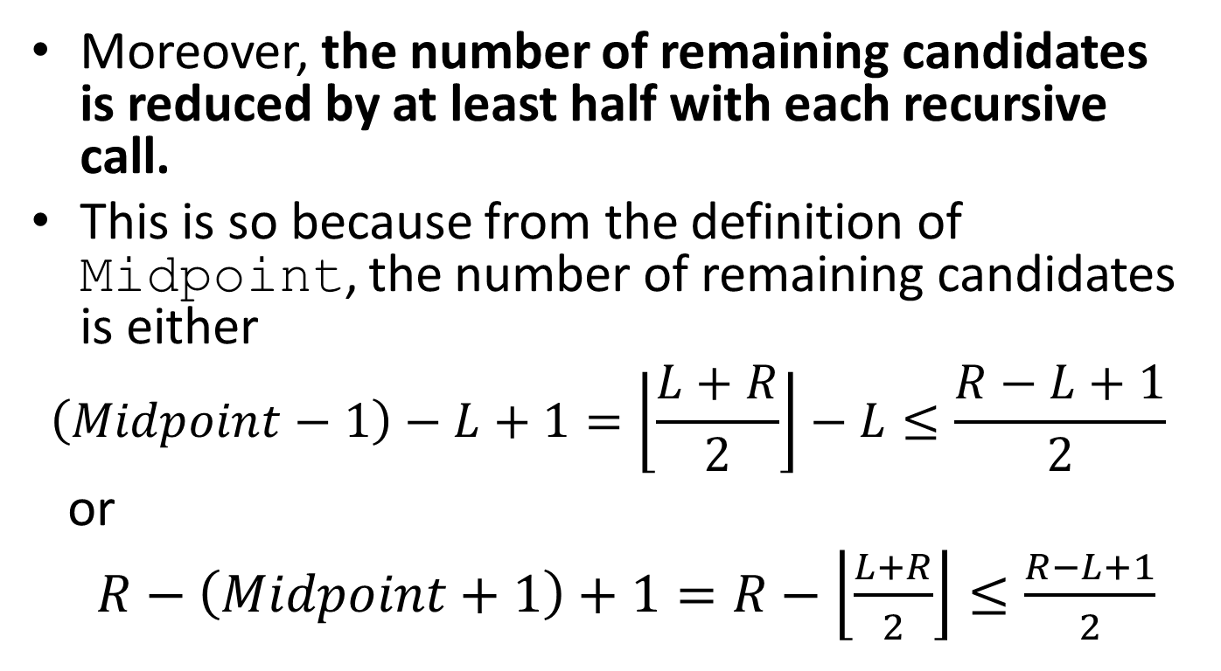
Complexity (cont’d)
Moreover, the number of remaining candidates is reduced by at least half with each recursive call.
This is so because from the definition of Midpoint, the number of remaining candidates is either
$$\left(Midpoint−1\right)−L+1=\left\lfloor \frac{L+R}{2}\right\rfloor −L≤\frac{R−L+1}{2}$$
or
$R−\left(Midpoint+1\right)+1=R−\left\lfloor \frac{L+R}{2}\right\rfloor ≤\frac{R−L+1}{2}$

Slide 13
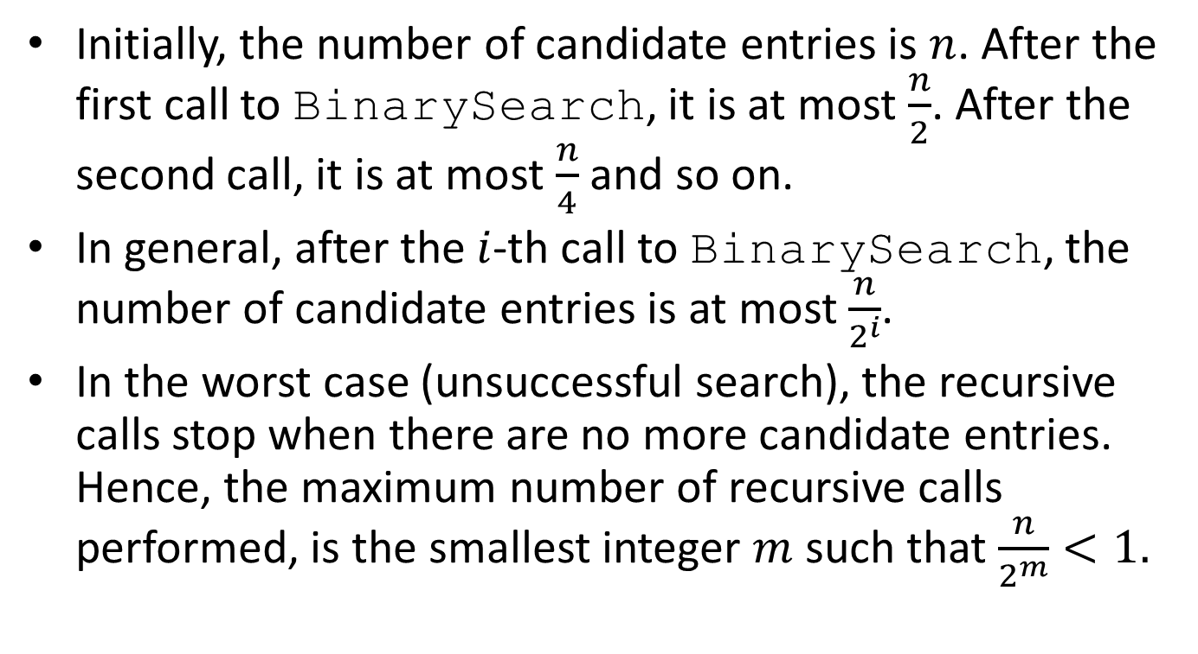
Complexity (cont’d)
Initially, the number of candidate entries is $n$. After the first call to BinarySearch, it is at most $\frac{n}{2}$. After the second call, it is at most $\frac{n}{4}$ and so on.
In general, after the $i$-th call to BinarySearch, the number of candidate entries is at most $\frac{n}{2^{i}}$.
In the worst case (unsuccessful search), the recursive calls stop when there are no more candidate entries. Hence, the maximum number of recursive calls performed, is the smallest integer $m$ such that $\frac{n}{2^{m}}<1.$

Slide 14
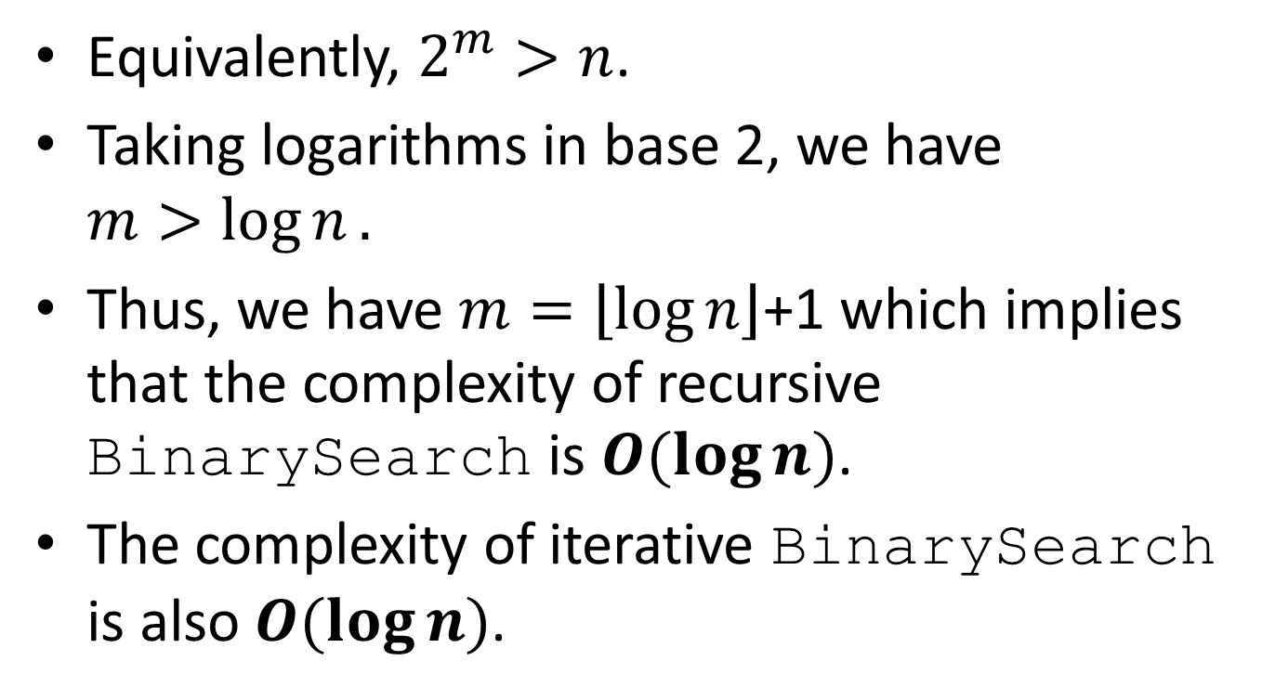
Complexity (cont’d)
Equivalently, $2^{m}>n$.
Taking logarithms in base 2, we have $m>\log{n}.$
Thus, we have $m=\left\lfloor \log{n}\right\rfloor$+1 which implies that the complexity of recursive BinarySearch is $O(\log{n})$.
The complexity of iterative BinarySearch is also $O(\log{n})$.

Slide 15
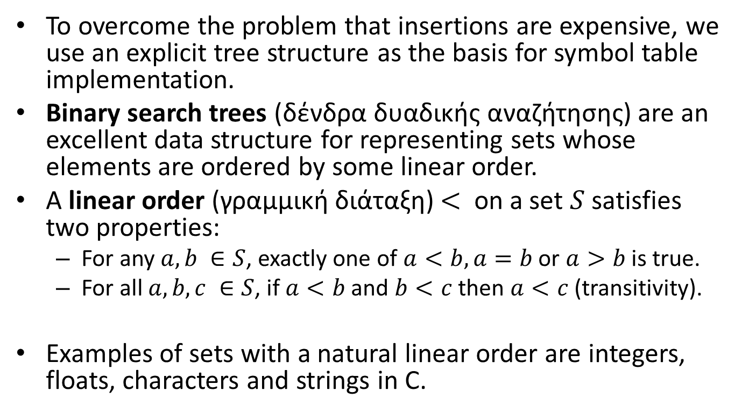
Binary Search Trees
To overcome the problem that insertions are expensive, we use an explicit tree structure as the basis for symbol table implementation.
Binary search trees (δένδρα δυαδικής αναζήτησης) are an excellent data structure for representing sets whose elements are ordered by some linear order.
A linear order (γραμμική διάταξη) $<$ on a set $S$ satisfies two properties:
  For any $a, b ∈S$, exactly one of $a<b, a=b$ or $a>b$ is true.
  For all $a, b,c ∈S$, if $a<b$ and $b<c$ then $a<c$ (transitivity).
Examples of sets with a natural linear order are integers, floats, characters and strings in C.

Slide 16
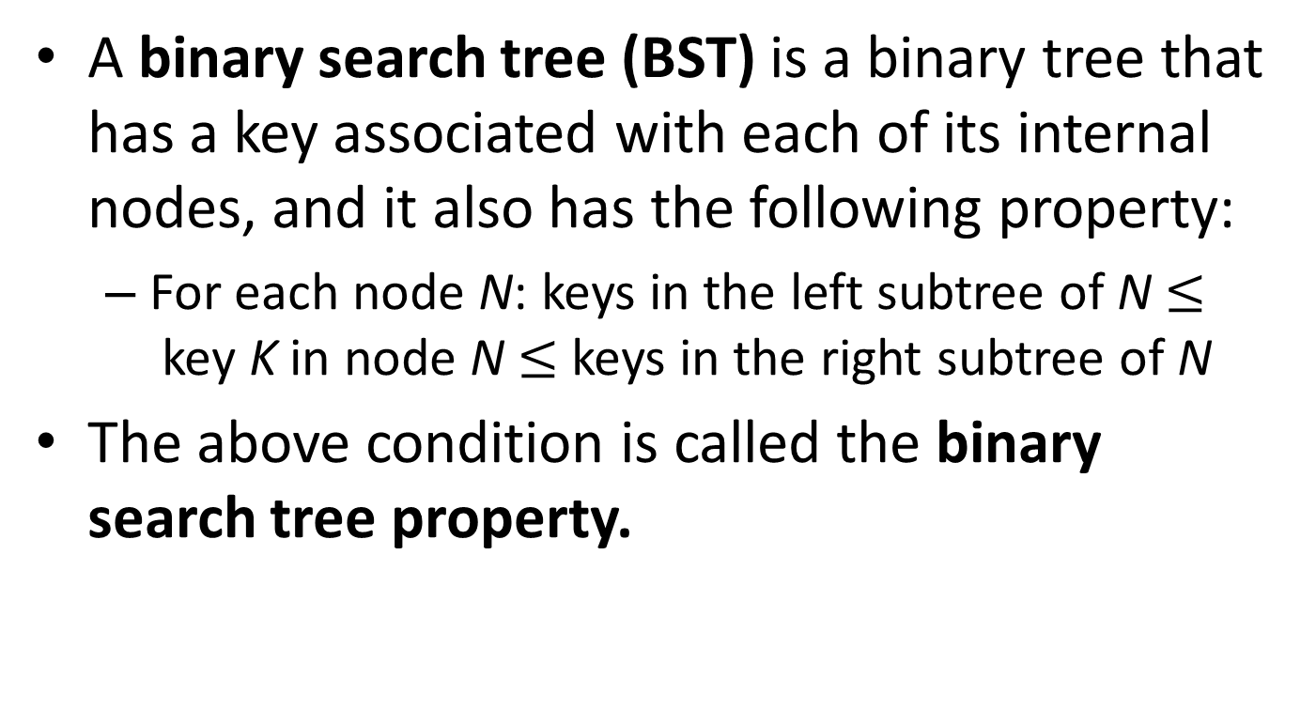
Definition
A binary search tree (BST) is a binary tree that has a key associated with each of its internal nodes, and it also has the following property:
  For each node N: keys in the left subtree of N $≤$key K in node N $≤$ keys in the right subtree of N
The above condition is called the binary search tree property.

Slide 17
Example
10
5
14
7
12
18
15

Slide 18
Example (for the same set)
15
14
18
5
10
7
12

Slide 19
Example
ORY
JFK
ZRH
BRU
MEX
ARN
DUS
ORD
GLA
NRT

Slide 20
Type Definitions for BSTs
The following statements define the data structure for a BST:
  typedef struct STnode* link;
  struct STnode { Item item; link l, r; int N; };
Each node in a BST contains an item (with a key), a left link, a right link and an integer which counts how many nodes there are in the tree (or subtree).
Items, their data types and operations on them can be defined in an appropriate interface file Item.h.

Slide 21
The Interface File Item.h
typedef int Item;
typedef int Key;
#define NULLitem -1 /* NULLitem is a constant */
#define key(A) (A)
#define less(A, B) (key(A) < key(B))
#define eq(A, B) (!less(A, B) && !less(B, A))
Item ITEMrand(void);
int ITEMscan(Item *);
void ITEMshow(Item);

Slide 22
Notes
The previous interface file assumes that items consist just of keys. This assumption can be changed.
NULLitem is a constant to be returned when a BST does not contain a key.
The function ITEMrand returns a random item.
The function ITEMscan reads an item from the standard input.
The function ITEMshow prints an item on the standard output.
less and eq are macros that we will be using in our code (they could be defined as functions too).

Slide 23
An Implementation of the Item Interface
#include <stdio.h>
#include <stdlib.h>
#include "Item.h"
int ITEMrand(void)
{ return rand(); }
int ITEMscan(int *x)
{ return scanf("%d", x); }
void ITEMshow(int x)
{ printf("%5d ", x); }

Slide 24
The Operations Stinit and STcount
static link head, z;
link NEW(Item item, link l, link r, int N)
{ link x = malloc(sizeof *x);
x->item = item; x->l = l; x->r = r; x->N = N;
return x;
}
void STinit()
{ head = (z = NEW(NULLitem, NULL, NULL, 0)); }
int STcount() { return head->N; }

Slide 25
Notes
head is a static pointer variable that points to the root of the tree.
z is a static pointer variable which points to a dummy node representing empty trees or external nodes.
NEW is a function which creates a new tree node and returns a pointer to it.

Slide 26
Searching for a Key Recursively
To search for a key K in a BST T, we compare K to the key K_{r} of the root of T.
If K == K_{r}, the search terminates successfully.
If K < K_{r}, the search continues recursively in the left subtree of T.
If K ≥ K_{r}, the search continues recursively in the right subtree of T.
If T is the empty tree, we have a search miss and return NULLitem.

Slide 27
The Function STsearch
Item searchR(link h, Key v)
{ Key t = key(h->item);
if (h == z) return NULLitem;
if eq(v, t) return h->item;
if less(v, t) return searchR(h->l, v);
else return searchR(h->r, v);
}
Item STsearch(Key v)
{ return searchR(head, v); }

Slide 28
Notes
The function STsearch calls a recursive function searchR which does the work.
At each step of searchR, we are guaranteed that no parts of the tree other than the current subtree can contain items with the search key.
Just as the size of the interval in binary search shrinks by a little more than half on each iteration, the current subtree in binary tree search is smaller than the previous (by about half, ideally).

Slide 29
Inserting a Key
An essential feature of BSTs is that insertion is as easy to implement as search.

Slide 30
Inserting a Key Recursively
To insert an item with key K in a BST T, we compare K to the key K_{r} of the root of T.
If K == K_{r}, the key is already present in T and the algorithm stops.
If K < K_{r}, the algorithm continues recursively in the left subtree of T.
If K ≥ K_{r}, the algorithm continues recursively in the right subtree of T.
If T is the empty tree, then the item with key K is inserted there.

Slide 31
The Function STinsert
link insertR(link h, Item item)
{ Key v = key(item), t = key(h->item);
if (h == z) return NEW(item, z, z, 1);
if less(v, t)
h->l = insertR(h->l, item);
else h->r = insertR(h->r, item);
(h->N)++; return h;
}
void STinsert(Item item)
{ head = insertR(head, item); }

Slide 32
Notes
The function STinsert calls the recursive function insertR which does the work.

Slide 33
Example
Let us insert keys e, b, d, f, a, g, c into an initially empty tree in the order given.

Slide 34
Insert e
e

Slide 35
Insert b
e
b

Slide 36
Insert d
e
b
d

Slide 37
Insert f
e
b
f
d

Slide 38
Insert a
e
b
f
a
d

Slide 39
Insert g
e
b
f
a
d
g

Slide 40
Insert c
e
b
f
a
d
g
c

Slide 41
Inserting in the Natural Order
If we insert the previous keys in their natural order a, b, c, d, e, f, g then the tree constructed is a chain (αλυσίδα).

Slide 42
Insert a, b, c, d, e, f, g
a
b
c
d
e
f
g

Slide 43
Inserting in the Natural Order (cont’d)
As we will see below, chains result in inefficient searching. So we should never insert keys in their natural order in a BST.
Similar things hold if keys are in reverse order or if they are nearly ordered.

Slide 44
Example
e
b
f
a
d
g
c
Let us traverse this tree in inorder. What do you notice?

Slide 45
Inorder Traversal of BSTs
If we traverse a BST using the inorder traversal, then the keys of the nodes come out sorted in their natural order.
This gives rise to a sorting algorithm called TreeSort: insert the keys one by one in a BST, then traverse the tree inorder.

Slide 46
The Function STsort
void sortR(link h, void (*visit)(Item))
{
if (h == z) return;
sortR(h->l, visit);
visit(h->item);
sortR(h->r, visit);
}
void STsort(void (*visit)(Item))
{ sortR(head, visit); }

Slide 47
Notes
The second argument of sortR is visit which is a pointer to a function declared by void (*visit)(Item).
sortR can then be called with the name of a function as second argument; this is the function that we want to apply to each node of the tree when we visit it.

Slide 48
Example of a Symbol Table Client
#include <stdio.h>
#include <stdlib.h>
#include "Item.h"
#include "ST.h"
void main(int argc, char *argv[])
{ int N, maxN = atoi(argv[1]), sw = atoi(argv[2]);
Key v; Item item;
STinit(maxN);
for (N = 0; N < maxN; N++)
{
if (sw) v = ITEMrand();
else if (ITEMscan(&v) == EOF) break;
if (STsearch(v) != NULLitem) continue;
key(item) = v;
printf("Inserting item %d\n", item);
STinsert(item);
}
STsort(ITEMshow); printf("\n");
printf("%d keys\n", N);
printf("%d distinct keys\n", STcount());
}

Slide 49
Notes
The previous client program generates randomly or reads from the standard input at most MaxN integers, inserts them in a BST one by one and, then, prints them in sorted order using the inorder traversal of the tree.
It also prints the number of keys and the number of distinct keys encountered.

Slide 50
Rotations
Rotation (περιστροφή) is a fundamental operation on trees.
Rotation allows us to interchange the role of the root and one of the root’s children in a tree while still preserving the BST ordering among the keys in the nodes.
We will define right rotation and left rotation.

Slide 51
Example: Right Rotation at Node S
A
h
S
x
E
Y
C
R
H

Slide 52
Example: Right Rotation at Node S
A
E
h
x
S
C
R
Y
H

Slide 53
Example: Right Rotation at Node S
A
E
h
x
S
C
R
Y
H

Slide 54
Example: Right Rotation at Node S
A
E
h
x
S
C
R
Y
H

Slide 55
Example: Right Rotation at Node S
A
E
h
x
S
C
R
Y
H

Slide 56
Right Rotation
A right rotation involves the root and its left child.
The rotation puts the root on the right, essentially reversing the direction of the left link of the root.
Before the rotation, the left link of the root points from the root to the left child; after the rotation, it points from the old left child (the new root) to the old root (the right child of the new root).
The tricky part, which makes the rotation work, is to copy the right link of the left child to be the left link of the old root. This link points to all the nodes with keys between the two nodes involved in the rotation.
Finally, the link to the old root has to be changed to point to the new root.

Slide 57
Left Rotation
A left rotation involves the root and its right child.
The description of left rotation is identical to the description of the right rotation with “right” and “left” interchanged everywhere.

Slide 58
Example: Left Rotation at Node B
h
A
B
E
x
C
S
R
Y
H

Slide 59
Example: Left Rotation at Node B
A
E
x
h
B
S
C
R
Y
H

Slide 60
Example: Left Rotation at Node B
A
E
x
h
B
S
C
R
Y
H

Slide 61
Example: Left Rotation at Node B
A
E
x
h
B
S
C
R
Y
H

Slide 62
Example: Left Rotation at Node B
A
E
x
h
B
S
C
R
Y
H

Slide 63
Functions for Rotation
link rotR(link h)
{
link x = h->l; h->l = x->r;
x->r = h; return x;
}
link rotL(link h)
{
link x = h->r; h->r = x->l;
x->l = h; return x;
}

Slide 64
Insertion at the Root
In the implementation of insertion presented earlier, every new node inserted goes somewhere at the bottom of the tree.
We can consider an alternative insertion method where we insist that each new node is inserted at the root.
In practice, the advantage of the root insertion method is that recently inserted keys are near the top. This can be useful in some applications.

Slide 65
Insertion at the Root (cont’d)
The rotation operations provide a straightforward implementation of root insertion:
  Recursively insert the new item into the appropriate subtree, leaving it, when the recursion is complete, at the root of that tree.
  Then, rotate repeatedly to make it the root of the tree.

Slide 66
Example: Root Insertion of G
A
S
E
X
C
R
H

Slide 67
Example: G is inserted
A
S
E
X
C
R
H
G

Slide 68
Example: right rotation at H
A
S
E
X
C
R
G
H

Slide 69
Example: right rotation at R
A
S
E
X
C
G
R
H

Slide 70
Example: left rotation at E
A
S
G
X
E
R
C
H

Slide 71
Example: right rotation at S
A
G
E
S
R
X
C
H

Slide 72
Example: left rotation at A
G
A
S
E
R
X
C
H

Slide 73
Functions for Root Insertion
link insertT(link h, Item item)
{ Key v = key(item);
if (h == z) return NEW(item, z, z, 1);
if (less(v, key(h->item)))
{ h->l = insertT(h->l, item); h = rotR(h); }
else
{ h->r = insertT(h->r, item); h = rotL(h); }
return h;
}
void STinsert(Item item)
{ head = insertT(head, item); }

Slide 74
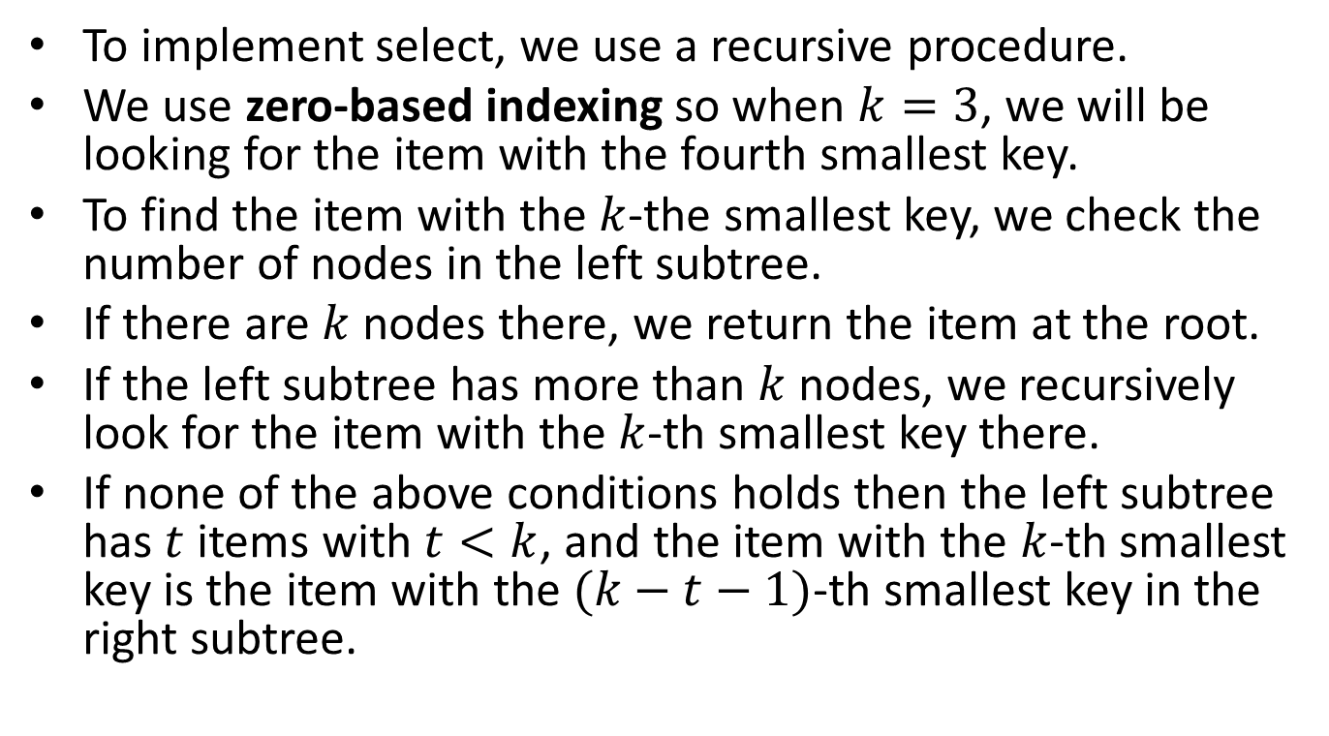

Selecting the $k$-th Smallest Key
To implement select, we use a recursive procedure.
We use zero-based indexing so when $k=3$, we will be looking for the item with the fourth smallest key.
To find the item with the $k$-the smallest key, we check the number of nodes in the left subtree.
If there are $k$ nodes there, we return the item at the root.
If the left subtree has more than $k$ nodes, we recursively look for the item with the $k$-th smallest key there.
If none of the above conditions holds then the left subtree has $t$ items with $t<k$, and the item with the $k$-th smallest key is the item with the $(k−t−1)$-th smallest key in the right subtree.

Slide 75
Functions for Selection
Item selectR(link h, int k)
{
int t;
if (h == z) return NULLitem;
t = (h->l == z) ? 0 : h->l->N;
if (t > k) return selectR(h->l, k);
if (t < k) return selectR(h->r, k-t-1);
return h->item;
}
Item STselect(int k)
{ return selectR(head, k); }

Slide 76
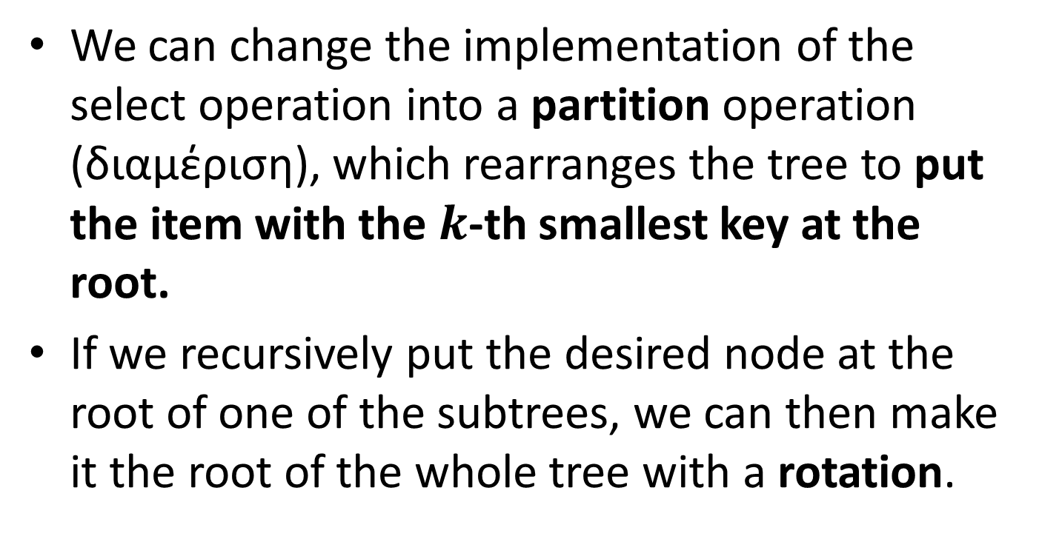
Partition
We can change the implementation of the select operation into a partition operation (διαμέριση), which rearranges the tree to put the item with the $k$-th smallest key at the root.
If we recursively put the desired node at the root of one of the subtrees, we can then make it the root of the whole tree with a rotation.

Slide 77
Functions for Partition
link partR(link h, int k)
{
int t = h->l->N;
if (t > k )
{ h->l = partR(h->l, k);
h = rotR(h); }
if (t < k )
{ h->r = partR(h->r, k-t-1);
h = rotL(h); }
return h;
}

Slide 78
Deletion from a BST
An algorithm for deleting a key K from a BST T is the following.
If K is in an internal node with only (dummy) external nodes as children then delete it and replace the link to the deleted node by a link to a new (dummy) external node.
If K is an internal node with a single (dummy) external node as its child then delete it and adjust the link from its parent to point to its non-empty subtree.
If K is in a node with both a left and a right non-empty subtree then delete it and combine the two subtrees into one tree. But how?

Slide 79
Deletion from a BST (cont’d)
Various options are available.
One simple option is to find the lowest-valued key K’ in the descendants of the right child and replace K by K’.
This key is in a node N’ which is the successor of N under the inorder traversal of the tree.
This node can be found by starting at the right child of N and then following left child pointers until we find a node with a left child which is an external node.
Of course, we also need to remove node N’ from the tree. This can be done easily since this node has at most one (right) child.

Slide 80
Deletion from a BST (cont’d)
Notice that the highest-valued key among the descendants of the left child would do as well.
This key is in a node N’’ which is the predecessor of N under the inorder traversal of the tree.

Slide 81
Example: Delete 10
10
5
14
7
12
18
13
15
The lowest-valued key among the descendants of 14 is 12. This key will replace 10
In the tree and its current node will be removed.

Slide 82
Example: Result
12
5
14
7
13
18
15

Slide 83
Example: Delete 10
10
5
14
7
12
18
13
15
Alternatively, we can replace 10 with the highest-valued key among the descendants of its left child. This is the key 7.

Slide 84
Example: Alternative Result
7
5
14
12
18
13
15

Slide 85
Functions for Deletion
link joinLR(link a, link b)
{
if (b == z) return a;
b = partR(b, 0);
b->l = a;
return b;
}
link deleteR(link h, Key v)
{
link x;
Key t = key(h->item);
if (h == z) return z;
if (less(v, t)) h->l = deleteR(h->l, v);
if (less(t, v)) h->r = deleteR(h->r, v);
if (eq(v, t)) { x = h; h = joinLR(h->l, h->r); free(x); }
return h;
}
void STdelete(Key v) { head = deleteR(head, v); }

Slide 86
Notes
The function deleteR implements the algorithm we discussed in a recursive way.
The function joinLR combines the two subtrees into a new tree by utilizing the partition function partR we presented earlier for making the smallest key of the right subtree as the new root.

Slide 87
The Join Operation (Ένωση)
To merge two BSTs into one, we work as follows.
First, we delete the root of the first BST and insert it into the second BST using root insertion.
This operation gives us two subtrees with keys known to be smaller than this root, and two subtrees with keys known to be larger than this root.
We recursively combine the former pair to be the left subtree of the root and the latter to be the right subtree of the root.

Slide 88
Functions for Join
link STjoin(link a, link b)
{
if (b == z) return a;
if (a == z) return b;
b = STinsert(b, a->item);
b->l = STjoin(a->l, b->l);
b->r = STjoin(a->r, b->r);
free(a);
return b;
}

Slide 89
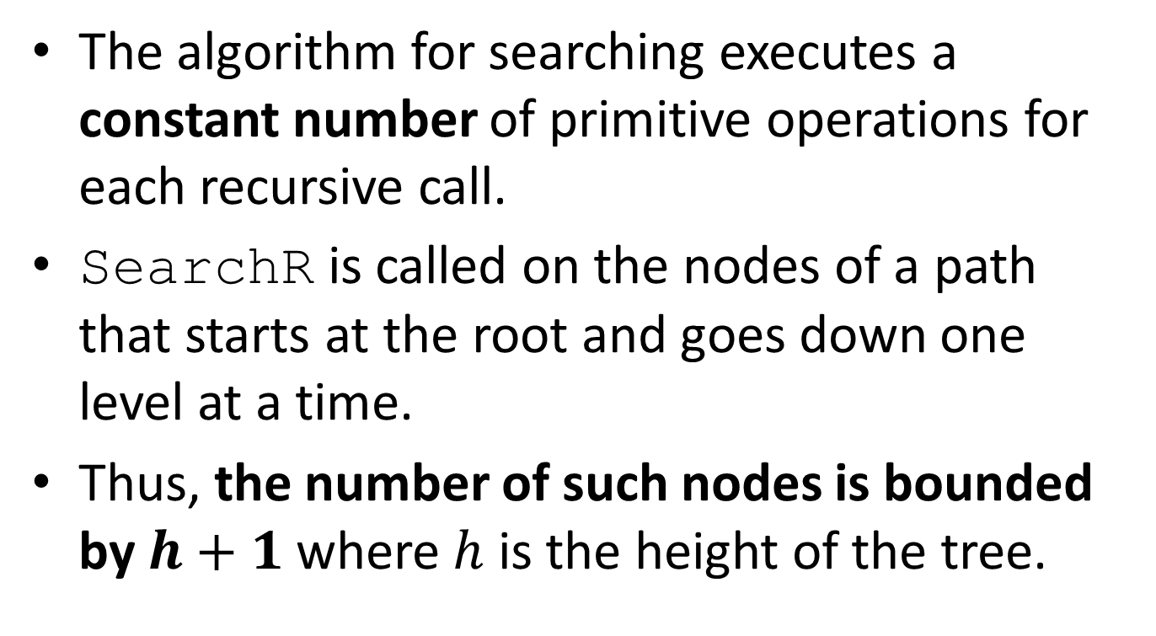
Complexity Analysis
The algorithm for searching executes a constant number of primitive operations for each recursive call.
SearchR is called on the nodes of a path that starts at the root and goes down one level at a time.
Thus, the number of such nodes is bounded by $h+1$ where $h$ is the height of the tree.

Slide 90
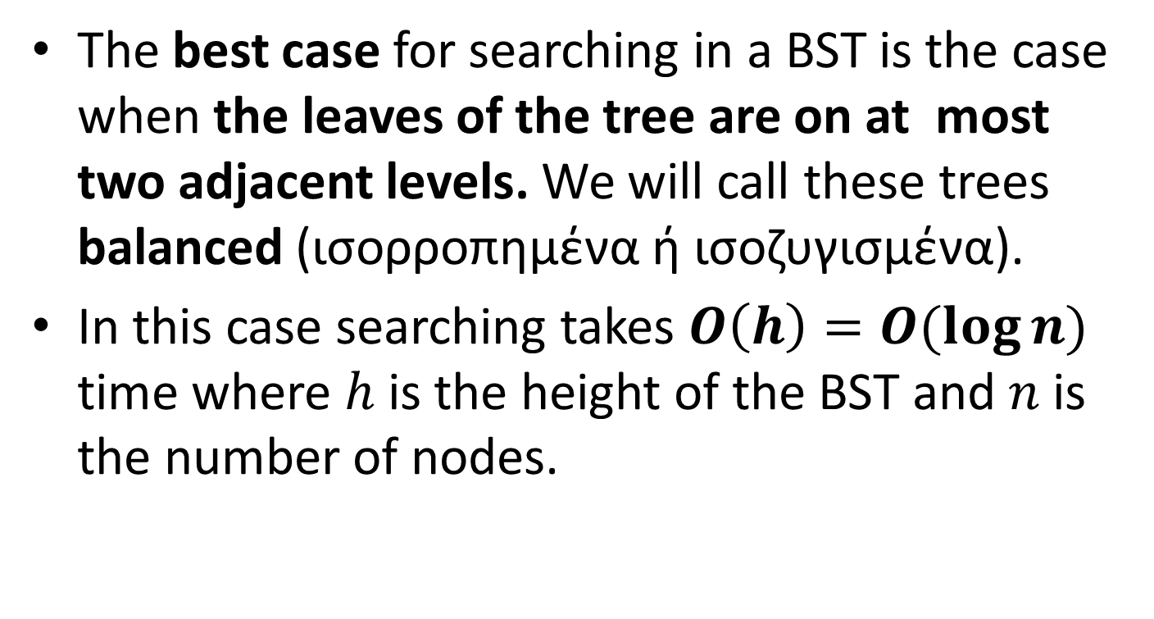
Complexity Analysis (cont’d)
The best case for searching in a BST is the case when the leaves of the tree are on at most two adjacent levels. We will call these trees balanced (ισορροπημένα ή ισοζυγισμένα).
In this case searching takes $O\left(h\right)=O(\log{n})$ time where $h$ is the height of the BST and $n$ is the number of nodes.

Slide 91
Best Case Examples

Slide 92
Best Case Examples (cont’d)

Slide 93
Best Case Examples (cont’d)

Slide 94
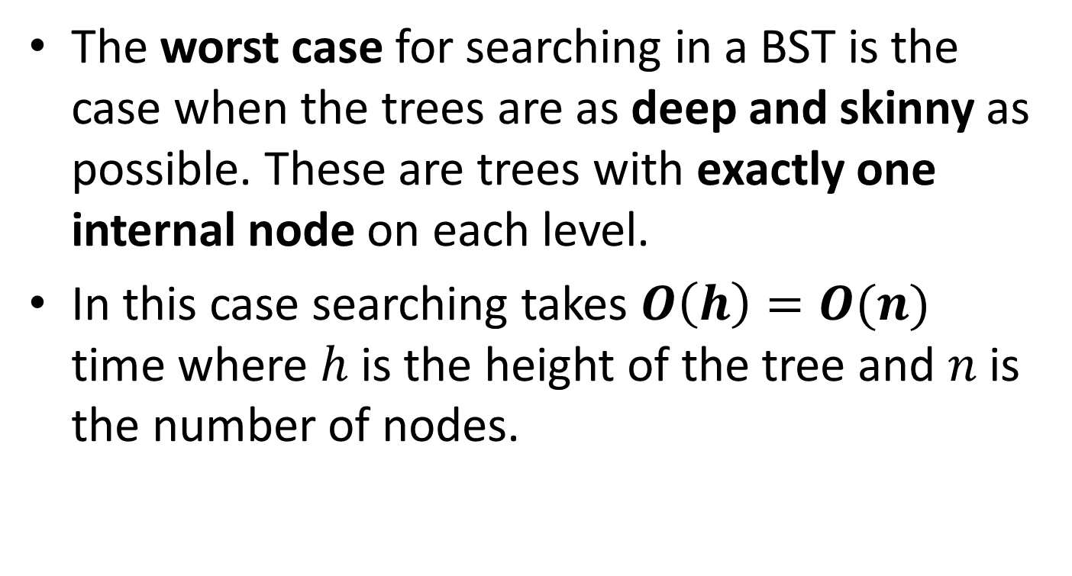
Complexity Analysis (cont’d)
The worst case for searching in a BST is the case when the trees are as deep and skinny as possible. These are trees with exactly one internal node on each level.
In this case searching takes $O\left(h\right)=O(n)$ time where $h$ is the height of the tree and $n$ is the number of nodes.

Slide 95
Worst Case Example (Left-linear Tree)

Slide 96
Worst Case Example (Zig-zag)

Slide 97
Worst Case Example (Right-linear)

Slide 98
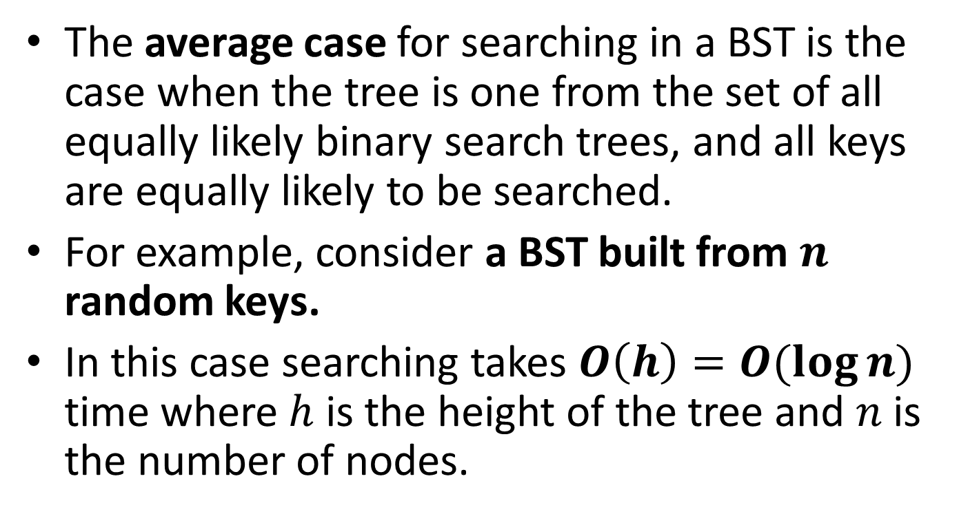
Complexity Analysis (cont’d)
The average case for searching in a BST is the case when the tree is one from the set of all equally likely binary search trees, and all keys are equally likely to be searched.
For example, consider a BST built from $n$ random keys.
In this case searching takes $O\left(h\right)=O(\log{n})$ time where$h$ is the height of the tree and $n$ is the number of nodes.

Slide 99
Complexity Analysis (cont’d)
The complexity of insertion in a binary search tree is the same as the complexity of search given that it makes the same comparisons plus changing a few pointers.
The complexity of deletion is also the same.

Slide 100
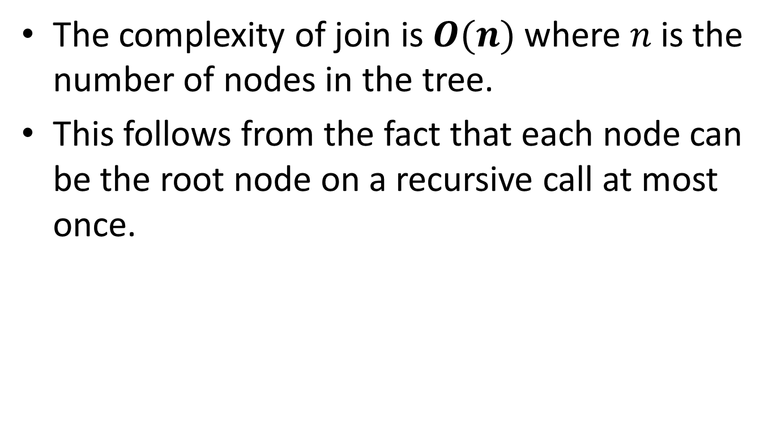
Complexity Analysis (cont’d)
The complexity of join is $O(n)$ where $n$ is the number of nodes in the tree.
This follows from the fact that each node can be the root node on a recursive call at most once.

Slide 101
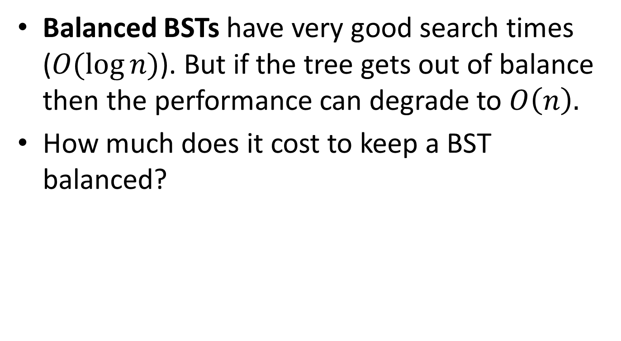
Discussion
Balanced BSTs have very good search times ($O(\log{n})$). But if the tree gets out of balance then the performance can degrade to $O\left(n\right).$
How much does it cost to keep a BST balanced?

Slide 102
Example
5
3
7
2
4
6

Slide 103
Inserting Key 1
5
3
7
2
4
6
1

Slide 104

Rebalancing
Note that every key was moved to a new node, hence rebalancing can take $O(n)$ time.
4
2
6
1
3
5
7

Slide 105
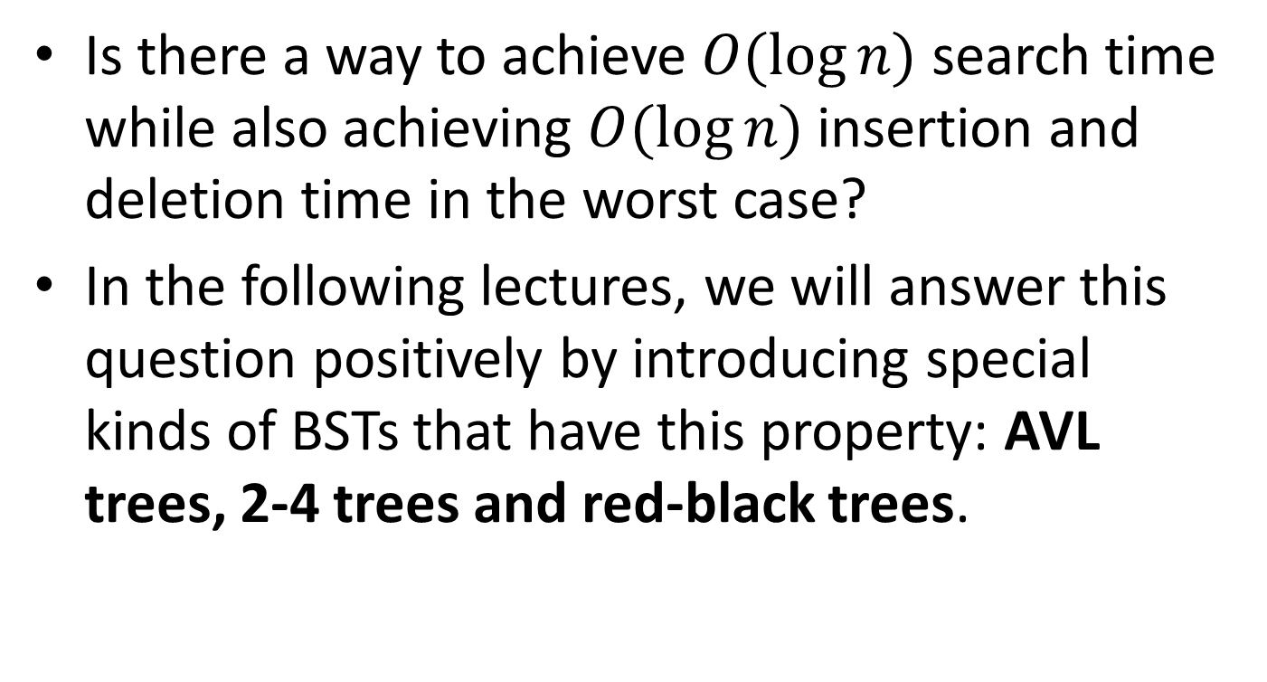
Question
Is there a way to achieve $O(\log{n})$ search time while also achieving $O(\log{n})$ insertion and deletion time in the worst case?
In the following lectures, we will answer this question positively by introducing special kinds of BSTs that have this property: AVL trees, 2-4 trees and red-black trees.

Slide 106
Readings
T. A. Standish. Data Structures, Algorithms and Software Principles in C.
  Chapter 5. Sections 5.6 and 6.5.
  Chapter 9. Section 9.7.
R. Sedgewick. Αλγόριθμοι σε C.
  Κεφ. 12.
M.T. Goodrich, R. Tamassia and D. Mount. Data Structures and Algorithms in C++. 2nd edition.
  Section 9.3 and 10.1

