Slide 1
Data Structures for Disjoint Sets
Manolis Koubarakis

Slide 2
Dynamic Sets
Sets are fundamental for mathematics but also for computer science.
In computer science, we usually study dynamic sets i.e., sets that can grow, shrink or otherwise change over time.
The data structures we have presented so far in this course offer us ways to represent finite, dynamic sets and manipulate them on a computer.

Slide 3
Dynamic Sets and Symbol Tables
Many of the data structures we have so far presented for symbol tables can be used to implement a dynamic set (e.g., a linked list, a hash table, a (2,4) tree etc.).

Slide 4
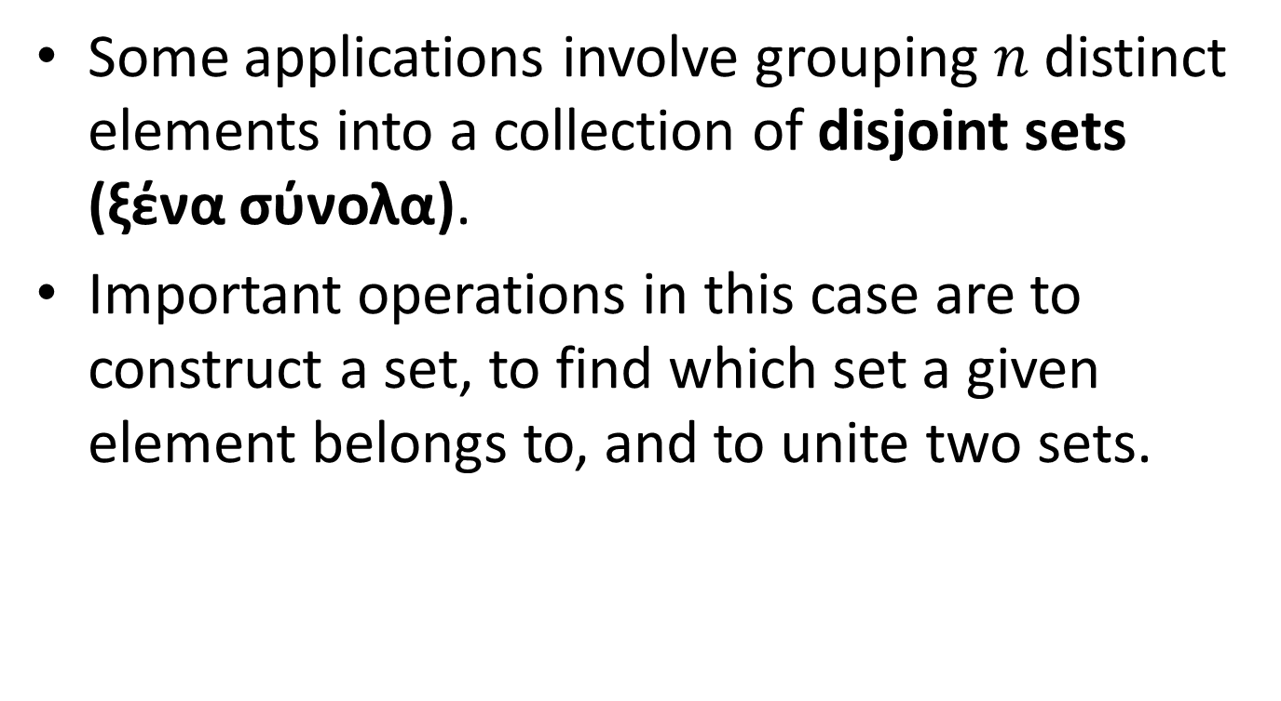
Disjoint Sets
Some applications involve grouping $n$ distinct elements into a collection of disjoint sets (ξένα σύνολα).
Important operations in this case are to construct a set, to find which set a given element belongs to, and to unite two sets.

Slide 5
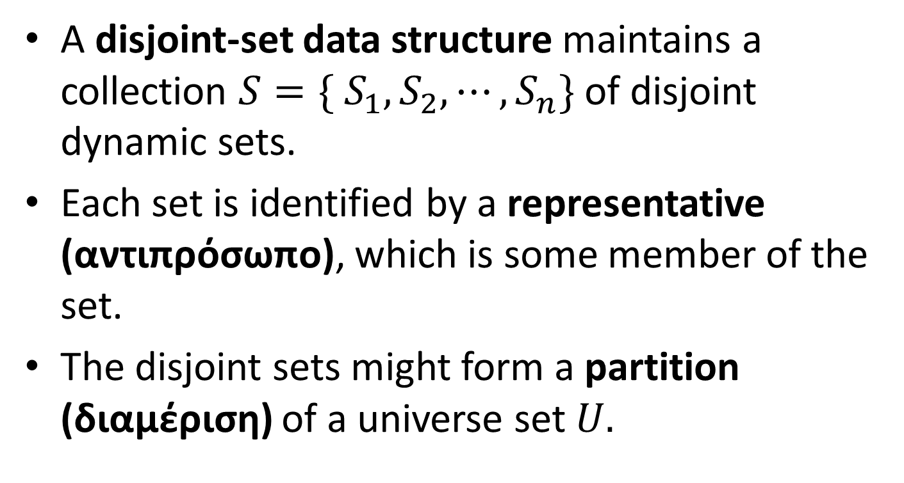
Definitions
A disjoint-set data structure maintains a collection $S=\{ S_{1}, S_{2},⋯,S_{n}\}$ of disjoint dynamic sets.
Each set is identified by a representative (αντιπρόσωπο), which is some member of the set.
The disjoint sets might form a partition (διαμέριση) of a universe set $U.$

Slide 6
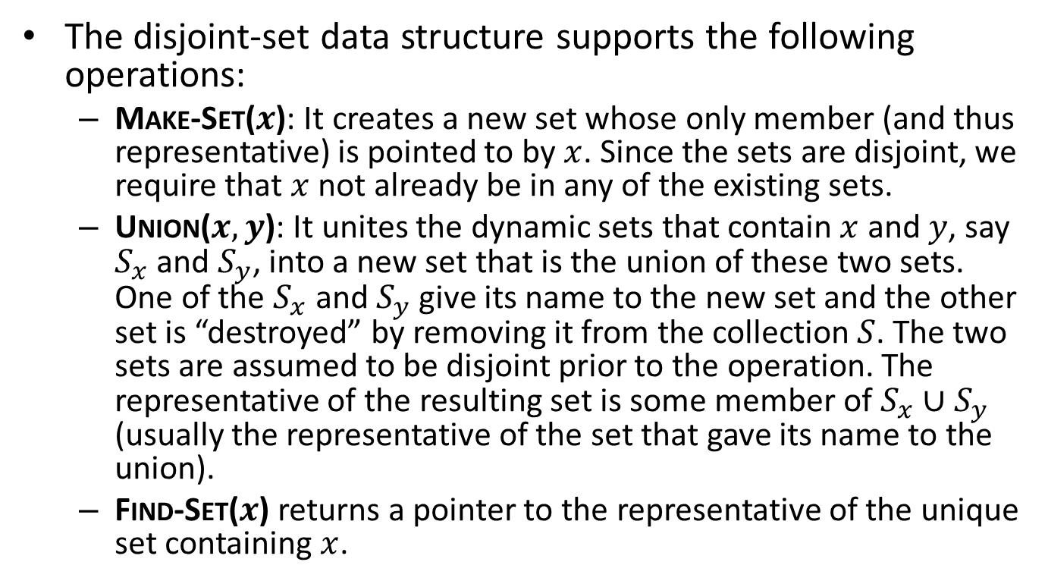
Definitions (cont’d)
The disjoint-set data structure supports the following operations:
  Make-Set($x$): It creates a new set whose only member (and thus representative) is pointed to by $x$. Since the sets are disjoint, we require that $x$ not already be in any of the existing sets.
  Union($x,y$): It unites the dynamic sets that contain $x$ and $y$, say $S_{x}$ and $S_{y}$, into a new set that is the union of these two sets. One of the $S_{x}$ and $S_{y}$ give its name to the new set and the other set is “destroyed” by removing it from the collection $S$. The two sets are assumed to be disjoint prior to the operation. The representative of the resulting set is some member of $S_{x}∪S_{y}$ (usually the representative of the set that gave its name to the union).
  Find-Set($x$) returns a pointer to the representative of the unique set containing $x$.

Slide 7
Determining the Connected Components of an Undirected Graph
One of the many applications of disjoint-set data structures is determining the connected components (συνεκτικές συνιστώσες) of an undirected graph.
The implementation based on disjoint-sets that we will present here is appropriate when the edges of the graph are not static e.g., when edges are added dynamically and we need to maintain the connected components as each edge is added.

Slide 8
Example Graph
a
b
e
f
h
j
c
d
g
i

Slide 9
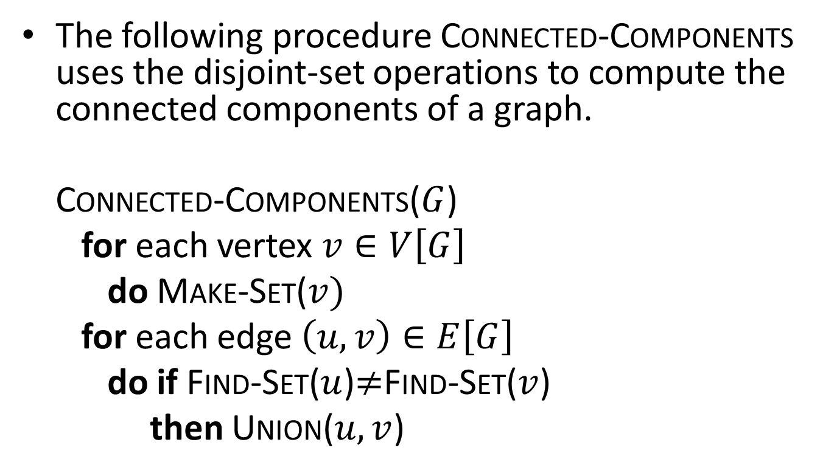
Computing the Connected Components of an Undirected Graph
The following procedure Connected-Components uses the disjoint-set operations to compute the connected components of a graph.
Connected-Components($G$)
for each vertex $v∈V\left[G\right]$
do Make-Set($v)$
for each edge $\left(u,v\right)∈E\left[G\right]$
do if Find-Set($u$)$≠$Find-Set($v$)
then Union($u,v$)

Slide 10
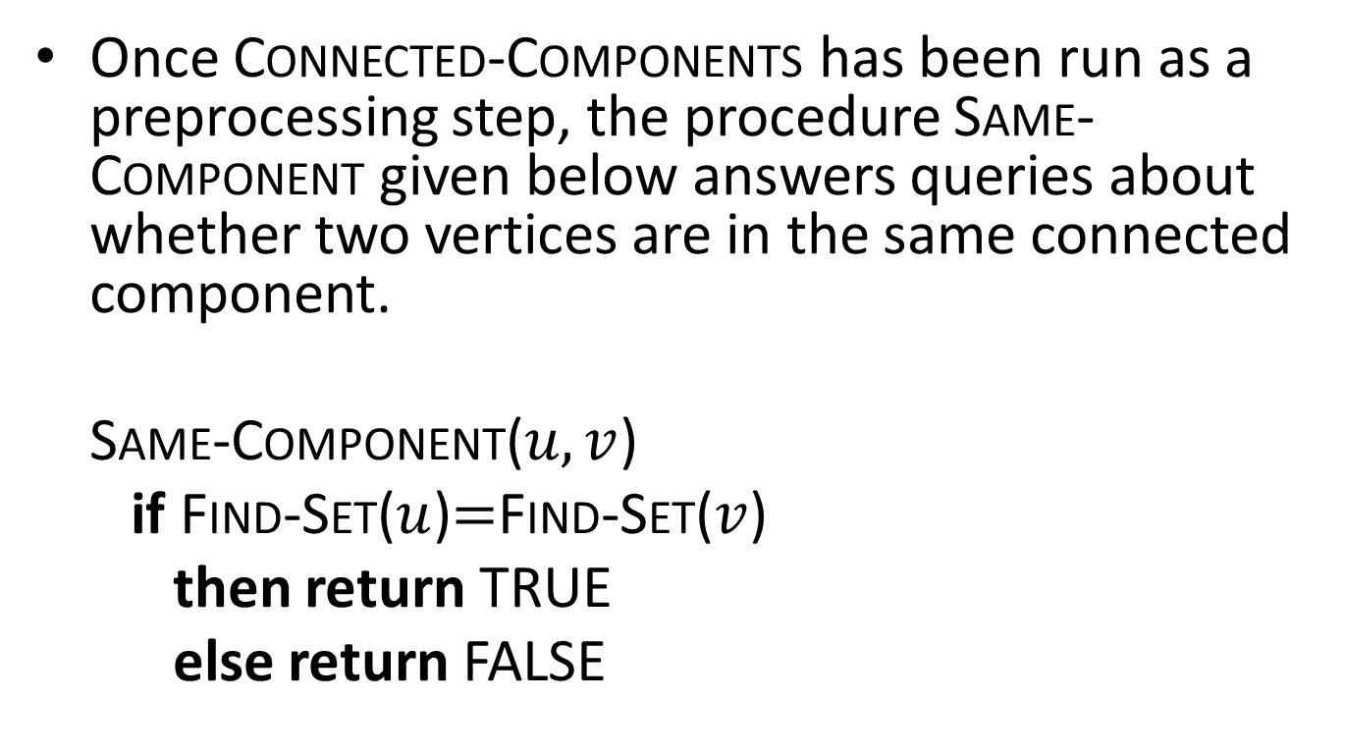
Computing the Connected Components (cont’d)
Once Connected-Components has been run as a preprocessing step, the procedure Same-Component given below answers queries about whether two vertices are in the same connected component.
Same-Component($u,v$)
if Find-Set($u$)$=$Find-Set($v$)
then return TRUE
else return FALSE

Slide 11
Example Graph
a
b
e
f
h
j
c
d
g
i

Slide 12
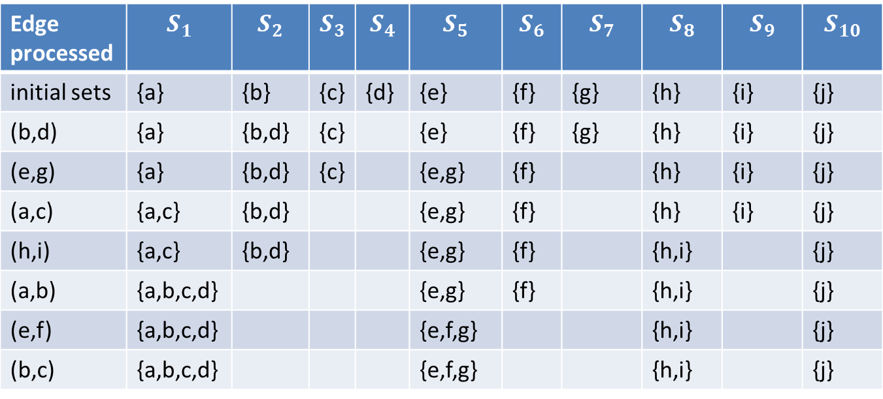
The Collection of Disjoint Sets After Each Edge is Processed
Edge processed | $$S_{1}$$ | $$S_{2}$$ | $$S_{3}$$ | $$S_{4}$$ | $$S_{5}$$ | $$S_{6}$$ | $$S_{7}$$ | $$S_{8}$$ | $$S_{9}$$ | $$S_{10}$$
initial sets | {a} | {b} | {c} | {d} | {e} | {f} | {g} | {h} | {i} | {j}
(b,d) | {a} | {b,d} | {c} |  | {e} | {f} | {g} | {h} | {i} | {j}
(e,g) | {a} | {b,d} | {c} |  | {e,g} | {f} |  | {h} | {i} | {j}
(a,c) | {a,c} | {b,d} |  |  | {e,g} | {f} |  | {h} | {i} | {j}
(h,i) | {a,c} | {b,d} |  |  | {e,g} | {f} |  | {h,i} |  | {j}
(a,b) | {a,b,c,d} |  |  |  | {e,g} | {f} |  | {h,i} |  | {j}
(e,f) | {a,b,c,d} |  |  |  | {e,f,g} |  |  | {h,i} |  | {j}
(b,c) | {a,b,c,d} |  |  |  | {e,f,g} |  |  | {h,i} |  | {j}

Slide 13
Minimum Spanning Trees
Another application of the disjoint set operations that we will see is Kruskal’s algorithm for computing the minimum spanning tree of a graph.

Slide 14
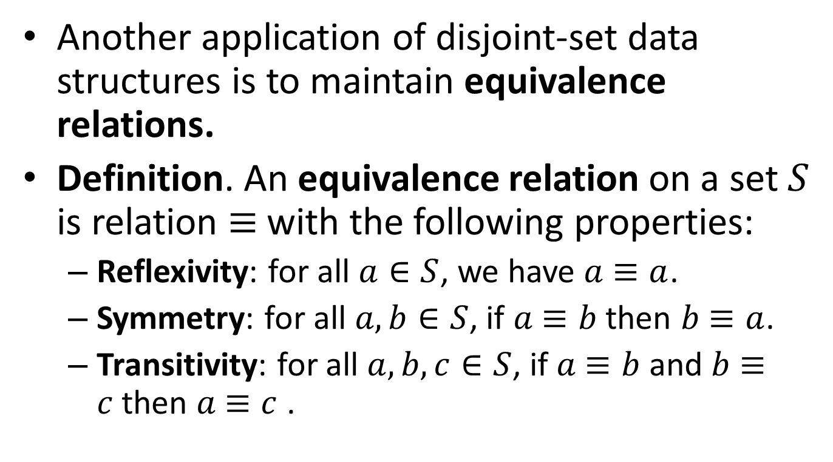
Maintaining Equivalence Relations
Another application of disjoint-set data structures is to maintain equivalence relations.
Definition. An equivalence relation on a set $S$ is relation $≡$with the following properties:
  Reflexivity: for all $a∈S$, we have $a$ $≡a$.
  Symmetry: for all $a,b∈S$, if $a$ $≡b$ then $b$ $≡a$.
  Transitivity: for all $a,b, c∈S$, if $a$ $≡b$ and $b$ $≡c$then $a$ $≡c$ .

Slide 15
Examples of Equivalence Relations
Equality
Equivalent type definitions in programming languages. For example, consider the following type definitions in C:
  struct A {
  int a;
  int b;
  };
  typedef A B;
  typedef A C;
  typedef A D;
The types A, B, C and D are equivalent in the sense that variables of one type can be assigned to variables of the other types without requiring any casting.

Slide 16
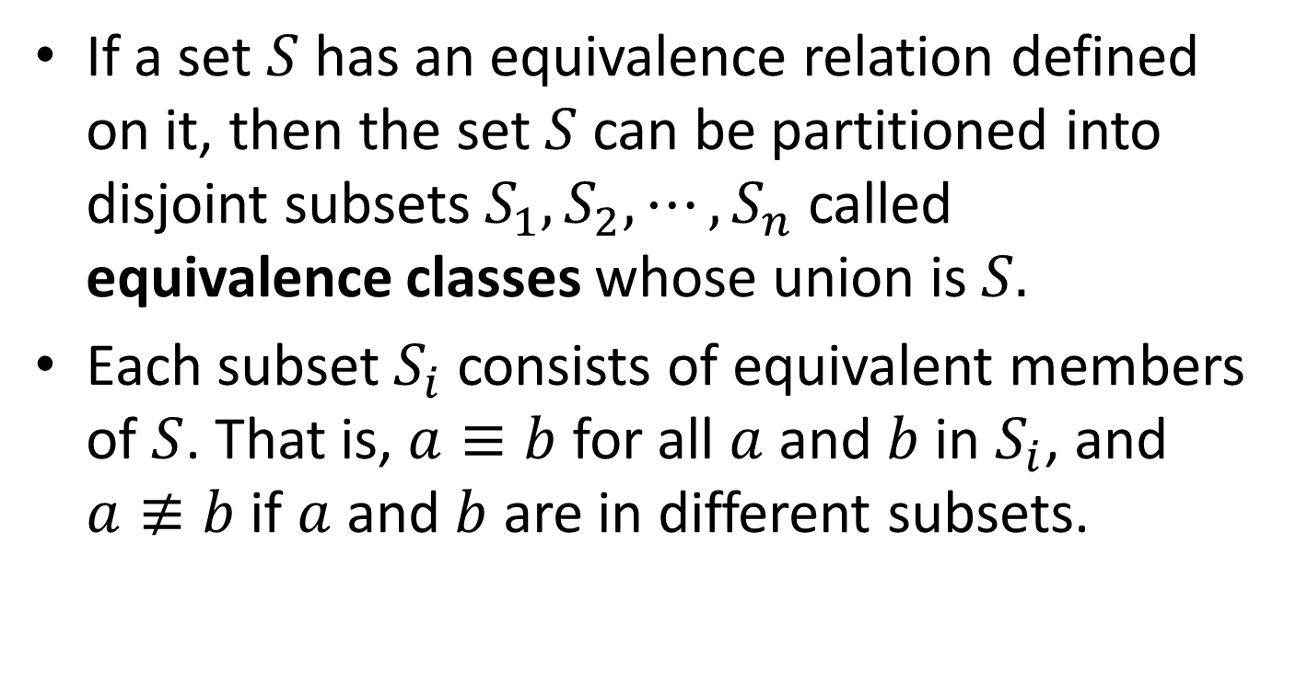
Equivalent Classes
If a set $S$ has an equivalence relation defined on it, then the set $S$ can be partitioned into disjoint subsets $S_{1}, S_{2}, ⋯, S_{n}$ called equivalence classes whose union is $S.$
Each subset $S_{i}$ consists of equivalent members of $S$. That is, $a≡b$ for all $a$ and $b$ in $S_{i}$, and $a≢b$ if $a$ and $b$ are in different subsets.

Slide 17
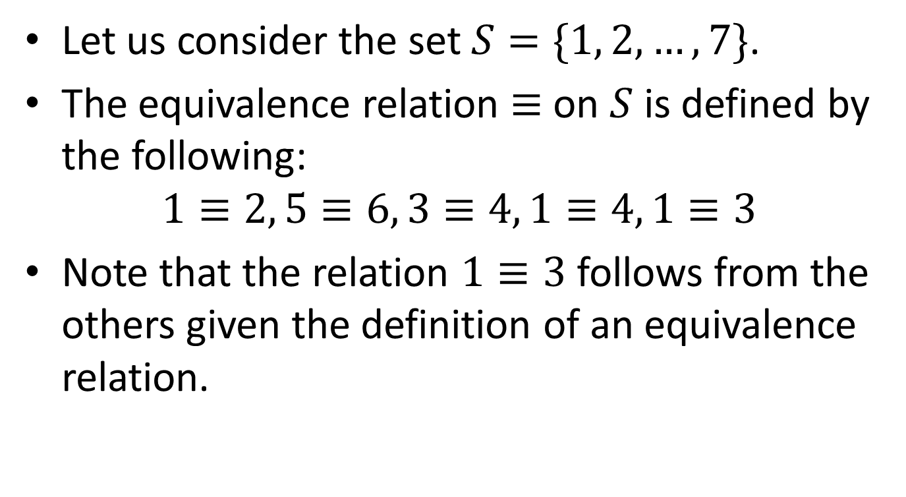
Example
Let us consider the set $S=\{1, 2, …, 7\}$.
The equivalence relation $≡$ on $S$ is defined by the following:
$$1≡2, 5≡6, 3≡4, 1≡4, 1≡3$$
Note that the relation $1≡3$ follows from the others given the definition of an equivalence relation.

Slide 18
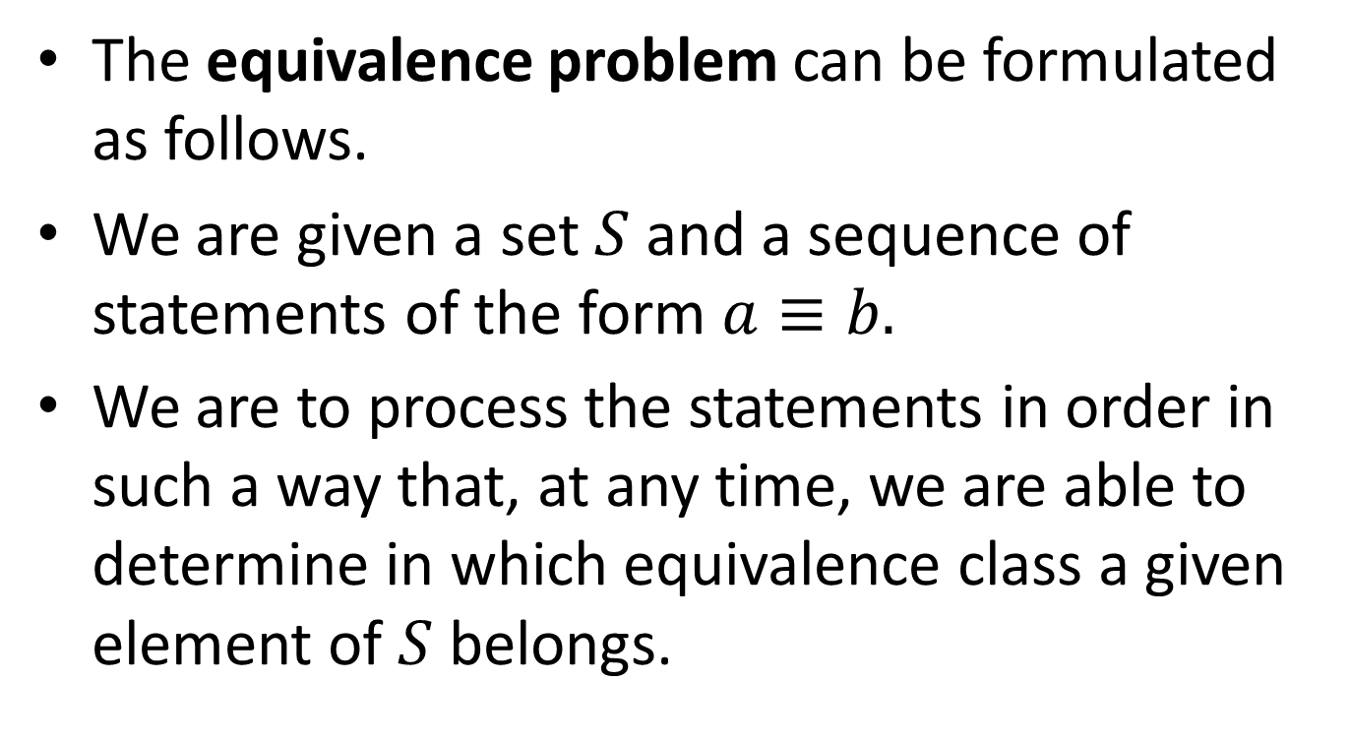
The Equivalence Problem
The equivalence problem can be formulated as follows.
We are given a set $S$ and a sequence of statements of the form $a≡b.$
We are to process the statements in order in such a way that, at any time, we are able to determine in which equivalence class a given element of $S$ belongs.

Slide 19
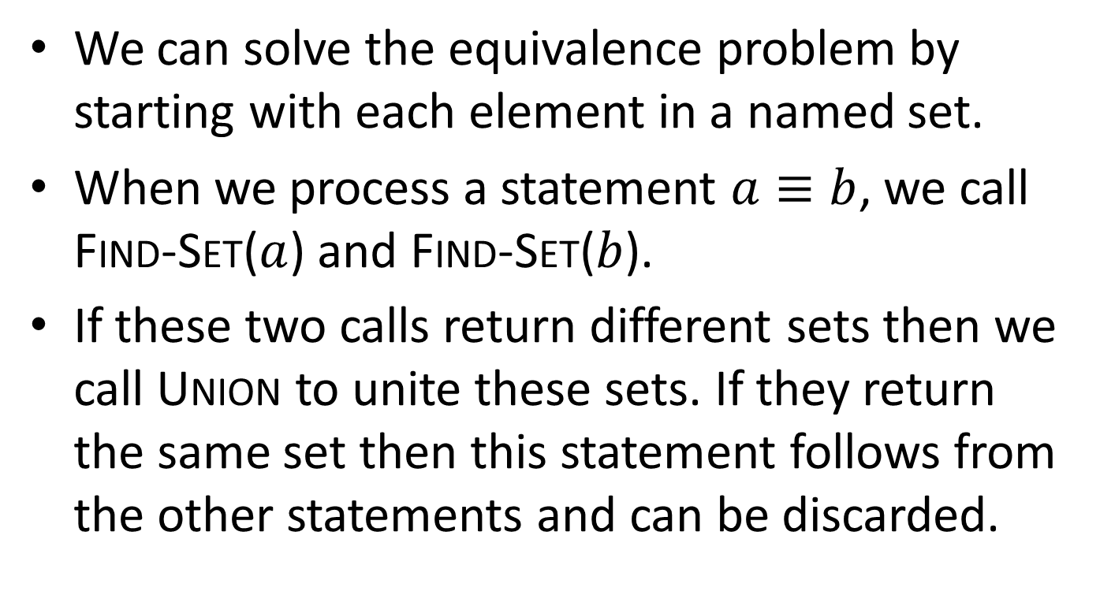
The Equivalence Problem (cont’d)
We can solve the equivalence problem by starting with each element in a named set.
When we process a statement $a≡b$, we call Find-Set($a$) and Find-Set($b$).
If these two calls return different sets then we call Union to unite these sets. If they return the same set then this statement follows from the other statements and can be discarded.

Slide 20
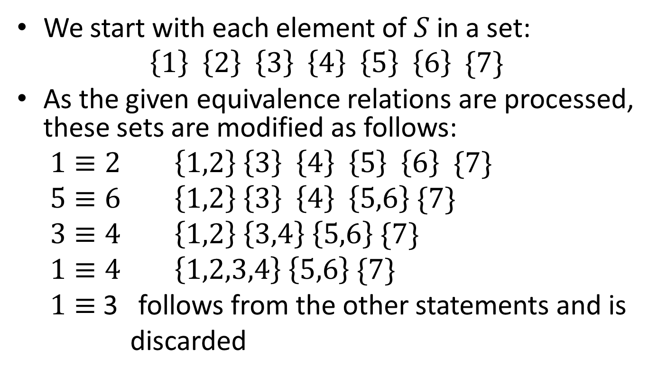
Example (cont’d)
We start with each element of $S$in a set:
$$\left\{1\right\} \left\{2\right\} \left\{3\right\} \left\{4\right\} \left\{5\right\} \left\{6\right\} \{7\}$$
As the given equivalence relations are processed, these sets are modified as follows:
$1≡2$ $\left\{1,2\right\} \left\{3\right\} \left\{4\right\} \left\{5\right\} \left\{6\right\} \{7\}$
$5≡6$ $\left\{1,2\right\} \left\{3\right\} \left\{4\right\} \left\{5,6\right\} \{7\}$
$3≡4$ $\left\{1,2\right\} \left\{3,4\right\} \left\{5,6\right\} \{7\}$
$1≡4$ $\left\{1,2,3,4\right\} \left\{5,6\right\} \{7\}$
$1≡$ 3 follows from the other statements and is
discarded

Slide 21

Example (cont’d)
Therefore, the equivalent classes of $S$ are the subsets $\left\{1,2,3,4\right\}, \left\{5,6\right\}$ and $\{7\}$.

Slide 22
Linked-List Representation of Disjoint Sets
A simple way to implement a disjoint-set data structure is to represent each set by a linked list.
The first object in each linked list serves as its set’s representative. The remaining objects can appear in the list in any order.
Each object in the linked list contains a set member, a pointer to the object containing the next set member, and a pointer back to the representative.

Slide 23
The Structure of Each List Object
Set Member
Pointer Back to
Representative
Pointer to Next Object

Slide 24
Example: the Sets {c, h, e, b} and
{f, g, d}
.
c
h
e
b
.
f
g
d
The representatives of the two sets are c and f.

Slide 25
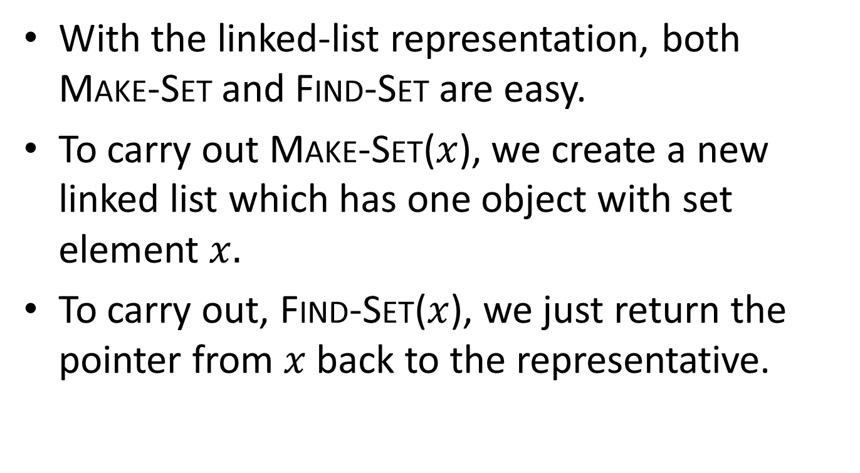
Implementation of Make-Set and
Find-Set
With the linked-list representation, both Make-Set and Find-Set are easy.
To carry out Make-Set($x$), we create a new linked list which has one object with set element $x.$
To carry out, Find-Set($x$), we just return the pointer from $x$ back to the representative.

Slide 26
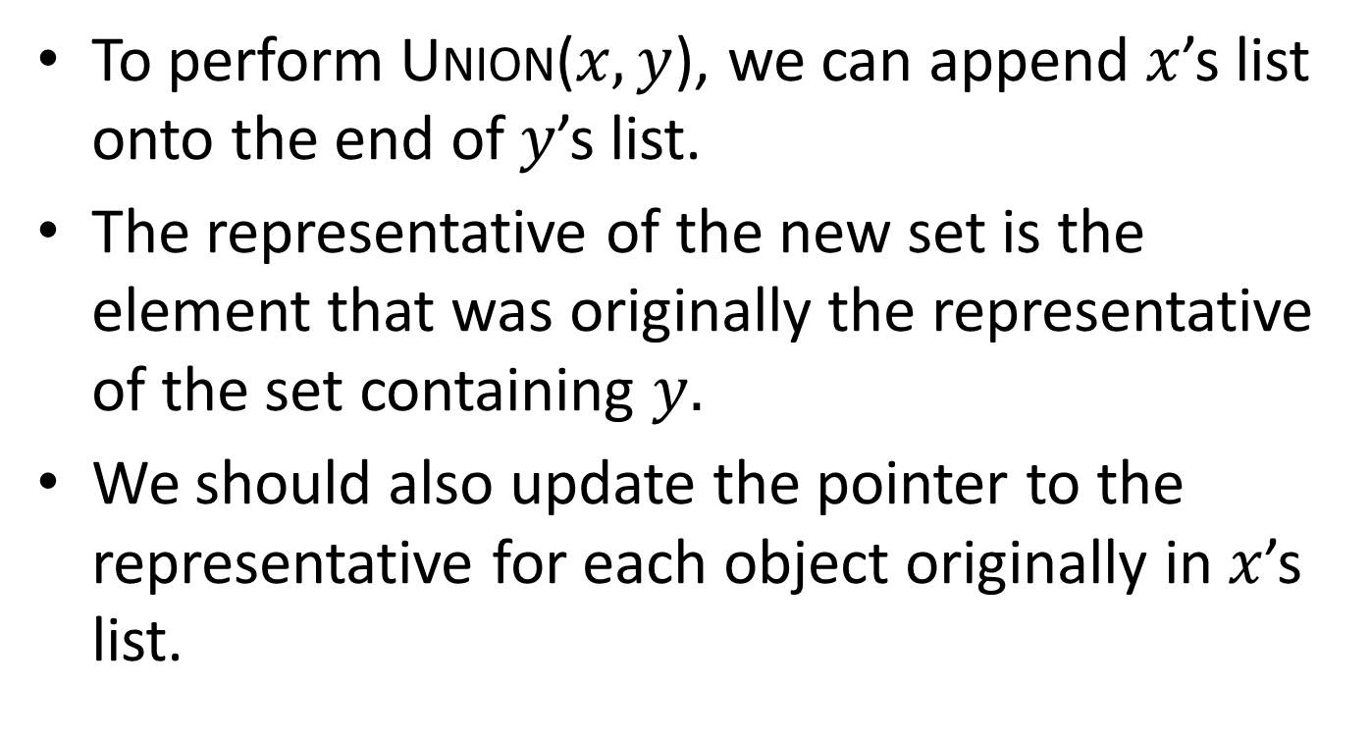
Implementation of Union
To perform Union($x,y$), we can append $x$’s list onto the end of $y$’s list.
The representative of the new set is the element that was originally the representative of the set containing $y.$
We should also update the pointer to the representative for each object originally in $x$’s list.

Slide 27
Amortized Analysis
In an amortized analysis (επιμερισμένη ανάλυση), the time required to perform a sequence of data structure operations is averaged over all operations performed.
Amortized analysis can be used to show that the average cost of an operation is small, if one averages over a sequence of operations, even though a single operation might be expensive.
Amortized analysis differs from the average-case analysis in that probability is not involved; an amortized analysis guarantees the average performance of each operation in the worst case.

Slide 28
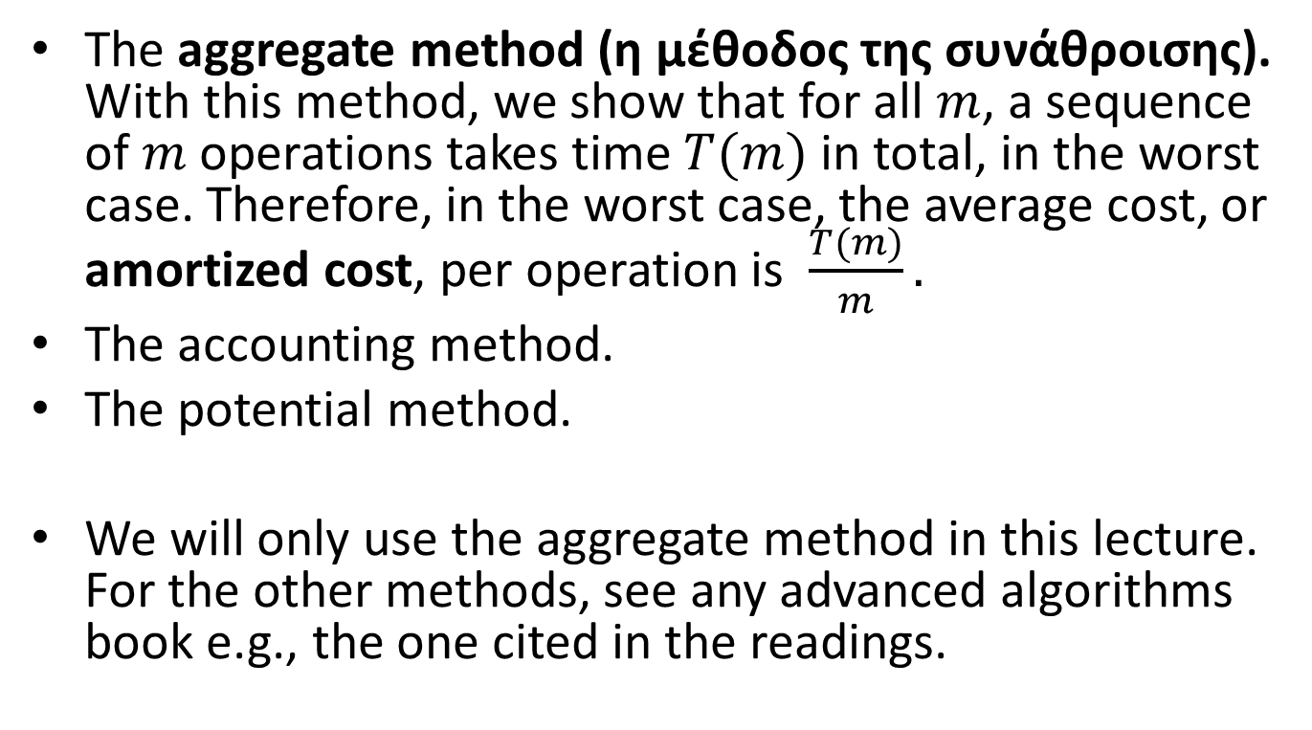
Techniques for Amortized Analysis
The aggregate method (η μέθοδος της συνάθροισης). With this method, we show that for all $m$, a sequence of $m$ operations takes time $T(m)$ in total, in the worst case. Therefore, in the worst case, the average cost, or amortized cost, per operation is $\frac{T(m)}{m}.$
The accounting method.
The potential method.
We will only use the aggregate method in this lecture. For the other methods, see any advanced algorithms book e.g., the one cited in the readings.

Slide 29
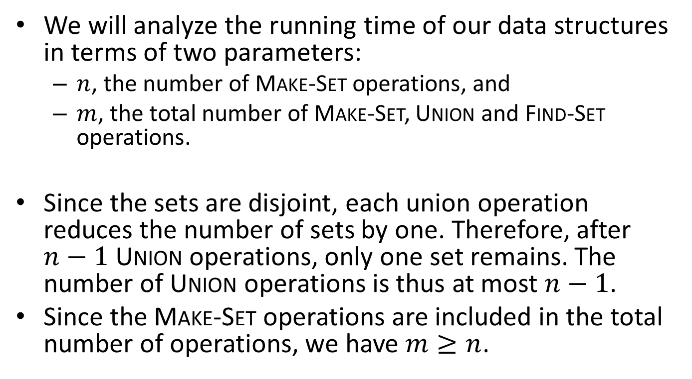
Complexity Parameters for the Disjoint-Set Data Structures
We will analyze the running time of our data structures in terms of two parameters:
  $n$, the number of Make-Set operations, and
  $m$, the total number of Make-Set, Union and Find-Set operations.
Since the sets are disjoint, each union operation reduces the number of sets by one. Therefore, after $n−1$ Union operations, only one set remains. The number of Union operations is thus at most $n−1$.
Since the Make-Set operations are included in the total number of operations, we have $m≥n$.

Slide 30
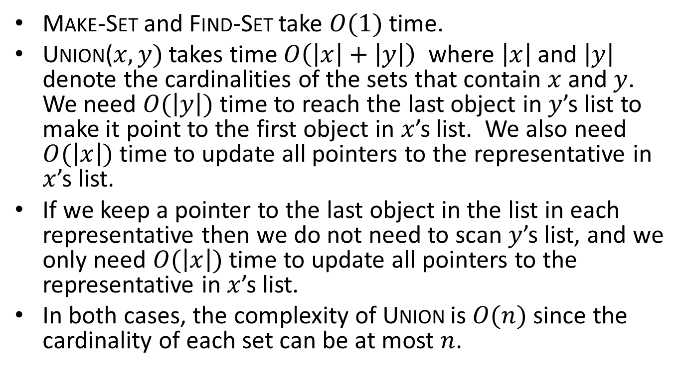
Complexity of Operations for the Linked List Representation
Make-Set and Find-Set take $O(1)$ time.
Union($x,y)$ takes time $O\left(\left|x\right|+\left|y\right|\right)$ where $\left|x\right|$ and $\left|y\right|$ denote the cardinalities of the sets that contain $x$ and $y$. We need $O(\left|y\right|)$ time to reach the last object in $y$’s list to make it point to the first object in $x$’s list. We also need $O(\left|x\right|)$ time to update all pointers to the representative in $x$’s list.
If we keep a pointer to the last object in the list in each representative then we do not need to scan $y$’s list, and we only need $O(\left|x\right|)$ time to update all pointers to the representative in $x$’s list.
In both cases, the complexity of Union is $O(n)$ since the cardinality of each set can be at most $n$.

Slide 31
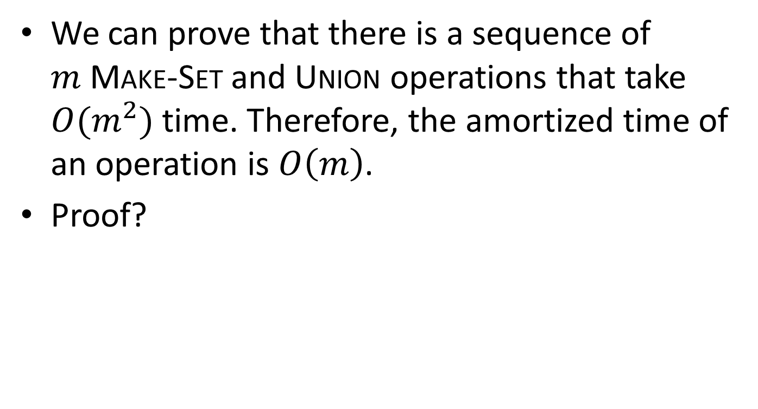
Complexity (cont’d)
We can prove that there is a sequence of $m$Make-Set and Union operations that take $O(m^{2})$ time. Therefore, the amortized time of an operation is $O\left(m\right)$.
Proof?

Slide 32
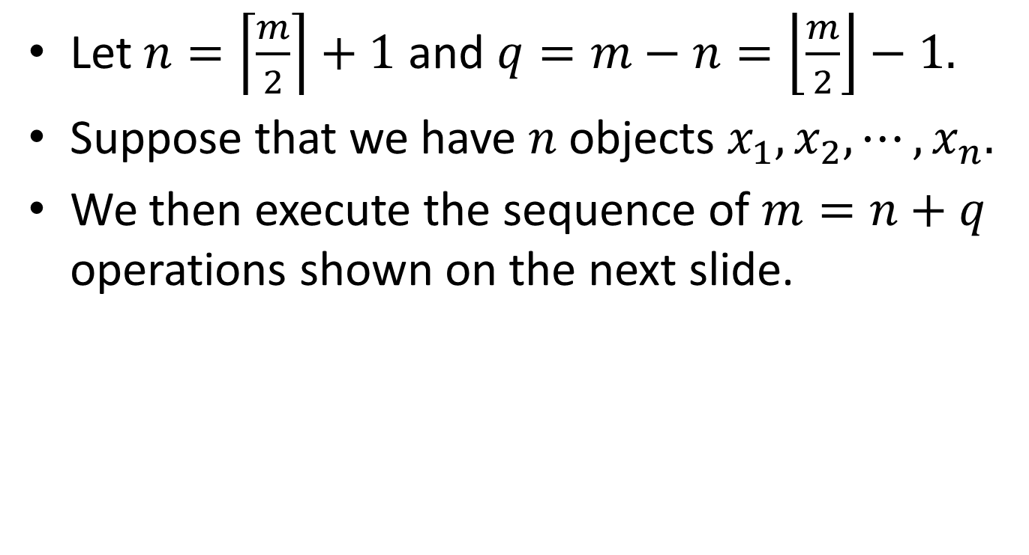
Proof
Let $n=\left\lceil \frac{m}{2}\right\rceil +1$ and $q=m−n=\left\lfloor \frac{m}{2}\right\rfloor −1.$
Suppose that we have $n$ objects $x_{1},x_{2},⋯,x_{n}.$
We then execute the sequence of $m=n+q$ operations shown on the next slide.

Slide 33
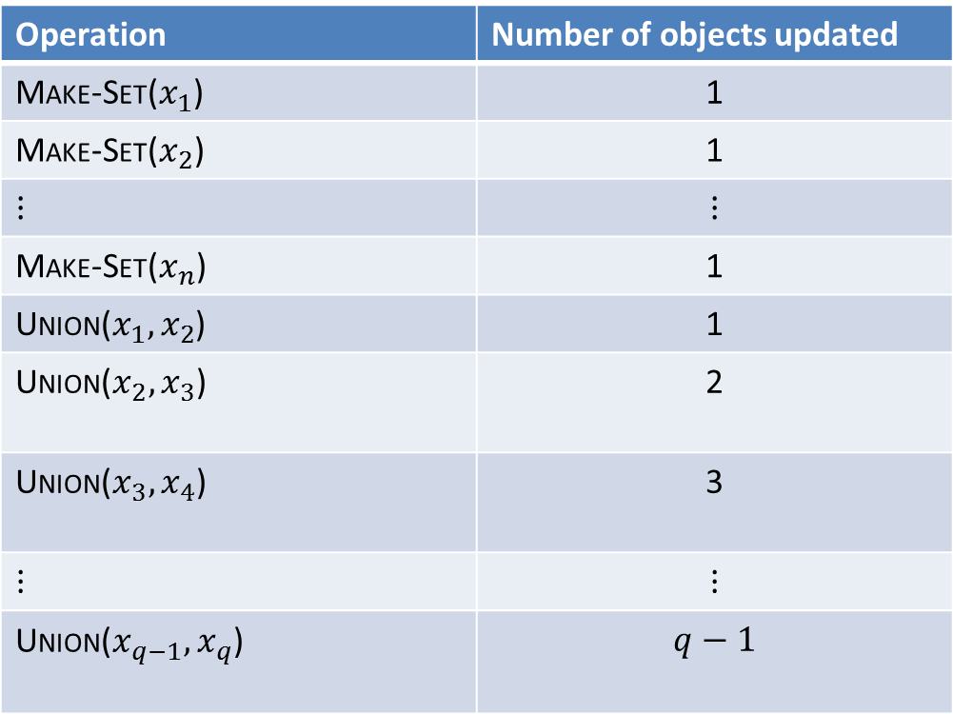
Operations
Operation | Number of objects updated
Make-Set($x_{1}$) | 1
Make-Set($x_{2}$) | 1
$$⋮$$ | $$⋮$$
Make-Set($x_{n}$) | 1
Union($x_{1},x_{2}$) | 1
Union($x_{2},x_{3}$) | 2
Union($x_{3},x_{4}$) | 3
$$⋮$$ | $$⋮$$
Union($x_{q−1},x_{q}$) | $$q−1$$

Slide 34
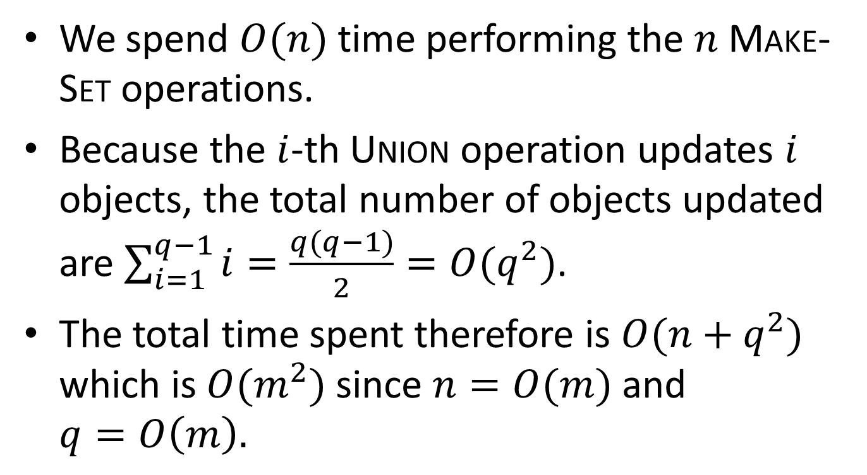
Proof (cont’d)
We spend $O(n)$ time performing the $n$ Make-Set operations.
Because the $i$-th Union operation updates $i$ objects, the total number of objects updated are $\sum_{i=1}^{q−1}{i}=\frac{q(q−1)}{2}=O(q^{2})$.
The total time spent therefore is $O(n+q^{2})$ which is $O(m^{2})$ since $n=O(m)$ and $q=O\left(m\right).$

Slide 35

The Weighted Union Heuristic
The above implementation of the Union operation requires an average of $O(m)$ time per operation because we may be appending a longer list onto a shorter list, and we must update the pointer to the representative of each member of the longer list.
If each representative also includes the length of the list then we can always append the smaller list onto the longer, with ties broken arbitrarily. This is called the weighted union heuristic.

Slide 36
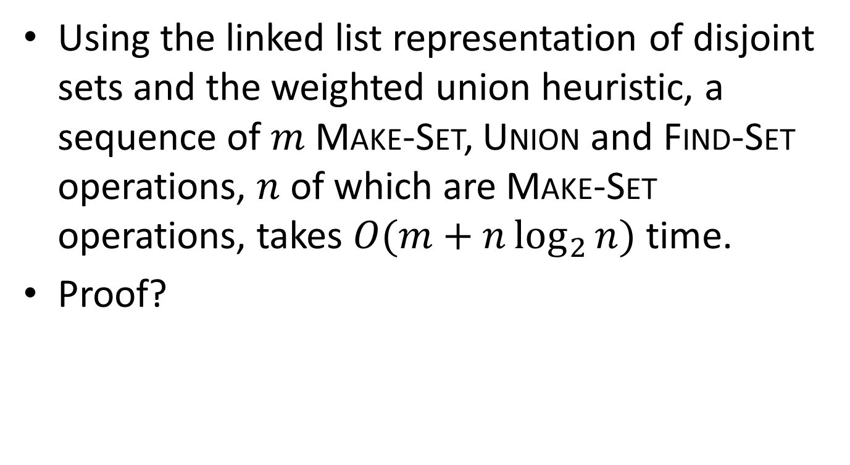
Theorem
Using the linked list representation of disjoint sets and the weighted union heuristic, a sequence of $m$ Make-Set, Union and Find-Set operations, $n$ of which are Make-Set operations, takes $O(m+n\log_{2}{n})$ time.
Proof?

Slide 37
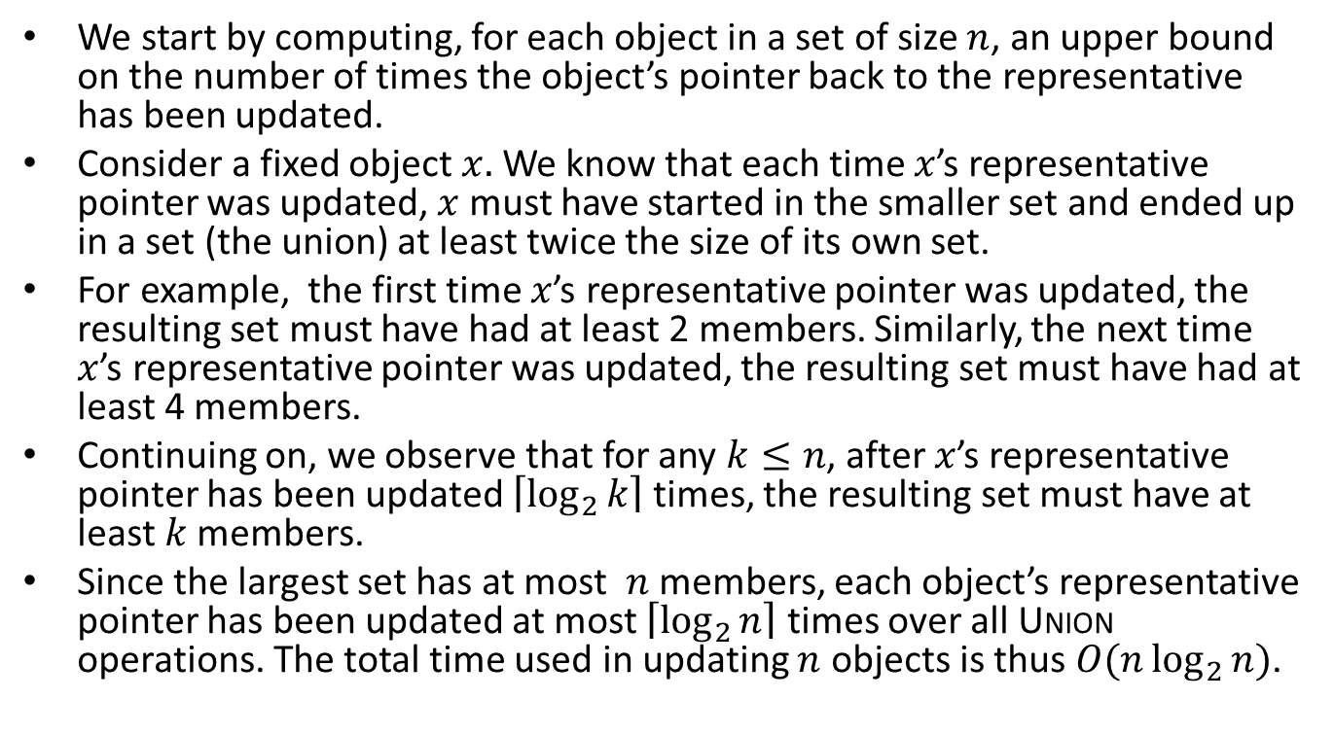
Proof
We start by computing, for each object in a set of size $n$, an upper bound on the number of times the object’s pointer back to the representative has been updated.
Consider a fixed object $x.$ We know that each time $x$’s representative pointer was updated, $x$ must have started in the smaller set and ended up in a set (the union) at least twice the size of its own set.
For example, the first time $x$’s representative pointer was updated, the resulting set must have had at least 2 members. Similarly, the next time $x$’s representative pointer was updated, the resulting set must have had at least 4 members.
Continuing on, we observe that for any $k≤n$, after $x$’s representative pointer has been updated $\left\lceil \log_{2}{k}\right\rceil$ times, the resulting set must have at least $k$members.
Since the largest set has at most $n$ members, each object’s representative pointer has been updated at most $\left\lceil \log_{2}{n}\right\rceil$ times over all Union operations. The total time used in updating $n$ objects is thus $O(n\log_{2}{n})$.

Slide 38
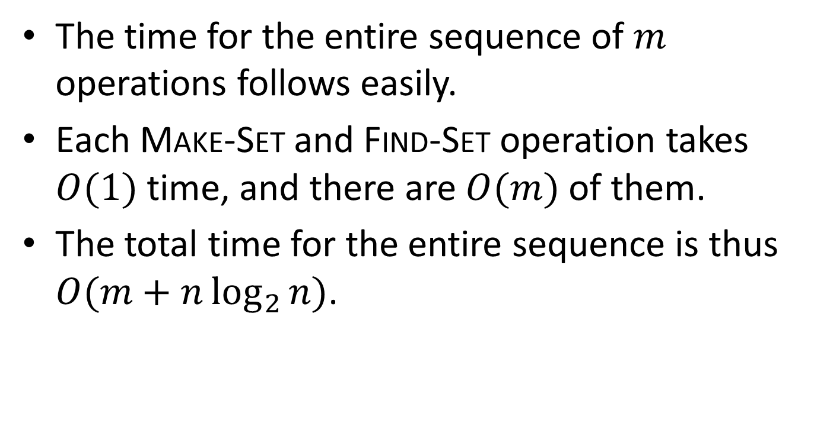
Proof (cont’d)
The time for the entire sequence of $m$ operations follows easily.
Each Make-Set and Find-Set operation takes $O(1)$ time, and there are $O(m)$ of them.
The total time for the entire sequence is thus $O(m+n\log_{2}{n})$.

Slide 39
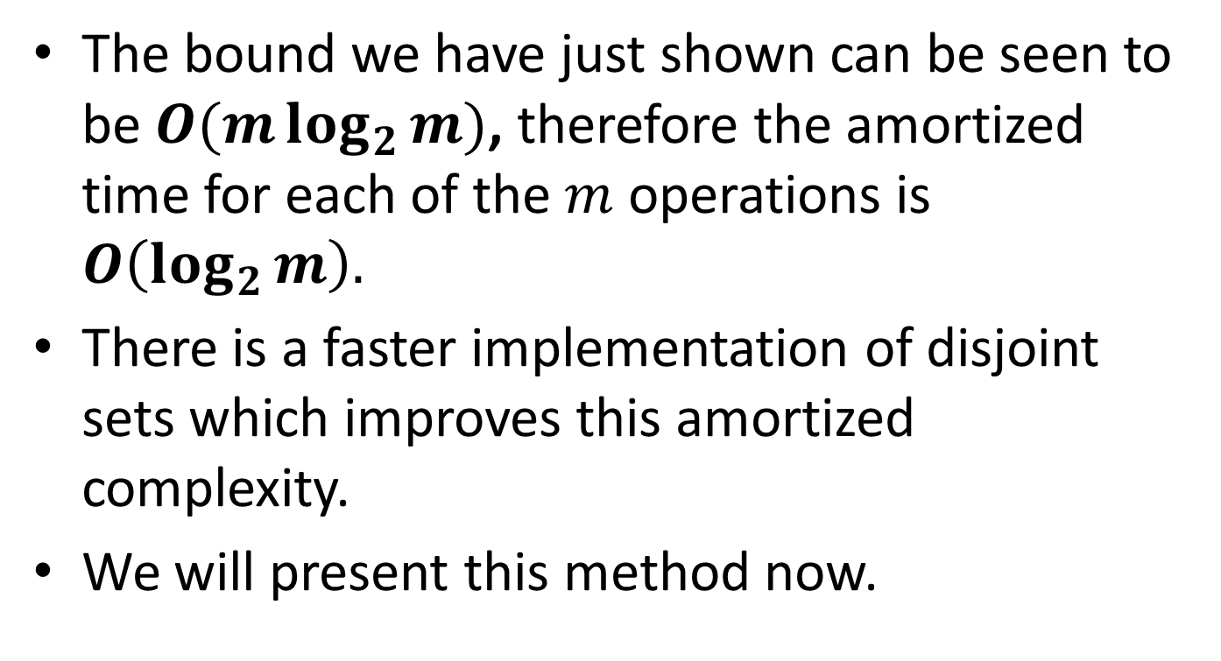
Complexity (cont’d)
The bound we have just shown can be seen to be $O(m\log_{2}{m})$, therefore the amortized time for each of the $m$ operations is $O\left(\log_{2}{m}\right).$
There is a faster implementation of disjoint sets which improves this amortized complexity.
We will present this method now.

Slide 40
Disjoint-Set Forests
In the faster implementation of disjoint sets, we represent sets by rooted trees.
Each node of a tree represents one set member and each tree represents a set.
In a tree, each set member points only to its parent. The root of each tree contains the representative of the set and is its own parent.
For many sets, we have a disjoint-set forest.

Slide 41
Example: the Sets {b, c, e, h} and
{d, f, g}
c
f
h
e
d
b
g
The representatives of the two sets are c and f.

Slide 42
Implementing Make-Set,
Find-Set and Union
A Make-Set operation simply creates a tree with just one node.
A Find-Set operation can be implemented by chasing parent pointers until we find the root of the tree. The nodes visited on this path towards the root constitute the find-path.
A Union operation can be implemented by making the root of one tree to point to the root of the other.

Slide 43
Example: the Union of Sets {b, c, e, h} and {d, f, g}
f
c
d
h
e
g
b

Slide 44
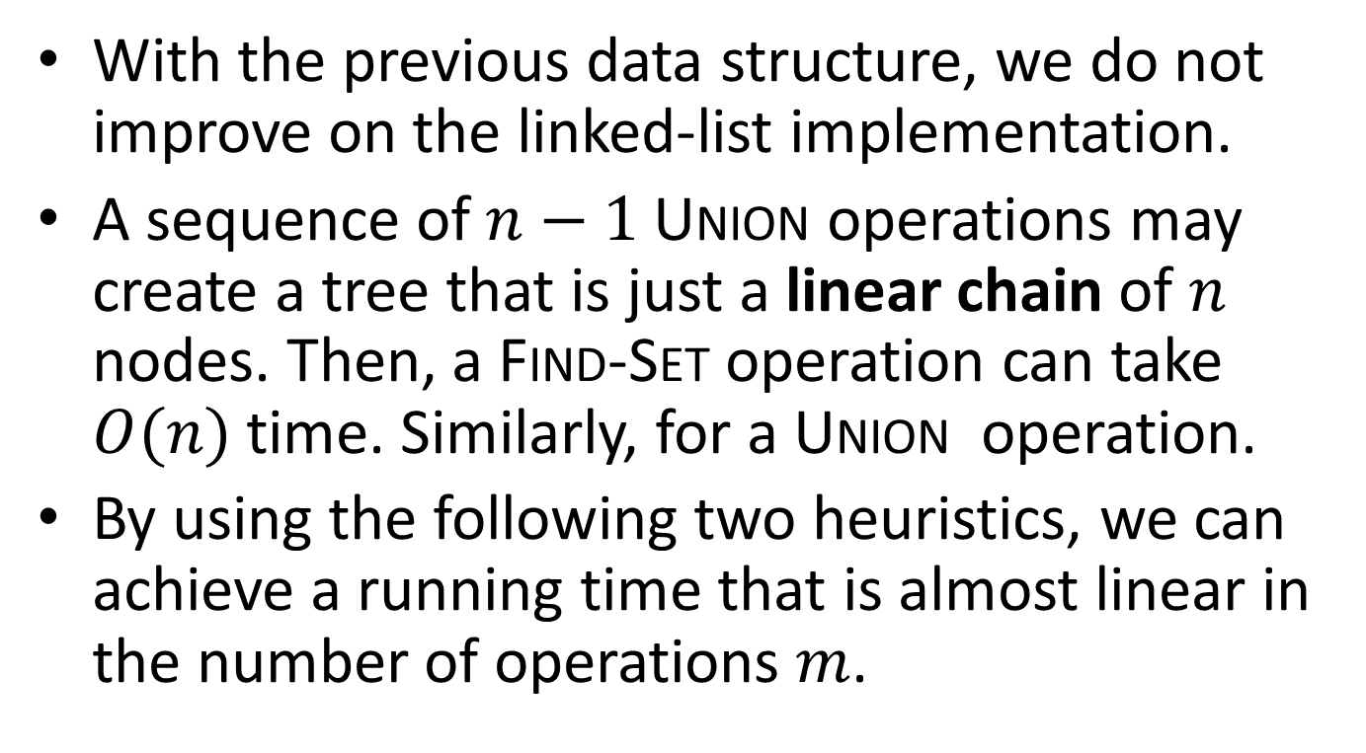
Complexity
With the previous data structure, we do not improve on the linked-list implementation.
A sequence of $n−1$Union operations may create a tree that is just a linear chain of $n$ nodes. Then, a Find-Set operation can take $O(n)$ time. Similarly, for a Union operation.
By using the following two heuristics, we can achieve a running time that is almost linear in the number of operations $m$.

Slide 45
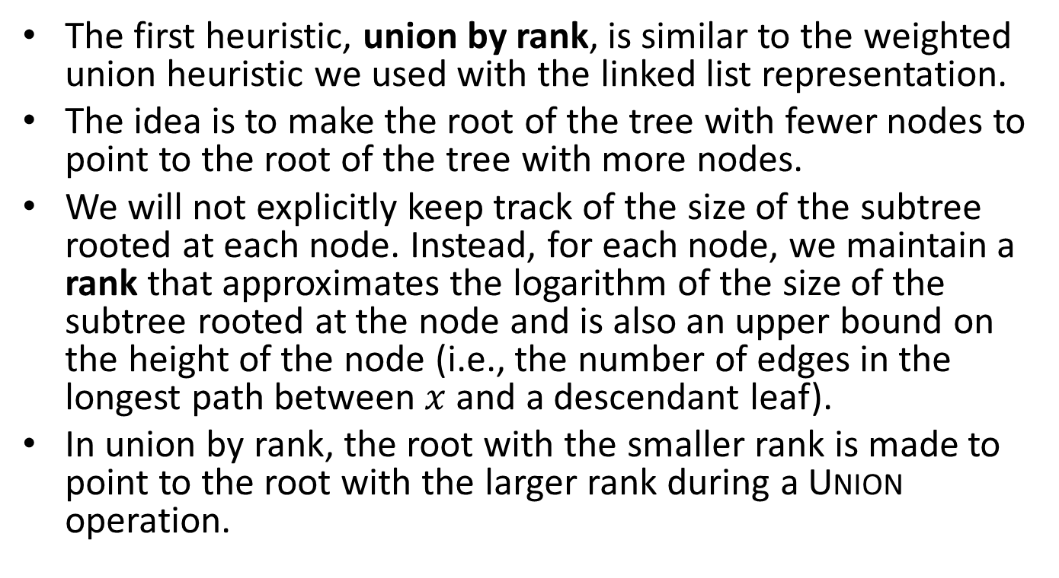
The Union by Rank Heuristic
The first heuristic, union by rank, is similar to the weighted union heuristic we used with the linked list representation.
The idea is to make the root of the tree with fewer nodes to point to the root of the tree with more nodes.
We will not explicitly keep track of the size of the subtree rooted at each node. Instead, for each node, we maintain a rank that approximates the logarithm of the size of the subtree rooted at the node and is also an upper bound on the height of the node (i.e., the number of edges in the longest path between $x$ and a descendant leaf).
In union by rank, the root with the smaller rank is made to point to the root with the larger rank during a Union operation.

Slide 46
The Path Compression Heuristic
The second heuristic, path compression, is also simple and very effective.
This heuristic is used during Find-Set operations to make each node on the find path point directly to the root.
In this way, trees with small height are constructed.
Path compression does not change any ranks.

Slide 47
The Path Compression Heuristic Graphically
f
e
d
c
b

Slide 48
The Path Compression Heuristic Graphically (cont’d)
f
b
c
d
e

Slide 49
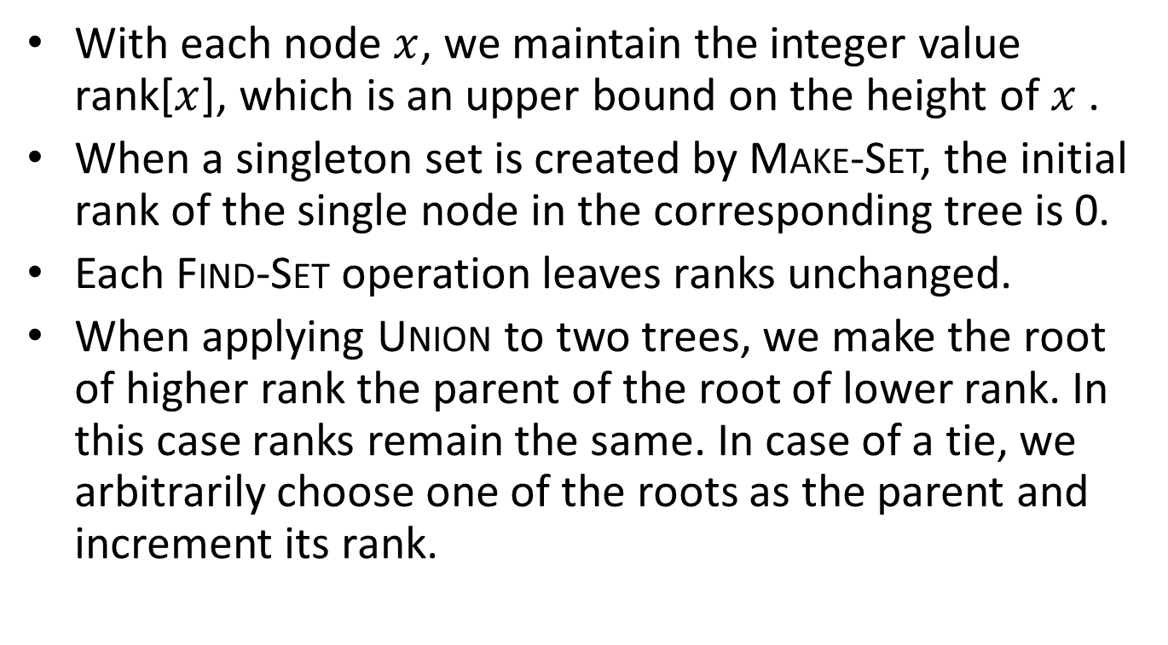
Implementing Disjoint-Set Forests
With each node $x$, we maintain the integer value rank[$x$], which is an upper bound on the height of $x$ .
When a singleton set is created by Make-Set, the initial rank of the single node in the corresponding tree is 0.
Each Find-Set operation leaves ranks unchanged.
When applying Union to two trees, we make the root of higher rank the parent of the root of lower rank. In this case ranks remain the same. In case of a tie, we arbitrarily choose one of the roots as the parent and increment its rank.

Slide 50
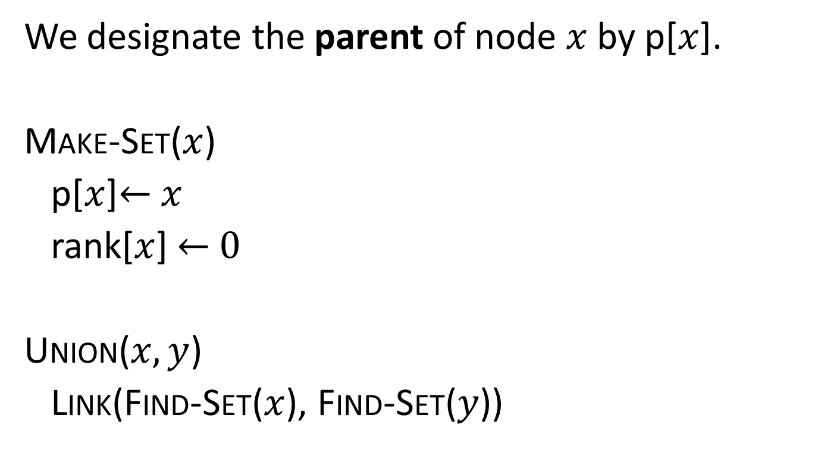
Pseudocode
We designate the parent of node $x$ by p[$x$].
Make-Set($x$)
p[$x$]← $x$
rank[$x$] ← 0
Union($x,y$)
Link(Find-Set($x$), Find-Set($y$))

Slide 51
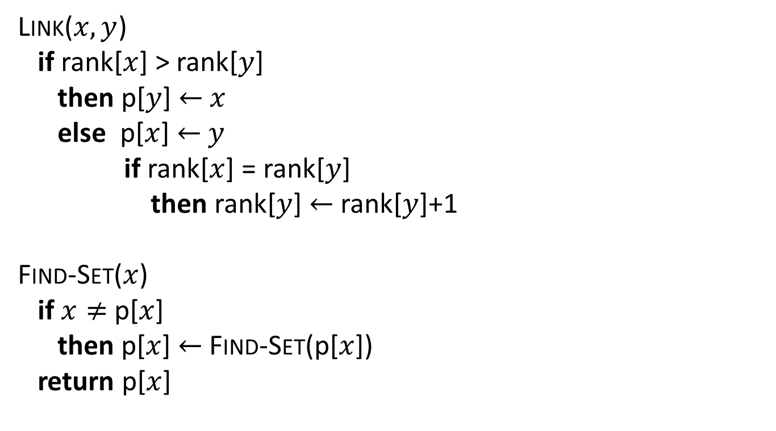
Pseudocode (cont’d)
Link($x,y$)
if rank[$x$] > rank[$y$]
then p[$y$] ← $x$
else p[$x$] ← $y$
if rank[$x$] = rank[$y$]
then rank[$y$] ← rank[$y$]+1
Find-Set($x$)
if $x≠$ p[$x$]
then p[$x$] ← Find-Set(p[$x$])
return p[$x$]

Slide 52
The Find-Set Procedure
Notice that the Find-Set procedure is a two-pass method: it makes one pass up the find path to find the root, and it makes a second pass back down the find path to update each node so it points directly to the root.
The second pass is made as the recursive calls return.

Slide 53
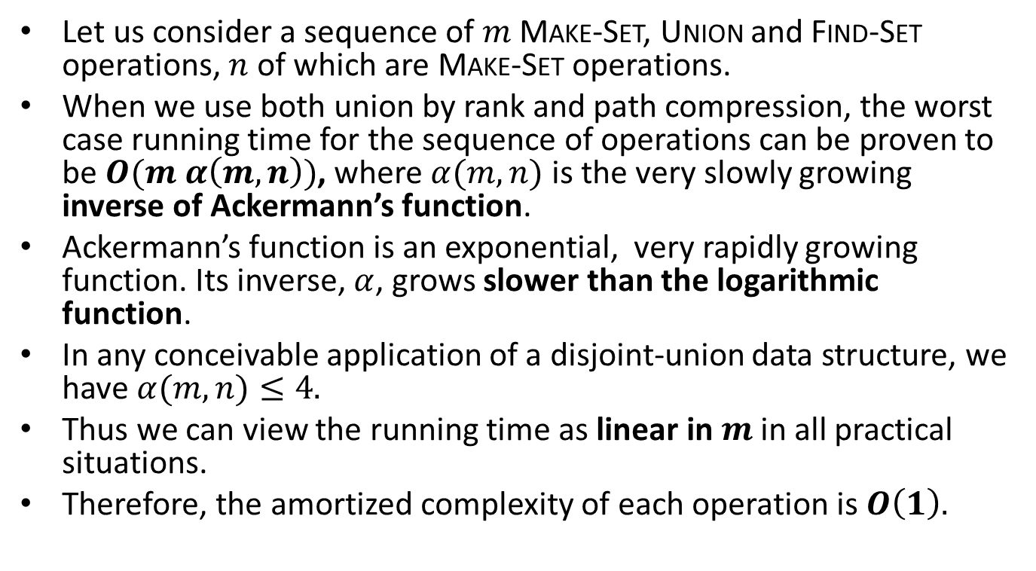
Complexity
Let us consider a sequence of $m$ Make-Set, Union and Find-Set operations, $n$ of which are Make-Set operations.
When we use both union by rank and path compression, the worst case running time for the sequence of operations can be proven to be$O(m α\left(m,n\right))$, where $α(m,n)$ is the very slowly growing inverse of Ackermann’s function.
Ackermann’s function is an exponential, very rapidly growing function. Its inverse, $α$, grows slower than the logarithmic function.
In any conceivable application of a disjoint-union data structure, we have $α(m,n)≤4.$
Thus we can view the running time as linear in $m$ in all practical situations.
Therefore, the amortized complexity of each operation is $O\left(1\right).$

Slide 54
Implementation in C
Let us assume that the sets will have positive integers in the range 0 to N-1 as their members.
The simplest way to implement in C the disjoint sets data structure is to use an array id[N] of integers that take values in the range 0 to N-1. This array will be used to keep track of the representative of each set but also the members of each set.
Initially, we set id[i]=i, for each i between 0 and N-1. This is equivalent to N Make-Set operations that create the initial versions of the sets.
To implement the Union operation for the sets that contain integers p and q, we scan the array id and change all the array elements that have the value p to have the value q.
The implementation of the Find-Set(p) simply returns the value of id[p].

Slide 55
Implementation in C (cont’d)
The program on the next slide initializes the array id, and then reads pairs of integers (p,q) and performs the operation Union(p,q) if p and q are not in the same set yet.
The program is an implementation of the equivalence problem defined earlier. Similar programs can be written for the other applications of disjoint sets presented.

Slide 56
Implementation in C (cont’d)
#include <stdio.h>
#define N 10000
main()
{ int i, p, q, t, id[N];
for (i = 0; i < N; i++) id[i] = i;
while (scanf("%d %d", &p, &q) == 2)
{
if (id[p] == id[q]) continue;
for (t = id[p], i = 0; i < N; i++)
if (id[i] == t) id[i] = id[q];
printf("%d %d\n", p, q);
}
}

Slide 57
Implementation in C (cont’d)
The extension of this implementation to the case where sets are represented by linked lists is left as an exercise.

Slide 58
Implementation in C (cont’d)
The disjoint-forests data structure can easily be implemented by changing the meaning of the elements of array id. Now each id[i] represents an element of a set and points to another element of that set. The root element points to itself.
The program on the next slide illustrates this functionality. Note that after we have found the roots of the two sets, the Union operation is simply implemented by the assignment statement id[i]=j.
The implementation of the Find-Set operation is similar.

Slide 59
Implementation in C (cont’d)
#include <stdio.h>
#define N 10000
main()
{ int i, j, p, q, t, id[N];
for (i = 0; i < N; i++) id[i] = i;
while (scanf("%d %d", &p, &q) == 2)
{
for (i = p; i != id[i]; i = id[i]) ;
for (j = q; j != id[j]; j = id[j]) ;
if (i == j) continue;
id[i] = j;
printf("%d %d\n", p, q);
}
}

Slide 60
Implementation in C (cont’d)
We can implement a weighted version of the Union operation by keeping track of the size of the two trees and making the root of the smaller tree point to the root of the larger.
The code on the next slide implements this functionality by making use of an array sz[N] (for size).

Slide 61
Implementation in C (cont’d)
#include <stdio.h>
#define N 10000
main()
{ int i, j, p, q, id[N], sz[N];
for (i = 0; i < N; i++)
{ id[i] = i; sz[i] = 1; }
while (scanf("%d %d", &p, &q) == 2)
{
for (i = p; i != id[i]; i = id[i]) ;
for (j = q; j != id[j]; j = id[j]) ;
if (i == j) continue;
if (sz[i] < sz[j])
{ id[i] = j; sz[j] += sz[i]; }
else { id[j] = i; sz[i] += sz[j]; }
printf("%d %d\n", p, q);
}
}

Slide 62
Implementation in C (cont’d)
In a similar way, we can implement the union by rank heuristic.
This heuristic together with the path compression heuristic are left as exercises.

Slide 63
Readings
T.H. Cormen, C. E. Leiserson and R. L. Rivest. Introduction to Algorithms. MIT Press.
  Chapter 22
Robert Sedgewick. Αλγόριθμοι σε C. 3^{η} Αμερικανική Έκδοση. Εκδόσεις Κλειδάριθμος.
  Κεφάλαιο 1

