Slide 1
Graphs (Γράφοι)
Manolis Koubarakis

Slide 2
Graphs
Graphs are collections of nodes in which various pairs are connected by line segments. The nodes are usually called vertices (κορυφές) and the line segments edges (ακμές).
Graphs are more general than trees. Graphs are allowed to have cycles and can have more than one connected component.
Some authors use the terms nodes (κόμβοι) and arcs (τόξα) instead of vertices and edges.

Slide 3
Example of Graphs (Directed)

Slide 4
Example of Graphs (Undirected)

Slide 5
Examples of Graphs
Transportation networks
Interesting problem: What is the path with one or more stops of shortest overall distance connecting a starting city and a destination city?

Slide 6
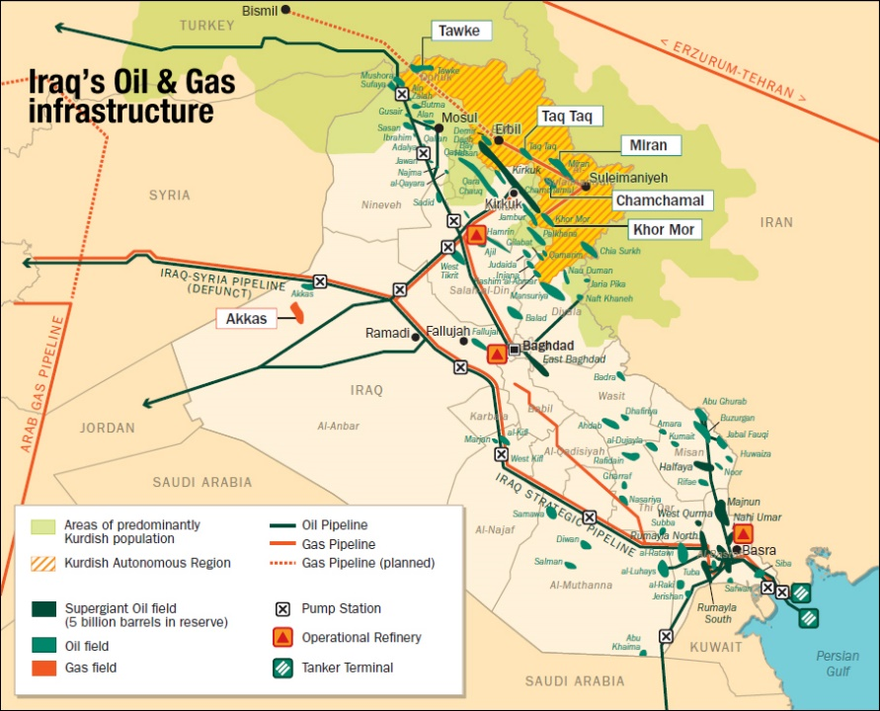
Examples (cont’d)
A network of oil pipelines
Interesting problem: What is the maximum possible overall flow of oil from the source to the destination?

Slide 7

Examples (cont’d)
The Internet
Interesting problem: Deliver an e-mail from user A to user B

Slide 8

Examples (cont’d)
The Web
Interesting problem: What is the PageRank of a Web site?

Slide 9
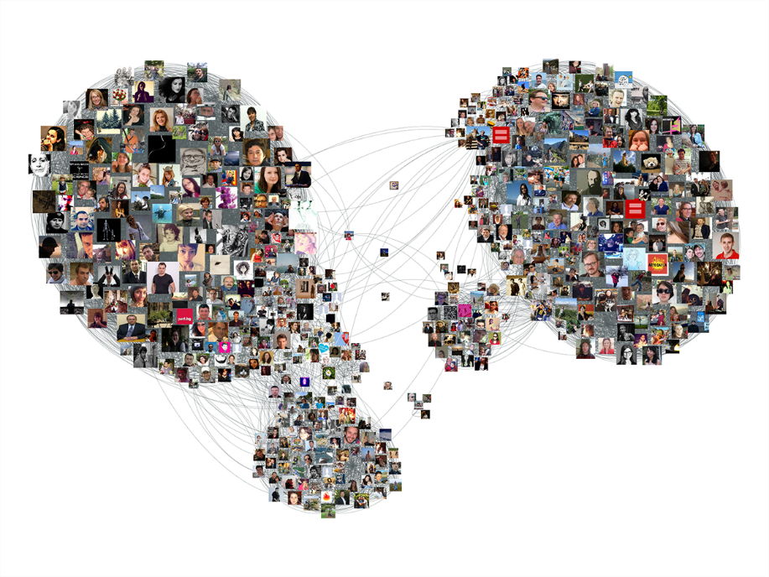
Examples (cont’d)
The Facebook social network
Interesting problem: Are John and Mary connected? What interesting clusters exist?

Slide 10
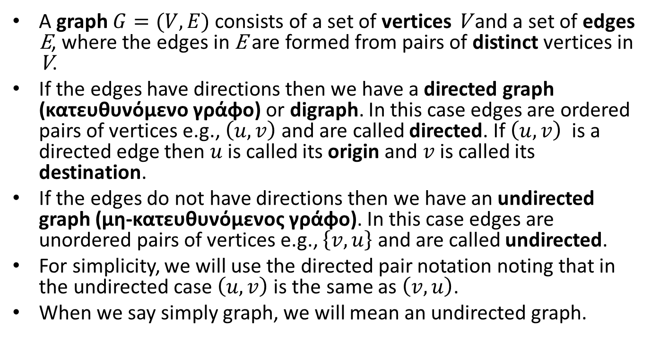
Formal Definitions
A graph $G=(V,E)$ consists of a set of vertices V and a set of edges E, where the edges in E are formed from pairs of distinct vertices in V.
If the edges have directions then we have a directed graph (κατευθυνόμενο γράφο) or digraph. In this case edges are ordered pairs of vertices e.g., $\left(u,v\right)$ and are called directed. If $\left(u,v\right)$ is a directed edge then $u$ is called its origin and $v$ is called its destination.
If the edges do not have directions then we have an undirected graph (μη-κατευθυνόμενος γράφο). In this case edges are unordered pairs of vertices e.g., $\left\{v,u\right\}$ and are called undirected.
For simplicity, we will use the directed pair notation noting that in the undirected case $\left(u,v\right)$ is the same as $\left(v,u\right)$.
When we say simply graph, we will mean an undirected graph.

Slide 11
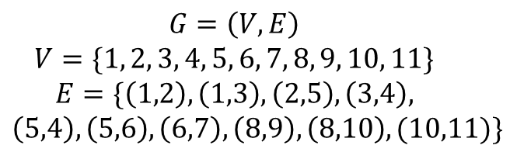
Example of a Directed Graph
2
5
6
1
3
4
7
8
9
$$G=\left(V,E\right)$$
$$V=\{1, 2, 3, 4, 5, 6, 7, 8, 9, 10, 11\}$$
$$E=\{\left(1,2\right), \left(1,3\right), \left(2,5\right), \left(3,4\right),$$
$$\left(5,4\right), \left(5,6\right), \left(6,7\right), \left(8,9\right), \left(8,10\right), (10,11)\}$$
10
11

Slide 12
Example of an Undirected Graph
2
5
6
1
3
4
7
8
9
$$G=\left(V,E\right)$$
$$V=\{1, 2, 3, 4, 5, 6, 7, 8, 9, 10, 11\}$$
$$E=\{\left(1,2\right), \left(1,3\right), \left(2,5\right), \left(3,4\right),$$
$$\left(5,4\right), \left(5,6\right), \left(6,7\right), \left(8,9\right), \left(8,10\right), (10,11)\}$$
10
11

Slide 13
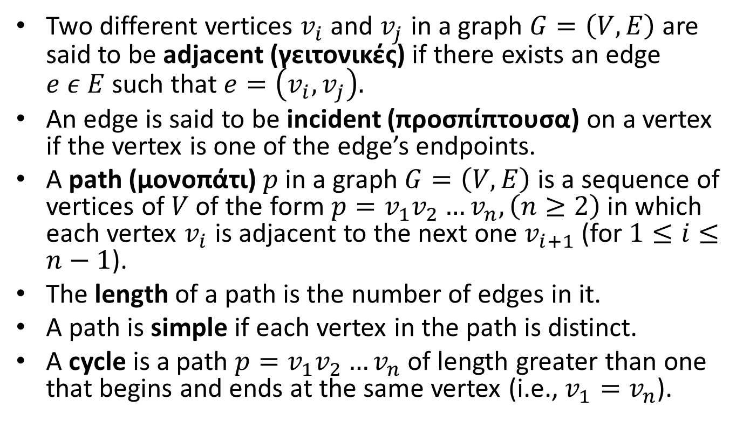
More Definitions
Two different vertices $v_{i}$ and $v_{j}$ in a graph $G=\left(V,E\right)$ are said to be adjacent (γειτονικές) if there exists an edge $e ε E$such that $e=\left(v_{i},v_{j}\right).$
An edge is said to be incident (προσπίπτουσα) on a vertex if the vertex is one of the edge’s endpoints.
A path (μονοπάτι) $p \text{in} \text{a} \text{graph} G=\left(V,E\right)$is a sequence of vertices of $V$ of the form $p=v_{1}v_{2}…v_{n}, \left(n≥2\right)$in which each vertex $v_{i}$ is adjacent to the next one $v_{i+1}$ (for $1≤i≤n−1$).
The length of a path is the number of edges in it.
A path is simple if each vertex in the path is distinct.
A cycle is a path $p=v_{1}v_{2}…v_{n}$ of length greater than one that begins and ends at the same vertex (i.e., $v_{1}=v_{n}$).

Slide 14
Definitions (cont’d)
A directed path is a path such that all edges are directed and are traversed along their direction.
A directed cycle is similarly defined.

Slide 15
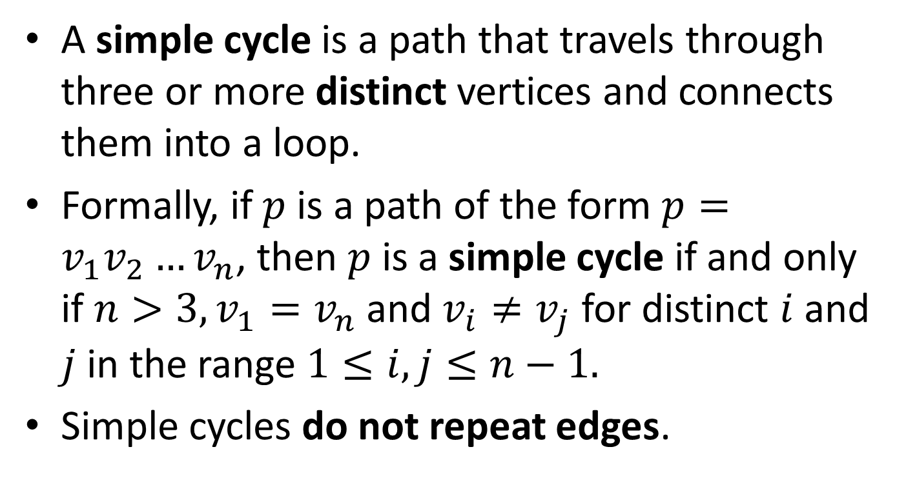
Definitions (cont’d)
A simple cycle is a path that travels through three or more distinct vertices and connects them into a loop.
Formally, if $p$is a path of the form $p=v_{1}v_{2}…v_{n}$, then $p$is a simple cycle if and only if $n>3, v_{1}=v_{n}$ and $v_{i}≠v_{j}$ for distinct $i$ and $j$ in the range $1≤i,j≤n−1.$
Simple cycles do not repeat edges.

Slide 16
Example
5
4
6
8
7
2
1
3
Four simple cycles: (1,2,3,1) (4,5,6,7,4) (4,5,6,4) (4,6,7,4)

Slide 17
Example (cont’d)
5
4
6
8
7
2
1
3
Two non-simple cycles: (1,2,1) (4,5,6,4,7,6,4)

Slide 18
Example (cont’d)
5
4
6
8
7
2
1
3
A path that is not a cycle: (1,2,4,6,8)

Slide 19
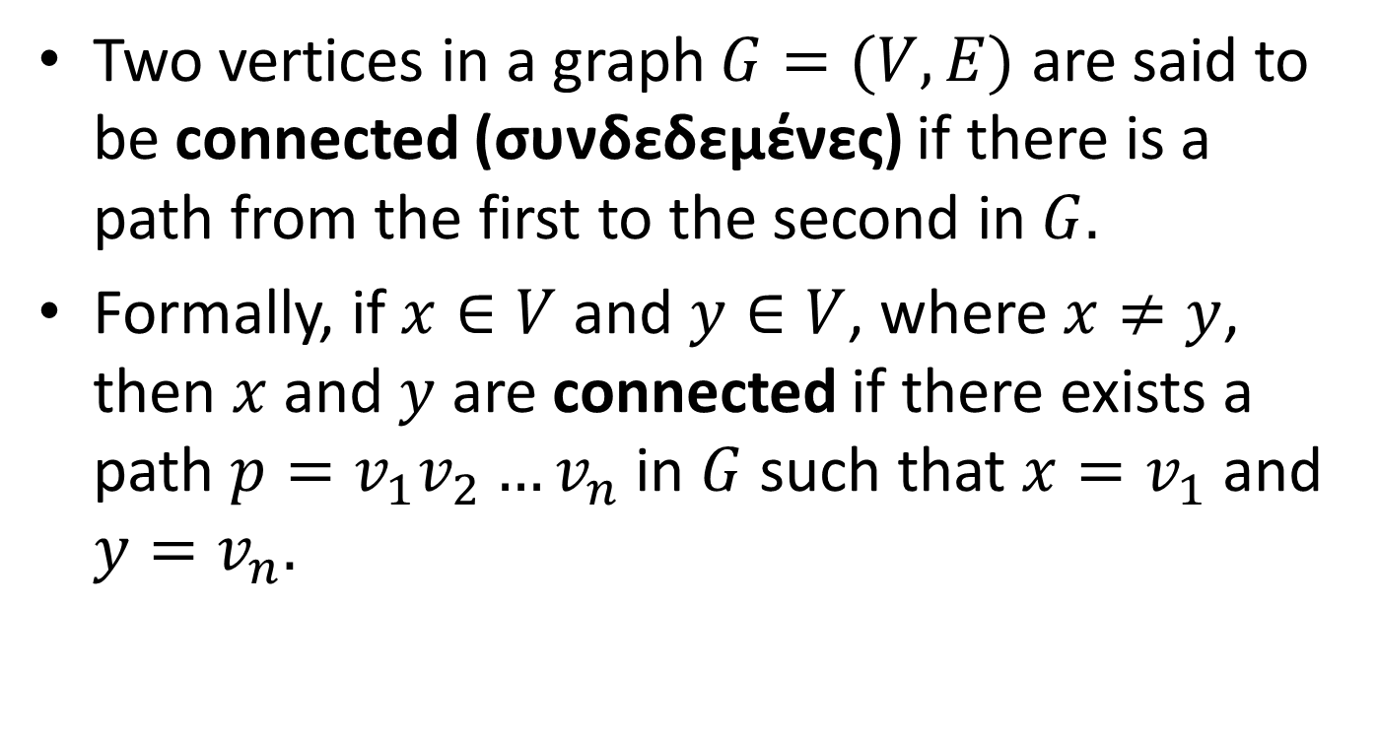
Connectivity and Components
Two vertices in a graph $G=(V,E)$ are said to be connected (συνδεδεμένες) if there is a path from the first to the second in $G.$
Formally, if $x∈V$ and $y∈V$, where $x≠y$, then $x$ and $y$ are connected if there exists a path $p=v_{1}v_{2}…v_{n}$ in $G$ such that $x=v_{1}$ and $y=v_{n}.$

Slide 20
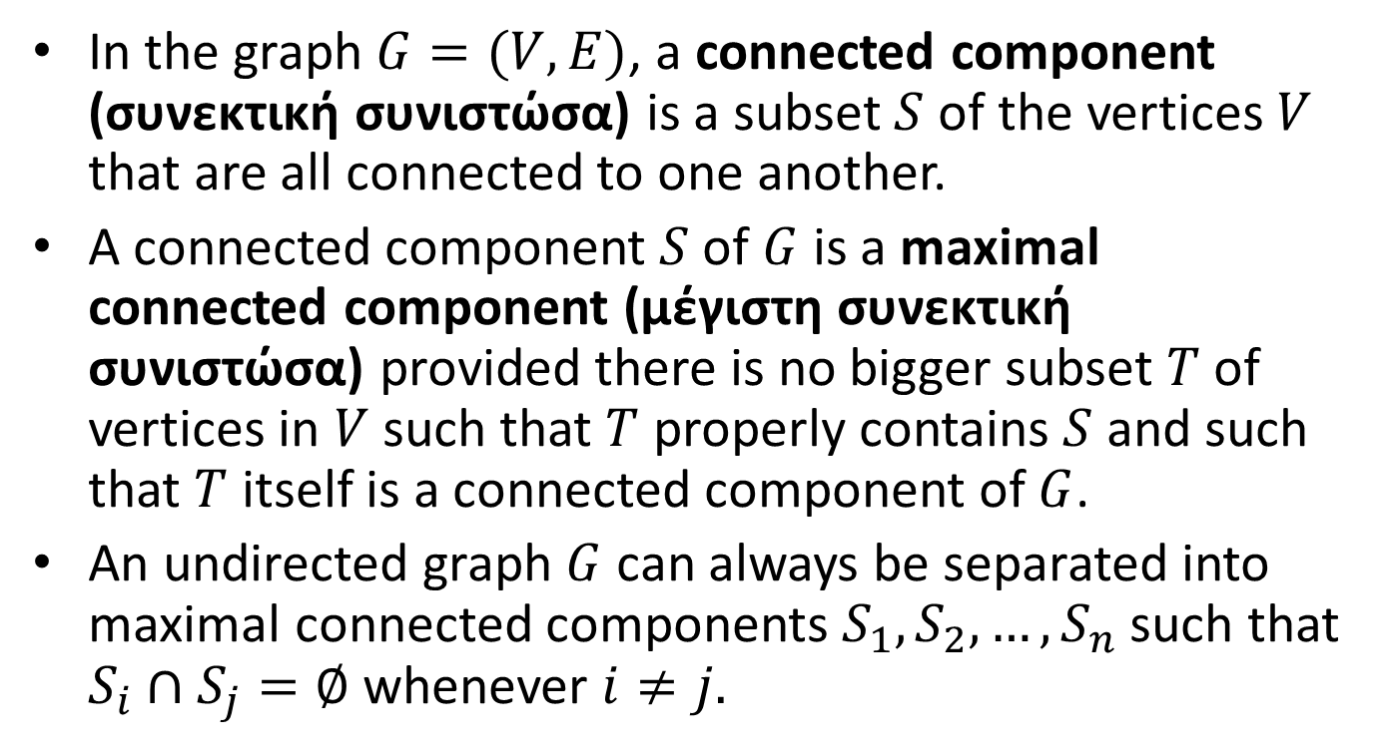
Connectivity and Components (cont’d)
In the graph $G=(V,E)$, a connected component (συνεκτική συνιστώσα) is a subset $S$ of the vertices $V$ that are all connected to one another.
A connected component $S$ of $G$ is a maximal connected component (μέγιστη συνεκτική συνιστώσα) provided there is no bigger subset $T$ of vertices in $V$ such that $T$ properly contains $S$ and such that $T$ itself is a connected component of $G$.
An undirected graph $G$ can always be separated into maximal connected components $S_{1},S_{2},…,S_{n}$ such that $S_{i}∩S_{j}=∅$ whenever $i≠j.$

Slide 21
Example of Undirected Graph and its Separation into Two Maximal Connected Components

Slide 22
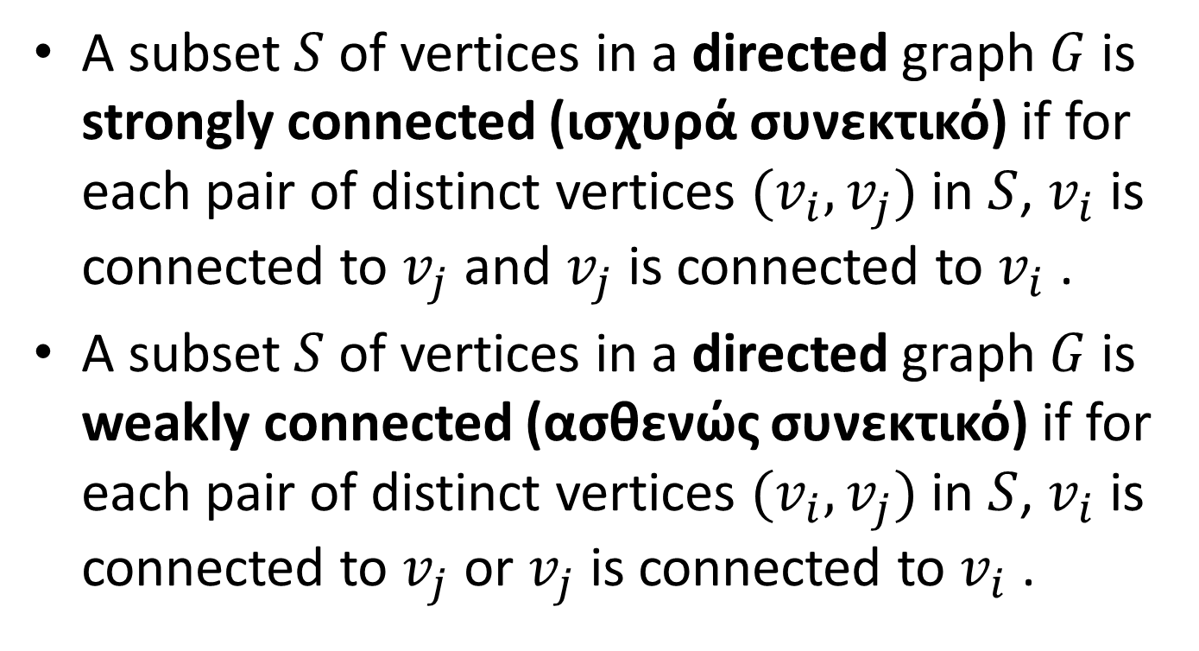
Connectivity and Components in Directed Graphs
A subset $S$ of vertices in a directed graph $G$ is strongly connected (ισχυρά συνεκτικό) if for each pair of distinct vertices $(v_{i},v_{j})$ in $S$, $v_{i}$ is connected to $v_{j}$ and $v_{j}$ is connected to $v_{i}$ .
A subset $S$ of vertices in a directed graph $G$ is weakly connected (ασθενώς συνεκτικό) if for each pair of distinct vertices $(v_{i},v_{j})$ in $S$, $v_{i}$ is connected to $v_{j}$ or $v_{j}$ is connected to $v_{i}$ .

Slide 23
Example: A Strongly Connected Digraph

Slide 24
Example: A Weakly Connected Digraph

Slide 25
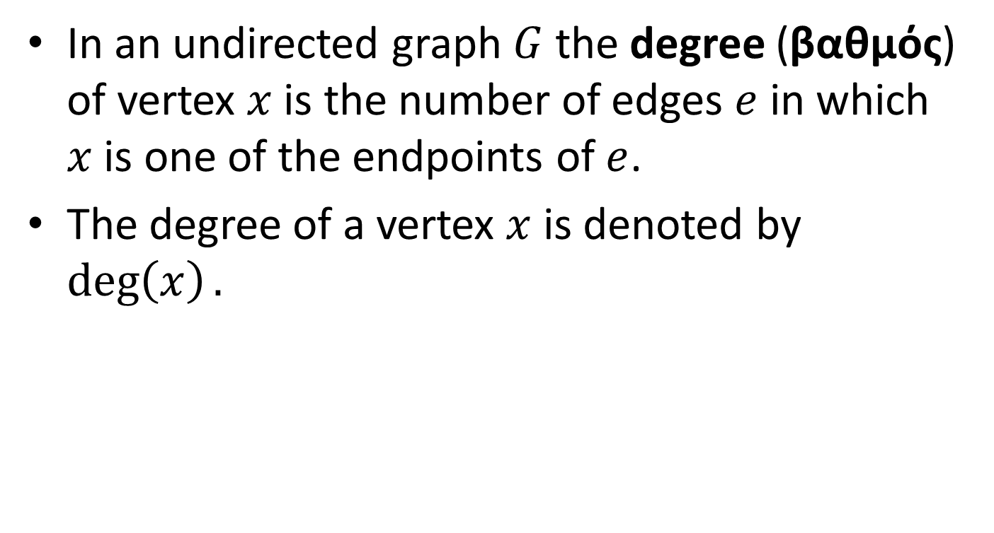
Degree in Undirected Graphs
In an undirected graph $G$ the degree (βαθμός) of vertex $x$ is the number of edges $e$ in which $x$ is one of the endpoints of $e$.
The degree of a vertex $x$ is denoted by $\deg\left(x\right).$

Slide 26
Example
5
4
6
8
7
2
1
3
The degree of node 1 is 2. The degree of node 4 is 4. The degree of node 8 is 1.

Slide 27
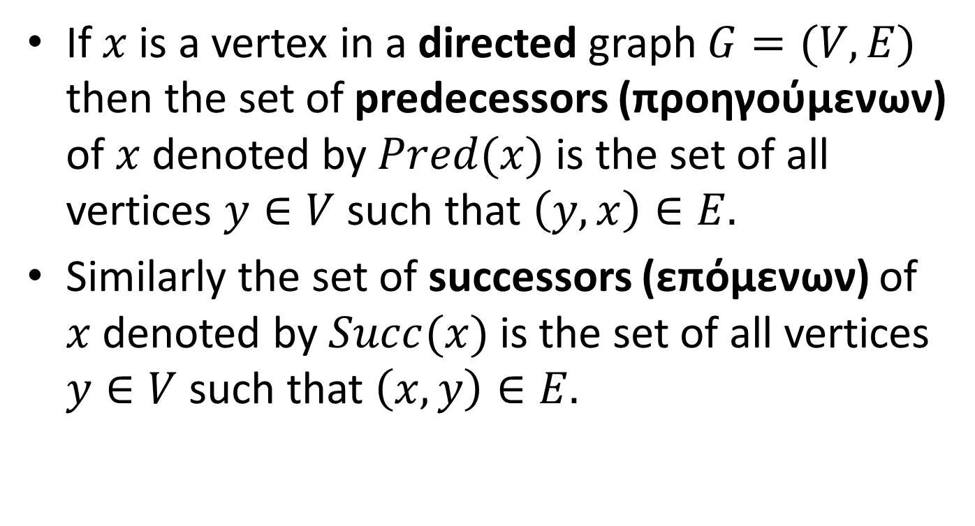
Predecessors and Successors in Directed Graphs
If $x$ is a vertex in a directed graph $G=(V,E)$ then the set of predecessors (προηγούμενων) of $x$ denoted by $Pred(x)$ is the set of all vertices $y∈V$ such that $\left(y,x\right)∈E.$
Similarly the set of successors (επόμενων) of $x$ denoted by $Succ(x)$ is the set of all vertices $y∈V$ such that $\left(x,y\right)∈E.$

Slide 28
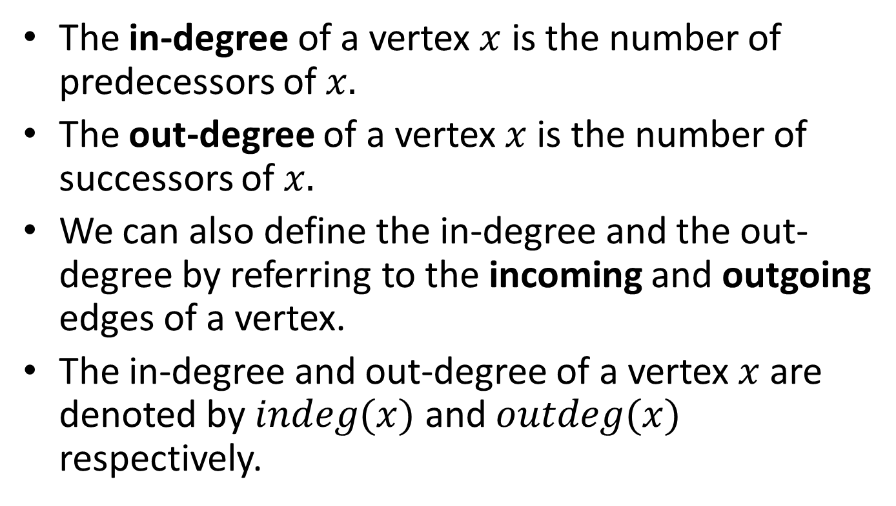
In-Degree and Out-Degree in Directed Graphs
The in-degree of a vertex $x$ is the number of predecessors of $x.$
The out-degree of a vertex $x$ is the number of successors of $x.$
We can also define the in-degree and the out-degree by referring to the incoming and outgoing edges of a vertex.
The in-degree and out-degree of a vertex $x$ are denoted by $indeg(x)$ and $outdeg(x)$ respectively.

Slide 29
Example
1
2
3
4
5
The in-degree of node 4 is 2. The out-degree of node 4 is 1.

Slide 30

Proposition
If $G$ is an undirected graph with $m$ edges, then
$$\sum_{v in G}{deg⁡(v)}=2m.$$
Proof?

Slide 31
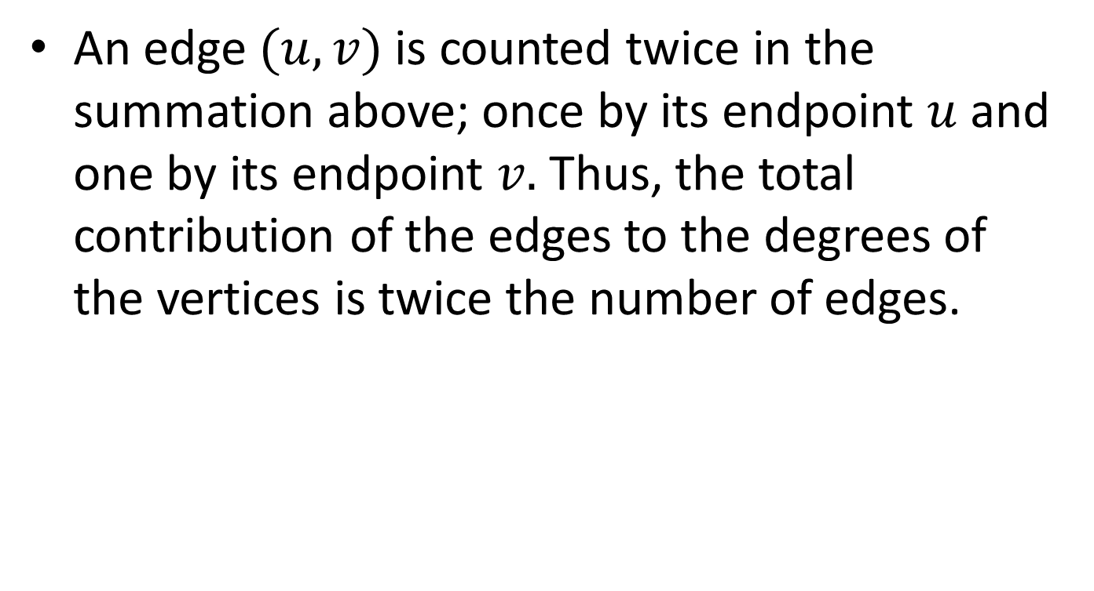
Proof
An edge $(u,v)$ is counted twice in the summation above; once by its endpoint $u$ and one by its endpoint $v.$ Thus, the total contribution of the edges to the degrees of the vertices is twice the number of edges.

Slide 32

Proposition
If $G$ is a directed graph with $m$ edges, then
$$\sum_{v in G}{indeg\left(v\right)=}\sum_{v in G}{outdeg(v)}=m.$$
Proof?

Slide 33
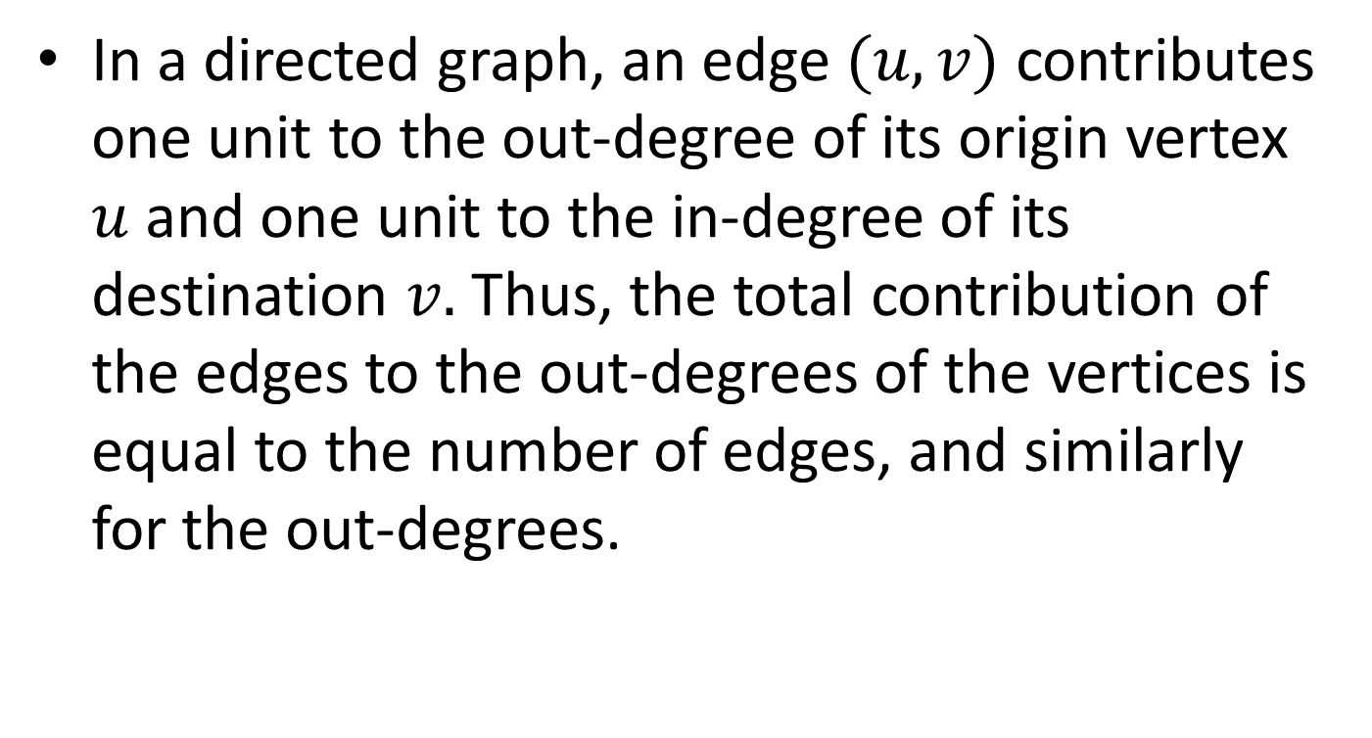
Proof
In a directed graph, an edge $(u,v)$ contributes one unit to the out-degree of its origin vertex $u$and one unit to the in-degree of its destination $v.$ Thus, the total contribution of the edges to the out-degrees of the vertices is equal to the number of edges, and similarly for the out-degrees.

Slide 34

Proposition
Let $G$ be a graph with$n$ vertices and $m$ edges. If $G$ is undirected, then $m≤\frac{n\left(n−1\right)}{2},$and if $G$ is directed, then $m≤n\left(n−1\right).$
Proof?

Slide 35
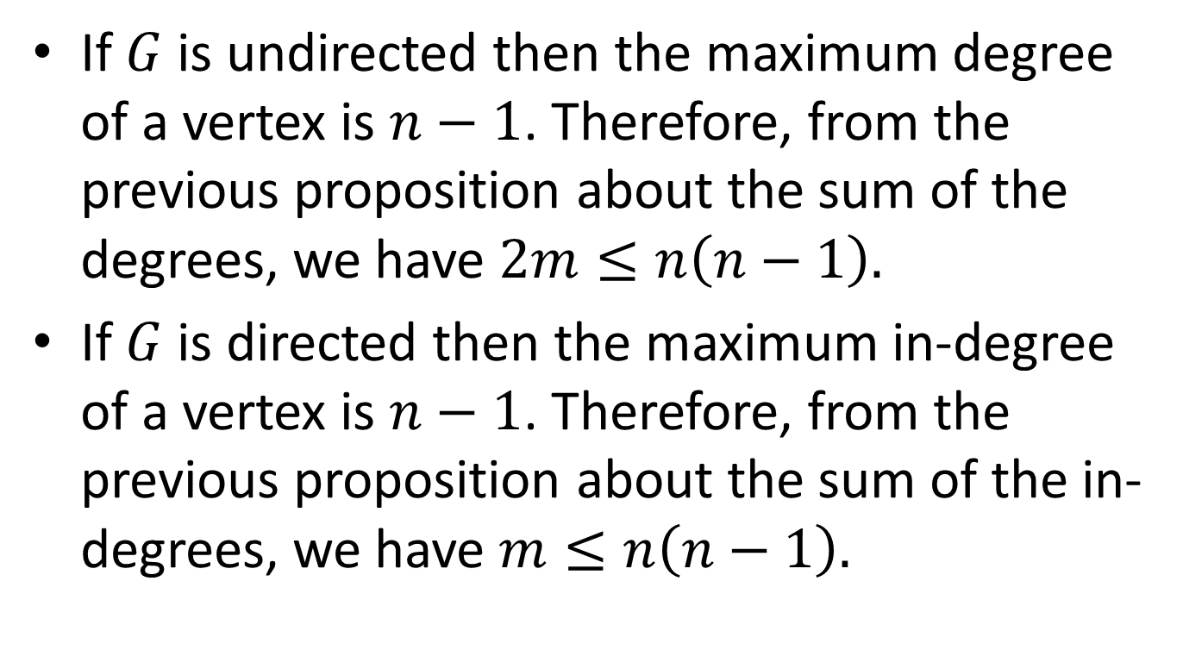
Proof
If $G$ is undirected then the maximum degree of a vertex is $n−1$. Therefore, from the previous proposition about the sum of the degrees, we have $2m≤n\left(n−1\right).$
If $G$ is directed then the maximum in-degree of a vertex is $n−1$. Therefore, from the previous proposition about the sum of the in-degrees, we have $m≤n\left(n−1\right).$

Slide 36
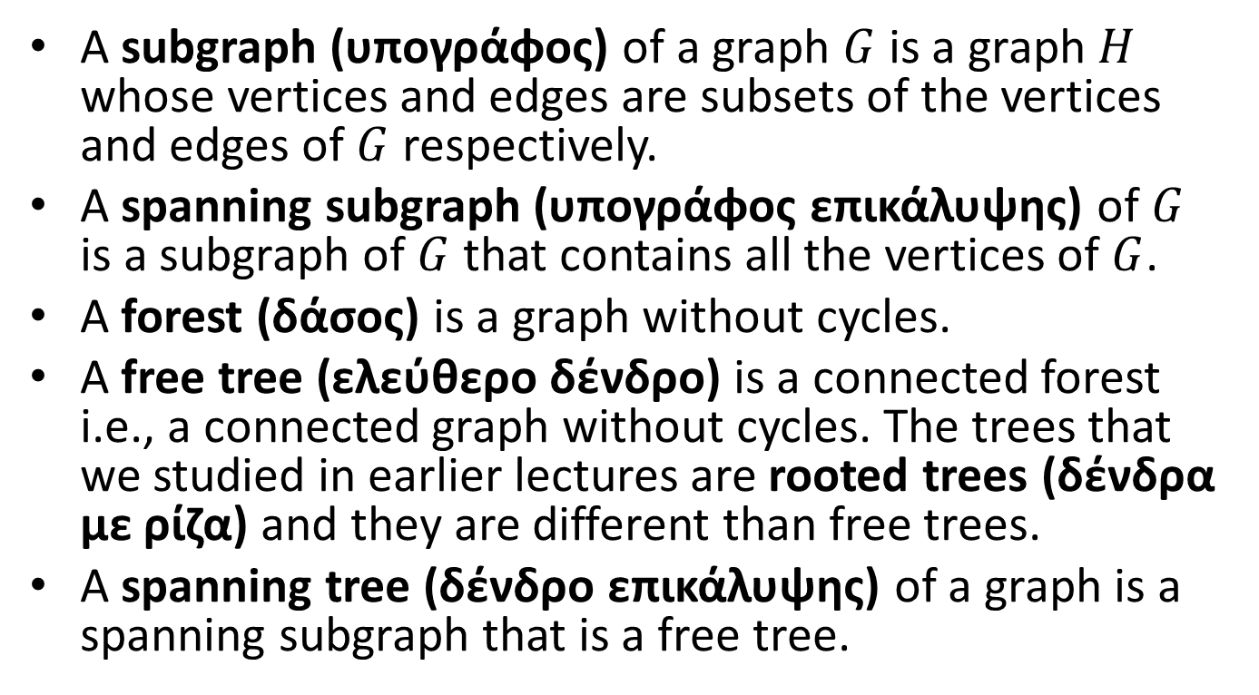
More definitions
A subgraph (υπογράφος) of a graph $G$ is a graph $H$ whose vertices and edges are subsets of the vertices and edges of $G$ respectively.
A spanning subgraph (υπογράφος επικάλυψης) of $G$ is a subgraph of $G$ that contains all the vertices of $G$.
A forest (δάσος) is a graph without cycles.
A free tree (ελεύθερο δένδρο) is a connected forest i.e., a connected graph without cycles. The trees that we studied in earlier lectures are rooted trees (δένδρα με ρίζα) and they are different than free trees.
A spanning tree (δένδρο επικάλυψης) of a graph is a spanning subgraph that is a free tree.

Slide 37
Example
5
4
6
8
7
2
1
3
The thick green lines define a spanning tree of the graph.

Slide 38
Example
The thick green lines define a forest which consists of two free trees.

Slide 39
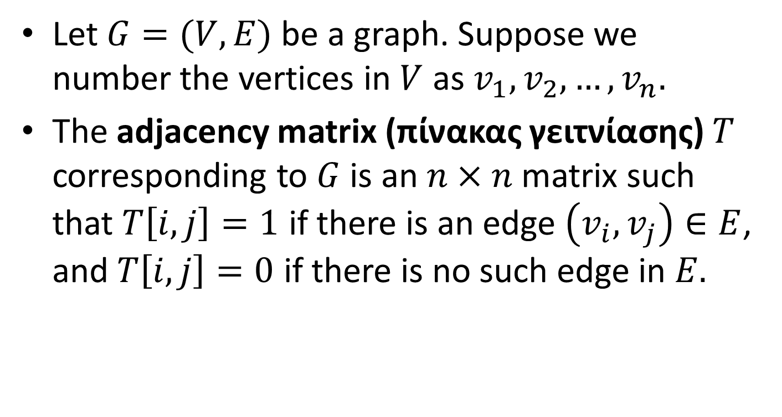
Graph Representations: Adjacency Matrices
Let $G=(V,E)$ be a graph. Suppose we number the vertices in $V$ as $v_{1},v_{2},…,v_{n}.$
The adjacency matrix (πίνακας γειτνίασης) $T$ corresponding to $G$ is an $n×n$ matrix such that $T\left[i,j\right]=1$ if there is an edge $\left(v_{i},v_{j}\right)∈E$, and $T\left[i,j\right]=0$ if there is no such edge in $E.$

Slide 40
Example
1
2
1
2
3
4
1
0 | 1 | 0 | 0
0 | 0 | 1 | 1
1 | 0 | 0 | 1
1 | 0 | 0 | 0
2
3
4
3
4
A graph G
The adjacency matrix for graph G

Slide 41
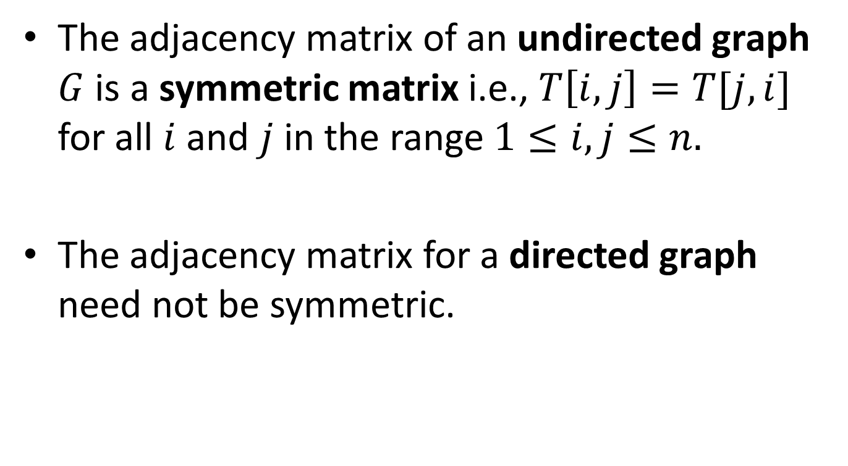
Adjacency Matrices
The adjacency matrix of an undirected graph $G$ is a symmetric matrix i.e., $T\left[i,j\right]=T[j,i]$ for all $i$ and $j$ in the range $1≤i,j≤n.$
The adjacency matrix for a directed graph need not be symmetric.

Slide 42
Adjacency Matrices
The diagonal entries in an adjacency matrix (of a directed or undirected graph) are zero, since graphs as we have defined them are not permitted to have looping self-referential edges that connect a vertex to itself.

Slide 43
Example
1
2
1
2
3
4
1
0 | 1 | 1 | 1
1 | 0 | 1 | 1
1 | 1 | 0 | 1
1 | 1 | 1 | 0
2
3
4
3
4
An undirected graph G
The adjacency matrix for graph G

Slide 44
Adjacency Matrices in C
#define MAXVERTEX 10
typedef enum {FALSE, TRUE} Boolean
typedef Boolean
AdjacencyMatrix[MAXVERTEX][MAXVERTEX]
typedef struct graph {
int n /*number of vertices in graph */
AdjacencyMatrix A;
} Graph;

Slide 45
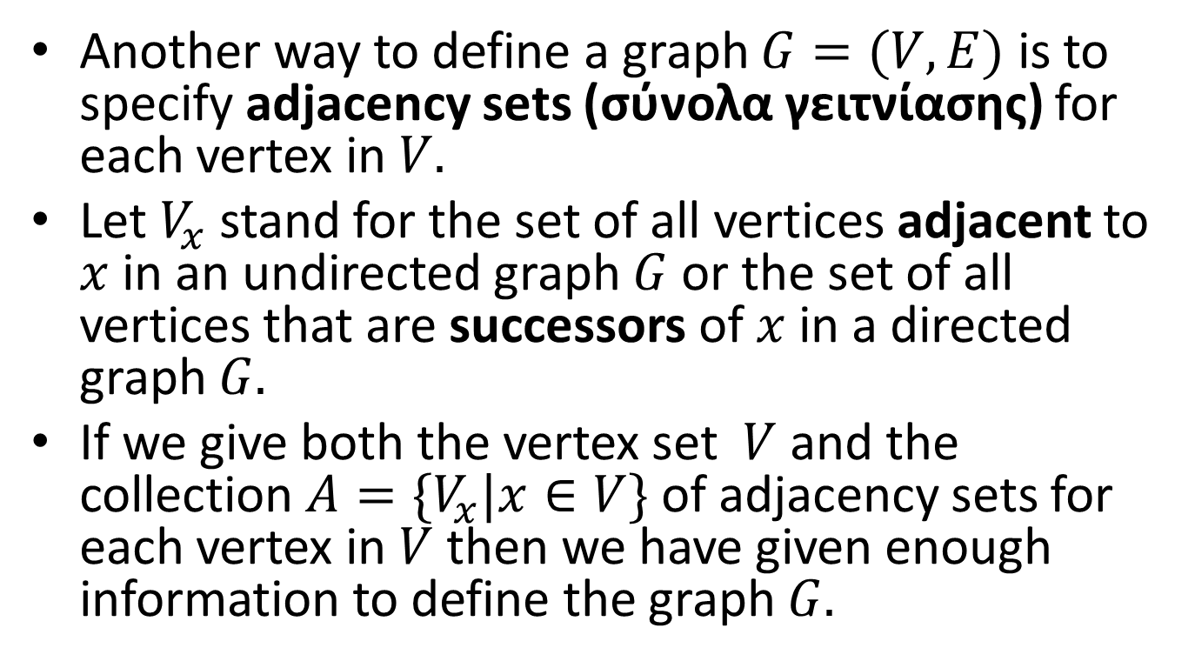
Adjacency Sets
Another way to define a graph $G=(V,E)$ is to specify adjacency sets (σύνολα γειτνίασης) for each vertex in $V.$
Let $V_{x}$ stand for the set of all vertices adjacent to $x$ in an undirected graph $G$ or the set of all vertices that are successors of $x$ in a directed graph $G.$
If we give both the vertex set $V$ and the collection $A=\{V_{x}|x∈V\}$ of adjacency sets for each vertex in $V$ then we have given enough information to define the graph $G.$

Slide 46

Graph Representations: Adjacency Lists
Another family of representations for a graph uses adjacency lists (λίστες γειτνίασης) to represent the adjacency set $V_{x}$ for each vertex $x$ in the graph.

Slide 47
Example Directed Graph
2
Vertex Number
1
3
Out Degree
Adjacency list
1 | 2 | 2 3
2 | 3 | 3 4 5
3 | 1 | 4
4 | 0
5 | 1 | 1
5
4
A directed graph G
The sequential adjacency lists for graph G. Notice that vertices are listed in their natural order.

Slide 48
Example Directed Graph
.
2
1:
2
3
.
2:
3
.
4
5
1
3
3:
.
4
4:
.
5
4
5:
1
A directed graph G
The linked adjacency lists for graph G. Notice that vertices in a list are organized according to their natural order.

Slide 49
Example Undirected Graph
2
Vertex Number
1
3
Degree
Adjacency list
1 | 3 | 2 3 5
2 | 4 | 1 3 4 5
3 | 3 | 1 2 4
4 | 2 | 2 4
5 | 2 | 1 2
5
4
An undirected graph G
The sequential adjacency lists for graph G

Slide 50
Sequential Adjacency Lists in C
typedef int AdjacencyList[MAXVERTEX];
typedef struct graph{
int n; /*number of vertices in graph */
int degree[MAXVERTEX];
AdjacencyList A[MAXVERTEX];
} Graph;

Slide 51
Linked Adjacency Lists in C
typedef int Vertex;
typedef struct edge {
Vertex endpoint;
struct edge *nextedge;
} Edge;
typedef struct graph{
int n; /*number of vertices in graph */
Edge *firstedge[MAXVERTEX];
} Graph;

Slide 52
Linked Adjacency Lists in C (cont’d)
The previous representation used an array for the vertices and linked lists for the adjacency lists.
We can use linked lists for the vertices as well as follows.

Slide 53
Linked Adjacency Lists in C (cont’d)
typedef struct vertex Vertex;
typedef struct edge Edge;
struct vertex {
Edge *firstedge;
Vertex *nextvertex;
}
struct edge {
Vertex *endpoint;
Edge *nextedge;
};
typedef Vertex *Graph;

Slide 54
Graph Searching
To search a graph G, we need to visit all vertices of G in some systematic order.
Let us define an enumeration
typedef enum {FALSE, TRUE} Boolean;
Each vertex v can be a structure with a Boolean valued member v.Visited which is initially FALSE for all vertices of G. When we visit v, we will set it to TRUE.

Slide 55
An Algorithm for Graph Searching
void GraphSearch(G,v)
{
Let G=(V,E) be a graph.
Let C be an empty container.
for (each vertex x in V){
x.Visited=FALSE;
}
Put v into C;
while (C is non-empty){
Remove a vertex x from container C;
if (!(x.Visited)){
Visit(x);
x.Visited=TRUE;
for (each vertex w in V_{x}){
if (!(w.Visited)) Put w into C;
}
}
}
}

Slide 56
Graph Searching (cont’d)
Let us consider what happens when the container C is a stack.

Slide 57
Example
1
2
3
4
5
6
7
8
What is the order vertices are visited?

Slide 58
Example (cont’d)
1
2
3
4
5
6
7
8
The vertices are visited in the order 1, 4, 8, 7, 3, 2, 6 and 5.

Slide 59
Depth-First Search (DFS)
When C is a stack, the tree in the previous example is searched in depth-first order.
Depth-first search (αναζήτηση πρώτα κατά βάθος) at a vertex always goes down (by visiting unvisited children) before going across (by visiting unvisited brothers and sisters).
Depth-first search of a graph is analogous to a pre-order traversal of an ordered tree.

Slide 60
Graph Searching (cont’d)
Let us consider what happens when the container C is a queue.

Slide 61
Example
1
2
3
4
5
6
7
8
What is the order vertices are visited?

Slide 62
Example (cont’d)
1
2
3
4
5
6
7
8
The vertices are visited in the order 1, 2, 3, 4, 5, 6, 7 and 8.

Slide 63
Breadth-First Search (BFS)
When C is a queue, the tree in the previous example is searched in breadth-first order.
Breadth-first search (αναζήτηση πρώτα κατά πλάτος) at a vertex always goes broad before going deep.
Breadth-first traversal of a graph is analogous to a traversal of an ordered tree that visits the nodes of the tree in level-order.
BFS subdivides the vertices of a graph in levels. The starting vertex is at level 0, then we have the vertices adjacent to the starting vertex at level 1, then the vertices adjacent to these vertices at level 2 etc.

Slide 64
Example
8
4
7
1
3
6
2
5
What is the order of visiting vertices for DFS?

Slide 65
Example (cont’d)
8
4
7
1
3
6
2
5
Depth-first search visits the vertices in the order 1, 4, 8, 6, 5, 7, 3 and 2

Slide 66
Example (cont’d)
8
4
7
1
3
6
2
5
What is the order of visit for BFS?

Slide 67
Example (cont’d)
8
4
7
1
3
6
2
5
Breadth-first search visits the vertices in the order 1, 2, 3, 4, 5, 6, 7 and 8.

Slide 68
Exhaustive Search
Either the stack version or the queue version of the algorithm GraphSearch will visit every vertex in a graph G provided that G consists of a single strongly connected component.
If this is not the case, then we can enumerate all the vertices of G and run GraphSearch starting from each one of them in order to visit all the vertices of G.

Slide 69
Exhaustive Search (cont’d)
void ExhaustiveGraphSearch(G)
{
Let G=(V,E) be a graph.
for (each vertex v in G){
GraphSearch(G, v)
}
}

Slide 70
Theseus in the Labyrinth
DFS and BFS can be simulated using a string and a can of paint for painting the vertices i.e., using a version of the algorithm that Theseus might have used in the labyrinth of the Minotaur!

Slide 71
Implementing DFS in C
We will now show how to implement depth-first search in C.
We will use the linked adjacency lists representation of a graph.
We will write a function DepthFirst which calls the recursive function Traverse.

Slide 72
Implementing DFS in C (cont’d)
/* global variable visited */
Boolean visited[MAXVERTEX];
/* DepthFirst: depth-first traversal of a graph
Pre: The graph G has been created.
Post: The function Visit has been performed at each vertex of G in
depth-first order
Uses: Function Traverse produces the recursive depth-first order */
void DepthFirst(Graph G, void (*Visit)(Vertex x))
{
Vertex v;
for (v=0; v < G.n; v++)
visited[v]=FALSE;
for (v=0; v < G.n; v++)
if (!visited[v]) Traverse(G, v, Visit);
}

Slide 73
Implementing DFS in C (cont’d)
/* Traverse: recursive traversal of a graph
Pre: v is a vertex of graph G
Post: The depth first traversal, using function Visit, has been
completed for v and for all vertices adjacent to v.
Uses: Traverse recursively, Visit */
void Traverse(Graph G, Vertex v, void (*Visit)(Vertex x))
{
Vertex w;
Edge *curedge;
visited[v]=TRUE;
Visit(v);
curedge=G.firstedge[v]; /* curedge is a pointer to the first edge (v,_) of V */
while (curedge){
w=curedge->endpoint; /* w is a successor of v and (v,w) is the current edge */
if (!visited[w]) Traverse(G, w, Visit);
curedge=curedge->nextedge; /*curedge is a pointer to the next edge (v,_) of V */
}
}

Slide 74
Example of Recursive DFS
1
2
3
4
5
6
7
8
What is the order vertices are visited?

Slide 75
Example (cont’d)
1
2
3
4
5
6
7
8
The vertices are visited in the order 1, 2, 5, 6, 3, 4, 7 and 8. This is different than the order we got when using a stack!

Slide 76
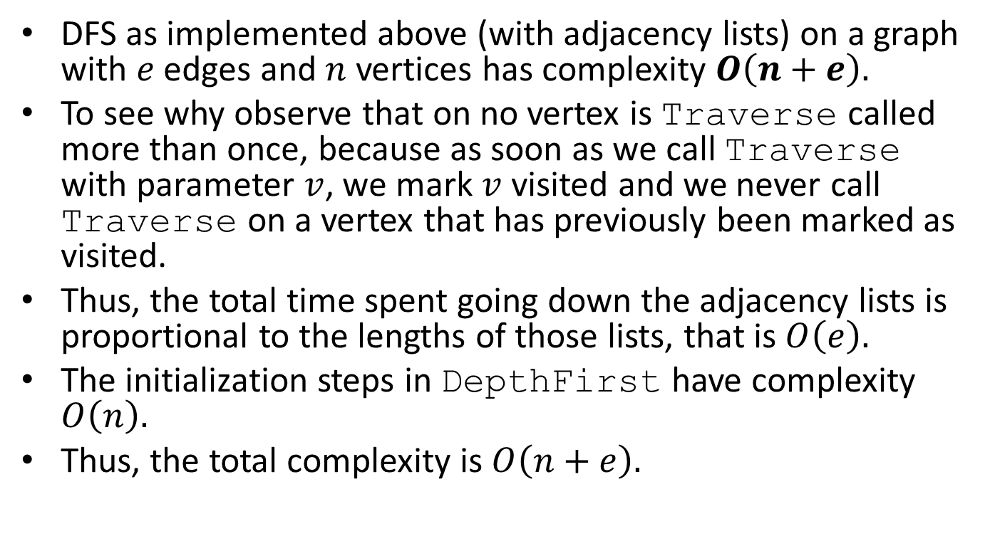
Complexity of DFS
DFS as implemented above (with adjacency lists) on a graph with $e$ edges and $n$ vertices has complexity $O\left(n+e\right).$
To see why observe that on no vertex is Traverse called more than once, because as soon as we call Traverse with parameter $v$, we mark $v$ visited and we never call Traverse on a vertex that has previously been marked as visited.
Thus, the total time spent going down the adjacency lists is proportional to the lengths of those lists, that is $O\left(e\right).$
The initialization steps in DepthFirst have complexity $O\left(n\right).$
Thus, the total complexity is $O\left(n+e\right).$

Slide 77
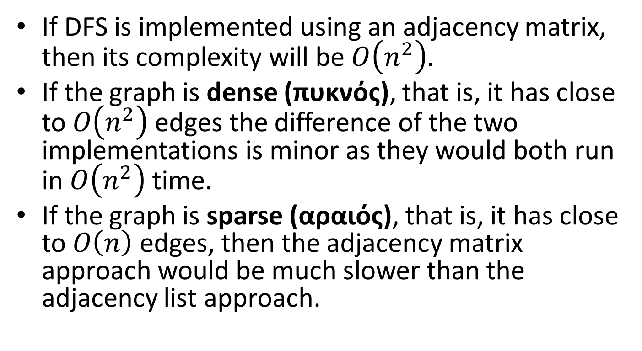
Complexity of DFS (cont’d)
If DFS is implemented using an adjacency matrix, then its complexity will be $O\left(n^{2}\right).$
If the graph is dense (πυκνός), that is, it has close to $O\left(n^{2}\right)$ edges the difference of the two implementations is minor as they would both run in $O\left(n^{2}\right)$ time.
If the graph is sparse (αραιός), that is, it has close to $O\left(n\right)$ edges, then the adjacency matrix approach would be much slower than the adjacency list approach.

Slide 78
Implementing BFS in C
Let us now show how to implement breadth-first search in C.
The algorithm BreadthFirst makes use of a queue which can be implemented using any of the implementations we presented in an earlier lecture.

Slide 79
Implementing BFS in C (cont’d)
/* BreadthFirst: breadth-first traversal of a graph
Pre: The graph G has been created
Post: The function visit has been performed at each vertex of G, where the vertices
are chosen in breadth-first order.
Uses: Queue functions */
void BreadthFirst(Graph G, void (*Visit)(Vertex))
{
Queue Q;
Boolean visited[MAXVERTEX];
Vertex v, w;
Edge *curedge;
for (v=0; v < G.n; v++)
visited[v]=FALSE;
InitializeQueue(&Q);
for (v=0; v < G.n; v++)
if (!visited[v]){
Insert(v, &Q);
do {
Remove(&Q, &v);;
if (!visited[v]){
visited[v]=TRUE;
Visit(v);
}
curedge=G.firstedge[v]; /* curedge is a pointer to the first edge (v,_) of V */
while (curedge){
w=curedge->endpoint; /* w is a successor of v and (v,w) is the current edge */
if (!visited[w]) Insert(w, &Q);
curedge=curedge->nextedge; /*curedge is a pointer to the next edge (v,_) of V */
}
} while (!Empty(&Q));
}
}

Slide 80

Complexity of BFS
BFS as implemented above (with adjacency lists) has the same complexity as DFS i.e., $O(n+e).$

Slide 81
DFS Traversal of a Directed Graph
During a depth-first traversal of a directed graph, certain edges, when traversed, lead to unvisited vertices. The edges leading to new vertices are called tree edges (ακμές δένδρου) and they form a depth-first spanning forest (πρώτα κατά βάθος δάσος επικάλυψης) for the given digraph.
There are also edges called back edges (ακμές οπισθοχώρησης) that go from a vertex to one of its ancestors in the spanning forest.
There also edges that do not belong to the spanning forest and go from a vertex to a proper descendant. These are called forward edges (ακμές προώθησης).
Finally, there are edges that go from a vertex to another vertex that is neither an ancestor nor a descendant that are called cross edges (εγκάρσιες ακμές).

Slide 82
Example
F
B
A
E
G
D
C

Slide 83
Example (cont’d)
A
E
F
G
B
C
D
Tree edges
Cross edges
Back edges
There are no forward edges

Slide 84
Classification of Edges
How do we distinguish among the four types of edges?
Tree edges are easy to find since they lead to an unvisited vertex during DFS.
Let us number the vertices of the digraph in the order in which we first mark them as visited during a depth first search. For this we can use an array dfnumber and add the code
dfnumber[v]=count;
count++;
in the function Traverse, immediately after the
statement marking a vertex as visited.
Let us call this the depth-first numbering (πρώτα κατά βάθος αρίθμηση) of a digraph.

Slide 85
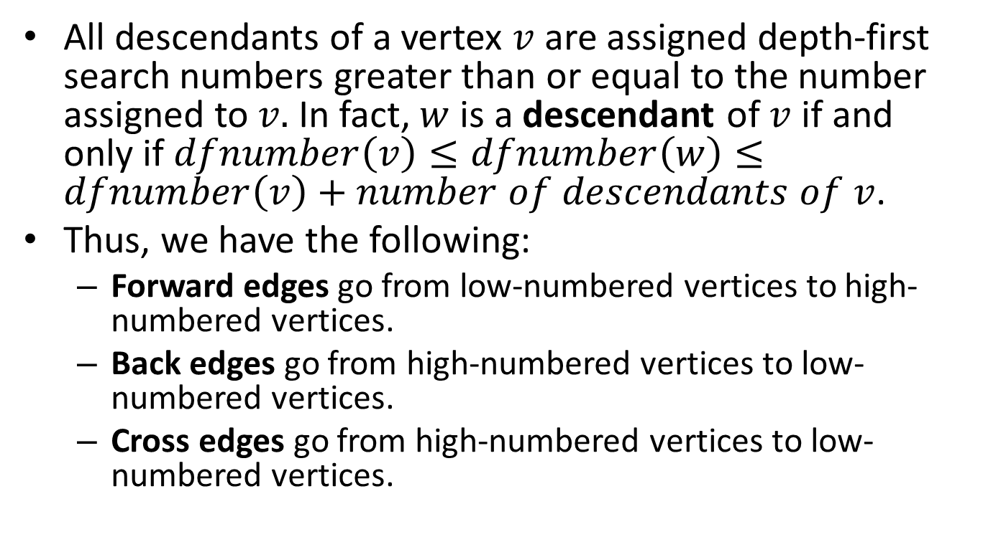
Classification of Edges (cont’d)
All descendants of a vertex $v$ are assigned depth-first search numbers greater than or equal to the number assigned to $v.$ In fact, $w$ is a descendant of $v$ if and only if $dfnumber\left(v\right)≤dfnumber\left(w\right)≤dfnumber\left(v\right)+number of descendants of v$.
Thus, we have the following:
  Forward edges go from low-numbered vertices to high-numbered vertices.
  Back edges go from high-numbered vertices to low-numbered vertices.
  Cross edges go from high-numbered vertices to low-numbered vertices.

Slide 86
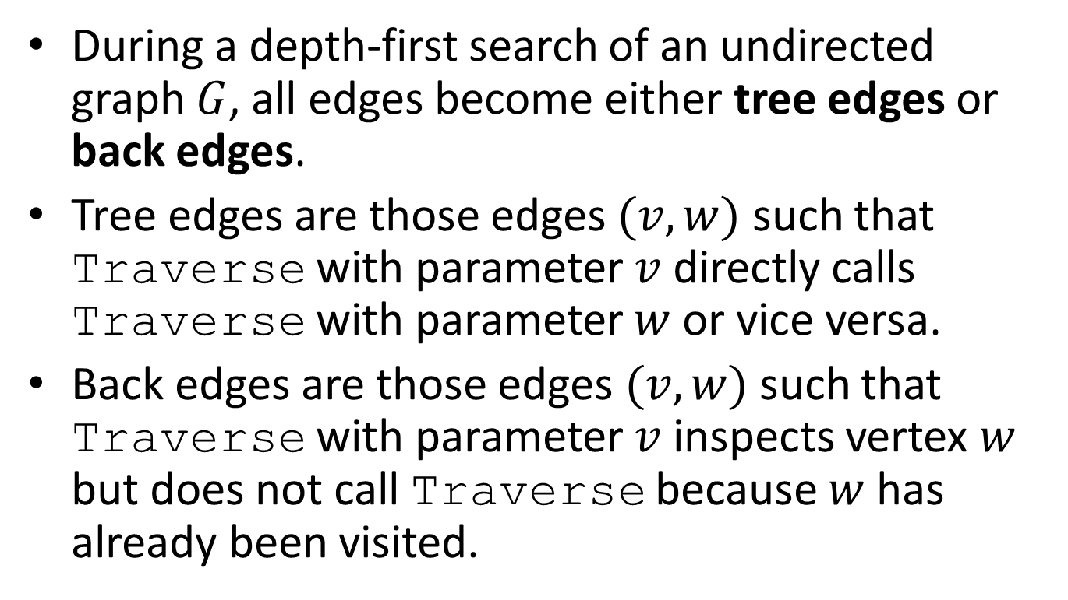
DFS of an Undirected Graph
During a depth-first search of an undirected graph $G$, all edges become either tree edges or back edges.
Tree edges are those edges $(v,w)$ such that Traverse with parameter $v$ directly calls Traverse with parameter $w$ or vice versa.
Back edges are those edges $(v,w)$ such that Traverse with parameter $v$ inspects vertex $w$ but does not call Traverse because $w$ has already been visited.

Slide 87
Example
A
B
C
F
G
D
E

Slide 88
Example (cont’d)
A
B
C
F
G
D
E
Tree edges
Back edges

Slide 89

DFS of an Undirected Graph
During a DFS of an undirected graph $G$, tree edges form a depth-first spanning forest of $G.$

Slide 90
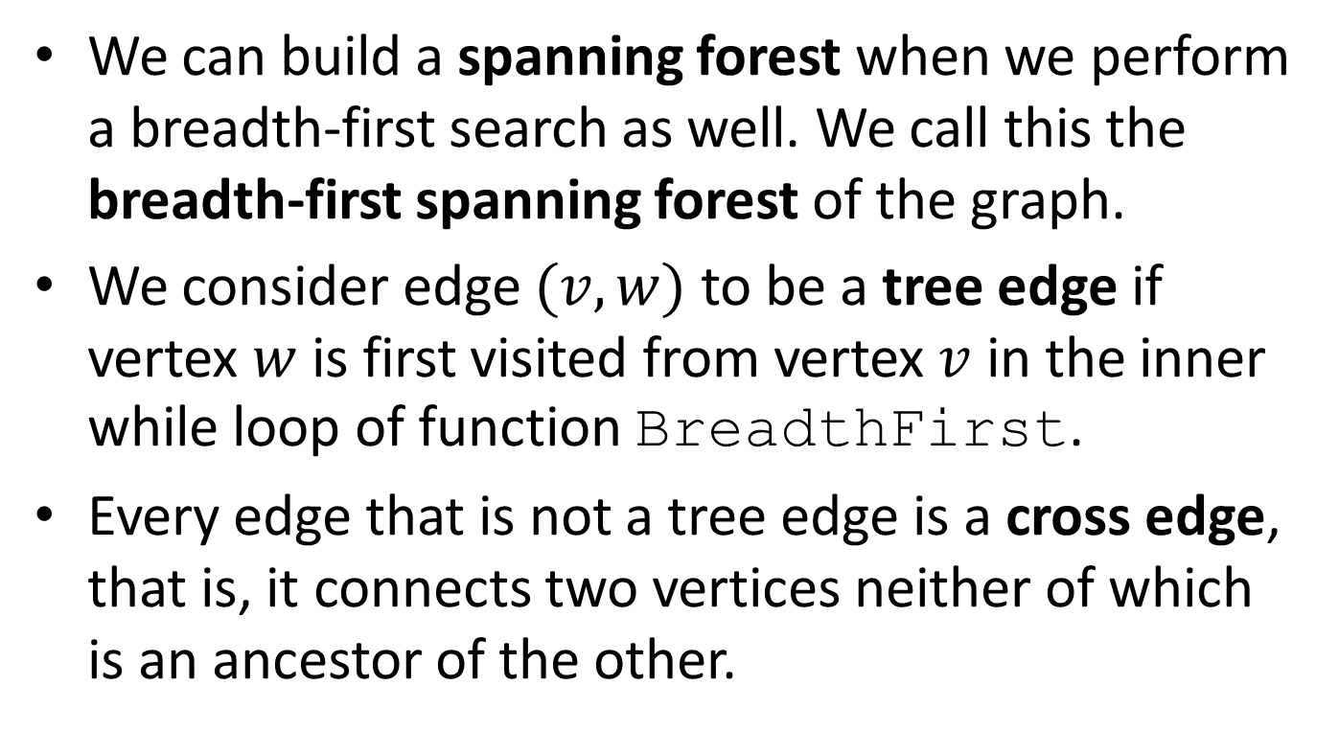
BFS of an Undirected Graph
We can build a spanning forest when we perform a breadth-first search as well. We call this the breadth-first spanning forest of the graph.
We consider edge $(v,w)$ to be a tree edge if vertex $w$ is first visited from vertex $v$ in the inner while loop of function BreadthFirst.
Every edge that is not a tree edge is a cross edge, that is, it connects two vertices neither of which is an ancestor of the other.

Slide 91
Example
A
B
C
F
G
D
E
Let us execute BFS with start node A.

Slide 92
Example (cont’d)
A
B
C
F
G
D
E
Tree edges
Cross edges

Slide 93
BFS of Directed Graphs
BFS can also work on directed graphs.
The algorithm visits vertices level by level and partitions the edges into two sets: tree edges and non-tree edges.
Tree edges define a breadth-first spanning forest.
Non-tree edges are of two kinds: back edges and cross edges.
Back edges connect a vertex to one of its ancestors. Cross edges connect a vertex to another vertex that is neither its ancestor nor its descendant.
There are no forward edges.

Slide 94
Directed Acyclic Graphs
Let G be a directed graph with no cycles. Such a graph is called acyclic. We abbreviate the term directed acyclic graph to dag.
Dags are more general than trees but less general than arbitrary directed graphs.

Slide 95
Example Tree

Slide 96
Example Dag

Slide 97
Example Dag

Slide 98
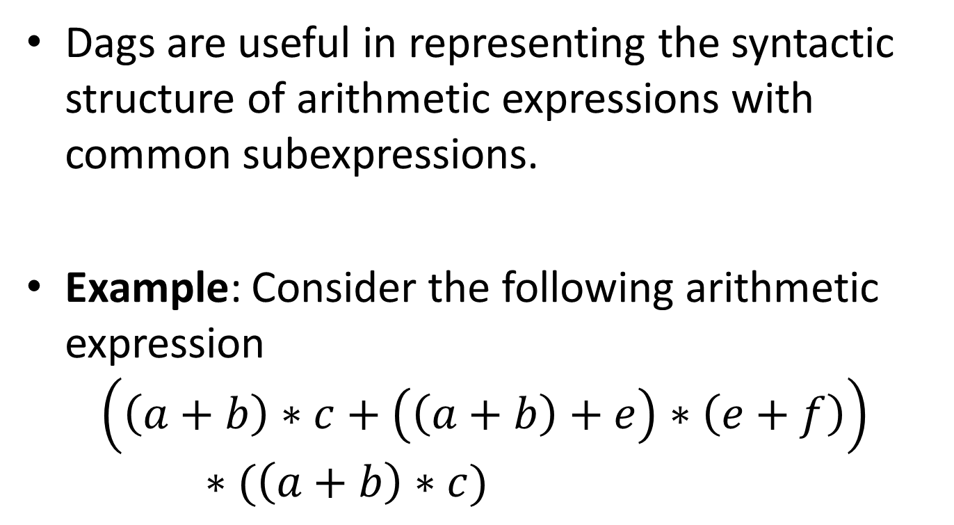
Applications of Dags
Dags are useful in representing the syntactic structure of arithmetic expressions with common subexpressions.
Example: Consider the following arithmetic expression
$$\left(\left(a+b\right)∗c+\left(\left(a+b\right)+e\right)∗\left(e+f\right)\right)∗(\left(a+b\right)∗c)$$

Slide 99
The Dag for the Example
*
+
*
*
c
+
+
+
a
b
e
f

Slide 100
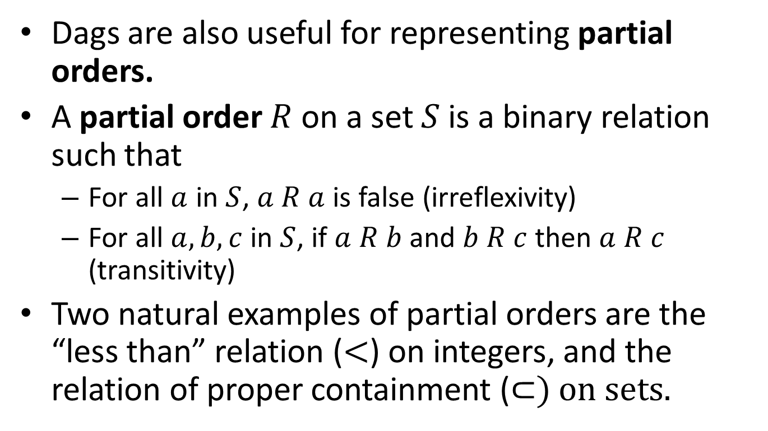
Applications of Dags
Dags are also useful for representing partial orders.
A partial order $R$ on a set $S$ is a binary relation such that
  For all $a$ in $S$, $a R a$ is false (irreflexivity)
  For all $a,b,c$ in $S$, if $a R b$ and $b R c$ then $a R c$ (transitivity)
Two natural examples of partial orders are the “less than” relation ($<$) on integers, and the relation of proper containment (⊂) on sets.

Slide 101

Example
Let $S=\left\{1, 2, 3\right\}$ and let $P(S)$ be the power set of $S$, that is, the set of all subsets of $S$. The relation ⊂ is a partial order on $S$.

Slide 102








The Dag of the Example
$$\{1,2,3\}$$
$$\{1,2\}$$
$$\{1,3\}$$
$$\{2,3\}$$
$$\{1\}$$
$$\{2\}$$
$$\{3\}$$
$$∅$$

Slide 103
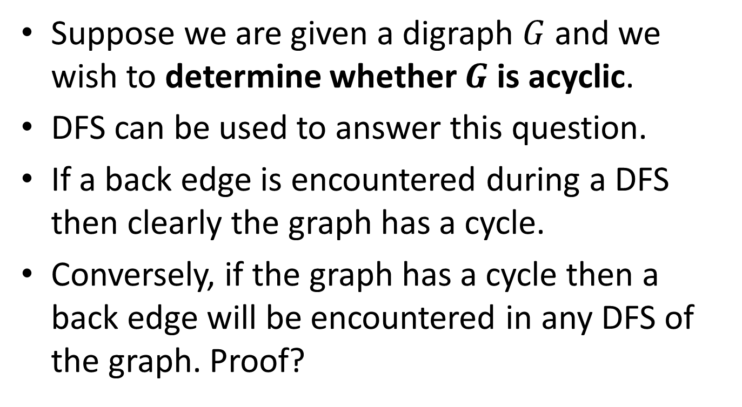
Test for Acyclicity
Suppose we are given a digraph $G$ and we wish to determine whether $G$ is acyclic.
DFS can be used to answer this question.
If a back edge is encountered during a DFS then clearly the graph has a cycle.
Conversely, if the graph has a cycle then a back edge will be encountered in any DFS of the graph. Proof?

Slide 104
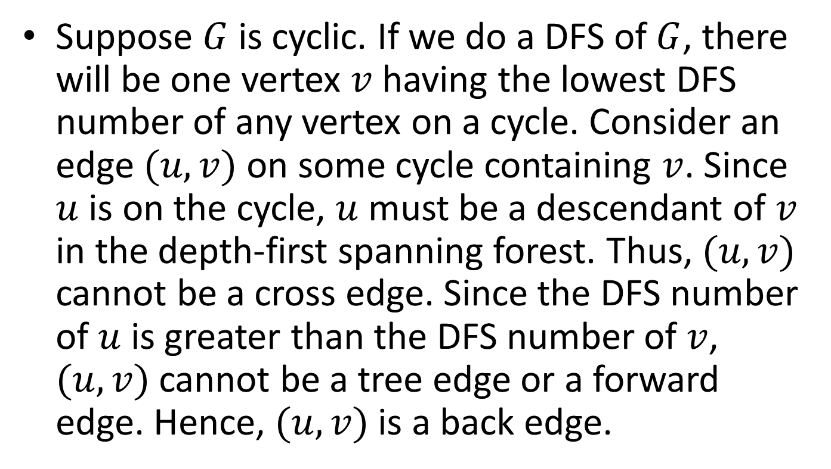
Proof
Suppose $G$ is cyclic. If we do a DFS of $G$, there will be one vertex $v$ having the lowest DFS number of any vertex on a cycle. Consider an edge $(u,v)$ on some cycle containing $v$. Since $u$ is on the cycle, $u$ must be a descendant of $v$ in the depth-first spanning forest. Thus, $(u,v)$ cannot be a cross edge. Since the DFS number of $u$ is greater than the DFS number of $v$, $(u,v)$ cannot be a tree edge or a forward edge. Hence, $(u,v)$ is a back edge.

Slide 105
Topological Ordering of a DAG
A topological ordering (τοπολογική ταξινόμηση) of the vertices of a dag G is a sequential list L of the vertices of G (a linear ordering) such that if there is a directed path from vertex A to vertex B in G, then A comes before B in the list L.

Slide 106
Example
G might be a graph in which the vertices represent university courses to take and in which an edge is directed from the vertex for course A to the vertex for course B if course A is a prerequisite of B.
Then a topological ordering of the vertices of G gives us a possible way to organize one’s studies.

Slide 107
Example
2
1
3
1
3
2
4
5
4
5
A Topological Ordering
A DAG

Slide 108
Computing a Topological Ordering
We will compute a list of vertices L that contains the vertices of G in topological order.
We will use an array D such that D[v] gives the number of predecessors p of vertex v in graph G such that p is not in L.
We will use a queue Q of vertices from where we will take vertices to process (from the front of the queue).
The vertices of G in Q will be processed in breadth-first order.
Initially Q will contain all the vertices of G with no predecessors.
When we find a vertex w of G such that D[w]==0, we see that w has all its predecessors in list L so we add w to the rear of queue Q so it can be processed.

Slide 109
Algorithm for Topological Ordering
void BreadthTopSort(Graph G, List *L)
{
Let G=(V,E) be the input graph.
Let L be a list of vertices.
Let Q be a queue of vertices.
Let D[V] be an array of vertices indexed by vertices
in V.
/* Compute the in-degrees D[x] of the vertices x
in G */
for (each vertex x in V) D[x]=0;
for (each vertex x in V){
for (each successor w in Succ(x)) D[w]++;
}

Slide 110
Algorithm for Topological Ordering (cont’d)
/* Initialize the queue Q to contain all vertices having zero in-degrees */
Initialize(&Q);
for (each vertex x in V){
if (D[x]==0) Insert(x, &Q);
}

Slide 111
Algorithm for Topological Ordering (cont’d)
/* Initialize the list L to be the empty list */
InitializeList(&L);
/* Process vertices in the queue Q until the queue becomes
empty */
while (!Empty(&Q)){
Remove(&Q,x);
AddToList(x,&L);
for (each successor w in Succ(x)){
D[w]--;
if (D[w]==0) Insert(w, &Q);
}
}
/* The list L now contains the vertices of G in
topological order */
}

Slide 112
Implementing Topological Sort in C
We first need to define a new type for an array that will be used to store the vertices of a graph in topological order:
typedef Vertex Toporder[MAXVERTEX];
We will also use the functions for the ADT queue that we have defined in a previous lecture.

Slide 113
Topological Sort in C (cont’d)
/* BreadthTopSort: generates breadth-first topological ordering
Pre: G is a directed graph with no cycles implemented with a contiguous list of vertices
and linked adjacency lists.
Post: The function makes a breadth-first traversal of G and generates the resulting
topological order in T
Uses: Queue functions */
void BreadthTopSort(Graph G, Toporder T)
{
int predecessorcount[MAXVERTEX]; /* number of predecessors of each vertex */
Queue Q;
Vertex v, succ;
Edge *curedge;
int place;
/* initialize all the predecessor counts to 0 */
for (v=0; v < G.n; v++)
predecessorcount[v]=0;
/* increase the predecessor count for each vertex that is a successor of another one */
for (v=0; v < G.n; v++)
for (curedge=G.firstedge[v]; curedge; curedge=curedge->nextedge)
predecessorcount[curedge->endpoint]++;

Slide 114
Topological Sort in C (cont’d)
/* initialize a queue */
InitializeQueue(&Q);
/* place all vertices with no predecessors into the queue */
for (v=0; v < G.n; v++)
if (predecessorcount[v]==0)
Insert(v, &Q);
/* start the breadth-first traversal */
place=-1;
while (!Empty(&Q)) {
/* visit v by placing it into the topological order */
Remove(&Q, &v);
place++;
T[place]=v;
/* traverse the list of successors of v */
for (curedge=G.firstedge[v]; curedge; curedge=curedge->nextedge){
/* reduce the predecessor count for each successor */
succ=curedge->endpoint;
predecessorcount[succ]--;
if (predecessorcount[succ]==0)
/* succ has no further predecessors, so it is ready to process */
Insert(succ, &Q);
}
}
}

Slide 115

Complexity of Topological Sort
The complexity of topological sort is again $O(n+e).$

Slide 116
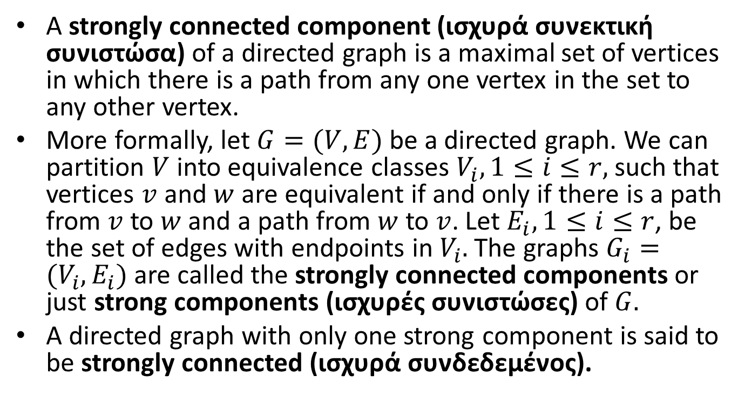
Strongly Connected Components
A strongly connected component (ισχυρά συνεκτική συνιστώσα) of a directed graph is a maximal set of vertices in which there is a path from any one vertex in the set to any other vertex.
More formally, let $G=(V,E)$ be a directed graph. We can partition $V$ into equivalence classes $V_{i}, 1≤i≤r,$ such that vertices $v$ and $w$ are equivalent if and only if there is a path from $v$ to $w$ and a path from $w$ to $v$. Let $E_{i}, 1≤i≤r$, be the set of edges with endpoints in $V_{i}.$ The graphs $G_{i}=(V_{i},E_{i})$ are called the strongly connected components or just strong components (ισχυρές συνιστώσες) of $G.$
A directed graph with only one strong component is said to be strongly connected (ισχυρά συνδεδεμένος).

Slide 117
Example Directed Graph
A
B
D
C

Slide 118
The Strong Components of the Digraph
A
B
D
C

Slide 119
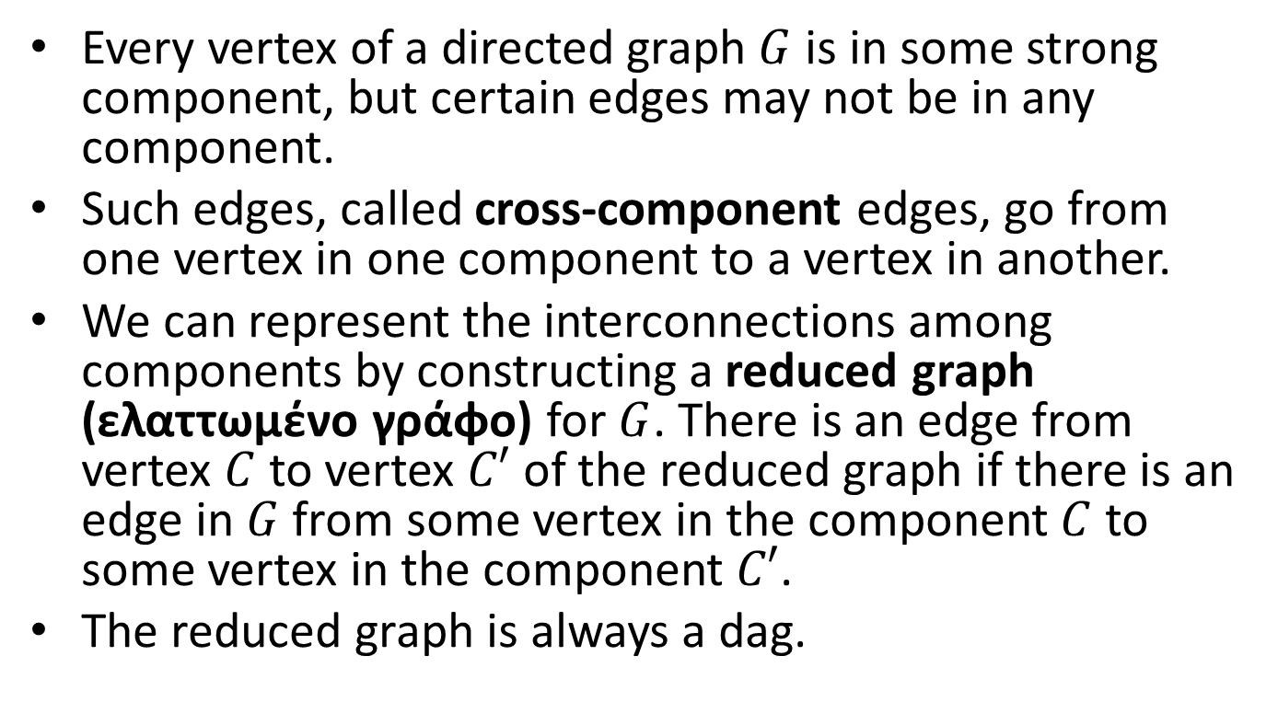
Strong Components (cont’d)
Every vertex of a directed graph $G$ is in some strong component, but certain edges may not be in any component.
Such edges, called cross-component edges, go from one vertex in one component to a vertex in another.
We can represent the interconnections among components by constructing a reduced graph (ελαττωμένο γράφο) for $G$. There is an edge from vertex $C$ to vertex $C′$ of the reduced graph if there is an edge in $G$from some vertex in the component $C$ to some vertex in the component $C′$.
The reduced graph is always a dag.

Slide 120

Example Directed Graph $G$
A
B
D
C

Slide 121
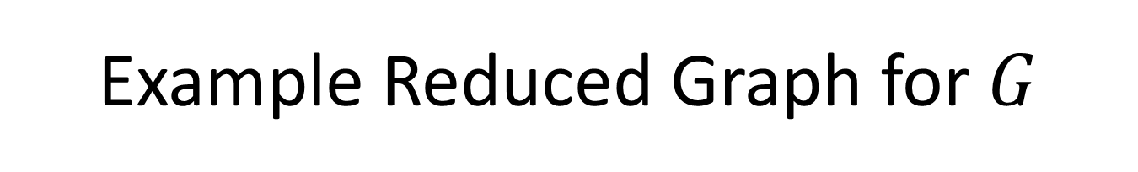
Example Reduced Graph for $G$
A, B, C
D

Slide 122
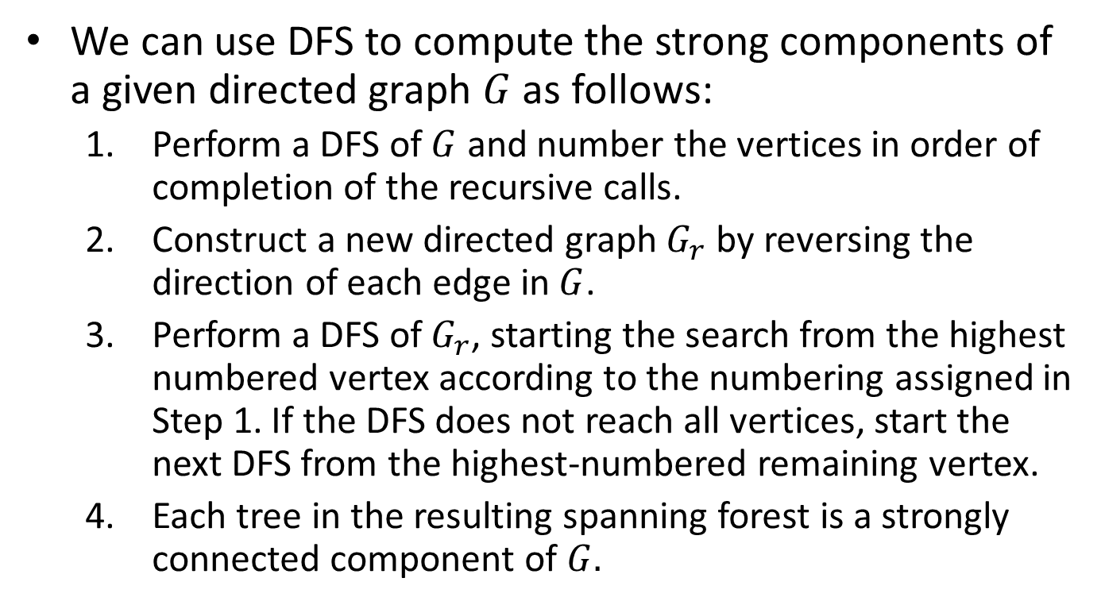
Algorithm for Computing Strong Components
We can use DFS to compute the strong components of a given directed graph $G$ as follows:
  Perform a DFS of $G$ and number the vertices in order of completion of the recursive calls.
  Construct a new directed graph $G_{r}$ by reversing the direction of each edge in $G$.
  Perform a DFS of $G_{r}$, starting the search from the highest numbered vertex according to the numbering assigned in Step 1. If the DFS does not reach all vertices, start the next DFS from the highest-numbered remaining vertex.
  Each tree in the resulting spanning forest is a strongly connected component of $G.$

Slide 123
Example Directed Graph $G$
A
B
D
C

Slide 124
After Step 1
4
A
B
3
1
D
C
2
Tree edges
Forward edges
Back edges

Slide 125

The DAG $G_{r}$
4
A
B
3
1
D
C
2

Slide 126
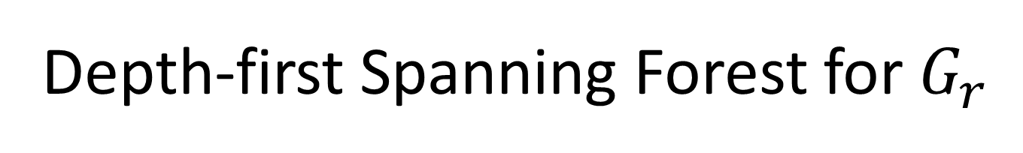
Depth-first Spanning Forest for $G_{r}$
4
A
B
3
1
D
C
2
Tree edges
Cross edges
Back edges

Slide 127
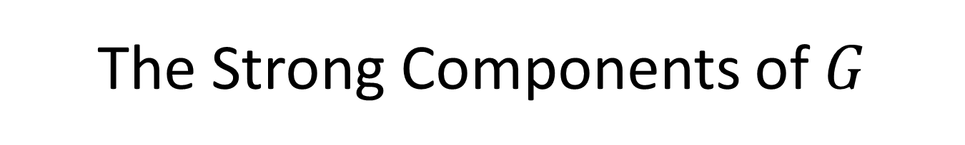
The Strong Components of $G$
A
B
D
C

Slide 128

Complexity of Algorithm for Computing Strong Components
The complexity of the algorithm we presented for computing strong components is again $O(n+e).$

Slide 129
Readings
T. A. Standish. Data Structures , Algorithms and Software Principles in C.
  Chapter 10
R. Kruse and C.L. Tondo and B. Leung. Data Structures and Program Design in C. 2nd edition.
  Chapter 11
A. V. Aho, J. E. Hopcroft and J. D. Ullman. Data Structures and Algorithms.
  Chapters 6 and 7
M. T. Goodrich, R. Tamassia and D. Mount. Data Structures and Algorithms in C++. 2nd edition.
  Chapter 13

