Slide 1
Lists and Strings
Manolis Koubarakis

Slide 2
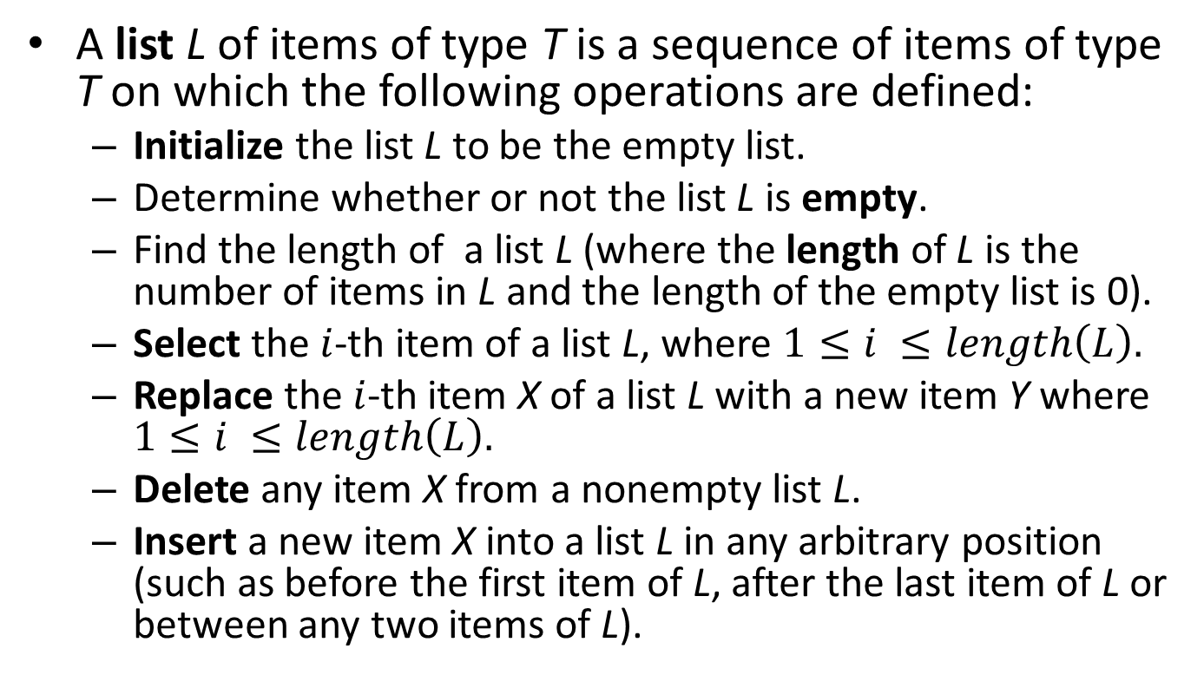
A List ADT
A list L of items of type T is a sequence of items of type T on which the following operations are defined:
  Initialize the list L to be the empty list.
  Determine whether or not the list L is empty.
  Find the length of a list L (where the length of L is the number of items in L and the length of the empty list is 0).
  Select the $i$-th item of a list L, where $1≤i ≤length\left(L\right).$
  Replace the $i$-th item X of a list L with a new item Y where $1≤i ≤length\left(L\right).$
  Delete any item X from a nonempty list L.
  Insert a new item X into a list L in any arbitrary position (such as before the first item of L, after the last item of L or between any two items of L).

Slide 3
Lists
Lists are more general kinds of containers than stacks and queues.
Lists can be represented by sequential representations and linked representations.

Slide 4
Sequential List Representations
We can use an array A[0:MaxSize-1] as we show graphically (items are stored contiguously):
FirstFree
MaxSize-1
A:
x₁
x₂
x₃
x₄

Slide 5
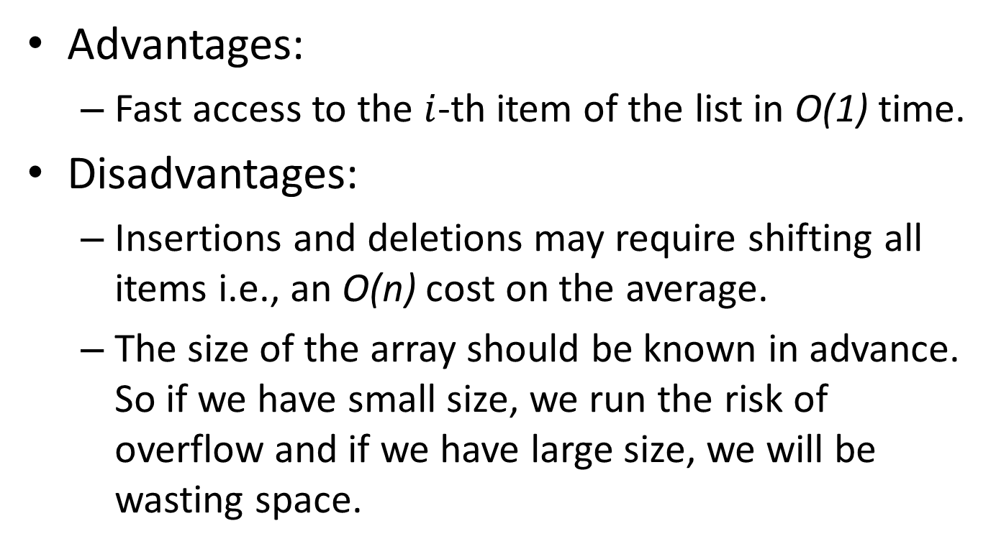
Advantages and Disadvantages
Advantages:
  Fast access to the $i$-th item of the list in O(1) time.
Disadvantages:
  Insertions and deletions may require shifting all items i.e., an O(n) cost on the average.
  The size of the array should be known in advance. So if we have small size, we run the risk of overflow and if we have large size, we will be wasting space.

Slide 6
One-Way Linked Lists Representation
We can use chains of linked nodes as shown below:
.
L:
x₁
x₂
x₃

Slide 7
Declaring Data Types for Linked Lists
The following statements declare appropriate data types for our linked lists from earlier lectures:
typedef char AirportCode[4];
typedef struct NodeTag {
AirportCode Airport;
struct NodeTag *Link;
} NodeType;
typedef NodeType *NodePointer;
We can now define variables of these datatypes:
NodePointer L;
or equivalently
NodeType *L;

Slide 8
Accessing the i^{th} Item
void PrintItem(int i, NodeType *L)
{
while ((i > 1) && (L != NULL)){
L=L->Link;
i--;
}
if ((i == 1) && (L != NULL)){
printf(“%s”, L->Item);
} else {
printf(“Error – attempt to print an item that is not on the list.\n”);
}
}

Slide 9
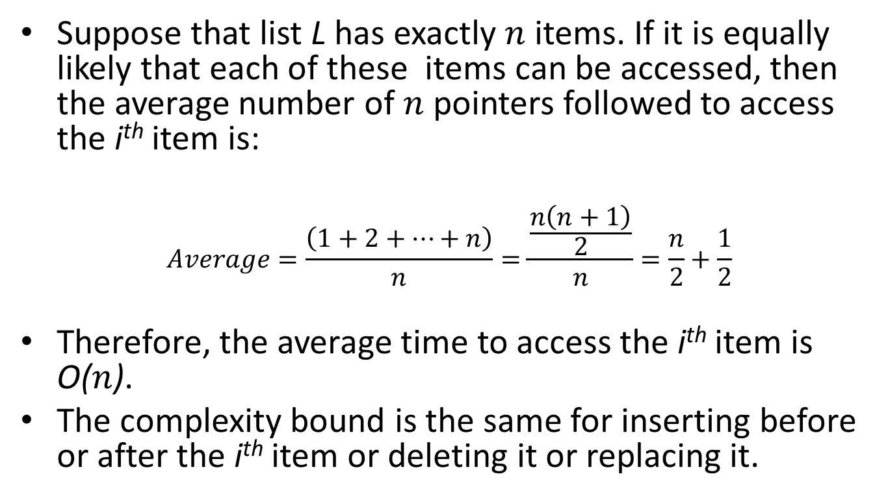
Computational Complexity
Suppose that list L has exactly $n$items. If it is equally likely that each of these items can be accessed, then the average number of $n$pointers followed to access the i^{th} item is:
$$Average=\frac{\left(1+2+⋯+n\right)}{n}=\frac{\frac{n\left(n+1\right)}{2}}{n}=\frac{n}{2}+\frac{1}{2}$$
Therefore, the average time to access the i^{th} item is O($n$).
The complexity bound is the same for inserting before or after the i^{th} item or deleting it or replacing it.

Slide 10
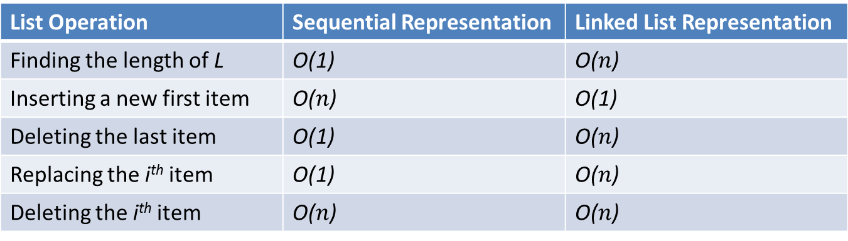
Comparing Sequential and Linked List Representations
List Operation | Sequential Representation | Linked List Representation
Finding the length of L | O(1) | O($n$)
Inserting a new first item | O($n$) | O(1)
Deleting the last item | O(1) | O($n$)
Replacing the i^{th} item | O(1) | O($n$)
Deleting the i^{th} item | O($n$) | O($n$)
The above table gives average running times. But time is not the only resource that is of interest. Space can also be an important resource in some applications.

Slide 11
Other Linked List Representations
Circular linked lists
Two-way linked lists
Linked lists with header nodes

Slide 12
Circular linked lists
A circular linked list is formed by having the link in the last node of a one-way linked list point back to the first node.
The advantage of a circular linked list is that any node on it is accessible by any other node.
L:
x₁
x₂
x₃

Slide 13
Two-Way Linked Lists
Two-way linked lists are formed from nodes that have pointers to both their right and left neighbors on the list.
.
LLink
Item
RLink
LLink
Item
RLink
LLink
Item
RLink
.
L:
x₁
x₂
x₃

Slide 14
Two-Way Linked Lists (cont’d)
Given a pointer to a node N in a two-way linked list, we can follow links in either direction to access other nodes.
We can insert a node M either before or after N starting only with the information given by the pointer to N.

Slide 15
Linked Lists with Header Nodes
Sometimes it is convenient to have a special header node that points to the first node in a linked list of item nodes.
Header Node
.
x₁
x₂
x₃
L:

Slide 16
Linked Lists with Header Nodes (cont’d)
Header nodes can be used to hold information such as the number of nodes in the list etc.

Slide 17
Generalized Lists
A generalized list is a list in which the individual list items are permitted to be sublists.
Example: (a₁, a₂, (b₁, (c₁, c₂), b₃), a₄, (d₁, d₂), a₆)
If a list item is not a sublist, it is said to be atomic.
Generalized lists can be represented by sequential or linked representations.

Slide 18
Generalized Lists (cont’d)
The generalized list L=(((1, 2, 3), 4), 5, 6, (7)) can be represented without shared sublists as follows:
L:
Atom
SL
Link
Atom
Item
Link
Atom
Item
Link
Atom
SL
Link
.
False
True
5
True
6
False
SL
Atom
Item
Link
Atom
Item
.
Atom
Link
.
Link
False
True
4
True
7
Atom
Item
Link
Atom
Item
Link
Atom
Item
Link
.
True
1
True
2
True
3

Slide 19
Generalized Lists (cont’d)
The generalized list L=(((1, 2, 3), (1, 2, 3), (2, 3), 6), 4, 5, ((2, 3), 6) can be represented with shared sublists as follows:
L:
Atom
SL
Link
Atom
Item
Link
Atom
Item
Link
Atom
SL
Link
.
False
True
4
True
5
False
SL
Link
Atom
SL
Link
Atom
SL
Link
Atom
Item
.
Atom
Link
False
True
True
6
Atom
Item
Link
Atom
Item
Link
Atom
Item
Link
.
True
1
True
2
True
3

Slide 20
A Datatype for Generalized List Nodes
typedef struct GenListTag {
GenListTag *Link;
int Atom;
union SubNodeTag {
ItemType Item;
struct GenListTag *Sublist;
} SubNode;
} GenListNode;

Slide 21
Printing Generalized Lists
void PrintList(GenListNode *L)
{
GenListNode *G;
printf(“(“);
G=L;
while (G != NULL){
if (G->Atom){
printf(“%d”, G->SubNode.Item);
} else {
printList(G->SubNode.SubList);
}
if (G->Link != NULL) printf(“,”);
G=G->Link;
}
printf(“)”);
}

Slide 22
Applications of Generalized Lists
Artificial Intelligence programming languages LISP and Prolog offer generalized lists as a language construct.
Generalized lists are often used in Artificial Intelligence applications.
More in the courses “Artificial Intelligence” and “Logic Programming”.

Slide 23
Strings
Strings are sequences of characters. They have many applications:
  Word processors
  E-mail systems
  Databases
  …

Slide 24
Strings in C
A string in C is a sequence of characters terminated by the null character “\0”.
Example: To represent a string S==“canine” in C, we allocate a block of memory B at least seven bytes long and place the characters “canine” in bytes B[0:5]. Then, in byte B[6], we place the character “\0”.

Slide 25
A String ADT
In C’s standard library you can access a collection of useful string operations by including the header file <string.h> in your program.
These functions define a predefined string ADT.

Slide 26
Examples of String Operations
Let us assume that S and T are string variables (i.e., of type char *). Then:
  strlen(S): returns the number of characters in string S (not including the terminating character ‘\0’).
  strstr(S,T): returns a pointer to the first occurrence of string S in string T (or NULL if there is no occurrence of string S in string T).
  strcat(S,T): concatenate a copy of string T to the end of string S and return a pointer to the beginning of the enlarged string S.
  strcpy(S,T): make a copy of the string T including a terminating last character ‘\0’, and store it starting at the location pointed to by the character pointer S.

Slide 27
Concatenating Two Strings
char *Concat(char *S, char *T)
{
char *P;
char *temp;
P=(char *)malloc(1+strlen(S)+strlen(T));
temp=P;
while ((*P++=*S++)!=‘\0’)
;
P--;
while ((*P++=*T++)!=‘\0’)
;
return(temp);
}

Slide 28
Readings
T. A. Standish. Data Structures, Algorithms and Software Principles in C.
Chapter 8, Sections 8.1-8.5.
Robert Sedgewick. Αλγόριθμοι σε C.
Κεφ. 3.

