Slide 1
Multi-Way Search Trees
Manolis Koubarakis

Slide 2
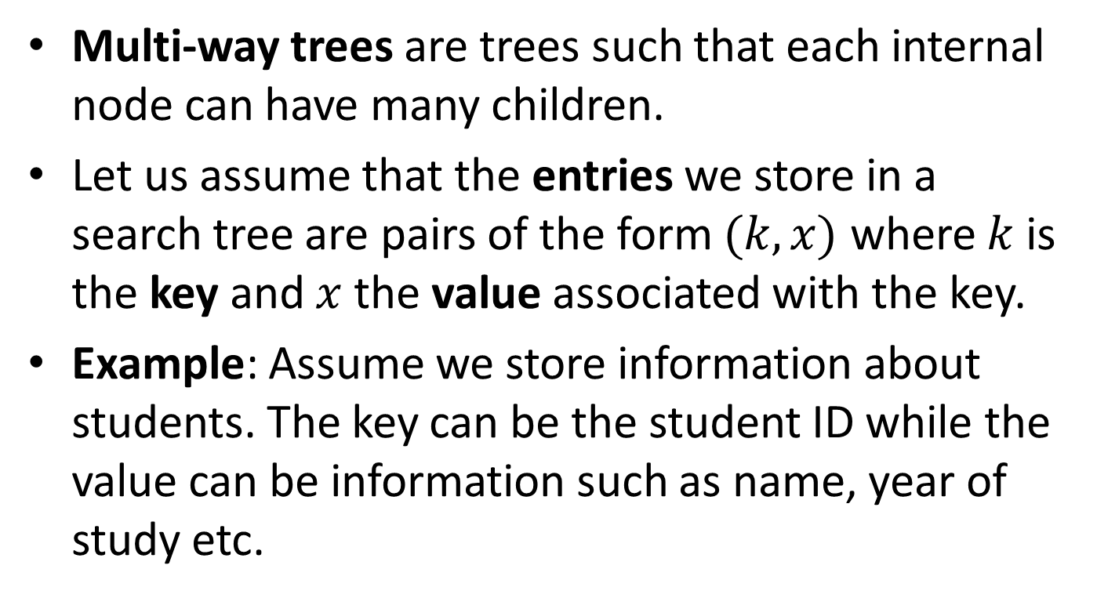
Multi-Way Search Trees
Multi-way trees are trees such that each internal node can have many children.
Let us assume that the entries we store in a search tree are pairs of the form $(k,x)$ where $k$ is the key and $x$ the value associated with the key.
Example: Assume we store information about students. The key can be the student ID while the value can be information such as name, year of study etc.

Slide 3
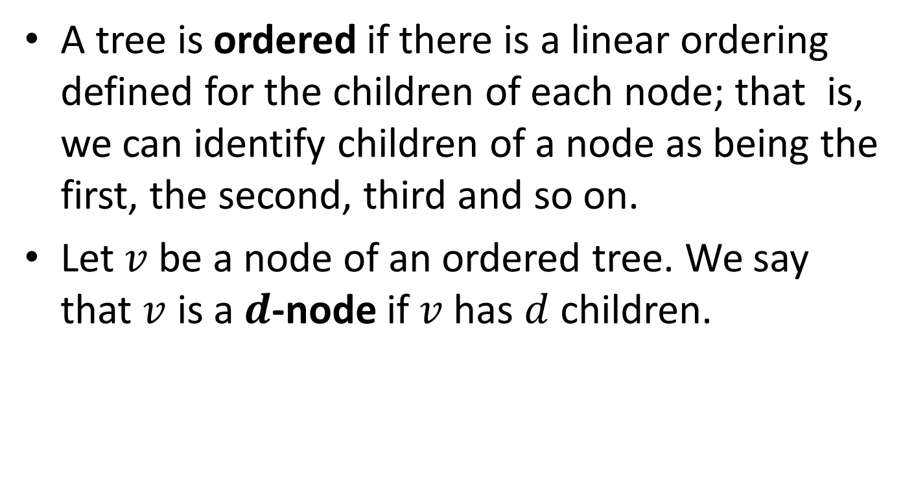
Definitions
A tree is ordered if there is a linear ordering defined for the children of each node; that is, we can identify children of a node as being the first, the second, third and so on.
Let $v$ be a node of an ordered tree. We say that $v$ is a $d$-node if $v$ has $d$ children.

Slide 4
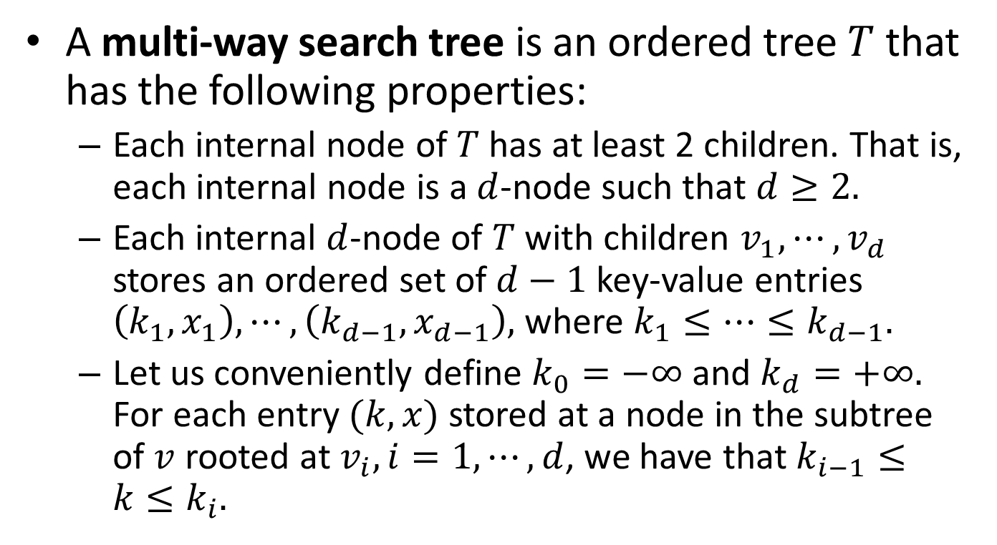
Definitions (cont’d)
A multi-way search tree is an ordered tree $T$ that has the following properties:
  Each internal node of $T$ has at least 2 children. That is, each internal node is a $d$-node such that $d≥2.$
  Each internal $d$-node of $T$ with children $v_{1},⋯,v_{d}$ stores an ordered set of $d−1$ key-value entries $\left(k_{1},x_{1}\right),⋯,\left(k_{d−1},x_{d−1}\right),$ where $k_{1}≤⋯≤k_{d−1}.$
  Let us conveniently define $k_{0}=−∞$ and $k_{d}=+∞.$ For each entry $(k,x)$ stored at a node in the subtree of $v$ rooted at $v_{i},i=1,⋯,d$, we have that $k_{i−1}≤k≤k_{i}.$

Slide 5
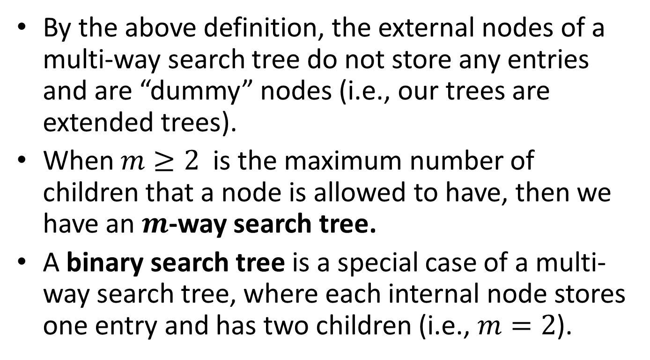
Definitions (cont’d)
By the above definition, the external nodes of a multi-way search tree do not store any entries and are “dummy” nodes (i.e., our trees are extended trees).
When $m≥2$ is the maximum number of children that a node is allowed to have, then we have an $m$-way search tree.
A binary search tree is a special case of a multi-way search tree, where each internal node stores one entry and has two children (i.e., $m=2$).

Slide 6

Example Multi-Way Search Tree ($m=3$)
22
5 10
25
3 4
6 8
14
23 24
27
11 13
17

Slide 7
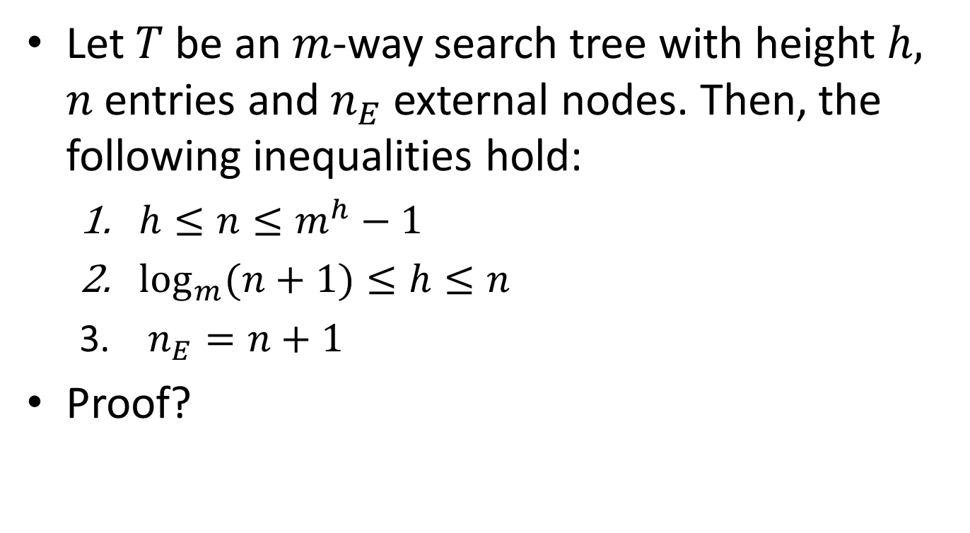
Proposition
Let $T$ be an $m$-way search tree with height $h,$ $n$ entries and $n_{E}$ external nodes. Then, the following inequalities hold:
  $h≤n≤m^{h}−1$
  $\log_{m}{(n+1)}≤h≤n$
  $n_{E}=n+1$
Proof?

Slide 8
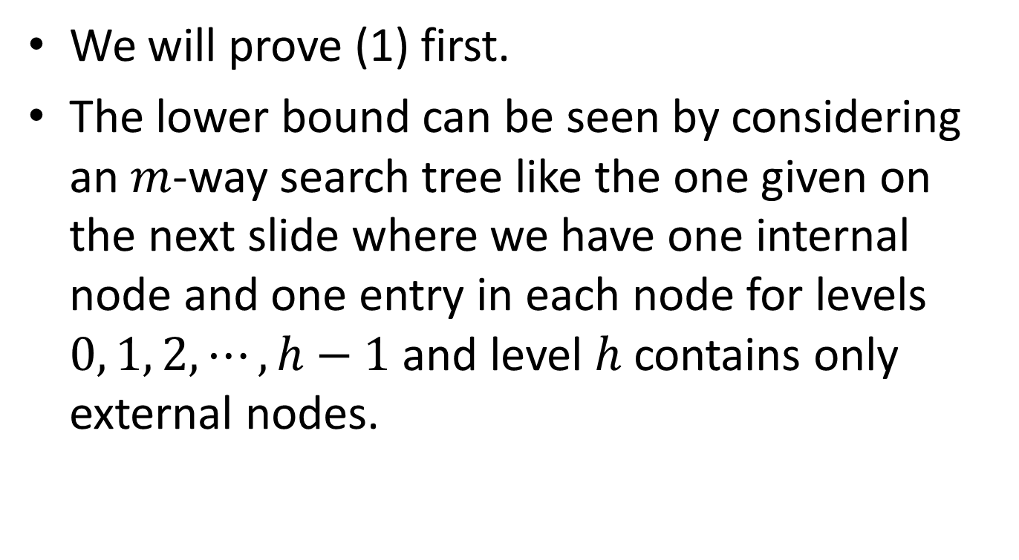
Proof
We will prove (1) first.
The lower bound can be seen by considering an $m$-way search tree like the one given on the next slide where we have one internal node and one entry in each node for levels $0, 1, 2, ⋯, h−1$ and level $h$ contains only external nodes.

Slide 9






Proof (cont’d)
$$0$$
$$1$$
$$2$$
$$⋮$$
$$h−1$$
$$h$$

Slide 10
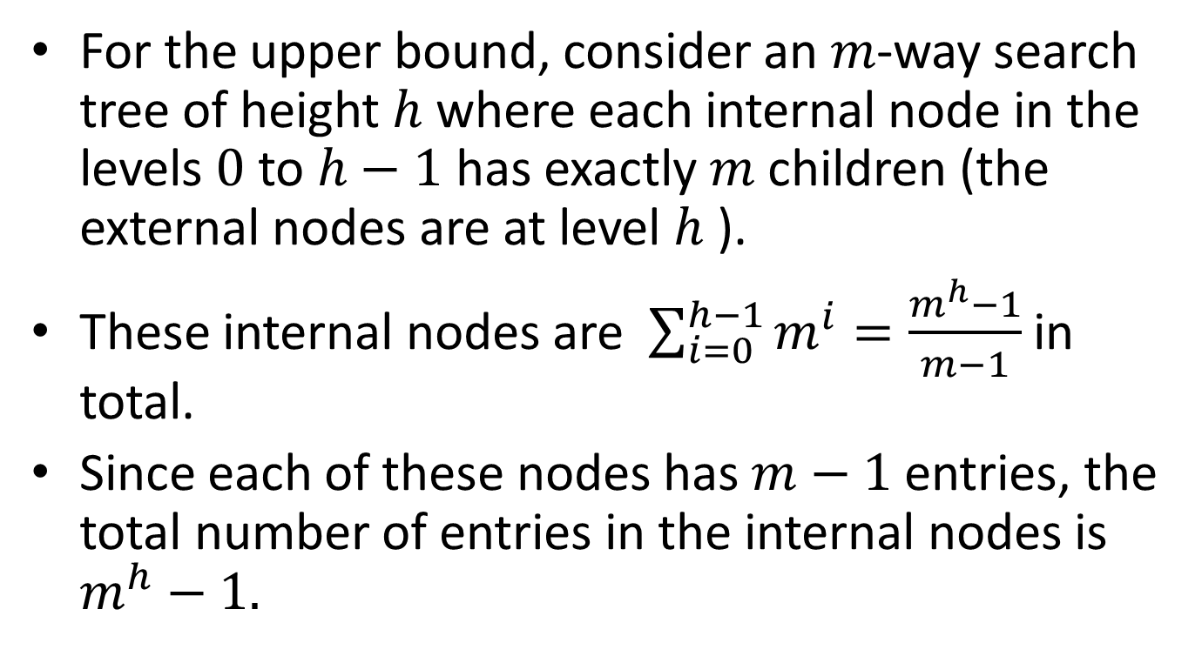
Proof (cont’d)
For the upper bound, consider an $m$-way search tree of height $h$ where each internal node in the levels $0$ to $h−1$ has exactly $m$ children (the external nodes are at level $h$ ).
These internal nodes are $\sum_{i=0}^{h−1}{m^{i}}=\frac{m^{h}−1}{m−1}$ in total.
Since each of these nodes has $m−1$ entries, the total number of entries in the internal nodes is $m^{h}−1.$

Slide 11
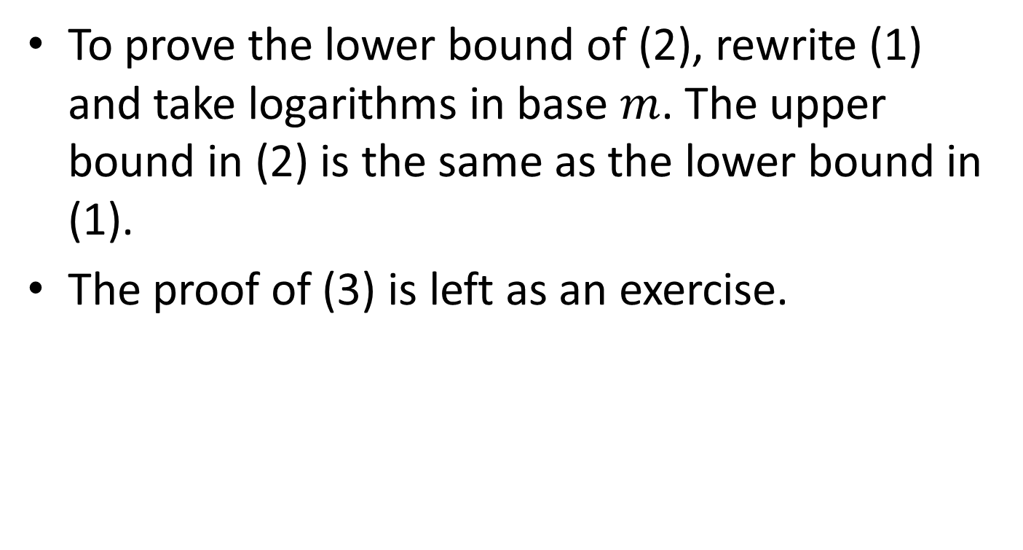
Proof (cont’d)
To prove the lower bound of (2), rewrite (1) and take logarithms in base $m$. The upper bound in (2) is the same as the lower bound in (1).
The proof of (3) is left as an exercise.

Slide 12
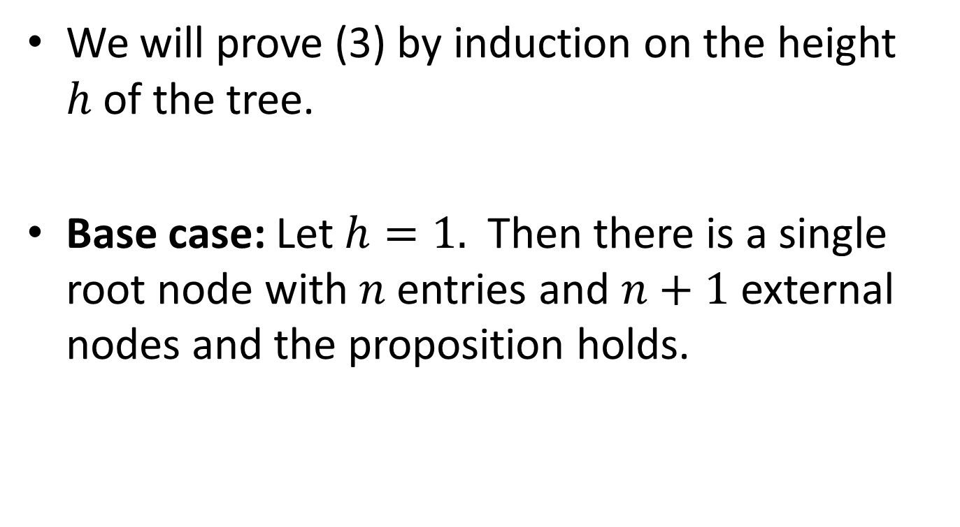
Proof (cont’d)
We will prove (3) by induction on the height $h$of the tree.
Base case: Let $h=1.$ Then there is a single root node with $n$ entries and $n+1$ external nodes and the proposition holds.

Slide 13
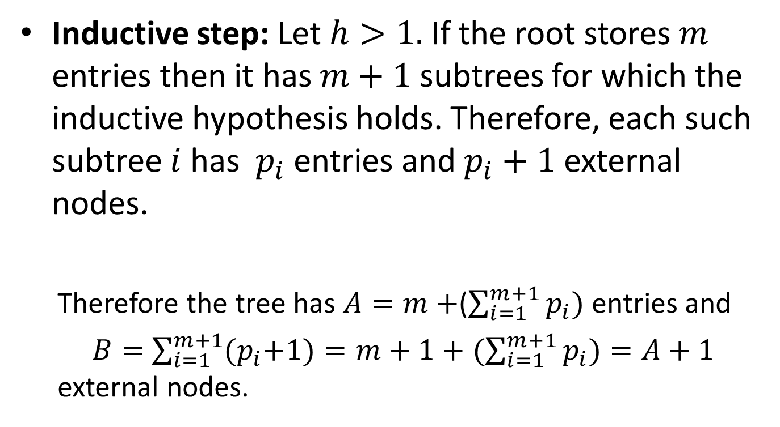
Proof (cont’d)
Inductive step: Let $h>1.$If the root stores $m$ entries then it has $m+1$ subtrees for which the inductive hypothesis holds. Therefore, each such subtree $i$has $p_{i}$ entries and $p_{i}+1$ external nodes.
  Therefore the tree has $A=m+$($\sum_{i=1}^{m+1}{p_{i})}$ entries and
  $B=$ $\sum_{i=1}^{m+1}{{(p}_{i}+1)}=m+1+$ $(\sum_{i=1}^{m+1}{p_{i})}=A+1$ external nodes.

Slide 14
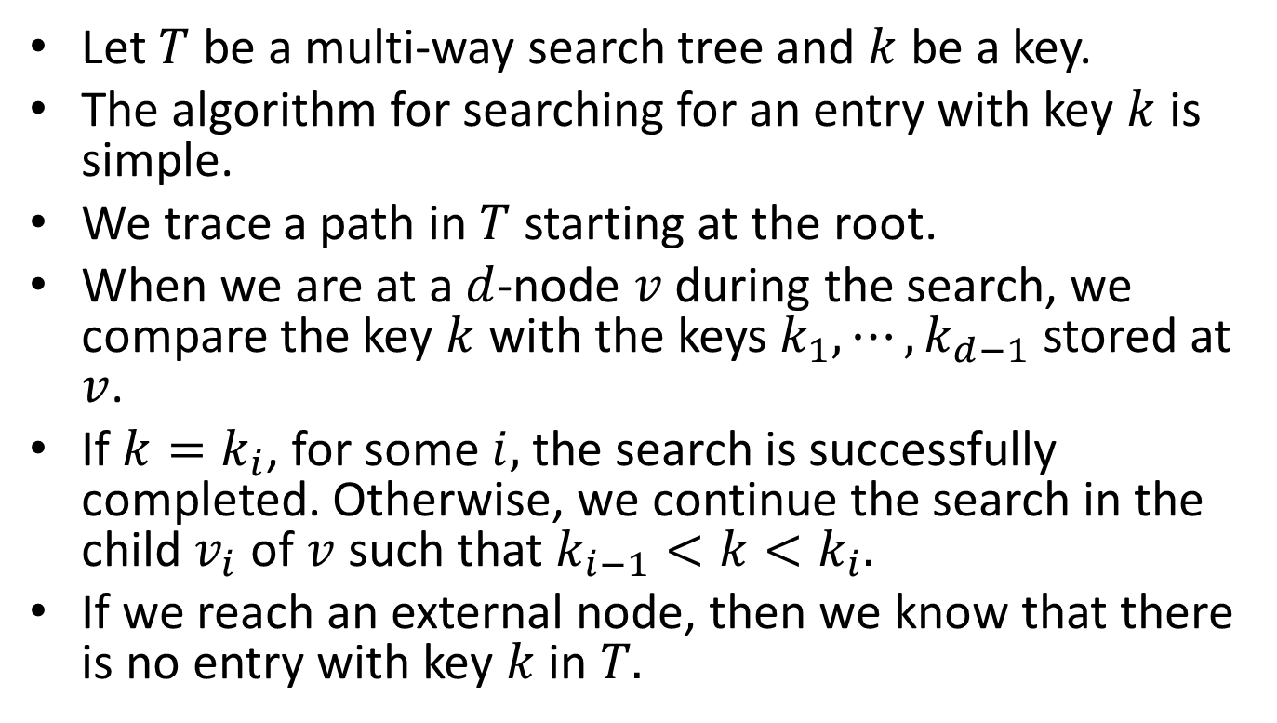
Searching in a Multi-Way Search Tree
Let $T$ be a multi-way search tree and $k$ be a key.
The algorithm for searching for an entry with key $k$ is simple.
We trace a path in $T$ starting at the root.
When we are at a $d$-node $v$ during the search, we compare the key $k$ with the keys $k_{1},⋯,k_{d−1}$ stored at $v$.
If $k=k_{i}$, for some $i,$ the search is successfully completed. Otherwise, we continue the search in the child $v_{i}$ of $v$ such that $k_{i−1}<k<k_{i}.$
If we reach an external node, then we know that there is no entry with key $k$ in $T.$

Slide 15
Example Multi-Way Search Tree
22
5 10
25
3 4
6 8
14
23 24
27
11 13
17

Slide 16
Search for Key 12
22
5 10
25
3 4
6 8
14
23 24
27
11 13
17
Unsuccessful search

Slide 17
Search for Key 24
22
5 10
25
3 4
6 8
14
23 24
27
Successful search
11 13
17

Slide 18
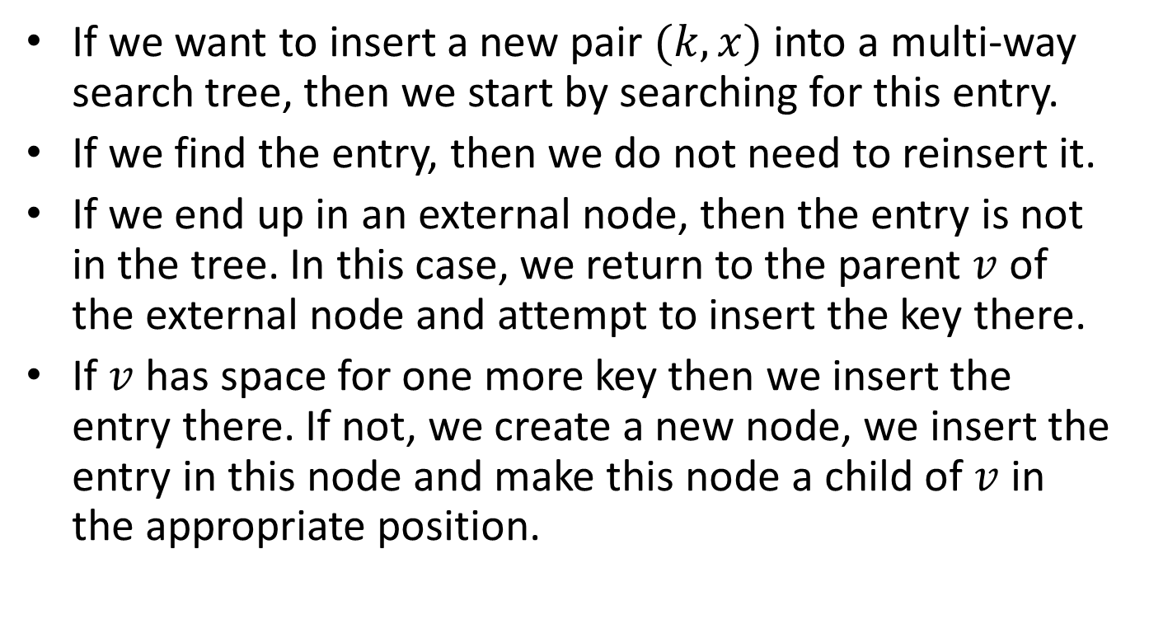
Insertion in a Multi-Way Search Tree
If we want to insert a new pair $(k,x)$ into a multi-way search tree, then we start by searching for this entry.
If we find the entry, then we do not need to reinsert it.
If we end up in an external node, then the entry is not in the tree. In this case, we return to the parent $v$ of the external node and attempt to insert the key there.
If $v$ has space for one more key then we insert the entry there. If not, we create a new node, we insert the entry in this node and make this node a child of $v$ in the appropriate position.

Slide 19

Insert Key 28 ($m=3$)
22
5 10
25
3 4
6 8
14
23 24
27
Unsuccessful search
11 13
17

Slide 20
Key 28 Inserted
22
5 10
25
3 4
6 8
14
23 24
27 28
11 13
17

Slide 21
Insert Key 32
22
5 10
25
3 4
6 8
14
23 24
27 28
Unsuccessful search
11 13
17

Slide 22
Key 32 Inserted
22
5 10
25
3 4
6 8
14
23 24
27 28
11 13
17
32

Slide 23
Insert Key 12
22
5 10
25
3 4
6 8
14
23 24
27 28
11 13
17
32
Unsuccessful Search

Slide 24
Key 12 Inserted
22
5 10
25
3 4
6 8
14
23 24
27 28
11 13
17
32
12

Slide 25
Deletion from a Multi-Way Search Tree
The algorithm for deletion from a multi-way search tree is left as an exercise.

Slide 26
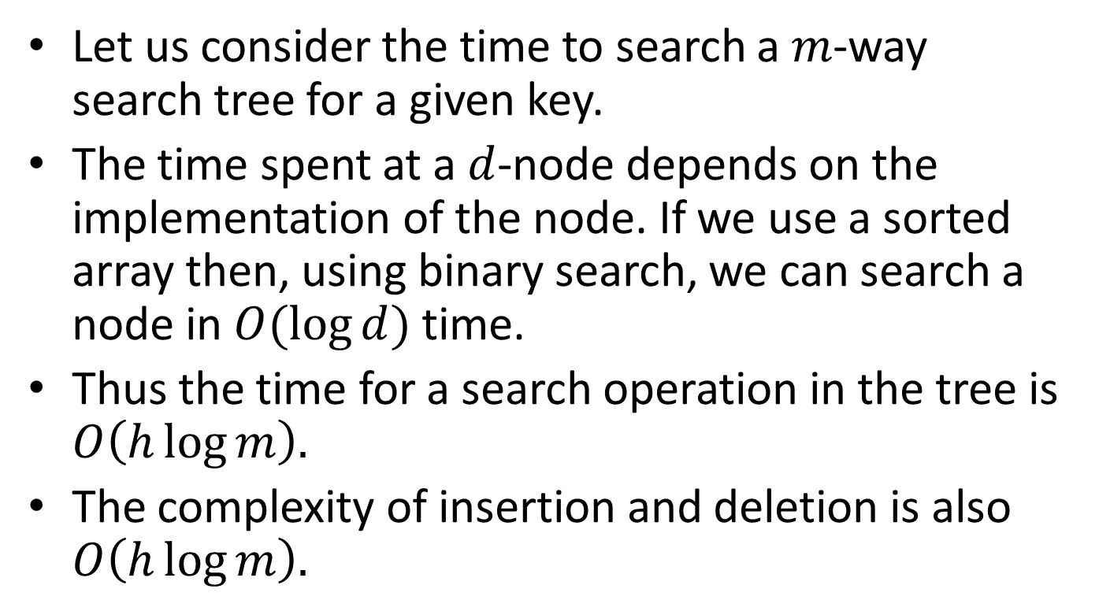
Complexity of Operations
Let us consider the time to search a $m$-way search tree for a given key.
The time spent at a $d$-node depends on the implementation of the node. If we use a sorted array then, using binary search, we can search a node in $O(\log{d})$ time.
Thus the time for a search operation in the tree is $O\left(h\log{m}\right).$
The complexity of insertion and deletion is also $O\left(h\log{m}\right).$

Slide 27
Efficiency Considerations
We know that maintaining perfect balance in binary search trees yields shortest average search paths, but the attempts to maintain perfect balance when we insert or delete nodes can incur costly rebalancing in which every node of the tree needs to be rearranged.
AVL trees showed us one way to solve this problem by abandoning the goal of perfect balance and adopt the goal of keeping the trees “almost balanced”.

Slide 28
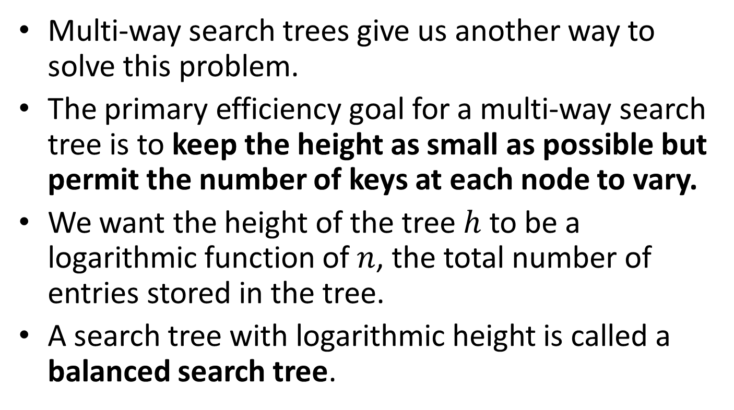
Efficiency Considerations (cont’d)
Multi-way search trees give us another way to solve this problem.
The primary efficiency goal for a multi-way search tree is to keep the height as small as possible but permit the number of keys at each node to vary.
We want the height of the tree $h$ to be a logarithmic function of $n$, the total number of entries stored in the tree.
A search tree with logarithmic height is called a balanced search tree.

Slide 29
Balanced Multi-way Search Trees
We will study two kinds of balanced multi-way search trees:
  2-3 trees
  2-3-4 trees or (2,4) trees.

Slide 30
2-3 Trees
A 2-3 tree is a multi-way search tree which has the following properties:
Size property: Each internal node contains one or two entries, and has either two or three children.
Depth property: All leaves of the tree are empty trees that have the same depth (lie on a single bottom level).

Slide 31
Example of 2-3 Tree
H
D
J
N
A
E
F
I
K
L
O
P

Slide 32
Searching in 2-3 Trees
To search for the key L, for example, we start at the root and since L > H, we follow the pointer to the right subtree of the root node.
Now we note that L lies between J and N, so we follow the middle pointer between the nodes J and N to the node containing the keys K and L.
L is found and the search terminates.

Slide 33
Search for Key L
H
D
J
N
A
E
F
I
K
L
O
P

Slide 34
Insertion of New Keys
Suppose we want to insert the new key B into the tree.
Since B<H, we follow the left pointer from the root node to the node containing D in the second row.
Then we follow the left pointer of D’s node to the node containing A.
Since B>A, we follow the right pointer of A’s node which lead us to an empty tree (an external node).
Then we go back to the parent of the external node and try to store the new key there.
The node containing A has room for one more key so we store key B there. We also add a new empty child to this node.

Slide 35
Example: Insert B
H
D
J
N
A
E
F
I
K
L
O
P

Slide 36
Example: Insert B
H
D
J
N
A
E
F
I
K
L
O
P

Slide 37
Example: Result
H
D
J
N
A
B
E
F
I
K
L
O
P

Slide 38
Insertion of New Keys (cont’d)
Let us now insert key M. This leads to the attempt to add M to the node containing K and L which now overflows with keys K, L and M.
The strategy for such cases is to split the overflowed node into two nodes and pass the middle key to the parent.
Hence we split the overflowed node into two new nodes containing K and M respectively.
We also pass the middle key L to the parent node containing J and N.

Slide 39
Insertion of New Keys (cont’d)
The attempt to add L to this parent node results in a new overflowed node in which the key L lies between keys J and N.
So we split this parent node into new nodes containing J and N respectively, and we pass the middle key L up to the root.
The root has room for L so we store it there.

Slide 40
Example: Insert M
H
D
J
N
A
B
E
F
I
K
L
O
P

Slide 41
Example: Insert M (cont’d)
H
D
J
N
A
B
E
F
I
K
L
O
P
M overflows
this node

Slide 42
Example: Insert M (cont’d)
H
D
J
N
L
A
B
E
F
I
M
O
P
K
The node is split in two and L is passed to the parent node

Slide 43
Example: Insert M (cont’d)
H
L overflows
this node
D
J
N
L
A
B
E
F
I
M
O
P
K

Slide 44
Example: Insert M (cont’d)
H
L
The node is split in two and L is passed
up to the parent
D
J
N
A
B
E
F
I
M
O
P
K

Slide 45
Example: Result
L is inserted in the root node
H
L
D
J
N
A
B
E
F
I
M
O
P
K

Slide 46
Insertion of New Keys (cont’d)
Let us now insert key Q. Q should be entered in the node containing O and P which now overflows.
Thus, this node is split up to two nodes one containing O and the other containing R, and the middle key is passed up towards the parent node.
The parent node has only key N so there is space for P and it is inserted there.

Slide 47
Example: Insert Q
H
L
D
J
N
A
B
E
F
I
M
O
P
K
Q overflows this node

Slide 48
Example: Insert Q (cont’d)
H
L
D
J
N
P
P
A
B
E
F
I
K
M
O
Q
This node is split up and P is passed up

Slide 49
Example: Result
H
L
D
J
N
P
P
A
B
E
F
I
K
M
O
Q

Slide 50
Insertion of New Keys (cont’d)
Let us now insert key R. R is inserted in the node with Q where there is space.

Slide 51
Example: Insert R
H
L
D
J
N
P
P
A
B
E
F
I
K
M
O
Q
R

Slide 52
Inserting New Keys (cont’d)
Let us now insert key S. S should be inserted in the node with Q and R.
This node overflows. Thus, it is split into two nodes one containing Q and the other containing S and R is passed up to the parent node.
R now oveflows this node where N and P are also stored. Thus, this node is split into two nodes one containing N and the other containing R and the middle key P is sent up to the parent (the root).

Slide 53
Inserting New Keys (cont’d)
The root now overflows with the addition of P so it is split into two nodes one containing H and the other containing P and the middle key L is used to create a new root.
Thus, we have added one more level to the tree.

Slide 54
Example: Insert S
H
L
D
J
N
P
P
A
B
E
F
I
K
M
O
Q
R
S overflows this node

Slide 55
Example: Insert S (cont’d)
H
L
D
J
N
P
R
A
B
E
F
I
K
O
Q
S
M
This node is split
and R is sent up

Slide 56
Example: Insert S (cont’d)
H
L
R overflows this
node
D
J
N
P
R
A
B
E
F
I
K
O
Q
S
M

Slide 57
Example: Insert S (cont’d)
P
H
L
This node is split up
and P is sent up
D
J
N
R
A
B
E
F
I
K
O
Q
S
M

Slide 58
Example: Insert S (cont’d)
P overflows the root
P
H
L
D
J
N
R
A
B
E
F
I
K
O
Q
S
M

Slide 59
Example: Result
The root splits and
L becomes the new root
L
H
P
D
J
N
R
A
B
E
F
I
K
O
Q
S
M

Slide 60
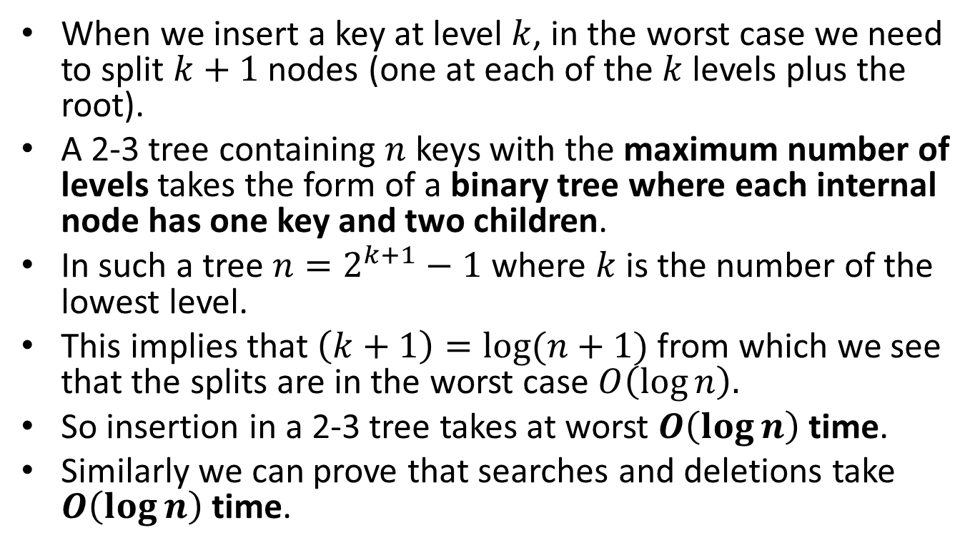
Complexity of Insertion in 2-3 Trees
When we insert a key at level $k$, in the worst case we need to split $k+1$ nodes (one at each of the $k$ levels plus the root).
A 2-3 tree containing $n$ keys with the maximum number of levels takes the form of a binary tree where each internal node has one key and two children.
In such a tree $n=2^{k+1}−1$ where $k$ is the number of the lowest level.
This implies that $\left(k+1\right)=\log{(n+1)}$ from which we see that the splits are in the worst case $O\left(\log{n}\right).$
So insertion in a 2-3 tree takes at worst $O\left(\log{n}\right)$ time.
Similarly we can prove that searches and deletions take $O\left(\log{n}\right)$ time.

Slide 61
(2,4) Trees
A (2,4) tree or 2-3-4 tree is a multi-way search tree which has the following two properties:
  Size property: Every internal node contains at least one and at most three keys, and has at least two and at most four children.
  Depth property: All the external nodes are empty trees that have the same depth (lie on a single bottom level).

Slide 62
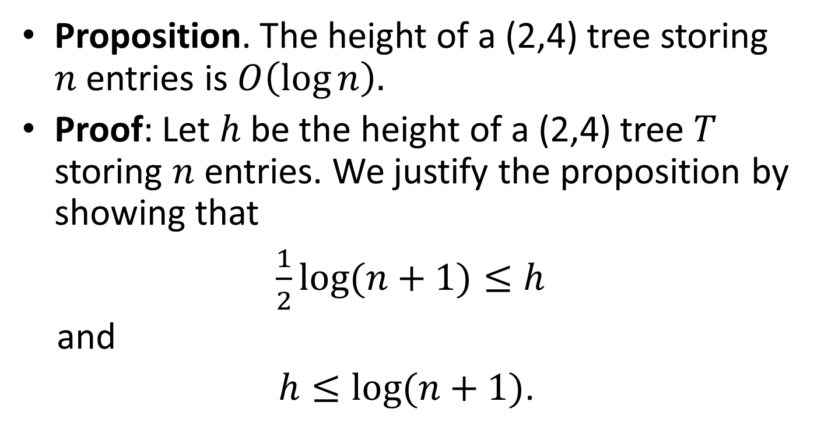
Result
Proposition. The height of a (2,4) tree storing $n$ entries is $O\left(\log{n}\right).$
Proof: Let $h$ be the height of a (2,4) tree $T$ storing $n$ entries. We justify the proposition by showing that
$\frac{1}{2}\log{(n+1)}≤h$
and
$h≤\log{(n+1)}$.

Slide 63
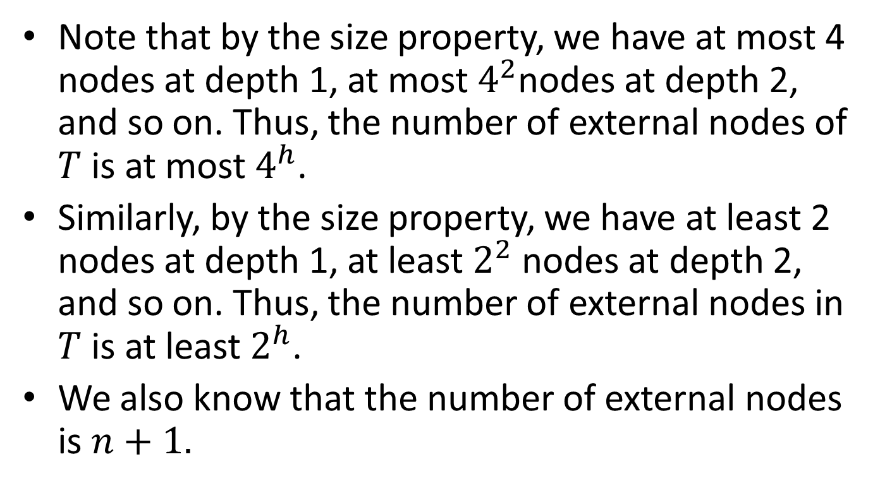
Result (cont’d)
Note that by the size property, we have at most 4 nodes at depth 1, at most $4^{2}$nodes at depth 2, and so on. Thus, the number of external nodes of $T$ is at most $4^{h}$.
Similarly, by the size property, we have at least 2 nodes at depth 1, at least $2^{2}$ nodes at depth 2, and so on. Thus, the number of external nodes in $T$ is at least $2^{h}$.
We also know that the number of external nodes is $n+1.$

Slide 64
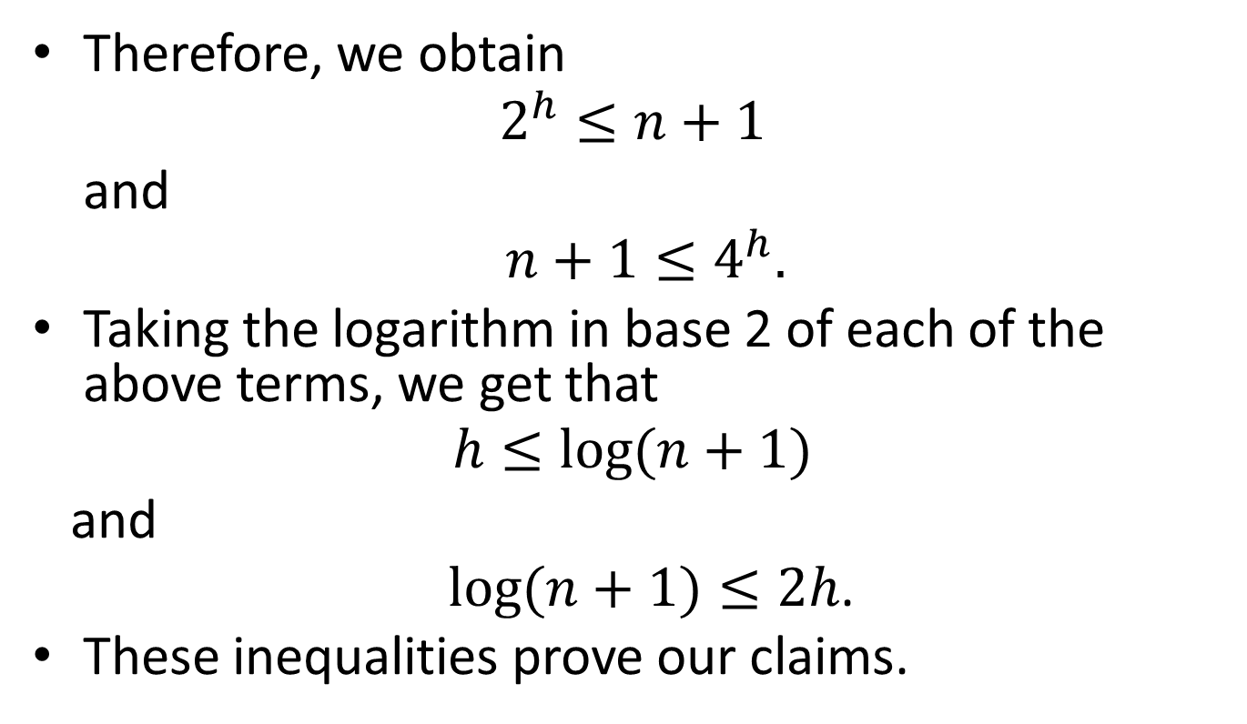
Result (cont’d)
Therefore, we obtain
$$2^{h}≤n+1$$
and
$n+1≤4^{h}.$
Taking the logarithm in base 2 of each of the above terms, we get that
$$h≤\log{(n+1)}$$
and
$\log{(n+1)}≤2h$.
These inequalities prove our claims.

Slide 65
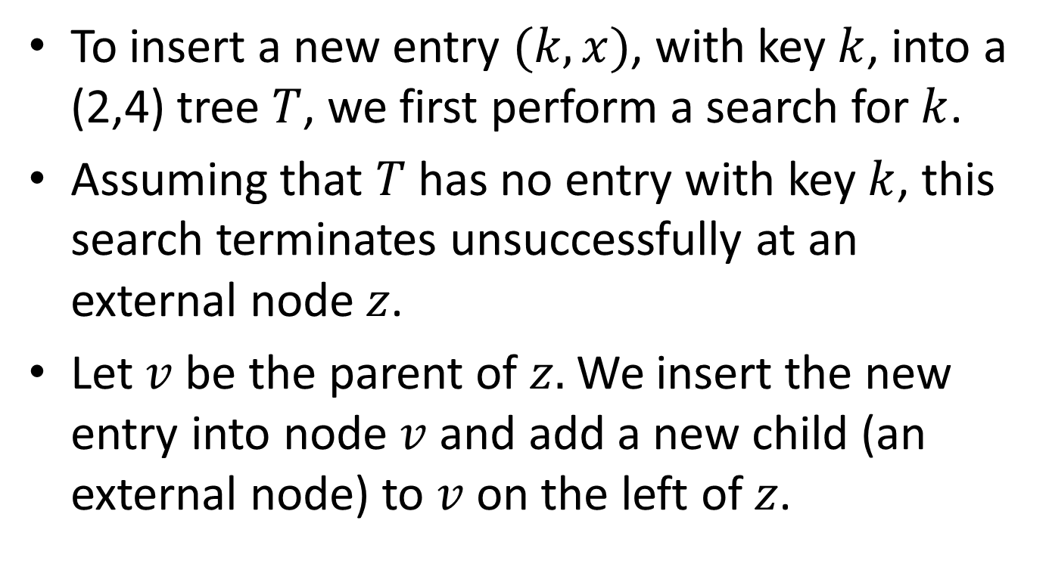
Insertion in (2,4) Trees
To insert a new entry $(k,x)$, with key $k$, into a (2,4) tree $T$, we first perform a search for $k$.
Assuming that $T$ has no entry with key $k$, this search terminates unsuccessfully at an external node $z$.
Let $v$ be the parent of $z.$We insert the new entry into node $v$ and add a new child (an external node) to $v$ on the left of $z$.

Slide 66
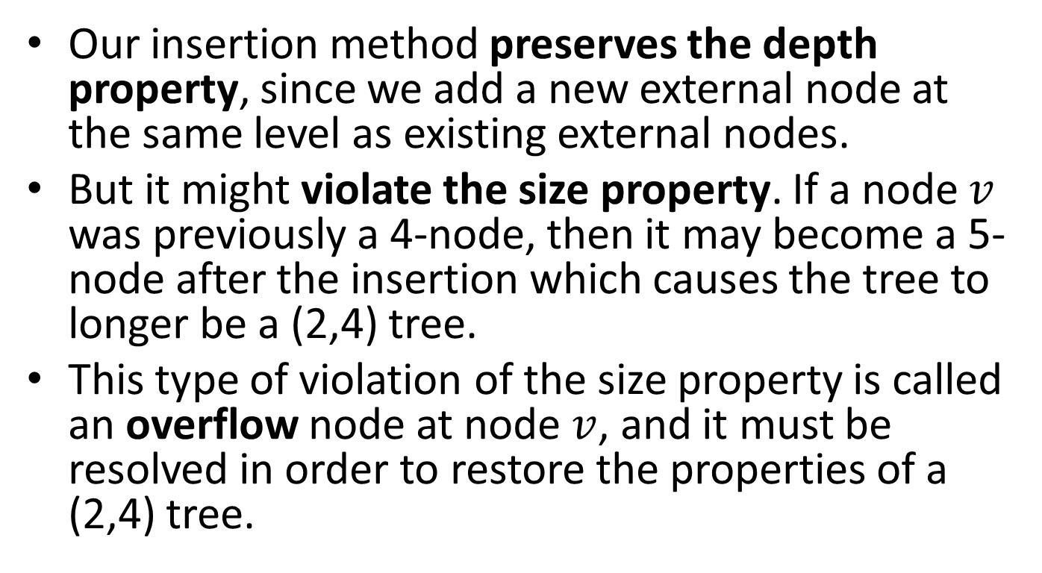
Insertion (cont’d)
Our insertion method preserves the depth property, since we add a new external node at the same level as existing external nodes.
But it might violate the size property. If a node $v$ was previously a 4-node, then it may become a 5-node after the insertion which causes the tree to longer be a (2,4) tree.
This type of violation of the size property is called an overflow node at node $v$, and it must be resolved in order to restore the properties of a (2,4) tree.

Slide 67
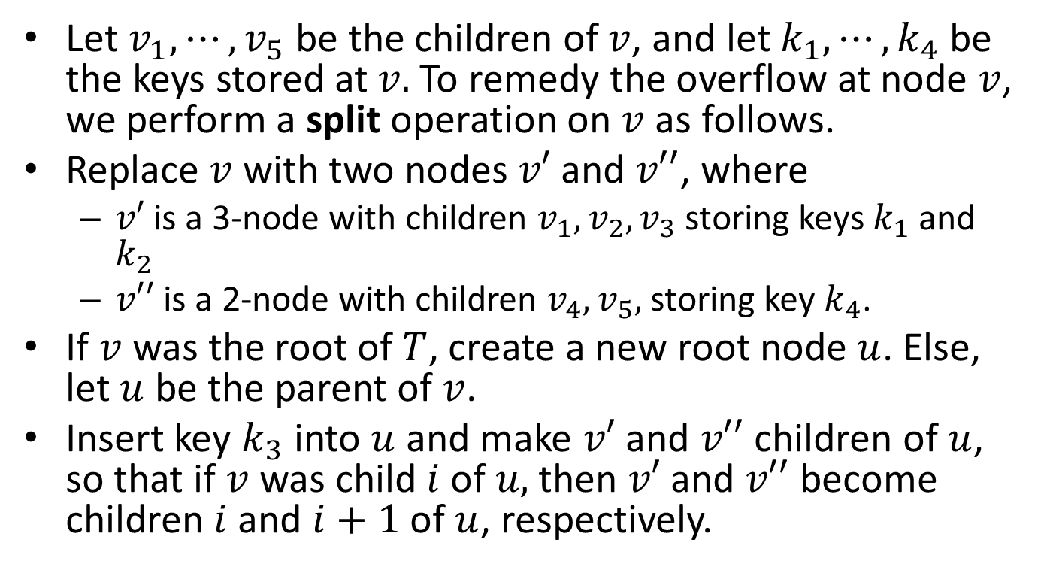
Dealing with Overflow Nodes
Let $v_{1},⋯,v_{5}$ be the children of $v$, and let $k_{1},⋯,k_{4}$ be the keys stored at $v.$To remedy the overflow at node $v$, we perform a split operation on $v$ as follows.
Replace $v$ with two nodes $v′$ and $v′′$, where
  $v′$ is a 3-node with children $v_{1},v_{2},v_{3}$ storing keys $k_{1}$ and $k_{2}$
  $v′′$ is a 2-node with children $v_{4},v_{5},$ storing key $k_{4}$.
If $v$ was the root of $T$, create a new root node $u$. Else, let $u$ be the parent of $v$.
Insert key $k_{3}$ into $u$ and make $v′$ and $v′′$ children of $u$, so that if $v$ was child $i$ of $u,$ then $v′$ and $v′′$ become children $i$ and $i+1$ of $u$, respectively.

Slide 68











Overflow at a 5-node
$$h_{1} h_{2}$$
$$u$$
$$v=u_{2}$$
$$u_{1}$$
$$u_{3}$$
$$k_{1}{ k}_{2}{ k}_{3}{ k}_{4}$$
$$v_{1}$$
$$v_{2}$$
$$v_{3}$$
$$v_{4}$$
$$v_{5}$$

Slide 69




The third key of $v$ inserted into the parent node $u$
$$h_{1} h_{2}$$
$$u$$
$$k_{3}$$
$$v=u_{2}$$
$$u_{1}$$
$$u_{3}$$
$$k_{1}{ k}_{2} { k}_{4}$$
$$v_{1}$$
$$v_{2}$$
$$v_{3}$$
$$v_{4}$$
$$v_{5}$$

Slide 70





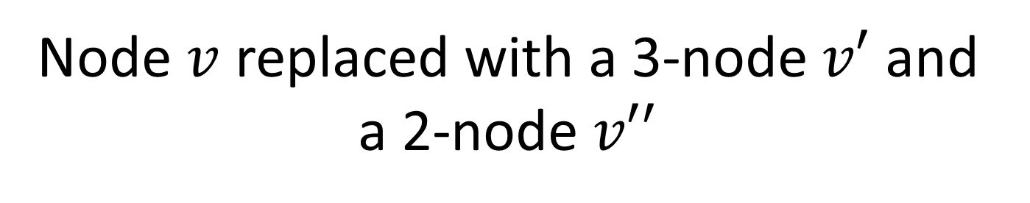






Node $v$ replaced with a 3-node$v′$ and a 2-node $v′′$
$$h_{1} k_{3} h_{2}$$
$$u$$
$$u_{1}$$
$$v^{′}=u_{2}$$
$$v^{′′}=u_{3}$$
$$u_{4}$$
$$k_{1}{ k}_{2}$$
$$k_{4}$$
$$v_{1}$$
$$v_{2}$$
$$v_{3}$$
$$v_{4}$$
$$v_{5}$$

Slide 71
Example
Let us now see an example of a few insertions into an initially empty (2,4) tree.

Slide 72
Insert 4
4

Slide 73
Insert 6
4 6

Slide 74
Insert 12
4 6 12

Slide 75
Insert 15 - Overflow
4 6 12 15

Slide 76
Creation of New Root Node
12
4 6 15

Slide 77
Split
12
4 6
15

Slide 78
Insert 3
12
3 4 6
15

Slide 79
Insert 5 - Overflow
12
3 4 5 6
15

Slide 80
5 is Sent to the Parent Node
12
5
3 4 6
15

Slide 81
Split
5 12
3 4
6
15

Slide 82
Insert 10
5 12
3 4
6 10
15

Slide 83
Insert 8
5 12
3 4
6 8 10
15

Slide 84
Insertion (cont’d)
Let us now see a more complicated example of insertion in a (2,4) tree.

Slide 85
Initial Tree
5 10 12
3 4
6 8
11
13 14 15

Slide 86
Insert 17 - Overflow
5 10 12
3 4
6 8
13 14 15 17
11

Slide 87
15 is Sent to the Parent Node
5 10 12
15
3 4
6 8
13 14 17
11

Slide 88
Split
5 10 12 15
3 4
6 8
13 14
17
11

Slide 89
Overflow at the Root
5 10 12 15
3 4
6 8
13 14
17
11

Slide 90
Creation of New Root
12
5 10 15
3 4
6 8
13 14
17
11

Slide 91
Split
12
5 10
15
3 4
6 8
13 14
17
11

Slide 92
Final Tree
12
5 10
15
3 4
6 8
13 14
17
11

Slide 93
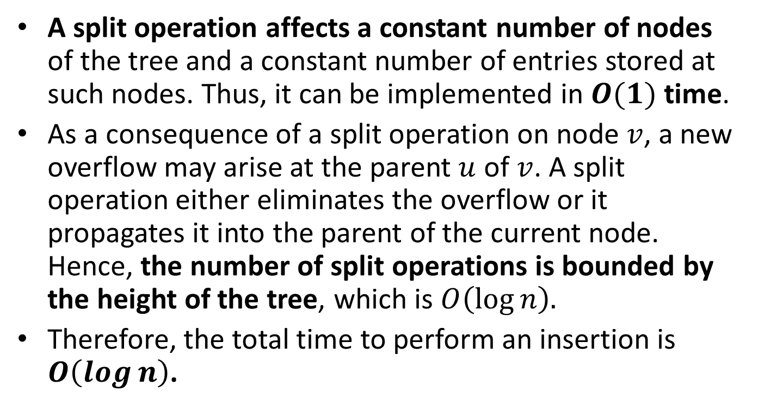
Complexity Analysis of Insertion
A split operation affects a constant number of nodes of the tree and a constant number of entries stored at such nodes. Thus, it can be implemented in $O(1)$ time.
As a consequence of a split operation on node $v$, a new overflow may arise at the parent $u$ of $v$. A split operation either eliminates the overflow or it propagates it into the parent of the current node. Hence, the number of split operations is bounded by the height of the tree, which is $O\left(\log{n}\right).$
Therefore, the total time to perform an insertion is $O\left(\log{n}\right)$.

Slide 94
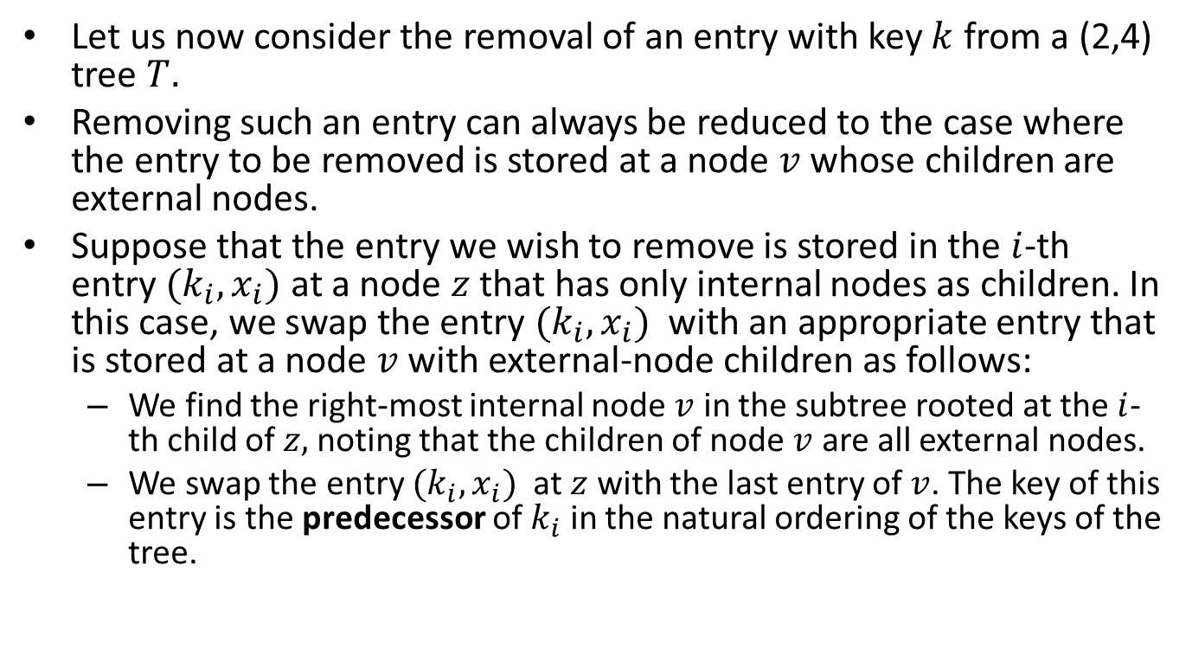
Removal in (2,4) Trees
Let us now consider the removal of an entry with key $k$ from a (2,4) tree $T.$
Removing such an entry can always be reduced to the case where the entry to be removed is stored at a node $v$ whose children are external nodes.
Suppose that the entry we wish to remove is stored in the $i$-th entry $(k_{i},x_{i})$ at a node $z$ that has only internal nodes as children. In this case, we swap the entry $(k_{i},x_{i})$ with an appropriate entry that is stored at a node $v$ with external-node children as follows:
  We find the right-most internal node $v$ in the subtree rooted at the $i$-th child of $z,$ noting that the children of node $v$ are all external nodes.
  We swap the entry $(k_{i},x_{i})$ at $z$ with the last entry of $v$. The key of this entry is the predecessor of $k_{i}$ in the natural ordering of the keys of the tree.

Slide 95
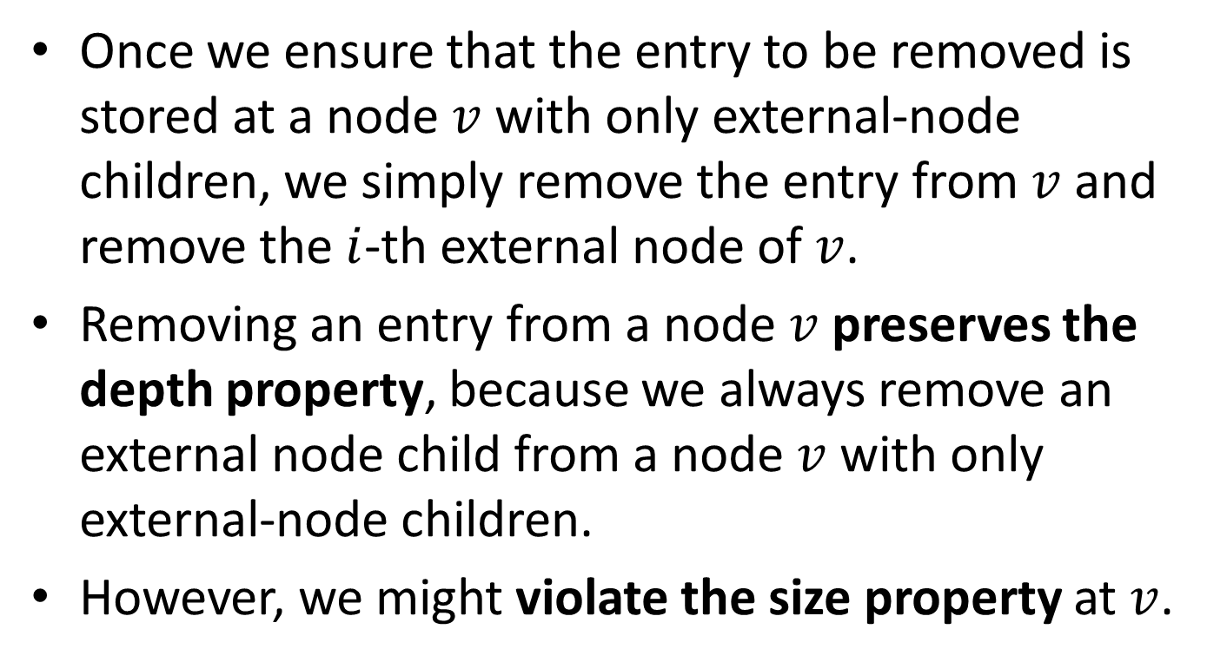
Removal (cont’d)
Once we ensure that the entry to be removed is stored at a node $v$ with only external-node children, we simply remove the entry from $v$ and remove the $i$-th external node of $v$.
Removing an entry from a node $v$ preserves the depth property, because we always remove an external node child from a node $v$ with only external-node children.
However, we might violate the size property at $v$.

Slide 96
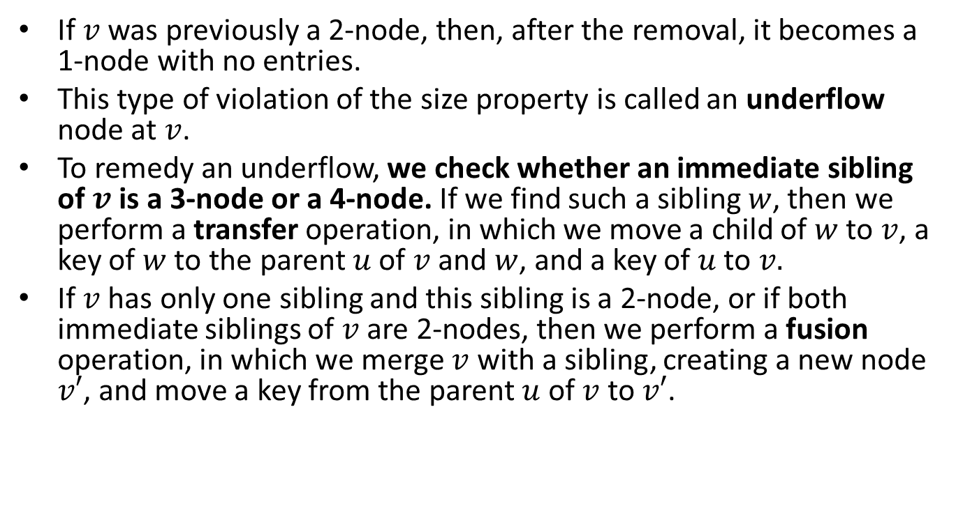
Removal (cont’d)
If $v$ was previously a 2-node, then, after the removal, it becomes a 1-node with no entries.
This type of violation of the size property is called an underflow node at $v$.
To remedy an underflow, we check whether an immediate sibling of $v$ is a 3-node or a 4-node. If we find such a sibling $w$, then we perform a transfer operation, in which we move a child of $w$ to $v$, a key of $w$ to the parent $u$ of $v$ and $w$, and a key of $u$ to $v.$
If $v$ has only one sibling and this sibling is a 2-node, or if both immediate siblings of $v$ are 2-nodes, then we perform a fusion operation, in which we merge $v$ with a sibling, creating a new node $v′$, and move a key from the parent $u$ of $v$ to $v′$.

Slide 97
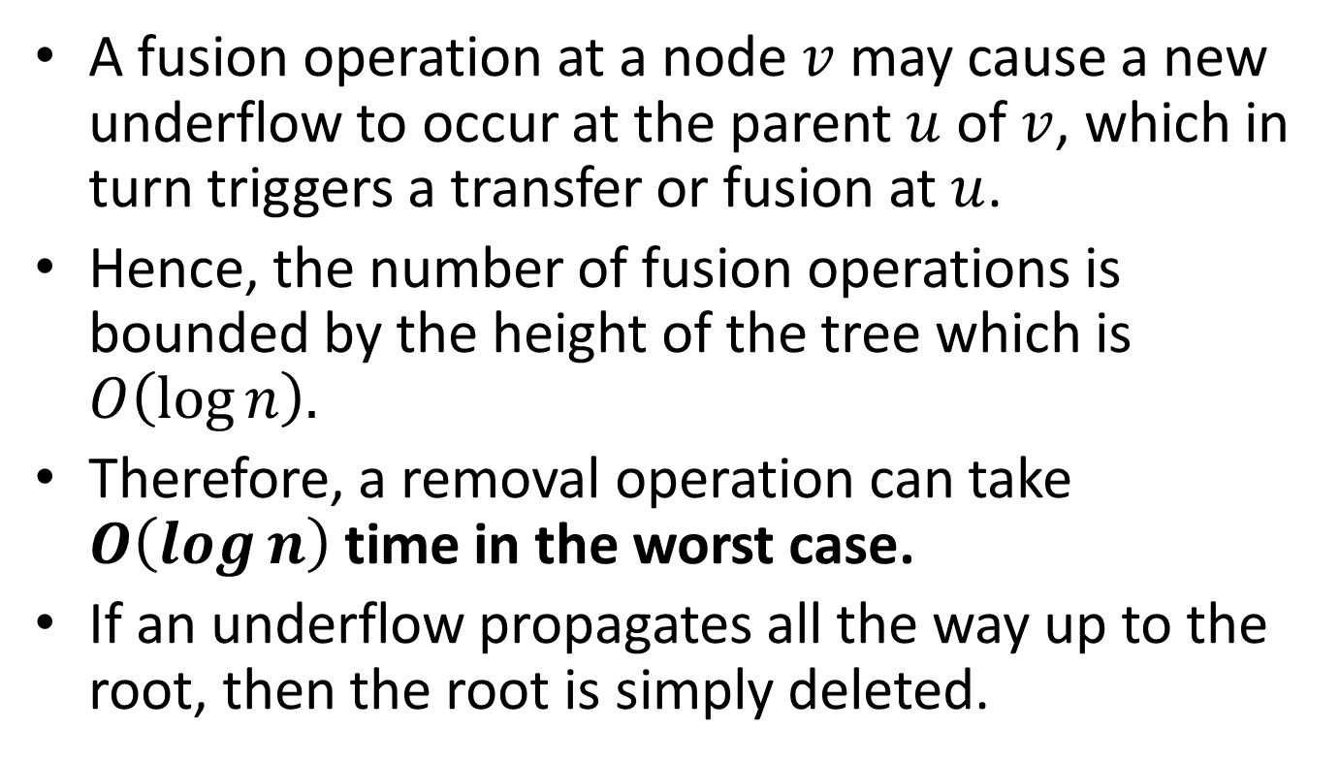
Removal (cont’d)
A fusion operation at a node $v$ may cause a new underflow to occur at the parent $u$ of $v$, which in turn triggers a transfer or fusion at $u$.
Hence, the number of fusion operations is bounded by the height of the tree which is $O\left(\log{n}\right).$
Therefore, a removal operation can take $O\left(\log{n}\right)$ time in the worst case.
If an underflow propagates all the way up to the root, then the root is simply deleted.

Slide 98
Examples
Let us now see some examples of removal from a (2,4) tree.

Slide 99
Initial Tree
12
5 10
15
4
6 8
13 14
17
11

Slide 100

Remove 4
12
5 10
15
4
$$v$$
6 8
13 14
17
11

Slide 101


Transfer
12
$$u$$
10
15
5
6
$$w$$
$$v$$
8
13 14
17
11

Slide 102
After the Transfer
12
$$u$$
6 10
15
$$w$$
$$v$$
5
8
13 14
17
11

Slide 103
Remove 12
12
$$u$$
6 10
15
$$w$$
$$v$$
5
8
13 14
17
11

Slide 104
Remove 12
12
6 10
11
15
$$w$$
$$v$$
5
8
13 14
17

Slide 105


Fusion of $w$ and $v$
11
$$u$$
6
15
10
$$w$$
$$v$$
5
8
$$v$$
13 14
17

Slide 106
After the Fusion
11
6
15
5
8 10
13 14
17

Slide 107
Remove 13
11
6
15
13
5
8 10
14
17

Slide 108
After the Removal of 13
11
6
15
5
8 10
14
17

Slide 109
Remove 14 - Underflow
11
6
15
14
5
8 10
17

Slide 110


Fusion
11
$$u$$
6
$$v$$
15
5
8 10
17

Slide 111

Underflow at $u$
11
$$u$$
6
5
8 10
15 17

Slide 112
Fusion
11
$$u$$
6
5
8 10
15 17

Slide 113
Remove the Root
6 11
5
8 10
15 17

Slide 114
Final Tree
6 11
5
8 10
15 17

Slide 115
Readings
T. A. Standish. Data Structures, Algorithms and Software Principles in C.
  Section 9.9
M. T. Goodrich, R. Tamassia and D. Mount. Data Structures and Algorithms in C++.
  Section 10.4
R. Sedgewick. Αλγόριθμοι σε C. 3^{η} Αμερικανική Έκδοση. Εκδόσεις Κλειδάριθμος.
  Section 13.3

