Slide 1
Red-Black Trees
Manolis Koubarakis

Slide 2
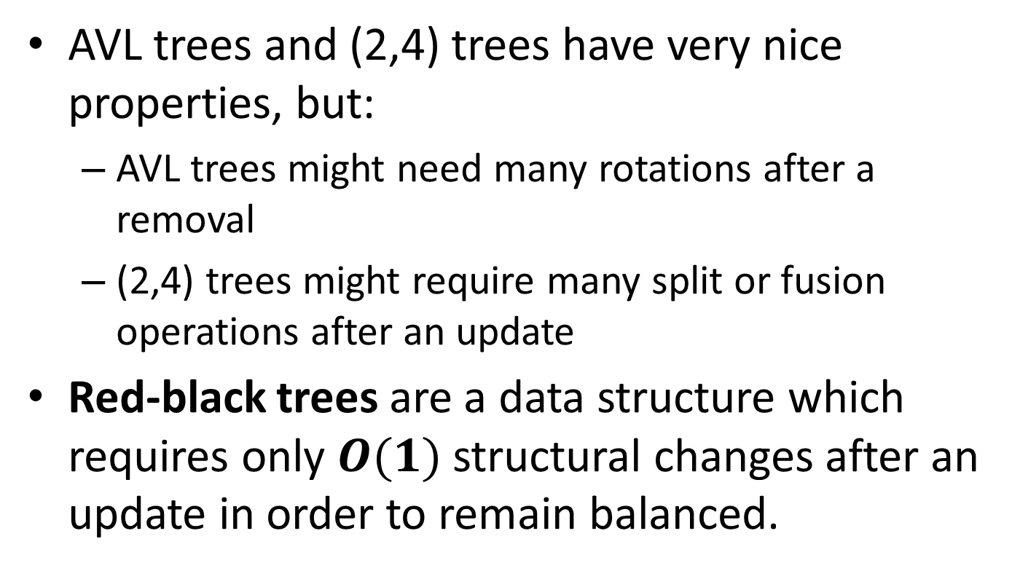
Red-Black Trees
AVL trees and (2,4) trees have very nice properties, but:
  AVL trees might need many rotations after a removal
  (2,4) trees might require many split or fusion operations after an update
Red-black trees are a data structure which requires only $O(1)$ structural changes after an update in order to remain balanced.

Slide 3
Definition
A red-black tree is a binary search tree with nodes colored red and black in a way that satisfies the following properties:
  Root Property: The root is black.
  External Property: Every external node is black.
  Internal Property: The children of a red node are black.
  Depth Property: All the external nodes have the same black depth, defined as the number of black ancestors minus one (recall that a node is an ancestor of itself).

Slide 4
Example (2,4) Tree
12
5 10
15
3 4
6 7 8
13 14
17
11

Slide 5
Corresponding Red-Black Tree
12
5
15
3
10
13
17
14
4
7
11
6
8
In our figures, we use light blue color instead of black.

Slide 6
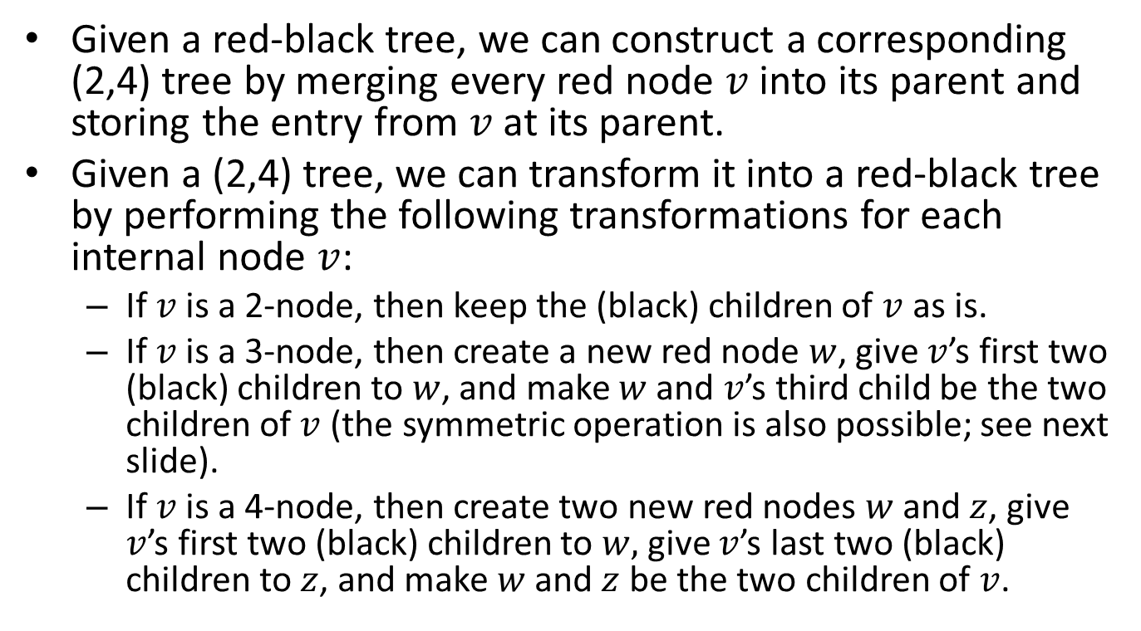
(2,4) Trees vs. Red-Black Trees
Given a red-black tree, we can construct a corresponding (2,4) tree by merging every red node $v$ into its parent and storing the entry from $v$ at its parent.
Given a (2,4) tree, we can transform it into a red-black tree by performing the following transformations for each internal node $v$:
  If $v$ is a 2-node, then keep the (black) children of $v$ as is.
  If $v$ is a 3-node, then create a new red node $w$, give $v$’s first two (black) children to $w$, and make $w$ and $v$’s third child be the two children of $v$(the symmetric operation is also possible; see next slide).
  If $v$ is a 4-node, then create two new red nodes $w$ and $z$, give $v$’s first two (black) children to $w,$give $v$’s last two (black) children to $z$, and make $w$ and $z$ be the two children of $v$.

Slide 7
(2,4) Trees vs. Red-Black Trees (cont’d)
15
15
13 14
13
14
14
13
6 7 8
7
6
8

Slide 8

Proposition
The height of a red-black tree storing $n$ entries is $O(\log{n})$.
Proof?

Slide 9
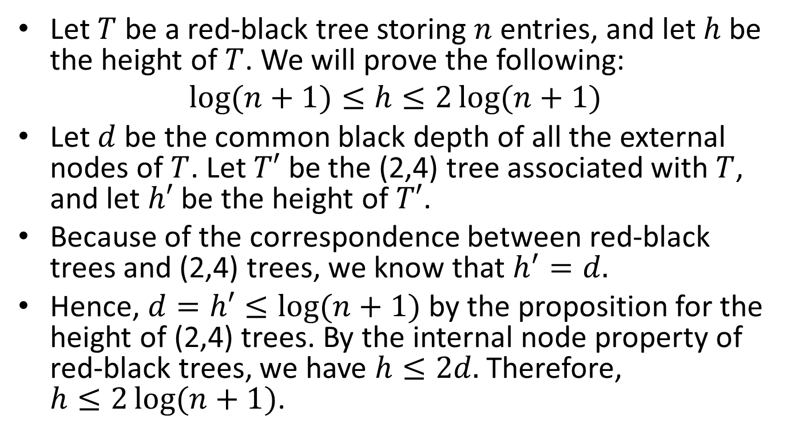
Proof
Let $T$ be a red-black tree storing $n$ entries, and let $h$ be the height of $T$. We will prove the following:
$$\log{(n+1)}≤h≤2\log{(n+1)}$$
Let $d$ be the common black depth of all the external nodes of $T$. Let $T′$ be the (2,4) tree associated with $T$, and let $h′$ be the height of $T′$.
Because of the correspondence between red-black trees and (2,4) trees, we know that $h^{′}=d.$
Hence, $d=h′≤\log{(n+1)}$ by the proposition for the height of (2,4) trees. By the internal node property of red-black trees, we have $h≤2d.$ Therefore, $h≤2\log{(n+1)}$.

Slide 10

Proof (cont’d)
The other inequality, $\log{(n+1)}≤h$ follows from the properties of proper binary trees and the fact that $T$ has $n$ internal nodes.

Slide 11
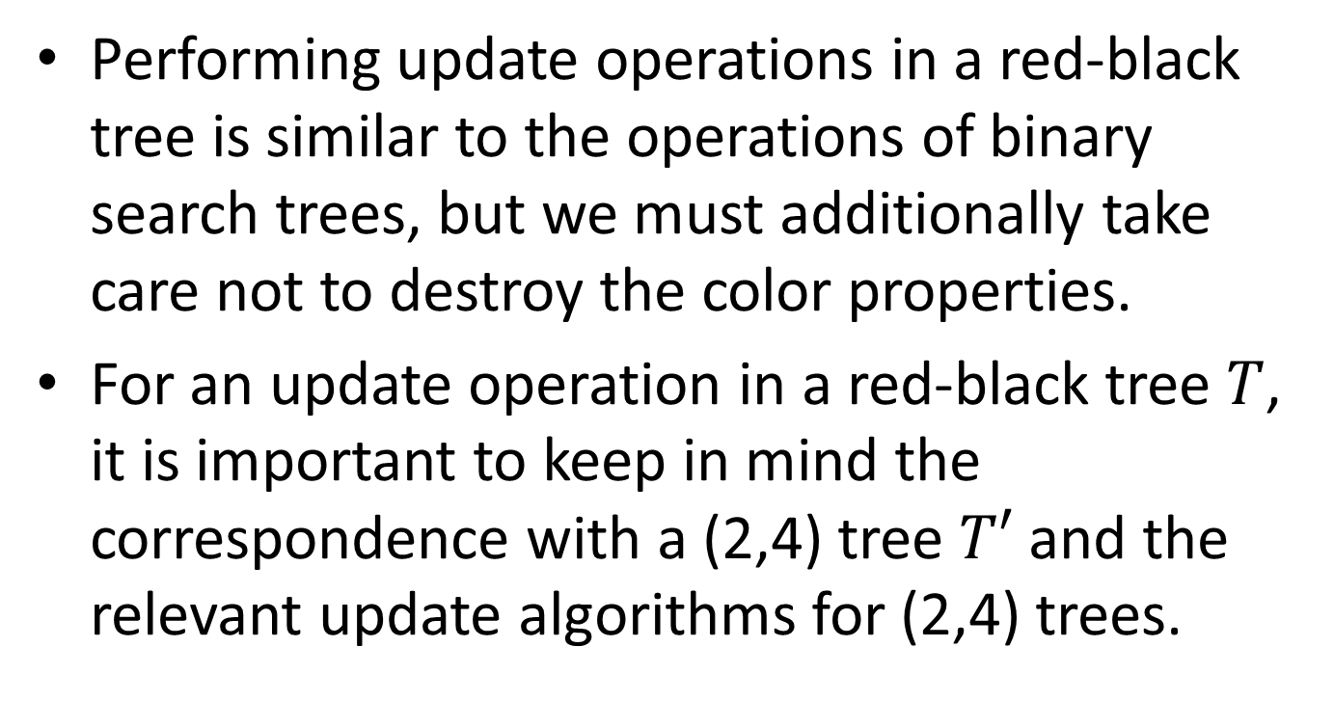
Updates
Performing update operations in a red-black tree is similar to the operations of binary search trees, but we must additionally take care not to destroy the color properties.
For an update operation in a red-black tree $T$, it is important to keep in mind the correspondence with a (2,4) tree $T′$ and the relevant update algorithms for (2,4) trees.

Slide 12
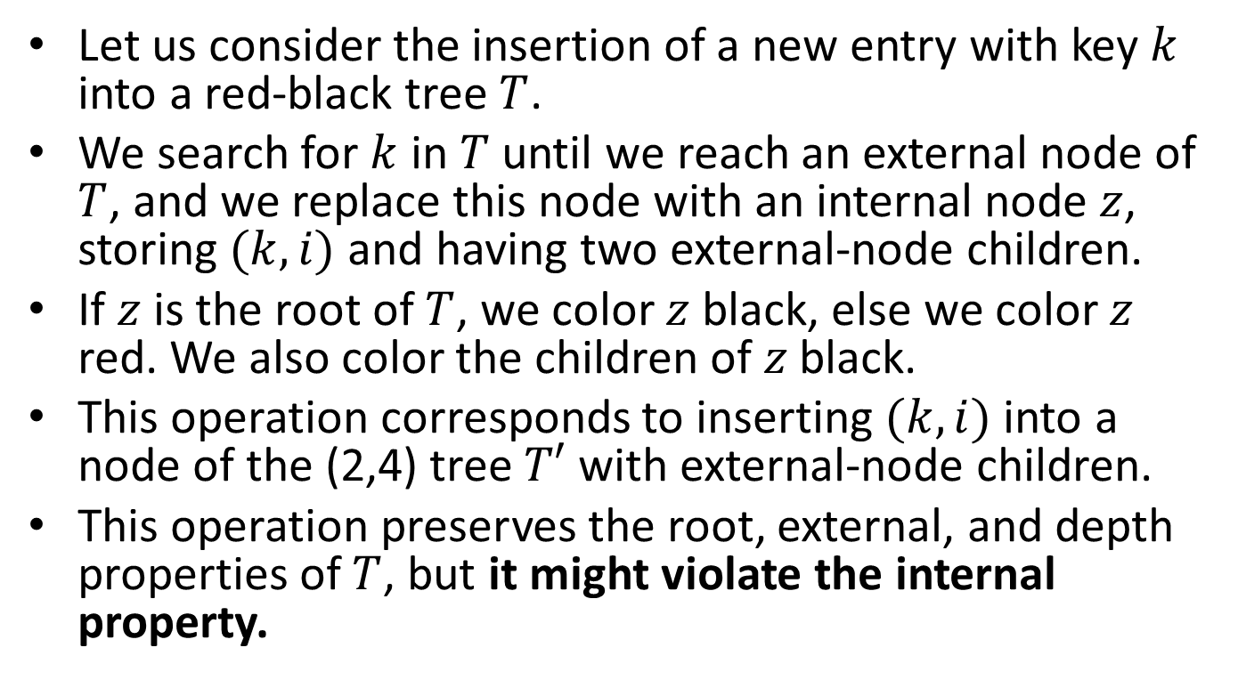
Insertion
Let us consider the insertion of a new entry with key $k$ into a red-black tree $T$.
We search for $k$ in $T$ until we reach an external node of $T$, and we replace this node with an internal node $z$, storing $(k,i)$ and having two external-node children.
If $z$ is the root of $T$, we color $z$ black, else we color $z$ red. We also color the children of $z$ black.
This operation corresponds to inserting $(k,i)$ into a node of the (2,4) tree $T′$ with external-node children.
This operation preserves the root, external, and depth properties of $T$, but it might violate the internal property.

Slide 13
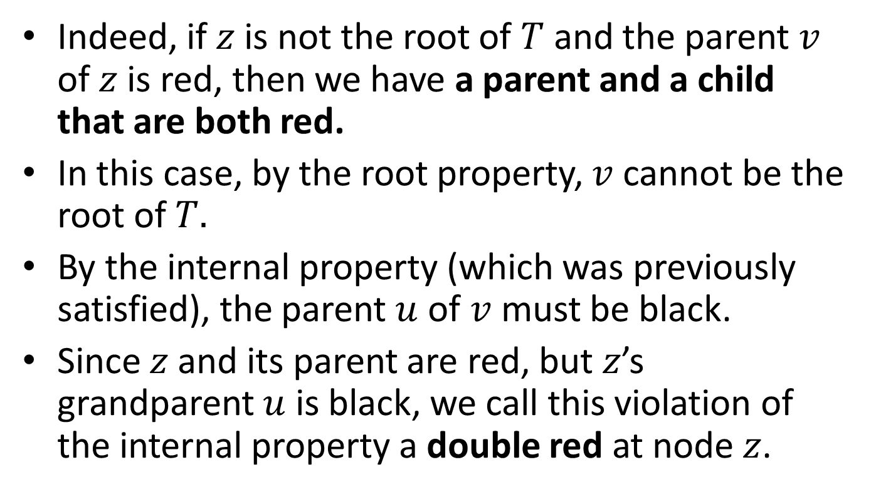
Insertion (cont’d)
Indeed, if $z$ is not the root of $T$ and the parent $v$ of $z$ is red, then we have a parent and a child that are both red.
In this case, by the root property, $v$ cannot be the root of $T.$
By the internal property (which was previously satisfied), the parent $u$ of $v$ must be black.
Since $z$ and its parent are red, but $z$’s grandparent $u$ is black, we call this violation of the internal property a double red at node $z$.

Slide 14
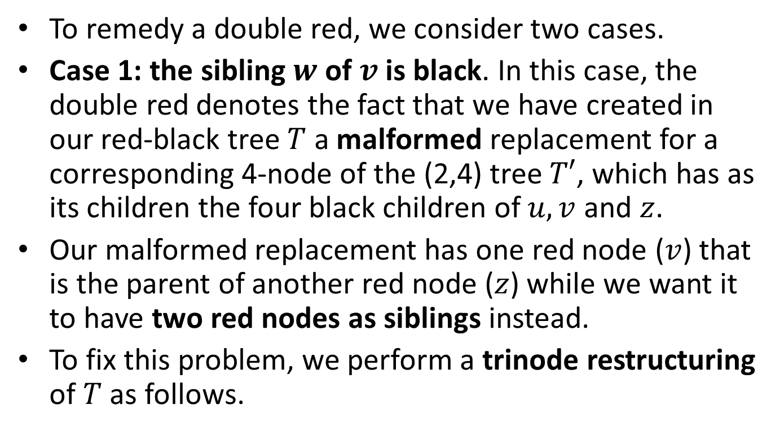
Insertion (cont’d)
To remedy a double red, we consider two cases.
Case 1: the sibling $w$ of $v$ is black. In this case, the double red denotes the fact that we have created in our red-black tree $T$ a malformed replacement for a corresponding 4-node of the (2,4) tree $T′$, which has as its children the four black children of $u,v$ and $z$.
Our malformed replacement has one red node ($v$) that is the parent of another red node ($z$) while we want it to have two red nodes as siblings instead.
To fix this problem, we perform a trinode restructuring of $T$ as follows.

Slide 15
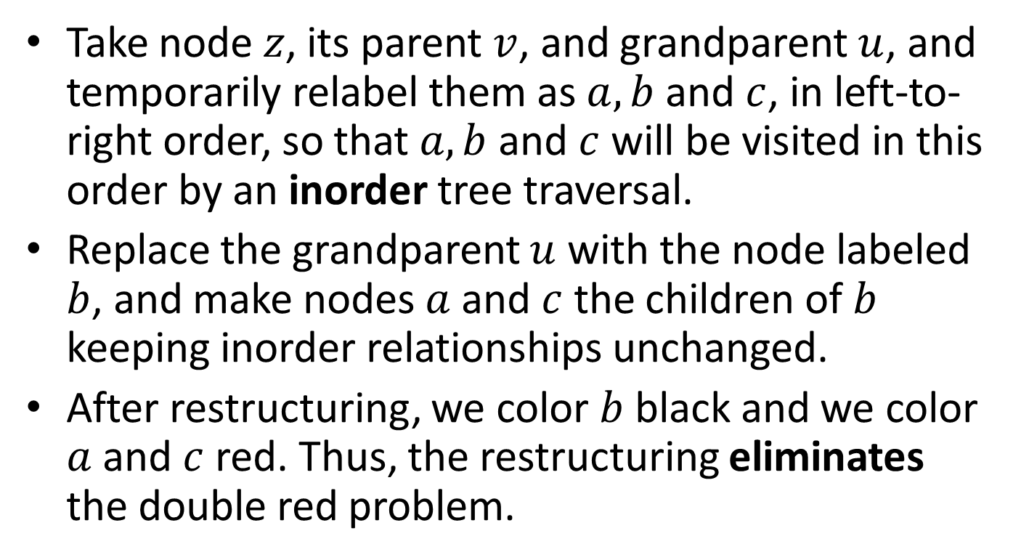
Trinode Restructuring
Take node $z$, its parent $v$, and grandparent $u$, and temporarily relabel them as $a,b$ and $c$, in left-to-right order, so that $a,b$ and $c$ will be visited in this order by an inorder tree traversal.
Replace the grandparent $u$ with the node labeled $b$, and make nodes $a$ and $c$ the children of $b$ keeping inorder relationships unchanged.
After restructuring, we color $b$ black and we color $a$ and $c$ red. Thus, the restructuring eliminates the double red problem.

Slide 16







Trinode Restructuring Graphically
$$b$$
$$u$$
30
20
$$v$$
20
$$w$$
$$a$$
10
30
$$c$$
$$z$$
10

Slide 17

Trinode Restructuring Graphically (cont’d)
$$b$$
$$u$$
30
20
$$v$$
10
$$w$$
$$a$$
10
30
$$c$$
$$z$$
20

Slide 18


Trinode Restructuring Graphically (cont’d)
$$b$$
$$u$$
10
20
$$w$$
$$v$$
20
$$a$$
10
30
$$c$$
$$z$$
30

Slide 19


Trinode Restructuring Graphically (cont’d)
$$b$$
$$u$$
10
20
$$w$$
$$v$$
30
$$a$$
10
30
$$c$$
$$z$$
20

Slide 20
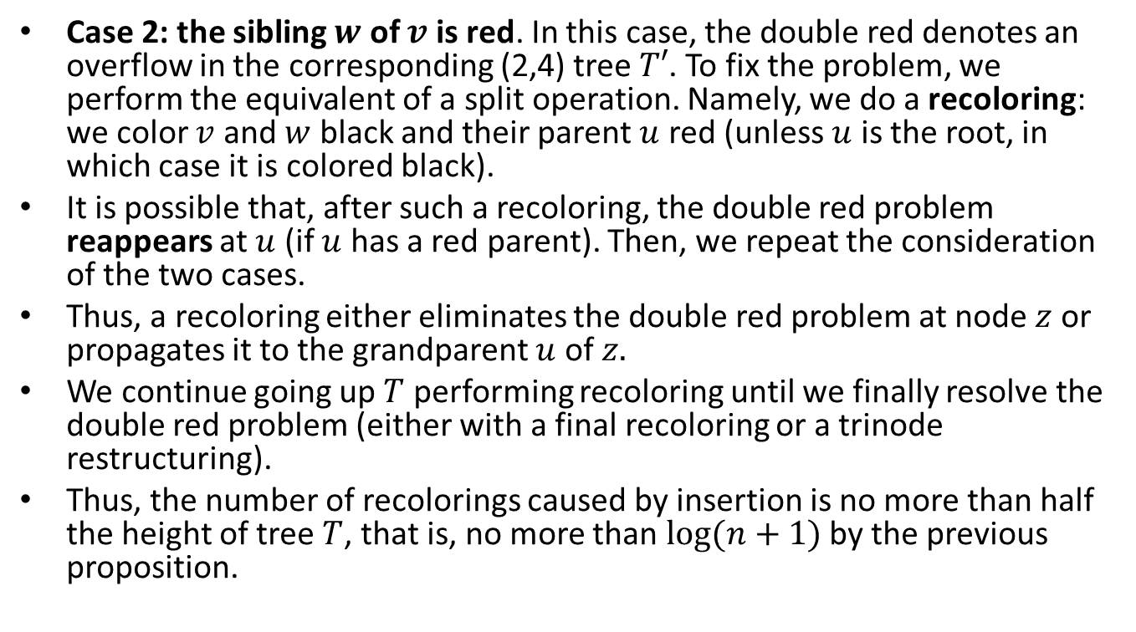
Insertion (cont’d)
Case 2: the sibling $w$ of $v$ is red. In this case, the double red denotes an overflow in the corresponding (2,4) tree $T′$. To fix the problem, we perform the equivalent of a split operation. Namely, we do a recoloring: we color $v$ and $w$ black and their parent $u$ red (unless $u$ is the root, in which case it is colored black).
It is possible that, after such a recoloring, the double red problem reappears at $u$ (if $u$ has a red parent). Then, we repeat the consideration of the two cases.
Thus, a recoloring either eliminates the double red problem at node $z$ or propagates it to the grandparent $u$ of $z.$
We continue going up $T$ performing recoloring until we finally resolve the double red problem (either with a final recoloring or a trinode restructuring).
Thus, the number of recolorings caused by insertion is no more than half the height of tree $T$, that is, no more than $\log{(n+1)}$ by the previous proposition.

Slide 21




Recoloring
$$u$$
30
10 20 30 40
$$v$$
20
40
$$w$$
$$z$$
10

Slide 22
Recoloring (cont’d)
$$u$$
… 30 …
30
…
…
10 20
40
$$v$$
20
40
$$w$$
$$z$$
10

Slide 23
Example
Let us now see some examples of insertions in an initially empty red-black tree.

Slide 24
Insert 4
4

Slide 25
Insert 7
4
7

Slide 26
Insert 12 – Double Red
4
7
12

Slide 27
After Restructuring
7
4
12

Slide 28
Insert 15 – Double Red
7
4
12
15

Slide 29
After Recoloring
7
4
12
15

Slide 30
Insert 3
7
4
12
3
15

Slide 31
Insert 5
7
4
12
3
5
15

Slide 32
Insert 14 – Double Red
7
4
12
3
5
15
14

Slide 33
After Restructuring
7
4
14
3
5
12
15

Slide 34
Insertion of 18 – Double Red
7
4
14
3
5
12
15
18

Slide 35
After Recoloring
7
4
14
3
5
12
15
18

Slide 36
Insertion of 16 – Double Red
7
4
14
3
5
12
15
18
16

Slide 37
After Restructuring
7
4
14
3
5
12
16
15
18

Slide 38
Insertion of 17 – Double Red
7
4
14
3
5
12
16
15
18
17

Slide 39
After Recoloring – Double Red
7
4
14
3
5
12
16
15
18
17

Slide 40
After Restructuring
14
7
16
4
12
15
18
3
5
17

Slide 41

Proposition
The insertion of a key-value entry in a red-black tree storing $n$ entries can be done in $O(log{n})$ time and requires $O(log{n})$ recolorings and one trinode restructuring.

Slide 42
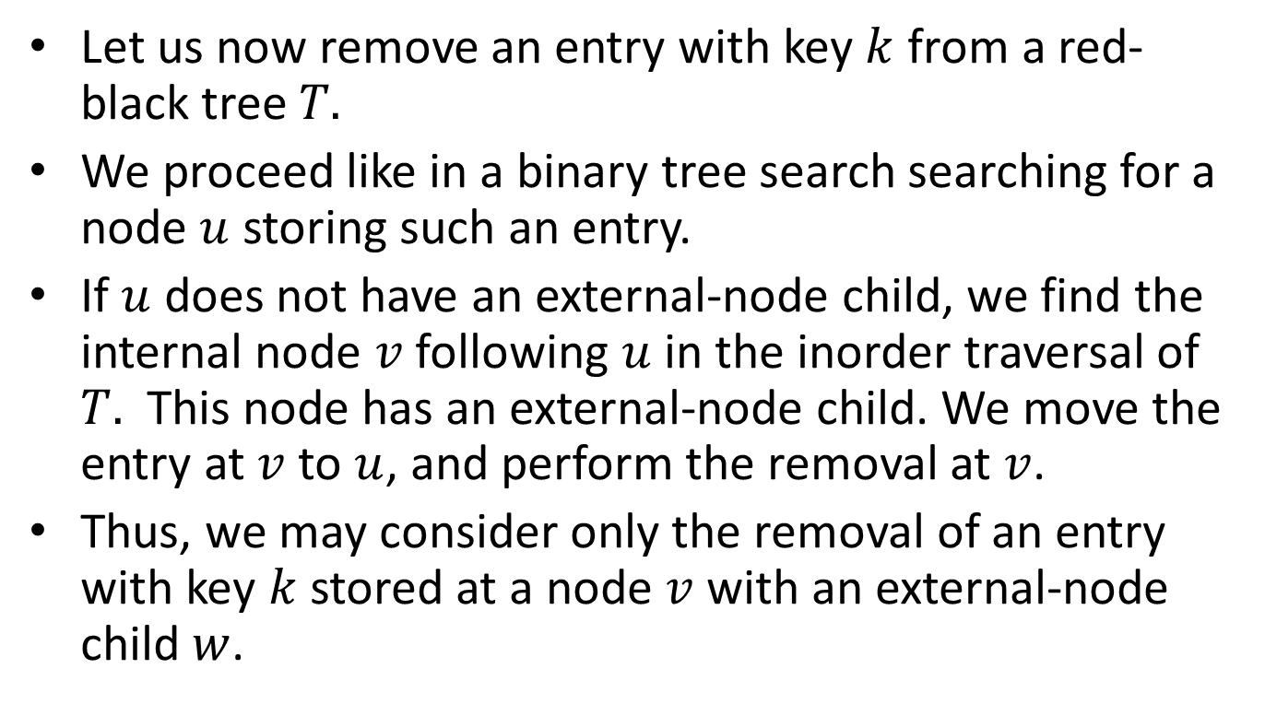
Removal
Let us now remove an entry with key $k$ from a red-black tree $T.$
We proceed like in a binary tree search searching for a node $u$ storing such an entry.
If $u$ does not have an external-node child, we find the internal node $v$ following $u$ in the inorder traversal of $T.$ This node has an external-node child. We move the entry at $v$ to $u$, and perform the removal at $v$.
Thus, we may consider only the removal of an entry with key $k$ stored at a node $v$ with an external-node child $w$.

Slide 43
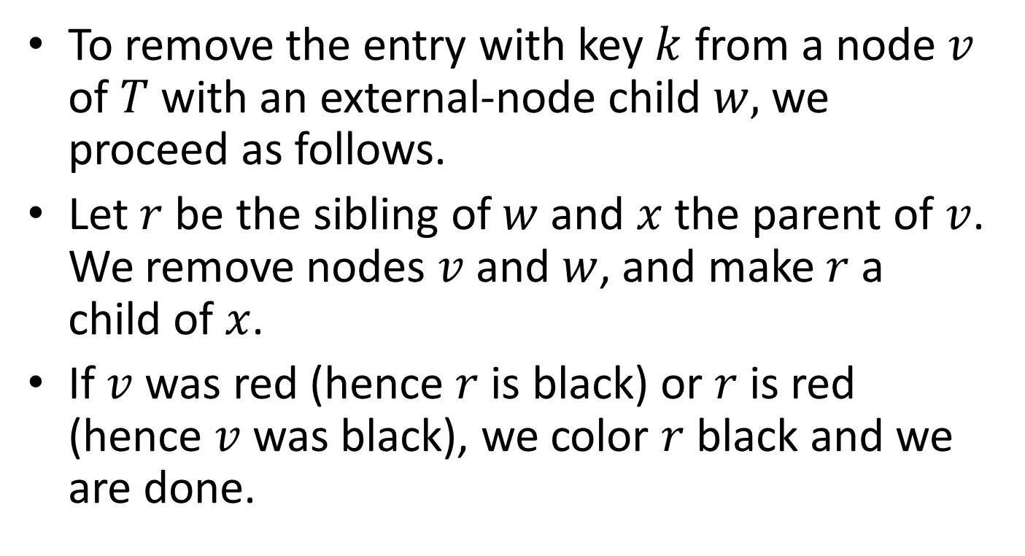
Removal (cont’d)
To remove the entry with key $k$ from a node $v$ of $T$with an external-node child $w,$we proceed as follows.
Let $r$ be the sibling of $w$ and $x$ the parent of $v$. We remove nodes $v$ and $w$, and make $r$ a child of $x$.
If $v$ was red (hence $r$ is black) or $r$ is red (hence $v$ was black), we color $r$ black and we are done.

Slide 44














Graphically
$$x$$
$$x$$
$$v$$
$$k$$
$$r$$
$$r$$
$$w$$
$$x$$
$$x$$
$$v$$
$$k$$
$$r$$
$$r$$
$$w$$

Slide 45
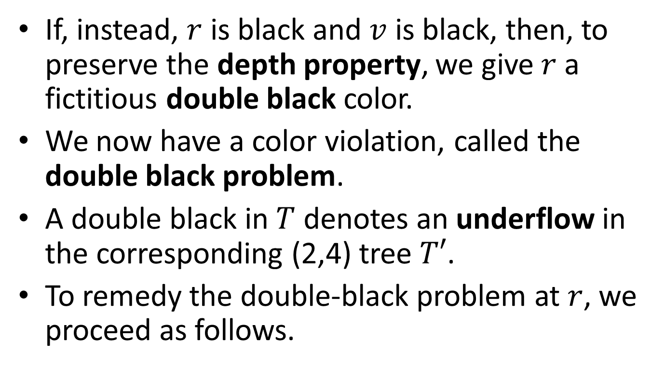
Removal (cont’d)
If, instead, $r$ is black and $v$ is black, then, to preserve the depth property, we give $r$ a fictitious double black color.
We now have a color violation, called the double black problem.
A double black in $T$ denotes an underflow in the corresponding (2,4) tree $T′$.
To remedy the double-black problem at $r$, we proceed as follows.

Slide 46
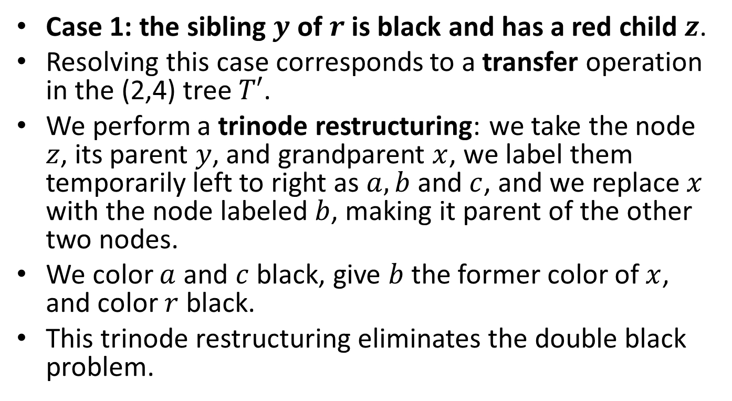
Removal (cont’d)
Case 1: the sibling $y$ of $r$ is black and has a red child $z$.
Resolving this case corresponds to a transfer operation in the (2,4) tree $T′$.
We perform a trinode restructuring: we take the node $z$, its parent $y$, and grandparent $x$, we label them temporarily left to right as $a,b$ and $c$, and we replace $x$ with the node labeled $b$, making it parent of the other two nodes.
We color $a$ and $c$ black, give $b$ the former color of $x$, and color $r$ black.
This trinode restructuring eliminates the double black problem.

Slide 47




Restructuring a Red-Black Tree to Remedy the Double Black Problem
$$x$$
… 30 …
30
…
…
10 20
$$y$$
$$r$$
20
40
40
$$z$$
10

Slide 48

Restructuring (cont’d)
$$x$$
… 30 …
30
…
…
10 20
$$y$$
$$r$$
10
40
40
$$z$$
20

Slide 49



After the Restructuring
$$b$$
… 20 …
20
…
…
10
30
$$a$$
$$c$$
10
30
40
40
$$r$$

Slide 50
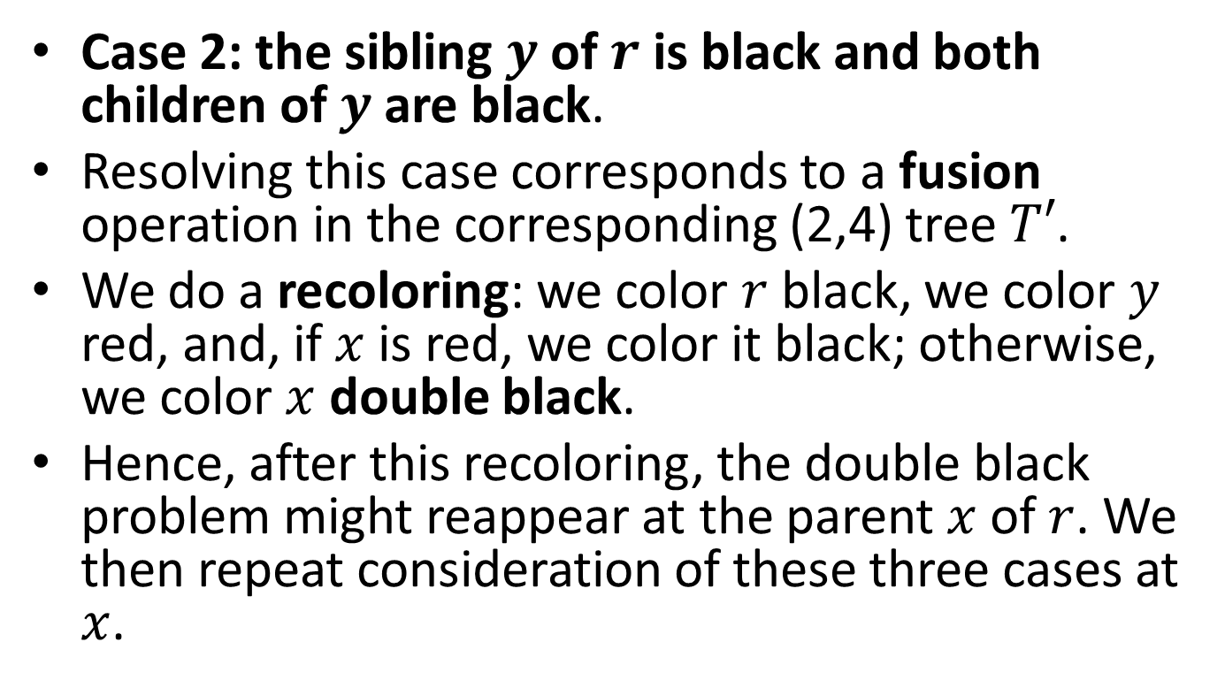
Removal (cont’d)
Case 2: the sibling $y$ of $r$ is black and both children of $y$ are black.
Resolving this case corresponds to a fusion operation in the corresponding (2,4) tree $T′$.
We do a recoloring: we color $r$ black, we color $y$ red, and, if $x$ is red, we color it black; otherwise, we color $x$ double black.
Hence, after this recoloring, the double black problem might reappear at the parent $x$ of $r$. We then repeat consideration of these three cases at $x$.

Slide 51



Recoloring a Red-Black Tree that Fixes the Double Black Problem
10 30 …
10
…
20
$$x$$
30
40
$$y$$
20
40
$$r$$

Slide 52
After the Recoloring
10 …
10
…
20 30
$$x$$
30
40
$$y$$
20
40
$$r$$

Slide 53



Recoloring a Red-Black Tree that Propagates the Double Black Problem
30
30
$$x$$
20
$$y$$
20
40
$$r$$
40

Slide 54
After the Recoloring
30
$$x$$
20 30
$$y$$
20
40
$$r$$
40

Slide 55
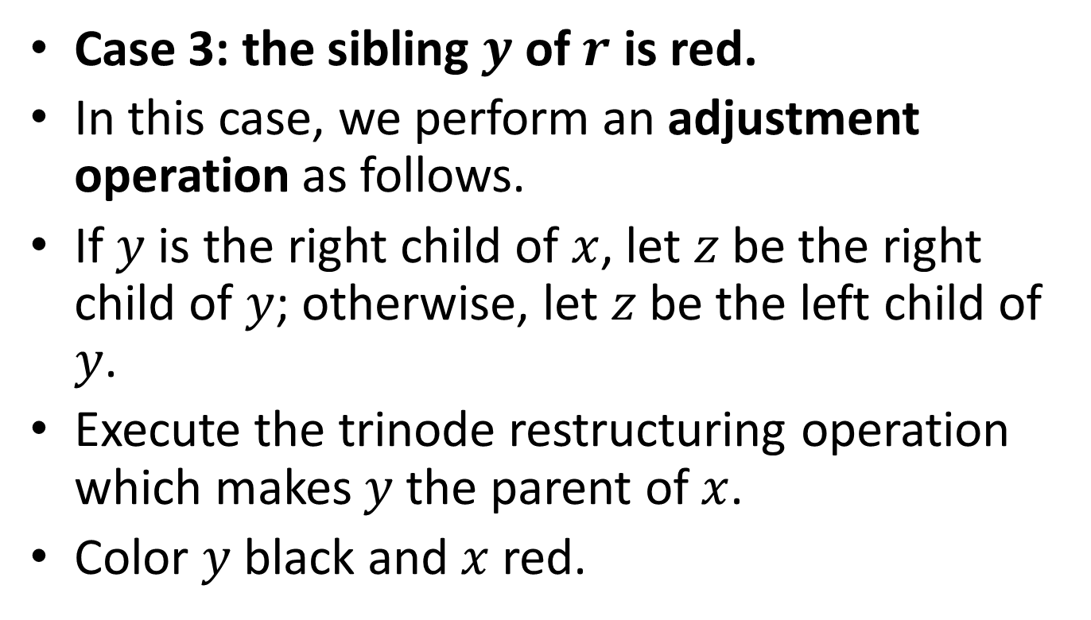
Removal (cont’d)
Case 3: the sibling $y$ of $r$ is red.
In this case, we perform an adjustment operation as follows.
If $y$ is the right child of $x$, let $z$ be the right child of $y$; otherwise, let $z$ be the left child of $y$.
Execute the trinode restructuring operation which makes $y$ the parent of $x$.
Color $y$ black and $x$ red.

Slide 56
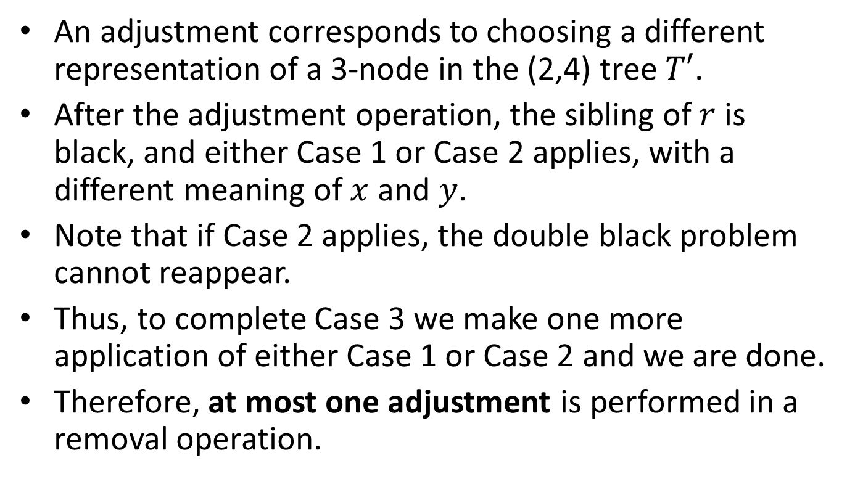
Removal (cont’d)
An adjustment corresponds to choosing a different representation of a 3-node in the (2,4) tree $T′$.
After the adjustment operation, the sibling of $r$ is black, and either Case 1 or Case 2 applies, with a different meaning of $x$ and $y$.
Note that if Case 2 applies, the double black problem cannot reappear.
Thus, to complete Case 3 we make one more application of either Case 1 or Case 2 and we are done.
Therefore, at most one adjustment is performed in a removal operation.

Slide 57




Adjustment of a Red-Black Tree in the Presence of a Double Black Problem
$$x$$
20 30
30
… 10 …
$$y$$
$$r$$
…
…
20
40
40
$$z$$
10

Slide 58




After the Adjustment
20 30
$$y$$
20
… 10 …
…
…
$$z$$
10
30
$$x$$
40
40
$$r$$

Slide 59
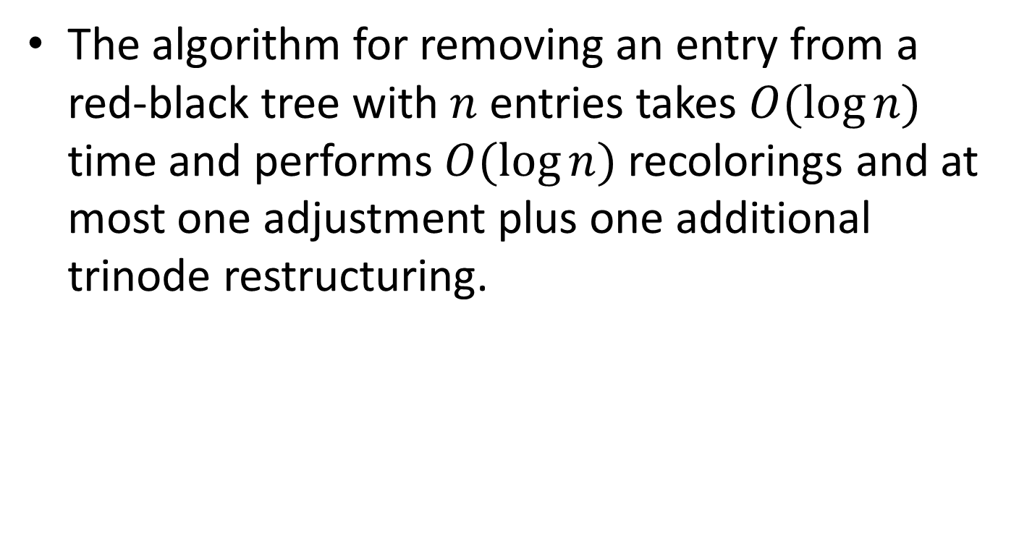
Removal (cont’d)
The algorithm for removing an entry from a red-black tree with $n$ entries takes $O(\log{n})$ time and performs $O(\log{n})$ recolorings and at most one adjustment plus one additional trinode restructuring.

Slide 60
Example
Let us now see a few removals from a given red-black tree.

Slide 61
Initial Tree
14
7
16
4
12
15
18
3
5
17

Slide 62
Remove 3
14
7
16
4
12
15
18
5
17

Slide 63
Remove 12 – Double Black
14
7
16
4
15
18
5
17

Slide 64
After Restructuring
14
5
16
4
7
15
18
17

Slide 65
Remove 17
14
5
16
4
7
15
18

Slide 66
Remove 18 – Double Black
14
5
16
4
7
15

Slide 67
After Recoloring
14
5
16
4
7
15

Slide 68
Remove 15
14
5
16
4
7

Slide 69
Remove 16 – Double Black
14
5
4
7

Slide 70
After the Adjustment – Double Black
5
4
14
7

Slide 71
After the Recoloring
5
4
14
7

Slide 72





Complexity of Operations in a Red-Black Tree
Time per level
Height
$$O(1)$$
Up phase
$$O(1)$$
$$O(\log{n})$$
$$O(1)$$
Down phase
Worst-case time:
$$O(\log{n})$$

Slide 73
Summary
The red-black tree data structure is slightly more complicated than its corresponding (2,4) tree.
However, the red-black tree has the conceptual advantage that only a constant number of trinode restructurings are ever needed to restore the balance after an update.

Slide 74
Readings
M. T. Goodrich, R. Tamassia and D. Mount. Data Structures and Algorithms in C++. 2nd edition. John Wiley.
  Section 10.5
M. T. Goodrich, R. Tamassia. Δομές Δεδομένων και Αλγόριθμοι σε Java. 5^{η} έκδοση. Εκδόσεις Δίαυλος.
  Κεφ. 10.5
R. Sedgewick. Αλγόριθμοι σε C.
  Κεφ. 13.4

