Slide 1
Weighted Graphs (Γράφοι με Βάρη)
Manolis Koubarakis

Slide 2
Weighted Graphs
Weighted graphs are directed graphs in which numbers called weights are attached to the directed edges.
Example: Let the vertices of a graph represent cities on a map. The weight on an edge connecting city A to city B can be the travel distance from A to B, the cost of an airline ticket to go from A to B, or the time required to travel from A to B.

Slide 3
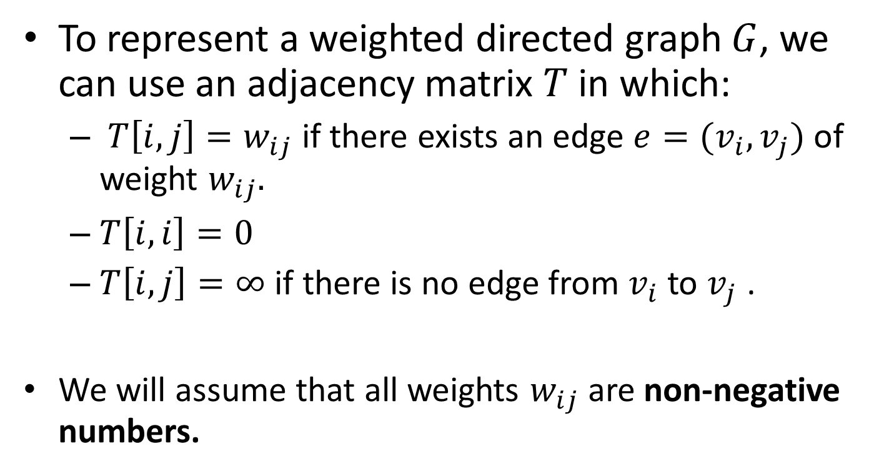
Weighted Graphs (cont’d)
To represent a weighted directed graph $G$, we can use an adjacency matrix $T$ in which:
  $T\left[i,j\right]=w_{ij}$ if there exists an edge $e=(v_{i},v_{j})$ of weight $w_{ij}.$
  $T\left[i,i\right]=0$
  $T\left[i,j\right]=∞$ if there is no edge from $v_{i}$ to $v_{j}$ .
  We will assume that all weights $w_{ij}$ are non-negative numbers.

Slide 4
Example Weighted Graph
7
2
3
3
5
8
10
1
1
4
2
5
6
6
7
5

Slide 5
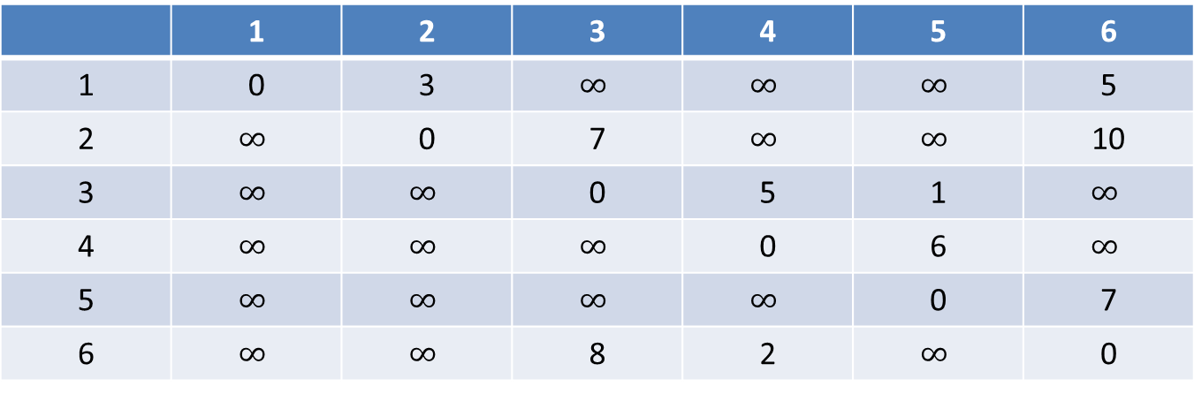
Adjacency Matrix for the Example Graph
 | 1 | 2 | 3 | 4 | 5 | 6
1 | 0 | 3 | $$∞$$ | $$∞$$ | $$∞$$ | 5
2 | $$∞$$ | 0 | 7 | $$∞$$ | $$∞$$ | 10
3 | $$∞$$ | $$∞$$ | 0 | 5 | 1 | $$∞$$
4 | $$∞$$ | $$∞$$ | $$∞$$ | 0 | 6 | $$∞$$
5 | $$∞$$ | $$∞$$ | $$∞$$ | $$∞$$ | 0 | 7
6 | $$∞$$ | $$∞$$ | 8 | 2 | $$∞$$ | 0

Slide 6
Shortest Paths (Συντομότερα Μονοπάτια)
The length of a path P is the sum of the weights of the edges of P.
A very interesting problem in a directed weighted graph is to find the shortest path from a vertex A to a vertex B.

Slide 7
The Shortest Path from Vertex 1 to Vertex 5
7
2
3
3
5
8
10
1
1
4
2
5
6
6
7
5

Slide 8
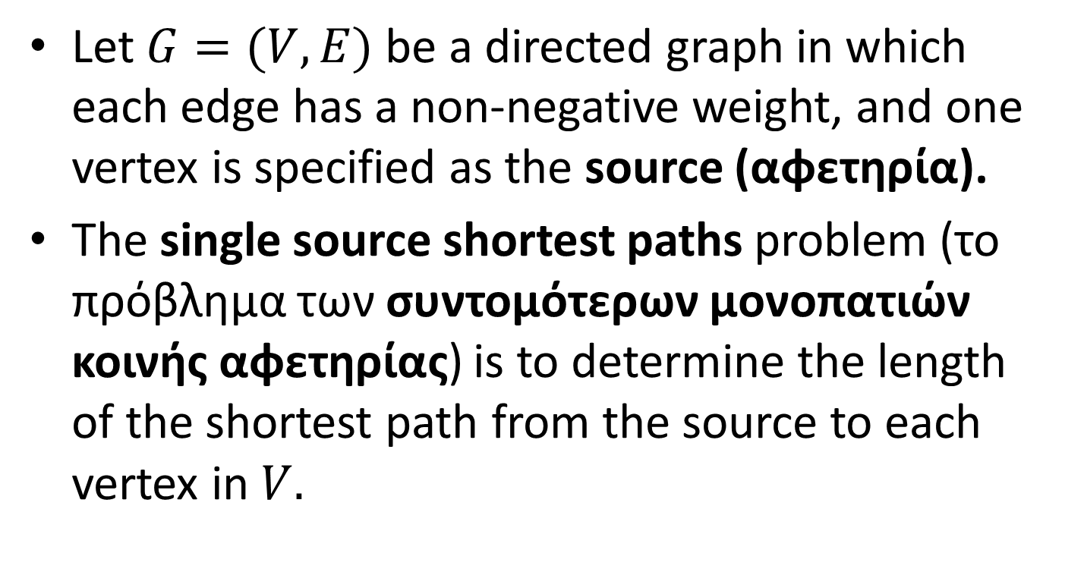
The Single Source Shortest Paths Problem
Let $G=(V,E)$ be a directed graph in which each edge has a non-negative weight, and one vertex is specified as the source (αφετηρία).
The single source shortest paths problem (το πρόβλημα των συντομότερων μονοπατιών κοινής αφετηρίας) is to determine the length of the shortest path from the source to each vertex in $V.$

Slide 9
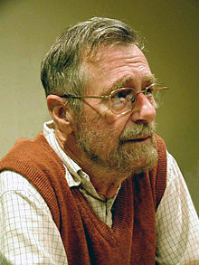
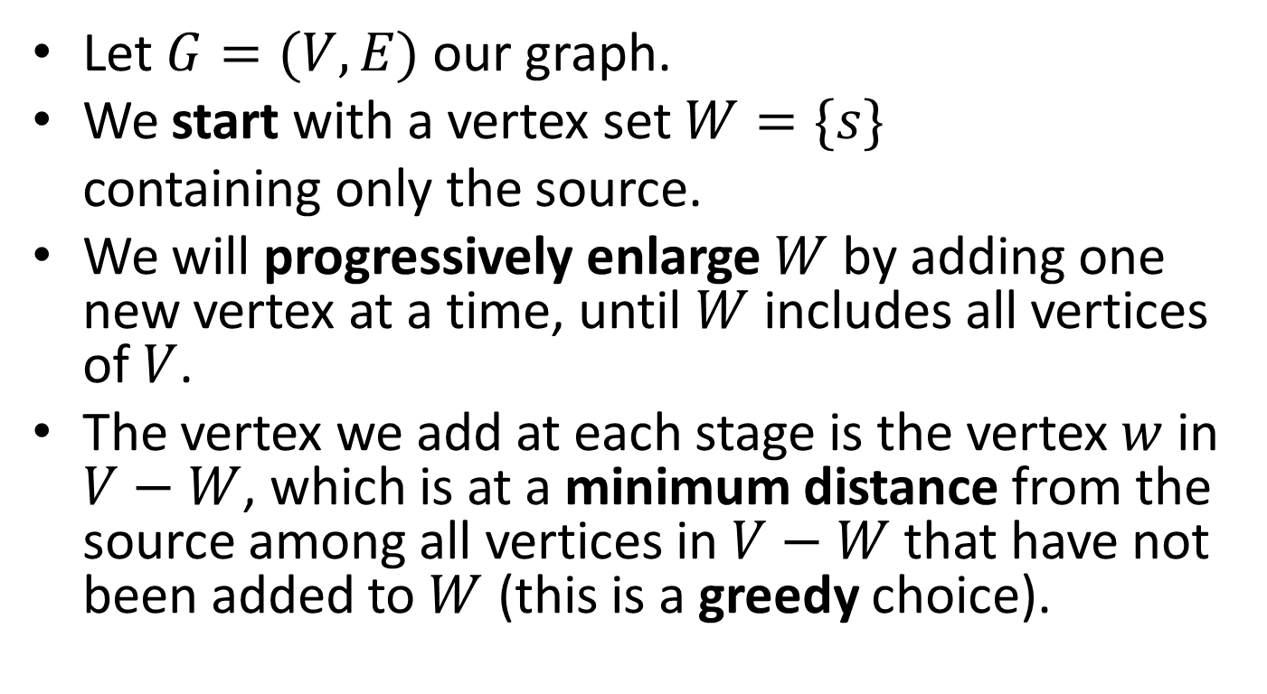
Dijkstra’s Greedy Algorithm for the Single Source Shortest Paths Problem
Let $G=(V,E)$ our graph.
We start with a vertex set $W=\{s\}$
containing only the source.
We will progressively enlarge $W$ by adding one new vertex at a time, until $W$includes all vertices of $V$.
The vertex we add at each stage is the vertex $w$ in $V−W$, which is at a minimum distance from the source among all vertices in $V−W$ that have not been added to $W$ (this is a greedy choice).

Slide 10
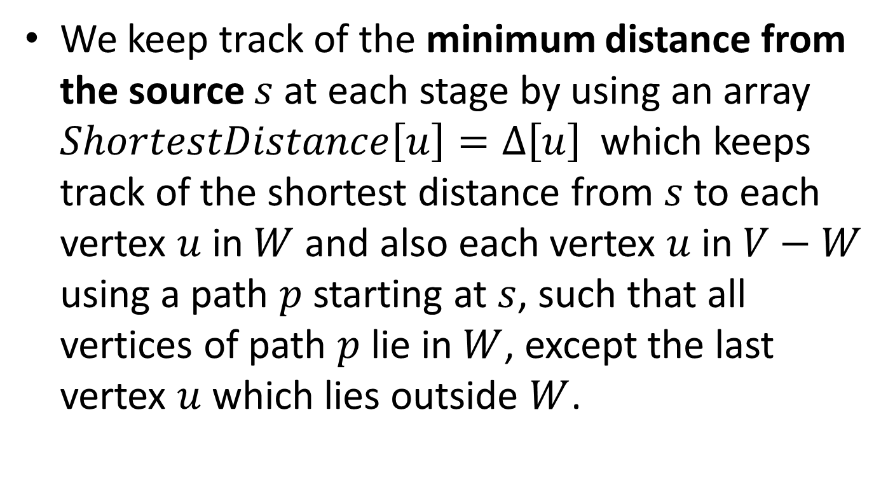
Dijkstra’s Algorithm (cont’d)
We keep track of the minimum distance from the source $s$ at each stage by using an array $ShortestDistance\left[u\right]=Δ\left[u\right]$which keeps track of the shortest distance from $s$ to each vertex $u$ in $W$ and also each vertex $u$in $V−W$ using a path $p$ starting at $s$, such that all vertices of path $p$ lie in $W$, except the last vertex $u$ which lies outside $W$.

Slide 11
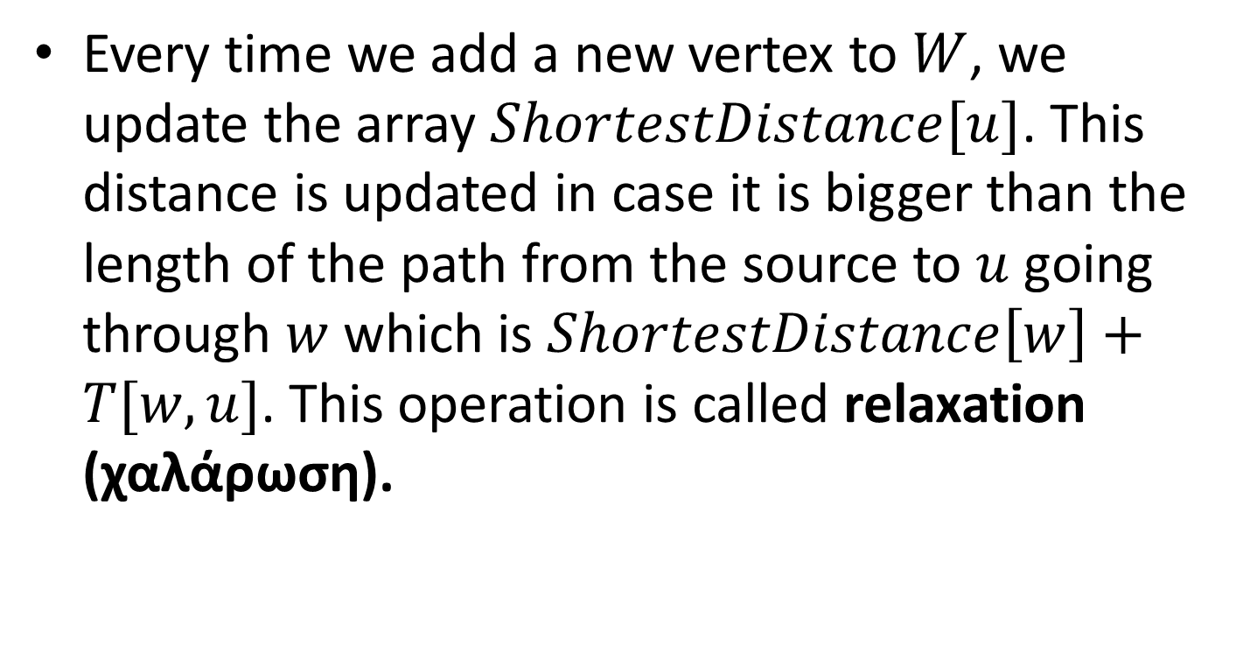
Dijkstra’s Algorithm (cont’d)
Every time we add a new vertex to $W$, we update the array $ShortestDistance[u]$. This distance is updated in case it is bigger than the length of the path from the source to $u$ going through $w$ which is $ShortestDistance\left[w\right]+T[w,u]$. This operation is called relaxation (χαλάρωση).

Slide 12
Example Graph
7
2
3
3
5
8
10
1
1
4
2
5
6
6
7
5

Slide 13
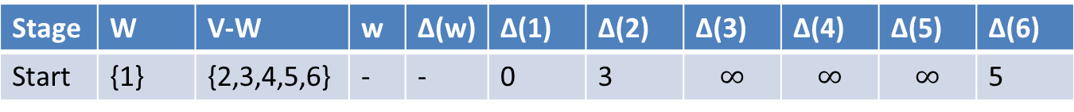
Expanding the Vertex Set W in Stages
Stage | W | V-W | w | Δ(w) | Δ(1) | Δ(2) | Δ(3) | Δ(4) | Δ(5) | Δ(6)
Start | {1} | {2,3,4,5,6} | - | - | 0 | 3 | $$∞$$ | $$∞$$ | $$∞$$ | 5
7
2
3
3
5
8
10
1
1
4
2
5
6
6
7
5

Slide 14
Expanding the Vertex Set W in Stages (cont’d)
Stage | W | V-W | w | Δ(w) | Δ(1) | Δ(2) | Δ(3) | Δ(4) | Δ(5) | Δ(6)
Start | {1} | {2,3,4,5,6} | - | - | 0 | 3 | $$∞$$ | $$∞$$ | $$∞$$ | 5
7
2
3
3
5
8
10
1
1
4
W=2 is chosen for the second stage.
2
5
6
6
7
5

Slide 15
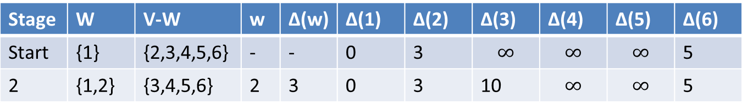
Expanding the Vertex Set W in Stages (cont’d)
Stage | W | V-W | w | Δ(w) | Δ(1) | Δ(2) | Δ(3) | Δ(4) | Δ(5) | Δ(6)
Start | {1} | {2,3,4,5,6} | - | - | 0 | 3 | $$∞$$ | $$∞$$ | $$∞$$ | 5
2 | {1,2} | {3,4,5,6} | 2 | 3 | 0 | 3 | 10 | $$∞$$ | $$∞$$ | 5
7
2
3
3
5
8
10
1
1
4
2
5
6
6
7
5

Slide 16
Expanding the Vertex Set W in Stages (cont’d)
Stage | W | V-W | w | Δ(w) | Δ(1) | Δ(2) | Δ(3) | Δ(4) | Δ(5) | Δ(6)
Start | {1} | {2,3,4,5,6} | - | - | 0 | 3 | $$∞$$ | $$∞$$ | $$∞$$ | 5
2 | {1,2} | {3,4,5,6} | 2 | 3 | 0 | 3 | 10 | $$∞$$ | $$∞$$ | 5
7
2
3
3
5
8
10
1
1
4
W=6 is chosen for the third stage.
2
5
6
6
7
5

Slide 17
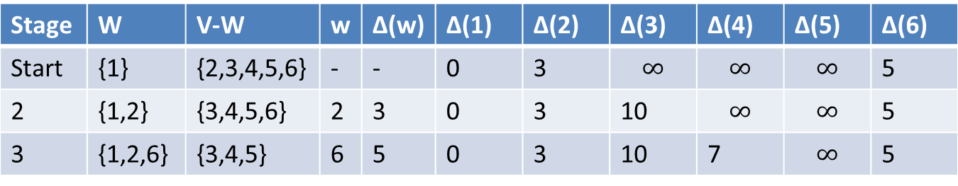
Expanding the Vertex Set W in Stages (cont’d)
Stage | W | V-W | w | Δ(w) | Δ(1) | Δ(2) | Δ(3) | Δ(4) | Δ(5) | Δ(6)
Start | {1} | {2,3,4,5,6} | - | - | 0 | 3 | $$∞$$ | $$∞$$ | $$∞$$ | 5
2 | {1,2} | {3,4,5,6} | 2 | 3 | 0 | 3 | 10 | $$∞$$ | $$∞$$ | 5
3 | {1,2,6} | {3,4,5} | 6 | 5 | 0 | 3 | 10 | 7 | $$∞$$ | 5
7
2
3
3
5
8
10
1
1
4
2
5
6
6
7
5

Slide 18
Expanding the Vertex Set W in Stages (cont’d)
Stage | W | V-W | w | Δ(w) | Δ(1) | Δ(2) | Δ(3) | Δ(4) | Δ(5) | Δ(6)
Start | {1} | {2,3,4,5,6} | - | - | 0 | 3 | $$∞$$ | $$∞$$ | $$∞$$ | 5
2 | {1,2} | {3,4,5,6} | 2 | 3 | 0 | 3 | 10 | $$∞$$ | $$∞$$ | 5
3 | {1,2,6} | {3,4,5} | 6 | 5 | 0 | 3 | 10 | 7 | $$∞$$ | 5
7
2
3
3
5
8
10
1
1
4
W=4 is chosen for the fourth stage.
2
5
6
6
7
5

Slide 19
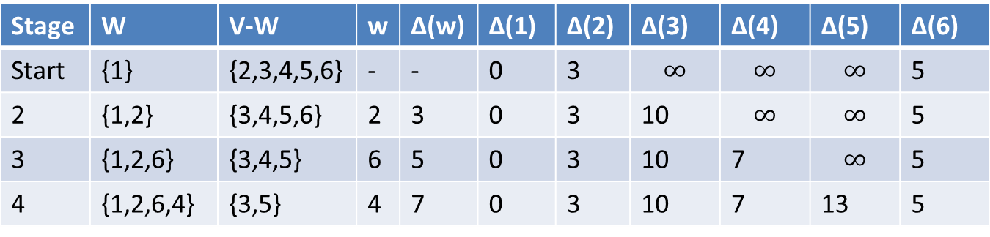
Expanding the Vertex Set W in Stages (cont’d)
Stage | W | V-W | w | Δ(w) | Δ(1) | Δ(2) | Δ(3) | Δ(4) | Δ(5) | Δ(6)
Start | {1} | {2,3,4,5,6} | - | - | 0 | 3 | $$∞$$ | $$∞$$ | $$∞$$ | 5
2 | {1,2} | {3,4,5,6} | 2 | 3 | 0 | 3 | 10 | $$∞$$ | $$∞$$ | 5
3 | {1,2,6} | {3,4,5} | 6 | 5 | 0 | 3 | 10 | 7 | $$∞$$ | 5
4 | {1,2,6,4} | {3,5} | 4 | 7 | 0 | 3 | 10 | 7 | 13 | 5
7
2
3
3
5
8
10
1
1
4
2
5
6
6
7
5

Slide 20
Expanding the Vertex Set W in Stages (cont’d)
Stage | W | V-W | w | Δ(w) | Δ(1) | Δ(2) | Δ(3) | Δ(4) | Δ(5) | Δ(6)
Start | {1} | {2,3,4,5,6} | - | - | 0 | 3 | $$∞$$ | $$∞$$ | $$∞$$ | 5
2 | {1,2} | {3,4,5,6} | 2 | 3 | 0 | 3 | 10 | $$∞$$ | $$∞$$ | 5
3 | {1,2,6} | {3,4,5} | 6 | 5 | 0 | 3 | 10 | 7 | $$∞$$ | 5
4 | {1,2,6,4} | {3,5} | 4 | 7 | 0 | 3 | 10 | 7 | 13 | 5
7
2
3
3
5
8
10
1
1
4
W=3 is chosen for the fifth stage.
2
5
6
6
7
5

Slide 21
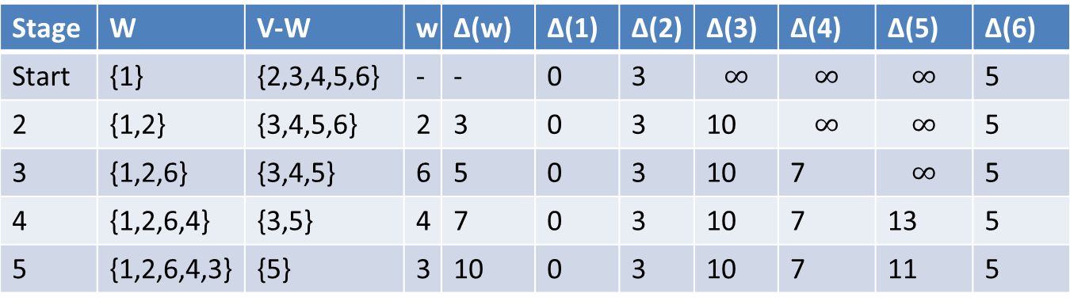
Expanding the Vertex Set W in Stages (cont’d)
Stage | W | V-W | w | Δ(w) | Δ(1) | Δ(2) | Δ(3) | Δ(4) | Δ(5) | Δ(6)
Start | {1} | {2,3,4,5,6} | - | - | 0 | 3 | $$∞$$ | $$∞$$ | $$∞$$ | 5
2 | {1,2} | {3,4,5,6} | 2 | 3 | 0 | 3 | 10 | $$∞$$ | $$∞$$ | 5
3 | {1,2,6} | {3,4,5} | 6 | 5 | 0 | 3 | 10 | 7 | $$∞$$ | 5
4 | {1,2,6,4} | {3,5} | 4 | 7 | 0 | 3 | 10 | 7 | 13 | 5
5 | {1,2,6,4,3} | {5} | 3 | 10 | 0 | 3 | 10 | 7 | 11 | 5
7
2
3
3
5
8
10
1
1
4
2
5
6
6
7
5

Slide 22
Expanding the Vertex Set W in Stages (cont’d)
Stage | W | V-W | w | Δ(w) | Δ(1) | Δ(2) | Δ(3) | Δ(4) | Δ(5) | Δ(6)
Start | {1} | {2,3,4,5,6} | - | - | 0 | 3 | $$∞$$ | $$∞$$ | $$∞$$ | 5
2 | {1,2} | {3,4,5,6} | 2 | 3 | 0 | 3 | 10 | $$∞$$ | $$∞$$ | 5
3 | {1,2,6} | {3,4,5} | 6 | 5 | 0 | 3 | 10 | 7 | $$∞$$ | 5
4 | {1,2,6,4} | {3,5} | 4 | 7 | 0 | 3 | 10 | 7 | 13 | 5
5 | {1,2,6,4,3} | {5} | 3 | 10 | 0 | 3 | 10 | 7 | 11 | 5
7
2
3
3
5
8
10
1
W=5 is chosen for the sixth stage.
1
4
2
5
6
6
7
5

Slide 23
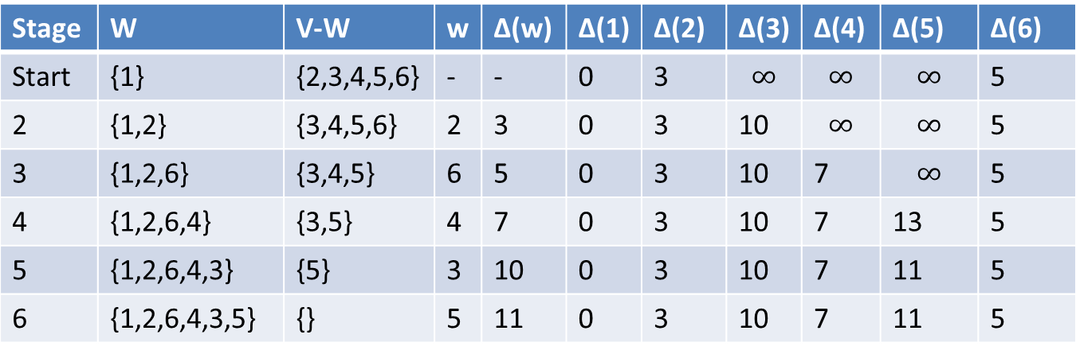
Expanding the Vertex Set W in Stages (cont’d)
Stage | W | V-W | w | Δ(w) | Δ(1) | Δ(2) | Δ(3) | Δ(4) | Δ(5) | Δ(6)
Start | {1} | {2,3,4,5,6} | - | - | 0 | 3 | $$∞$$ | $$∞$$ | $$∞$$ | 5
2 | {1,2} | {3,4,5,6} | 2 | 3 | 0 | 3 | 10 | $$∞$$ | $$∞$$ | 5
3 | {1,2,6} | {3,4,5} | 6 | 5 | 0 | 3 | 10 | 7 | $$∞$$ | 5
4 | {1,2,6,4} | {3,5} | 4 | 7 | 0 | 3 | 10 | 7 | 13 | 5
5 | {1,2,6,4,3} | {5} | 3 | 10 | 0 | 3 | 10 | 7 | 11 | 5
6 | {1,2,6,4,3,5} | {} | 5 | 11 | 0 | 3 | 10 | 7 | 11 | 5
7
2
3
3
5
8
10
1
1
4
2
5
6
6
7
5

Slide 24
Dijkstra’s Algorithm in Pseudocode
void ShortestPath(void)
{
Let MinDistance be a variable that takes edge
weights as values.
Let Minimum(x,y) be a function whose value is the lesser
of x and y.
/* Let s in V be the source vertex at which the
shortest paths starts. */
/* Initialize W and ShortestDistance[u] as follows: */
W={s};
ShortestDistance[s]=0;
for (each u in V-{s}) ShortestDistance[u]=T[s][u];

Slide 25

Dijkstra’s Algorithm (cont’d)
/*Now repeatedly enlarge W until W includes all vertices in V */
while (W!=V){
/* find the vertex w in V-W at the minimum distance from s */
MinDistance=$∞;$
for (each v in V-W){
if (ShortestDistance[v] < MinDistance){
MinDistance=ShortestDistance[v];
w=v;
}
}
/* add w to W */
W=W $∪$ {w};
/* relaxation step: update the shortest distance to vertices in V-W */
for (each u in V-W){
ShortestDistance[u]=Minimum(ShortestDistance[u],
ShortestDistance[w]+T[w][u]);
}
}
}

Slide 26
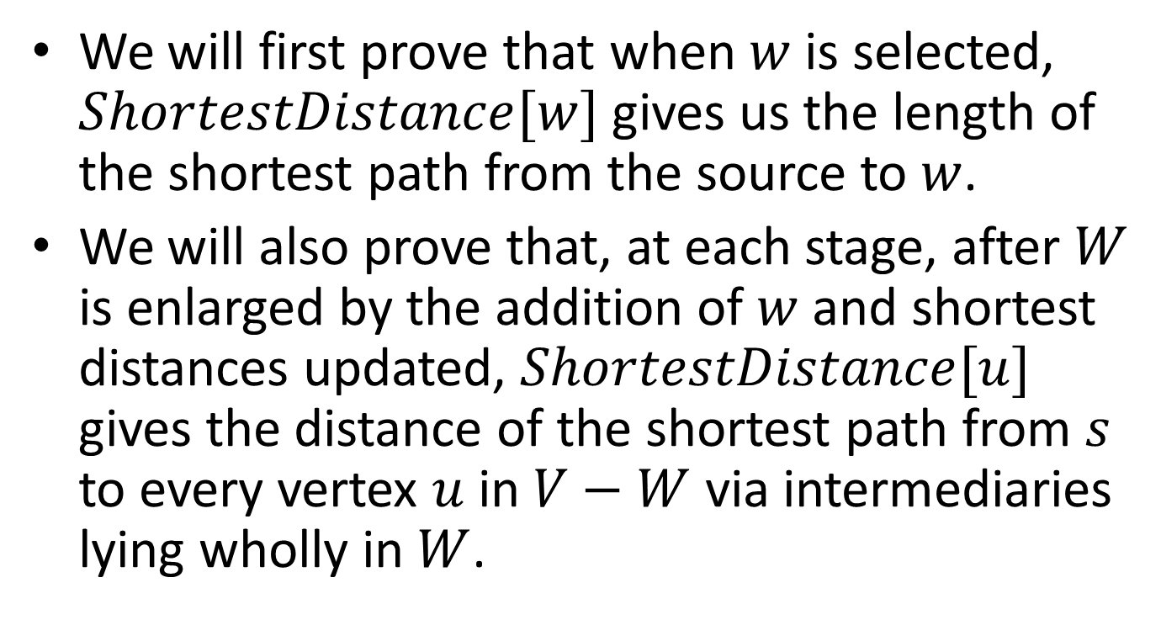
Proof of Correctness
We will first prove that when $w$ is selected, $ShortestDistance[w]$ gives us the length of the shortest path from the source to $w$.
We will also prove that, at each stage, after $W$ is enlarged by the addition of $w$ and shortest distances updated, $ShortestDistance[u]$ gives the distance of the shortest path from $s$ to every vertex $u$ in $V−W$ via intermediaries lying wholly in $W$.

Slide 27
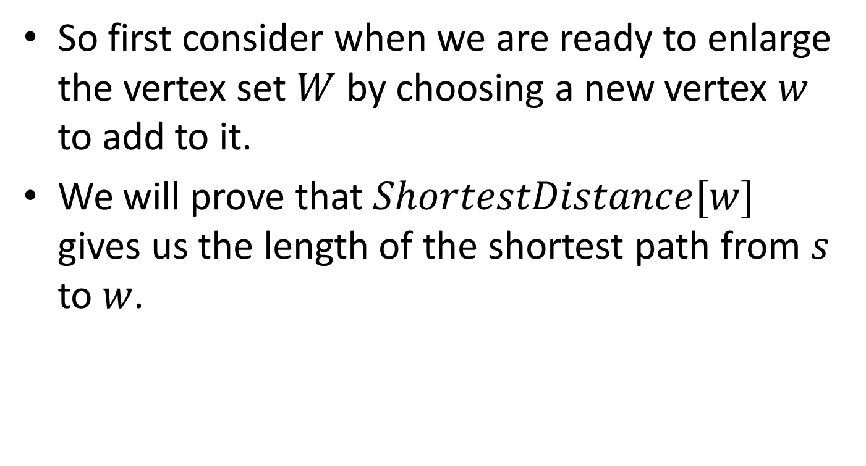
Proof (cont’d)
So first consider when we are ready to enlarge the vertex set $W$ by choosing a new vertex $w$ to add to it.
We will prove that $ShortestDistance[w]$ gives us the length of the shortest path from $s$ to $w$.

Slide 28
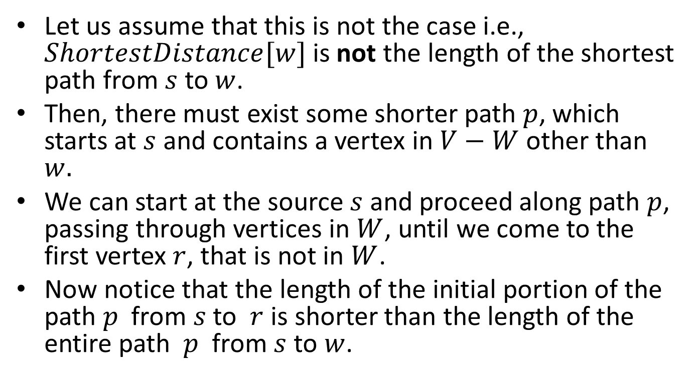
Proof (cont’d)
Let us assume that this is not the case i.e., $ShortestDistance[w]$ is not the length of the shortest path from $s$ to $w$.
Then, there must exist some shorter path $p$, which starts at $s$ and contains a vertex in $V−W$ other than $w.$
We can start at the source $s$ and proceed along path $p$, passing through vertices in $W$, until we come to the first vertex $r$, that is not in $W$.
Now notice that the length of the initial portion of the path $p$ from $s$ to $r$is shorter than the length of the entire path $p$ from $s$ to $w$.

Slide 29

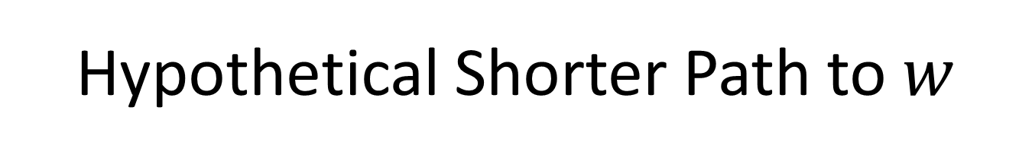



Hypothetical Shorter Path to $w$
$$w$$
$$s$$
$$W$$
$$r$$

Slide 30
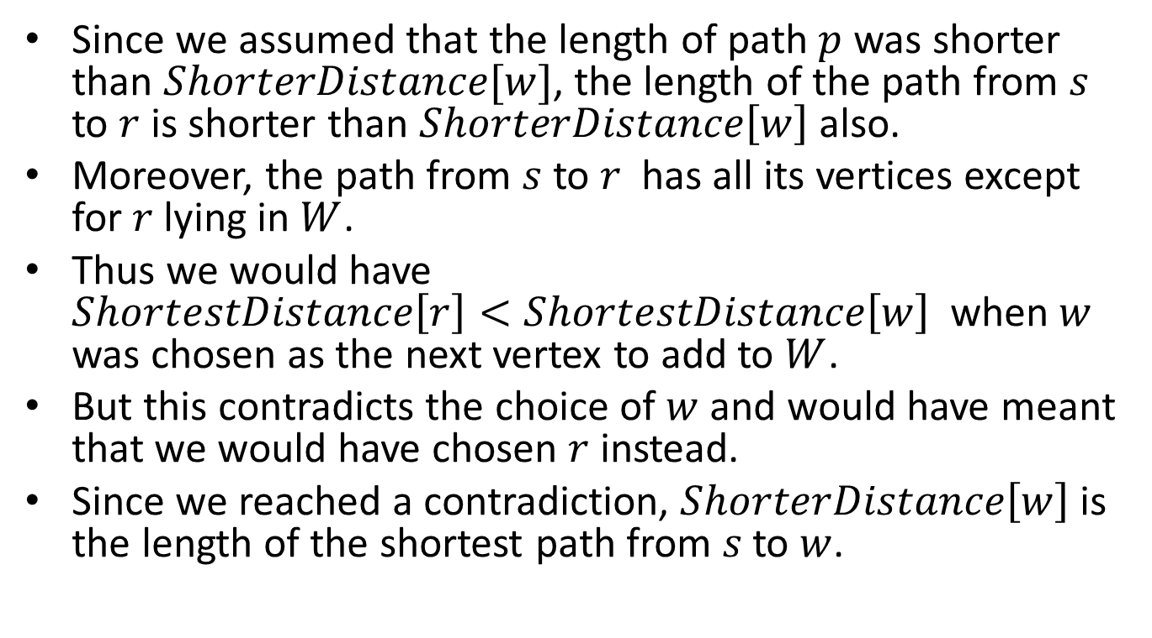
Proof (cont’d)
Since we assumed that the length of path $p$ was shorter than $ShorterDistance[w]$, the length of the path from $s$ to $r$ is shorter than $ShorterDistance\left[w\right]$also.
Moreover, the path from $s$ to $r$ has all its vertices except for $r$lying in $W$.
Thus we would have $ShortestDistance\left[r\right]<ShortestDistance\left[w\right]$ when $w$ was chosen as the next vertex to add to $W$.
But this contradicts the choice of $w$and would have meant that we would have chosen $r$ instead.
Since we reached a contradiction, $ShorterDistance\left[w\right]$ is the length of the shortest path from $s$to $w$.

Slide 31
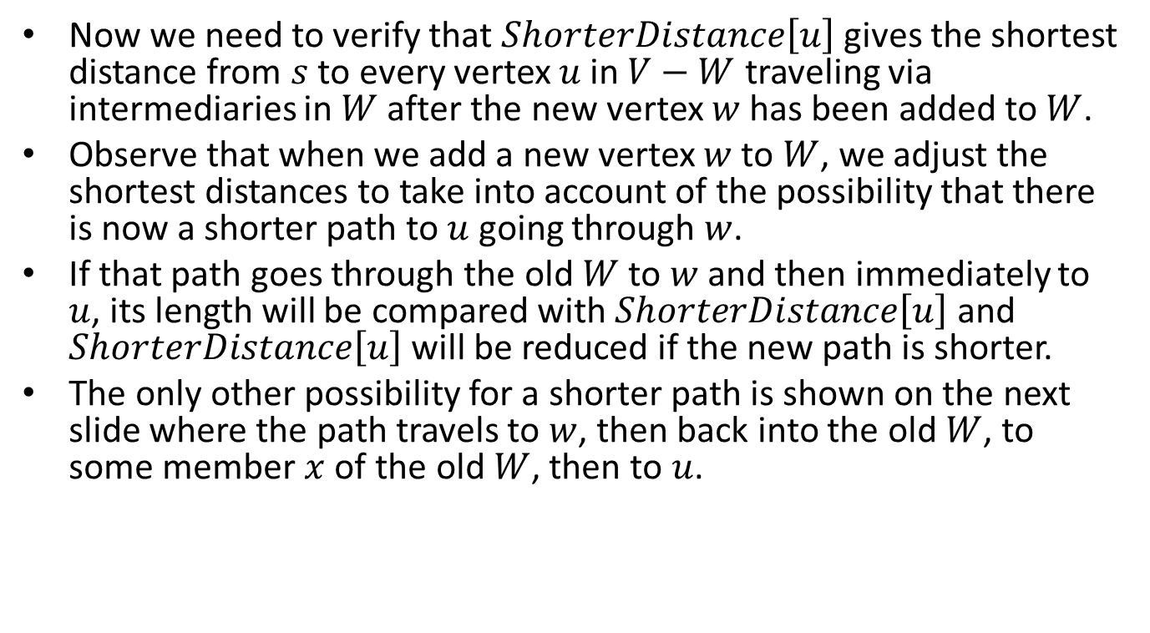
Proof (cont’d)
Now we need to verify that $ShorterDistance\left[u\right]$ gives the shortest distance from $s$ to every vertex $u$ in $V−W$ traveling via intermediaries in $W$ after the new vertex $w$ has been added to $W$.
Observe that when we add a new vertex $w$ to $W$, we adjust the shortest distances to take into account of the possibility that there is now a shorter path to $u$ going through $w$.
If that path goes through the old $W$ to $w$ and then immediately to $u$, its length will be compared with $ShorterDistance\left[u\right]$ and $ShorterDistance\left[u\right]$ will be reduced if the new path is shorter.
The only other possibility for a shorter path is shown on the next slide where the path travels to $w$, then back into the old $W$, to some member $x$ of the old $W$, then to $u$.

Slide 32





Impossible Shortest Path
$$u$$
$$x$$
$$Old W$$
$$s$$
$$w$$

Slide 33
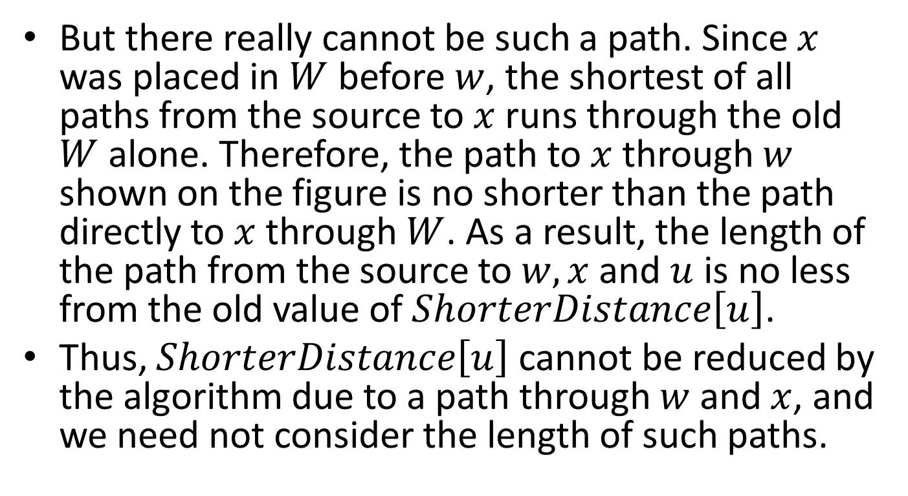
Proof (cont’d)
But there really cannot be such a path. Since $x$ was placed in $W$ before $w$, the shortest of all paths from the source to $x$ runs through the old $W$ alone. Therefore, the path to $x$ through $w$ shown on the figure is no shorter than the path directly to $x$ through $W$. As a result, the length of the path from the source to $w, x$ and $u$ is no less from the old value of $ShorterDistance\left[u\right]$.
Thus, $ShorterDistance\left[u\right]$ cannot be reduced by the algorithm due to a path through $w$ and $x$, and we need not consider the length of such paths.

Slide 34
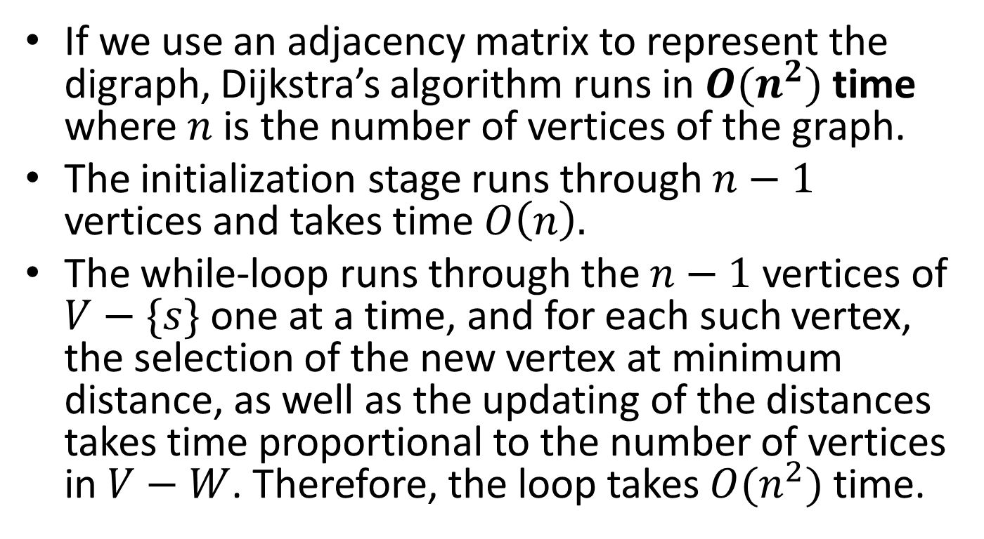
Time Complexity
If we use an adjacency matrix to represent the digraph, Dijkstra’s algorithm runs in $O(n^{2})$ time where $n$ is the number of vertices of the graph.
The initialization stage runs through $n−1$ vertices and takes time $O\left(n\right).$
The while-loop runs through the $n−1$ vertices of $V−\{s\}$ one at a time, and for each such vertex, the selection of the new vertex at minimum distance, as well as the updating of the distances takes time proportional to the number of vertices in $V−W$. Therefore, the loop takes $O(n^{2})$ time.

Slide 35
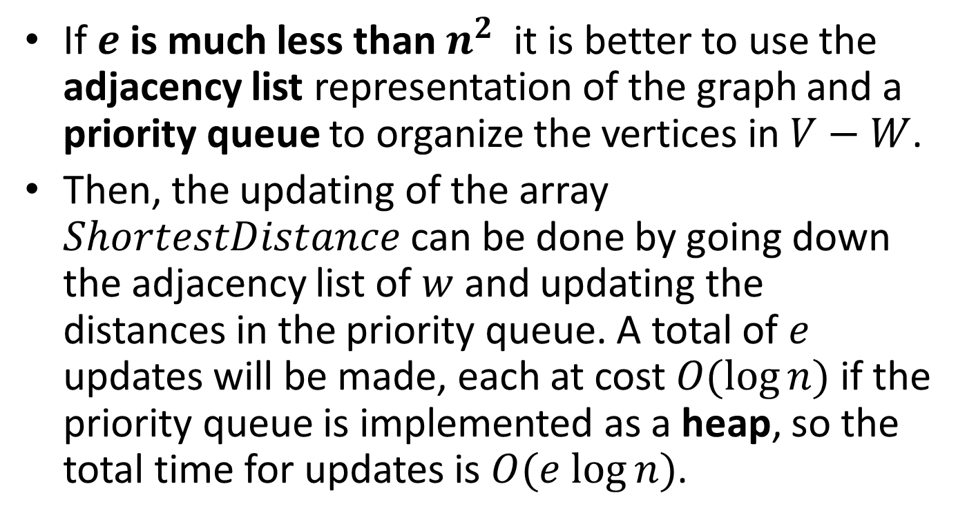
Time Complexity (cont’d)
If $e$ is much less than $n^{2}$ it is better to use the adjacency list representation of the graph and a priority queue to organize the vertices in $V−W$.
Then, the updating of the array $ShortestDistance$ can be done by going down the adjacency list of $w$ and updating the distances in the priority queue. A total of $e$ updates will be made, each at cost $O(\log{n})$ if the priority queue is implemented as a heap, so the total time for updates is $O(e log{n})$.

Slide 36
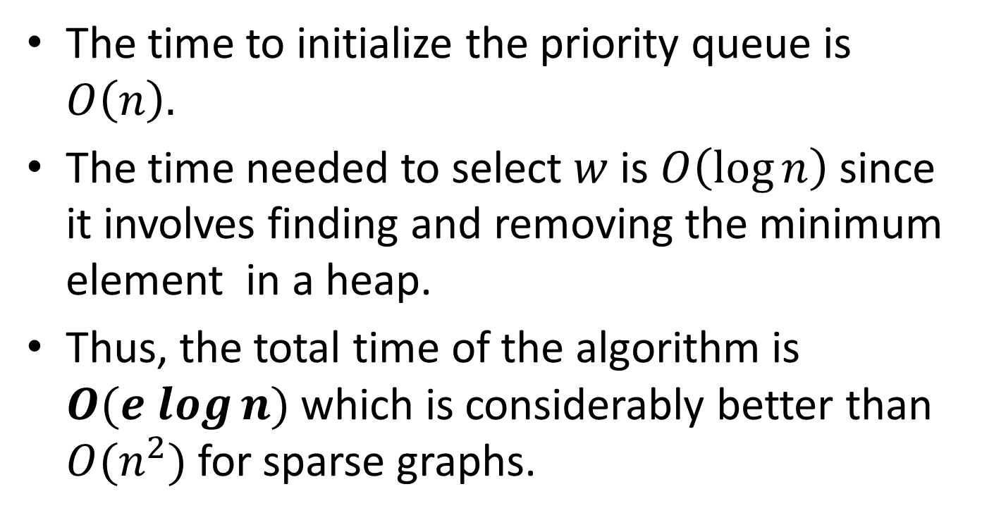
Time Complexity (cont’d)
The time to initialize the priority queue is $O\left(n\right).$
The time needed to select $w$ is $O\left(\log{n}\right)$ since it involves finding and removing the minimum element in a heap.
Thus, the total time of the algorithm is $O(e log{n})$ which is considerably better than $O(n^{2})$ for sparse graphs.

Slide 37
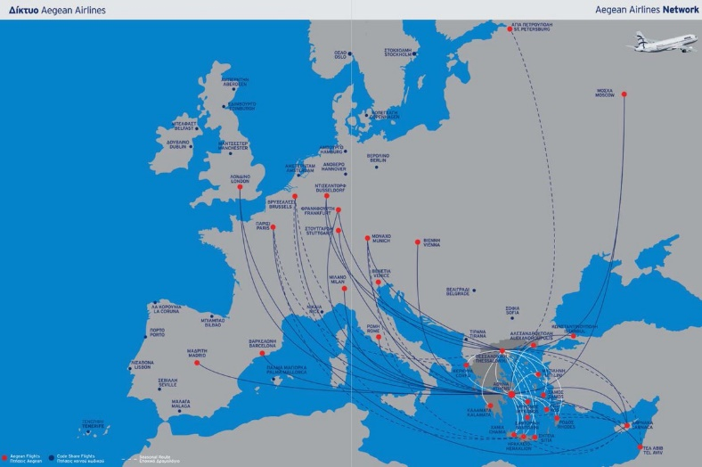
The All-Pairs Shortest Path Problem
Suppose we have a weighted digraph that gives the flying time on certain routes containing cities, and we wish to construct a table that gives the shortest time required to fly from any one city to any other.
This is an instance of the all-pairs shortest path problem.

Slide 38
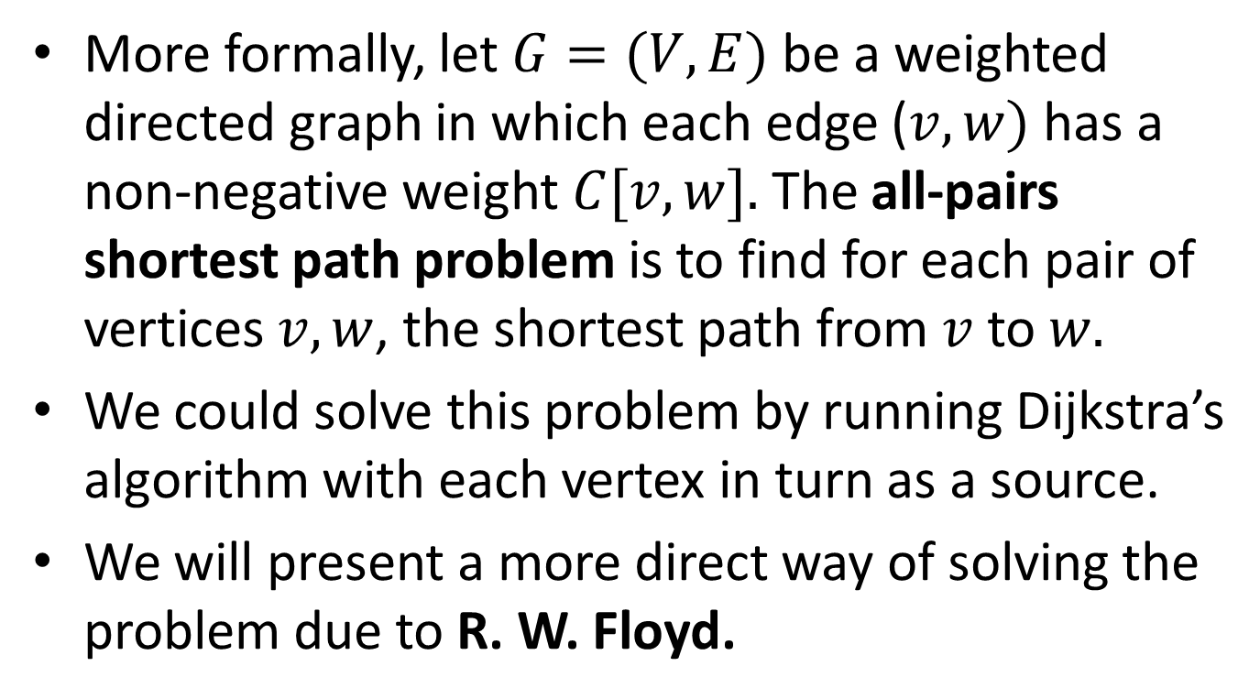
The All-Pairs Shortest Path Problem (cont’d)
More formally, let $G=(V,E)$ be a weighted directed graph in which each edge ($v,w)$ has a non-negative weight $C[v,w].$ The all-pairs shortest path problem is to find for each pair of vertices $v,w$, the shortest path from $v$ to $w.$
We could solve this problem by running Dijkstra’s algorithm with each vertex in turn as a source.
We will present a more direct way of solving the problem due to R. W. Floyd.

Slide 39
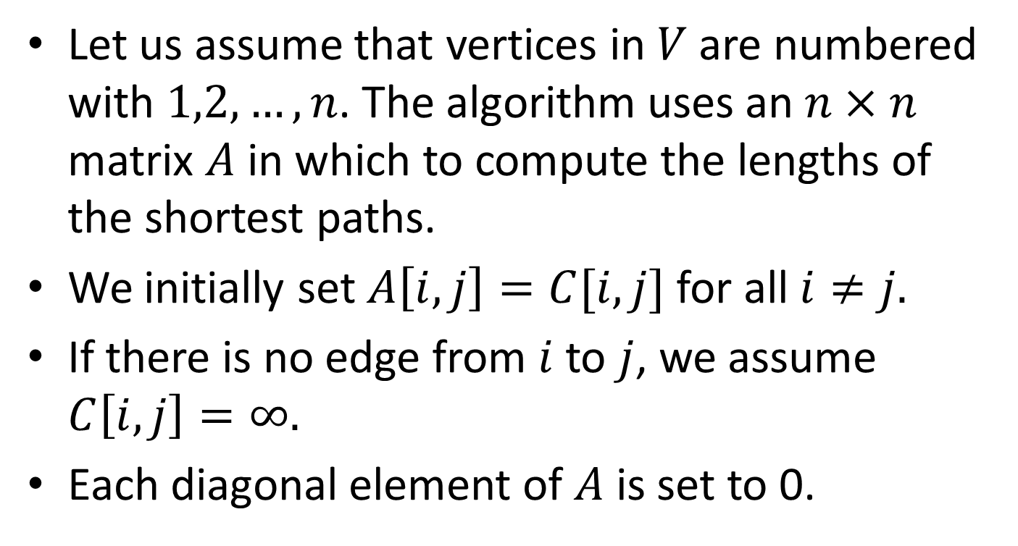
Floyd’s Algorithm
Let us assume that vertices in $V$are numbered with $1,2, …,n$. The algorithm uses an $n×n$ matrix $A$ in which to compute the lengths of the shortest paths.
We initially set $A\left[i,j\right]=C[i,j]$ for all $i≠j.$
If there is no edge from $i$ to $j$, we assume $C\left[i,j\right]=∞.$
Each diagonal element of $A$ is set to 0.

Slide 40
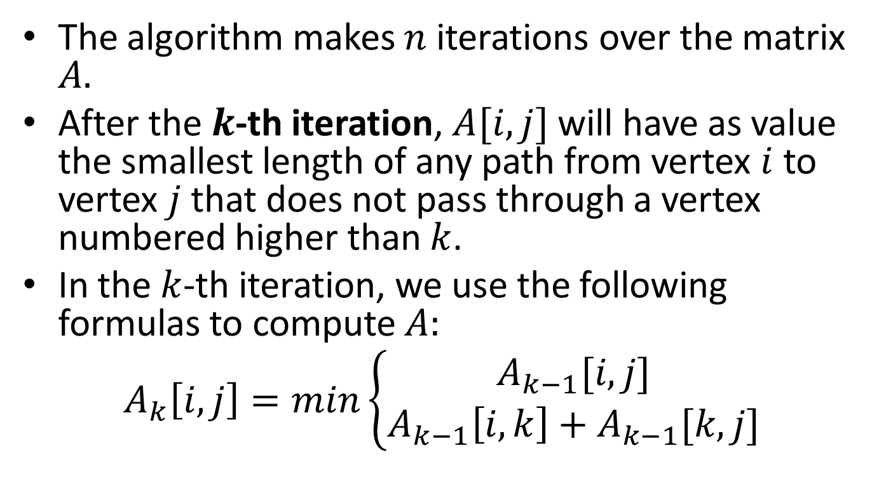
Floyd’s Algorithm (cont’d)
The algorithm makes $n$ iterations over the matrix $A.$
After the $k$-th iteration, $A[i,j]$ will have as value the smallest length of any path from vertex $i$ to vertex $j$ that does not pass through a vertex numbered higher than $k$.
In the $k$-th iteration, we use the following formulas to compute $A:$
$$A_{k}\left[i,j\right]=min\left\{\begin{aligned}A_{k−1}[i,j] \\ A_{k−1}\left[i,k\right]+A_{k−1}[k,j]\end{aligned}\right.$$

Slide 41







The $k$-th Iteration Graphically
$$k$$
$$A_{k−1}[i,k]$$
$$A_{k−1}[k,j]$$
$$i$$
$$j$$
$$A_{k−1}[i,j]$$

Slide 42
Floyd’s Algorithm (cont’d)
void APSP(void)
{
int i,j,k;
int A[MAX][MAX], C[MAX][MAX];
for (i=0; i<=MAX-1; i++)
for (j=0; j<=MAX-1; j++)
A[i][j]=C[i][j];
for (i=0; i<=MAX-1; i++)
A[i][i]=0;
for (k=0; k<=MAX-1; k++)
for (i=0; i<=MAX-1; i++)
for (j=0; j<=MAX-1; j++)
if (A[i][k]+A[k][j] < A[i][j])
A[i][j]=A[i][k]+A[k][j];
}

Slide 43

Time Complexity
The running time of Floyd’s algorithm is $O(n^{3})$ where $n$ is the number of vertices.

Slide 44
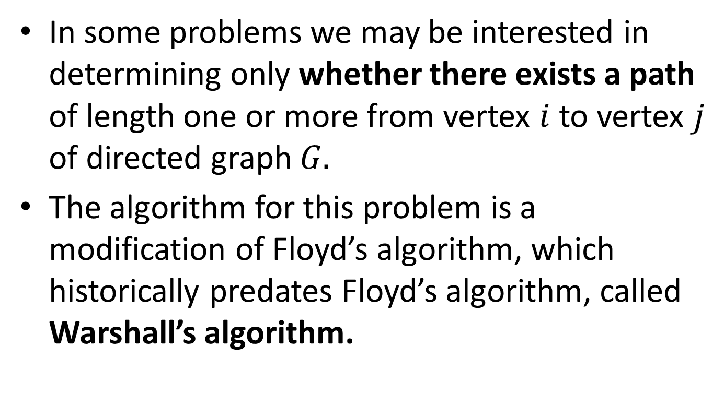
Transitive Closure (Μεταβατική Κλειστότητα)
In some problems we may be interested in determining only whether there exists a path of length one or more from vertex $i$ to vertex $j$ of directed graph $G.$
The algorithm for this problem is a modification of Floyd’s algorithm, which historically predates Floyd’s algorithm, called Warshall’s algorithm.

Slide 45
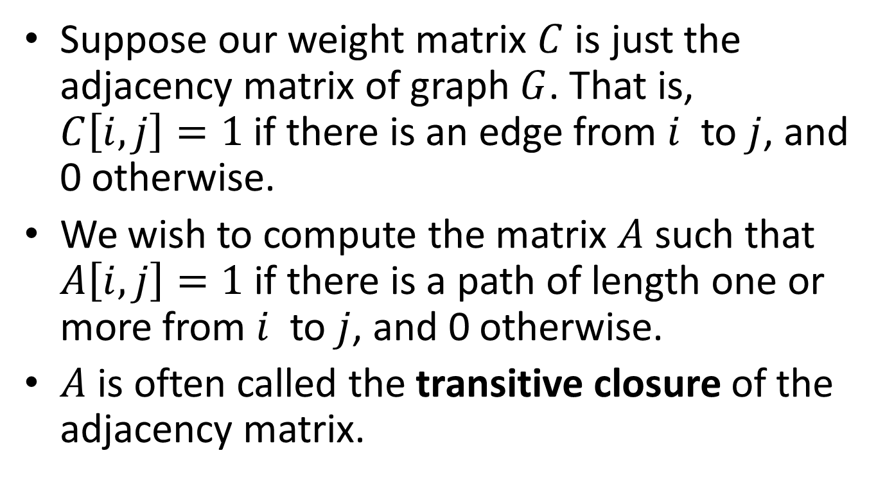
Transitive Closure (cont’d)
Suppose our weight matrix $C$ is just the adjacency matrix of graph $G$. That is, $C\left[i,j\right]=1$ if there is an edge from $i$ to $j$, and 0 otherwise.
We wish to compute the matrix $A$ such that $A\left[i,j\right]=1$ if there is a path of length one or more from $i$ to $j$, and 0 otherwise.
$A$ is often called the transitive closure of the adjacency matrix.

Slide 46
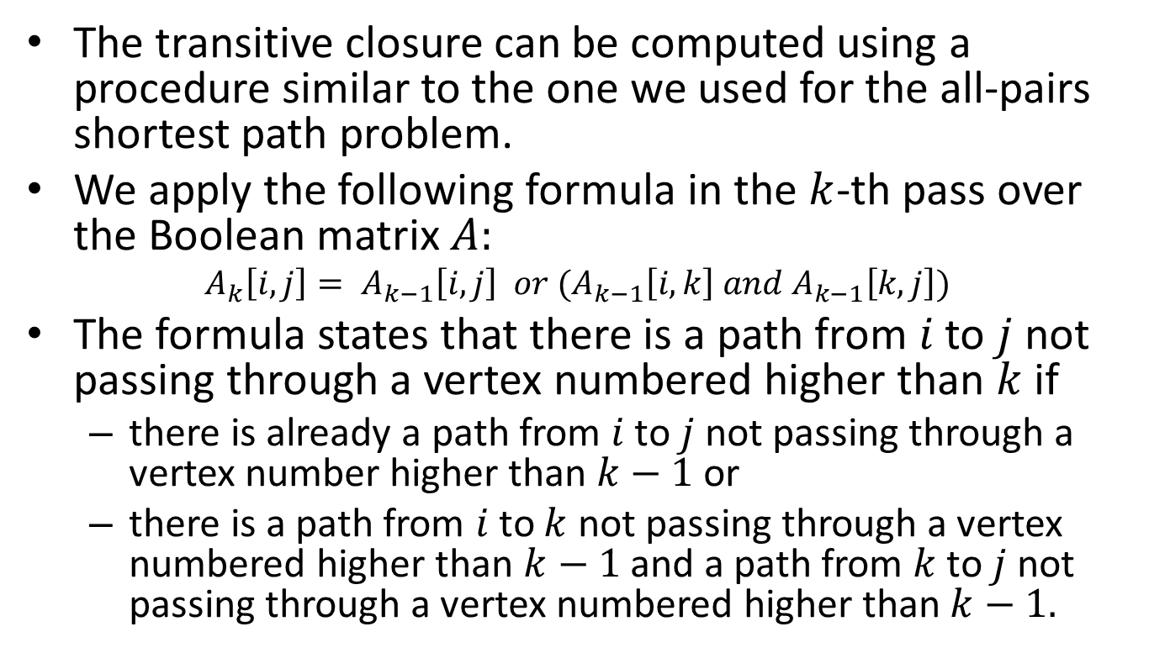
Transitive Closure (cont’d)
The transitive closure can be computed using a procedure similar to the one we used for the all-pairs shortest path problem.
We apply the following formula in the $k$-th pass over the Boolean matrix $A:$
$$A_{k}\left[i,j\right]= A_{k−1}\left[i,j\right] or (A_{k−1}\left[i,k\right] and A_{k−1}\left[k,j\right])$$
The formula states that there is a path from $i$ to $j$ not passing through a vertex numbered higher than $k$ if
  there is already a path from $i$ to $j$ not passing through a vertex number higher than $k−1$ or
  there is a path from $i$ to $k$ not passing through a vertex numbered higher than $k−1$ and a path from $k$ to $j$ not passing through a vertex numbered higher than $k−1.$

Slide 47
Transitive Closure (cont’d)
void TransitiveClosure(void)
{
int i,j,k;
int A[MAX][MAX], C[MAX][MAX];
for (i=0; i<=MAX-1; i++)
for (j=0; j<=MAX-1; j++)
A[i][j]=C[i][j];
for (k=0; k<=MAX-1; k++)
for (i=0; i<=MAX-1; i++)
for (j=0; j<=MAX-1; j++)
if (!A[i][j])
A[i][j]=A[i][k] && A[k][j];
}

Slide 48

Time Complexity
The running time of Warshall’s algorithm is $O(n^{3})$ where $n$ is the number of vertices.

Slide 49
Readings
T. A. Standish. Data Structures , Algorithms and Software Principles in C.
  Chapter 10
A. V. Aho, J. E. Hopcroft and J. D. Ullman. Data Structures and Algorithms.
  Chapters 6 and 7

