Slide 1
Building Semantic Sensor Webs and Applications
ESWC 2011 Tutorial
29 May 2011

Slide 2
Tutorial Objectives
Knowledge of the basic concepts and tools to build semantically-enabled applications and services that rely partially or totally on data coming from sensor networks
Whom of this group are you in?
  Developers who wish to build such applications
  People interested in the basic concepts of semantic sensor web applications
  Experts in Semantic Sensor Web applications

Slide 3
Whom we are?
Oscar Corcho (UPM)
Alasdair Gray (UNIMAN)
Kostis Kyzirakos (NKUA)
Jean Paul Calbimonte (UPM)
Kevin Page (SOTON)

Slide 4
Schedule for today
Introduction (20’)
Semantic Sensor Web components (20’)
Discovering Sources for a Region: (20 minutes theory + 30 minutes practical)
Coffee break (20 minutes)
Querying Streaming Data through Ontologies: (20 minutes theory + 30 minutes practical)
Sensor Data and Semantic Mashups: (20 minutes theory + 30 minutes practical)

Slide 5
Introduction to the
Semantic Sensor Web
ESWC 2011 Tutorial
29 May 2011

Slide 6
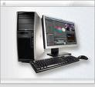
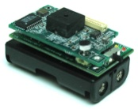

Sensor Networks
Increasing availability of cheap, robust, deployable sensors as ubiquitous information sources
Dynamic and reactive, but noisy, and unstructured data streams
Source: Antonis Deligiannakis

Slide 7
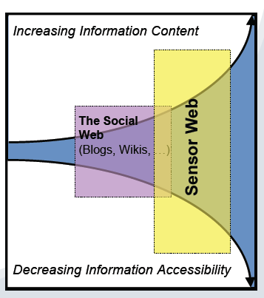
The Sensor Web
Sensor networks may be networked, mostly wireless, hence global and integrated
Universal, web-based access to sensor data
Each network with some kind of authority and administration
Sensor networks vs robust networks
Source: Adapted from Alan Smeaton’s invited talk at ESWC2009

Slide 8
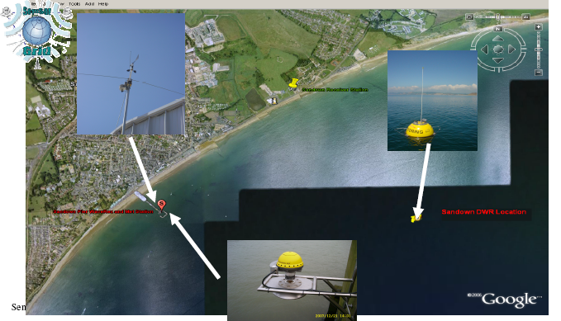
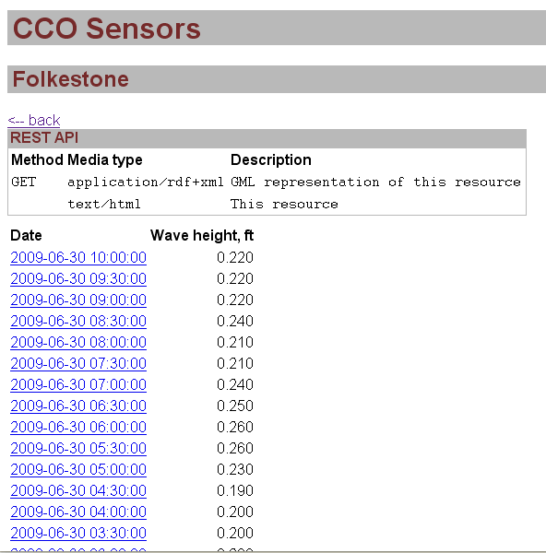
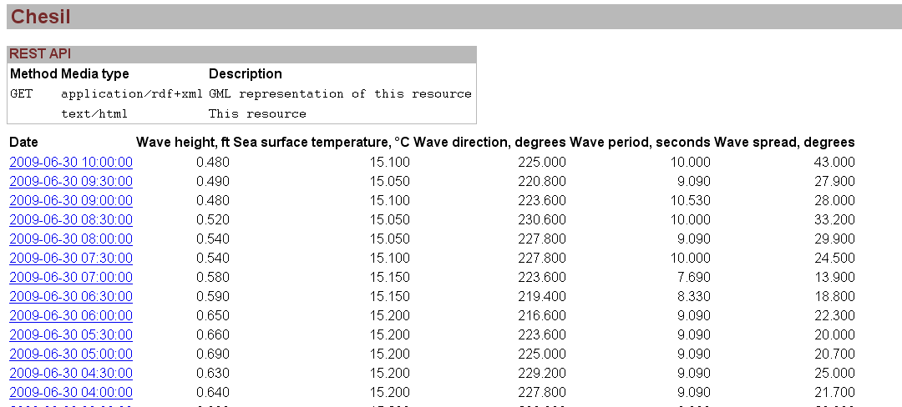
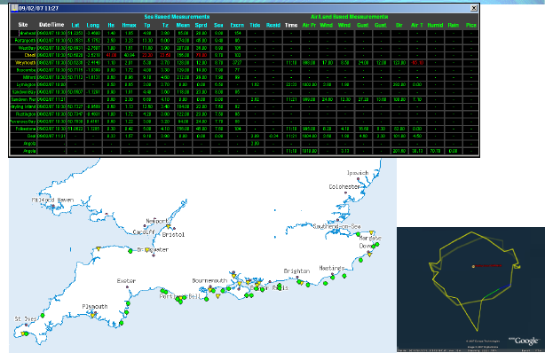
Sensor Web: Is this part of the Web/Internet?
Source: SemsorGrid4Env consortium

Slide 9
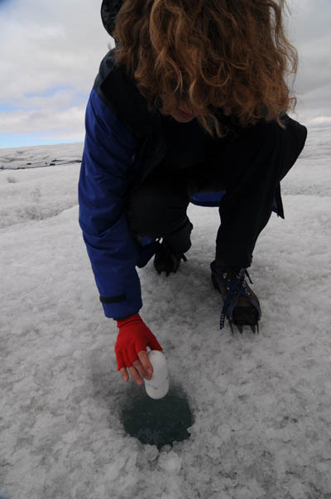
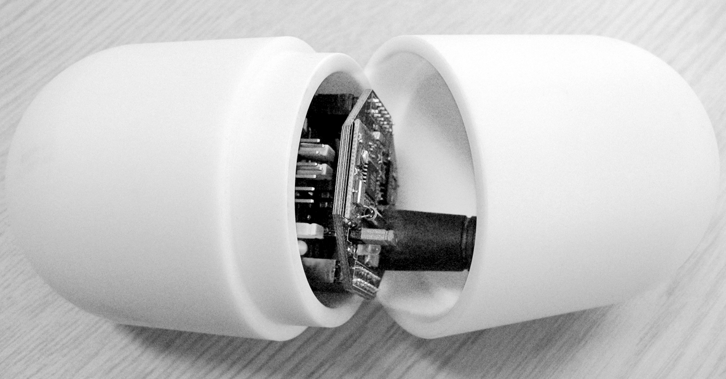
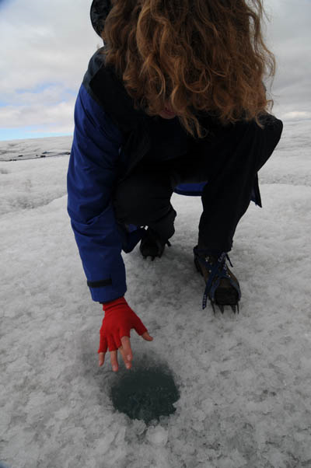
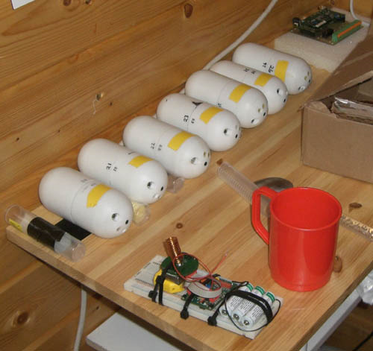
Who are the end users of sensor networks?
The climate change expert, or a simple citizen
Source: Dave de Roure
Notes:
The climate change researcher
The citizen
with RFID tag, phone, MP3, GPS, ...
The sensor network support guys

Slide 10
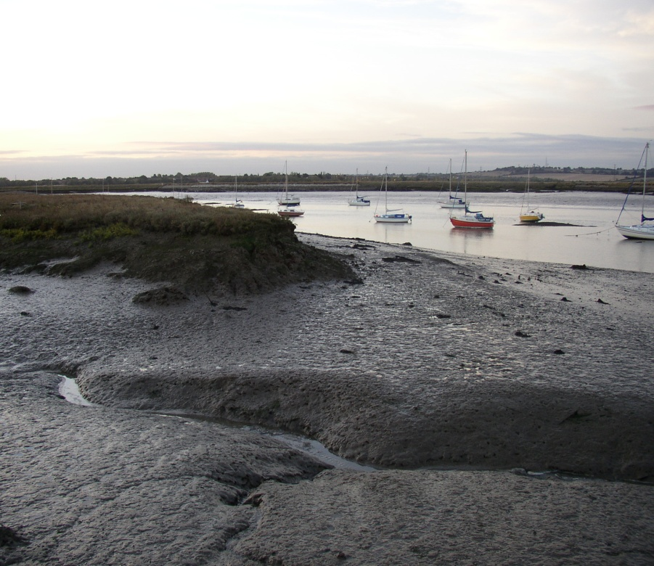
Most of you are computer scientists.
Why is it worth working on this?
You may like helping scientists, or…
You want to address any of the following challenges in Computer Science:
  Scale, scalable
  Autonomic behaviour versus control
  Persistent, heterogeneous, evolving
  Deployment challenge
  Some mobile devices
Source: Dave de Roure

Slide 11
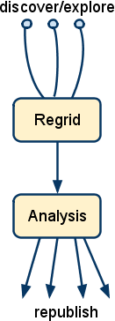
A set of challenges in sensor data management
Data Provisioning
  Complexity of acquisition: distributed sources, data volumes, uncertainty, data quality, incompleteness
  Pre-processing incoming data: calibration on instruments (specific), lack of re-grid, calibration, gap-filling features
  Tools for data ingestion needed: generic, customizable, provide estimates, uncertainty degree, etc.
Spatial/temporal
Analysis, modeling
  Discovery: identify sources, metadata
  Data quality: gaps, faulty data, loss, estimates
  Analysis models
  Republish analytic results, computations,
  Workflows for data stream processing
Source: Data Management in the WorldWide Sensor Web. Balazinska et al.
IEEE Pervasive Computing, 2007

Slide 12
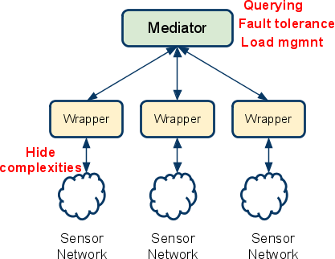
A set of challenges in sensor data management
Interoperability
  Data aggregation/integration
Uncertainty, data quality
  Noise, failures,
  measurement errors,
  confidence, trust
Distributed processing
  High volume, time critical
  Fault-tolerance
  Load management
  Stream processing features
  Continuous queries
  Live & historical data
Source: Data Management in the WorldWide Sensor Web. Balazinska et al.
IEEE Pervasive Computing, 2007

Slide 13
A semantic perspective on these challenges
Sensor data querying and (pre-)processing
  Data heterogeneity → Data integration and fusion
  Data quality
  New inference capabilities required to deal with sensor information
Sensor data model representation and management
  For data publication, integration and discovery
  Bridging between sensor data and ontological representations for data integration → Abstraction level
  Event models
Rapid development of applications
  User interaction with sensor data
Source: Five Challenges for the Semantic Sensor Web. García-Castro R, Corcho O.
Semantic Web Journal, 2010

Slide 14
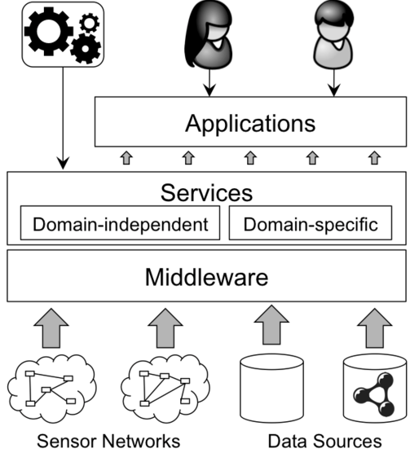
Challenges. A high-level application
Mashup development
Registry
Information Integration
Sensor Network Ontologies

