Slide 1
An Edge-Centric Ensemble Scheme for Queries Assignment
Kostas Kolomvatsos, Christos Anagnostopoulos
8th International Workshop on Combinations of Intelligent Methods and Applications
in conjunction with
30th International Conference on Tools with Artificial Intelligence
November 5-7, 2018
Volos, Greece

Slide 2
Outline
Introduction
Edge Nodes
High Level Description
Delivering the Complexity Class
The Ensemble Scheme
The Matching Process
Experimental Evaluation
Conclusions and Future Work

Slide 3
Introduction
In the era of the Internet of Things (IoT), numerous devices form a vast infrastructure
Devices can process tasks and exchange data
Data can be processed at the devices, at the edge of the network (Edge/Fog) or at the Cloud

Slide 4
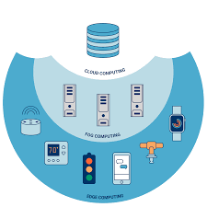
Edge Nodes
Current research efforts focus on the data streams management at the edge
Edge Nodes (ENs) act as distributed data repositories where queries can be executed
ENs are responsible to report the results to the requested entity

Slide 5
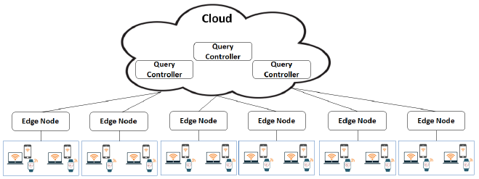
Edge Nodes
We deal with queries allocation to the appropriate ENs
Queries are reported into a set of Query Controllers (QCs)
It is a multi-dimensional problem involving queries and ENs characteristics

Slide 6
High Level Description
Step 1. Classify queries into a set of complexity classes
Step 2. Compare the requirements of queries with the ENs' load
We propose models for both steps
An ensemble similarity scheme for the estimation of the complexity class
Decision for the selection of ENs based on the current and future load

Slide 7
High Level Description
A Query Processor (QP) is adopted in every EN to respond to any incoming query
QCs (i) receive queries, (ii) ‘invoke’ the appropriate QPs, (iii) get their responses and (iv) return the final result

Slide 8
High Level Description
In each EN, a dataset is formulated i.e., a geodistributed local data repository
Each dataset stores multivariate data

Slide 9
Matching Queries with Processors
Every EN/QP exhibits specific characteristics
Examples:
The load
The speed
Queries also have a set of characteristics
Examples:
The complexity
The need for instant response
We focus on the query class; it depicts the complexity

Slide 10
Delivering the Query Complexity
For delivering the complexity class, we propose a ‘fuzzy’ approach and define a Fuzzy Classification Process (FCP)
The FCP derives the membership of a query in each of the pre-defined classes (e.g., we can have |Θ| classes)
We also adopt a dataset of historical queries together with their corresponding classes
The same class may be involved in multiple tuples, thus, in multiple queries

Slide 11
Delivering the Query Complexity
We build on top of a function f
f gets the query and delivers a similarity vector
Example (|Θ|=3): q^{s} = <0.2, 0.8, 0.3>
The ensemble scheme evaluates the final similarity between the query and every tuple in the training set

Slide 12
The Ensemble Scheme
Similarity metrics are applied on each tuple classified into a class
All the results are aggregated
Every single result represents the membership of the query to a ‘virtual’ fuzzy set
We adopt the Hamacher product for the final aggregation

Slide 13
The Ensemble Scheme
Disagreements are managed through the use of top-k similarity values based on their significance level
The Significance Level (SL) depicts if a value is ‘representative’ for many other results
Density based: Only values with a ‘dense’ neighborhood are considered

Slide 14
The Ensemble Scheme
Over a set of aggregated similarity values for a class, we apply an operator
We adopt the Quasi-Arithmetic mean for the second level of aggregation

Slide 15
The Matching Process
We consider an additional vector containing steps for each complexity class
The expected number of steps for a query is compared with the available load
When the number of steps can be covered: reward
Otherwise: penalty
We process both, the current and the future load

Slide 16
Experimental Evaluation
Datasets
Queries found at http://www.tpc.org
For each, we define the complexity class (six classes)*
Performance Metrics
Ψ: seconds to allocate a query
Ξ: difference of the selected load with the lowest
Ties management
Scenario A: Random selection
Scenario B: The lowest load first
* Vashistha, A., Jain, S., 'Measuring Query Complexity in SQLShare Workload', Proc. of the Int. Conf. on Management of Data, 2016.

Slide 17
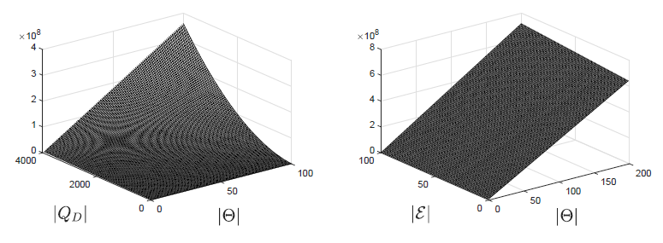
Experimental Evaluation
Complexity of the scheme*
* |Q_{D}|: size of the training dataset, |E|: number of similarity metrics, |Θ|: number of classes

Slide 18
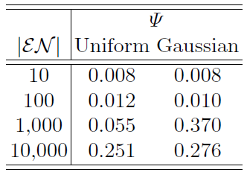
Experimental Evaluation
Conclusion time (in seconds)
* |EN|: number of nodes

Slide 19
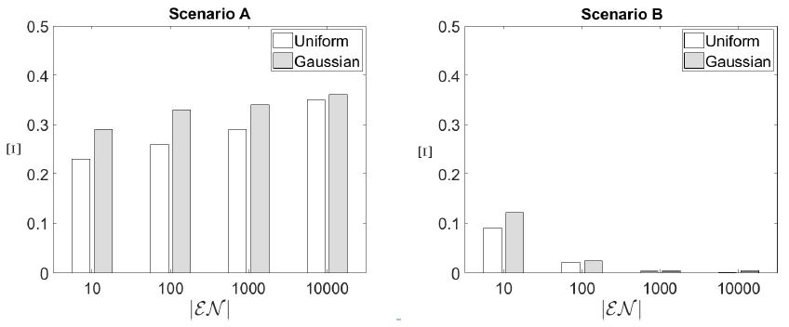
Experimental Evaluation
The load of the selected EN

Slide 20
Conclusions and Future Work
The proposed model exhibits good performance
We manage to perform efficient allocations
Our future research plans involve the incorporation of more parameters
the deadline
the statistics of data
The aim is to provide an adaptive mechanism

Slide 21
Thank You!!
Questions?

