Slide 1
In-Network Decision Making Intelligence for Task Allocation in Edge Computing
Kostas Kolomvatsos, Christos Anagnostopoulos
30th International Conference on Tools with Artificial Intelligence
November 5-7, 2018
Volos, Greece

Slide 2
Outline
Introduction
Challenges
Tasks Allocation
Data Aware Mechanism
Experimental Evaluation
Conclusions and Future Work

Slide 3
Introduction
Internet of Things (IoT) offers a vast infrastructure of devices
Intelligent analytics are offered on top of data collected by IoT nodes, i.e., sensing and computing devices
Nodes can become knowledge producers through local processing

Slide 4
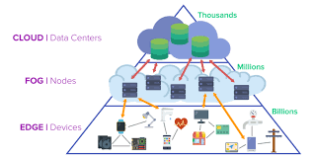
Introduction
Legacy techniques involve data processing at the Cloud
Cloud supports centralized processing
Problem: Increased latency
Need for support time sensitive applications
Solution: Edge Computing
It applies local processing at the edge nodes

Slide 5
Challenges
Keep analytics processing close to nodes
We try to limit the latency in providing responses
Avoid data migration (increases the communication overhead)
To provide analytics, nodes should execute a set of tasks

Slide 6
Tasks Allocation at the Edge
Task management is used for distributing tasks among Edge Devices
It should be done in an automated manner
It is not necessary to explicitly define the capabilities or location of edge nodes
Data are distributed as they are generated at different geographical places

Slide 7
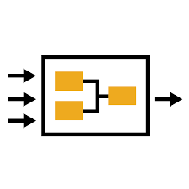
Autonomous Tasks Processing
We focus on the behavior/status of each node (nodes’ context)
Nodes may act autonomously and decide about the allocation of tasks (local execution or not)
Our technique takes into consideration:
Tasks characteristics
Nodes’ characteristics
The data present in every node

Slide 8
Autonomous Tasks Processing
Tasks may be delivered through streams
They have specific characteristics, e.g., size, complexity, deadline, priority, software requirements
Nodes also exhibit specific characteristics, e.g., load, throughput
Nodes ‘own’ a multidimensional dataset
We should decide on the local execution of a task

Slide 9
Data Aware mechanism
We can support an adaptive scheme to be fully aligned with nodes’ internal status, tasks requirements and the collected data
Target:
Develop a relevant decision mechanism
Decisions should be taken in a distributed, autonomous manner

Slide 10
Data Aware mechanism
Upon a task reception, nodes create the context vector
Nodes load
Tasks priority
Available resources

Slide 11
Data Aware mechanism
The mechanism takes into consideration the data present at the nodes
Nodes decide:
Local execution
Execution in the group
Execution at the Cloud

Slide 12
Data Aware mechanism
Nodes exchange contextual information
Such information will affect the decision making
Every node calculates an information vector for every peer
Data statistical difference
The load
The communication cost

Slide 13
Data Aware mechanism
If a task will not be executed locally, it will be sent to a peer with:
Similar data
Low load
Low communication cost
If no peer is appropriate for executing the task, then send it to Cloud

Slide 14
Data Aware mechanism
The decision making:
Modeling
the contextual vectors (for tasks)
the information vectors (for peers)
Probabilistic local task allocation
Multi-criteria local task allocation

Slide 15
Data Aware mechanism
Probabilistic approach
We can adopt Bayesian inference
Two classes: Local execution (C1) or not (C2)
We build on a training dataset for classification
Based on context vector for a task the classifier delivers the result

Slide 16
Data Aware mechanism
Multi-criteria decision making
We build an ordered list of information vectors (data for peers)
We provide rankings for peers
Ratings are calculated based on the information vectors
The candidate with the highest score is selected to host the task

Slide 17
Experimental Evaluation
We assess
The correct selection of tasks that will be locally executed (Aspect A)
The correct identification of the appropriate peer when tasks is offloaded (Aspect B)
The ‘closeness’ of the result to the optimal solution (Aspect C)
Metrics
For Aspects A & B: Precision (P), Recall (R), F-Measure (F)
For Aspect C: We ‘create’ the ideal node and its information vector
[min_load, min_comm_cost, min_data_distance]
Closeness is represented by ω_{i}, i.e., the Euclidean distance with the ideal node

Slide 18
Experimental Evaluation
Datasets
Real dataset related to companies bankruptcy*
Real dataset related to indoor environmental data**
Training dataset
We create 300 context vectors and best actions
65% of vectors indicate local processing
35% of vectors indicate tasks offloading
We construct networking topology of 5,000 nodes
* https://archive.ics.uci.edu/ml/datasets/qualitative bankruptcy
** http://db.csail.mit.edu/labdata/labdata.html

Slide 19
Experimental Evaluation
In multi-criteria optimized tasks allocation, we focus on the following scenarios (different weights for each criterion)

Slide 20
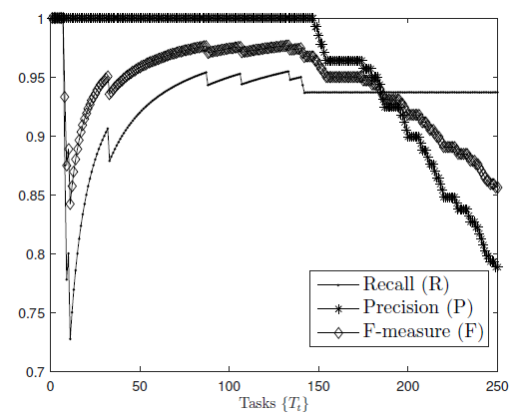
Experimental Evaluation
Results for Precision, Recall and F-Measure

Slide 21
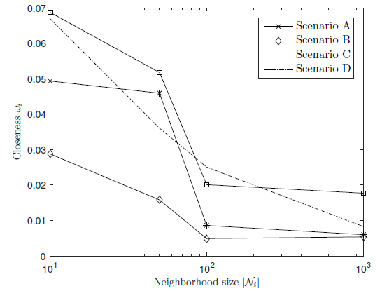
Experimental Evaluation
Closeness with the ideal node

Slide 22
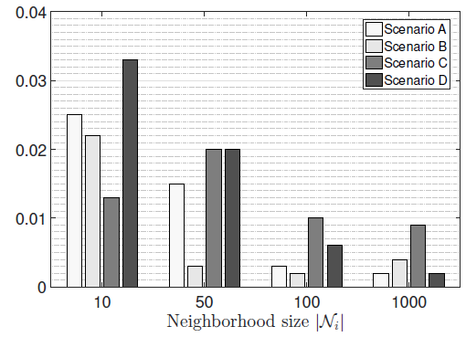
Experimental Evaluation
Closeness for load

Slide 23
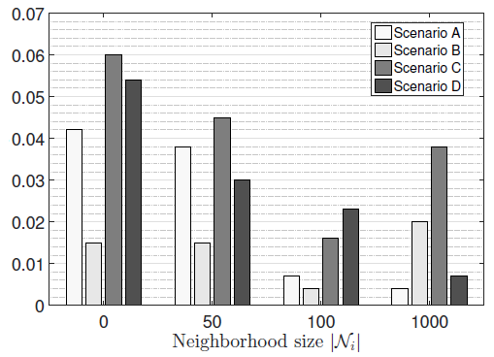
Experimental Evaluation
Closeness for data

Slide 24
Conclusions and Future Work
Our sequential decision making manages to select the appropriate action for each task
We manage to get efficient decisions related to the local processing
We can select the best possible peer when tasks are offloaded
Time-optimized decisions could increase the efficiency

Slide 25
Thank You!!
Questions?

