Slide 1
An Intelligent Scheme for the Identification of QoS Violations in Virtualized Environments
Kostas Kolomvatsos, Maria Koziri, Thanasis Loukopoulos
30th International Conference on Tools with Artificial Intelligence
November 5-7, 2018
Volos, Greece

Slide 2
Outline
Introduction
Quality of Service and Challenges
The proposed mechanism
Window and data management
Decision making
Experimental evaluation
Conclusions and future work

Slide 3
Introduction
Software Defined Networking (SDN) accelerates the deployment of network services
It also accelerates the delivery of services
SDN separates data/devices plane from the control plane
It imposes the control to be realized by software

Slide 4
Quality of Service
SDN with virtualized resources hides the underlying complexity
Operators can easily handle scale in/out actions
We may be adapted to users/applications needs
Core objective: To keep the Quality of Service (QoS) at high levels
Suggestion: Enhance the SDN controller with intelligent QoS monitoring mechanisms

Slide 5
Challenges
Challenge 1. Real time identification of QoS violations
Challenge 2. Scale in/out to be aligned with the needs
Differences with legacy techniques
Event detection should be accompanied by the execution of mitigation plans
The monitoring process should be part of the controller
Our mechanism acts as the first step before the execution of mitigation plans

Slide 6
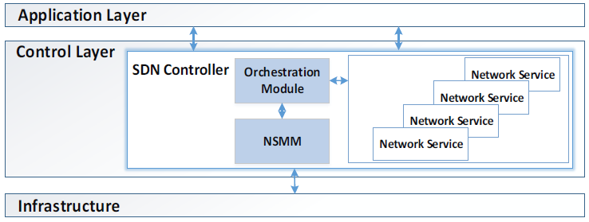
High Level Description
We propose the Network Services Monitoring Module (NSMM)

Slide 7
High Level Description
The NSMM monitors multiple parameters (e.g., latency, link utilization)
Every parameter has a different effect in QoS
Example:
Latency and error rate should be low
A set of mitigation plans are assigned to each event

Slide 8
The Proposed Mechanism
We adopt and adaptive sliding window
We define the window W as a monitoring era
At t, a set of values are observed
Decision: based on the W latest values for each parameter, is QoS violated?

Slide 9
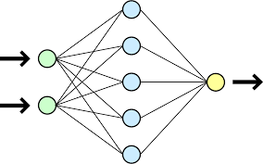
Window Definition
We propose a model for delivering W
After each era, the NSMM calculates a new W
We propose the use of a Neural Network
Inputs:
The previous W
The change in the collected data
Output:
The new W

Slide 10
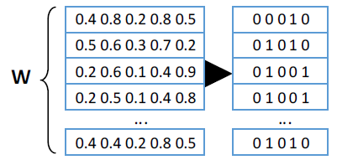
Data Management
We adopt specific thresholds for each parameter
The NSMM collects a vector of values $x^{t}=[x_{1}^{t},x_{2}^{t}, …]$
Then, it produces a Boolean vector with thresholds violation
Example:

Slide 11
Vectors Aggregation
The presence of multiple unity values may indicate an event
We aggregate the Boolean vectors into a final one
We apply conjunction to produce the aggregated vector applied over the columns
Aggregated
Boolean vector

Slide 12
Decision Making
We consider a set of pre-defined violation patterns
They depict QoS violation
We get the distance between the aggregated vector and patterns
We adopt the Hamming distance

Slide 13
Decision Making
We consider a threshold for the calculated distances (D_{T})
For patterns satisfying D_{T}, we apply an ensemble similarity scheme
We target to find the most similar patterns
Metrics:
Jaccard similarity
Dice similarity
Roger & Tanimoto similarity

Slide 14
Decision Making
A weighted average is applied for the final result
The most similar pattern is adopted
The corresponding mitigation plan is immediately fired

Slide 15
Experimental Evaluation
Different scenarios for an event
At least two parameters violate the thresholds
At least three parameters violate the thresholds
We produce Uniform or Exponential values for
Queue overflow
Average switches’ buffer size
Latency
Error rate
Evaluation for
Precision (π), Recall (ρ), F-Measure (φ)
We run 10,000 monitoring rounds

Slide 16
Experimental Evaluation
Scenario: Thresholds for violation are around 0.1
We need at least two parameters violating thresholds
Results (D_{T}=2.0):
Uniform Distribution
Precision: 0.99
Recall: 1.0
Exponential Distribution (λ=2.0, λ=0.5)
Precision: 0.97 & 0.99
Recall: 1.0 for both

Slide 17
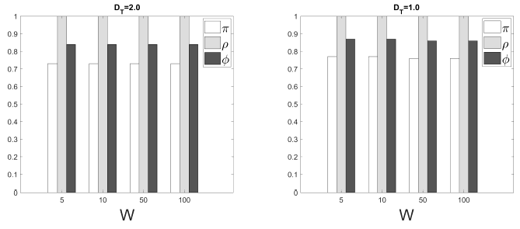
Experimental Evaluation
Scenario: Thresholds for violation are around 0.5
We need at least two parameters violating thresholds
The Uniform distribution case

Slide 18
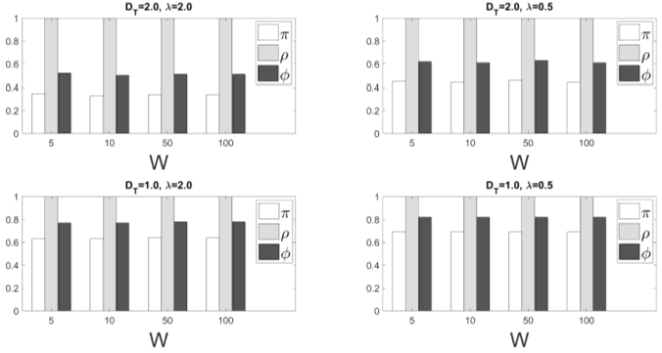
Experimental Evaluation
Scenario: Thresholds for violation are around 0.5
We need at least two parameters violating thresholds
The Exponential distribution case

Slide 19
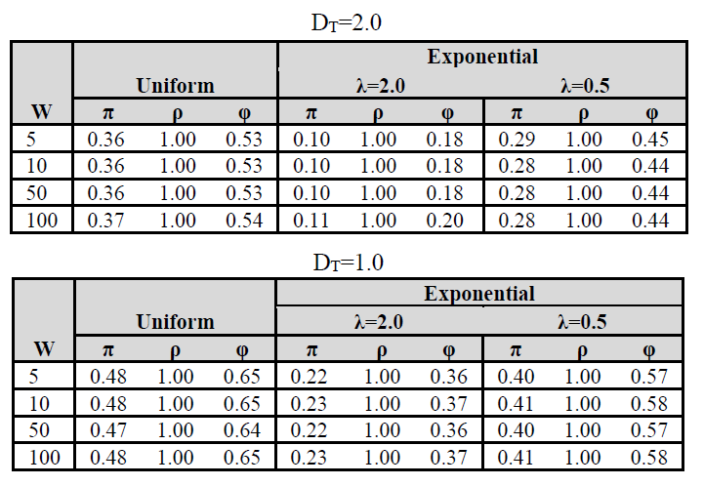
Experimental Evaluation
Scenario: Thresholds for violation are around 0.5
We need at least three parameters violating thresholds

Slide 20
Conclusions and Future Work
The proposed monitoring can easily and timely manage the data
It delivers the identified violations
We have to
Define a more complex/intelligent model for aggregating the measurements
Implicate an uncertainty management model

Slide 21
Thank You!!
Questions?

