Slide 1
Intelligence over the Edge of the Network
Dr Kostas Kolomvatsos

Slide 2
Outline
Cloud Computing
Fog Computing
Edge Computing
Use Cases
Edge Mesh
Tasks Management at the Edge
Centralized approach
Distributed approach
Edge Analytics and Data Management

Slide 3
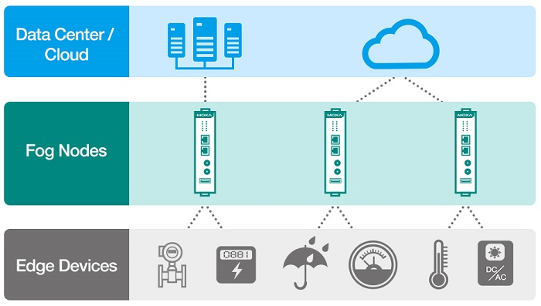
Introduction
Organizations that rely heavily on data are increasingly likely to use Cloud, Fog, and Edge computing
These architectures allow organizations to take advantage of a variety of computing and data storage resources

Slide 4
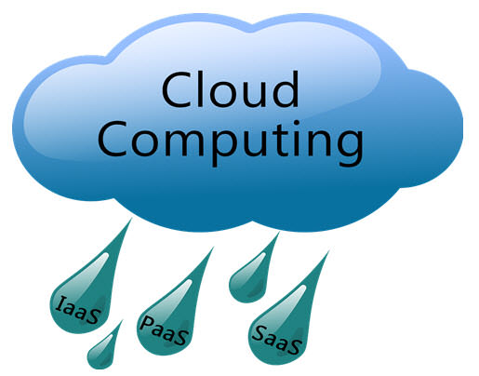
Cloud Computing
Cloud Computing has been considered a standard IT delivery platform
NIST definition:
a model for enabling ubiquitous, convenient, on-demand network access to a shared pool of configurable computing resources that can be rapidly provisioned and released with minimal management effort or service provider interaction

Slide 5
Cloud Computing
It delivers computing power (CPU, RAM, Network Speeds, Storage OS software) to numerous users
We can offer a service over a network (usually on the internet) rather than physically having the computing resources

Slide 6
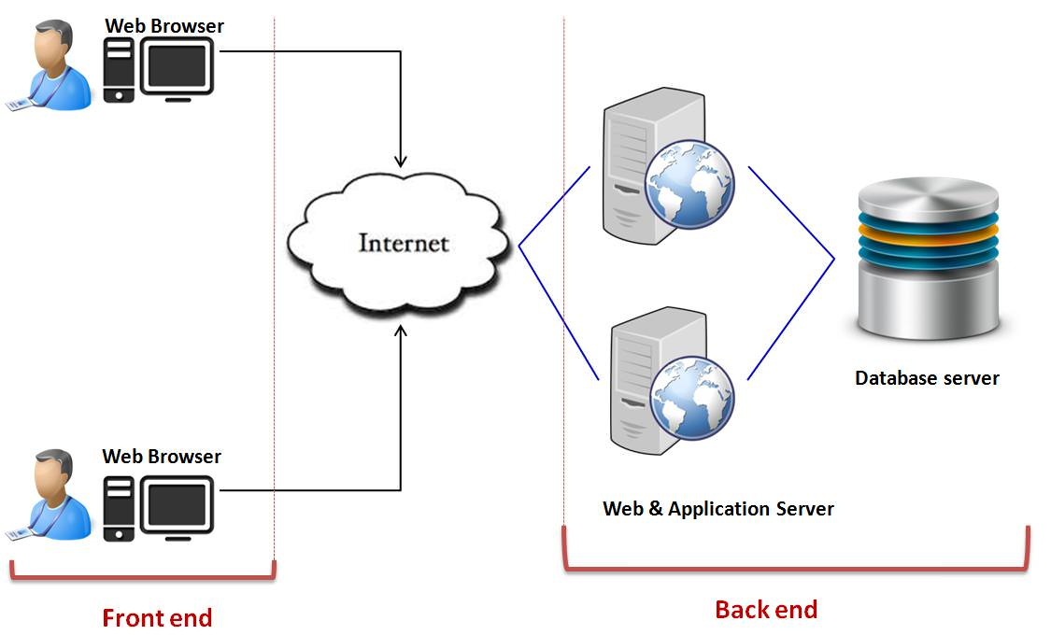
Cloud Computing
Architecture

Slide 7
Cloud Computing
Types of Clouds
Private Cloud: Computing resources are deployed for one particular organization
Community Cloud: Computing resources are provided for a community and organizations
Public Cloud: It is used for B2C (Business to Consumer) type interactions
Hybrid Cloud: It can be used for both type of interactions - B2B (Business to Business) or B2C (Business to Consumer)

Slide 8
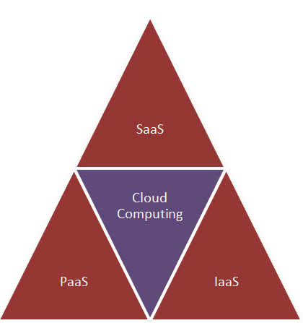
Cloud Computing
Cloud Computing offerings:
Software as a Service (SaaS). A software distribution model where applications are hosted by a vendor or service provider
Platform as a Service (PaaS). It provides an environment to allow developers to build applications
Infrastructure as a Service (IaaS). It provides access to computing resources in a virtualized environment

Slide 9
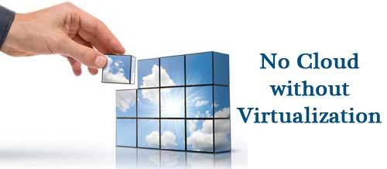
Cloud Computing
Main enabling technology: Virtualization
Virtualization is a partitioning of a single physical server into multiple logical servers
Each logical server behaves like a physical server and can run operating systems and applications

Slide 10
Cloud Computing
Virtualization is mainly used for three main purposes:
Network Virtualization. It combines the available resources by splitting up the available bandwidth
Server Virtualization. It is the masking of server resources like processors, RAM, operating system etc
Storage Virtualization. It is the pooling of physical storage from multiple devices into a virtual storage device

Slide 11
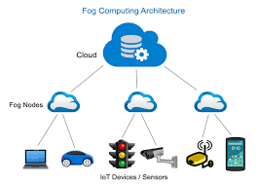
Fog Computing
Fog Computing and Edge Computing involve pushing intelligence and processing capabilities down
Fog Computing seamlessly extends Cloud Computing for secure control and management
Fog Computing enables rich data processing applications across the domain

Slide 12
Fog Computing
Fog Computing supports emerging Internet of Everything (IoE) applications that demand real-time/predictable latency
The Fog paradigm is well positioned for real time big data and real time analytics
Fog supports densely distributed data collection points adding a fourth axis to Big Data dimensions (volume, variety, velocity)

Slide 13
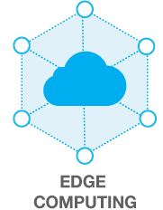
Edge Computing
Edge Computing first emerged by virtualizing network in Wide Area Networks (WANs)
Fog and Edge computing appear similar, i.e., they both involve bringing intelligence closer to the end devices
Key difference: the location of intelligence and compute power

Slide 14
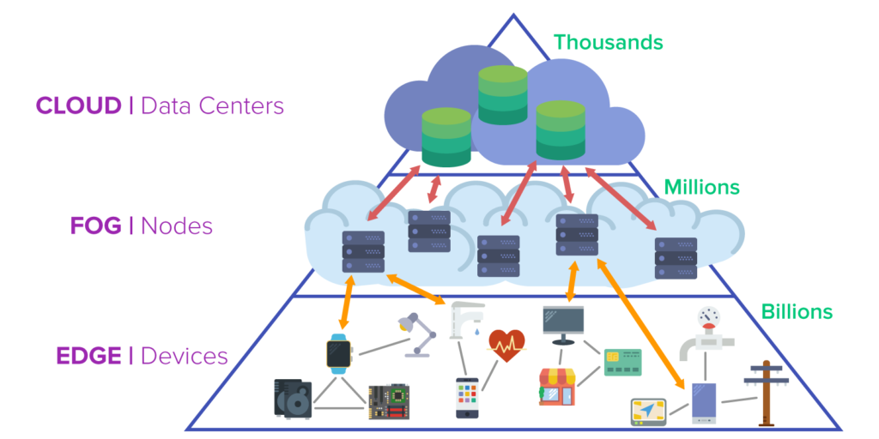
Edge Computing
The Edge and Fog layers complement each other
A fog environment places intelligence at the local area network (LAN)
Edge Computing places intelligence in devices

Slide 15
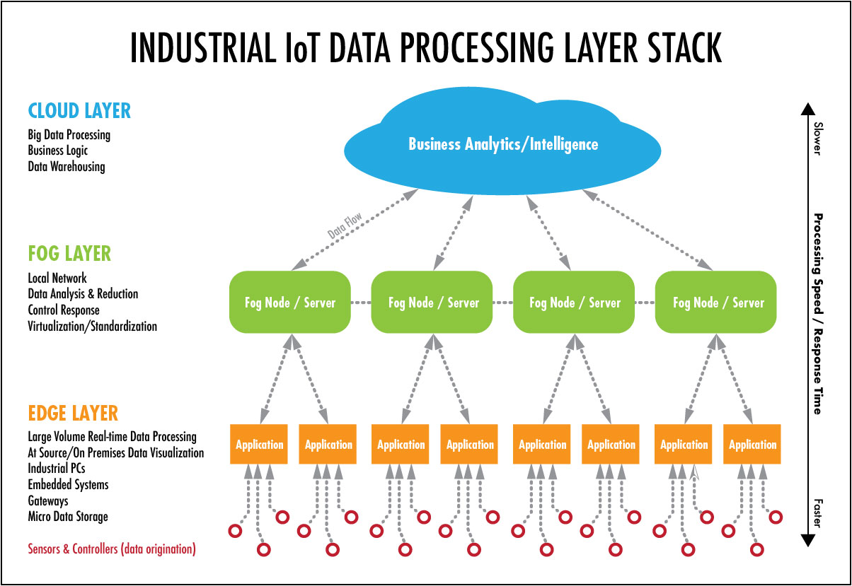
Putting All Together
Intelligence Creation
Raw Data & Processing

Slide 16
Edge Computing
Edge Computing benefits:
Time-sensitive data can be processed at the point of origin
Intermediary servers can be used to process data in close geographical proximity to the source
Cloud servers can be used to process less time sensitive data or to store data for the long-term
Edge application services significantly decrease the volumes of data that must be moved
Edge computing removes a major bottleneck and potential point of failure by de-emphasizing the dependency on the core computing environment

Slide 17
Edge Computing
Edge computing is driven the need for service delivery to be closer to users
Improvements result from:
Reducing latency: The latency to the end user will be lower than relying on the Cloud
Mitigating bandwidth limits: When moving workloads closer to the end users, we reduce the effect of limited bandwidth at a site

Slide 18
Edge Computing
Tradeoffs:
To deliver Edge Computing, it is necessary to vastly increase the number of deployments
How can an organization cope with hundreds or even thousands of small clouds?

Slide 19
Edge Computing
Requirements:
Standardization and infrastructure consistency are needed, i.e., each location has to be similar in a known quantity
Manageability needs to be automated; deployment, replacement and any recoverable failures should be simple and straightforward
Simple, cost-effective plans need to be laid for hardware failures
Locally fault-tolerant designs are important, e.g., when remote or unreachable infrastructure is desirable

Slide 20
Use Cases
There are probably dozens of ways to characterize use cases
Four major categories of workload requirements that benefit from a distributed architecture
Analytics
Compliance
Security
Network Functions Virtualization (NFVs)

Slide 21
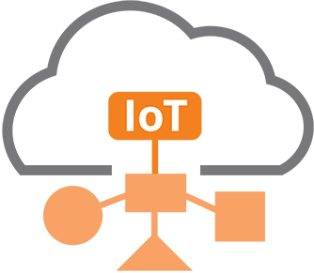
Data Collection and Analytics
IoT is an example of an application that benefits from the Edge Computing
We send large volumes of data to an analytics engine in a centralized data center
This setting may not be responsive enough, could contribute to excessive latency, and wastes bandwidth

Slide 22
Data Collection and Analytics
Taking the analytics closer to the source of the data can be more cost-effective
We send small batches of condensed information
There is a tradeoff here - balancing the cost of transporting data vs losing some information

Slide 23
Security
New attack vectors are emerging that take advantage of the proliferation of endpoints
Edge Computing can move security elements closer to the originating source of attack
It enables higher performance security applications
It increases the number of layers that help defend against breaches and risk

Slide 24
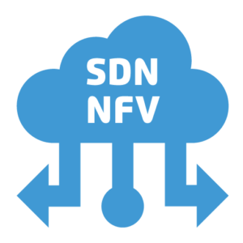
Network Function Virtualization
Network Function Virtualization (NFV) provides virtualized infrastructure functionalities
Operators run VNFs as part of an Edge Computing infrastructure
Running NFVs on Edge Computing can maximize efficiency and minimize cost/complexity

Slide 25
Real-Time Applications
Real-time applications (e.g., Augmented Reality - AR, Connected cars, Telemedicine, Smart cities) are unable to tolerate more than a few milliseconds of latency
Such applications are sensitive to latency variation
Response times in tens of milliseconds cannot be met without Edge Computing

Slide 26
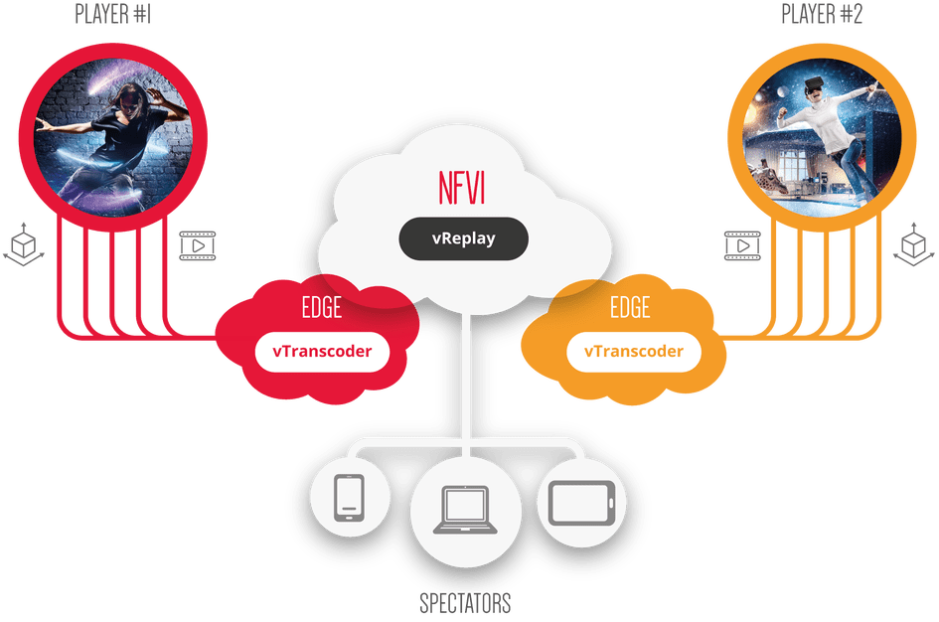
Immersive Applications
Edge Computing expands bandwidth capabilities
Examples: AR/VR, 4K video, and 360° imaging
Caching and optimizing content at the edge is a necessity since protocols don’t respond well to sudden changes

Slide 27
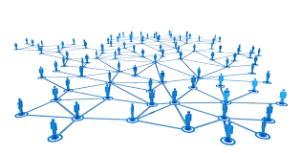
Network Efficiency
Edge Computing infrastructure reduces bandwidth requirements
It can also provide a platform for functions that enable the value of the application
We could sort the data at the Edge for anomalies/changes, and only report on the actionable data
Examples: video surveillance motion detection and threat recognition

Slide 28
Autonomous Site Operations
Edge computing supports such environments by allowing them to remain semi-autonomous when needed or the network connectivity is not available
Examples:
transportation (planes, buses, ships)
mining operations (oil rigs, pipelines, mines)
power infrastructure (wind farms, solar power plants)
The need for retail locations to maintain their point of sales (POS) systems with no connectivity

Slide 29
Privacy
Operator applications are workloads put on edge computing infrastructure
Any application could leverage any or all of the Cloud capabilities (e.g., compute, block storage, object storage, virtual networking, containers)
Example: medical applications should anonymize personal health information (PHI) before sending it to the cloud

Slide 30
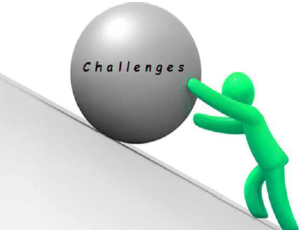
Challenges
Edge Computing has to be, by design, much more fault tolerant and robust
We need a virtual-machine/container/bare-metal manager for managing machine/container lifecycle (configuration, scheduling, deployment, suspend/resume, and shutdown)
We need an image manager in charge of template files (a.k.a. virtual-machine/container images)

Slide 31
Challenges
A network manager in charge of providing connectivity to the infrastructure
A storage manager, providing storage services to edge applications
Administrative tools, providing user interfaces to operate and use the dispersed infrastructure

Slide 32
Challenges
Edge Computing should be information-aware and reconfigured
Edge Computing should be proactive on top of big data
It should be feasible to utilize big data technology to extract interesting patterns or knowledge
Hierarchical data mining techniques should be also used
Data mining can be pre-executed in the edge devices to avoid the transmission of large volume of data

Slide 33
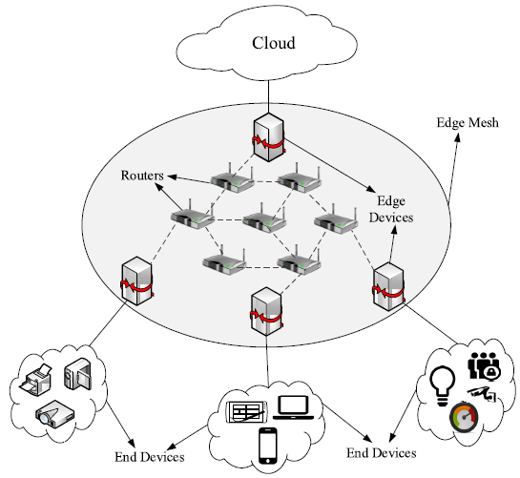
Edge Mesh
It uses a mesh network of Edge devices for distributed decision-making
It incorporates Cloud computing, Edge Computing, and Cooperative Computing
Edge device is any computing or networking resource residing between data sources and Cloud
All mesh nodes cooperate in the distribution of data in the network

Slide 34
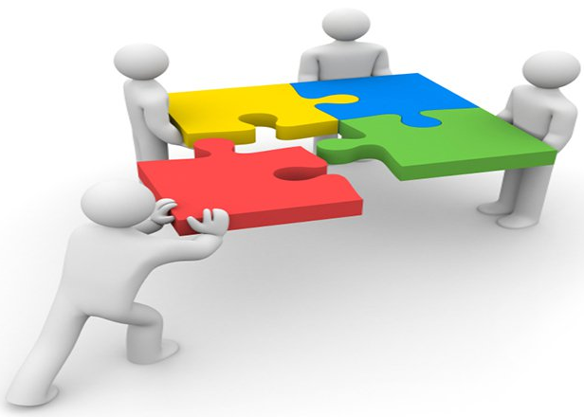
Edge Mesh
End devices are directly connected to Edge Devices
Many times end devices use different communication protocols and cannot communicate with each other
Interoperability between devices is related to standardization

Slide 35
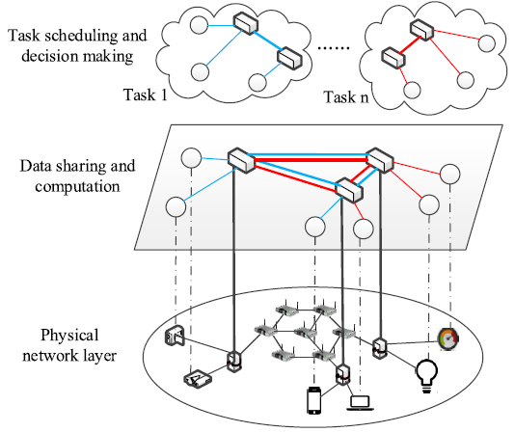
Edge Mesh
Bottom layer - the physical network that consists of
Routers
Edge devices
End devices
Different computational and communication capabilities

Slide 36
Edge Mesh
Virtual Data Sharing & Computation layer - Edge devices perform the computation tasks
All the devices share data
All the devices transmit the required data to each other

Slide 37
Edge Mesh
Task Scheduling - for each task, we calculate which devices should be involved
We partition the task into several subtasks
We assign subtasks to different Edge devices

Slide 38
Benefits of Edge Mesh
Its significance is revealed by:
Fault Tolerance: Edge Mesh provides fault tolerance in terms of both communication and computation
Scalability: A hierarchical network structure which is suitable for scaling
Load Distribution: Computation tasks can be offloaded to other Edge devices which speed up the processing time

Slide 39
Benefits of Edge Mesh
Its significance is revealed by:
Low Latency: Edge Mesh uses local Edge devices which can perform computation tasks and share data within the required deadline
Local Processing: In Edge Mesh, data processing is done by Edge devices which are located locally
Security and Privacy: Data is not shared with outside entities and no communication is required with intermediares which are usually prone to security attacks

Slide 40
Tasks Allocation at the Edge
Task management is used for distributing tasks among Edge Devices
It should be done in an automated manner
It is not necessary to explicitly define the capabilities or location of edge nodes
Data are distributed as they are generated by sensing devices at different geographical places

Slide 41
Problem Formulation
The problem can be formulated as a nonlinear integer programming problem
Applications and tasks
The application is modeled as a directed acyclic graph (DAG) G=(T, P)
T is the set of tasks - P is the set of dependencies between the tasks
Each task t_{i} has a computation load of processing p_{i}
Weight of each link connecting tasks t_{i} and t_{j} is P_{ij} - it represents the amount of data to be transmitted
Task t_{i} has some predecessor tasks which is given by a set R_{i}

Slide 42
Problem Formulation
The network
The communication network is modeled as a graph N = (A, D)
A is the set of devices
D = d_{ij} represents the distance between device a_{i} and a_{j}
For each device a_{i}, [v_{j}, e_{j}, e_{j,init}]* gives the initial list of parameters
* v_{j} is processing speed, e_{j} is the average power consumption, and e_{j,init} is the initial energy capacity of device a_{j}

Slide 43
Problem Formulation
Data
L is a M X N input data matrix
Each element l_{ij} is number of bits required for task t_{i} from node a_{j}
Data for task t_{i} is distributed among K_{i} nodes
Each node a_{j} provides data for W_{j} tasks

Slide 44
Problem Formulation
Task Allocation matrix
X is a M X N* order matrix
Each element x_{ij} in the matrix represents whether task t_{i} is executed on node a_{j}
x_{ij} is 1 if task t_{i} is executed on node a_{j}, 0 otherwise
* M: number of tasks, N: number of nodes

Slide 45
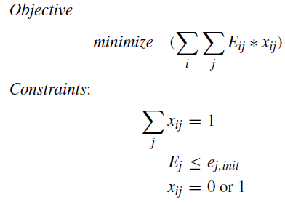
Problem Formulation
In a centralized approach we should solve an optimization problem
There is cost E_{ij} of processing a task
the sum of computation cost
cost to communicate input data
cost to communicate data from predecessor tasks
There is a cost of energy consumption E_{j}

Slide 46
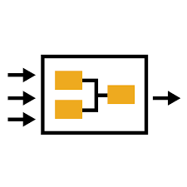
Autonomous Tasks Processing
We focus on the behavior of each node
Nodes may act autonomously and decide about the allocation of tasks (local execution or not)
Any technique should take into consideration:
Tasks characteristics
The data present in every node

Slide 47
Autonomous Tasks Processing
Tasks may be delivered through streams
Tasks may be reported to random intervals
They have specific characteristics, e.g., size, complexity, deadline, priority, software requirements
Nodes also exhibit specific characteristics, e.g., load, throughput
We should decide on the local execution of a task

Slide 48
Data Agnostic mechanism
The mechanism does not take into consideration the data present in a node
We can support an adaptive scheme to be fully aligned with nodes’ internal status and tasks requirements
The tasks that are ideally executed at the nodes should be non CPU intensive tasks and consume small amounts of energy
Target:
Develop a relevant decision mechanism
Decisions should be taken in a distributed, autonomous manner

Slide 49
Data Agnostic mechanism
System works in Execution Eras (EE)
During an era, a set of tasks arrives, with different characteristics of interest
Target node is battery powered (focus on mobile devices)
Task selection in two steps:
Preprocessing: Assigns a benefit weight to each task
Final Selection: Solve a (0,1) Knapsack problem to maximize system benefit

Slide 50
Data Agnostic mechanism
Suppose upon a task reception, nodes create the context vector
Nodes load
Tasks priority
Available resources

Slide 51
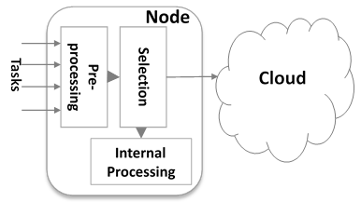
Data Agnostic mechanism

Slide 52
Data Agnostic mechanism
Distinguish between task deadline and remaining characteristics
Deadline benefit component: S1_{j}=1/T_{j} , T_{j} is the deadline for the j^{th} task
Derive the component for other characteristics using the Analytic Hierarchy Process (AHP)
Example table:
 | Size | Type | Demand
Size | 1/1 | 5/1 | 1/5
Type | 1/5 | 1/1 | 1/7
Demand | 5/1 | 7/1 | 1/1

Slide 53
Data Agnostic mechanism
Based on the AHP data, we deliver the significance of a task
The AHP delivers the weights for each characteristic
The aim is to execute locally significant tasks if the energy reserves are enough
We calculate the utility that a task offers to a node

Slide 54
Data Agnostic mechanism
Using AHP the benefit of the j^{th} task with regards to the remaining characteristics is derived as S2_{j}
Final benefit assignment:
S_{j}= α S1_{j} + (1- α) S2_{j}, α $∈$ [0,1]
Defining α can be the subject of a learning process

Slide 55
Data Agnostic mechanism
When the focus is on mobile devices, battery consumption is crucial
Knapsack problem:
Given an energy budget for an execution era (Knapsack size), select tasks to execute locally so as to maximize total benefit S without the cumulatively consumed energy exceeding Knapsack size

Slide 56
Data Agnostic mechanism
The Knapsack solution will give us the tasks executed locally
The aim is to keep the most significant tasks

Slide 57
Data Aware mechanism
The mechanism takes into consideration the data present at the nodes
Nodes sense and store d-dimensional contextual data
Nodes decide:
Local execution
Execution in the group
Execution at the Cloud

Slide 58
Data Aware mechanism
Nodes exchange contextual information
Such information will affect the decision making
Every node calculates an information vector for every peer
Data statistical difference
The load
The communication cost

Slide 59
Data Aware mechanism
If a task will not be executes locally, it will be sent to a peer with:
Similar data
Low load
Low communication cost
If no peer is appropriate for executing the task, then send it to Cloud

Slide 60
Data Aware mechanism
The decision making:
Modeling the contextual vectors (for tasks and peers)
Probabilistic local task allocation
Multi-criteria local task allocation

Slide 61
Data Aware mechanism
Probabilistic approach
We can adopt Bayesian inference
Two classes: Local execution (C1) or not (C2)
We build on a training dataset for classification
Based on context vector for a task the classifier delivers the result

Slide 62
Data Aware mechanism
Multi-criteria decision making
We build an ordered list of vectors
Vectors depict the information for peers
We provide rankings for peers
Ratings are calculated based on the information vectors
The candidate with the highest score is selected to host the task

Slide 63
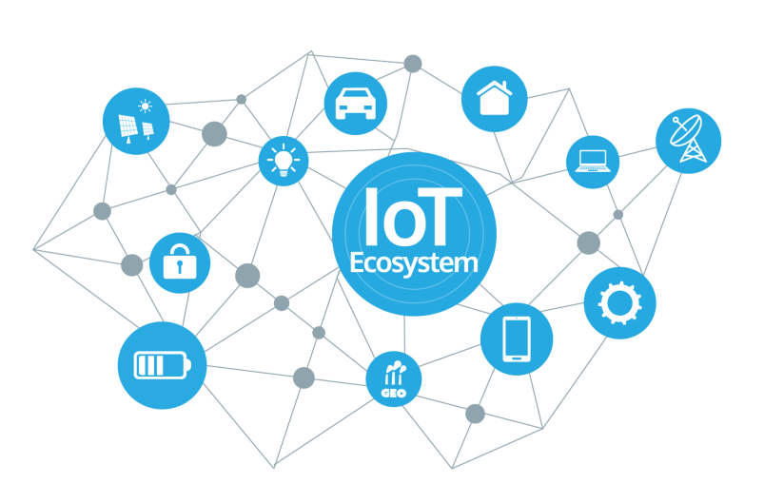
Edge Analytics
IoT gives a boost for the edge analytics
The majority of the collected IoT data is never analysed
Many existing IoT platforms are slow, expensive and a drain on resources
Gartner mentioned that 90% of deployed data will be useless

Slide 64
Edge Analytics
The key is that data is the most valuable asset for any organization
The load will continue to rise exponentially
We should make sense of the various endpoints of information and help in delivering business outcomes
In time critical applications any delay may negatively affect the results

Slide 65
Edge Analytics
Edge analytics will address these issues
They may support the data analysis at the point where data are generated
It is about analysing in real-time on site
Examples:
security cameras
intelligent monitoring and management of traffic

Slide 66
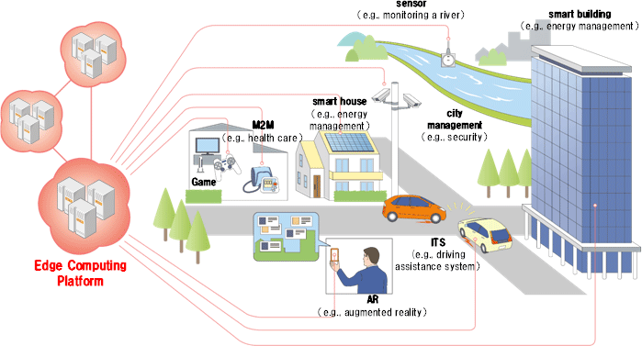
Edge Analytics

Slide 67
Edge Analytics
Compromises
Only a subset of data is processed and analysed
The analysis result is transmitted over the network
We will have to learn by experience
Edge analytics is an exciting space and is the answer of maintenance and usability of data

Slide 68
Real-Time Descriptive Analytics
There is a fast growing of data streams generated by the IoT devices
Edge computing brings the opportunity to analyze massive data streams
Steps for delivering analytics
Data pre-processing
Analytics processing

Slide 69
Real-Time Descriptive Analytics
Missing values
Too many missing values may affect to the final analytical results
Solutions can be:
Ignore the value
Use a global constant to fill in the missing value
Use a measure of central tendency
Use the attribute mean or median
Use the most probable value

Slide 70
Real-Time Descriptive Analytics
Duplicated values
Data tuples are sometimes transmitted twice or more
Any duplicated tuple is automatically found using its timestamp and then removed
Redundant Attributes
A new data field is introduced to the data tuple
The extra attribute should be automatically deleted

Slide 71
Real-Time Descriptive Analytics
Analytical tasks:
Semantic annotation
Temporal aggregation
Summaries

Slide 72
Real-Time Descriptive Analytics
Semantic annotation
We can rely on ontologies
Three phases:
Summarizing the stream data - It analyzes the nodes characteristics and timestamps
Constructing the base ontology – It constructs the ontology based on the representation of the domain knowledge for data
Sub-window partitioning and parallel query processing - The semantically annotated data enable the reasoner to provide the link to the data repositories

Slide 73
Real-Time Descriptive Analytics
Temporal aggregation
We calculate the correlations between streams based on time-based sliding window
The aim is to capture meaningful events
We can create services to generate complex events from certain set of primitive events
Each proactive data service can be deployed in edge nodes and do preliminary processing
Only meaningful events are transmitted to cloud server

Slide 74
Real-Time Descriptive Analytics
Temporal aggregation
Events are of a certain type, have a timestamp, and hold specific data
Many event detection technologies utilize event patterns to represent events
We regard the correlation’s variations among multiple streams as events

Slide 75
Real-Time Descriptive Analytics
Temporal aggregation
Pearson’s correlation coefficient (PCC) is a metric adopted to measure the streams’ correlations
The aim is to capture the change of correlation as event
The correlation among data usually shifts in time
Declarative rules can be also adopted to handle external events

Slide 76
Real-Time Descriptive Analytics
Events capturing
Once any two streams’ correlation is changed, an event is through to be captured
When analyzing correlations among data, misjudgment of correlation can be also occurred
The lag-correlation analysis can be considered to find the time lag vector to maximize the PCC

Slide 77
Real-Time Descriptive Analytics
Types of aggregation
Statistical aggregation (e.g., max, min, average, sum, count, quantiles, frequent items)
Approximate aggregation schemes (e.g., contours, wavelet histograms)
Data fusion (e.g., contextors – they perform logical processing and are combined each other, chains of actions)
Probabilistic data association

Slide 78
Real-Time Descriptive Analytics
Summaries
A summary should contain a few, but informative items
Given such a summary, we can use it to
perform certain actions, once a new item is added to the summary
compare summaries of different devices
provide a quick overview for human experts
For numerical data streams, moving averages have been used
For categorical values, data summarization describes the extraction of representative items

Slide 79
Real-Time Descriptive Analytics
Summaries
The main questions are:
What items are “novel” enough to be included into the summary?
Which are too similar to already seen items?
We adopt a novelty threshold
If this novelty threshold is chosen too small, the summary will contain redundant items
If the novelty is too high, we will not add any item to the summary

Slide 80
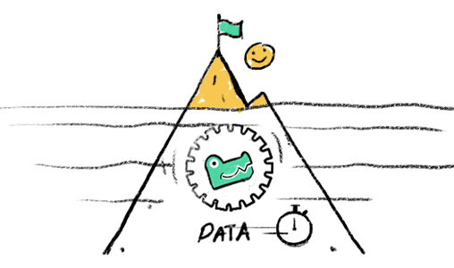
Synopsis Construction
Techniques that can be adopted for synopsis construction:
Sampling methods
Histograms
Wavelets
Sketches
Micro-cluster based summarization

Slide 81
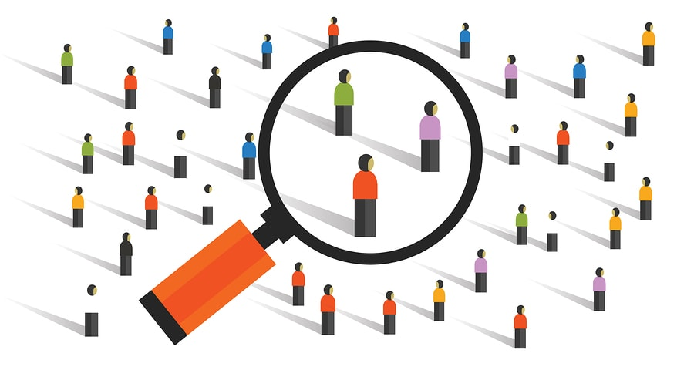
Synopsis Construction
Sampling
It is the most simple method for synopsis construction
It uses the same multi-dimensional representation as the original data
We randomly select a sub-set of the data

Slide 82
Synopsis Construction
Sampling
Advantages
It is easy and efficient
It provides an unbiased estimate of data with provable error guarantees
It is easy to use with any data mining application or database operation
The random sampling technique is often the only method of choice for high dimensional applications

Slide 83
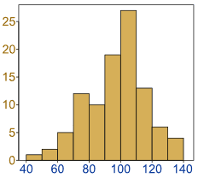
Synopsis Construction
Histograms
They are widely used for static data sets
They use of dynamic programming techniques for optimal construction
A histogram is an accurate representation of the distribution of numerical data
We divide the data along any attribute into a set of ranges, and maintain the count for each bucket
Their extension to the data stream case could be a challenging task

Slide 84
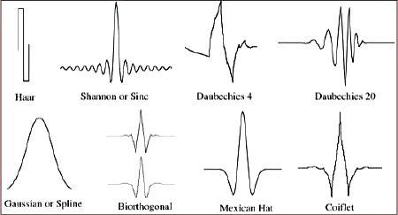
Synopsis Construction
Wavelets
Wavelets have traditionally been used in a variety of image and query processing
Example: Haar Wavelet - This technique is particularly simple to implement, and is widely used for hierarchical decomposition and summarization
The basic idea is to create a decomposition of the data characteristics into a set of wavelet functions

Slide 85
Synopsis Construction
Sketches
The idea of sketches is essentially an extension of the random projection technique to the time series domain
In random projection, we can reduce a data point of dimensionality d to an axis system of dimensionality k
We pick k random vectors of dimensionality d and calculating the dot product of the data point with each of these random vectors
Each component of the k random vectors is drawn from the normal distribution with zero mean and unit variance

Slide 86
Synopsis Construction
Micro-cluster based summarization
Clustering data streams posed additional challenges:
Single pass clustering
Limited time - the algorithm has to handle the speed of data streams
Limited memory - data streams are infinite
Number and size of clusters - the number and the shape of clusters are unknown in advance
Evolving data - data streams may change over the time
Noisy data - the clustering algorithm has to handle the noise in data, which affects clustering.

Slide 87
Synopsis Construction
Micro-cluster based summarization
Examples:
DBSCAN
DENCLUE
OPTICS
CLIQUE

Slide 88
Thank You!!
Questions?

