Slide 1




Colored Huge Pages
A Hardware-Software Approach for
Enhanced Isolation and Performance
Georgios-Alexandros Kostas Dimitris Gizopoulos Vasileios Karakostas
University of Athens

Slide 2
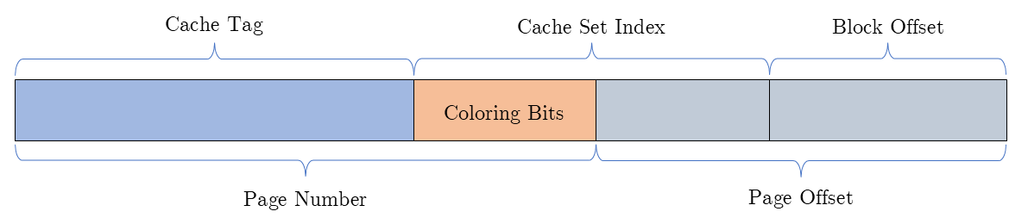
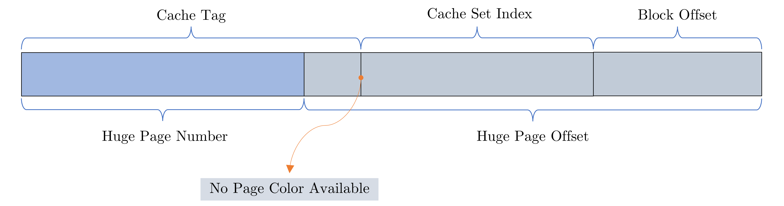
Page Coloring + Huge Pages (?)
Page Coloring: software approach for partitioning shared resources
  Bits of PFN can influence which portions of a shared resource a process can access
Huge Pages: improve virtual memory performance
  A single TLB entry provides address translation for a larger memory region
Page coloring and huge pages are incompatible
When using huge pages:
When using regular pages:
Page Coloring + Huge Pages

Slide 3
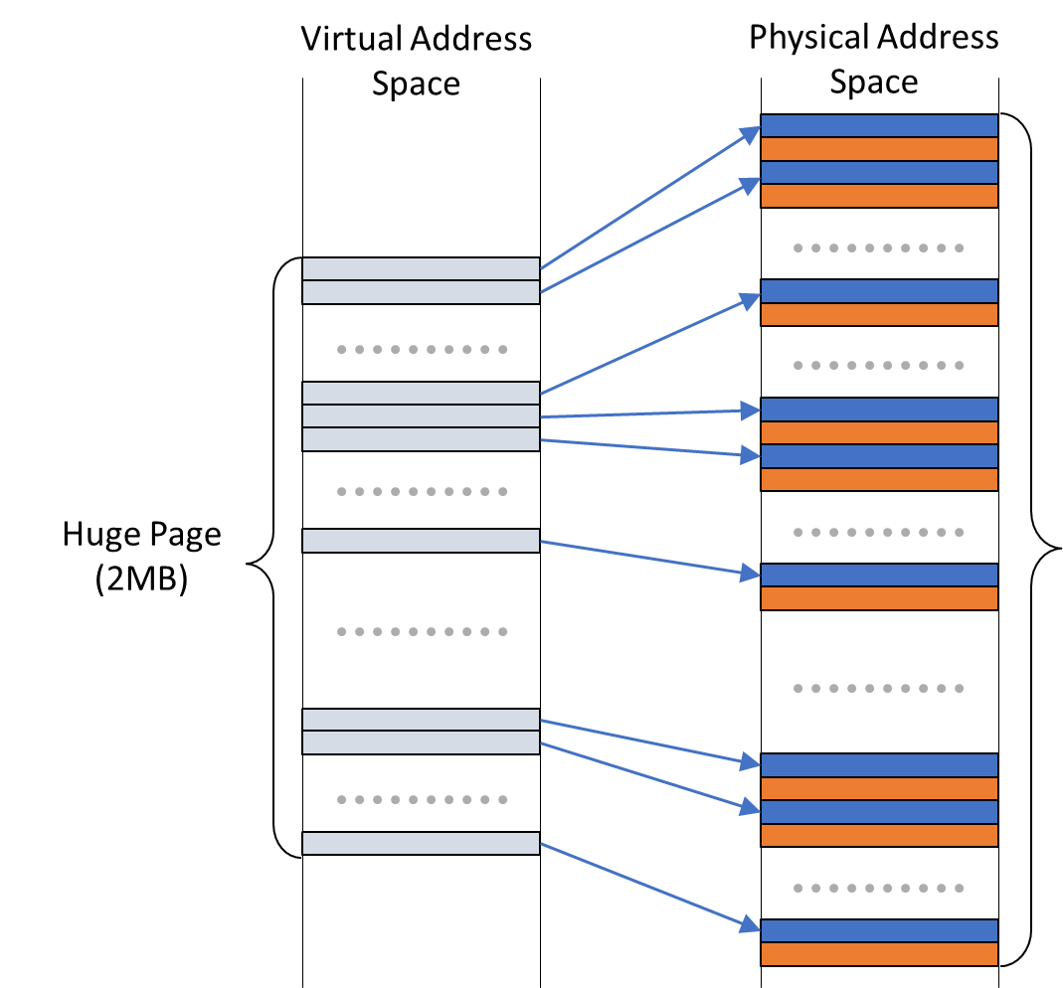


Prior Work: Scattered Superpages
Scattered Superpages [ICCD’13]: break down physical huge page into individual base pages of the desired color:
Problem: massive physical contiguity required
Skip pages with colors other than the desired one

Slide 4
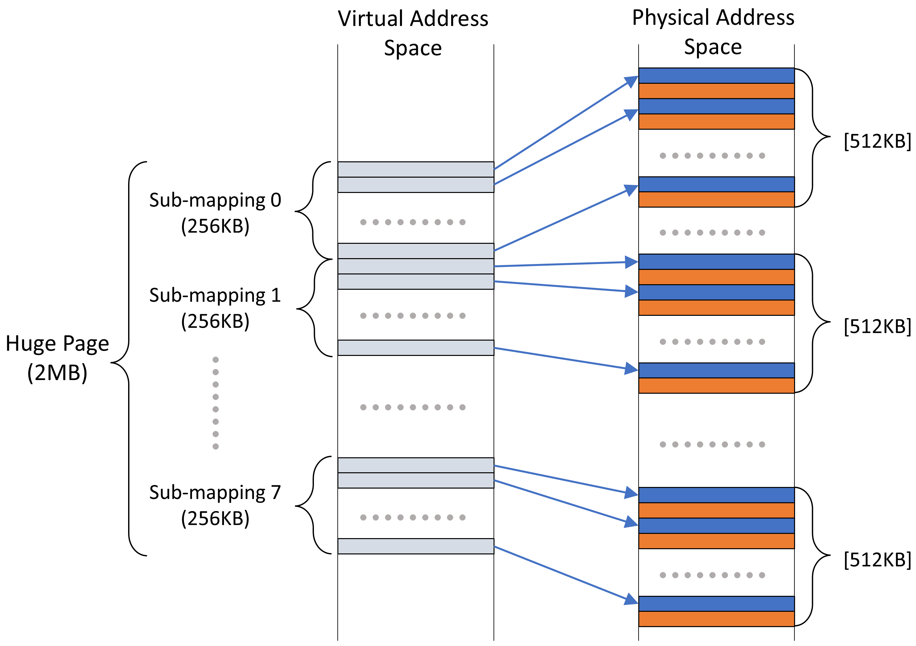
Our Approach: Colored Huge Pages
Colored Huge Pages: allow each 2MB strided mapping to break down into multiple sub-mappings:
CHP Components
Hardware: efficient translation with simple modifications in L2 TLB and Page Table Walker
Software: OS constructs and installs these mappings in process address space
Each sub-mapping begins independently

Slide 5
Enhanced L2 TLB
Challenge 1: need to hold 8 PFNs per CHP translation
Solution: widen each L2 TLB entry to fit 7 additional PFNs
  More silicon required but indexing time remains practically unaffected
Looked up after L1 TLB miss
Upon L2 TLB hit for a CHP, construct & install 4KB entry in L1 TLB
Only modify the L2 TLB

Slide 6
Fetching CHP Translations
Challenge 2: need to retrieve 8 PFNs per CHP translation
Solution: retrieve all 8 PFNs with a single memory reference
  Fetching all 8 sub-mapping translations almost as cheap as fetching just one
All 8 PFNs fit into one cache line
…
PFN0
PFN1
PFN2
PFN3
PFN4
PFN5
PFN6
PFN7
…
8 PFNs per
CHP translation
64-byte cache line
in the cache hierarchy

Slide 7
Address Translation with CHP
Huge Page Offset
VPN
num_colors is power of 2 →
use shifts
① VPN Extraction
page
index
base page offset
③ Sub-entry Index Calculation
② Parallel Lookup
Extended L2 TLB
page_index * num_colors
V
tag
PFN0
PFN1
PFN7
flags
⑤ Page Offset Computation
④ Sub-entry Extraction
+
sub-map 0
sub-map 1
sub-map 7
⑥ Final PFN Calculation
Target PFN
huge offset

Slide 8
Evaluation
Linux kernel + analytical modeling
Performance
Page Coloring:
17.4% speedup (up to 37%)
Colored Huge Pages (CHP):
33.7% speedup (up to 45.6%)
Huge Pages (THP):
21% speedup (up to 42.4%)
Contention with 4KB Pages:
Baseline

Slide 9
Colored Huge Pages
A Hardware-Software Approach for
Enhanced Isolation and Performance
Georgios-Alexandros Kostas Dimitris Gizopoulos Vasileios Karakostas
University of Athens

