Slide 1




Colored Huge Pages
A Hardware-Software Approach for
Enhanced Isolation and Performance
Georgios-Alexandros Kostas Dimitris Gizopoulos Vasileios Karakostas
University of Athens

Slide 2
Executive Summary
Microarchitectural components are shared by multiple cores
  Up to 94% overhead from interference in the Last-Level Cache (LLC)
  Mitigation: cache partitioning using page coloring (reduces overhead to 16%)
Ever-growing application memory footprints stress virtual memory
  Page table walks become a bottleneck (50+% of execution time)
  Mitigation: improved TLB performance with huge pages (40+% speedup)
Problem: page coloring and huge pages are fundamentally incompatible!
Our Proposal: Colored Huge Pages
  Hardware/Software approach combining both techniques efficiently & robustly
  Enhances performance through LLC isolation & improved address translation

Slide 3
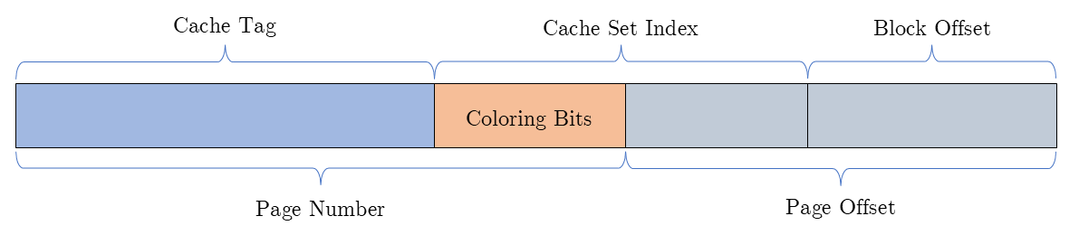
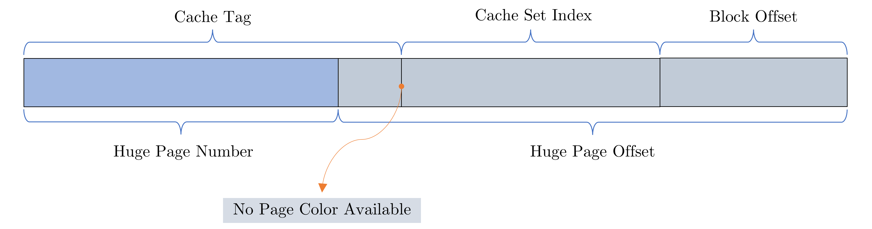
Page Coloring + Huge Pages (?)
Page Coloring: Software-based approach for partitioning shared hardware components
Key idea: bits of PFN can influence which portions of a shared resource a process can access → OS steers frame allocation to achieve partitioning
Example: LLC partitioning
When using huge pages:
Huge page occupies all colors ☹
2^{color_bits} distinct cache domains

Slide 4

Motivation
`
Page Coloring:
reduce overhead to 1.18x
Can we get both?
Huge Pages (THP):
reduce overhead to 1.11x
LLC Contention:
1.41x slowdown

Slide 5
Prior Approaches
Colored Huge Pages (CHP) vs. Prior Approaches
Approach | Fragmentation Robustness | No Extra LLC Conflict Misses | HW/SW Compatibility | OS Design & Evaluation
Scattered Superpages [ICCD ‘13]
SWAP [DAC ‘14]
Colored Huges Pages (this work)

Slide 6
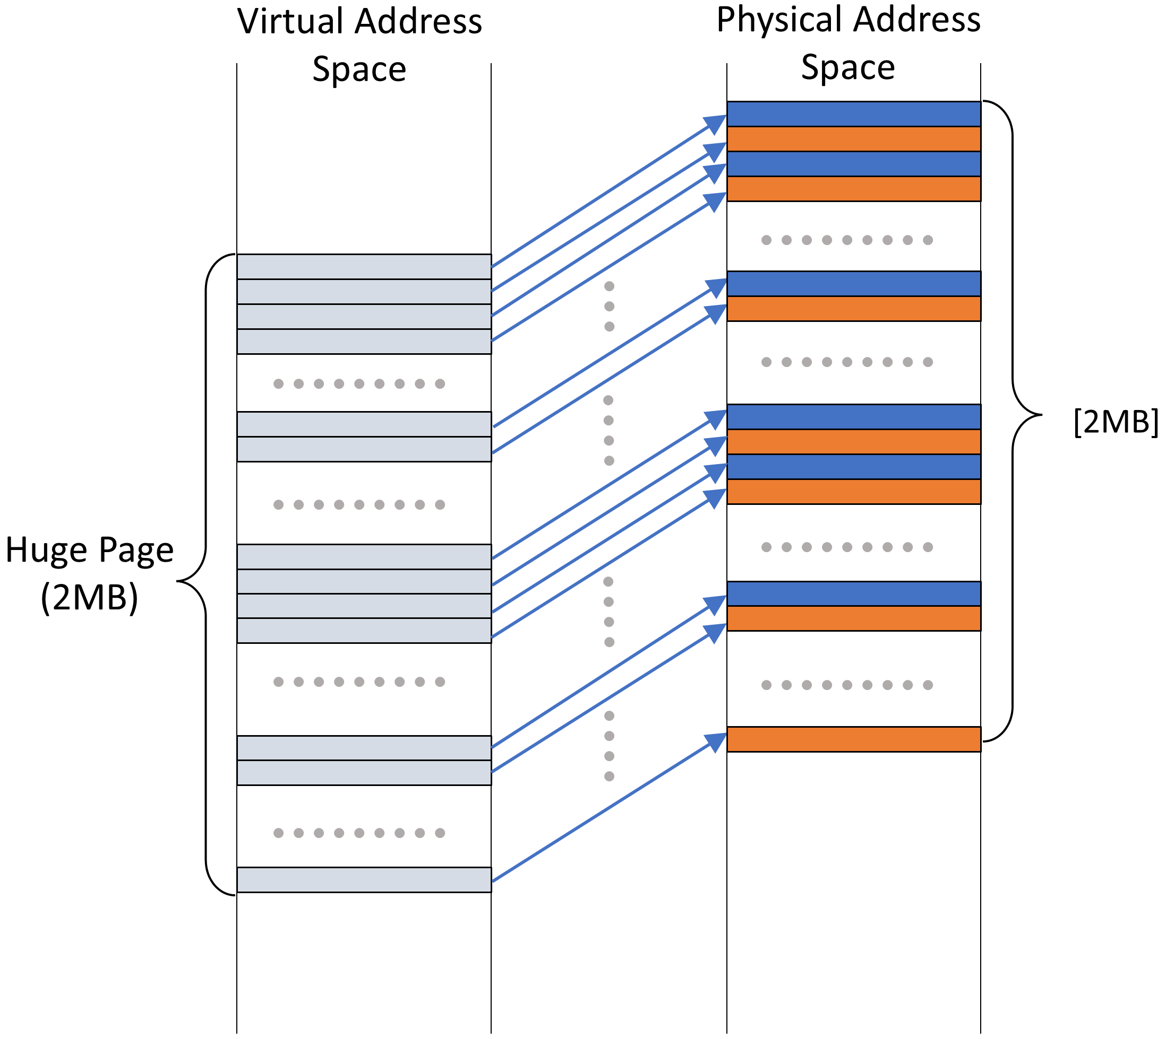
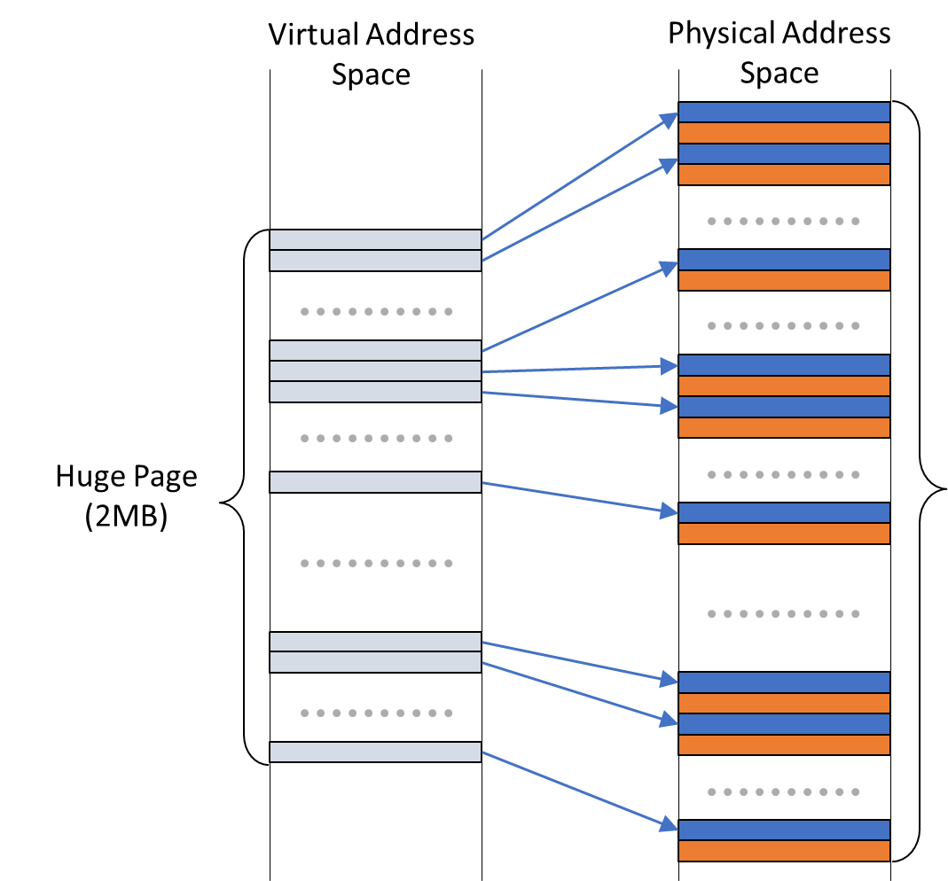

Scattered Superpages [ICCD ’13]
Problem: huge page occupies
all colors → no coloring possible
Approach: break down physical huge page into individual base pages of the desired color
Problem: massive physical contiguity required
Skip pages with colors other than the desired one

Slide 7
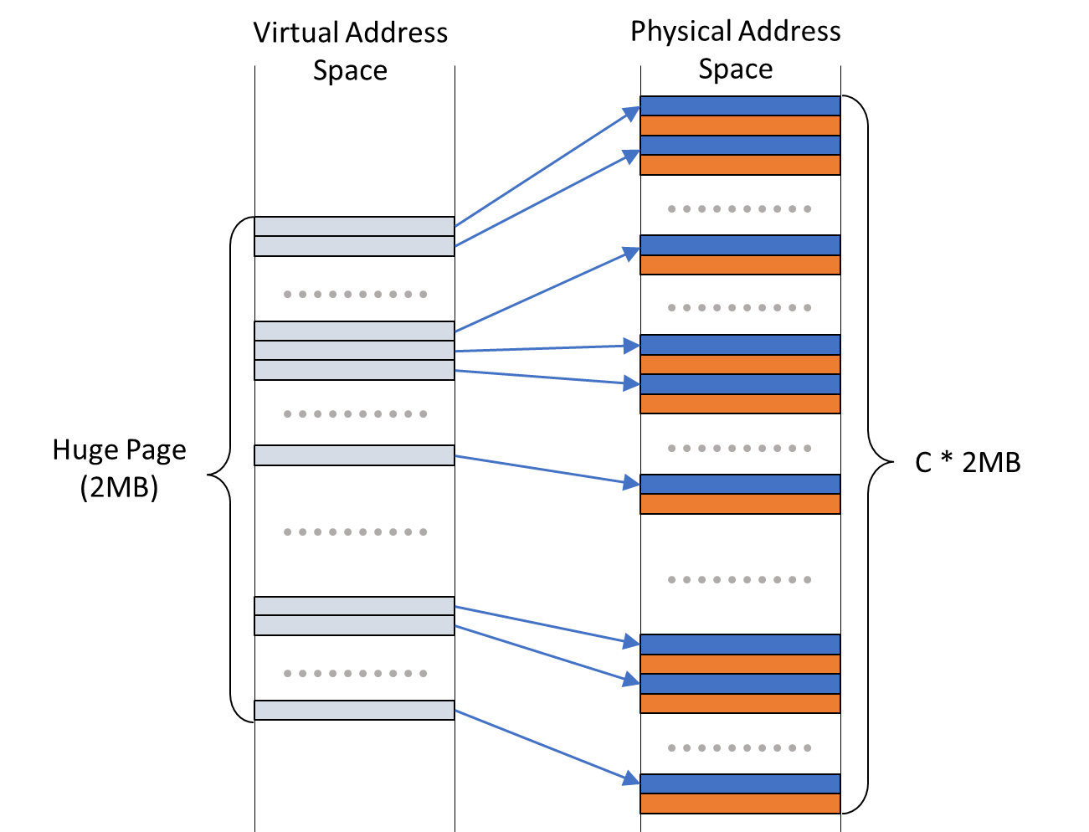
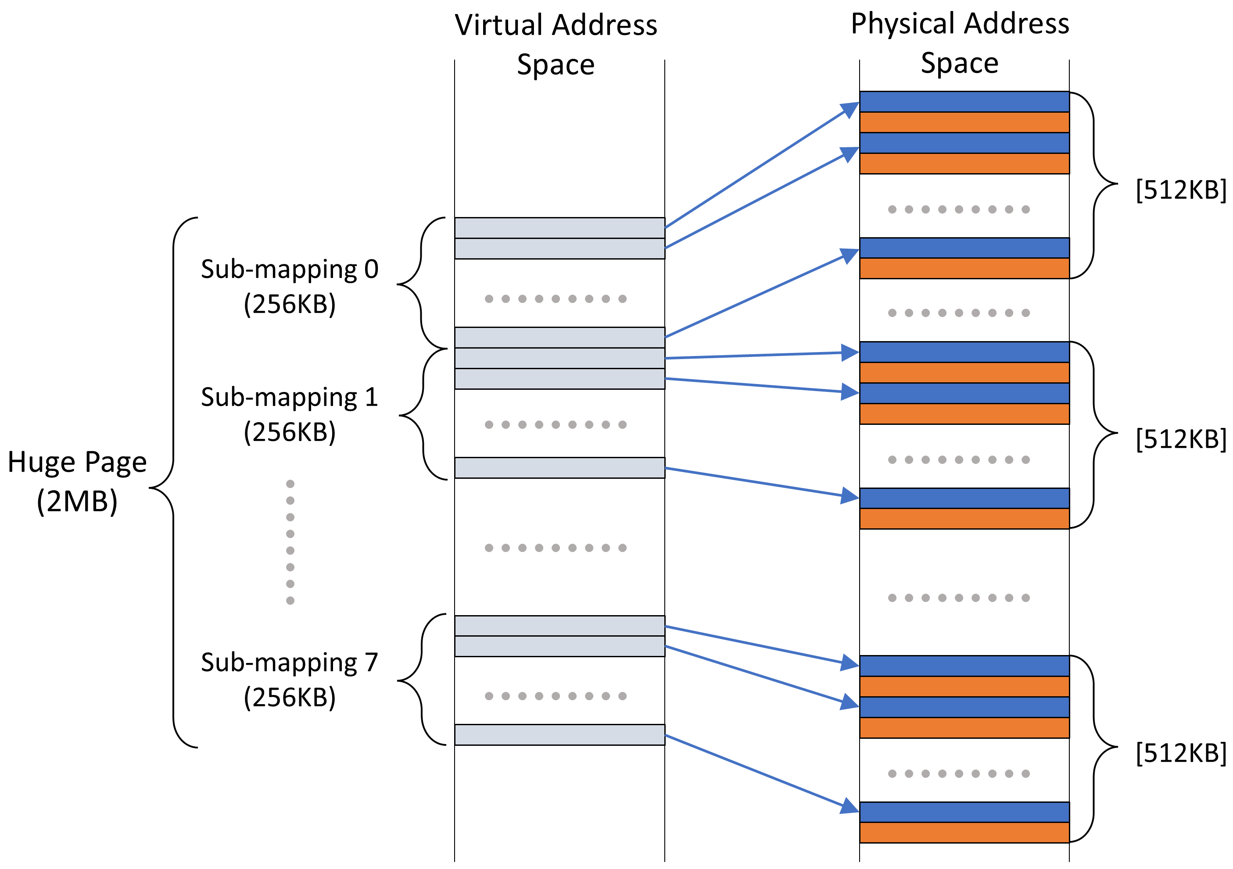
Colored Huge Pages
Key Idea: allow each 2MB strided
mapping to break down into multiple
sub-mappings (i.e., 8)
  Each 256KB sub-mapping maintains the
  same strided structure
  Can begin independently of the others
  Lowers contiguity requirements
Hardware: efficient translation with simple
modifications in the TLB and PTW
Software: OS constructs and installs these mappings in process address space

Slide 8
Enhanced L2 TLB
Challenge 1: need to hold 8 PFNs per CHP translation
Solution: widen each L2 TLB entry to fit 7 additional PFNs
  More silicon required but indexing time remains practically unaffected
Looked up after L1 TLB miss
Upon L2 TLB hit for a CHP, construct & install 4KB entry in L1 TLB
Why only modify the L2 TLB?

Slide 9
Fetching CHP Translations
Challenge 2: need to retrieve 8 PFNs per CHP translation
Solution: retrieve all 8 PFNs with a single memory reference
  Fetching all 8 sub-mapping translations almost as cheap as fetching just one
All 8 PFNs fit into one cache line

Slide 10
Address Translation with CHP
Huge Page Offset
VPN
① VPN Extraction
page
index
base page offset
③ Sub-entry Index Calculation
② Parallel Lookup
Extended L2 TLB
page_index * num_colors
V
tag
PFN0
PFN1
PFN7
flags
⑤ Page Offset Computation
④ Sub-entry Extraction
+
sub-map 0
sub-map 1
sub-map 7
⑥ Final PFN Calculation
Target PFN
huge offset

Slide 11
Enhanced Page Table (Walk)
CHP bit in PMD is set by the OS
L2 TLB Miss
Commence PTW
Reach PMD stage
CHP Bit set?
Construct new L2 TLB Entry with CHP
yes
no
Continue with
default PTW

Slide 12
OS Design & Implementation
Intercept page faults in large anonymous VMAs
  Best-effort to back faulting 2MB region with a CHP
  If not available, fall back to 4KB page coloring based on PALLOC [RTAS’14]
Allocate 8 strided 256KB sub-mappings
  Request a #colors * 256KB contiguous chunk from the buddy allocator
  Carve out the individual 4KB pages of the desired color
  Install pages in process address space
  Cache left-over mappings in Allocator Cache for future use
  Repeat 8x
    Pick a different color for each sub-mapping for better distribution

Slide 13
Methodology
Intel Comet Lake 2.9 GHz, 8 Cores, 16 GB DDR4
  16 MB 16-way shared LLC
  8 colors
Prototyped on Linux kernel v6.6
Memory-intensive workloads (SPEC 2006, GAPBS)
Performance estimation using hardware counters & analytical modeling
Co-location scenarios using stress-ng to introduce LLC contention
  Enough colors for each workload so <4% performance degradation when running alone
  Remaining colors assigned to stressor

Slide 14
Evaluation
Performance
Page Coloring:
17.4% speedup (up to 37%)
Colored Huge Pages (CHP):
33.7% speedup (up to 45.6%)
Huge Pages (THP):
21% speedup (up to 42.4%)
Contention with 4KB Pages:
Baseline

Slide 15
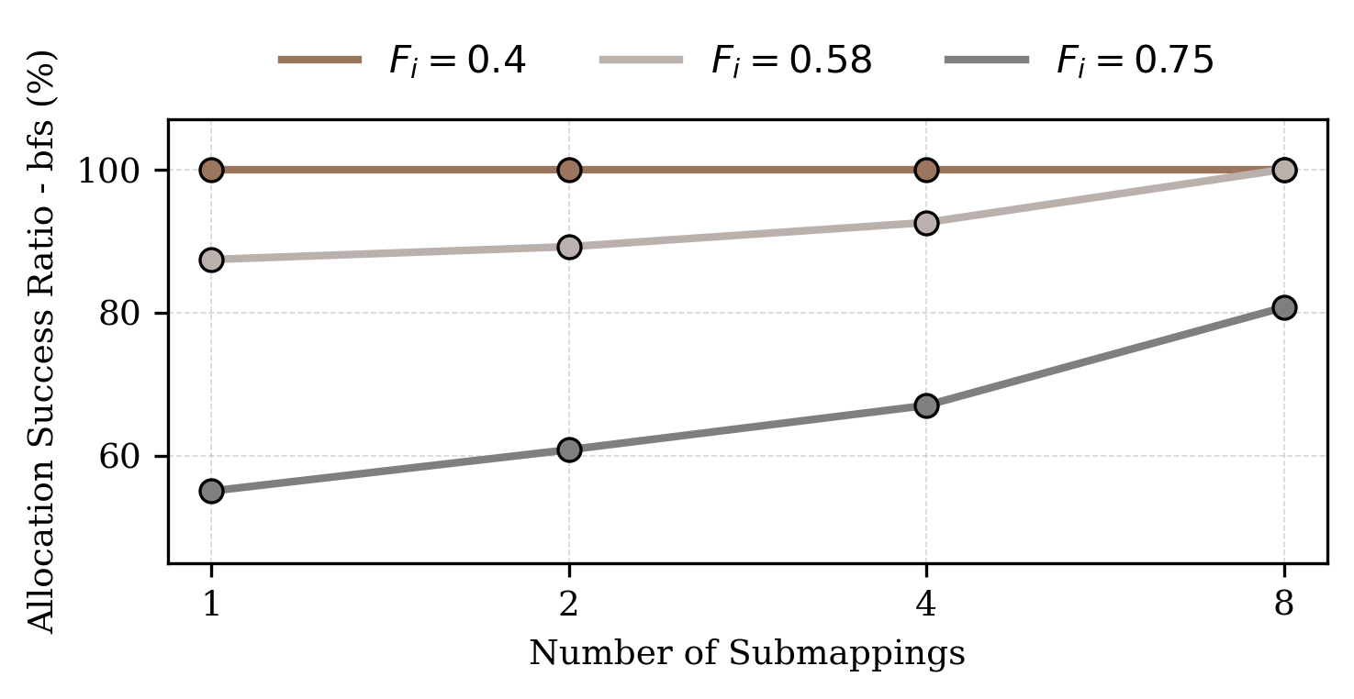
Evaluation
Impact of the #Sub-mappings
  Decreased allocation effectiveness when fewer sub-mappings are used
  Difference more pronounced under higher fragmentation
  Best results with 8 sub-mappings
1 sub-mapping corresponds to Scattered Superpages [ICCD ‘13]
`
`
More detailed evaluation in the paper
`

Slide 16
Executive Summary
Microarchitectural components are shared by multiple cores
  Up to 94% overhead from interference in the Last-Level Cache (LLC)
  Mitigation: cache partitioning using page coloring (reduces overhead to 16%)
Ever-growing application memory footprints stress virtual memory
  Page table walks become a bottleneck (50+% of execution time)
  Mitigation: improved TLB performance with huge pages (40+% speedup)
Problem: page coloring and huge pages are fundamentally incompatible!
Our Proposal: Colored Huge Pages
  Hardware/Software approach combining both techniques efficiently & robustly
  Enhances performance through LLC isolation & improved address translation

Slide 17
Colored Huge Pages
A Hardware-Software Approach for
Enhanced Isolation and Performance
Georgios-Alexandros Kostas Dimitris Gizopoulos Vasileios Karakostas
University of Athens

